Slide 1
SA 2013.08.02

Slide 2
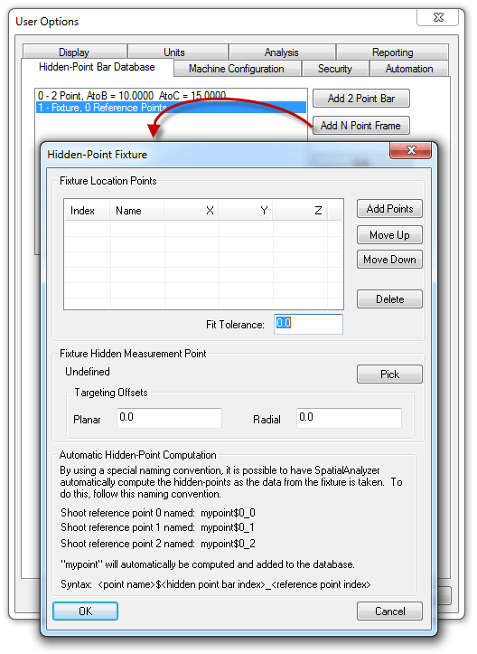
Hidden Point Fixtures
Use 3 or more points to define a hidden point.
Add custom fixtures to the Hidden Point-Bar Database.

Slide 3
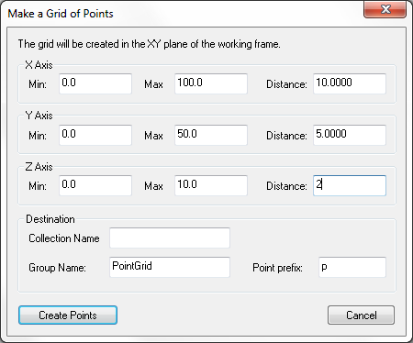
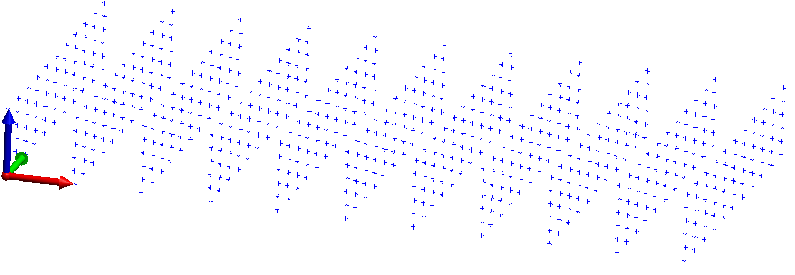
Grid by Distance
Create a grid of points in any two, or all three dimensions.
Points will be spaced evenly at a user-defined spacing in a volume defined by the total distance.

Slide 4
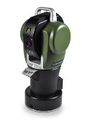
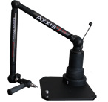
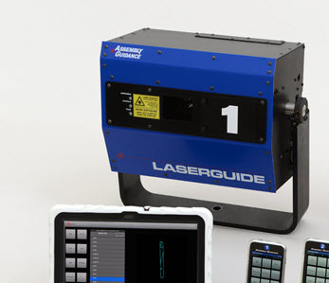
New Instrument Interfaces
API Axxis 7-100
7-dof probe arm
API OmniTrack 2
Laser tracker
Assembly Guidance LaserGuide Projector

Slide 5
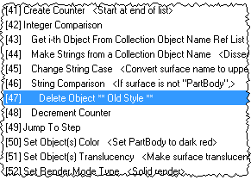
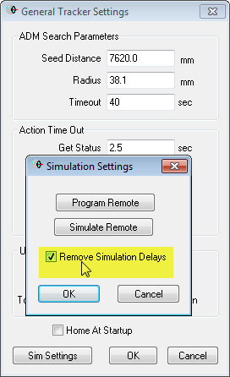
Remove Simulation Delays
Speeds up testing
MP Line Indentation
33 New MP Commands including:
Construct Surface from Point Groups
Make a Point Name Ref List – Wildcard Select
Make a Point Name – Ensure Unique
Make a Collection Object Name – Ensure Unique
Cloud Display Control

Slide 6
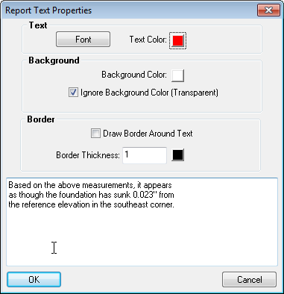
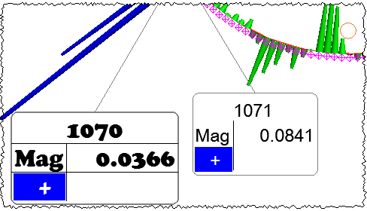
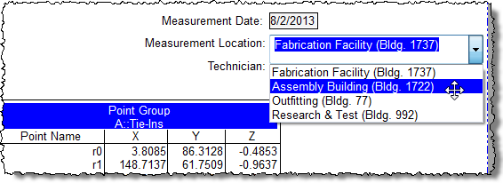
Reporting Improvements
ComboBox in reports
“Filename Short” tag eliminates full path
Borderless tables
Text properties
Font
Background color
Text color
Border color
Border thickness
Arrowhead ends (start, end, both)
Vector Group tolerance color box (TCB) toggle
Individual callout styling
Callout snapping (constrain leader to 45° increments)

Slide 7
Direct CAD Access support added for:
ACIS v23 (.SAT, .SAB)
Autodesk Inventor 2014
CATIA V5-6R2013 (R23)
Adobe 3D PDF (.PRC)
Rhinoceros (.3DM)
Siemens NX 8.5
File>>Export>>Other>>Surface Wireframe Curve Files (.crv) has been added
File>>Import>>Custom Formats>>Leica ADF (.adf) has been added
XML import and export format has been published

Slide 8
SA 2013.10.02

Slide 9
Instrument Toolbar
Laser tracker interface(s) simplified and conveniently located
4 common measurement modes and 4 more that are user-defined

Slide 10
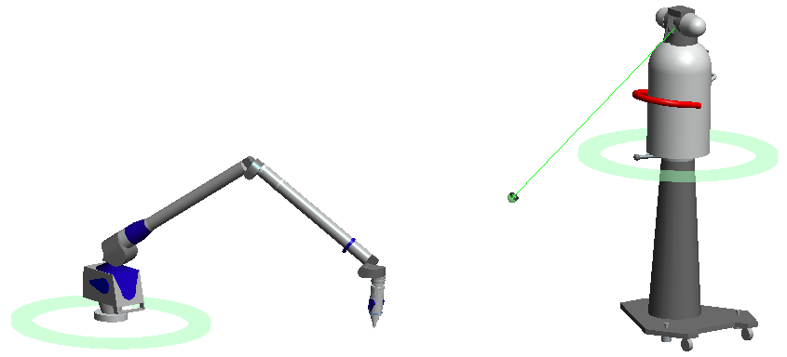
Instrument Connection Indicator
Highlights active instrument(s)
Display of the ring editable in User Options

Slide 11
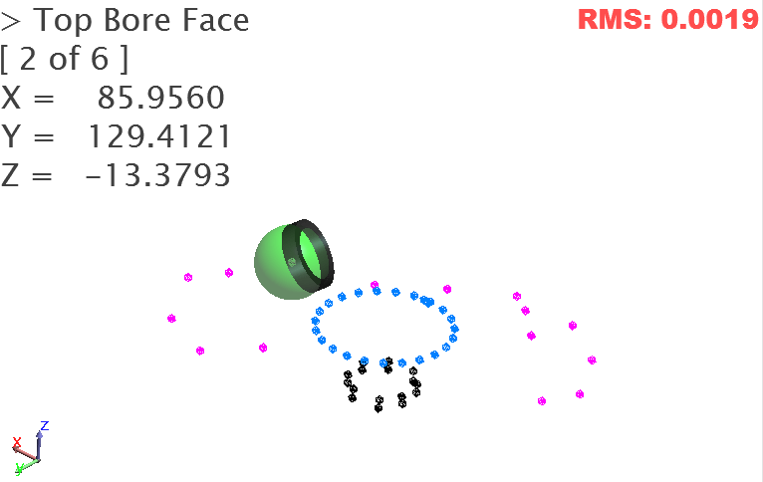
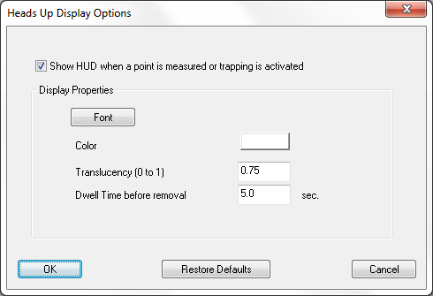
Heads Up Display (HUD)

Slide 12
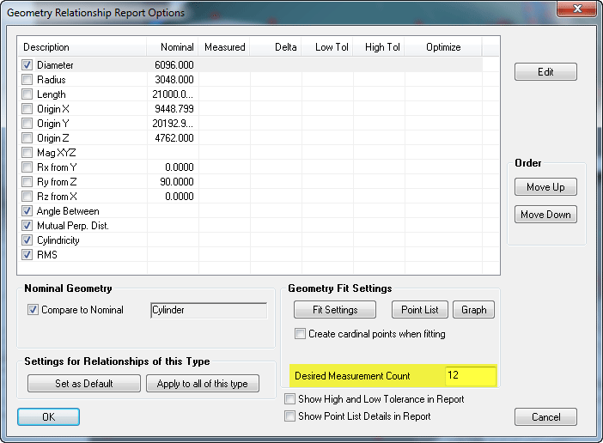
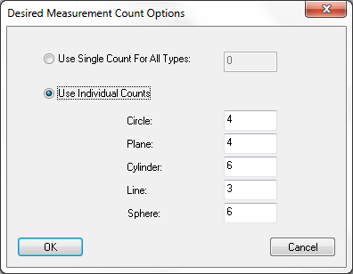
Desired Measurement Count
Automatically advance to next feature measurement when count is reached.

Slide 13
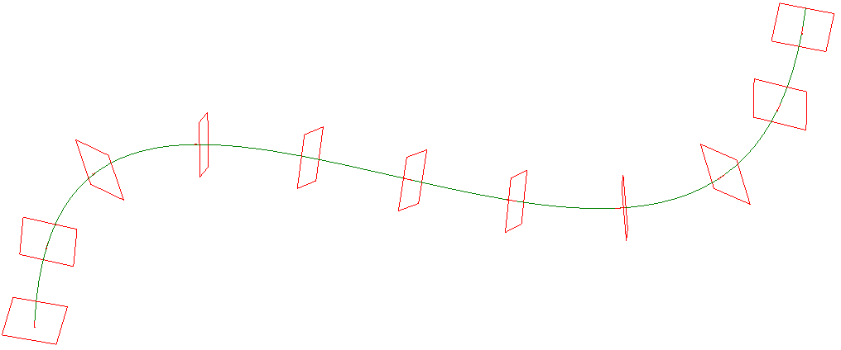
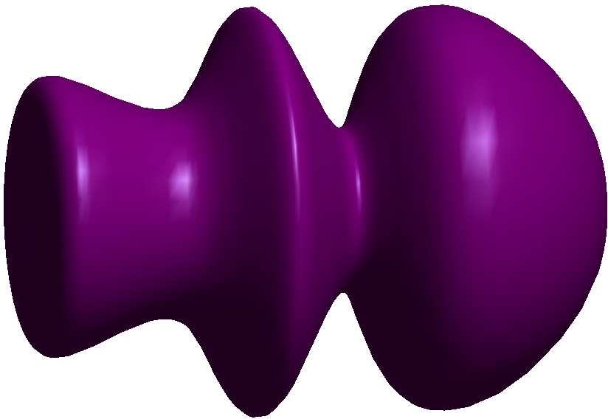
Layout Planes on a Curve
Revolved Surfaces

Slide 14
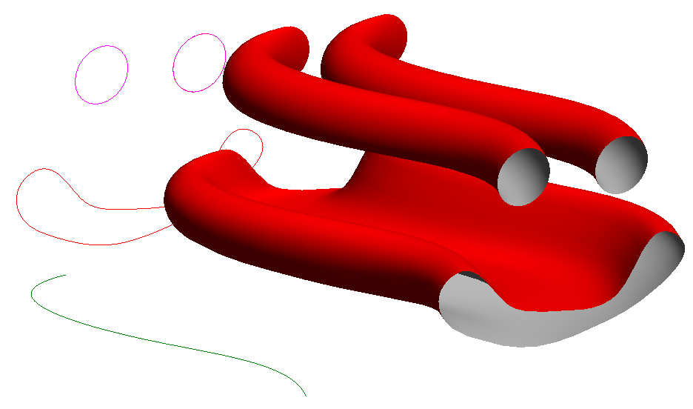
Swept Surfaces

Slide 15
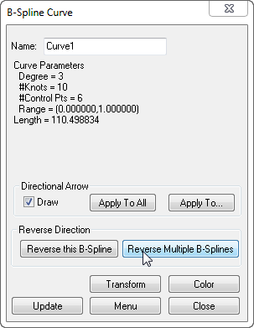
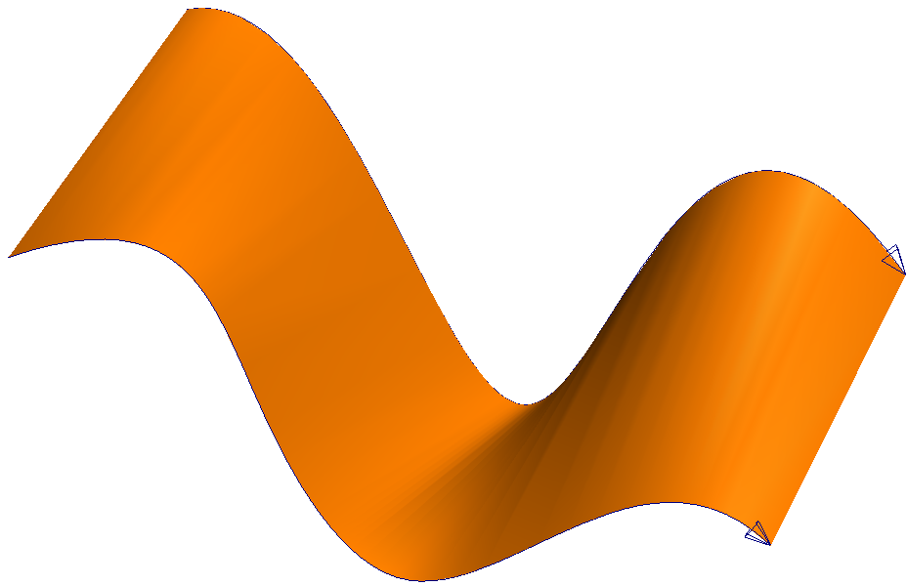
Surfaces from b-splines or point group
Now only 2 are required (was 4)
B-spline reversal
Reverse one or many

Slide 16
Improved GD&T functionality
Improved Surface Datum Handling
Preserves Primary/Secondary/Tertiary relationships via association with an offset line or plane to define dof to constrain
Cross Section Analysis Control
Distance between points used to group points together as a single cross section
Manual “GD&T” Alignment
Evaluate feature check using current alignment.

Slide 17
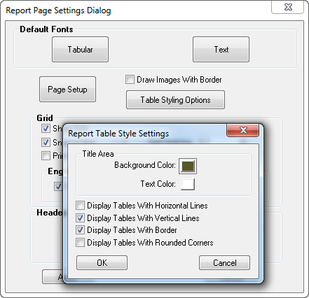
Reporting Enhancements
Table Styling
Check Boxes

Slide 18
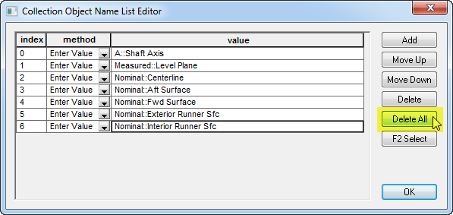
25 New MP commands including…
4 XML commands
Get/Set Notes
Construct Point Clouds – Runtime Select
Get/Set Relationship Associated Data
Automatic backup of MPs when working in MP editor!
Delete All in
reference lists.

Slide 19
For more information on What’s New, check out www.kinematics.com.
Thank You!

