Slide 1


Scott Sandwith
NRK Application Engineer
Todd Burch
NRK Director of Training

Slide 2

Notes:
USMN stands for Unified Spatial Metrology Network.

Slide 3
Unified Spatial Metrology Network
An advanced bundling technique that optimizes instrument and target positions by way of measurement uncertainty weighting.
Notes:
USMN is an advanced bundling technique that optimizes instrument and target positions by way of measurement uncertainty weighting.

Slide 4

Characterizing measurement systems and their uncertainty.
Optimizing instrument networks.
Determining network uncertainty.
Notes:
USMN has three main uses:
[CLICK]It’s used to characterize measurement system uncertainty,
[CLICK]It’s used to optimize instrument networks, and
[CLICK]it’s used to characterize network uncertainty.
But why is it needed?

Slide 5

Notes:
Let’s talk first about best-fit, because it has been a common method for station alignment for a long time.
We tend to use best fit frequently. It’s easy to understand, simple, and ubiquitous. And while best fit is useful, it has drawbacks:

Slide 6


Less accurate
It doesn’t intelligently consider points.
Notes:
The first is that it doesn’t intelligently consider the points. Best fit involves jiggling points around in space until the average component errors for all points are zeroed. On the one hand, it results in the fit with the least possible error between corresponding points. However, it makes zero assumptions about the accuracy of a point used in the fit. Every point is assumed to be a perfect measurement, and we know that this is certainly not the case. For instance, points far from an instrument are known to be less accurate, and therefore should have less influence over the fit than nearby points.

Slide 7
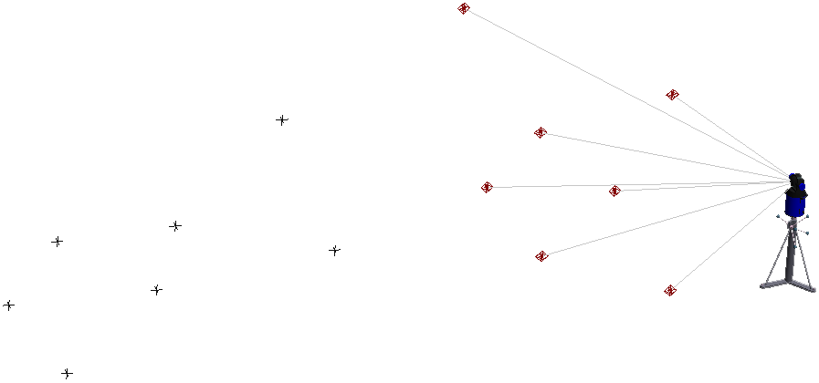
It is limited to one moving and one fixed set of points.
Notes:
Secondly, best-fit is limited to just one moving and one fixed set of points. It can only be performed between two instruments at a time, so networks of three or more instruments require multiple fit iterations. This leads to sub-optimal networks.

Slide 8
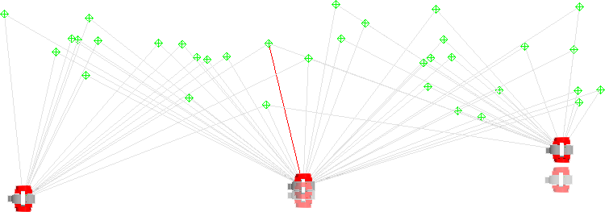
Fit
location
Fit
location
C
A
True
location
B
True
location
Leapfrogging leads to rapid error stack-up.
Notes:
Since only pairs of instruments can be fit at a time, instrument stations tend to be leapfrogged. Instrument B is fit to instrument A, then Instrument C is fit to Instrument B, and so on. When doing this, as is commonly done with large or long survey jobs, error stacks up rapidly.

Slide 9

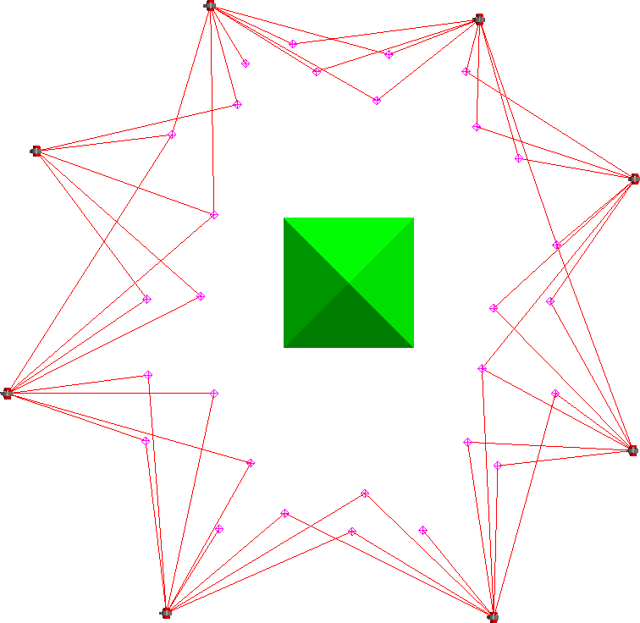
G
F
H
E
A
D
B
C
Measurement loops can’t be “closed”.
Notes:
Again, since only two instrument stations can be fit at a time, if toward the end of a chain of instruments I can tie back into my first instrument, that will improve my overall fit. This can’t be done using Best-Fit, because it only optimizes one instrument position at a time.

Slide 10
Provides no measurement uncertainty information.
Notes:
Best-fit gives you no measurement uncertainty information. You end up with a network at the end, but how good is the network? How good are your other measurements, which are likely the real points of interest?

Slide 11



Inst. 2
Most Likely Point?
Inst. 1
Doesn’t yield a “best set” of measurements.
Notes:
Best fit also doesn’t yield a set of points representing the best set or most likely target positions for pairs of points.

Slide 12

Notes:
What about traditional bundling? Bundling is used quite a bit as well—what drawbacks does it have?

Slide 13
It uses constant weighting.
Notes:
When you have multiple instruments to tie together, bundling is generally a better option than best fit. But the standard bundle in SA applies constant weighting to distance and angle components when solving. Individual points are not weighted separately. If you have total stations and trackers in your bundle, for instance, the angular component of the measurements will be weighted the same. This turns out to not be ideal, since different instruments have different characteristics.

Slide 14
Provides no measurement uncertainty information.
Notes:
Bundles also provide you with no measurement uncertainty information. You end up with a network at the end, but how good is the network? How good are your other measurements, which are likely the real points of interest?

Slide 15

Solves multi-station networks simultaneously.
Uses measurement information intelligently.
Yields ideal network of common points.
Provides uncertainty information for all measurements.
Can be used to characterize measurement system performance.
Provides results both numerically and graphically.
Notes:
And so this leads to the advantages of USMN:
[CLICK]USMN solves multi-station networks simultaneously, so you can solve for multiple instrument stations in one go.
[CLICK]It uses measurement information intelligently, yielding networks that more closely reflect reality.
[CLICK]It also provides results both numerically and graphically, which is useful to both metrology and non-metrology audiences.
[CLICK]At the conclusion of a USMN calculation, you end up with a network of common points that best represent the true measured targets.
[CLICK]Measurement uncertainty for all measured targets can be obtained.
[CLICK]The same process can be used to characterize the performance of a measurement system.

Slide 16

Notes:
This session is about USMN, but in order to understand USMN we first need to discuss measurement uncertainty.

Slide 17
Measurement Uncertainty
A characterization of the spread of values attributed to a given measured quantity.
Notes:
Measurement uncertainty, defined loosely, is a characterization of the spread of values attributed to some measured quantity.

Slide 18

Notes:
So you might be asking “Isn’t this the same as repeatability?”
And the answer is no: Repeatability is an indicator of how clustered together individual observations are in the same measurement condition, but says nothing about the accuracy of those measurements when compared back to the correct value.

Slide 19


Actual Target Location
Observed Target Locations
Notes:
For instance, here are a set of measurements that have high repeatability, but they say nothing about the uncertainty of the measurement with respect to the true location. Of course this is an exaggerated graphic, but it gets the point across. You may have many measurements clustered together (indicating high repeatability), but if that cluster is not near the actual location of the target, the instrument will have high uncertainty.

Slide 20

Notes:
And so you might then be asking yourself “isn’t that the same as accuracy?”
And the answer is: almost, but not quite. Accuracy describes the closeness of the agreement between a measured value and the exact value. In the case of real-world measurement, we don’t have exact knowledge of a measured value, so instead we look at uncertainty.
Uncertainty describes a range of possible values that is likely to contain the true measured value to some degree of confidence.
A highly accurate instrument has low uncertainty, and likewise an instrument with high uncertainty has low accuracy. Because of their similar connotations in everyday language, you’ll often see and hear the terms uncertainty and accuracy used interchangeably in industry. For instance, instrument manufacturers regularly mix “accuracy” and “uncertainty” in their specs and literature.

Slide 21
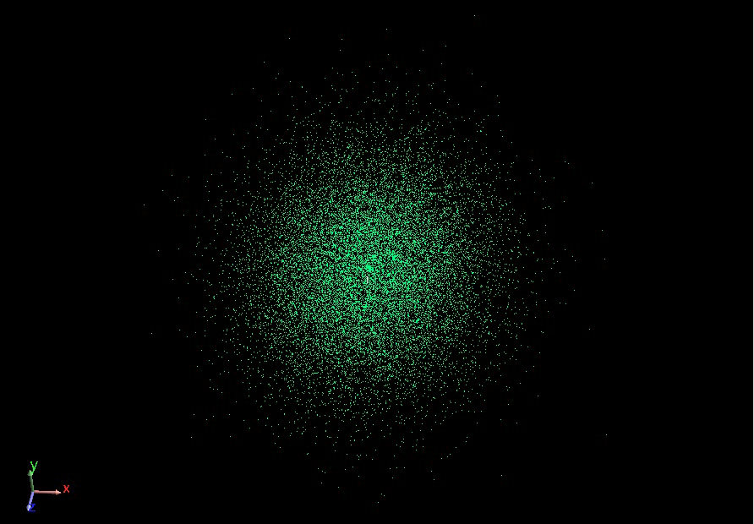
Notes:
We represent the uncertainty of a measurement using an “uncertainty cloud”, also sometimes referred to as a “sensitivity cloud” or “uncertainty field”.
An uncertainty cloud is a cluster of points that, taken as a whole, express the shape and distribution of uncertainty for a given measurement. You can imagine that this cloud is produced by taking thousands of measurements, each varied a small amount based on the amount of uncertainty in the individual measurement sample.
Expressing the cloud this way has a number of advantages which we won’t discuss in the interest of time.

Slide 22

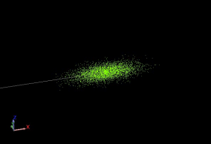
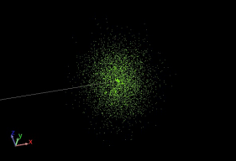
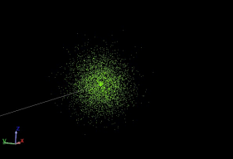
Clouds have different shapes
20” Distance
200” Distance
1200” Distance
Notes:
So here are some facts on uncertainty clouds.
First, they have different shapes, and are usually not spherical. For a given instrument, the shape is highly influenced by position of the target relative to the instrument.
Here are three uncertainty clouds for a laser tracker, looking at measurements 20”, 200”, and 1200” from the tracker. Notice that the near measurement is cigar-shaped along the line of sight, the mid-distance measurement is more spherical, and the far-distance measurement is more pancake-shaped. The rightmost cloud is about 6 times the diameter of the mid-distance cloud, and the mid-distance cloud is about 10 times the diameter of the near cloud. (If you recognize this as being the same as the ratios of their distances, this is not a coincidence).

Slide 23


Notes:
The way that an instrument influences the shape of an uncertainty cloud depends on the type of instrument: whether it’s a spherical measurement instrument, kinematic instrument (such as a portable arm), or something else.
We can get a grasp of why the shape changes by looking at this graphic, which is representative of a spherical measurement instrument, such as a laser tracker. In this case, the instrument measures three components: vertical angle, horizontal angle, and distance.
The vertical and horizontal angular uncertainty of a laser tracker is generally constant, but due to geometric similarity in that “uncertainty cone”, doubling the distance from the instrument will double the uncertainty in the direction perpendicular to the line of sight.
Distance error, on the other hand, increases with distance from the instrument, but at a much much smaller rate. This explains why tracker uncertainty clouds look cigar-shaped up close and pancake-shaped at larger measurement distances.

Slide 24
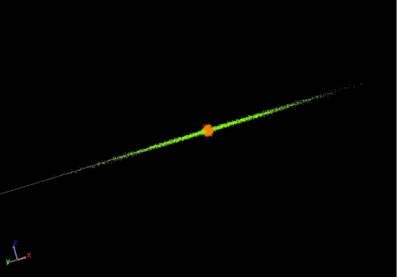
Instrument characteristics affect the shape
200” Distance
Notes:
The characteristics of the instrument affect the shape as well. Here, I have the uncertainty cloud for a total station (green) displayed on top of the cloud for a laser tracker (orange).
We know that total stations generally have more accuracy in their angular component than laser trackers, so their clouds tend to be thinner. Total station distance measurements are also generally much worse than distance measurement from a tracker, explaining the much longer cloud.

Slide 25
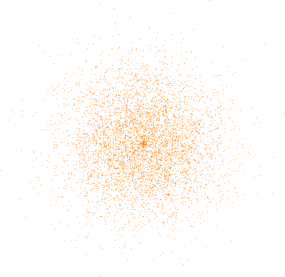
Clouds are not of constant density
Notes:
Another aspect of the cloud is that it is not of constant density. The cloud is more dense near the middle and more sparse toward the edges. These outer cloud points represent greater error but are less common. In other words, they are outliers.
The distribution of samples in the cloud follows a “Gaussian” or “Normal” distribution, colloquially known as a “bell curve”.

Slide 26
Notes:
So the question now becomes: how do we determine the uncertainty of a measurement?
Well, there are ways to do it using fairly sophisticated or expensive hardware, such as very accurate calibrated reference lengths or interferometers, but these have some limitations. They’re expensive, they need to be maintained properly, and most importantly, they only reflect the uncertainty of the instrument itself.

Slide 27

Notes:
Suppose we fix three pucks to random locations in the room. The locations of the pucks themselves don’t matter, but they should be rigidly placed.
Then, imagine setting up an instrument in a random location and shooting those reference points.
Next, we move the same instrument to a different location in the room and shoot the targets again.
If the instruments were perfectly accurate, there was no error in the measurement process, and we lived in a Utopian world, can you imagine that the two sets of points would fit together perfectly?

Slide 28


Notes:
In SA, the measurement set might look like this.
If we were then to best-fit these two instruments together, if there was no error and everything was perfect, the two point groups would fit together perfectly.
This would illustrate the perfect case of zero uncertainty in the system.

Slide 29
Notes:
Suppose we now repeat the exact same process, but now introducing error back into our world. Now, when we fit the data together, we’ll see that the targets no longer match up.

Slide 30
Notes:
The amount of disagreement between these corresponding points is an indicator of the uncertainty of the measurement system.
In reality, the process is more complicated than this. Instead of looking at the deviation between corresponding points, SA looks at the distance, horizontal angle, and vertical angle components separately. Also, more data is required than this simple example illustrated, but this hopefully gets the idea across.
By performing a measurement test like this example illustrated, you can actually determine the uncertainty characteristics for your own instrument and measurement system. What’s especially neat about this technique is that since it uses empirical data—that is, it uses actual observed values from the instrument, it factors in all of the different sources of error to give you values that best reflect reality for your specific situation.

Slide 31
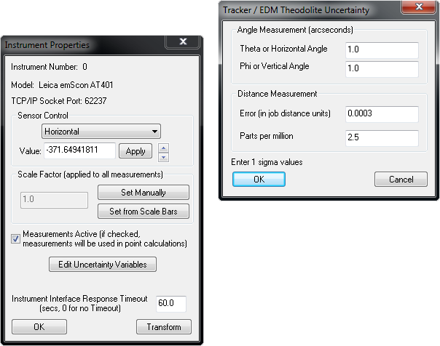
Uncertainty Variables:
Parameters describing the uncertainty characteristics of a given measurement system.
Notes:
In SA, the uncertainty characteristics of a given instrument are stored as “Uncertainty Variables”.
[CLICK]Uncertainty variables are accessed in the instrument’s properties window through the “Edit Uncertainty Variables” button.
What you see here depends on the type of instrument you’re looking at, but notice that there are four modifiable values for trackers: Horizontal angle uncertainty, Vertical angle uncertainty, distance error, and PPM.

Slide 32
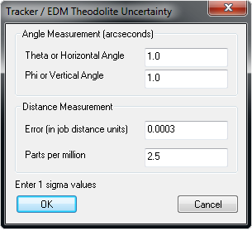
Notes:
Horizontal angle is the horizontal angle uncertainty. Likewise, vertical angle is the vertical angle uncertainty.
Error in job distance units is a general fixed error that applies to all distance measurements, and “Parts per million” is the amount of additional error in the distance component as target distance increases.
These values are default uncertainty values that are the exact same for all instruments of the same type. Faros, API, and Leica trackers will all have the same value here. Now, it’s certainly true that those instruments have different uncertainty characteristics, so why are all values the same for different trackers?

Slide 33
General Steps:
Establish network of eight (8) or more fixed monuments.
Locate instrument at four (4) or more stations, measuring common points at each station.
Perform a USMN on the network to calculate the uncertainty variables.
Copy resulting values into your instruments during the actual survey.
Notes:
So here’s how you can determine the uncertainty variables for your specific measurements.
[CLICK]First, establish eight or more fixed monuments to serve as control points.
[CLICK]Next, locate your instrument in 4 or more different locations, measuring the common points at each instrument station.
[CLICK]Then, perform a USMN on the network, which will calculate the uncertainty variables for you.
[CLICK]Finally, copy these variables into your instrument properties when performing the actual survey to get accurate uncertainty values/network.

Slide 34
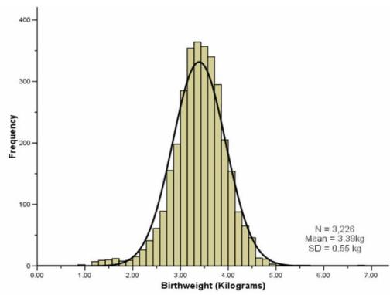
Notes:
Most natural random processes tend to have this sort of distribution of data--the majority of values are clustered around the middle, and the further you get from “average”, then less common the occurrence.
Just as an example, here is a distribution illustrating the birth weight of 3,226 babies measured by a hospital. It fits a Gaussian distribution quite well.

Slide 35
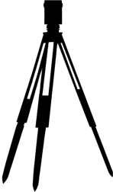

d

Notes:
The way we do it is by starting with the measured target and perturbing the instrument’s measurement components based on the uncertainty characteristics. In the case of a laser tracker, these components include horizontal angle, vertical angle, and distance. We then observe how those perturbations affect the resulting target, and place an uncertainty cloud point there. We do this many times over, placing uncertainty cloud points after each iteration. Soon, we have enough data to extract statistical information about the shape and size of the uncertainty cloud. (Just like a poll of sufficient people is representative of a population as a whole).
By the way, this type of analysis is called a Monte-Carlo analysis.
However, we can’t just randomly perturb the angles and distance willy nilly…

Slide 36
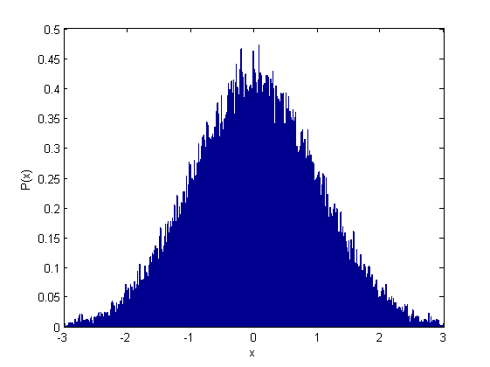
Notes:
It just so happens that SA uses a special random number generator that can create random numbers in a Gaussian distribution. (Called the Box-Muller algorithm, if you’re interested). That is, the majority of numbers generated are clustered around some central value, and their occurrence drops off as this image depicts.

Slide 37
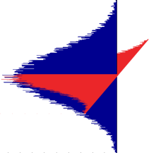


d

Notes:
So, we use this special random number generator to perturb the values as I mentioned before, but we perturb each of them in a Gaussian distribution to reflect what you would expect to see in reality.

Slide 38
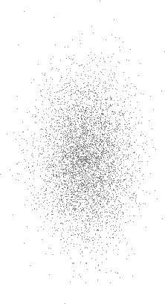
Notes:
And the end result in an uncertainty cloud.

Slide 39
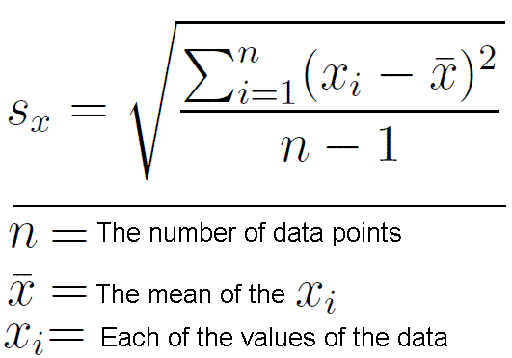
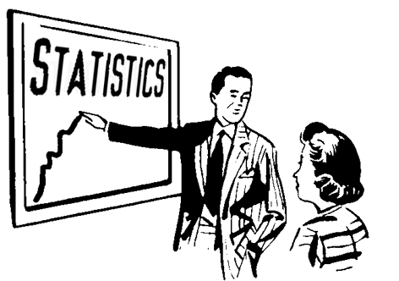
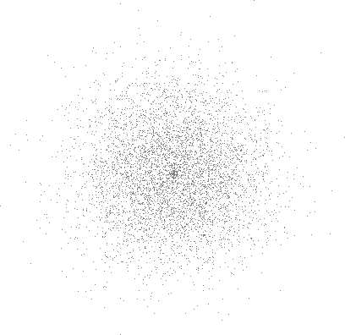
Notes:
Once we have this cloud, we can perform fairly basic statistical analysis on it to determine its uncertainty in the current working frame.

Slide 40
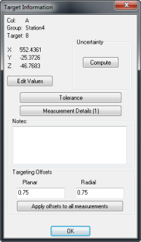
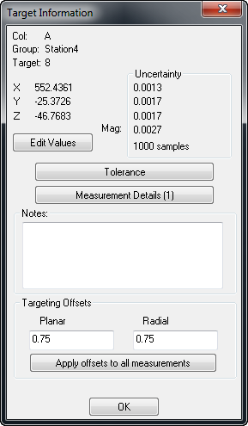
Notes:
And that’s exactly what happens when you click this “Compute” button, giving you uncertainties in X, Y, Z, and magnitude.
Notice below the uncertainty values there’s an indicator of the number of samples used for the analysis—in this case, 1000.

Slide 41
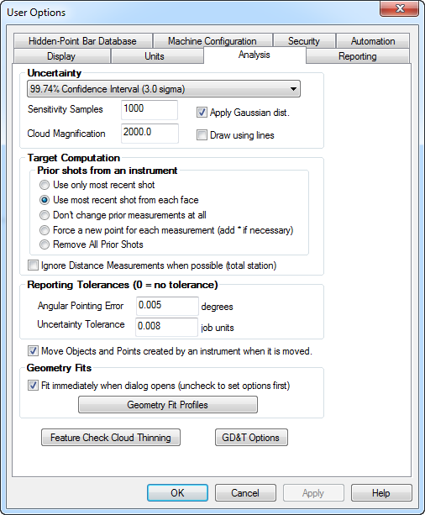
Notes:
The number of samples is set in SA’s User Options>Analysis tab.

Slide 42
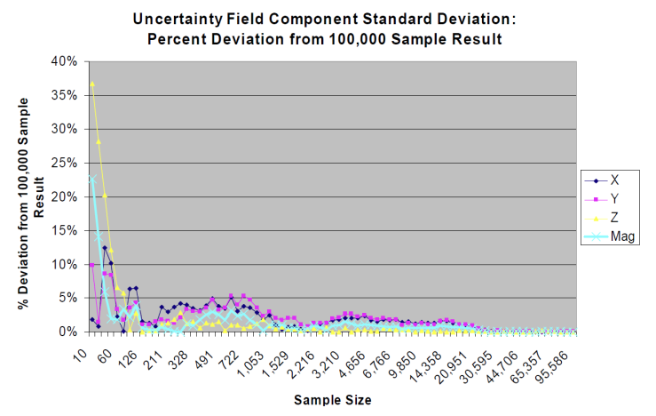
How many samples are enough?
Notes:
As with all statistical analyses, more samples is better, but there are always diminishing returns. So how many samples are enough?
When USMN was developed this question was investigated, and it turns out that above about 200-300 samples, you’re within 5%, and above about 1000 samples you’re within 3%.

Slide 43

Notes:
So with all this new-found knowledge of uncertainty and confidence intervals, we can now expand this to multi-station networks, which is the primary use for USMN.

Slide 44

Multi-station networks.
When uncertainty is required.
When establishing point-based reference systems.
Elongated surveys.
Large surveys that loop back on themselves.
Whenever you can!
Notes:
The first question to ask is: When should you use USMN?

Slide 45


U_{l} = ...
U = …
U = …
U_{l} = ...
U = …
U = …
U_{l} = ...
U = …
U = …
U_{l} = ...
U = …
U = …
Notes:
The idea with a USMN network is that we have a series of instrument measurements connected through a set of common points. We know the uncertainty characteristics of the instruments, and as discussed earlier we can determine the uncertainty of each instrument’s measurements in the network.
We then perform the weighted bundle, and end up with optimized instrument transforms and optimized USMN points.

Slide 46
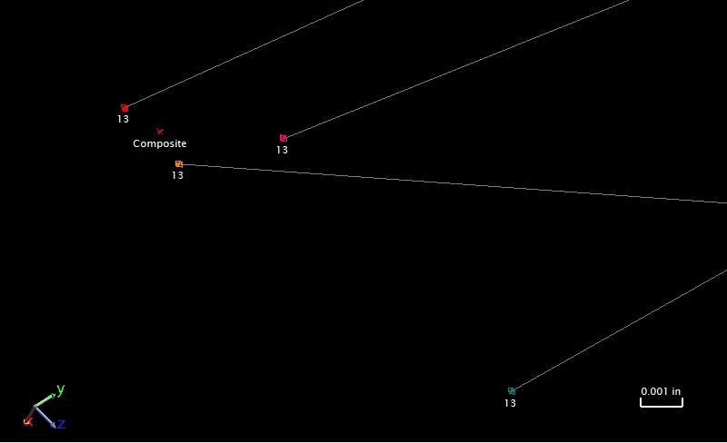
Notes:
The optimized USMN points are called “USMN Composite” points, and represent the most likely position of each point in the network.
In the case pictured here, the observation of point 13 in the bottom-right corner has been thrown out of the solution, because it was deemed to be an outlier. Notice that you can visually see this, as this instrument’s observation of the target is a significant distance from the other observations of the target.
Notice also that the composite point is *not* an average of the included observations.

Slide 47
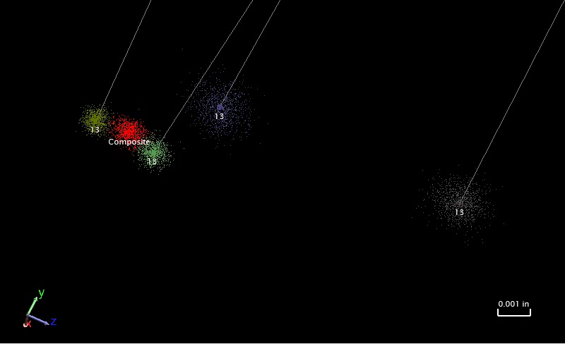
Notes:
Here is the same set of observations, but with each observation’s uncertainty cloud turned on. Notice that the composite point is located closer to the two points with smaller uncertainty clouds.
You might be wondering how SA determines the uncertainty of the composite point. It does this by actually solving the entire USMN network N number of times. The first time through SA takes the first cloud point from each uncertainty cloud, and solves the USMN for that set. It then solves the network for the second set of uncertainty cloud points, and so on, until you have a cloud of composite points.

Slide 48

Notes:
So to wrap things up, let me just cover a few commonly misunderstood properties of USMN.

Slide 49
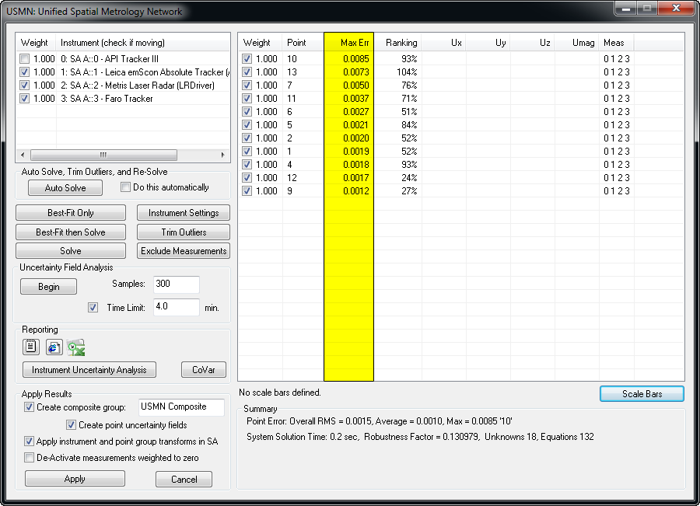
Max Error
Notes:
The first is Max Error.

Slide 50
13
Max Error
13
13
13
13
Notes:
Max error is the largest error between all observations to a common target. It is an indicator of the maximum spread among observations.

Slide 51
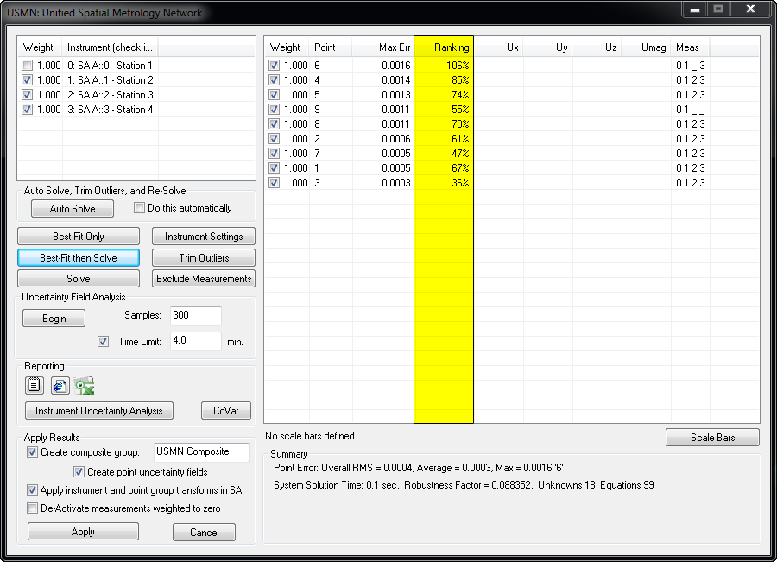
Ranking
Notes:
Now what about ranking? What is the ranking value describing?

Slide 52
Ranking
A quantitative indicator of measurement quality expressed as the percentage of the 3 sigma envelope the measurement residual is consuming.
Notes:
Ranking is a quantitative indicator of measurement quality expressed as the percentage of the 3 sigma envelope the measurement residual is consuming.

Slide 53

Notes:
Recall the Gaussian distribution we saw earlier. A sigma value of 3 encompasses 99.7% of all measurements. With ranking, an observation whose residuals (or errors) are 3 standard deviations from the mean will be assigned a ranking value of 100%.

Slide 54
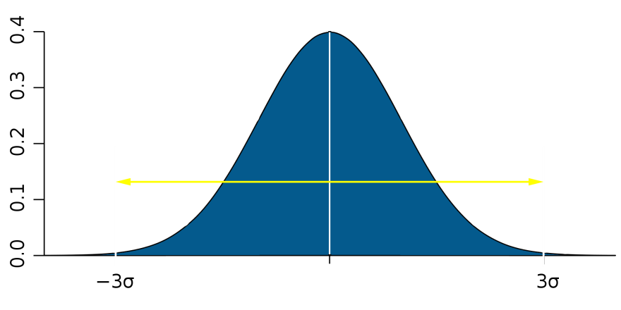
Std Dev = 0.002”
Ranking = 0%
100%
Notes:
So for instance, suppose a USMN network has residuals with a calculated standard deviation of 0.002”. An observation that sits right on top of the calculated USMN composite point is given a ranking of zero.

Slide 55
Error: 0.002” (1 Std. Dev.)
Ranking = 33.3%
100%
Notes:
A point 1 standard deviation (0.002”) from the USMN composite point will have a ranking of 33.3%,

Slide 56
Error: 0.004” (2 Std. Dev.)
Ranking = 66.6%
100%
Notes:
A point 2 standard deviations (0.004”) from the USMN composite point will have a ranking of 66.6%,

Slide 57
100%
Error: 0.006” (3 Std. Dev.)
Ranking = 100%
Notes:
And a point 3 standard deviations (0.006”) from the USMN composite point will have a ranking of 100%.

Slide 58
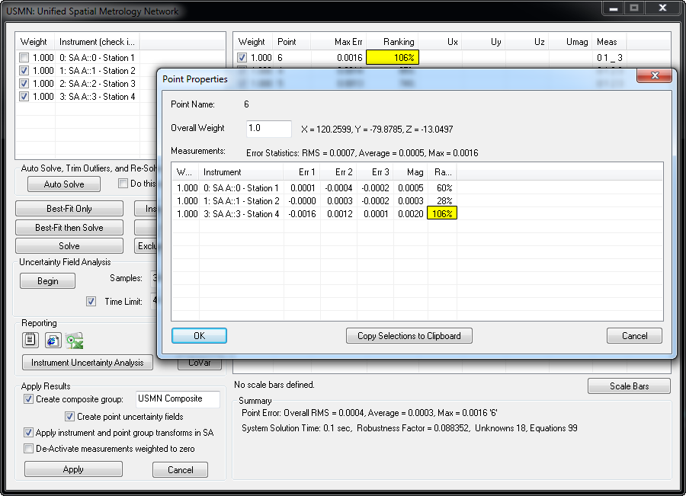
Notes:
Practically speaking, ranking is an indicator of whether a point is an outlier. When considering which values to trim, you really need to consider the point and the outliers in the entire network. The ranking value for a given point is the largest ranking of all observations of that point. In general, it is recommended to trim individual observations that exceed 100%, but retain those that do not—however this threshold may vary considerably depending on the situation.
For instance, if you see a single point with a ranking of 500%, and others with a ranking of 150%, it would be wise to eliminate just the 500% ranking point first, then re-evaluate. You will likely find that the 150% ranking points will now look good.

Slide 59


