Slide 1

Advanced Measurement Modes
Bruce Thomas
Gary Garrison

Slide 2
Advanced Measurement Modes
Trackers
Arms
Instrument Combinations
Importing Measurements

Slide 3
Trackers
MP command string
SA Remote for Tracker
Edge measurement
Level
High Point
Single Point Circle
3-Plane Points

Slide 4
Trackers, cont’d
Hidden Point
Geometry Trigger
(supersedes Cross Section)
Auto Proximity
  Auto-rename
  Points vs. vectors
  Proximity Trigger
Externally Triggered

Slide 5
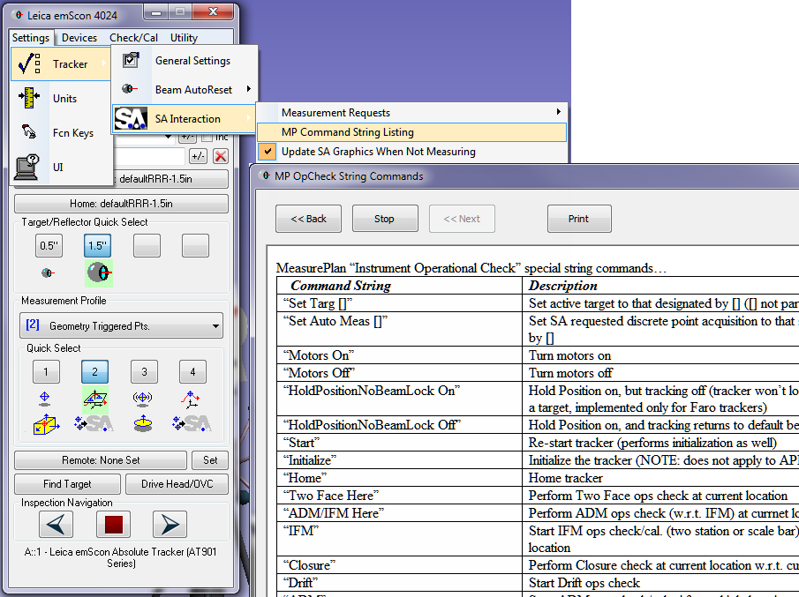
MP command string

Slide 6
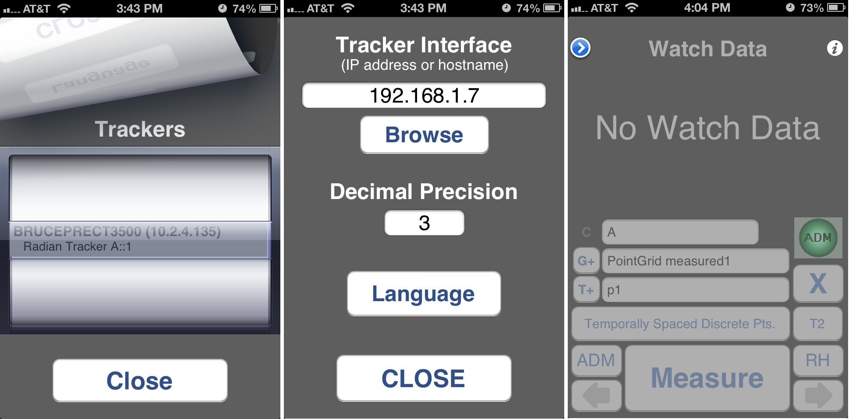
SA Remote for Tracker

Slide 7
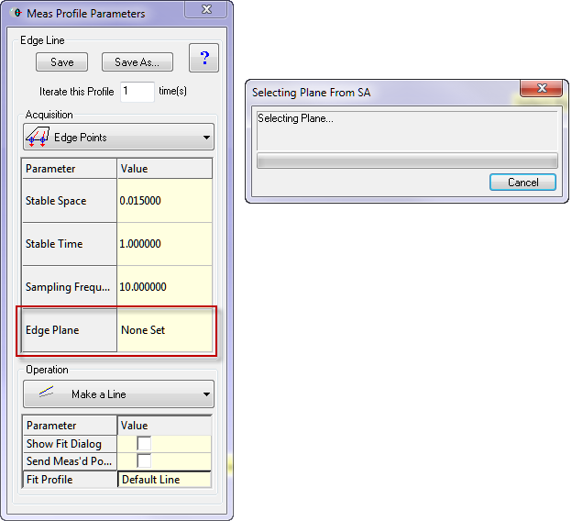
Edge measurement
Notes:
Point out Iterate, Acquisition & Operation generally, then Edge measurement profile specifically.

Slide 8
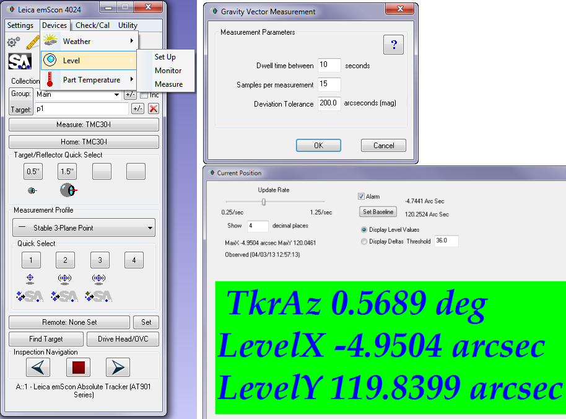
Level
Notes:
Don’t forget to make the frame active.

Slide 9
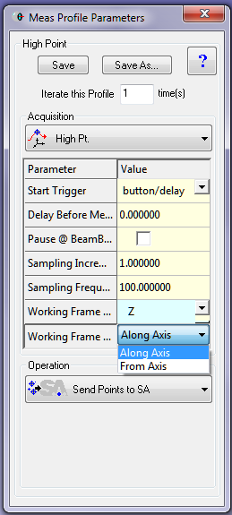
High Point

Slide 10
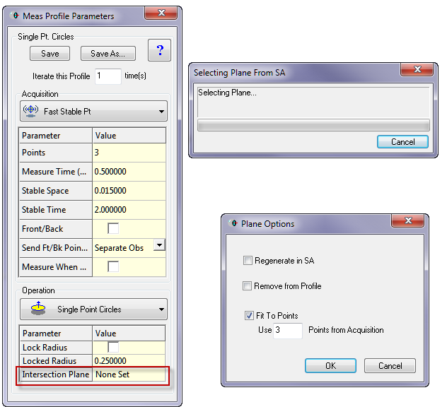
Single Point Circle
Notes:
Left click & right click highlighted region.

Slide 11
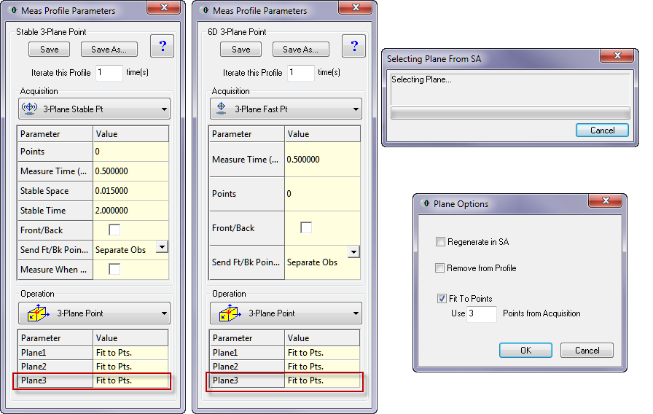
3-Plane Points

Slide 12
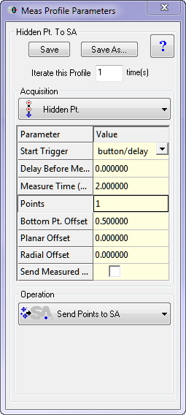
Hidden Point

Slide 13
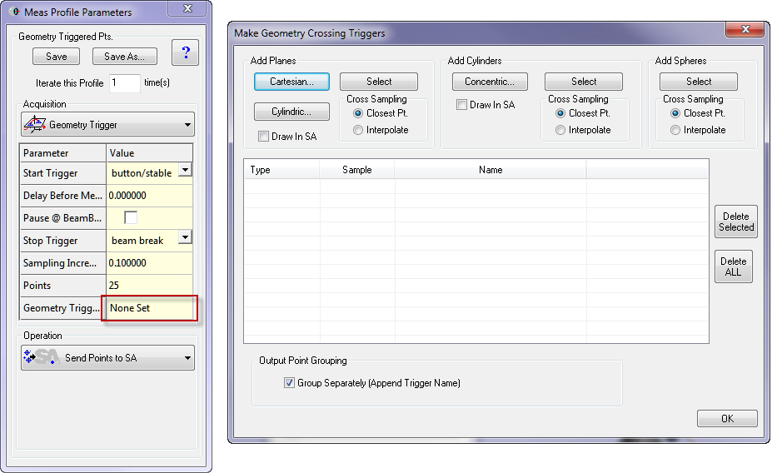
Cross Section/Geometry Trigger

Slide 14
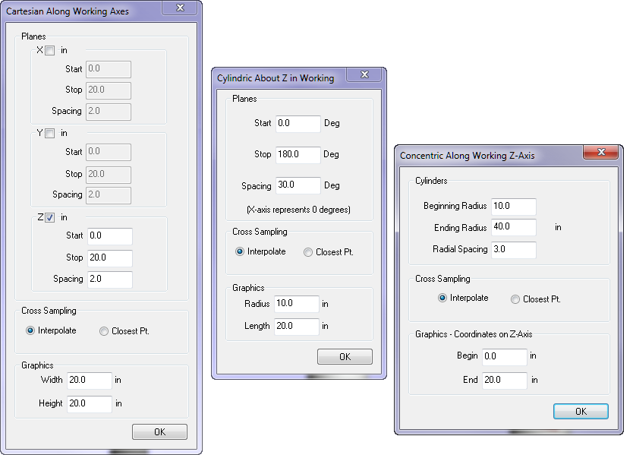
Geometry Trigger, cont’d

Slide 15
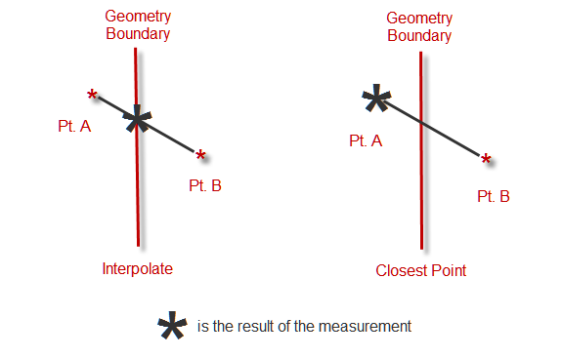
Geometry Trigger, cont’d

Slide 16
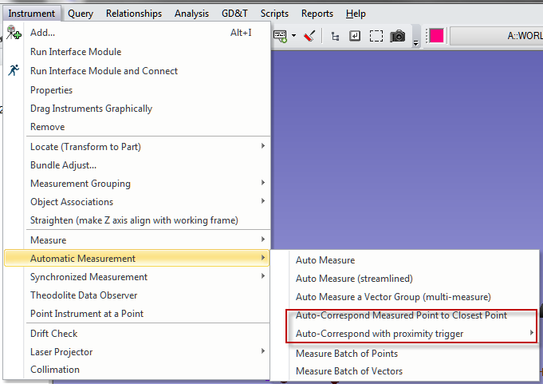
Auto Proximity

Slide 17
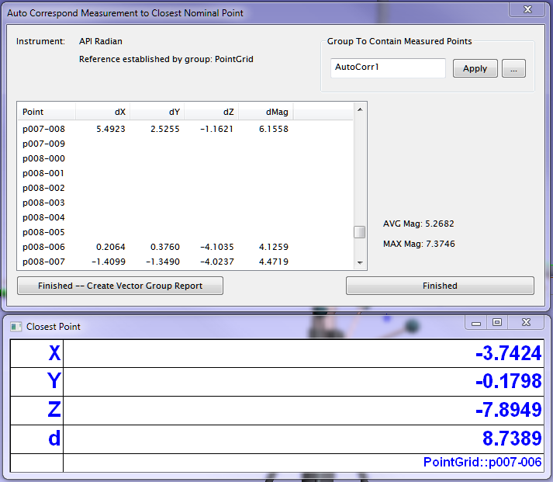
Auto Proximity, Auto-rename
Notes:
We should probably mention that this is what you get when you choose "Auto-Correspond Measured Point to Closest Point" from previous slide.

Slide 18
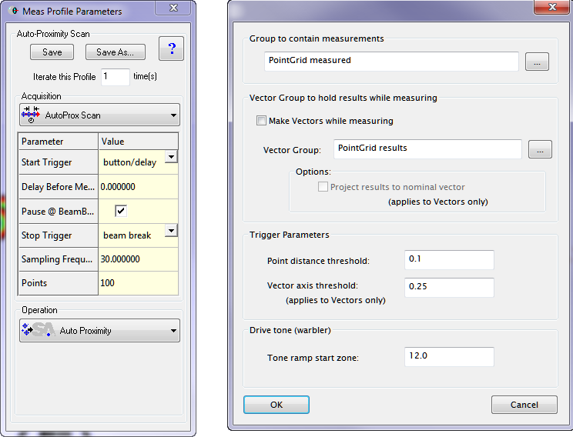
Auto Proximity, cont’d
Notes:
See Bruce. We should probably mention that these are what you get when you choose "Auto-Correspond with proximity trigger" from the menu.
Note Measure each point only once…

Slide 19
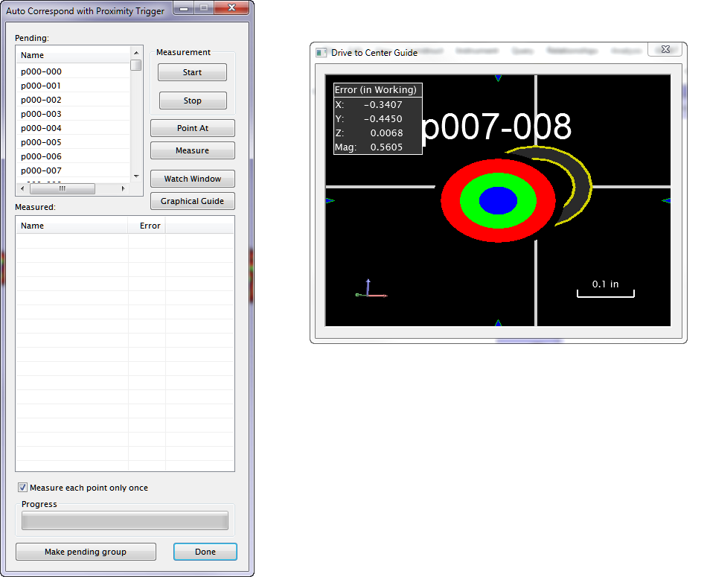
Auto Proximity, cont’d
Notes:
See Bruce. Which apply for point and vector goals?

Slide 20
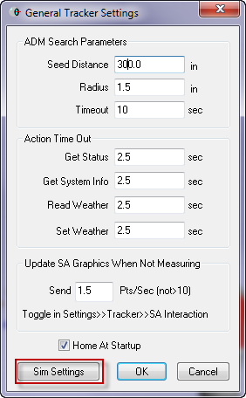
Externally Triggered
Notes:
Temporal scan acquisition

Slide 21
Arm/PCMM
MP command strings
SA Arm Pad
Edge-Line
Single Point Hole
Batch of Points
Section Cut
Geometry Trigger

Slide 22
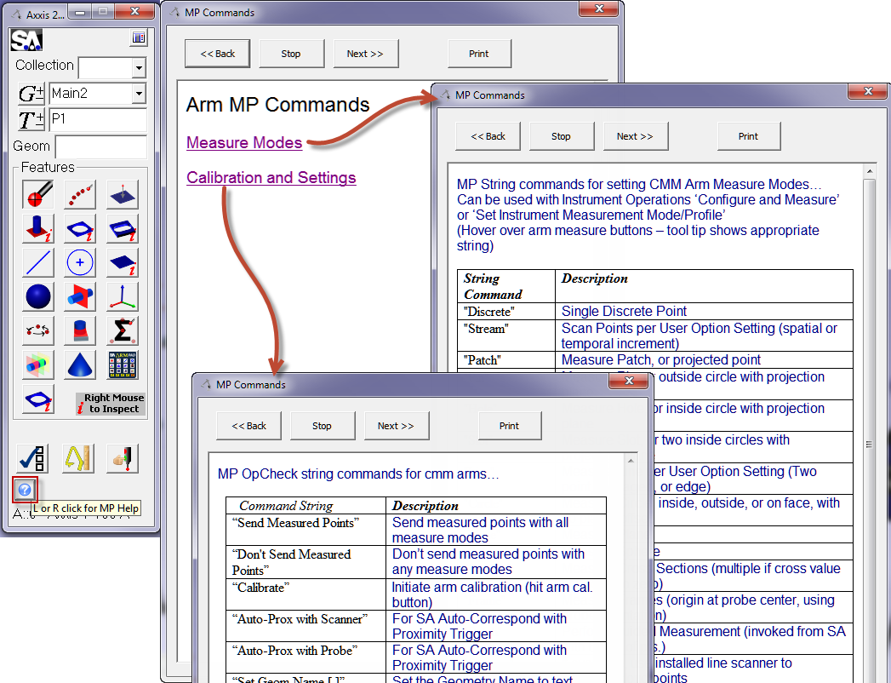
MP command string

Slide 23
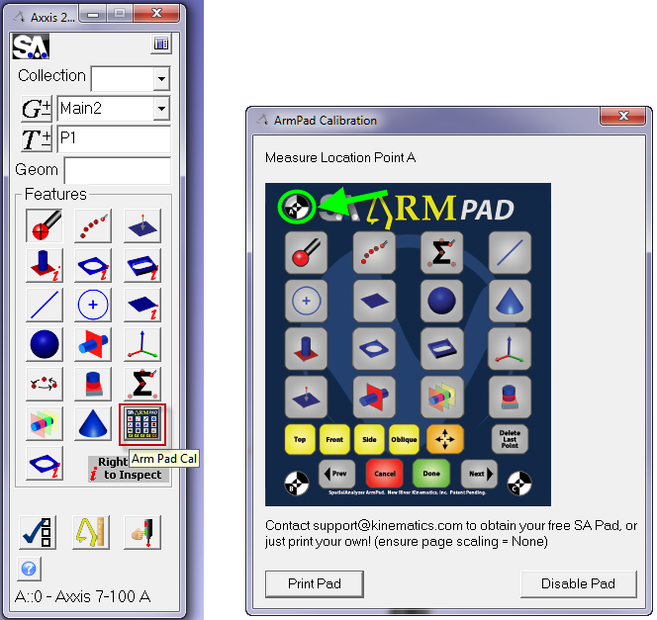
SA Arm Pad

Slide 24
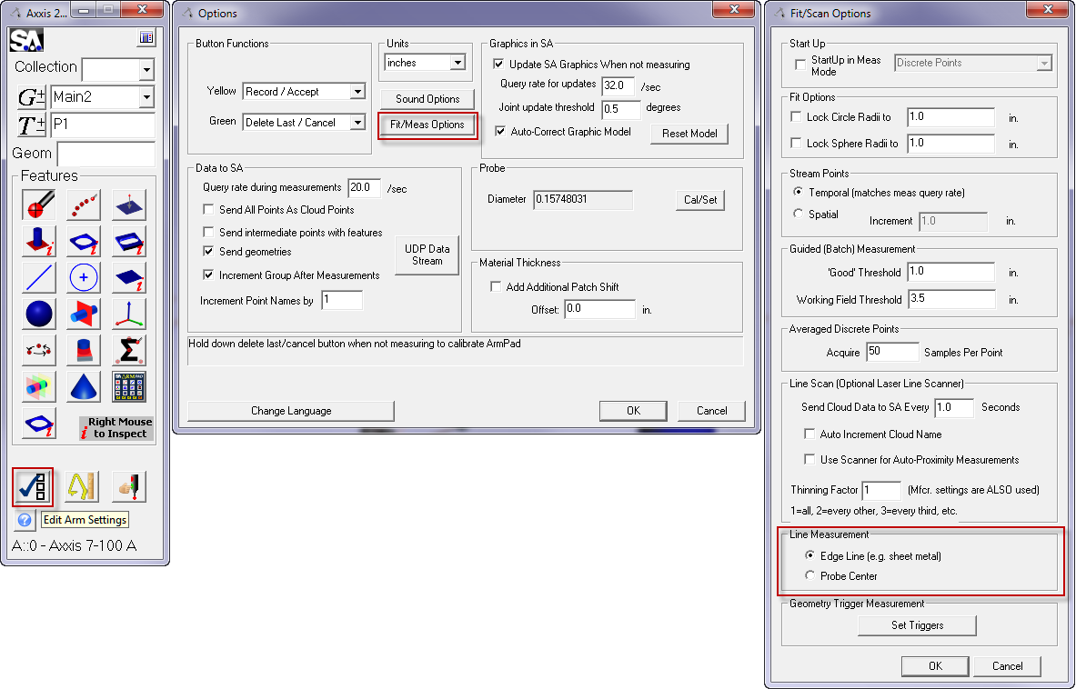
Edge-Line

Slide 25
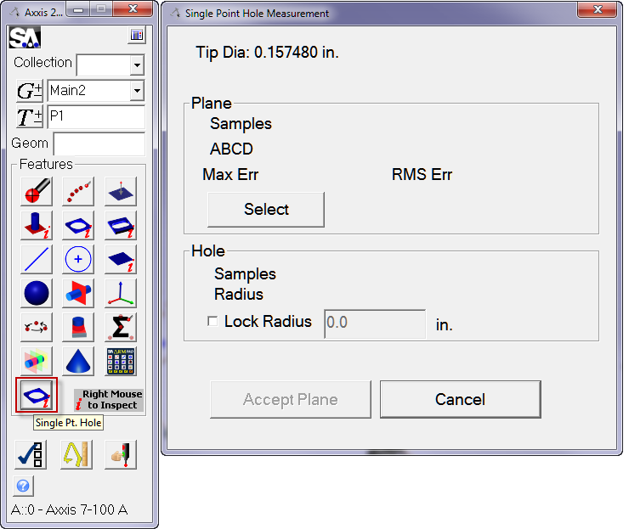
Single Point Hole

Slide 26
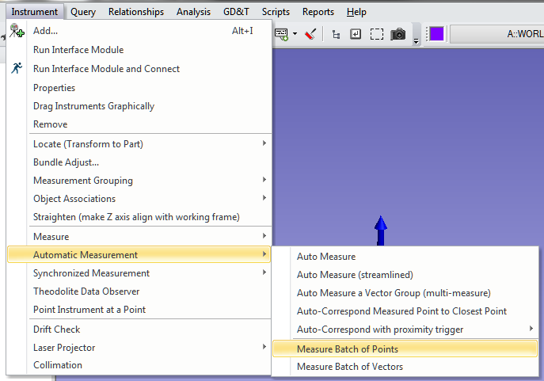
Batch of Points

Slide 27
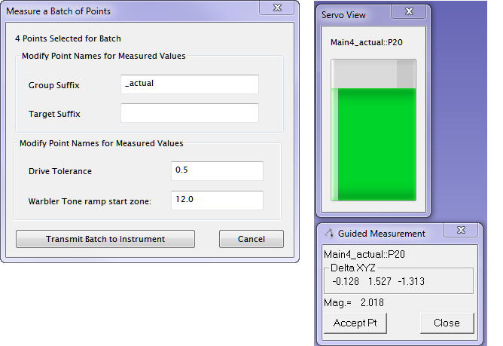
Batch of Points, cont’d

Slide 28
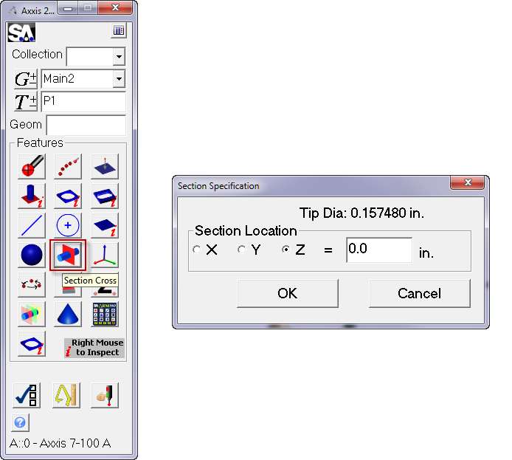
Section Cut

Slide 29
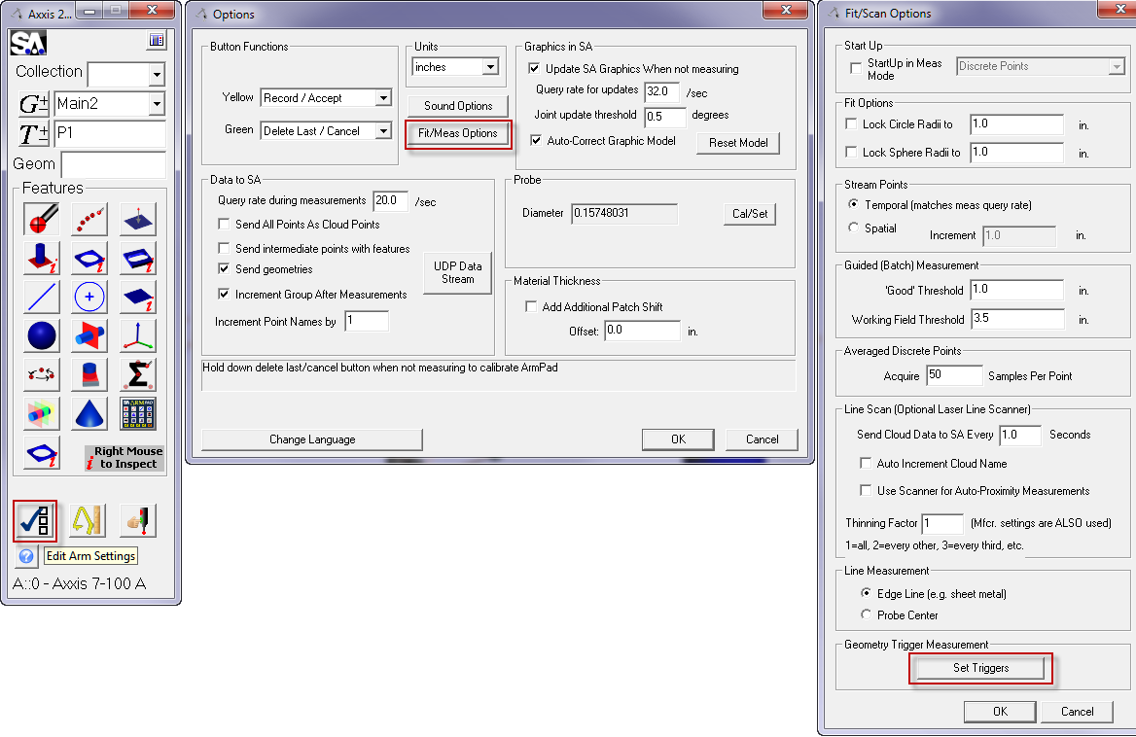
Geometry Trigger

Slide 30
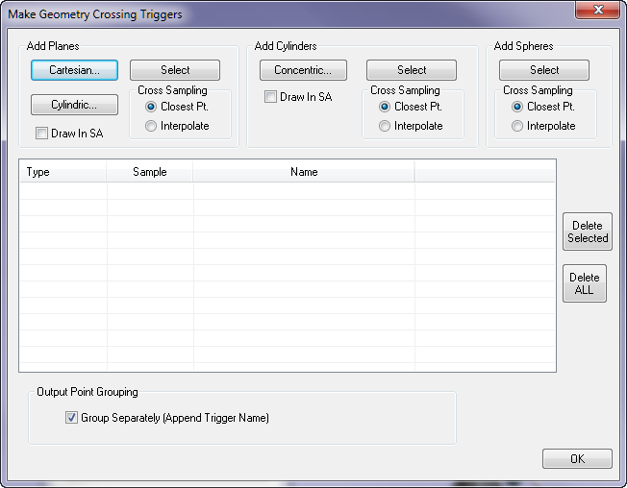
Geometry Trigger, cont’d

Slide 31
Geometry Trigger, cont’d

Slide 32
Geometry Trigger, cont’d

Slide 33
Combining Instruments
Master-Slave
TransTrack
  Single 6D instrument
  Three or more Trackers
  Single Tracker, Guide in 6D

Slide 34
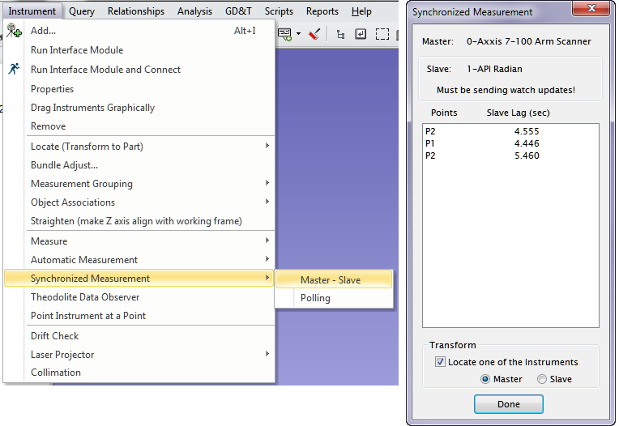
Master-Slave

Slide 35
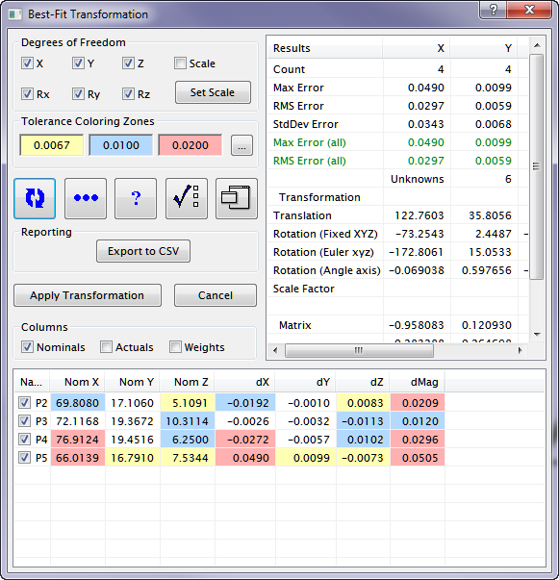
Master-Slave, cont’d

Slide 36
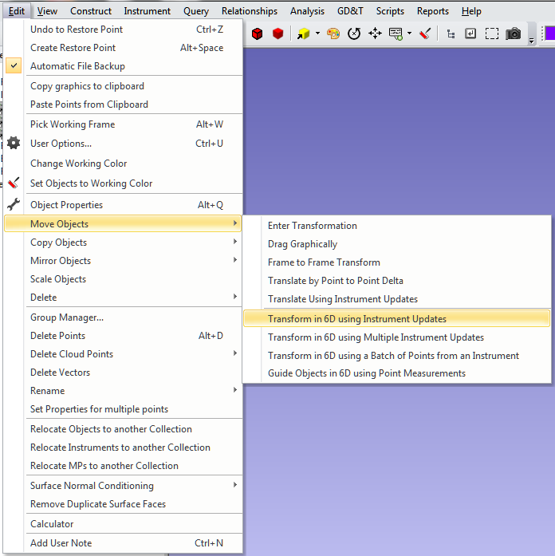
TransTrack

Slide 37
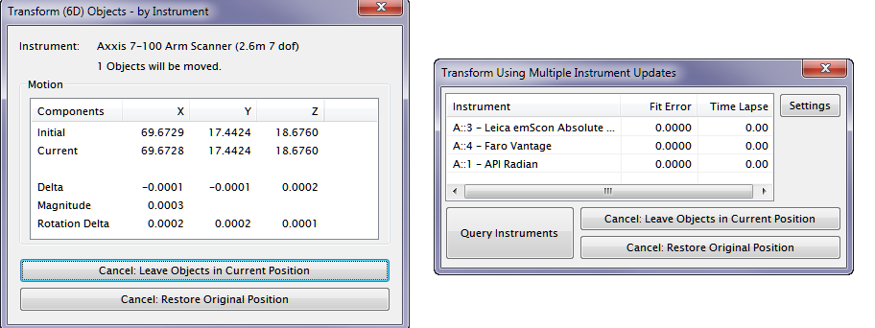
TransTrack, cont’d

Slide 38
Importing Measurements
Tracker interface
Theodolite manager

Slide 39
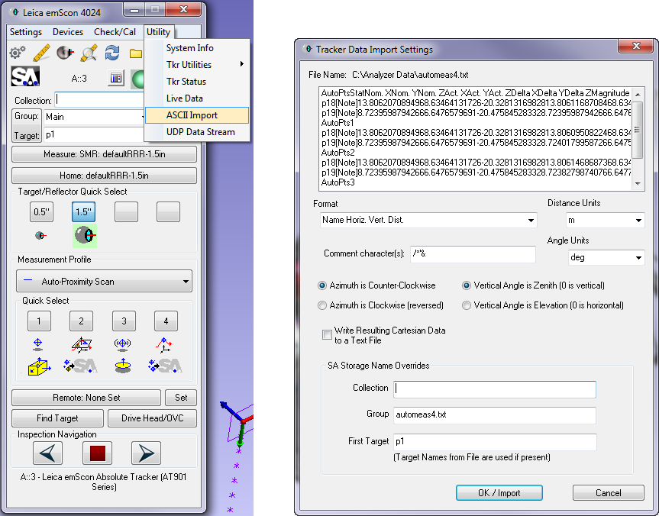
Tracker Import

Slide 40
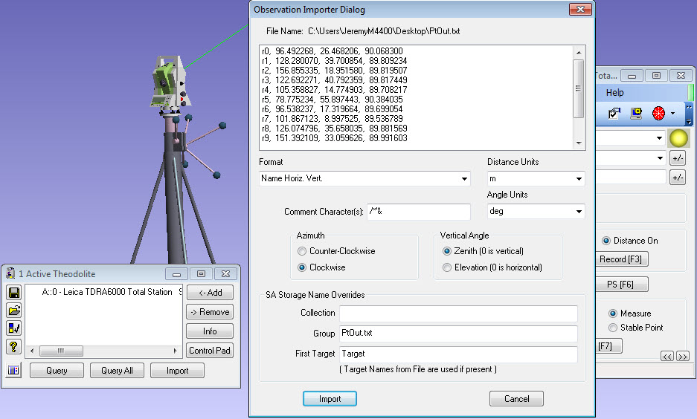
Theodolite Import

Slide 41
Thank You

