Slide 1
Automation Solutions
Scott Sandwith
Applications Engineer
New River Kinematics
Art Poley
Developer
New River Kinematics

Slide 2
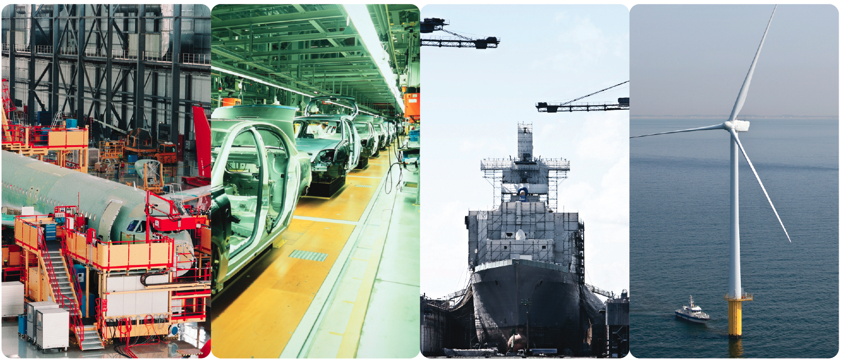

Slide 3
Automation: Introduction (brief, so we can get into examples)
Automation Solutions
Template Files
Toolkit (GD&T, Relationships, Inspect, Analysis, Report)
MPs (Setup, Acquisition, Analysis, Reporting, Archive)
SDK (C++, VB, Other Languages)
Interfaces
Simple MP
Task Overview
SA Button Control
HTML
Open Instrument
Examples
MP
SDK
Questions

Slide 4
Automation: SA Template Files (Key for Automation)
User Options (Vector Group Settings, Screen, Backups etc.)
Customize SA Menus and Toolbars
Imported Nominals
Points, CAD, Frames etc.
Setup
NAMING CONVENTION
Relationships
Feature Checks and Datums
Dimensions
Report Templates
Embed MP’s
Instrument Stations
Positions
Measurement Profiles
Targeting Offset
n SA Template Files
Input: Different Parts
SA MPs
Common Process
Solution
Output: Consistent Results

Slide 5
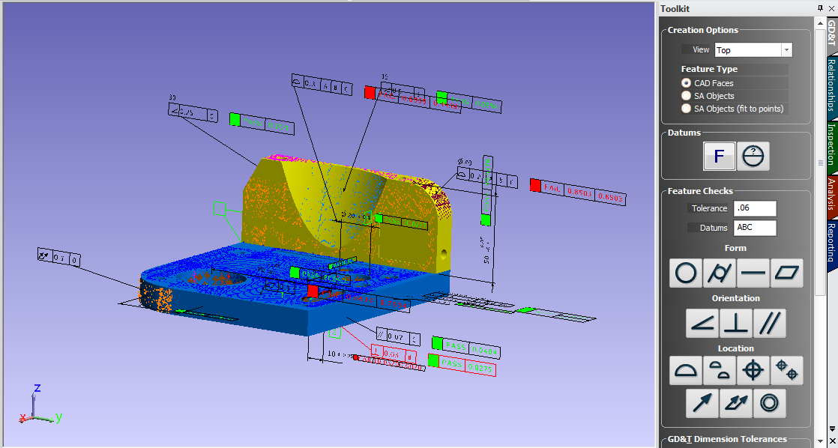
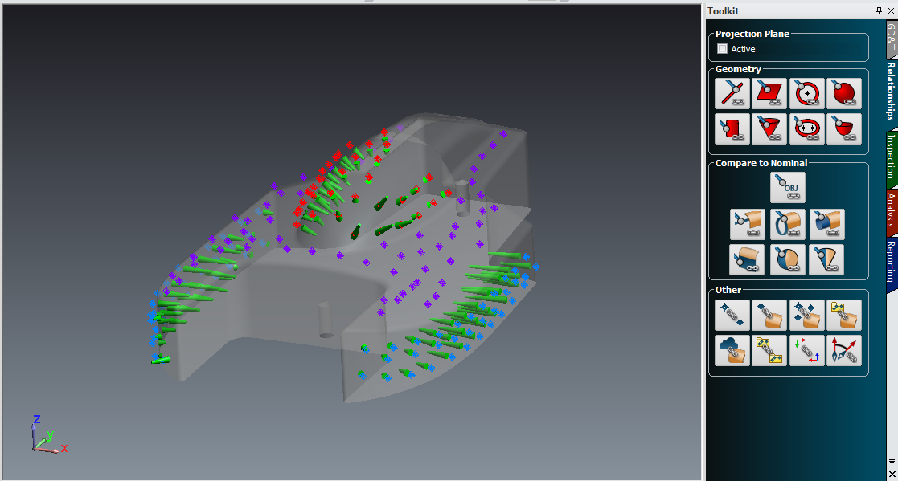
Toolkit Automation (covered in other sessions)
GD&T (Imported with CAD – Constructed)
Relationships
Inspection
Analysis
Reporting

Slide 6
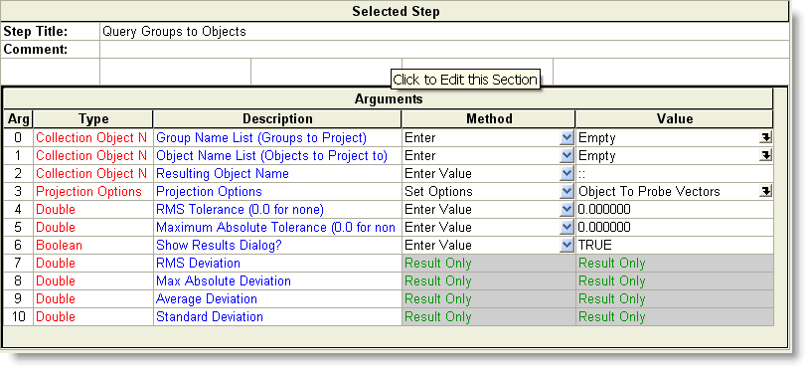
Measurement Plans
MP = Scripts of functions
Yikes, there are a lot of functions. Which is nice.
MP functions
Arguments (Input and Output)
Return Status
SA Data Types (make things easier)
Looping, Conditional Tests, Runtime Input and Feedback
Subroutines, Variables,
Data Exchange via ASCII, Excel, ODBC

Slide 7
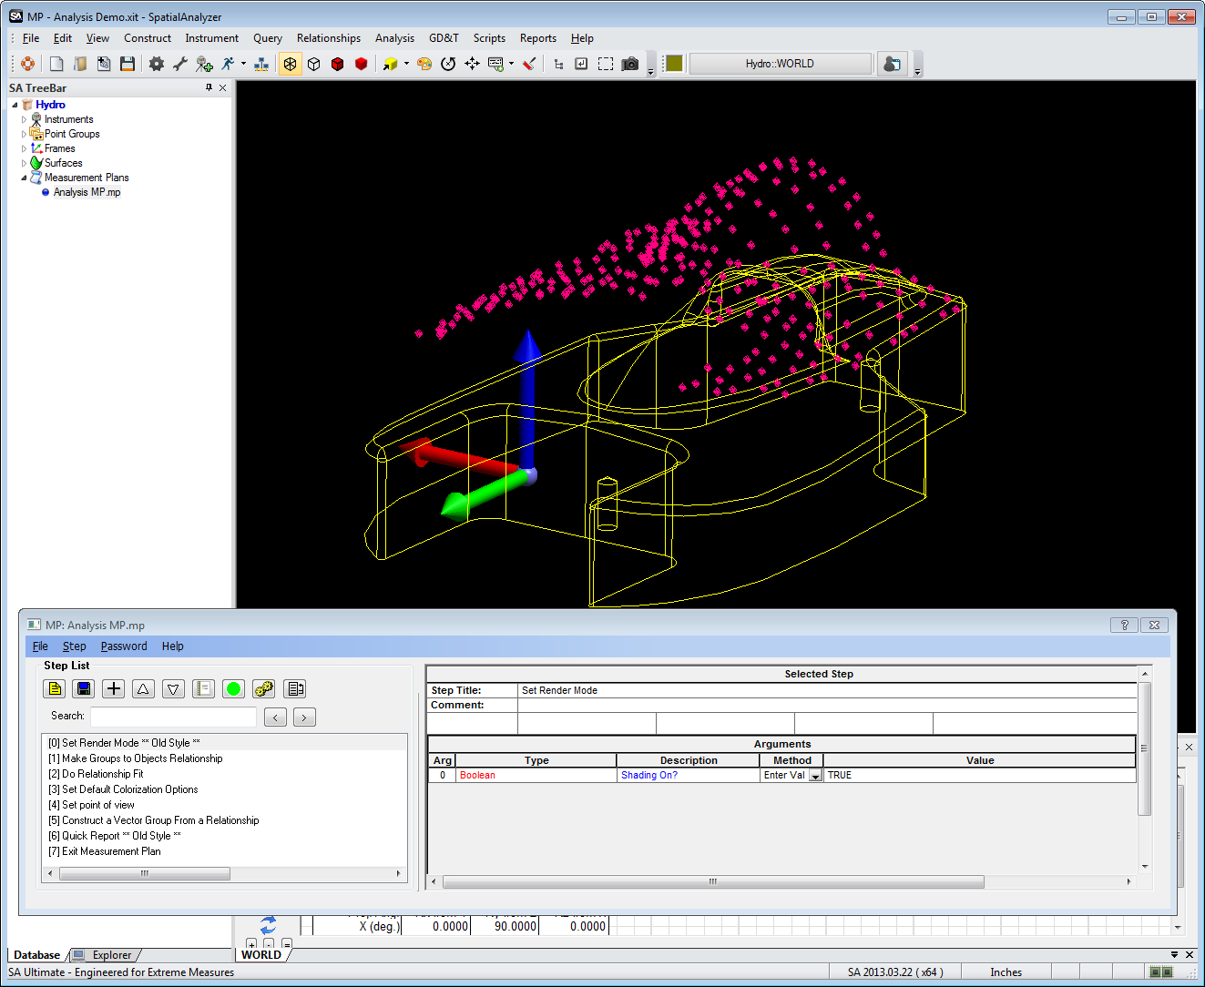
Simple MP: Relationship Fit and Report
Shade
Make Relationship
Optimize
Set POV
Set Analysis Options
Create VG
Report
MPs Auto Upgrade

Slide 8
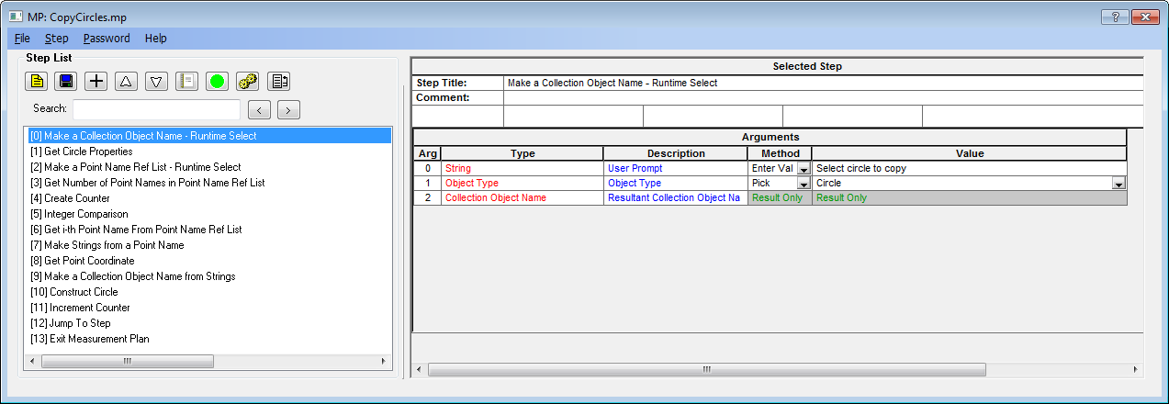
Create an MP from scratch
Duplicate circles on a series of points
Ask User to ‘Select Circle to Duplicate’
Ask User to ‘Select Points’
Get number of points
Loop
Copy Circle
End

Slide 9
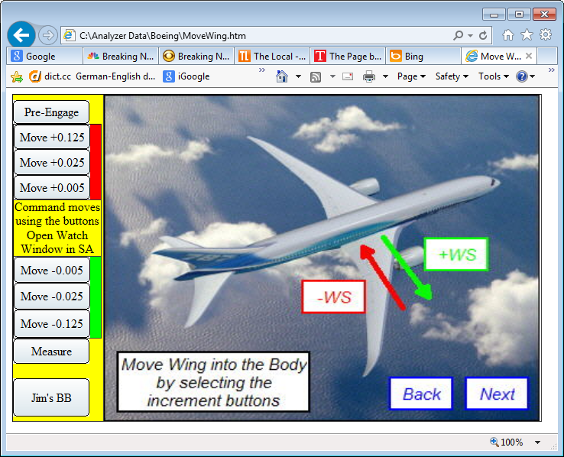
Automation: SA Button with HTML

Slide 10
SDK
Enables embedded integration SA functionality
Connect to SA via MP interface
MP provides stub code in C++ and VB
Direct data exchange between SA and Integration App

Slide 11
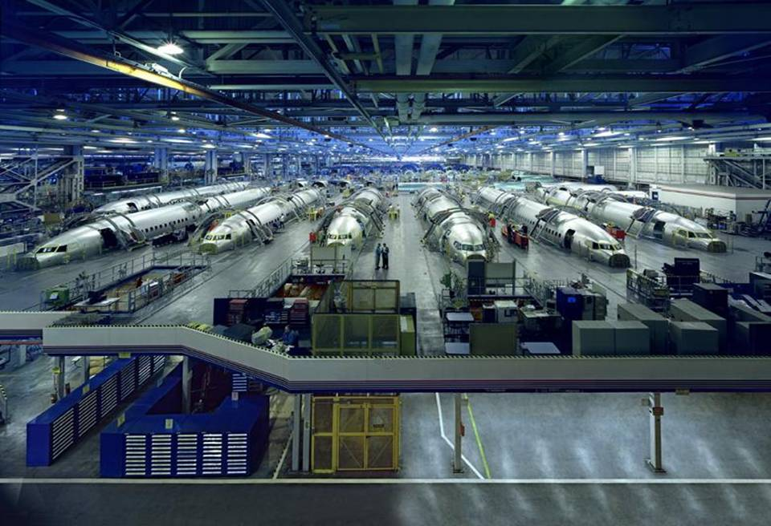
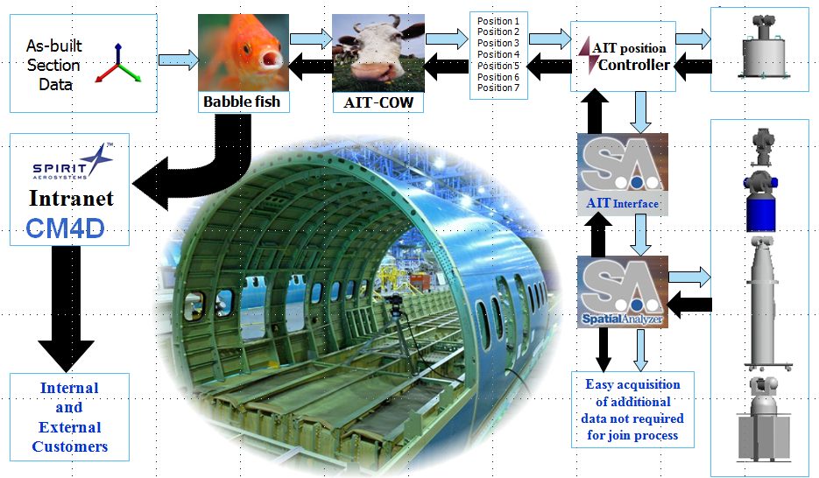
Automation: SDK Application
737 Fuselage Join

Slide 12
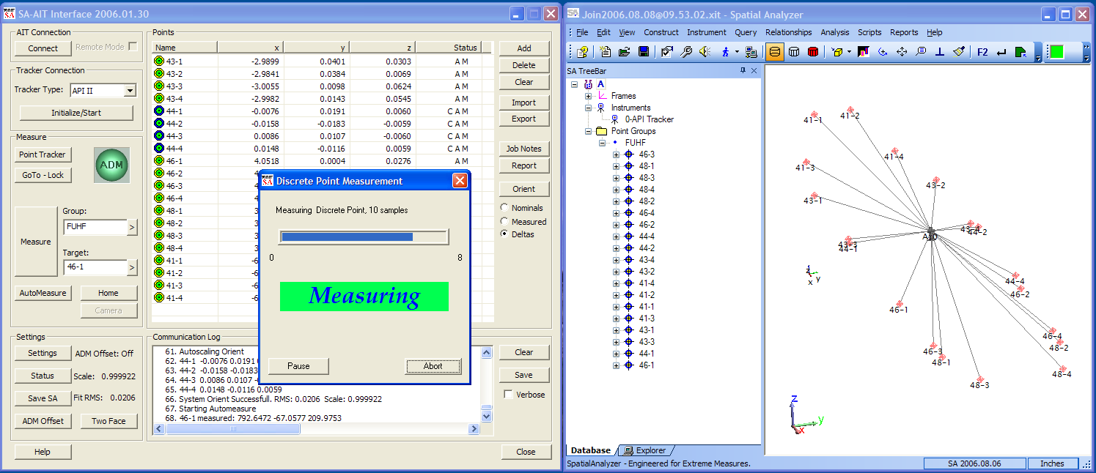
SDK Application: 737 Fuselage Join

Slide 13
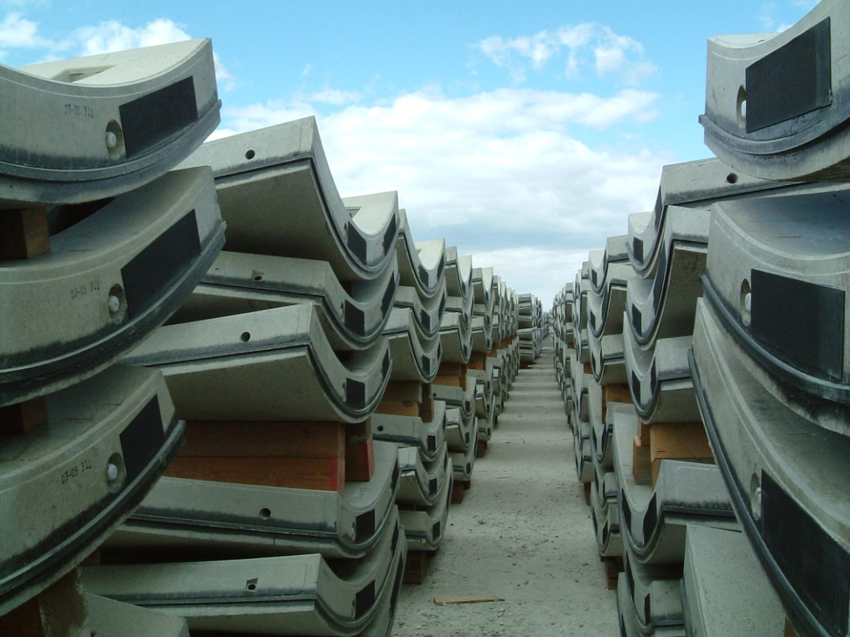
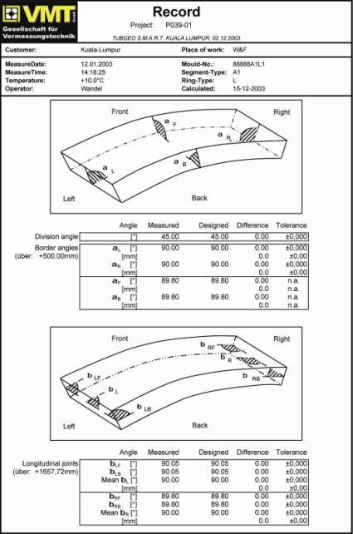
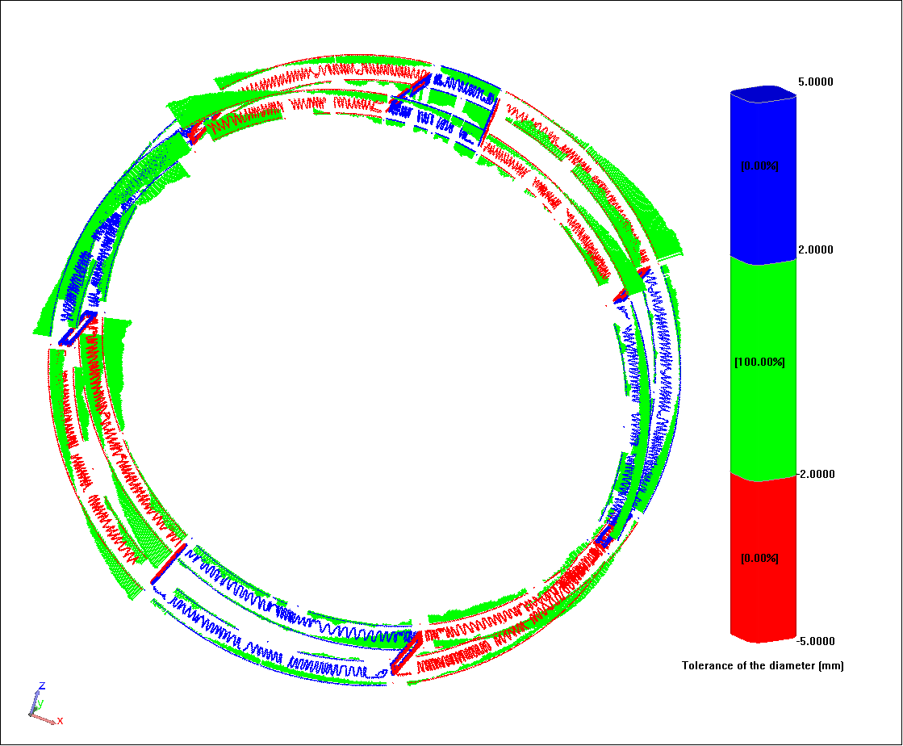
Automation: Mold and Segment Inspection

Slide 14
Questions and Answers

