Slide 1


Scott Sandwith
NRK Application Engineer
Todd Burch
NRK Director of Training

Slide 2

Notes:
USMN stands for Unified Spatial Metrology Network.

Slide 3
Unified Spatial Metrology Network
An advanced bundling technique that optimizes instrument and target positions by way of measurement uncertainty weighting.
Notes:
USMN is an advanced bundling technique that optimizes instrument and target positions by way of measurement uncertainty weighting.

Slide 4
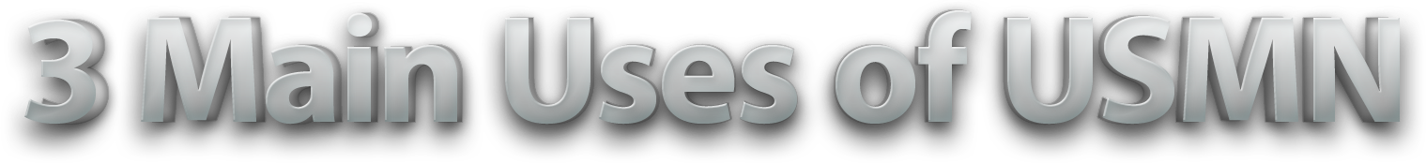
Characterizing measurement systems and their uncertainty.
Optimizing instrument networks.
Determining network uncertainty.
Notes:
USMN has three main uses:
[CLICK]It’s used to characterize measurement system uncertainty,
[CLICK]It’s used to optimize instrument networks, and
[CLICK]it’s used to characterize network uncertainty.
But why is it needed?

Slide 5

Notes:
Let’s talk first about best-fit, because it has been a common method for station alignment for a long time.
We tend to use best fit frequently. It’s easy to understand, simple, and ubiquitous. And while best fit is useful, it has drawbacks:

Slide 6


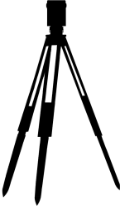
Less accurate
It doesn’t intelligently consider points.
Notes:
The first is that it doesn’t intelligently consider the points. Best fit involves jiggling points around in space until the average component errors for all points are zeroed. On the one hand, it results in the fit with the least possible error between corresponding points. However, it makes zero assumptions about the accuracy of a point used in the fit. Every point is assumed to be a perfect measurement, and we know that this is certainly not the case. For instance, points far from an instrument are known to be less accurate, and therefore should have less influence over the fit than nearby points.

Slide 7
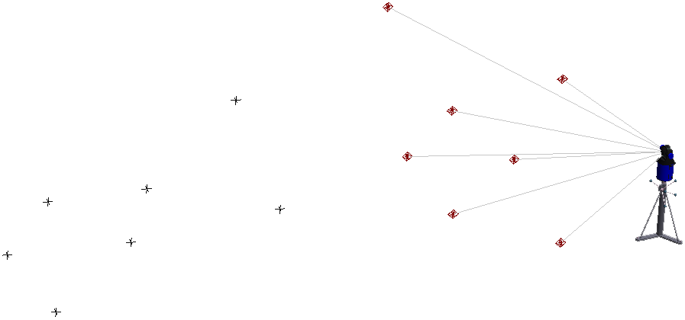
It is limited to one moving and one fixed set of points.
Notes:
Secondly, best-fit is limited to just one moving and one fixed set of points. It can only be performed between two instruments at a time, so networks of three or more instruments require multiple fit iterations. This leads to sub-optimal networks.

Slide 8
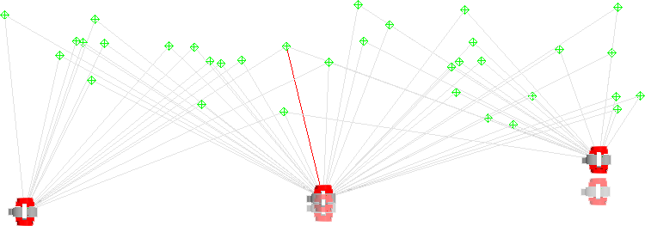
Fit
location
Fit
location
C
A
True
location
B
True
location
Leapfrogging leads to rapid error stack-up.
Notes:
Since only pairs of instruments can be fit at a time, instrument stations tend to be leapfrogged. Instrument B is fit to instrument A, then Instrument C is fit to Instrument B, and so on. When doing this, as is commonly done with large or long survey jobs, error stacks up rapidly.

Slide 9

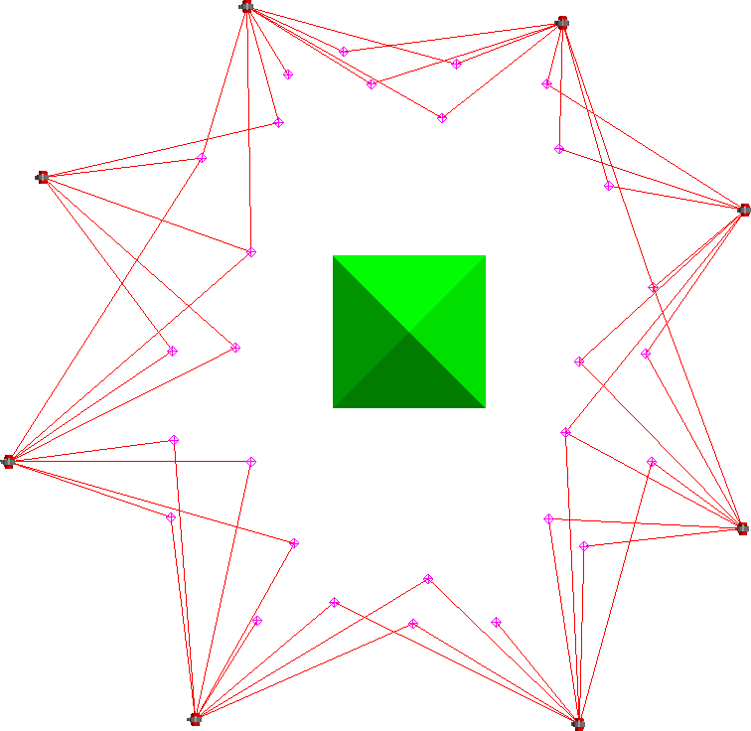

G
F
H
E
A
D
B
C
Measurement loops can’t be “closed”.
Notes:
Again, since only two instrument stations can be fit at a time, if toward the end of a chain of instruments I can tie back into my first instrument, that will improve my overall fit. This can’t be done using Best-Fit, because it only optimizes one instrument position at a time.

Slide 10
Provides no measurement uncertainty information.
Notes:
Best-fit gives you no measurement uncertainty information. You end up with a network at the end, but how good is the network? How good are your other measurements, which are likely the real points of interest?

Slide 11




Inst. 2
Most Likely Point?
Inst. 1
Doesn’t yield a “best set” of measurements.
Notes:
Best fit also doesn’t yield a set of points representing the best set or most likely target positions for pairs of points.

Slide 12

Notes:
What about traditional bundling? Bundling is used quite a bit as well—what drawbacks does it have?

Slide 13
It uses constant weighting.
Notes:
When you have multiple instruments to tie together, bundling is generally a better option than best fit. But the standard bundle in SA applies constant weighting to distance and angle components when solving. Individual points are not weighted separately. If you have total stations and trackers in your bundle, for instance, the angular component of the measurements will be weighted the same. This turns out to not be ideal, since different instruments have different characteristics.

Slide 14
Provides no measurement uncertainty information.
Notes:
Bundles also provide you with no measurement uncertainty information. You end up with a network at the end, but how good is the network? How good are your other measurements, which are likely the real points of interest?

Slide 15

Solves multi-station networks simultaneously.
Uses measurement information intelligently.
Yields ideal network of common points.
Provides uncertainty information for all measurements.
Can be used to characterize measurement system performance.
Provides results both numerically and graphically.
Notes:
And so this leads to the advantages of USMN:
[CLICK]USMN solves multi-station networks simultaneously, so you can solve for multiple instrument stations in one go.
[CLICK]It uses measurement information intelligently, yielding networks that more closely reflect reality.
[CLICK]It also provides results both numerically and graphically, which is useful to both metrology and non-metrology audiences.
[CLICK]At the conclusion of a USMN calculation, you end up with a network of common points that best represent the true measured targets.
[CLICK]Measurement uncertainty for all measured targets can be obtained.
[CLICK]The same process can be used to characterize the performance of a measurement system.

Slide 16
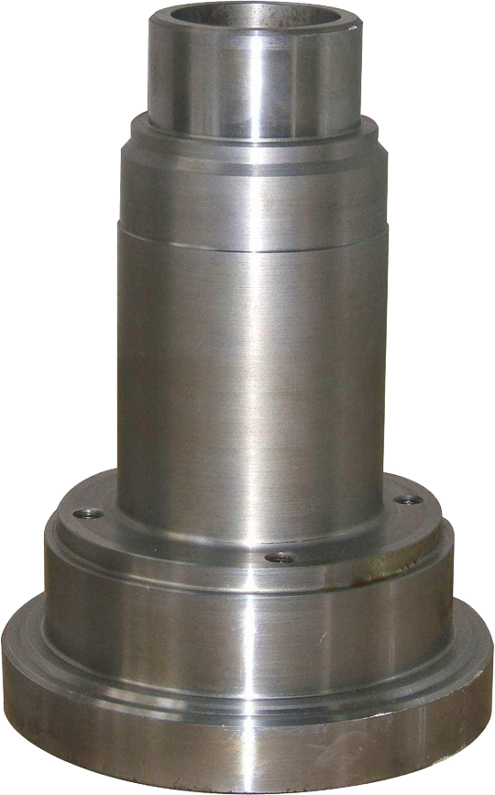
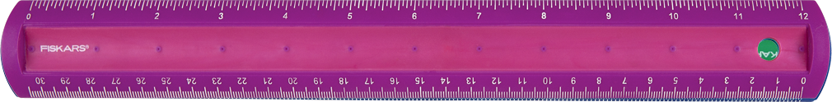
Tol: Dia. 2.500” ± 0.004”
Actual Measurement: 2.5”
Notes:
Suppose you have a part to measure, and you’re told that the tolerance on the diameter of this shaft is 2.500” ± 0.004”.
[CLICK]I then measure it and tell you that the actual diameter is 2.5”. Right on the nose, right? The part passes—pack it, ship it, bill it, right? Well, what if I showed you how I [CLICK]took that measurement. Would it change your mind about the readiness of this part to go out the door?
This is garbage, right? We might as well pull a random number out of thin air and report it.

Slide 17
Tol: Dia. 2.500” ± 0.500”
Actual Measurement: 2.5”
Notes:
What if I open up the tolerance? Are you satisfied now?
We’re probably happy to ship this part, because the tolerance is much larger than our understood accuracy of a ruler.

Slide 18
Tol: Dia. 2.500” ± 0.080”
Actual Measurement: 2.5”
Notes:
What about now? Gets a little fuzzy, doesn’t it? Now we’re not so sure anymore.

Slide 19

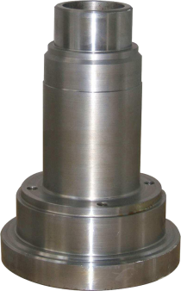


± x.xxx”
Tol: Dia. 2.500” ± 0.004”
Tol: Dia. 2.500” ± 0.500”
Tol: Dia. 2.500” ± 0.080”
Notes:
So this illustrates that a measurement result often can’t be given by itself. We have to have knowledge of the [CLICK]tolerance (how much potential error we’re willing to accept on a given part) as well as the [CLICK]uncertainty of the measurement itself in order for our values to be useful.
[CLICK]In the first case, the measurement instrument intuitively did not have the required accuracy to perform the measurement, given the tolerance on the part. This was based on our qualitative knowledge of a ruler’s accuracy: We know rulers just [CLICK]can’t measure to four thousandths of an inch.
[CLICK]In the second case, we felt comfortable in passing the part. Again, this was based on our qualitative knowledge of a ruler’s accuracy. The tolerance width is very large, and we intuitively [CLICK]understand that a ruler can measure accurately to within half an inch.
[CLICK]In the third case, it’s fuzzy—we just don’t know. [CLICK]Can we accurately measure to within eighty thousandths of an inch with an ordinary ruler? Your guess is as good as mine.
If we had a way to clearly communicate measurement confidence, we can save money.

Slide 20
“A measurement result is complete only when accompanied by a quantitative statement of its uncertainty.”
-National Institute of Standards and Technology (NIST)
Notes:
Having knowledge about the uncertainty of a measurement is so important that several standards describe it as an essential part of the measurement.
ISO specifications state that part measurements should be accompanied by two numbers: the actual measurement, and the uncertainty.
NIST states that “A measurement result is complete only when accompanied by a quantitative statement of its uncertainty.”
Often times, we’re “comfortable enough” that a measurement is well within the required tolerance that we don’t bother to think about uncertainty. But we should think about it more than we do.

Slide 21

Notes:
This session is about USMN, but in order to understand USMN we first need to discuss measurement uncertainty.

Slide 22
Measurement Uncertainty
A characterization of the spread of values attributed to a given measured quantity.
Notes:
Measurement uncertainty, defined loosely, is a characterization of the spread of values attributed to some measured quantity.

Slide 23

Notes:
So you might be asking “Isn’t this the same as repeatability?”
And the answer is no: Repeatability is an indicator of how clustered together individual observations are in the same measurement condition, but says nothing about the accuracy of those measurements when compared back to the correct value.

Slide 24


Actual Target Location
Observed Target Locations
Notes:
For instance, here are a set of measurements that have high repeatability, but they say nothing about the uncertainty of the measurement with respect to the true location. Of course this is an exaggerated graphic, but it gets the point across. You may have many measurements clustered together (indicating high repeatability), but if that cluster is not near the actual location of the target, the instrument will have high uncertainty.

Slide 25

Notes:
And so you might then be asking yourself “isn’t that the same as accuracy?”
And the answer is: almost, but not quite. Accuracy describes the closeness of the agreement between a measured value and the exact value. In the case of real-world measurement, we don’t have exact knowledge of a measured value, so instead we look at uncertainty.
Uncertainty describes a range of possible values that is likely to contain the true measured value to some degree of confidence.
A highly accurate instrument has low uncertainty, and likewise an instrument with high uncertainty has low accuracy. Because of their similar connotations in everyday language, you’ll often see and hear the terms uncertainty and accuracy used interchangeably in industry. For instance, instrument manufacturers regularly mix “accuracy” and “uncertainty” in their specs and literature.

Slide 26

Instrument
Environment
Operator
Geometry
Fixturing
Targeting
Scale
Notes:
So what sorts of things contribute to the uncertainty of a single measured point?
[CLICK]The most obvious contributor is the instrument itself. Things like the instrument technology, calibration, mounting, compensation, and noise.
[CLICK]Targeting also contributes. For example, with a laser tracker, both the SMR and nest have centering and sphericity imperfections that contribute.
[CLICK]The measurement environment contributes as well. Is it dusty or clean? Are there temperature fluctuations?
[CLICK]Operator technique affects uncertainty as well. For example, ability to sight on a target, whether an SMR is placed in a nest in the same orientation each time, etc.
[CLICK]The geometry of the measurement has an effect. Depending on the type of instrument, distance of the measured target from the instrument or its orientation to the instrument can affect uncertainty.
[CLICK]Fixturing is important as well. How is the part secured. Is it fastened securely?
[CLICK]And then there’s scale. For instance, the tooling itself expands and contracts with temperature fluctuations, which are typically not compensated for. One could argue that the inability to accurately characterize the thermal distortion, expansion, and contraction of measured parts contributes to overall uncertainty as well.
So how do we represent a measurement’s uncertainty?

Slide 27
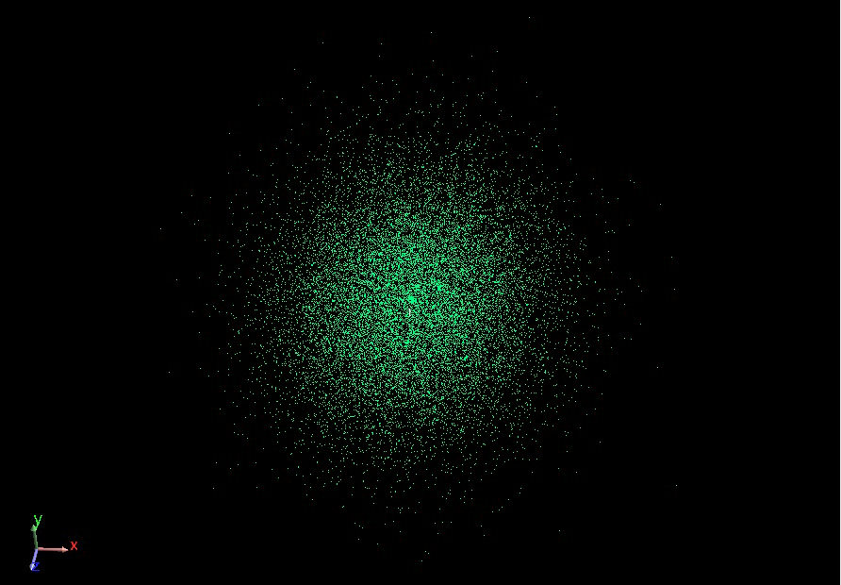
Notes:
We represent the uncertainty of a measurement using an “uncertainty cloud”, also sometimes referred to as a “sensitivity cloud” or “uncertainty field”.
An uncertainty cloud is a cluster of points that, taken as a whole, express the shape and distribution of uncertainty for a given measurement. You can imagine that this cloud is produced by taking thousands of measurements, each varied a small amount based on the amount of uncertainty in the individual measurement sample.
Expressing the cloud this way has a number of advantages which we won’t discuss in the interest of time.

Slide 28

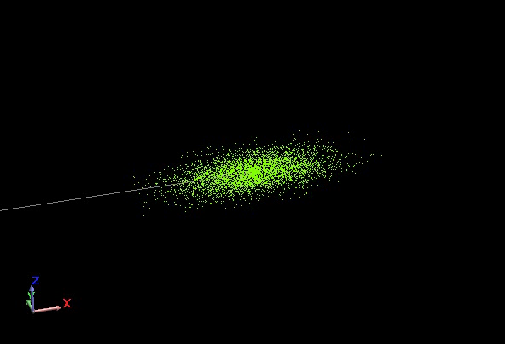
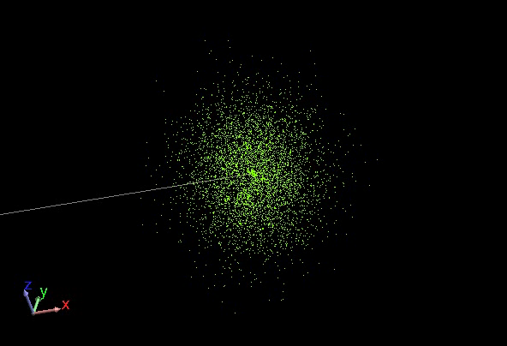
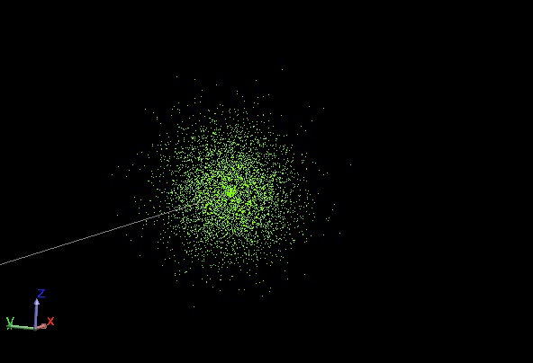
Clouds have different shapes
20” Distance
200” Distance
1200” Distance
Notes:
So here are some facts on uncertainty clouds.
First, they have different shapes, and are usually not spherical. For a given instrument, the shape is highly influenced by position of the target relative to the instrument.
Here are three uncertainty clouds for a laser tracker, looking at measurements 20”, 200”, and 1200” from the tracker. Notice that the near measurement is cigar-shaped along the line of sight, the mid-distance measurement is more spherical, and the far-distance measurement is more pancake-shaped. The rightmost cloud is about 6 times the diameter of the mid-distance cloud, and the mid-distance cloud is about 10 times the diameter of the near cloud. (If you recognize this as being the same as the ratios of their distances, this is not a coincidence).

Slide 29
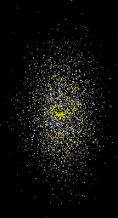
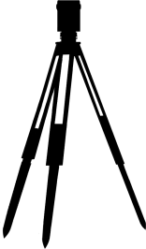

Notes:
The way that an instrument influences the shape of an uncertainty cloud depends on the type of instrument: whether it’s a spherical measurement instrument, kinematic instrument (such as a portable arm), or something else.
We can get a grasp of why the shape changes by looking at this graphic, which is representative of a spherical measurement instrument, such as a laser tracker. In this case, the instrument measures three components: vertical angle, horizontal angle, and distance.
The vertical and horizontal angular uncertainty of a laser tracker is generally constant, but due to geometric similarity in that “uncertainty cone”, doubling the distance from the instrument will double the uncertainty in the direction perpendicular to the line of sight.
Distance error, on the other hand, increases with distance from the instrument, but at a much much smaller rate. This explains why tracker uncertainty clouds look cigar-shaped up close and pancake-shaped at larger measurement distances.

Slide 30
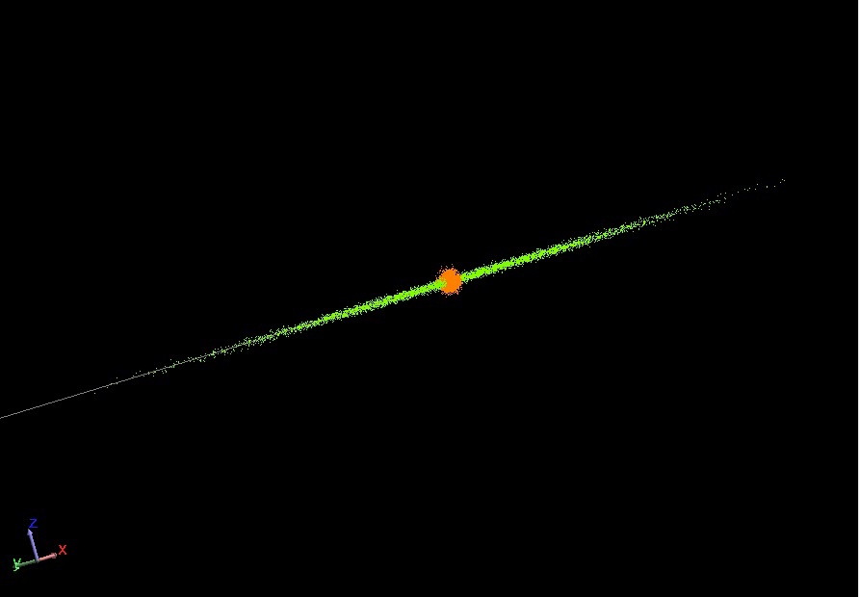
Instrument characteristics affect the shape
200” Distance
Notes:
The characteristics of the instrument affect the shape as well. Here, I have the uncertainty cloud for a total station (green) displayed on top of the cloud for a laser tracker (orange).
We know that total stations generally have more accuracy in their angular component than laser trackers, so their clouds tend to be thinner. Total station distance measurements are also generally much worse than distance measurement from a tracker, explaining the much longer cloud.

Slide 31
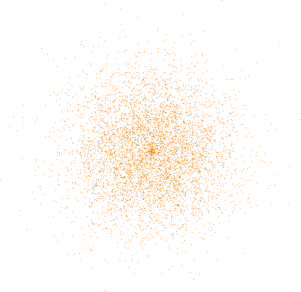
Clouds are not of constant density
Notes:
Another aspect of the cloud is that it is not of constant density. The cloud is more dense near the middle and more sparse toward the edges. These outer cloud points represent greater error but are less common. In other words, they are outliers.
The distribution of samples in the cloud follows a “Gaussian” or “Normal” distribution, colloquially known as a “bell curve”.

Slide 32
Notes:
So the question now becomes: how do we determine the uncertainty of a measurement?
Well, there are ways to do it using fairly sophisticated or expensive hardware, such as very accurate calibrated reference lengths or interferometers, but these have some limitations. They’re expensive, they need to be maintained properly, and most importantly, they only reflect the uncertainty of the instrument itself.

Slide 33
Instrument
Environment
Operator
Geometry
Fixturing
Targeting
Scale
Notes:
Remember this slide? We have a whole bunch of factors contributing to uncertainty. These contributors come in three basic types: systematic errors (biases), random errors, and blunders. In order to get the best results that most accurately reflect the real world, we should really somehow incorporate the effects from all of these different contributors. USMN is able to incorporate and evaluate the effects of all of these different types of error.
How might we do this?
Let’s perform a little thought experiment.

Slide 34

Notes:
Suppose we fix three pucks to random locations in the room. The locations of the pucks themselves don’t matter, but they should be rigidly placed.
Then, imagine setting up an instrument in a random location and shooting those reference points.
Next, we move the same instrument to a different location in the room and shoot the targets again.
If the instruments were perfectly accurate, there was no error in the measurement process, and we lived in a Utopian world, can you imagine that the two sets of points would fit together perfectly?

Slide 35

Notes:
In SA, the measurement set might look like this.
If we were then to best-fit these two instruments together, if there was no error and everything was perfect, the two point groups would fit together perfectly.
This would illustrate the perfect case of zero uncertainty in the system.

Slide 36
Notes:
Suppose we now repeat the exact same process, but now introducing error back into our world. Now, when we fit the data together, we’ll see that the targets no longer match up.

Slide 37
Notes:
The amount of disagreement between these corresponding points is an indicator of the uncertainty of the measurement system.
In reality, the process is more complicated than this. Instead of looking at the deviation between corresponding points, SA looks at the distance, horizontal angle, and vertical angle components separately. Also, more data is required than this simple example illustrated, but this hopefully gets the idea across.
By performing a measurement test like this example illustrated, you can actually determine the uncertainty characteristics for your own instrument and measurement system. What’s especially neat about this technique is that since it uses empirical data—that is, it uses actual observed values from the instrument, it factors in all of the different sources of error to give you values that best reflect reality for your specific situation.

Slide 38
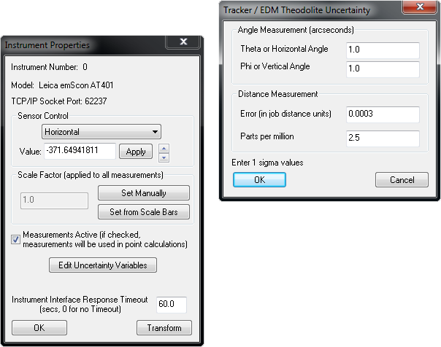
Uncertainty Variables:
Parameters describing the uncertainty characteristics of a given measurement system.
Notes:
In SA, the uncertainty characteristics of a given instrument are stored as “Uncertainty Variables”.
[CLICK]Uncertainty variables are accessed in the instrument’s properties window through the “Edit Uncertainty Variables” button.
What you see here depends on the type of instrument you’re looking at, but notice that there are four modifiable values for trackers: Horizontal angle uncertainty, Vertical angle uncertainty, distance error, and PPM.

Slide 39
Notes:
Horizontal angle is the horizontal angle uncertainty. Likewise, vertical angle is the vertical angle uncertainty.
Error in job distance units is a general fixed error that applies to all distance measurements, and “Parts per million” is the amount of additional error in the distance component as target distance increases.
These values are default uncertainty values that are the exact same for all instruments of the same type. Faros, API, and Leica trackers will all have the same value here. Now, it’s certainly true that those instruments have different uncertainty characteristics, so why are all values the same for different trackers?

Slide 40
Why only provide general values?
We’d have to constantly update the values ourselves.
One OEM would really love us. The rest? Maybe not so much.
Your instrument is different than mine.
Other factors we can’t determine for you.
Notes:
There are a few really good reasons for this.
[Click]First, if we gave more precise values, we’d have to continuously update the values in SA, which would require large effort.
[Click]Second, if we gave specific values, the OEM that came out on top would really love us, and the rest—well, probably wouldn’t.
[Click]Third, no two instruments are alike. Even though you and I might have the exact same manufacturer and model of instrument—and even though our instruments may have rolled off the production line right next to each other, our instruments are different. They perform differently.
[Click]Finally, a number of other factors go into determining these values, as we mentioned earlier. Operator technique, the measurement environment, survey geometry, instrument calibration state, compensation parameters, and a number of other factors all affect these numbers. So it would be impossible for us to provide decent values that worked well for everyone.
Instead, we give you the tool to determine these values FOR YOUR instrument, WITH YOUR operators, WITH YOUR tooling, with similar measurement geometry, etc. Instead of giving you fish, we’re teaching you how to fish.

Slide 41
General Steps:
Establish network of eight (8) or more fixed monuments.
Locate instrument at four (4) or more stations, measuring common points at each station.
Perform a USMN on the network to calculate the uncertainty variables.
Copy resulting values into your instruments during the actual survey.
Notes:
So here’s how you can determine the uncertainty variables for your specific measurements.
[CLICK]First, establish eight or more fixed monuments to serve as control points.
[CLICK]Next, locate your instrument in 4 or more different locations, measuring the common points at each instrument station.
[CLICK]Then, perform a USMN on the network, which will calculate the uncertainty variables for you.
[CLICK]Finally, copy these variables into your instrument properties when performing the actual survey to get accurate uncertainty values/network.

Slide 42
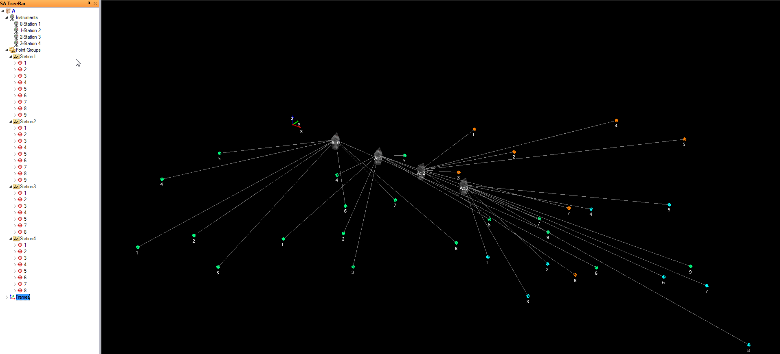
1. Measured survey with multiple instrument stations and at least 8 common targets.

Slide 43
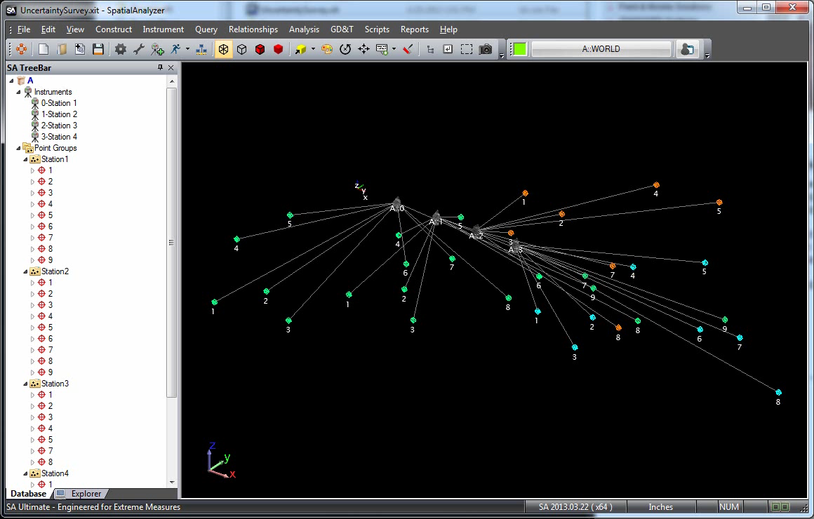
Notes:
[After playback]: Now one thing I should mention is that this first analysis used the default uncertainty values for the instrument. To be technically correct, you would iterate this multiple times until your uncertainty values converged on a solution. I’ve taken the liberty of doing this for you. The process involves applying the calculated uncertainty variables from the first iteration into the instruments, then solving the USMN again and evaluating the uncertainty variables.

Slide 44
Notes:
Here I’ve essentially plugged the uncertainty variables from the first solution into the instruments, and run the USMN, repeating this for 10 iterations.
This graph shows horizontal and vertical angle uncertainty for my test (distance is on the next slide). Notice that the values converge, and there is a maximum difference of about 0.06 arcseconds over the ten runs.
I should also mention that the test I performed was not ideal in that most of the monuments were on the floor due to setup constraints.

Slide 45
Notes:
This graph of distance error also shows convergence, changing by about 0.000121” over the ten runs.

Slide 46
Should I Iterate When Determining These Values?
Horizontal Angle Change: ~0.06 arcseconds
Vertical Angle Change: ~0.001 arcseconds
Distance Change: ~0.00012”
Notes:
If you look at the change over the ten iterations, it quite small—less than the resolution of the encoders. The initial “guesses” for this solution (which are the default values in SA) turn out to be good enough to get close on the very first iteration.
You can iterate if you’d like, but generally we don’t recommend it because the improvement isn’t worth the effort.

Slide 47
Some Rules of Thumb:
4 stations, 8 targets minimum.
Place targets throughout the measurement volume.
Imitate production conditions.
Balance tolerances with time/cost for determining level of effort.
Be careful about trimming outliers.
Default values are conservative. Don’t go further if you’re already “good enough”!
Notes:
There are some rules of thumb when doing this:
[CLICK]You should have a minimum of 4 stations and 8 targets. More stations and targets will yield better results, but keep in mind that you will get diminishing returns.
[CLICK]Use the full measurement volume. Placing all targets on the floor will give you a very limited picture. That’s like polling one state and using it to predict the outcome of a presidential election. Make sure you exercise the expected measurement volume and encoder values of the instrument. For best results for a general analysis, adjust height, rotation, and position of the instrument when measuring from different stations to ensure different horizontal/vertical/distance encoder values are used.
[CLICK]Your goal should be to imitate the conditions of the production work. DO NOT DO THIS IN A LAB IF THAT’S NOT WHERE YOU NORMALLY MEASURE! Try to match operator technique, environmental factors, tooling used, calibration and compensation state, and geometric conditions for the best results. But be reasonable—don’t waste all your resources on this just to tweak a few numbers!
[CLICK]You should balance the needs of the job—that is, the tolerances—against the time and cost of being overly particular. Use this to gauge your level of effort. Don’t spend a lot of time trying to squeeze the last drop out of the analysis if your uncertainties turn out to be well within your tolerances.
[CLICK]Be careful about trimming outliers when determining uncertainty variables. What it a true blunder, or is it true error that’s part of the system? More points/stations will better help you figure this out.
[CLICK]Default values are conservative. If they’re good enough, move on!

Slide 48

Notes:
OK, so now that USMN has characterized the uncertainty behavior of the instrument, how does it calculate the uncertainty of individual measurements? After all, we only measure a single point, and SA can somehow come up with this uncertainty cloud with potentially hundreds of thousands of points in it.

Slide 49
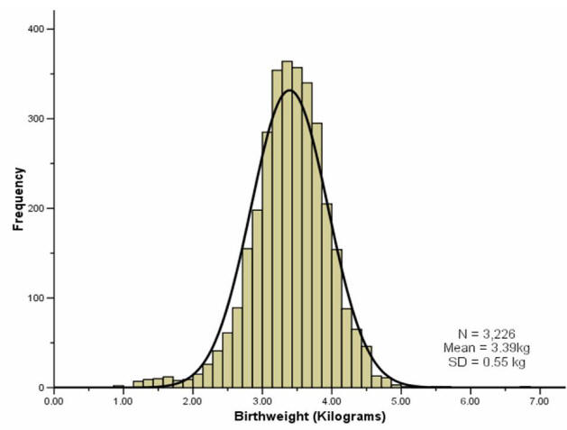
Notes:
Most natural random processes tend to have this sort of distribution of data--the majority of values are clustered around the middle, and the further you get from “average”, then less common the occurrence.
Just as an example, here is a distribution illustrating the birth weight of 3,226 babies measured by a hospital. It fits a Gaussian distribution quite well.

Slide 50
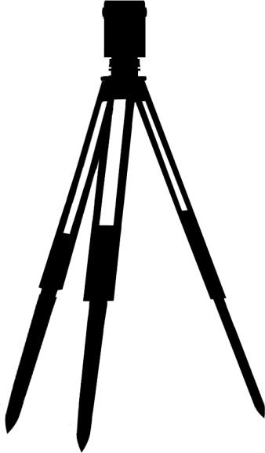


d

Notes:
The way we do it is by starting with the measured target and perturbing the instrument’s measurement components based on the uncertainty characteristics. In the case of a laser tracker, these components include horizontal angle, vertical angle, and distance. We then observe how those perturbations affect the resulting target, and place an uncertainty cloud point there. We do this many times over, placing uncertainty cloud points after each iteration. Soon, we have enough data to extract statistical information about the shape and size of the uncertainty cloud. (Just like a poll of sufficient people is representative of a population as a whole).
By the way, this type of analysis is called a Monte-Carlo analysis.
However, we can’t just randomly perturb the angles and distance willy nilly…

Slide 51
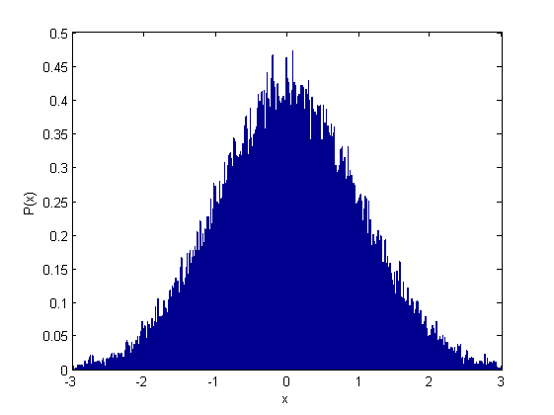
Notes:
It just so happens that SA uses a special random number generator that can create random numbers in a Gaussian distribution. (Called the Box-Muller algorithm, if you’re interetsed). That is, the majority of numbers generated are clustered around some central value, and their occurrence drops off as this image depicts.

Slide 52
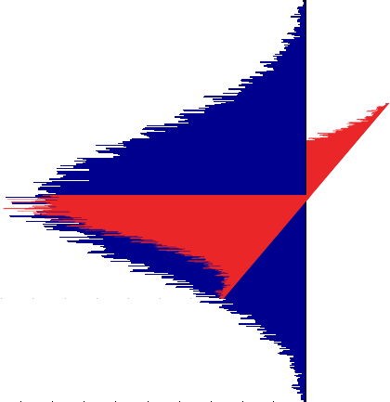
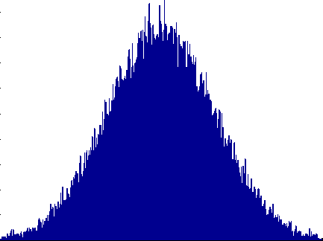

d

Notes:
So, we use this special random number generator to perturb the values as I mentioned before, but we perturb each of them in a Gaussian distribution to reflect what you would expect to see in reality.

Slide 53
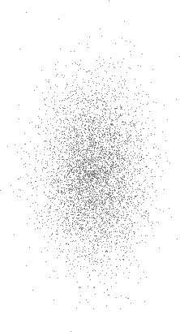
Notes:
And the end result in an uncertainty cloud.

Slide 54
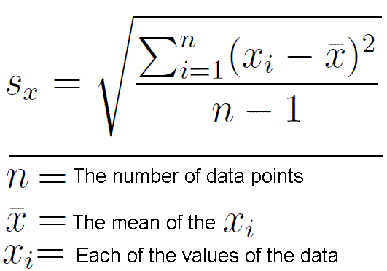
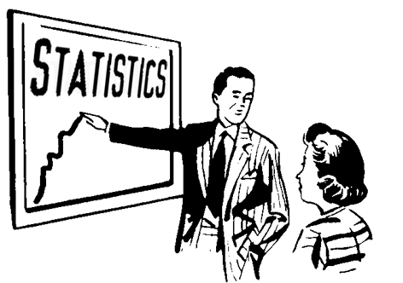
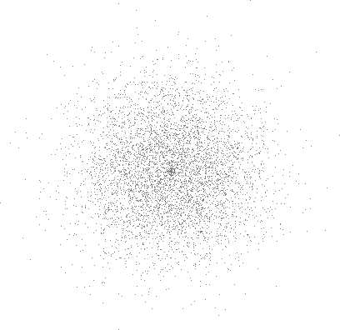
Notes:
Once we have this cloud, we can perform fairly basic statistical analysis on it to determine its uncertainty in the current working frame.

Slide 55
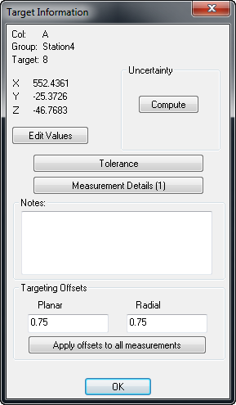
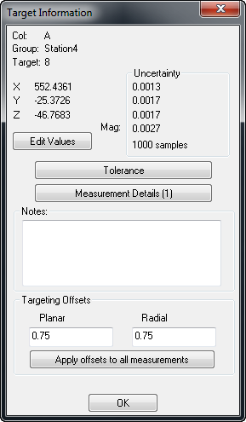
Notes:
And that’s exactly what happens when you click this “Compute” button, giving you uncertainties in X, Y, Z, and magnitude.
Notice below the uncertainty values there’s an indicator of the number of samples used for the analysis—in this case, 1000.

Slide 56
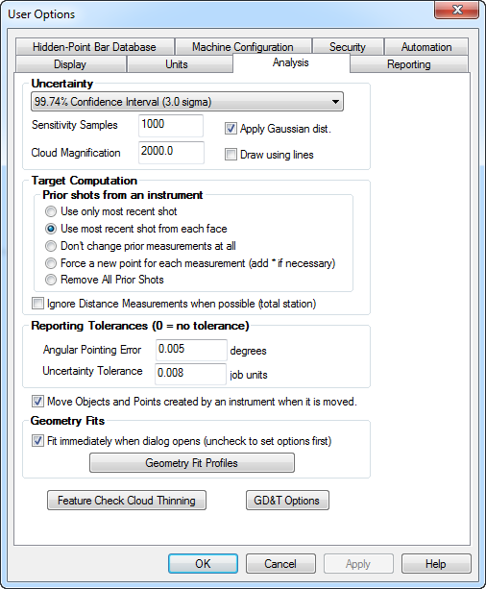
Notes:
The number of samples is set in SA’s User Options>Analysis tab.

Slide 57
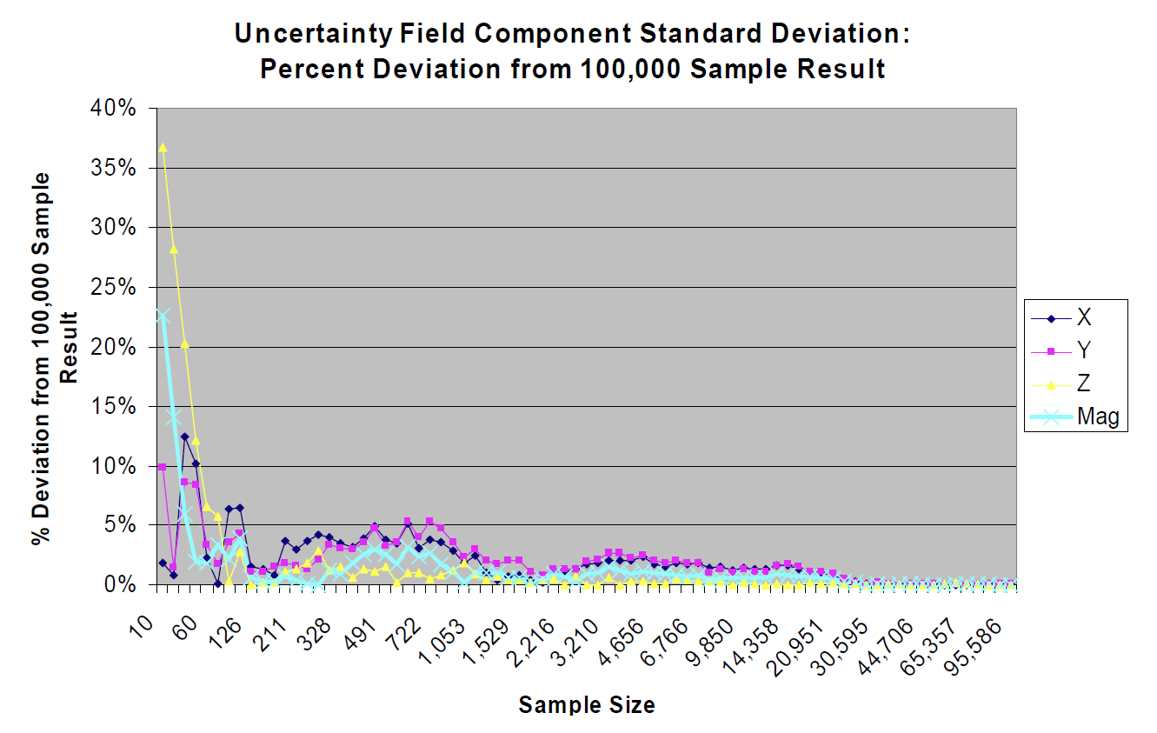
How many samples are enough?
Notes:
As with all statistical analyses, more samples is better, but there are always diminishing returns. So how many samples are enough?
When USMN was developed this question was investigated, and it turns out that above about 200-300 samples, you’re within 5%, and above about 1000 samples you’re within 3%.

Slide 58

Notes:
Now, there’s one little piece of this uncertainty puzzle I’ve left out up until this point:

Slide 59
(782.429”, 112.342”, 6.439”)
U_{X} = 0.00463”
U_{Y} = 0.00783”
U_{Z} = 0.00750”
X = 782.429” ± 0.00463”
Y = 112.342” ± 0.00783”
Z = 6.439” ± 0.00750”
Notes:
Stating an uncertainty value by itself doesn’t really make sense. It’s like an incomplete sentence.
[CLICK]Suppose I have a measurement and its coordinates are as follows. SA then calculates the uncertainty of that measurement to be [CLICK]this.
So how should we report the coordinates of the point? Well it should be [CLICK]this, right?
[CLICK]No! This means nothing! You have to quantify this statement by also including a confidence interval.

Slide 60
Confidence Interval
The confidence that the actual value is within a given range.
Notes:
Confidence interval is a statement of the confidence that the actual value is within a given range.

Slide 61
(782.429”, 112.342”, 6.439”)
U_{X} = 0.00463”
U_{Y} = 0.00783”
U_{Z} = 0.00750”
I’m 95.5% confident that
X = 782.429” ± 0.00463”
Y = 112.342” ± 0.00783”
Z = 6.439” ± 0.00750”
Notes:
Going back to this previous example, a proper way to state this might be “I’m 95.5% confident that…”
This essentially means that, measuring the same point in the same way 100 times, 95% of the measurements will be within the specified range.

Slide 62
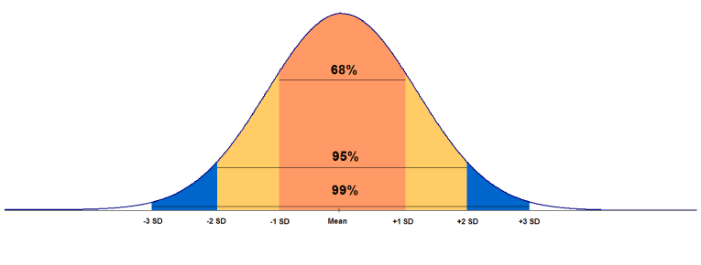
Sigma Values
Notes:
What you’re really doing is specifying the percentage of samples in the distribution that lie within your specify range. If you look at how the uncertainty samples are distributed in the cloud, 68% of them lie within this salmon-colored range, 95% of the samples lie within this orange range, and 99% of the samples lie within this blue range.
These ranges I’m referring to are also called [CLICK]“Sigma Values”. A sigma value of 1 is a range on the distribution in which 68.26% of the uncertainty cloud points are enclosed. A sigma value of 2 encompasses 95.46% of the cloud points, and so on. By the 1, 1 sigma happens to also be “one standard deviation”.

Slide 63
(782.429”, 112.342”, 6.439”)
U_{X} = 0.00463”
U_{Y} = 0.00783”
U_{Z} = 0.00750”
To 2 Sigma,
X = 782.429” ± 0.00463”
Y = 112.342” ± 0.00783”
Z = 6.439” ± 0.00750”
I’m 95.5% confident that
X = 782.429” ± 0.00463”
Y = 112.342” ± 0.00783”
Z = 6.439” ± 0.00750”
Notes:
Going back again to our example, a more formal way to express this would be that [CLICK]to 2 sigma, …..
So for instance, I’m 95.5% confident that X is within 0.00463” of 782.429”.

Slide 64
(782.429”, 112.342”, 6.439”)
To 3 Sigma (99.74% confidence),
X = 782.429” ± 0.00694”
Y = 112.342” ± 0.01174”
Z = 6.439” ± 0.01125”
Notes:
If someone told me that 95.5% confidence wasn’t enough, and instead they needed 99.7% confidence, I would instead report these values.
So as your confidence interval (or sigma value) goes up, the uncertainty range goes up as well. In fact, from 1 to 2 sigma the range doubles. From 1 to 3 sigma it triples, and so on.

Slide 65

Notes:
So with all this new-found knowledge of uncertainty and confidence intervals, we can now expand this to multi-station networks, which is the primary use for USMN.

Slide 66

Multi-station networks.
When uncertainty is required.
When establishing point-based reference systems.
Elongated surveys.
Large surveys that loop back on themselves.
Whenever you can!
Notes:
The first question to ask is: When should you use USMN?

Slide 67
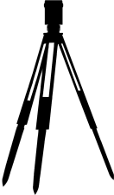

U_{l} = ...
U = …
U = …
U_{l} = ...
U = …
U = …
U_{l} = ...
U = …
U = …
U_{l} = ...
U = …
U = …
Notes:
The idea with a USMN network is that we have a series of instrument measurements connected through a set of common points. We know the uncertainty characteristics of the instruments, and as discussed earlier we can determine the uncertainty of each instrument’s measurements in the network.
We then perform the weighted bundle, and end up with optimized instrument transforms and optimized USMN points.

Slide 68
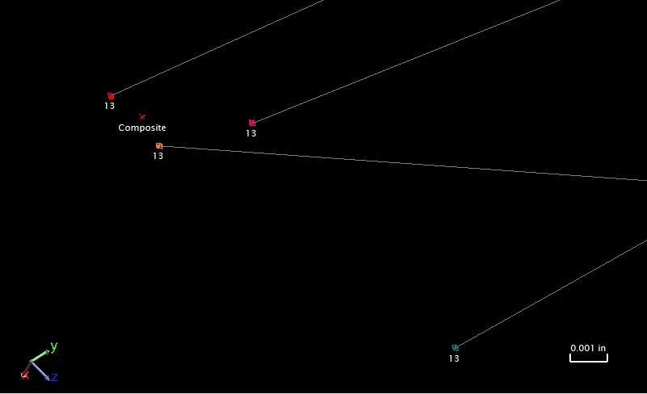
Notes:
The optimized USMN points are called “USMN Composite” points, and represent the most likely position of each point in the network.
In the case pictured here, the observation of point 13 in the bottom-right corner has been thrown out of the solution, because it was deemed to be an outlier. Notice that you can visually see this, as this instrument’s observation of the target is a significant distance from the other observations of the target.
Notice also that the composite point is *not* an average of the included observations.

Slide 69
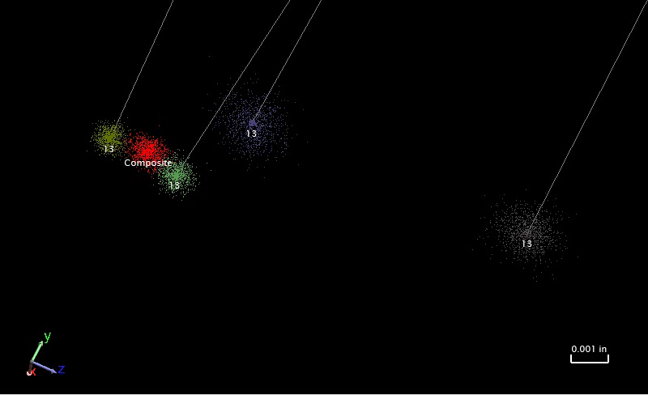
Notes:
Here is the same set of observations, but with each observation’s uncertainty cloud turned on. Notice that the composite point is located closer to the two points with smaller uncertainty clouds.
You might be wondering how SA determines the uncertainty of the composite point. It does this by actually solving the entire USMN network N number of times. The first time through SA takes the first cloud point from each uncertainty cloud, and solves the USMN for that set. It then solves the network for the second set of uncertainty cloud points, and so on, until you have a cloud of composite points.

Slide 70

Notes:
So to wrap things up, let me just cover a few commonly misunderstood properties of USMN.

Slide 71
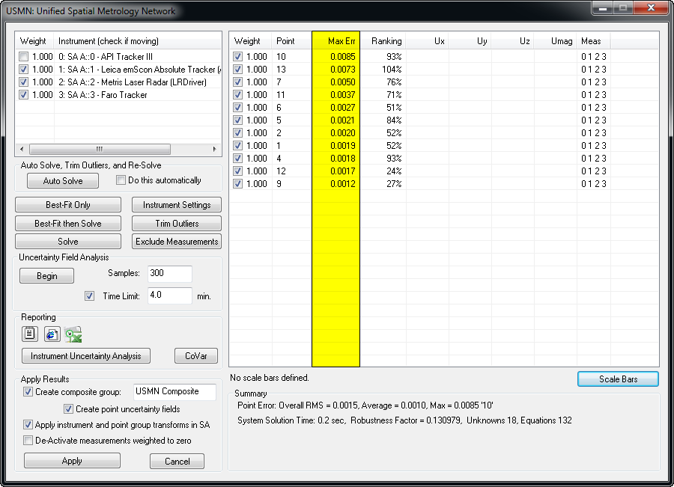
Max Error
Notes:
The first is Max Error.

Slide 72

13
Max Error
13
13
13
13
Notes:
Max error is the largest error between all observations to a common target. It is an indicator of the maximum spread among observations.

Slide 73
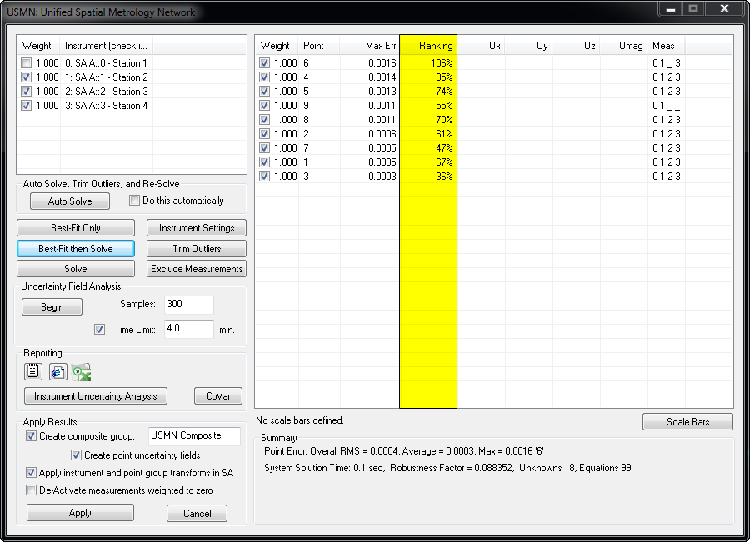
Ranking
Notes:
Now what about ranking? What is the ranking value describing?

Slide 74
Ranking
A quantitative indicator of measurement quality expressed as the percentage of the 3 sigma envelope the measurement residual is consuming.
Notes:
Ranking is a quantitative indicator of measurement quality expressed as the percentage of the 3 sigma envelope the measurement residual is consuming.

Slide 75
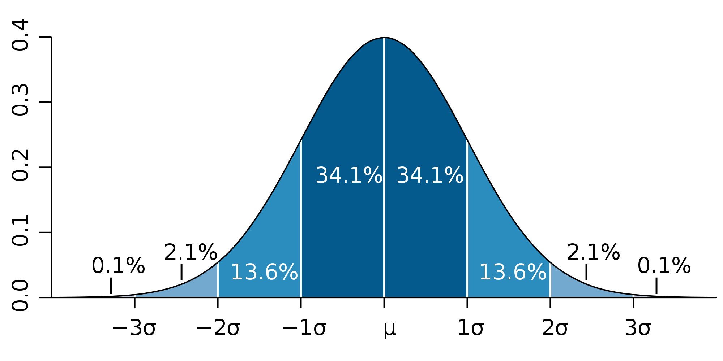
Notes:
Recall the Gaussian distribution we saw earlier. A sigma value of 3 encompasses 99.7% of all measurements. With ranking, an observation whose residuals (or errors) are 3 standard deviations from the mean will be assigned a ranking value of 100%.

Slide 76
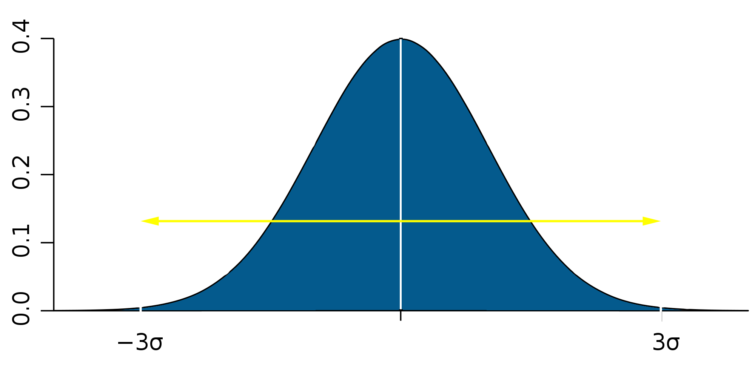
Std Dev = 0.002”
Ranking = 0%
100%
Notes:
So for instance, suppose a USMN network has residuals with a calculated standard deviation of 0.002”. An observation that sits right on top of the calculated USMN composite point is given a ranking of zero.

Slide 77
Error: 0.002” (1 Std. Dev.)
Ranking = 33.3%
100%
Notes:
A point 1 standard deviation (0.002”) from the USMN composite point will have a ranking of 33.3%,

Slide 78
Error: 0.004” (2 Std. Dev.)
Ranking = 66.6%
100%
Notes:
A point 2 standard deviations (0.004”) from the USMN composite point will have a ranking of 66.6%,

Slide 79
100%
Error: 0.006” (3 Std. Dev.)
Ranking = 100%
Notes:
And a point 3 standard deviations (0.006”) from the USMN composite point will have a ranking of 100%.

Slide 80
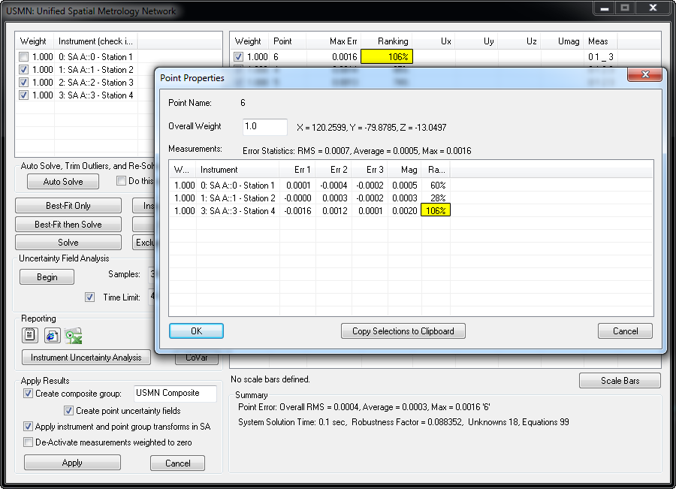
Notes:
Practically speaking, ranking is an indicator of whether a point is an outlier. When considering which values to trim, you really need to consider the point and the outliers in the entire network. The ranking value for a given point is the largest ranking of all observations of that point. In general, it is recommended to trim individual observations that exceed 100%, but retain those that do not—however this threshold may vary considerably depending on the situation.
For instance, if you see a single point with a ranking of 500%, and others with a ranking of 150%, it would be wise to eliminate just the 500% ranking point first, then re-evaluate. You will likely find that the 150% ranking points will now look good.

Slide 81
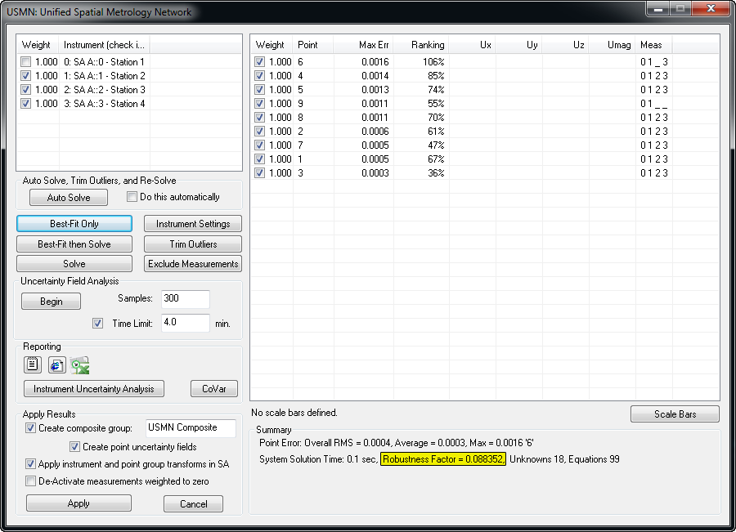
Robustness Factor
Notes:
The final value I’ll discuss is “Robustness Factor”. This is probably the single least-understood value in all of USMN.

Slide 82
Robustness Factor
An indicator of the numeric instability of the solution.
<0.00001 (including negatives) should raise a red flag.
Notes:
The robustness factor is an indicator of the numeric instability of the solution.

Slide 83


