Slide 1
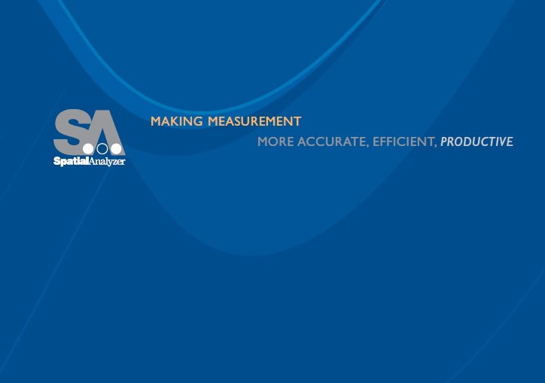
Optimization
Gary Garrison
Dave Calkins

Slide 2
Optimization
Basics
Potential Pitfalls
Available Controls
Specific interfaces
  Best fit points to points
  Best fit points to surfaces
  Relationship fit
  USMN

Slide 3
Basics
Over-determined system
Input system/Objective f(x)
Solution space
Local and global minima
Stopping condition

Slide 4
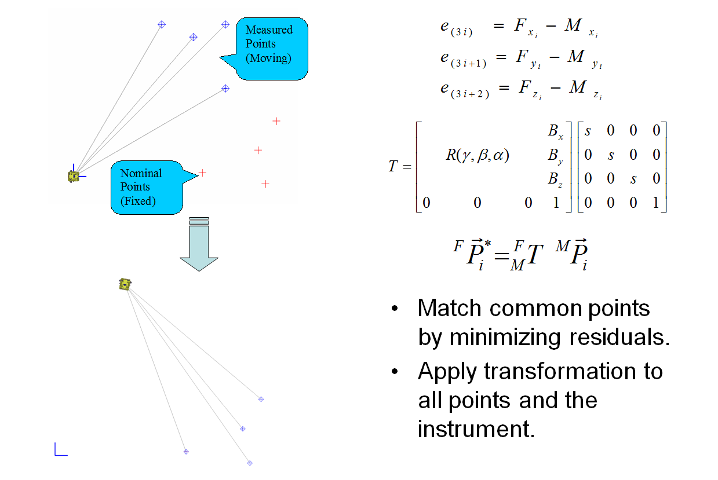
Example problem

Slide 5
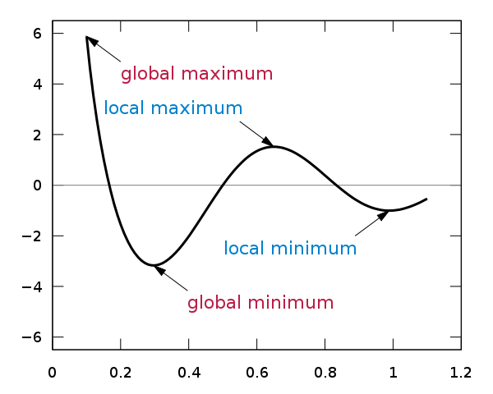
Minima: Finding the “correct” solution

Slide 6
Search method
“Run Optimization”
  Newton Raphson
  Quick
“Run Direct Search”
  Hooke and Jeeves
  Robust (local minima)

Slide 7

Run Optimization (Newton Raphson)

Slide 8

Run Direct Search (Hooke and Jeeves)

Slide 9
Potential Pitfalls
Long run time
Really short run time
Highly leveraged fit
Wrong solution

Slide 10
Available Controls
OK to cancel & apply fit
User Options, Units tab
Starting condition
Working Frame during fit
Iterative Approach
Weighting
Notes:
Pitfalls: misnaming, points in a line
Controls: weighting

Slide 11
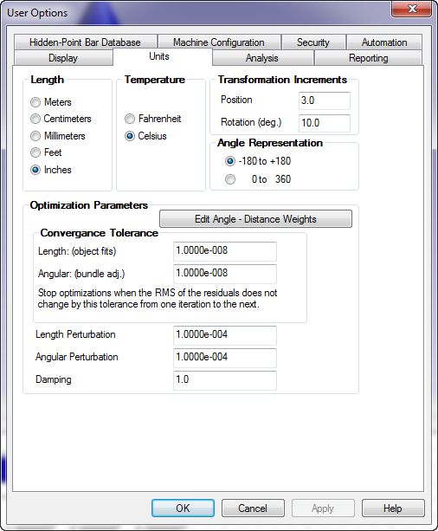
User Options

Slide 12
Specific Interfaces
Best fit points to points
Best fit points to objects
Relationship fit
USMN
Notes:
In order of complexity. Simpler problem, fewer controls

Slide 13
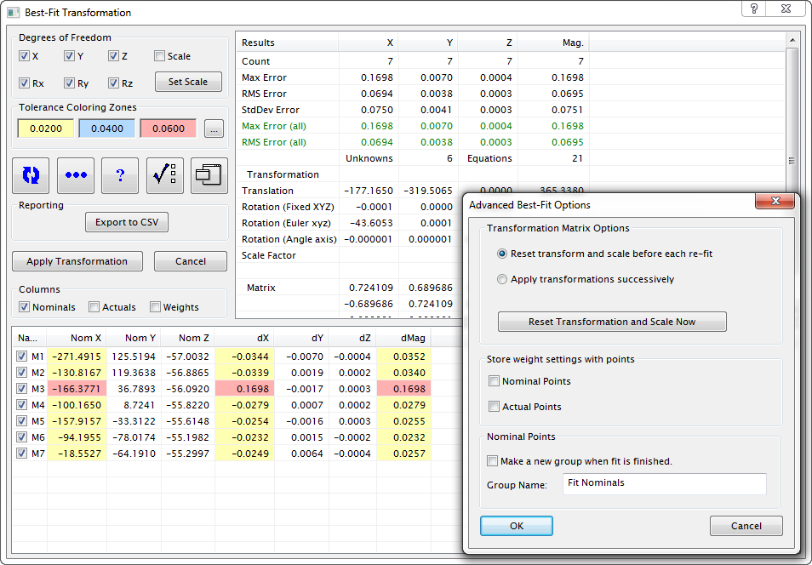
Best fit points to points
Notes:
Pitfalls: misnamed points, insufficient points, degenerate: linear
Controls: dof clamping, weighting, iterative approach

Slide 14
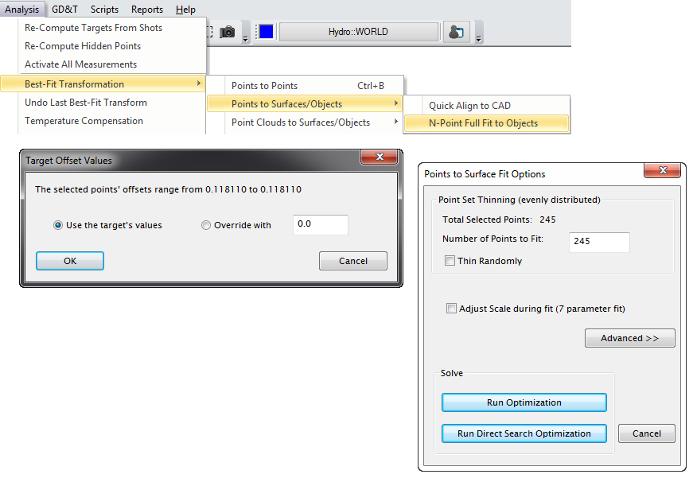
Best fit points to objects
Notes:
Pitfalls: excessive data, wrong solution
Controls: thinning, search type, and expanding the control…

Slide 15
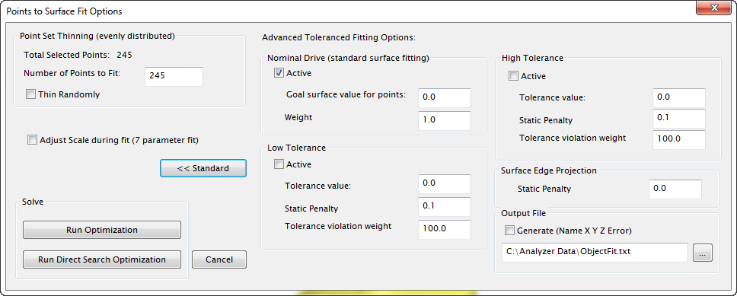
Best fit points to objects, cont’d

Slide 16
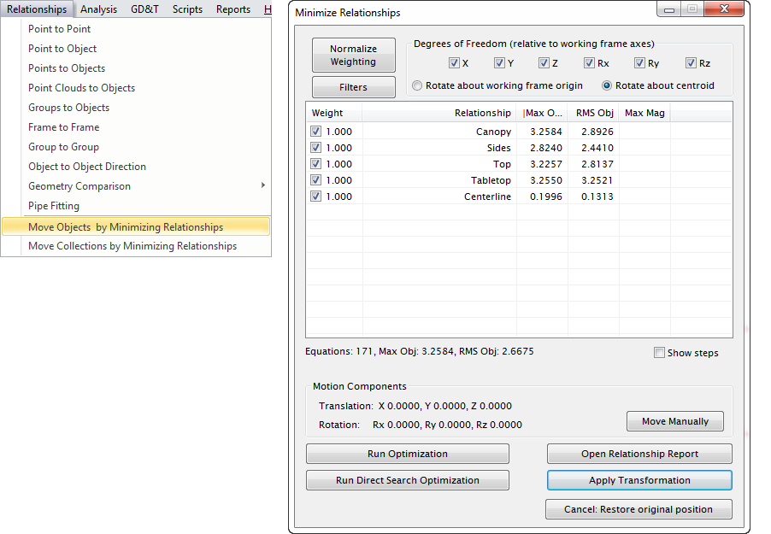
Relationship fit
Notes:
Compare & contrast the two menu selections: move objects & move collections

Slide 17
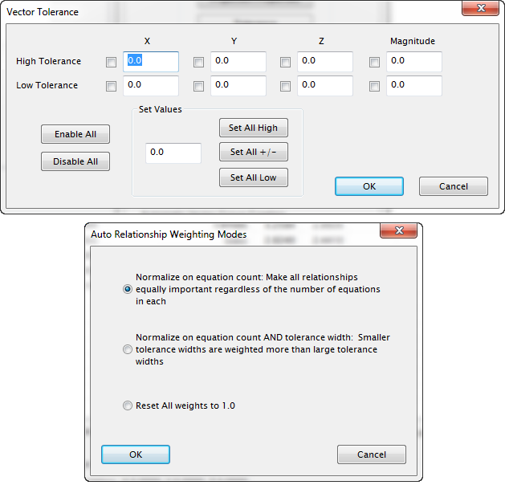
Relationship fit, cont’d

Slide 18
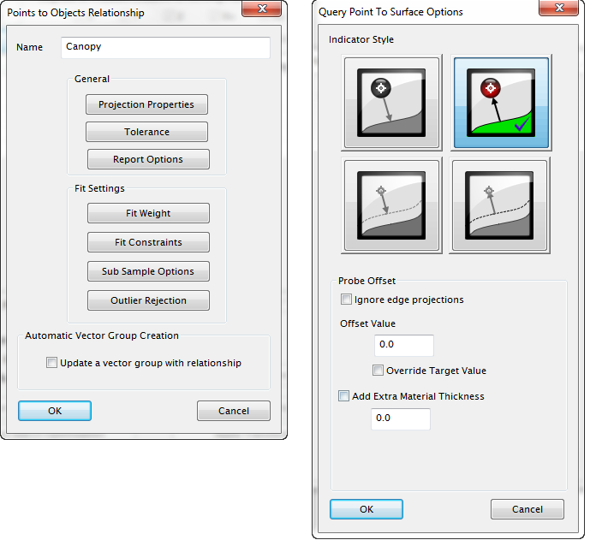
Relationship fit, cont’d

Slide 19
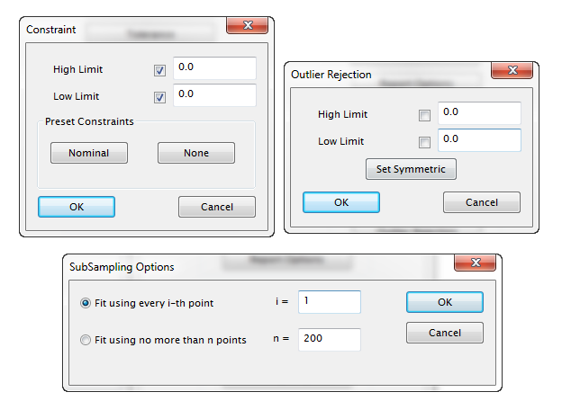
Relationship fit, cont’d

Slide 20
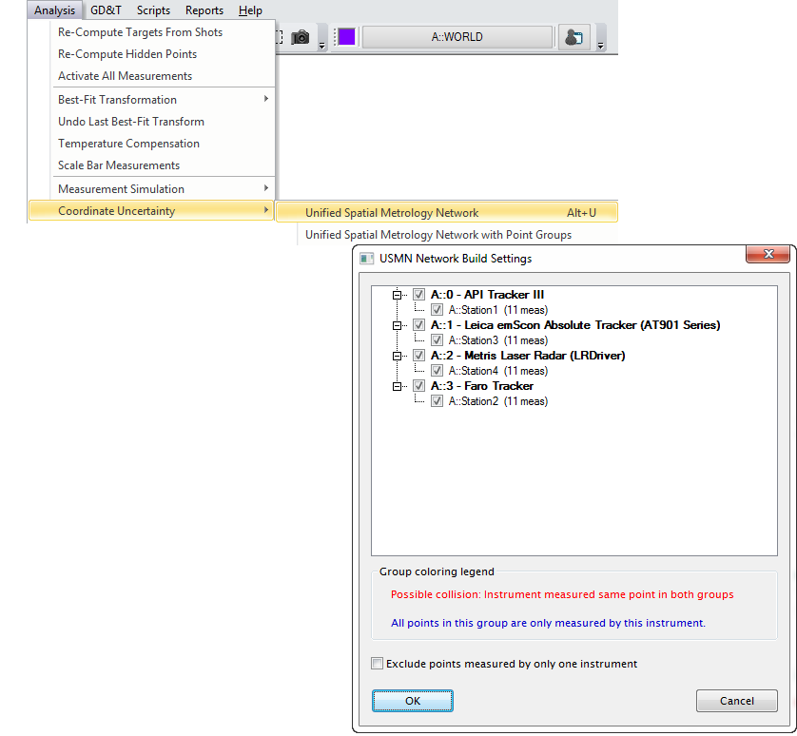
USMN

Slide 21
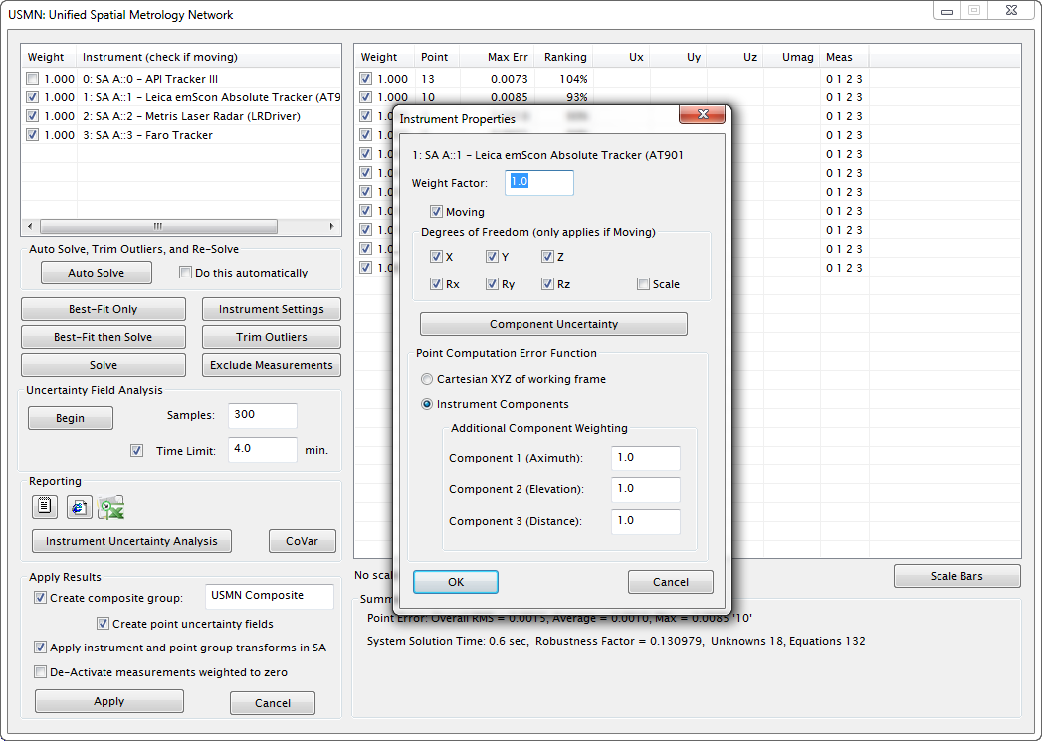
USMN, cont’d

Slide 22
Thank You

