Slide 1
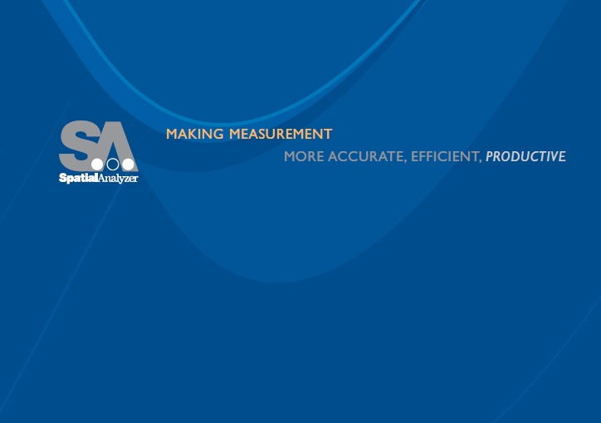


Scale and Temperature Compensation with SpatialAnalyzer
Zach Rogers & Philip Wilson
(the out of town guys)

Slide 2
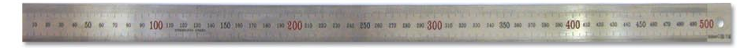
Background
Design at 20°C, measure at ?
Materials will grow & shrink w/ temperature
  CTE = Coefficient of Thermal Expansion
Grand assumption is that our materials are isotropic and CTE is linear
1-(T_{meas}-20°C)*CTE=Scale
Notes:
Thermal expansion is the tendency of matter to change in volume in response to a change in temperature

Slide 3
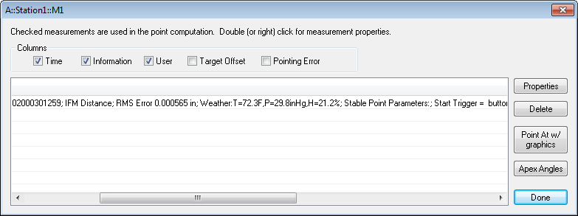
Instrument Weather Stations
Most instruments have a weather station
  Records temperature, pressure, & humidity
Instruments might also contain internal temperature sensors
  Usually record temperature
These sensors compensate the instrument, not the component being measured
Instrument weather station information is always stored with the measurement

Slide 4
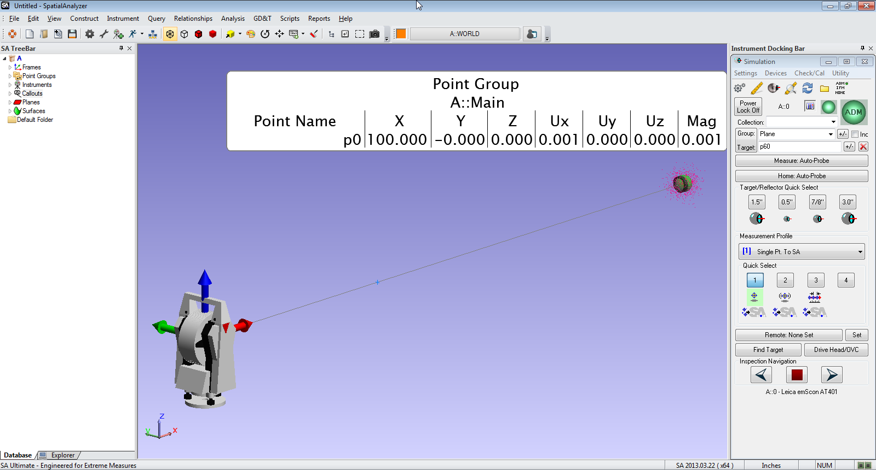
How Important is Scale
CTE of Aluminum → ~0.001”/100”length/degF*
Typical measurement uncertainty for 100” measurement = ~0.001”
*Actually it’s worse than that, but I like round numbers

Slide 5
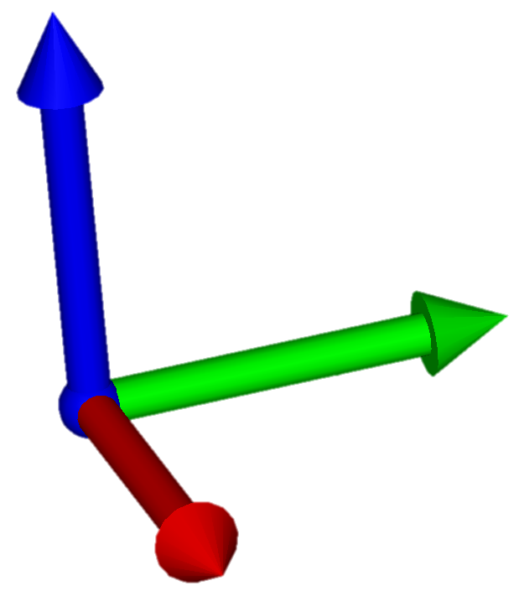
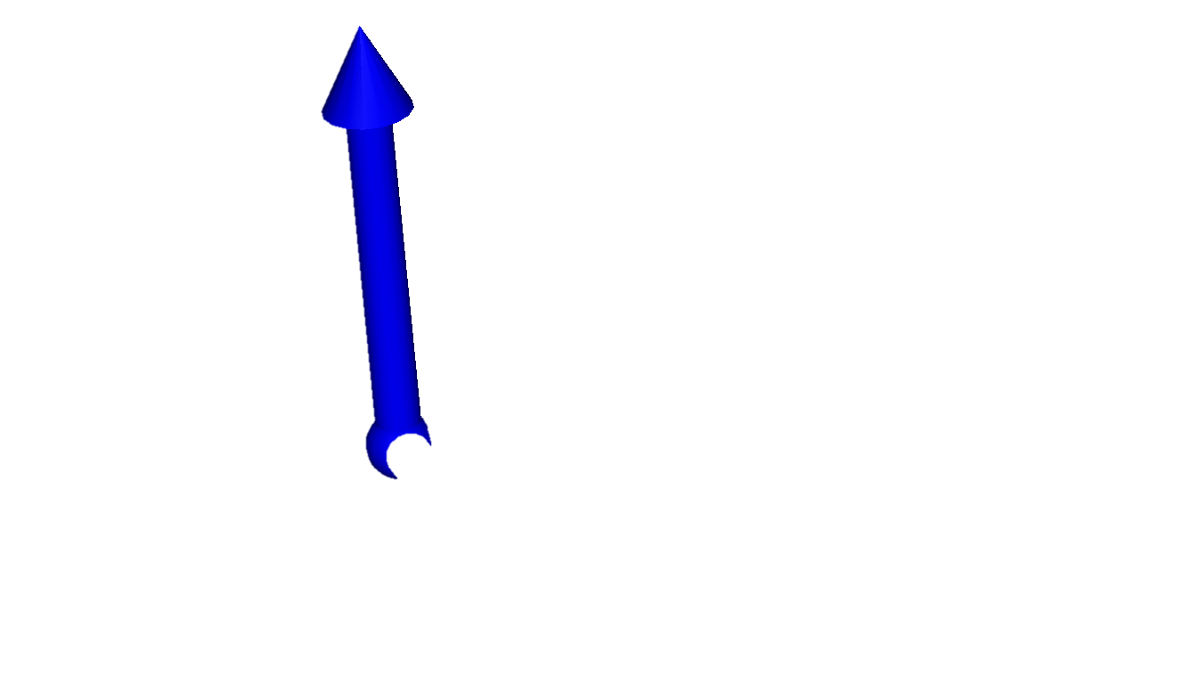
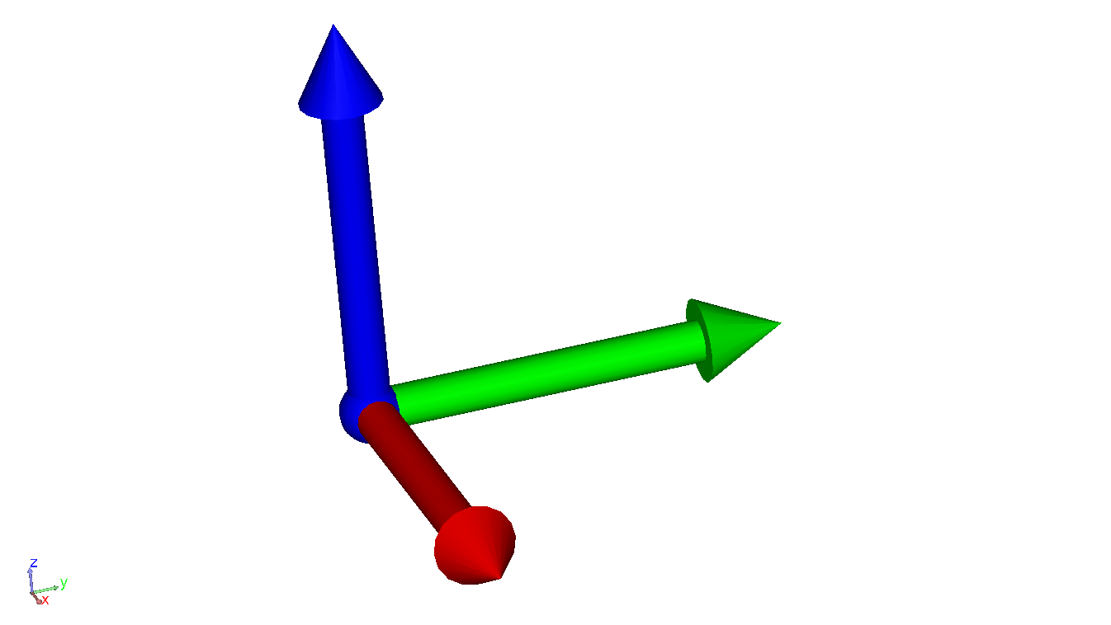
Do parts really expand and contract linearly?
No
All methods of temperature compensation have inherent limitations. Components are not always one homogenous thing (bolted, riveted, welded, clamped, & glued at all different orientations)
.
Do parts really expand and contract linearly with temperature?
Sometimes you really do need a temperature controlled facility…

Slide 6
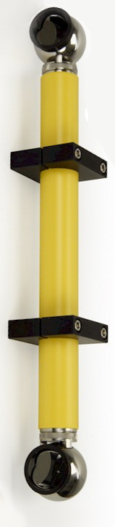
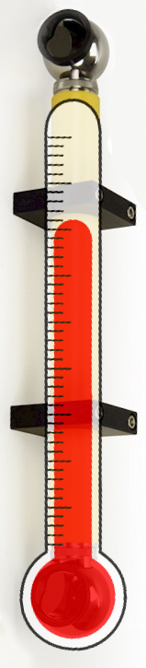
What about scale bars?
Scale bars are an option for setting scale when…
They are the same material as the object being measured
They are at the same temperature as the object being measure
They are sufficiently long
There is more than one, or more than one set of measurements on the scale bar
Scale bars can make great thermometers

Slide 7
So what to do?
First and most important, don’t change unless you know how you will affect downstream processes!
  You may have somebody downsteam that is expecting uncompensated data. Why? Who knows, but it happens.
Second, be consistent.
  Scaling can be done different ways & at different points in the process. Reduce uncertainty – use a consistent process
Third, do not ALWAYS float scale
  Floating scale is great, but first you need something have something to float it to

Slide 8


So, really… what do I do?
Set scale at the instrument level
This scales all measurements
Scale point groups individually
Copies and Scales selected point groups
Scale Nominals or CAD
Not common, but you can do it
Notes:
Manually (or calculated based on Temp & Material CTE)
Float Scale (7DOF fit)
Based on scale bar measurements -- When bundling Theodolites

Slide 9
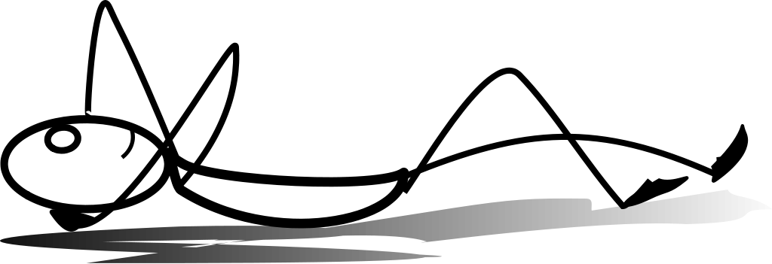
3 Step Best Practice
For the initial measurement, set scale based on part temperature
  Instrument→Properties & Set Scale Manually
  Instrument→Locate→BestFit & Set Scale Manually
When tying in for subsequent measurements or performing a station move, float scale
If a drift check fails, always evaluate scale

Slide 10
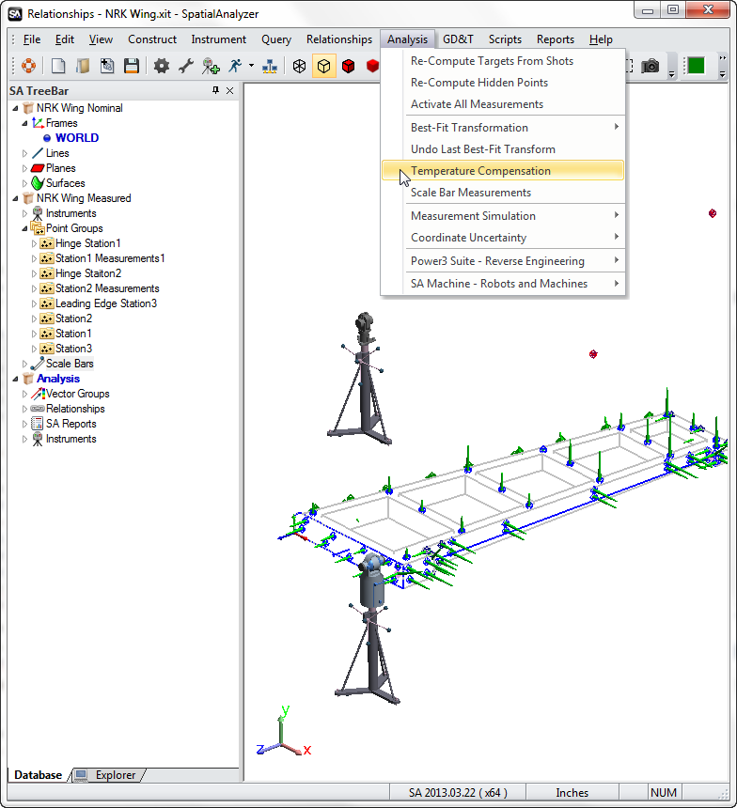
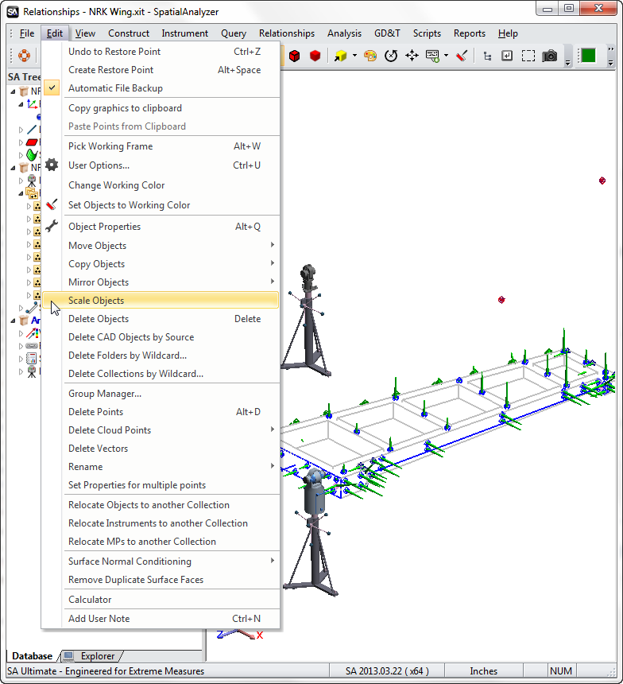
Scaling Individual Groups or Objects
Scaling Individual Groups
Scaling Objects or CAD

Slide 11
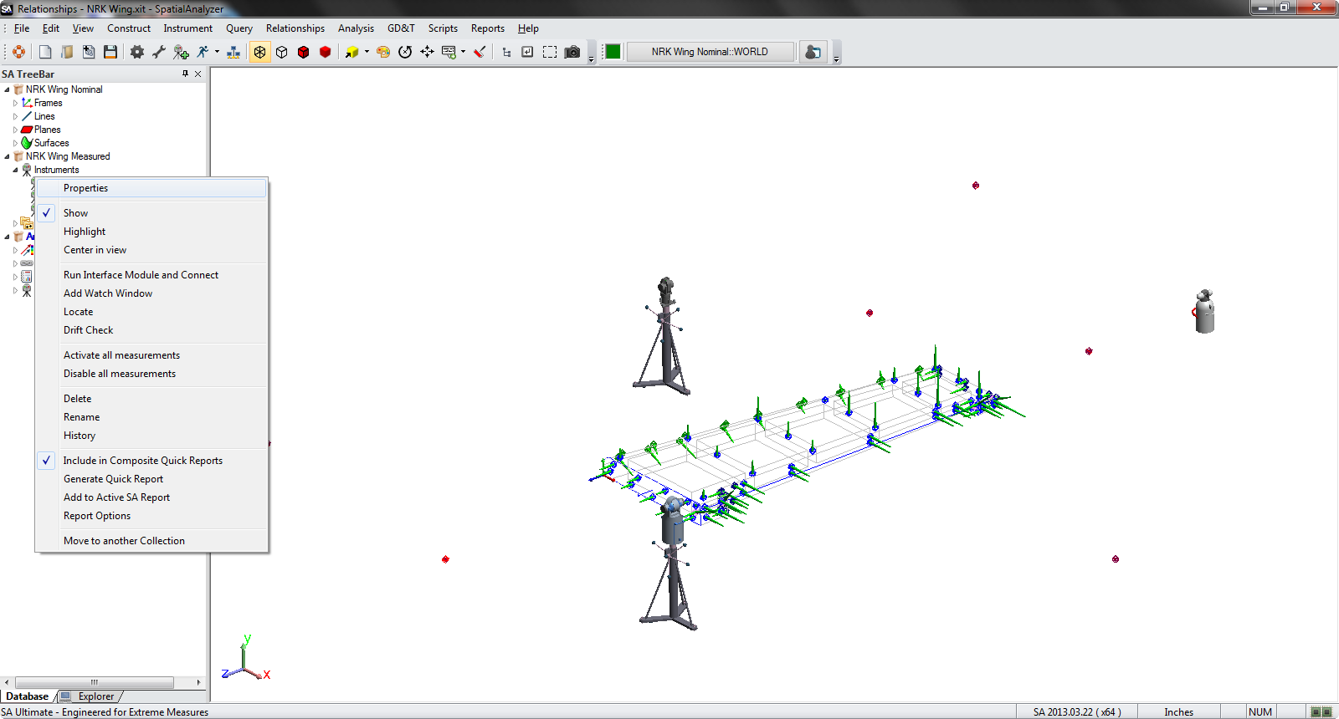
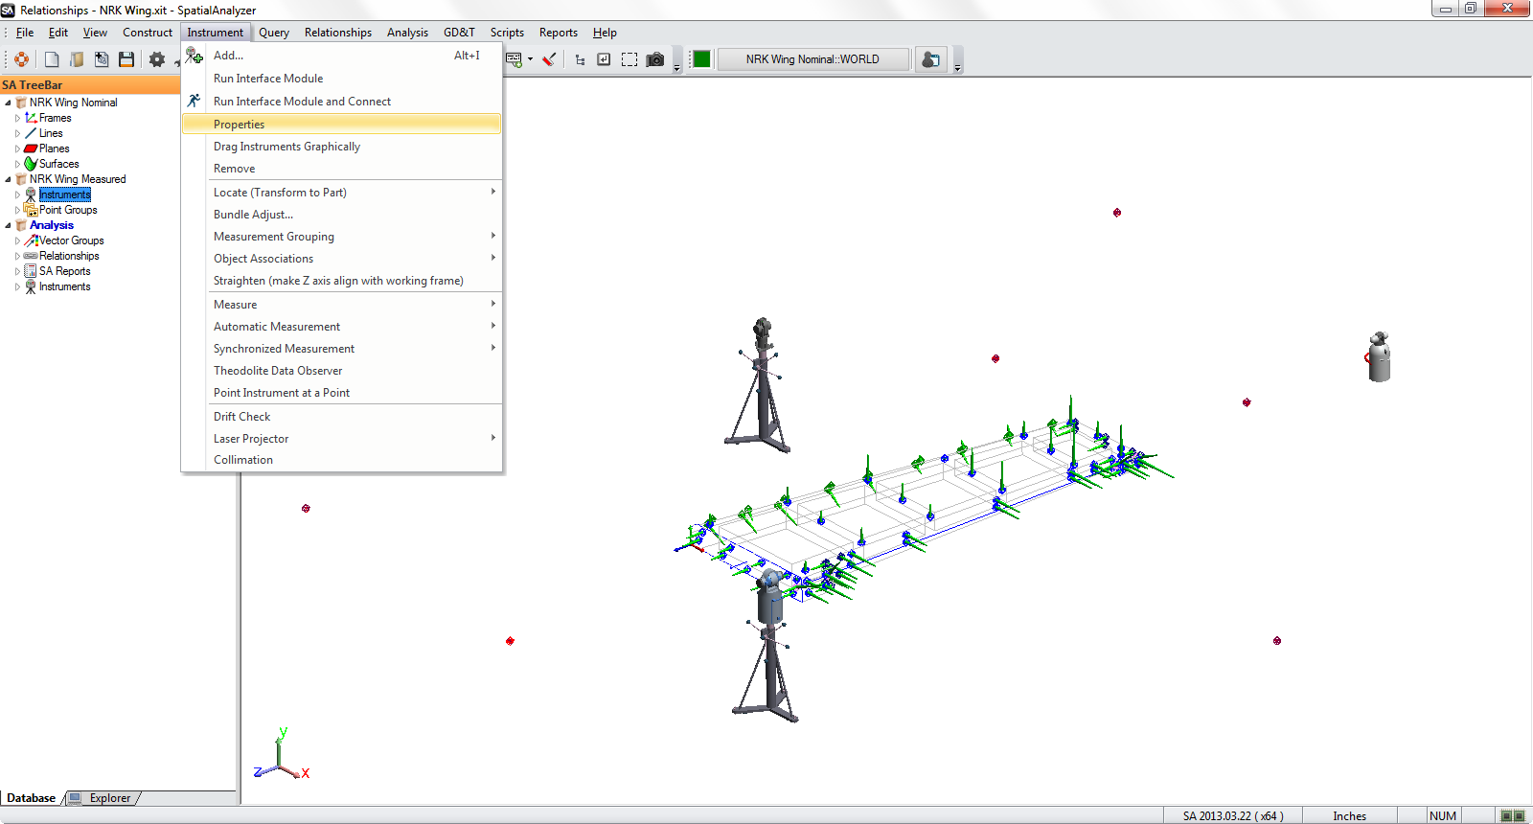
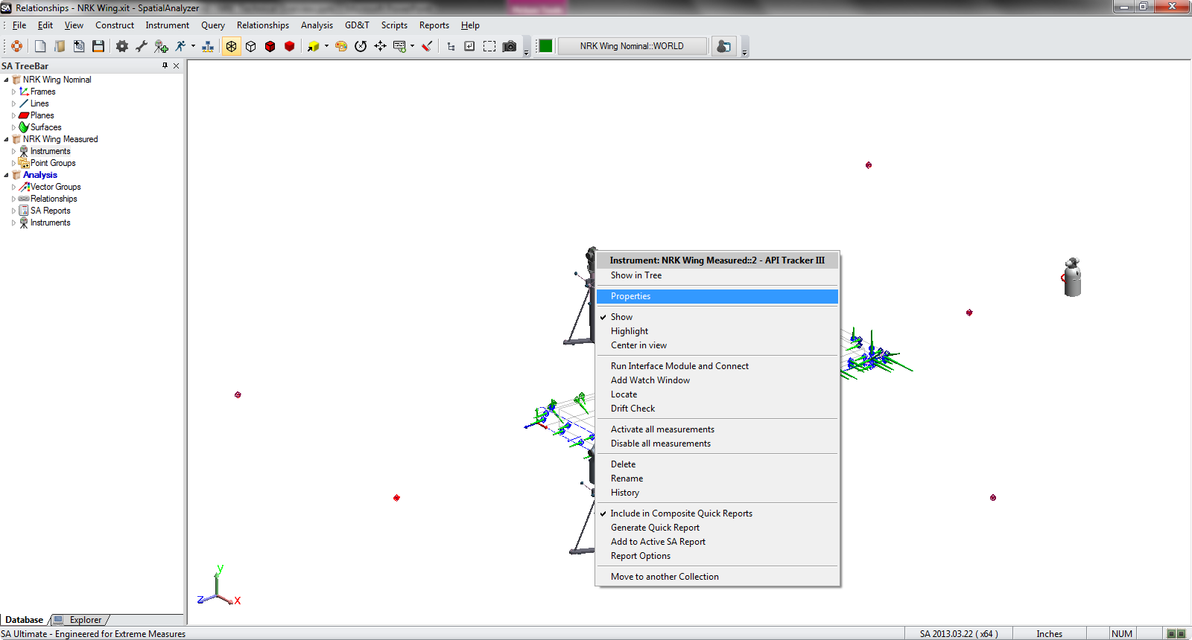
Setting Scale at the Instrument

Slide 12
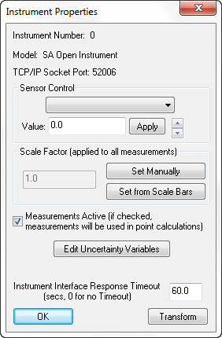
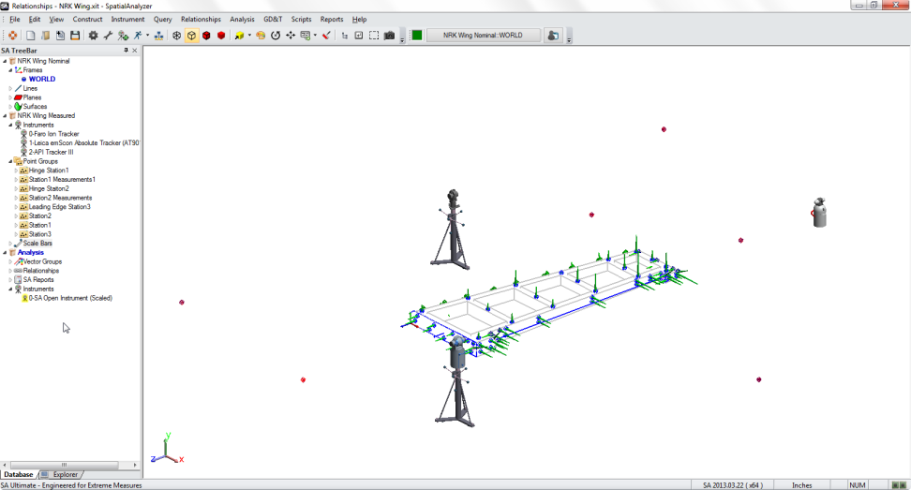

Setting Scale at the Instrument
SA will always note instruments which have been scaled in the treebar

Slide 13
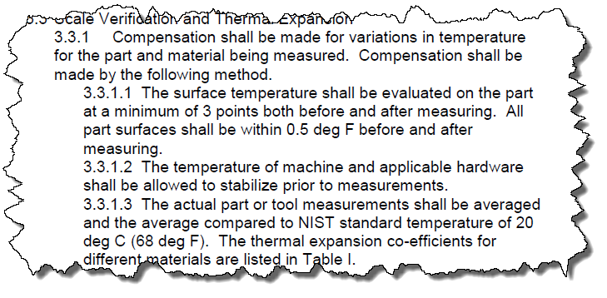
When to Set Scale?
At the start of the measurement
Using measured temperature or scale bars
All measurements are corrected as you take them
Constructed objects using measured data will use the scale at the time of construction
Instrument location, fits, & co-ordinate systems will all use the defined scale
At subsequent tieins, station moves, or after failed drift checks
Using measured temperature, scale bars, or floating scale
Floating scale can correct scale drift
At the end of the measurement
Using averaged temperature
When part temperature changes are unavoidable, this may be your best option
Verification, analysis, and construction geometry will all need to be done after scaling is performed

Slide 14
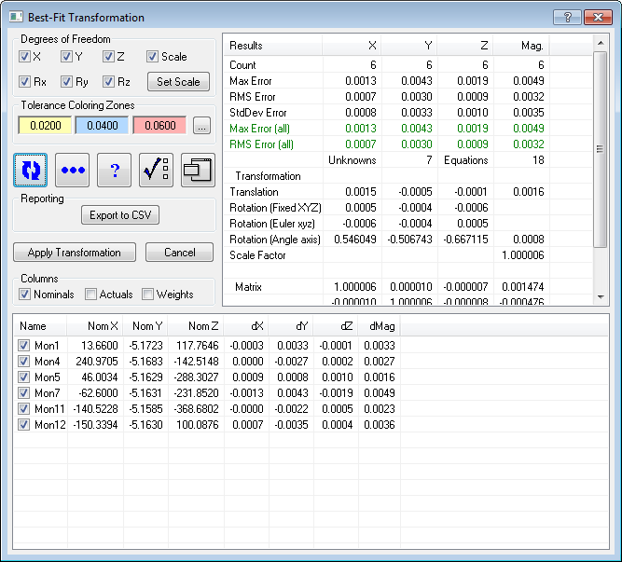
Floating Scale
Enable Here
A.K.A. “7-DOF Fit”
Use When…
Moving Station and refitting to previous measurements
Part reference system has already been established at design conditions by previous measurements
Do not use when…
Part Scale has not yet been determined
Verify Here

Slide 15
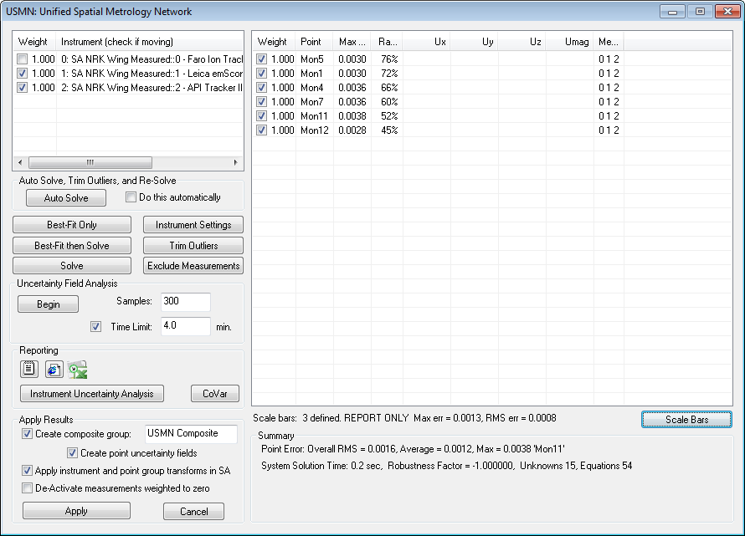
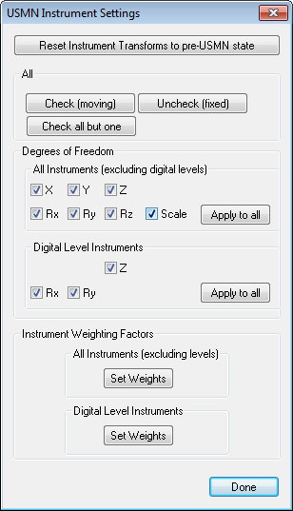
Floating Scale in USMN
Scale can also be solved for when using USMN…
Enable Here

Slide 16
3 Step Best Practice
For the initial measurement, set scale based on part temperature
  Instrument→Properties & Set Scale Manually
  Instrument→Locate→BestFit & Set Scale Manually
When tying in for subsequent measurements or performing a station move, float scale
If a drift check fails, always evaluate scale

Slide 17
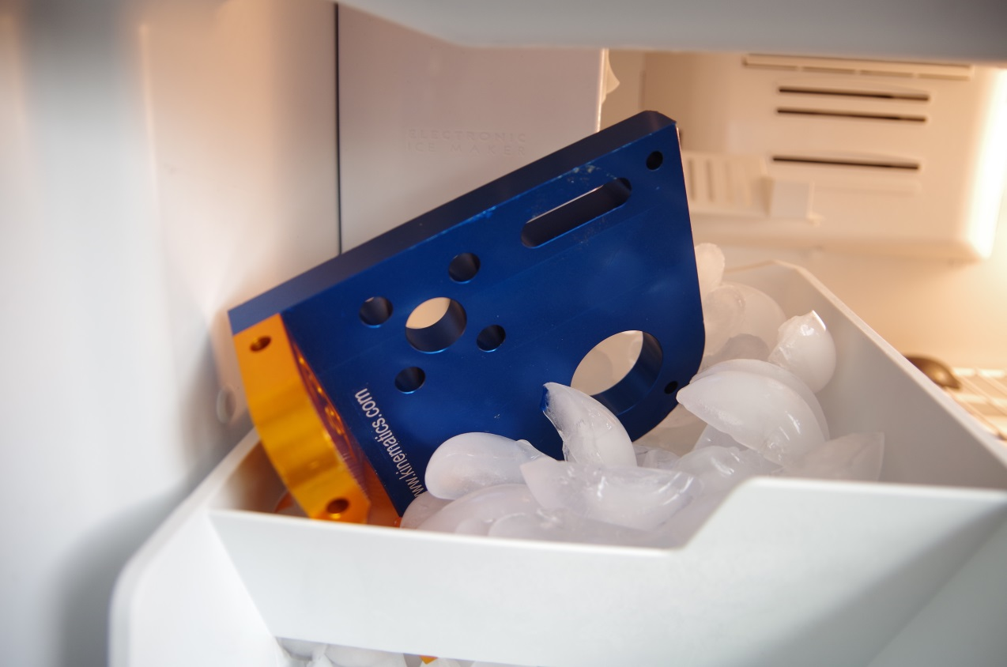
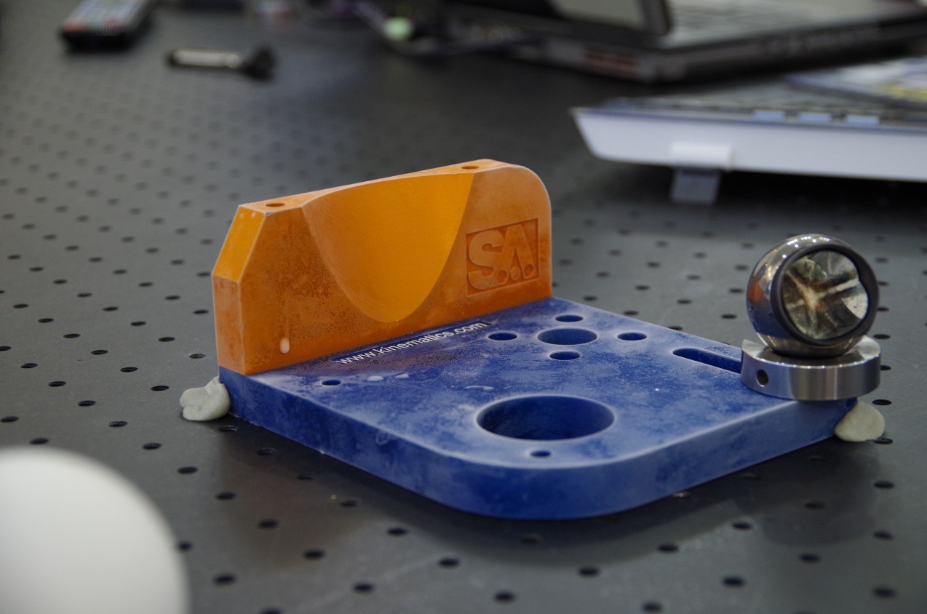
Examples…

Slide 18
  Questions?

Slide 19
Thank You

