Slide 1

Underwater Photogrammetric Verification Of Nuclear Fuel Assemblies Via Natural Feature Measurement
m | Giuseppe Ganci Gancell Pty. Ltd. 27 Browning Street Moonee Ponds, Victoria 3039, Australia gganci@gancell.com

Slide 2



A few warnings…
This presentation may cause
cancer in the state of California
There will be some blatant
copyright infringements
Presentation may digress at times
Some animated nudity may offend younger audience members, may excite older audience members (Rick)
Questionable content

Slide 3
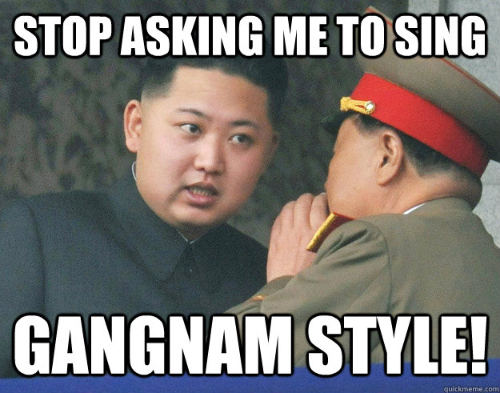
Who is the North Korean Nuclear
Industry Poster Boy?

Slide 4
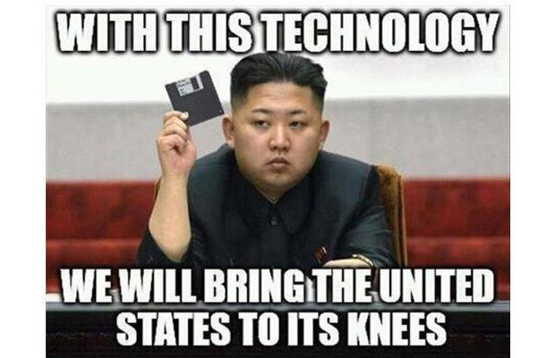
Who is the North Korean Nuclear
Industry Poster Boy?

Slide 5
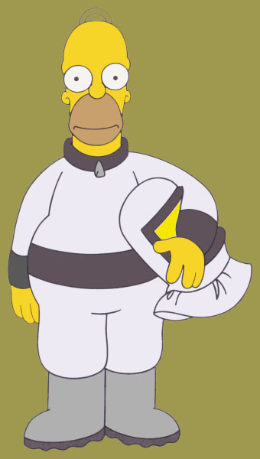
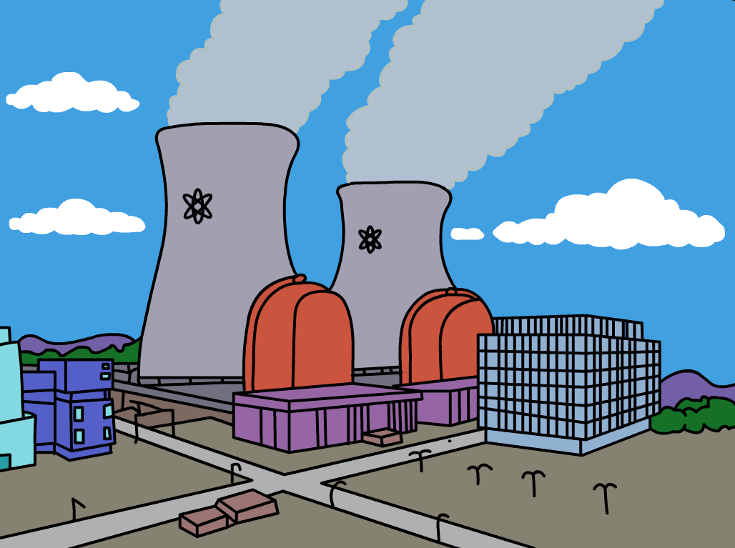
Who is the American Nuclear Industry Poster Boy?

Slide 6
Underwater Photogrammetric Verification Of Nuclear Fuel Assemblies Via Natural Feature Measurement
Three things a photogrammetrist never wants to hear…

Slide 7
Three things a photogrammetrist never wants to hear…
Underwater
  Lots of water
  Need to protect camera
  Standard calibration model not as suited
Nuclear
  Radioactivity
  Potential to damage electronics
Natural Feature
  No target to define point of interest
  Lower accuracy
  Limited measurement automation

Slide 8
Customer Brief
To measure the location in XY of 177 hold down plates located underwater in a nuclear reactor cell

Slide 9
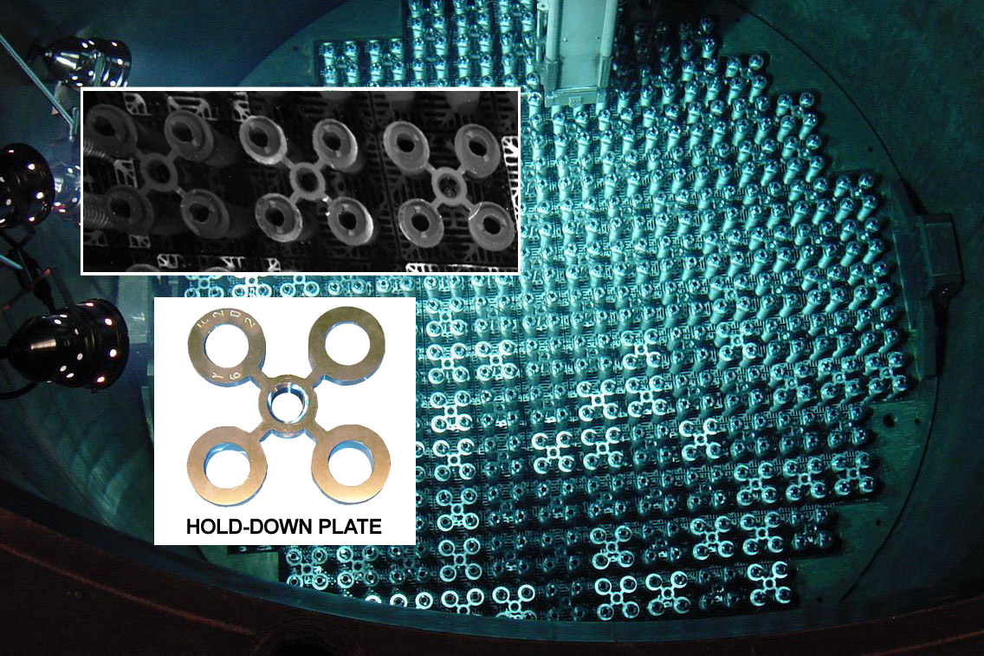
Chamber Overview

Slide 10
Customer Brief
To measure the location in XY of 177 hold down plates located underwater in a nuclear reactor cell
To measure in XY the location of a further 708 circular features on the hold down plates
To measure the location of fixed concrete points around the cell
To compute deviations from design value for the 805 points (177 + 708)
Point-to-point accuracy requirement of 0.76 mm (one-sigma) in X and Y

Slide 11
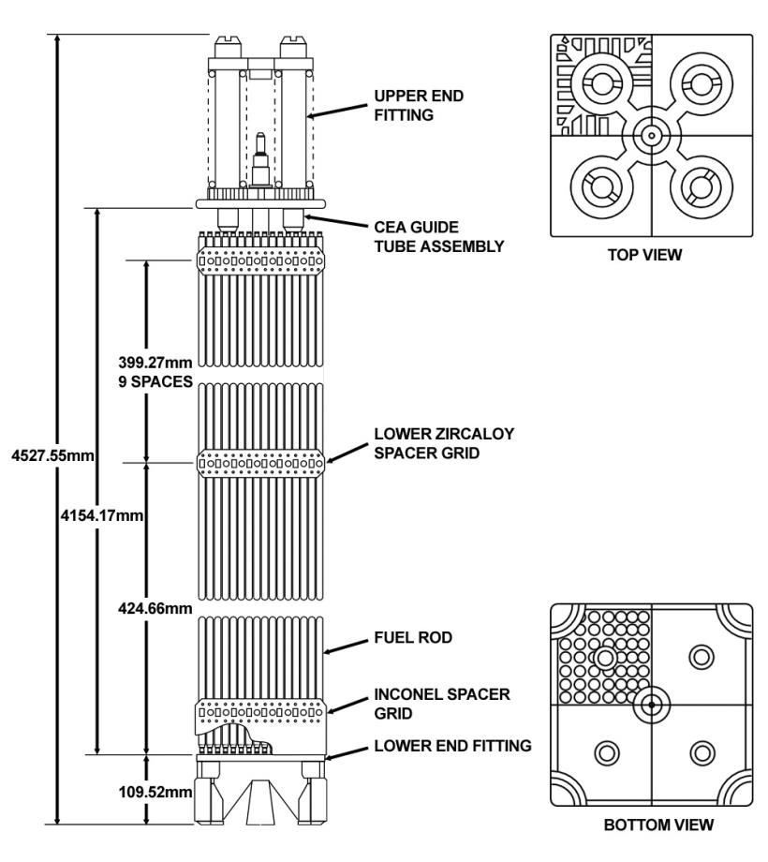
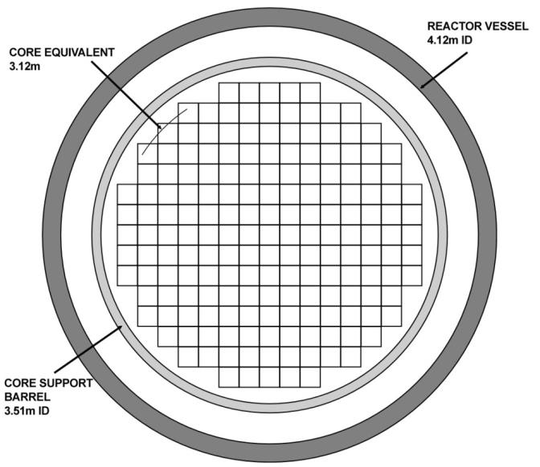
Chamber Overview

Slide 12
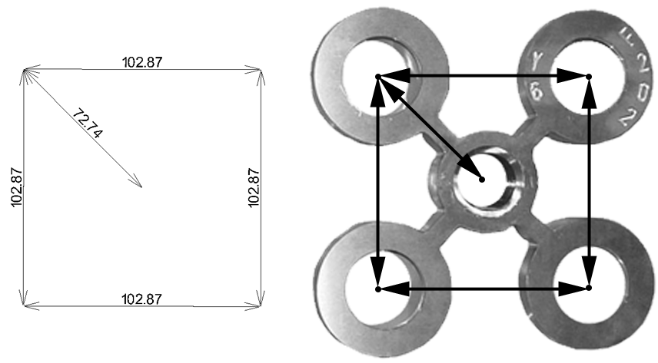
Chamber Overview

Slide 13
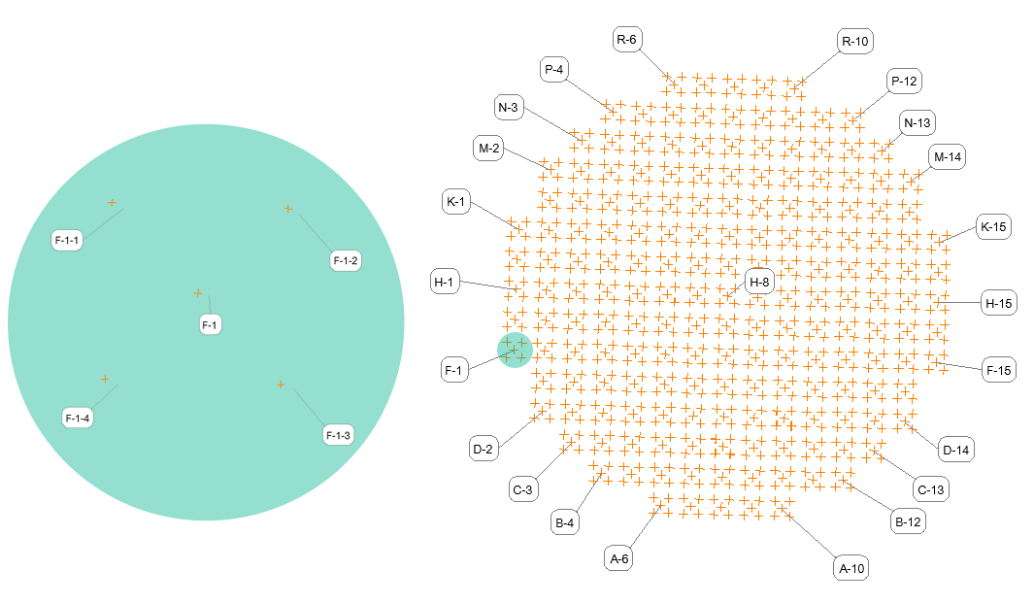
Chamber Overview

Slide 14
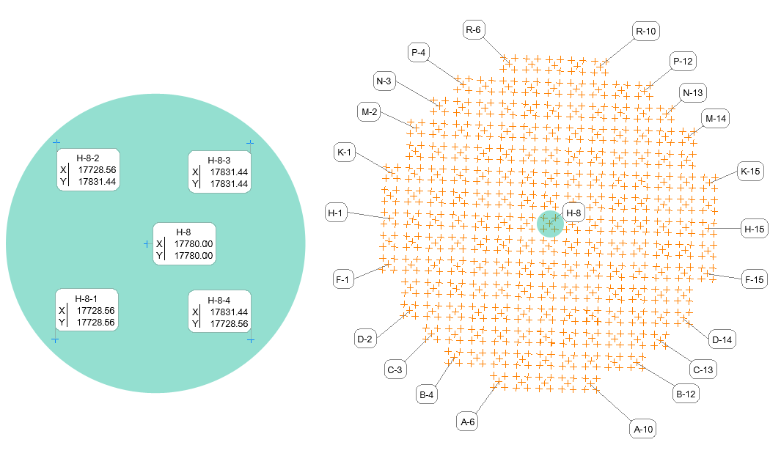
Chamber Overview

Slide 15
Measurement Constraints
No targeting in the cell area
No exterior orientation (EO) devices, no coded targets
No external scale artifacts for scale
Limited measurement window
Automated measurement of the hold down plate circles
Only some of the fuel bundles are changed during the refueling, which mean some of the plates are new and shiny whilst other are dull

Slide 16
Project Requirement Checklist
High accuracy camera with remote operation functionality
Underwater canister
Pan and tilt mechanism
Software development to detect edges and then compute best-fit ellipse of center points. SA to plot residuals and report
Pilot project measurements to verify system performance

Slide 17

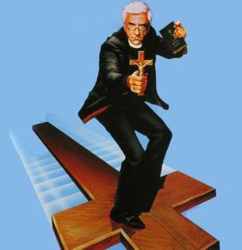
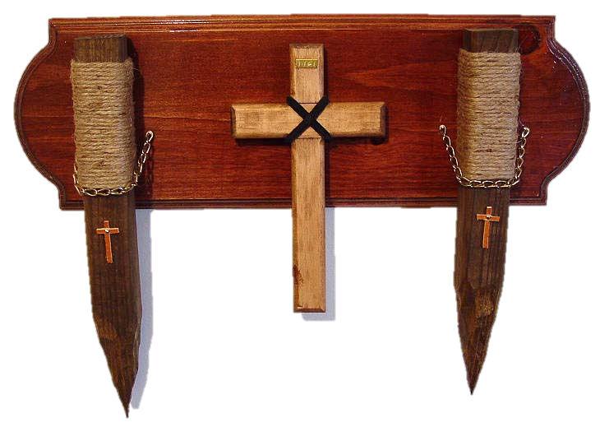
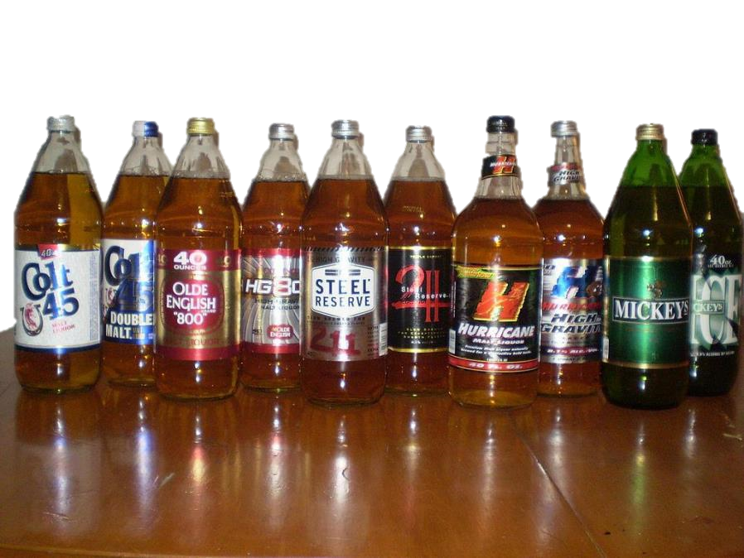
Photogrammetric Exorcism Checklist
One priest
Holy water
Wooden stakes
and a bottle of cheap booze

Slide 18
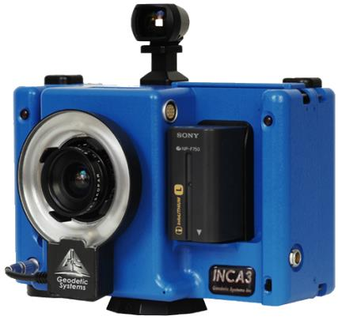
Hardware - camera
Geodetic Systems Inc. INCA3
was selected for this project
Camera has proven track record in canister environments (thermal chambers)
Camera can be powered and networked for remote operation
Camera has an integrated flash
Camera capable of producing accurate results (5μm + 5μm/m)

Slide 19
Hardware - canister
It was necessary to design a canister suitable of housing the INCA3
No suitable off the shelf canister was available, so one was designed
Development time limited by customer outage schedule
In addition to a waterproof environment, some mechanism was needed to rotate and tilt the housing

Slide 20
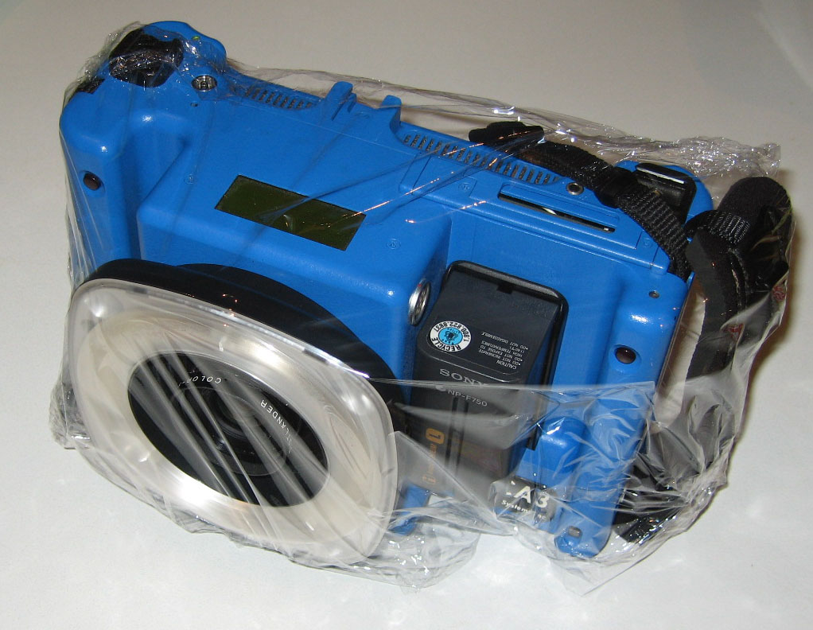
Hardware – canister early attempts

Slide 21
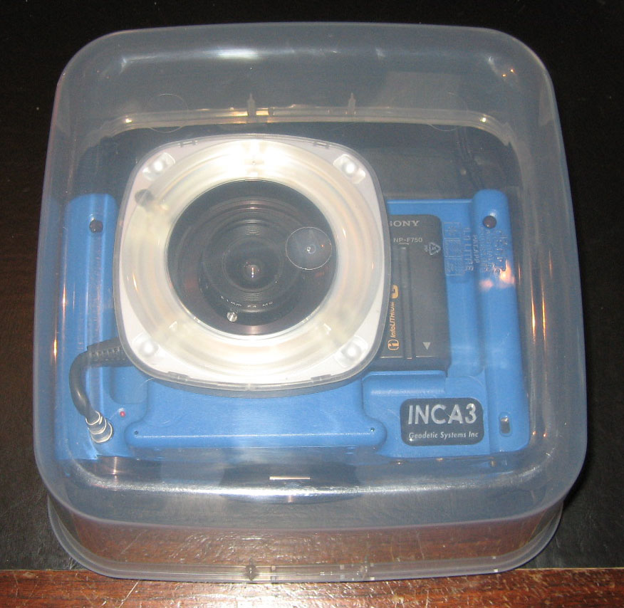
Hardware - canister early attempts

Slide 22
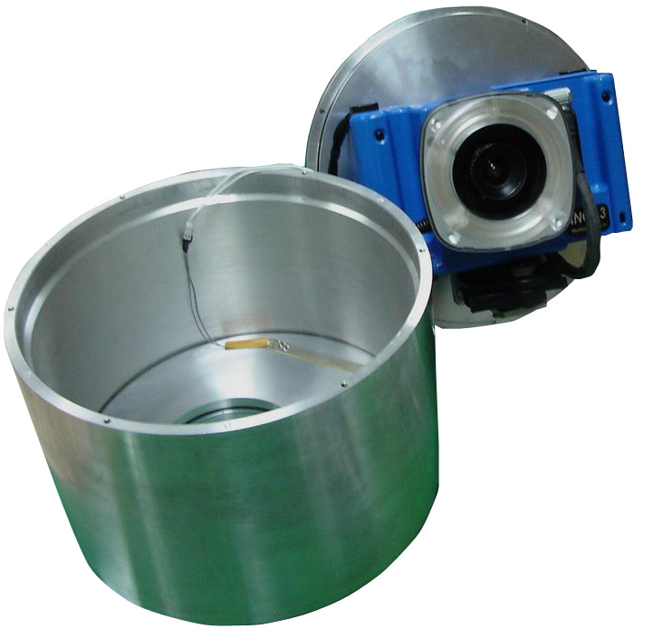
Hardware - canister
Housing made out of rolled aluminum and two end plates.
One end plate housed the non-browning quartz window.
The other plate included a mount for the camera

Slide 23
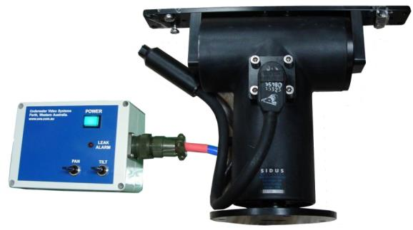
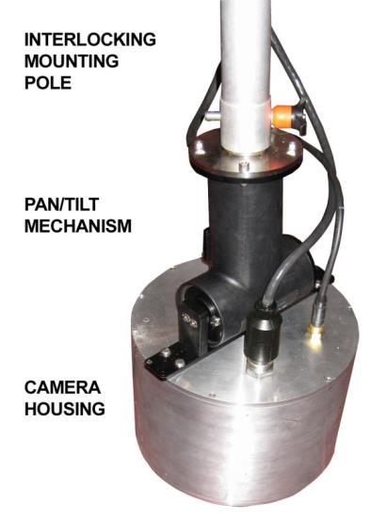
Hardware – pan and tilt mechanism
For self-calibration purposes
it is necessary to roll the
camera during the data
collection
This was achieved by hanging
the camera vertically and using
the “pan” function as a “roll”
The “tilt” was used to help point
the canister towards the center
of the field

Slide 24
Hardware - test
Once the hardware aspects of the test were resolved a live test was scheduled
The aim of the live test was to collect images that could be used to guide the software development
The results of the test would also indicate what level of accuracy was achievable using this method of measurement

Slide 25
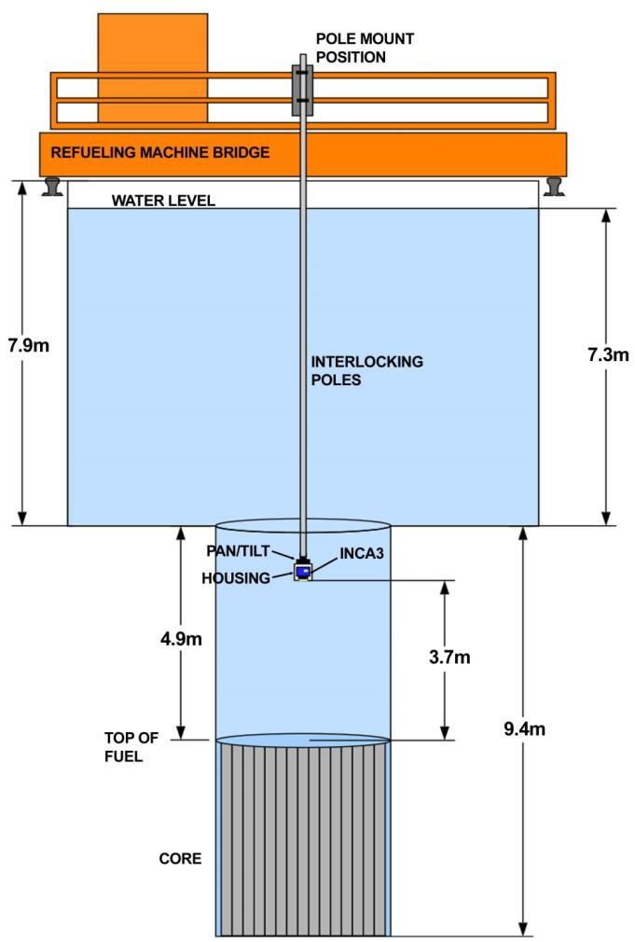
Hardware - test
The overhead refueling
crane was used to shuttle
the camera around the
cell
Lights lowered into cell to
illuminate area
Images at different
exposure were collected to
find the optimal
measurement conditions
The pole mount position
was moved to three
position on the overhead
crane

Slide 26
Before entering containment area…
Need to strip down to underwear and change into approved clothing
Two things crossed my mind…
  Am I even wearing underwear today?
  Is that underwear clean?

Slide 27
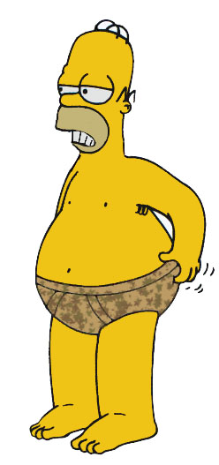
Before entering containment area…
Once nearly naked, stand around for 60 minutes in a public area hiding behind laptop bag

Slide 28
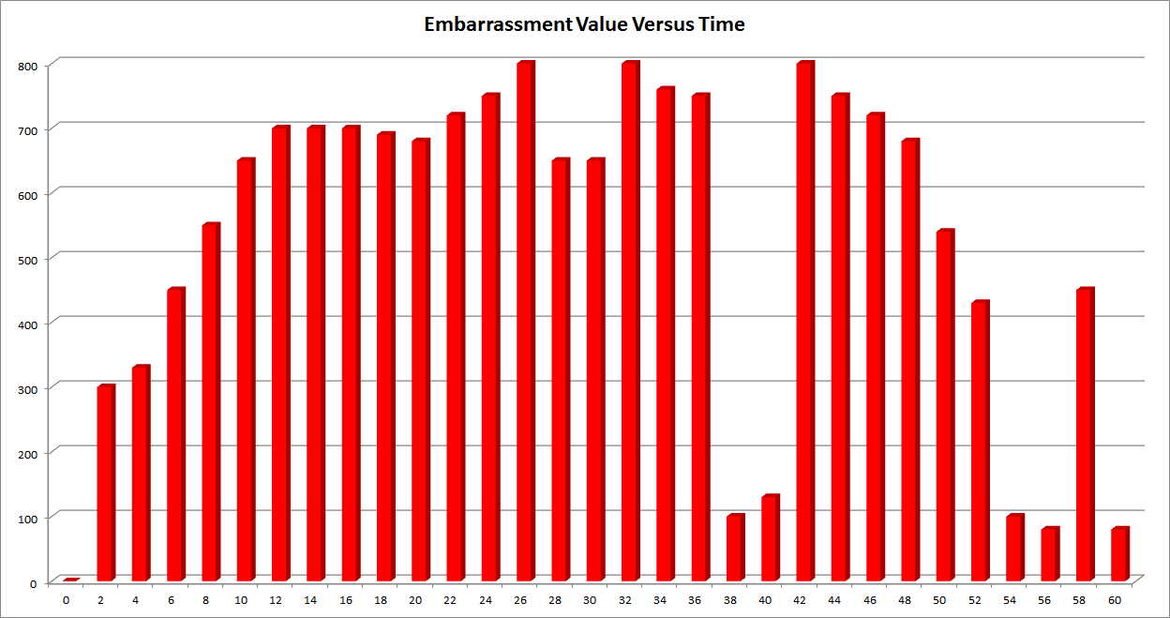
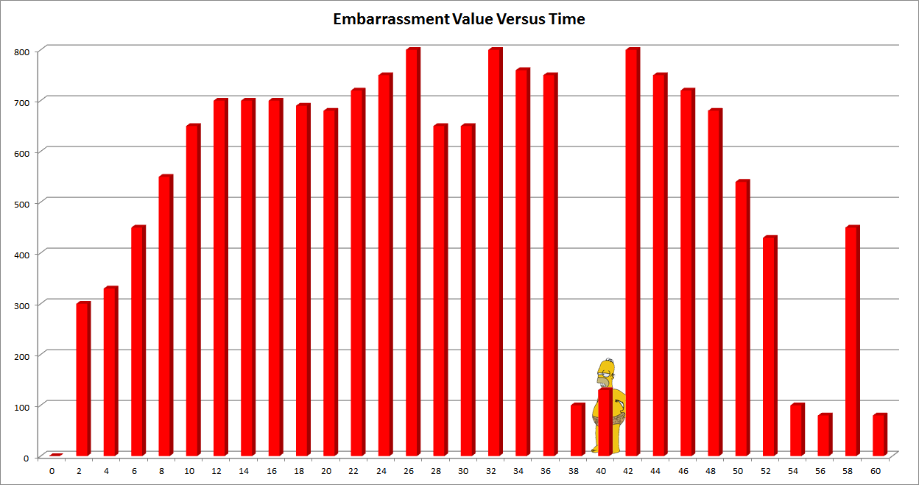
Before entering containment area…

Slide 29

Before entering containment area…
There was much animated discussion
and I saw many of my Korean
counterparts with their arms apart

Slide 30
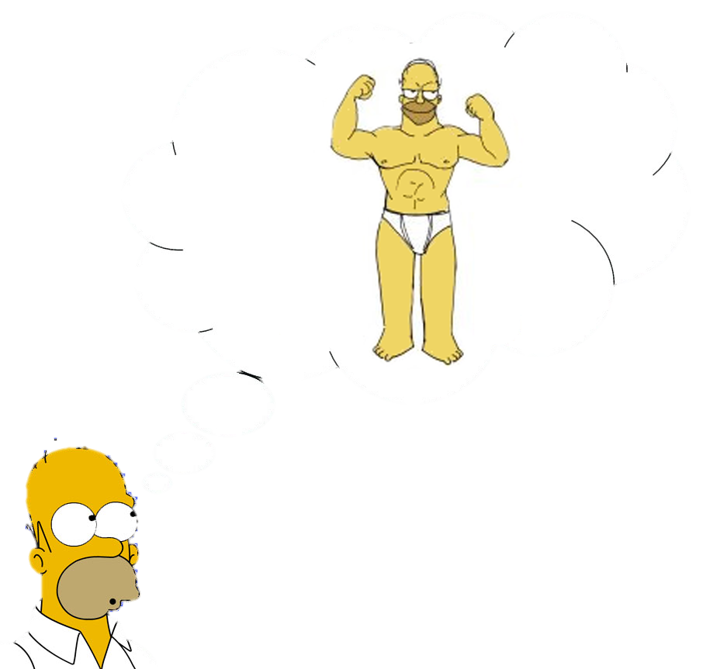
Before entering containment area…

Slide 31
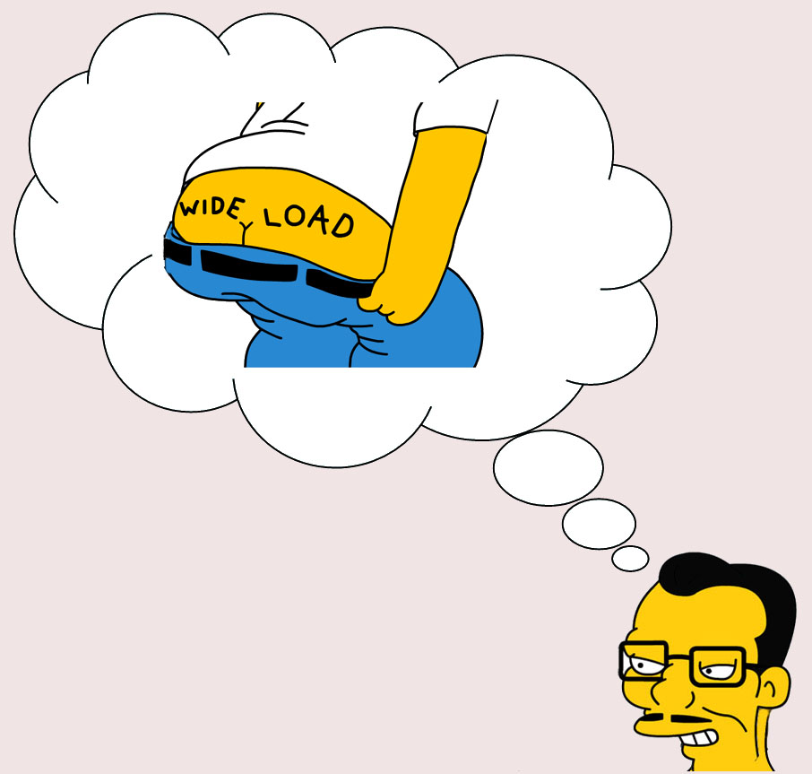
Before entering containment area…

Slide 32
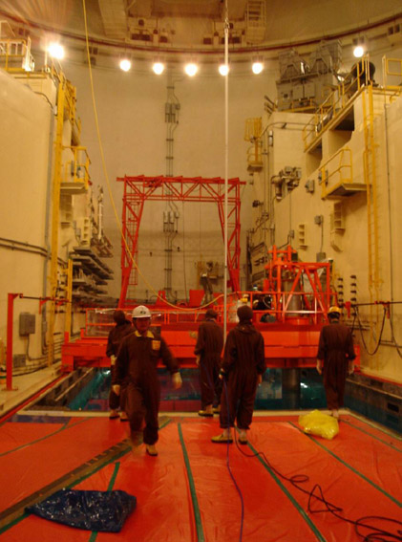
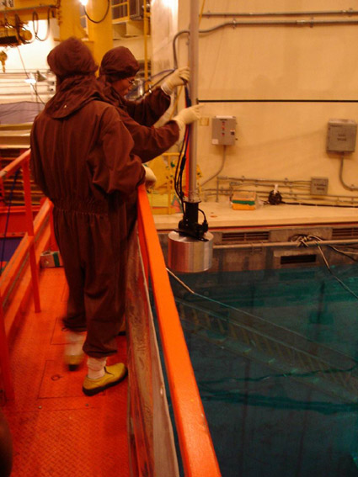
Hardware – test

Slide 33
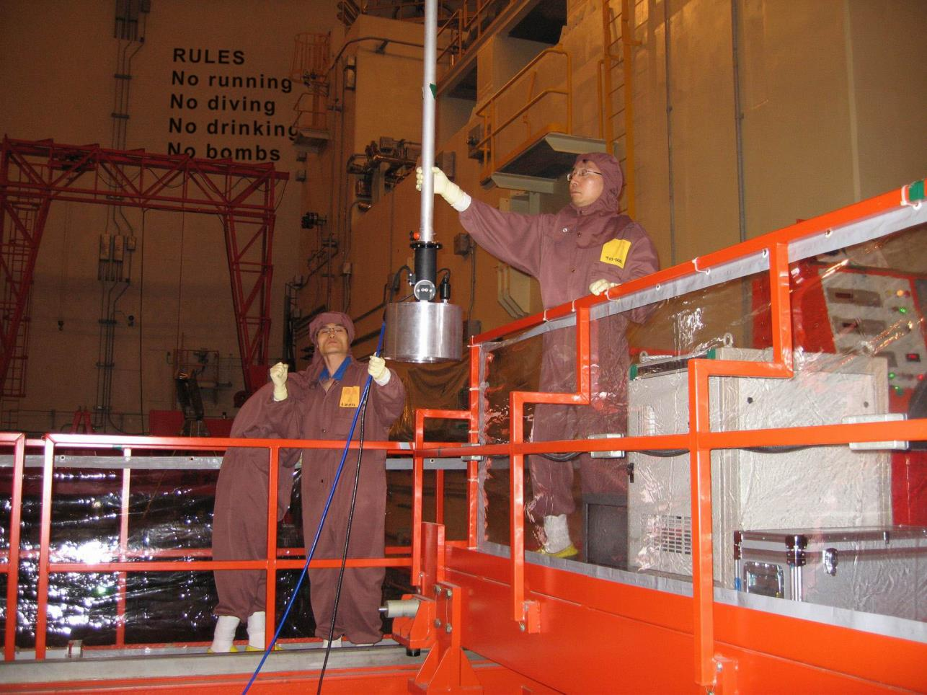
Hardware – test

Slide 34
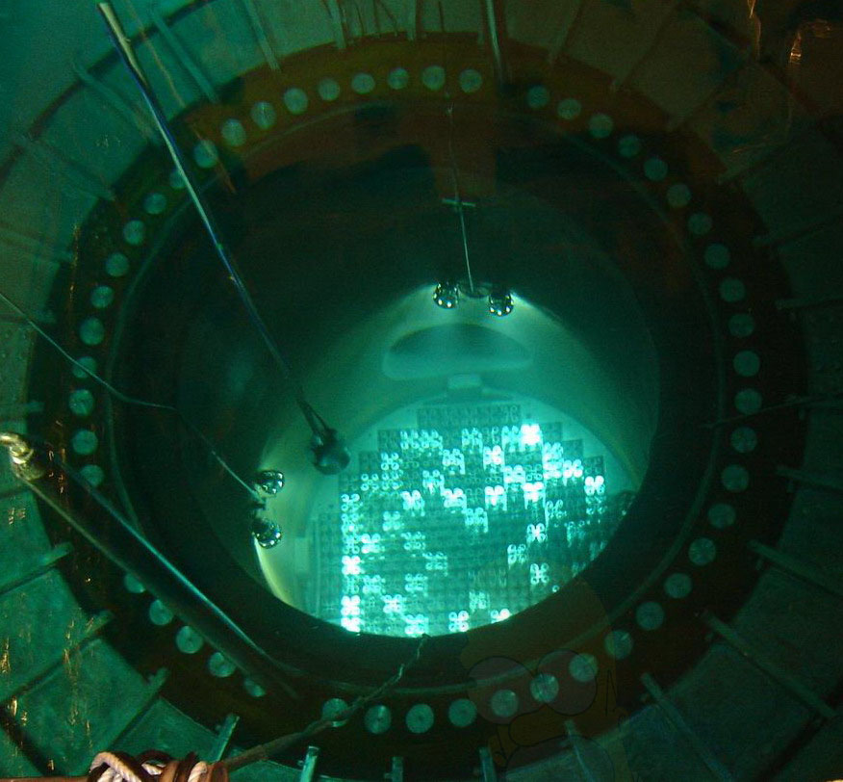
Hardware - test

Slide 35
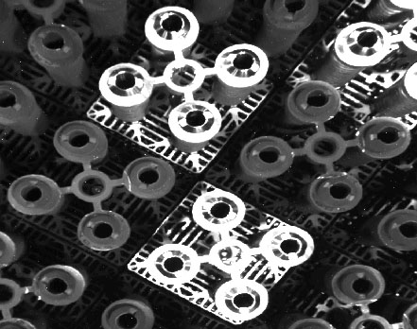
Hardware - test
Underwater lights were essential, but they caused reflections off the new plates.
A balance in
shutter time was
needed as the
new plates were
significantly
brighter than
the older ones
1000ms was
used for most of
the test

Slide 36

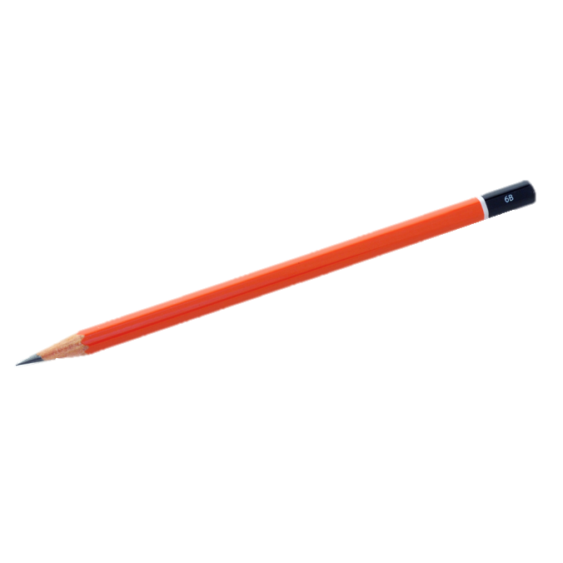
Cleaning up…
After the test we were escorted to change rooms and instructed to shower
Presented with a towel and
taken to the “prisoner” showers

Slide 37
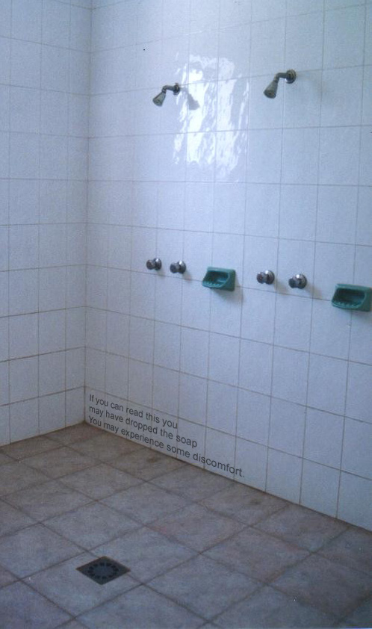
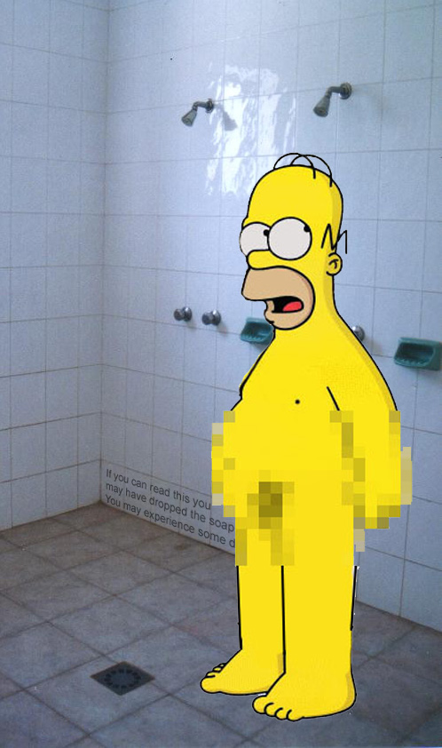
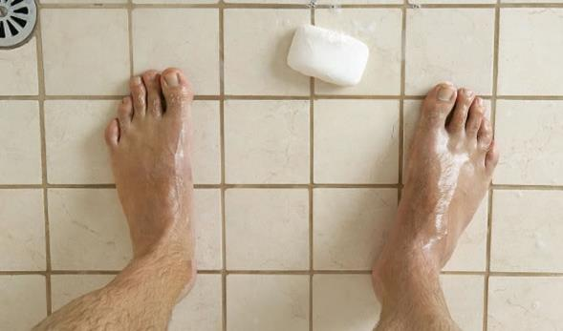
Cleaning up…

Slide 38
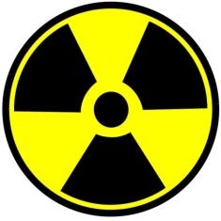
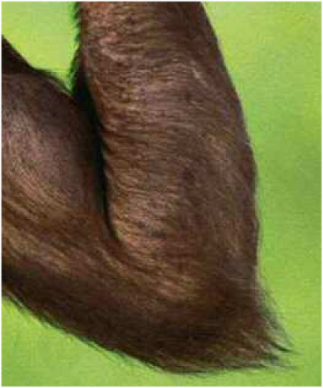
Cleaning up…
After dressing we returned to the screening area for final radiation dosage testing
I failed my test due to the
presence of Cobalt gamma
radiation
Their explanation?
Hairy arms!
Search tip?

Slide 39
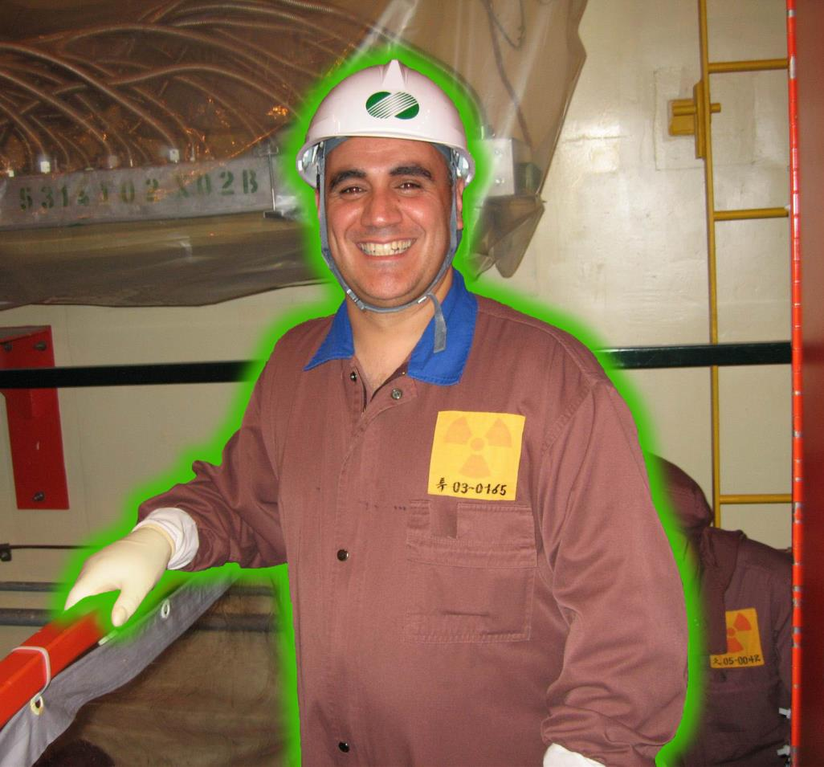
Radioactive…who knew?

Slide 40
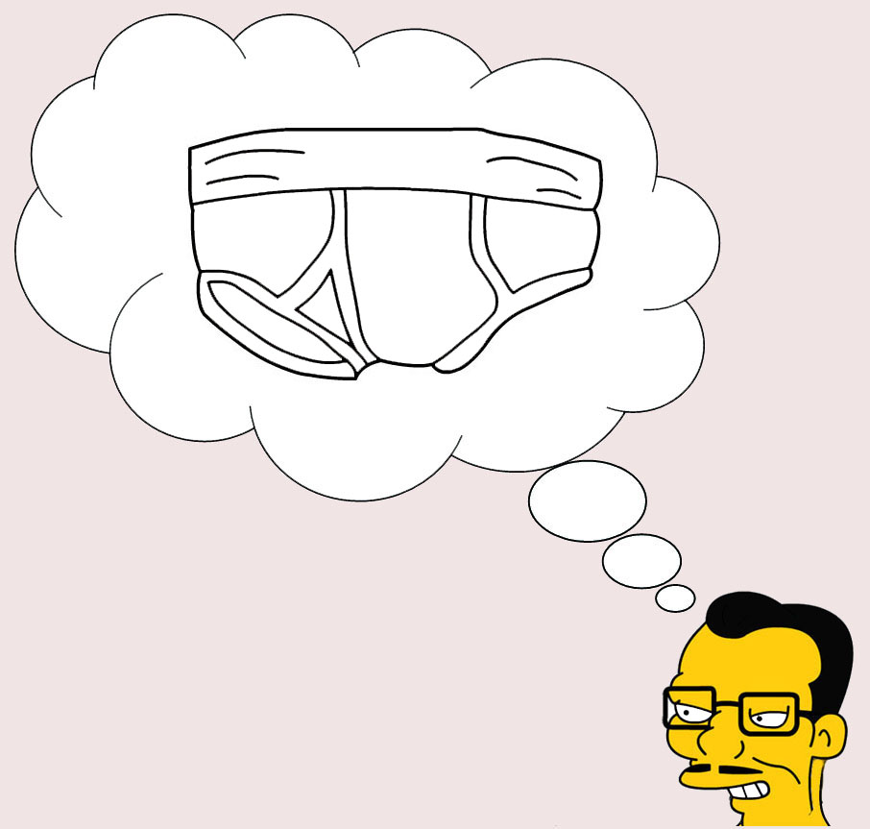
Got Radiation?
Excerpt of conversation whilst walking back to showers…
“Do you have spare panties?”

Slide 41

Got Radiation?
“Panties?”

Slide 42
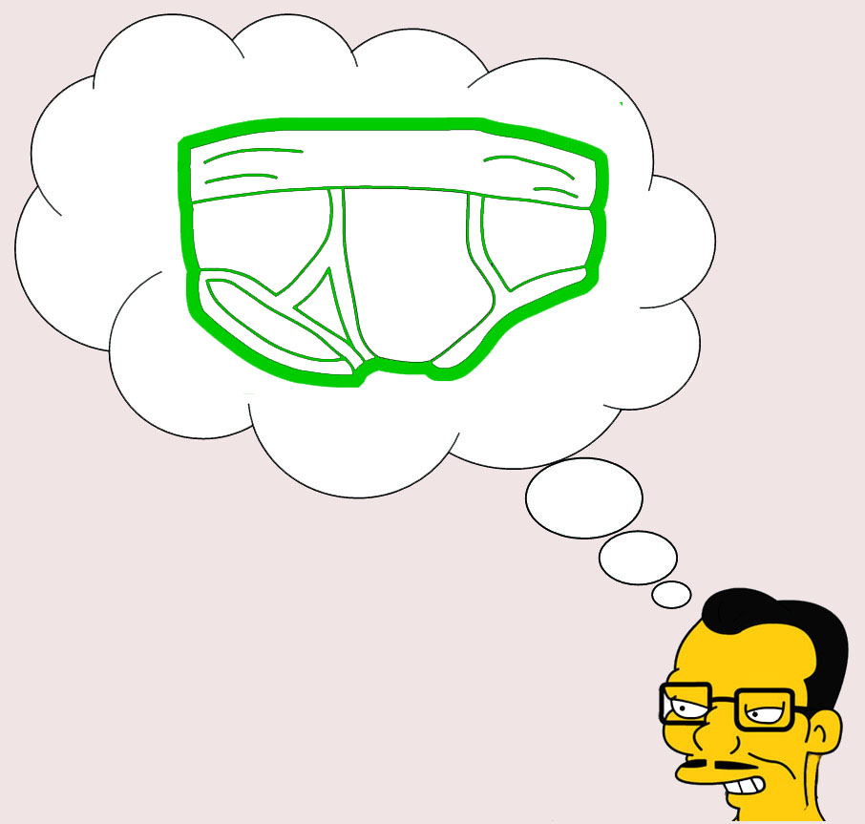
Got Radiation?
“Yes, maybe your panties
are contaminated.”

Slide 43
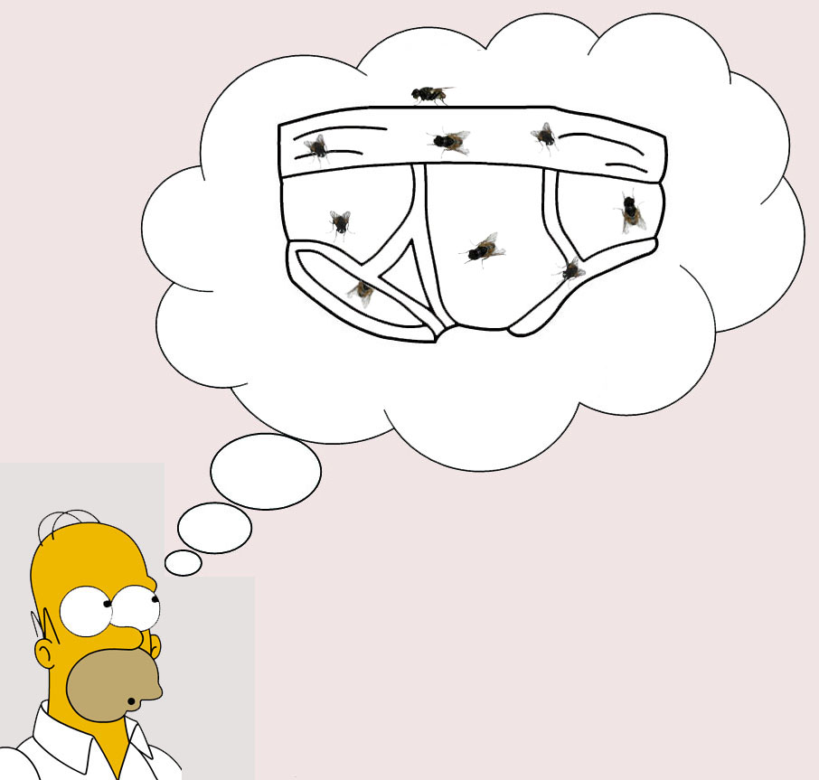
Got Radiation?
“but they are only a couple of days old.”

Slide 44
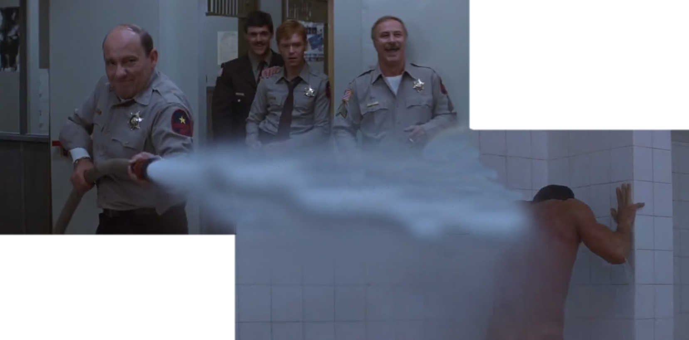
Got Radiation?
Need a hard core shower!
Rambo First Blood – Jail shower scene

Slide 45
Got Radiation?
Excerpt of conversation whilst returning from showers…
“Did you put the panties on?”

Slide 46
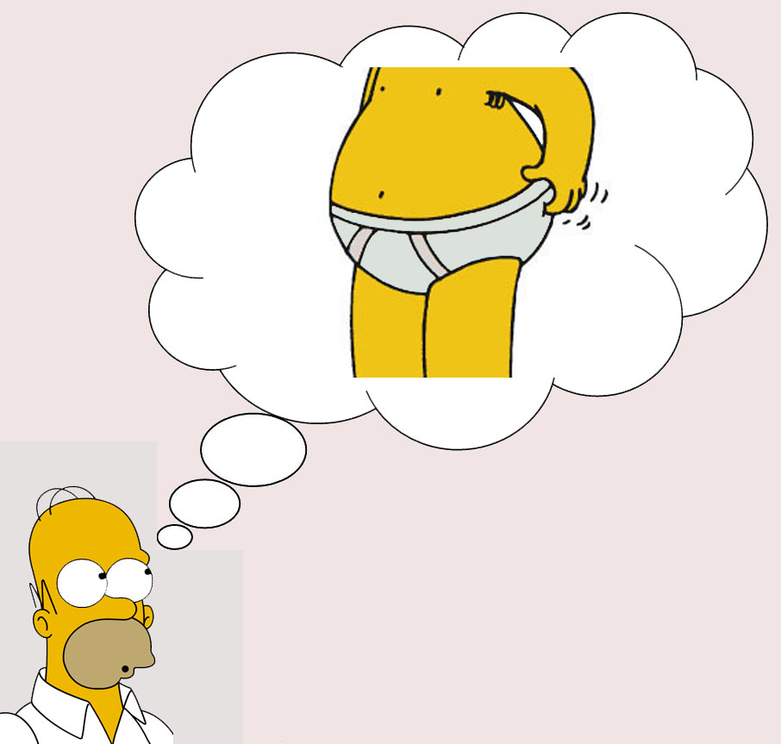
Got Radiation?
“Yes, I put the panties on.”

Slide 47
Got Radiation?
“Good, panties only used once.”

Slide 48

Got Radiation?
“ONCE!?”

Slide 49
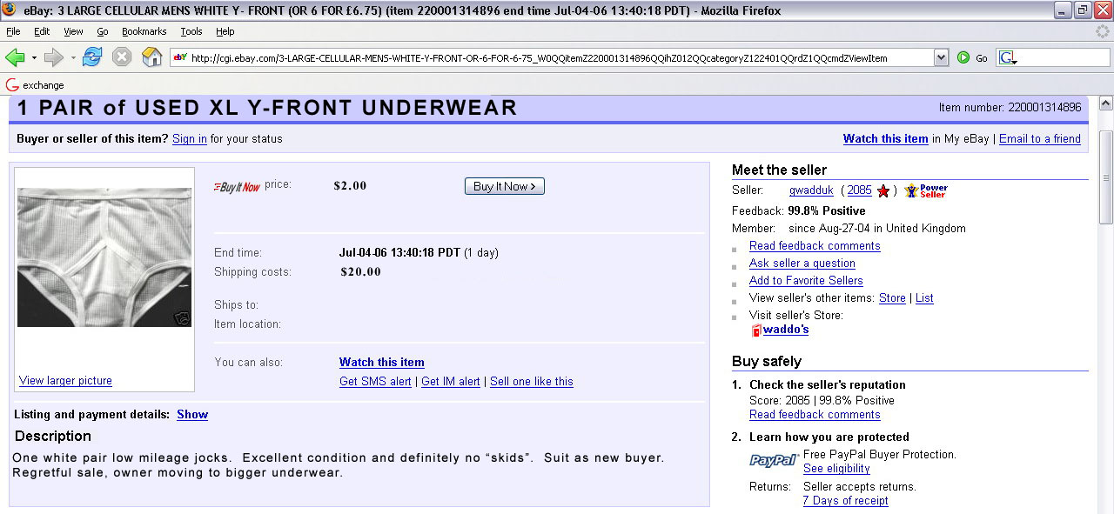

Got Radiation?

Slide 50
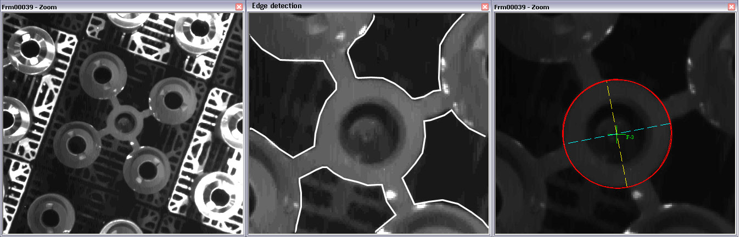
Plate measurement
Having collected a network of test images, work could commence on developing a suitable algorithm to measure the center of each circle
After examining different methods, an edge detection method coupled with ellipse fitting was implemented

Slide 51
Plate measurement
As the hold down plate is a precisely engineered item, apriori information about the radii and approximate image center could be used to guide the solution
Without the assistance of EO devices it is necessary to manually locate at least four well distributed points in each image
Once this has been done, the design XY values and the radii are used to measure the remaining circles
This data is then bundled to produce the required XY data

Slide 52
Test Measurement
A test measurement was scheduled to coincide with the next refueling outage
The aim of this test was to test the software and verify that the objectives outlined could be met
The test was carried out and approximately 45 images were collected
A typical image is measured in 30-60 seconds

Slide 53
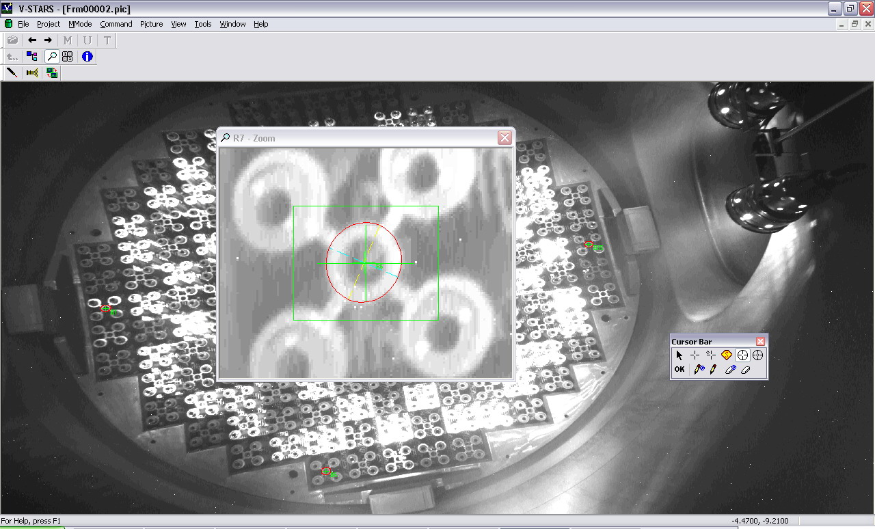
Test Measurement
For each image, four points well distributed points were manually measured

Slide 54
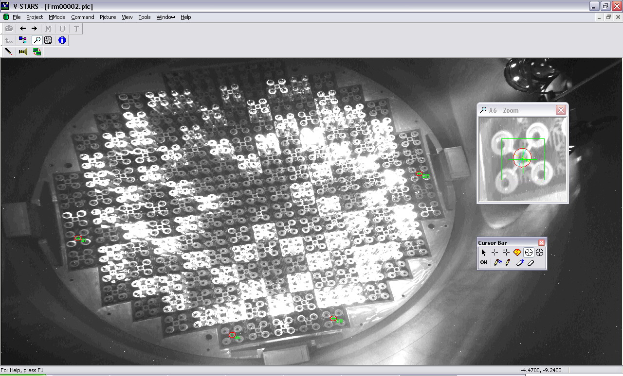
Test Measurement

Slide 55
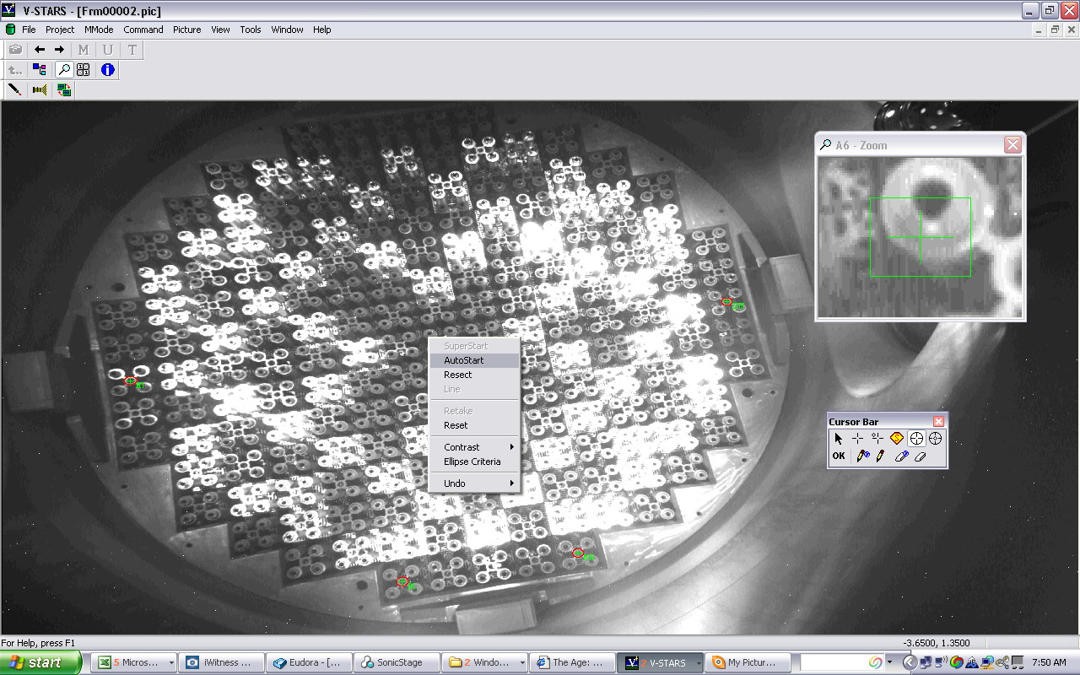
Test Measurement
The exterior orientation (camera location) was then determined from the four points

Slide 56
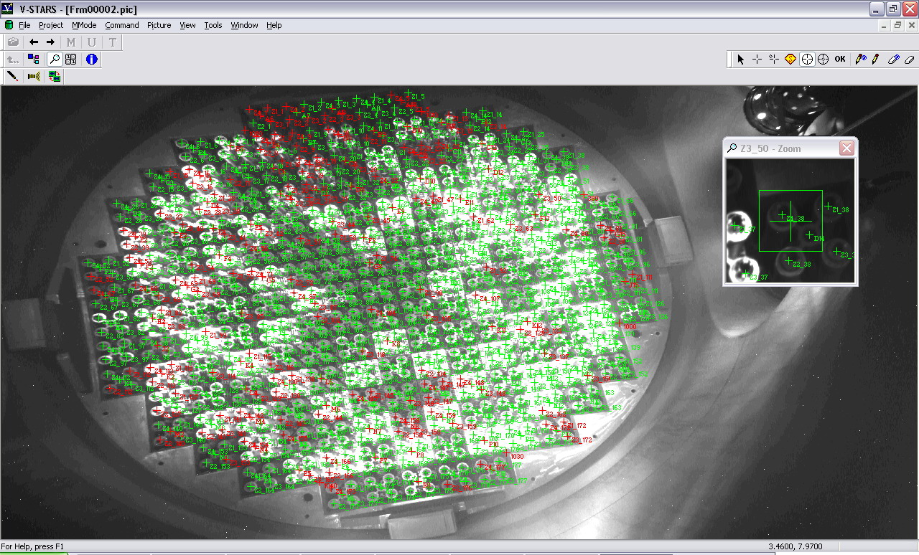
Test Measurement
The design coordinates were then used to guide the measurement of the remaining points

Slide 57
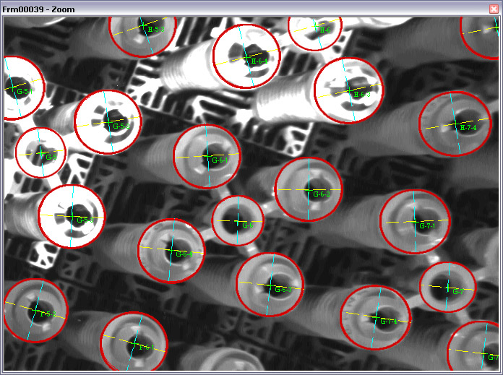
Test Measurement

Slide 58
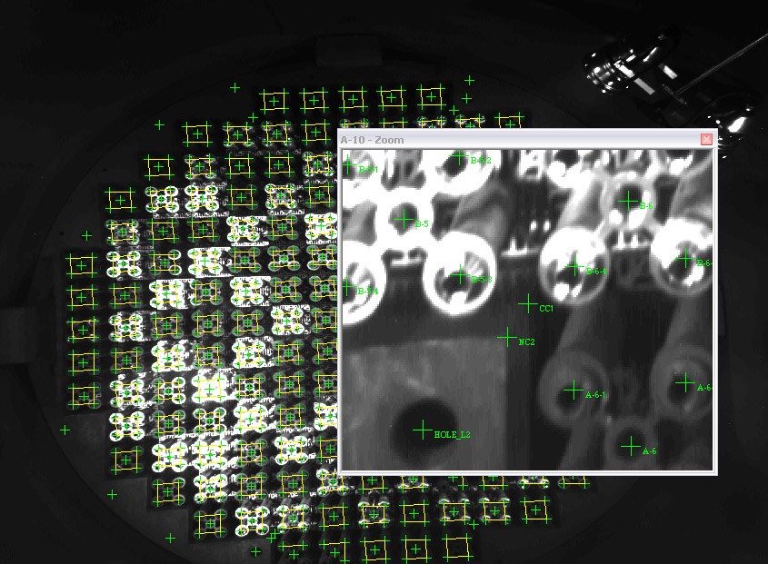
Test Measurement
Corners and holes in the concrete surrounding the cell were measured to provide an external reference frame
The accuracy
of these
points in lower
as they are
“manual”
measurements

Slide 59

Test Measurement
Once XY locations are available, the images are bundled like any normal
photogrammetry network

Slide 60

Test Measurement
The geometry used for the network is shown in the adjacent image
The physical conditions restrict the network geometry
Accepted observations are shown as green lines. Rejected observations are shown as red lines

Slide 61
Test Measurement
The measured corner data was referenced
against the supplied design data for the corners using a best-fit transformation. All points treated equally
Based on this alignment, the deviation for each point could be computed

Slide 62

Test Measurement

Slide 63

Test Measurement

Slide 64

Test Measurement

Slide 65

Test Measurement
Can use Relationships to alter weights and tolerance between new and old plates
Old plates given more weight as their location is assumed to be within tolerance

Slide 66
Concluding Remarks
Despite the difficulties related to working in an underwater, radioactive environment a successful feature based measurement technique was developed
Further work could be undertaken to evaluate underwater measurement on actual retro targets
The lessons learnt on this project will be used to facilitate other underwater measurements in both nuclear and non-nuclear environments

Slide 67

Audience Questions?

Slide 68
Thank You

