Slide 1
Evolving Automation Using SpatialAnalyzer
Ray Ryan
VP

Slide 2
OUTLINE
Varying Degrees of Automation
  SA Functions
  MP/Scripts
  Operator Assisted Process
  Fully Automated Process
Examples
  Relationships for LLNL-NIF
  MPs for Data Management - NIST
  Tool Recertification on A350
  Fuselage Assembly on Global 7000

Slide 3
Varying Degrees of Automation
Simplest – SA Functionality (i.e. Relationships)
MP/Scripts – Set of programmable steps/settings
Operator Assisted – User Interface or SA with prompts
Fully Automated – User Interface with SA in background running without operator required

Slide 4
Simple Automation
SA has ample functions for automating various measurement tasks:
    Auto Measuring
    Relationships
    Pipe Fit Module
    Auto Reporting
    6 DOF Trans-Track
    Machine Calibration

Slide 5
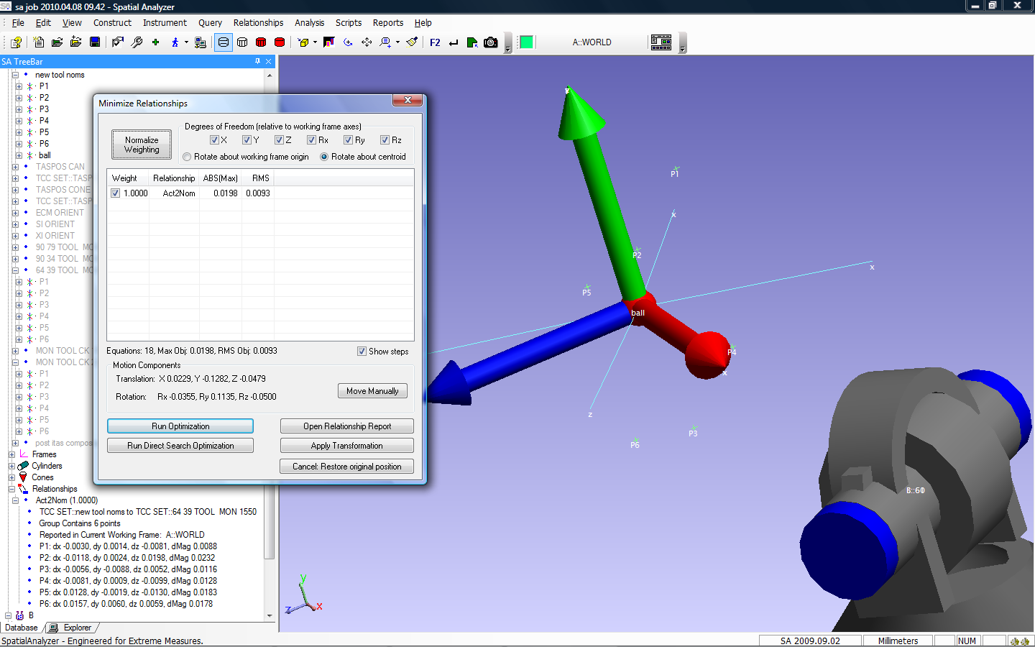
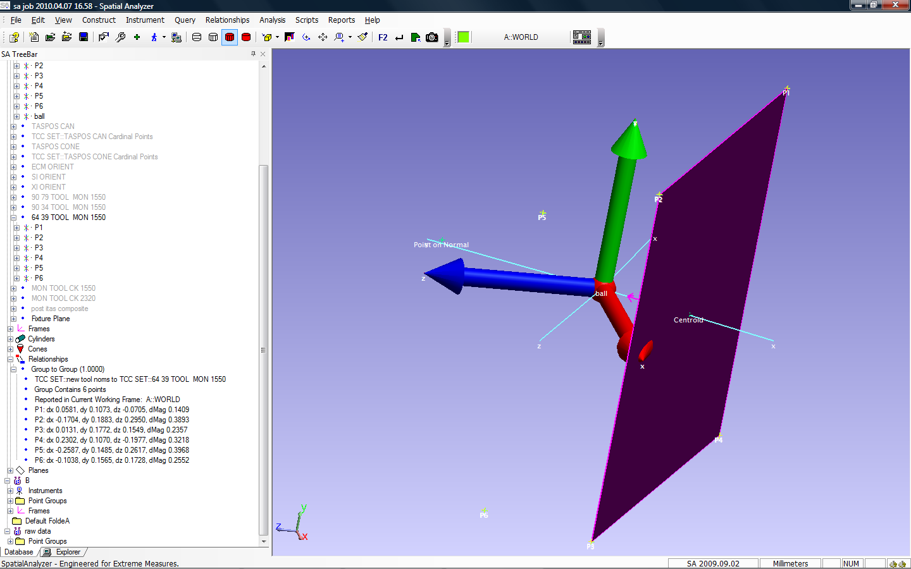
Group to Group Relationship
Initial errors
Final residuals

Slide 6
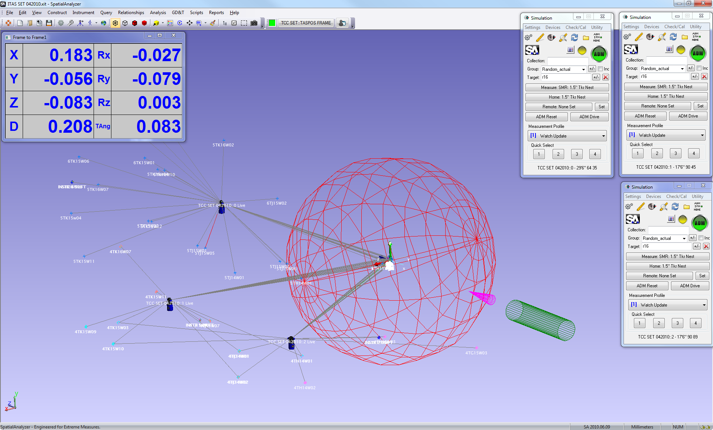
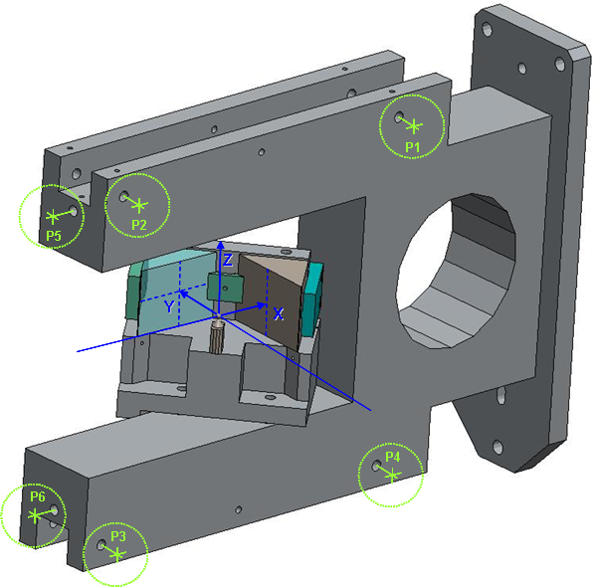
Frame to Frame Relationship

Slide 7
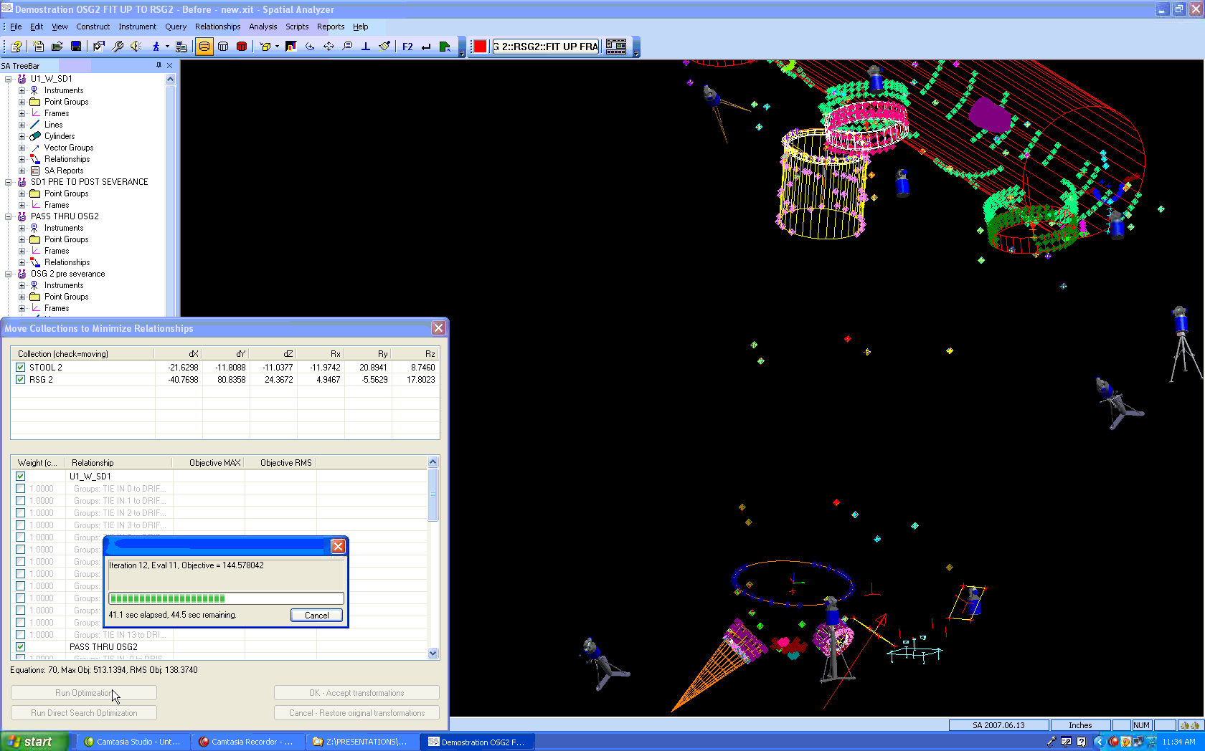
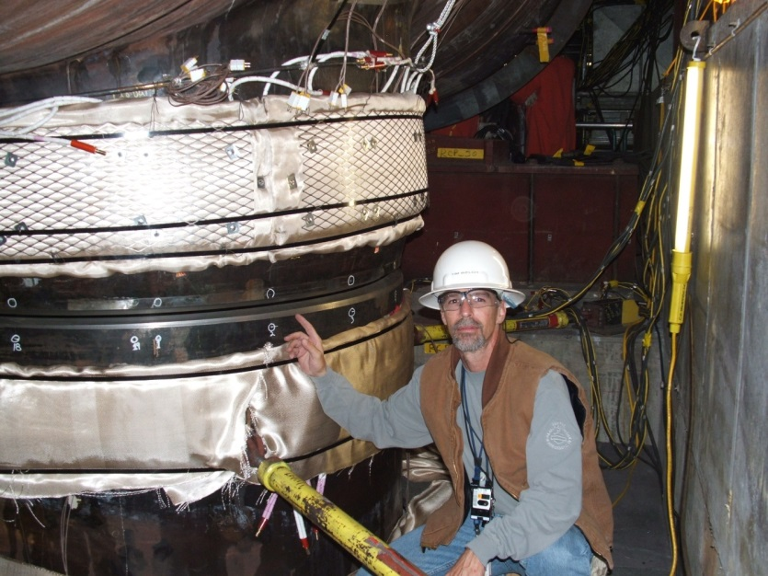
Pipe Fit Module - Relationships
Notes:
This is where Spatial Analyzer is defining the optimal fit.
Here we have one of our steam generators attempting to fit itself to the Primary Heat Transport (PHT) piping and the steam drum. The key features are the inlet pipe, the outlet pipe and the steam drum nozzle. You can see the steam generator model wobble around with each successive iteration. The pipe fit module allowed us to not only align the pipes, but was instrumental in accounting for pipe thickness and angularity.
On the left side of the screen, you can see the program is working through the iterations and trying to arrive at the best fit solution.
By changing constraints, relationships and the weighting of certain features, SA is able to determine the machining cut planes.
Arriving at this solution could take a minute or up to 45 minutes and multiple attempts may also have to be made before arriving at the final result.

Slide 8
Automation using Measurement Plans/Scripts
Increasing level of control of automation
SA User defines the steps and controls the level of complexity
MP is tailored to fit the application or process
Operator interaction can be highly refined
Data can be output to populate other files or to feed information into a auxiliary activity

Slide 9
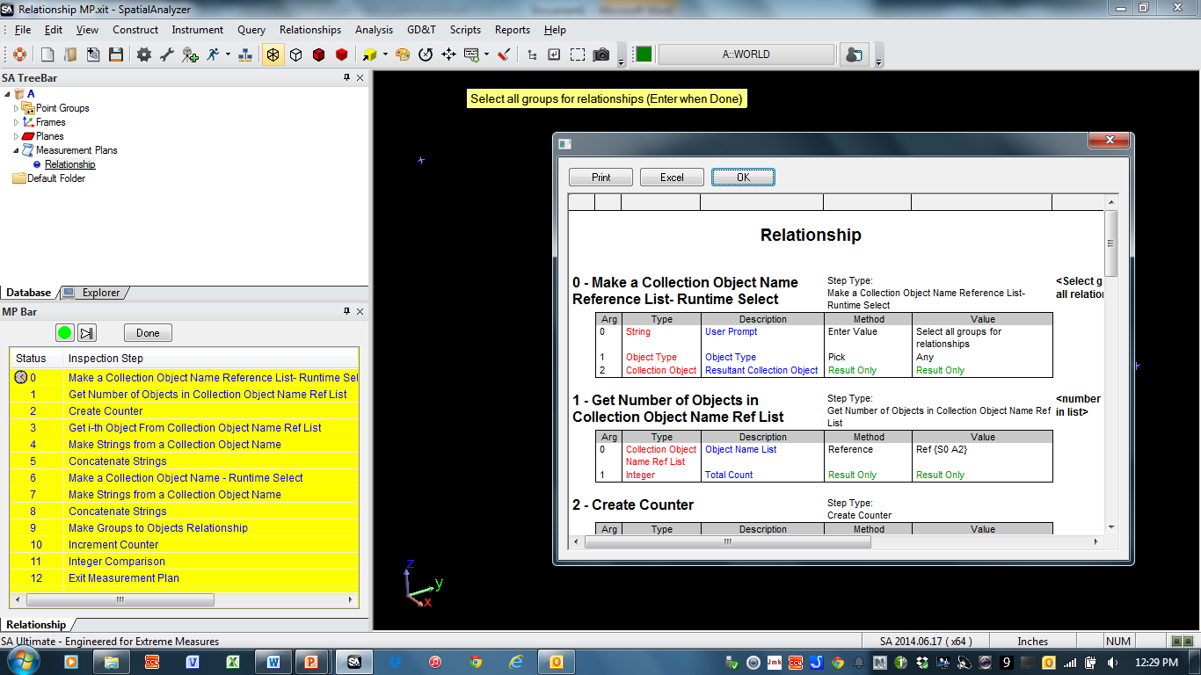
Measurement Plans in SA

Slide 10
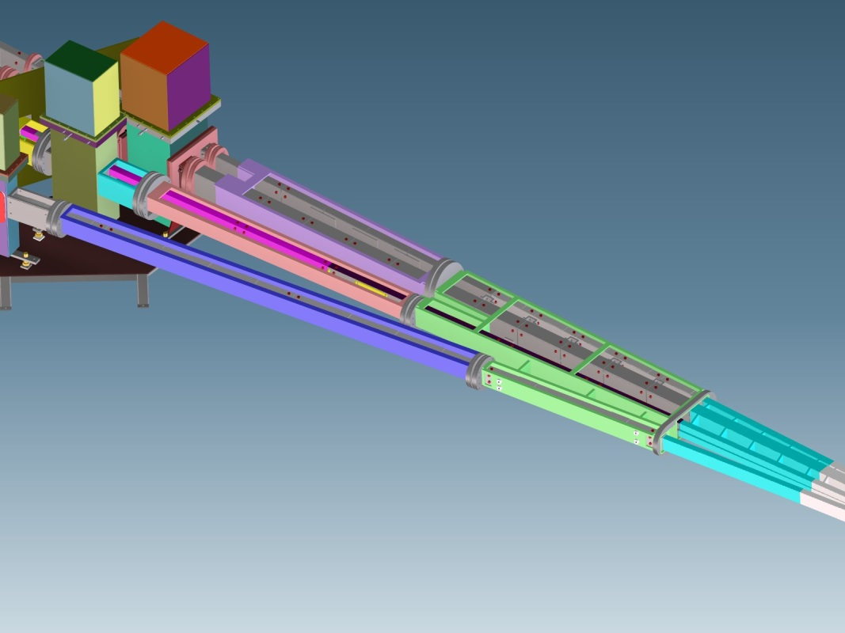
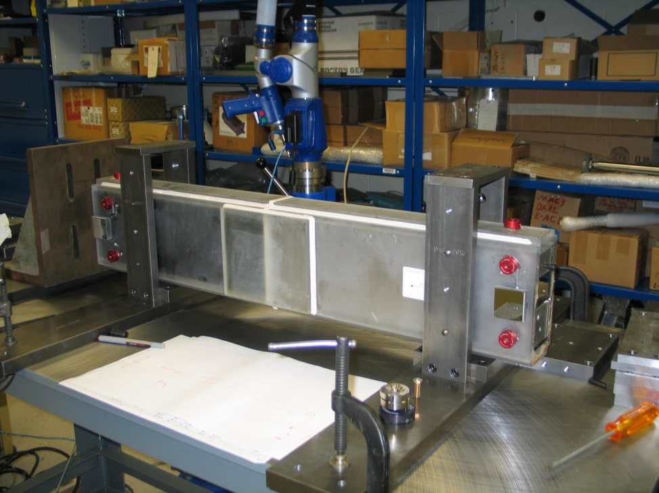
NIST – Neutron Guide Alignment

Slide 11

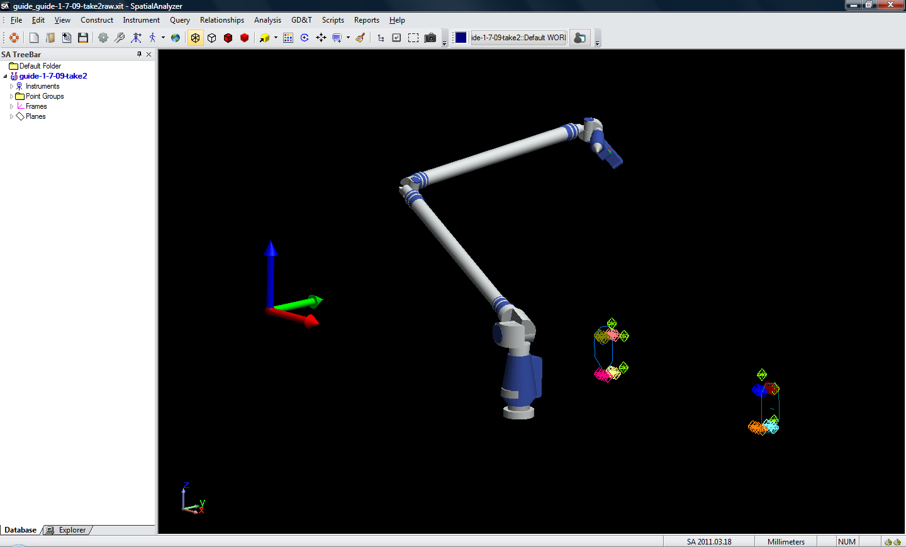
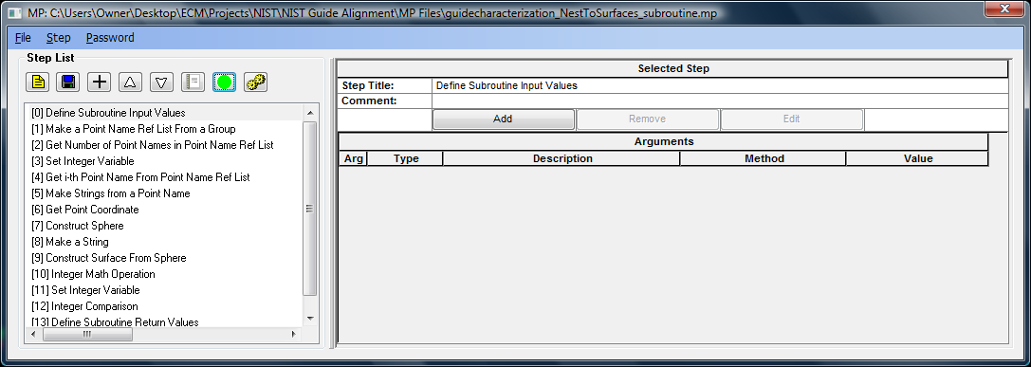
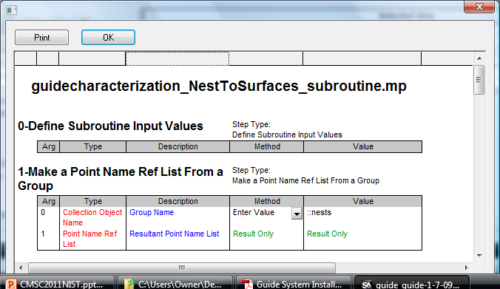
NRK SA with MPs for process automation

Slide 12
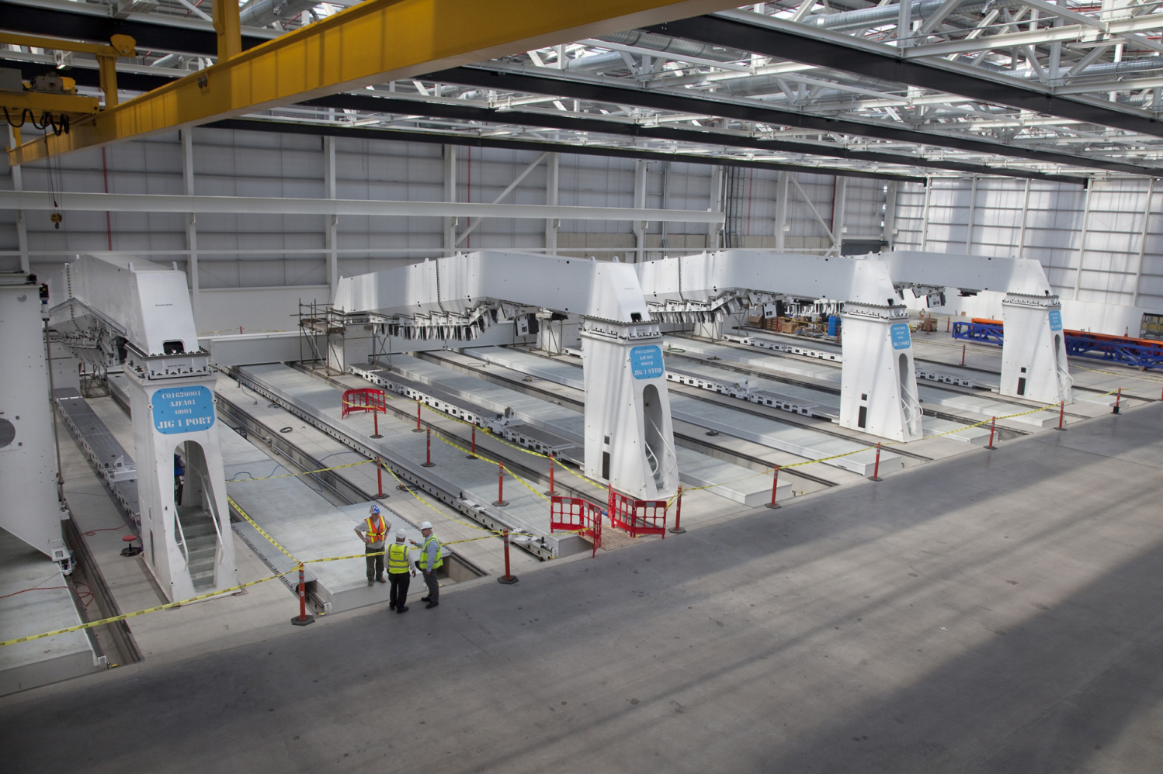
Operator Instructed Task
Airbus A350 Wing Jig Inspection

Slide 13
A350 Rapid Tool Recertification
Task Definition for Automating Measurements

Slide 14
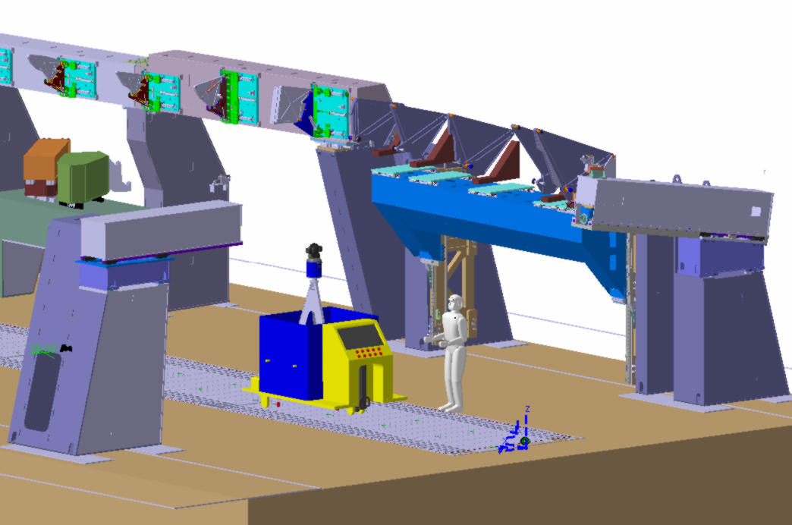
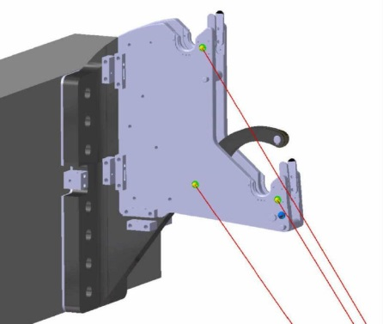
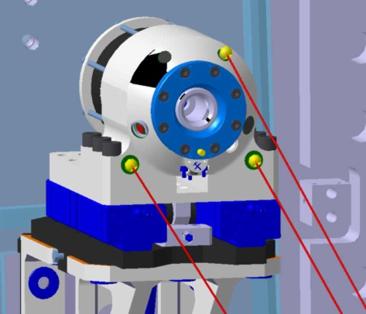

Slide 15
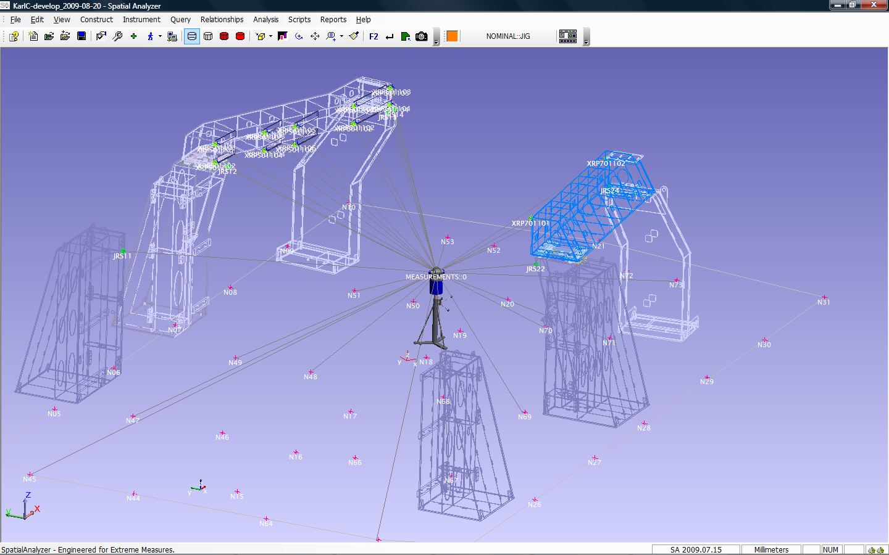
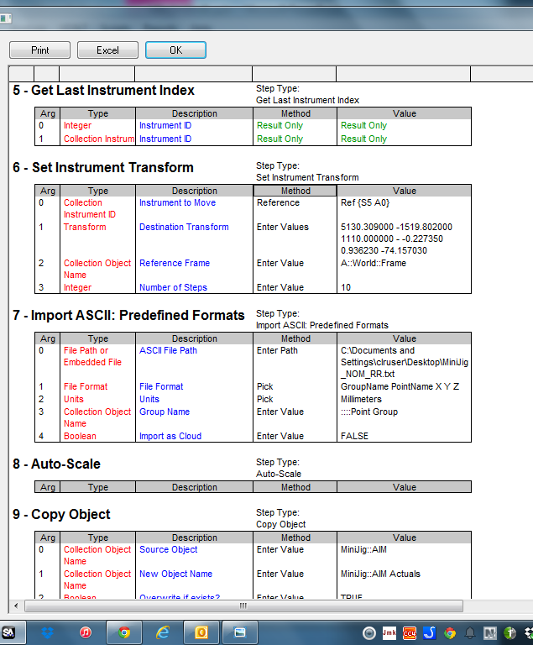
Mini Test Jig for A350

Slide 16
Fully Automated Aircraft Join
Fuselage Assembly of Business Jet
  Join Wings
  Join Center Fuselage to Wings
  Join Fwd / Aft to Center Section
  Align Flight Control Surfaces
Operation Must Not Require Metrologist
User Interface Will Not Show SA Screens
Joining and Measuring Tightly Integrated
Between Siemens Controller and SA
Reporting/Data Storage Automated

Slide 17
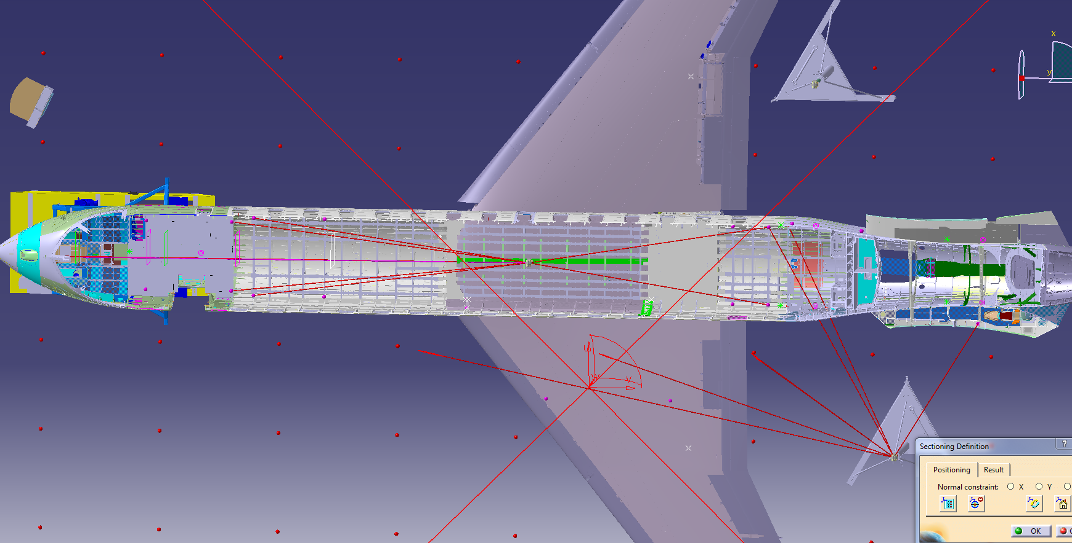

Forward/Aft Fuselage Join

Slide 18
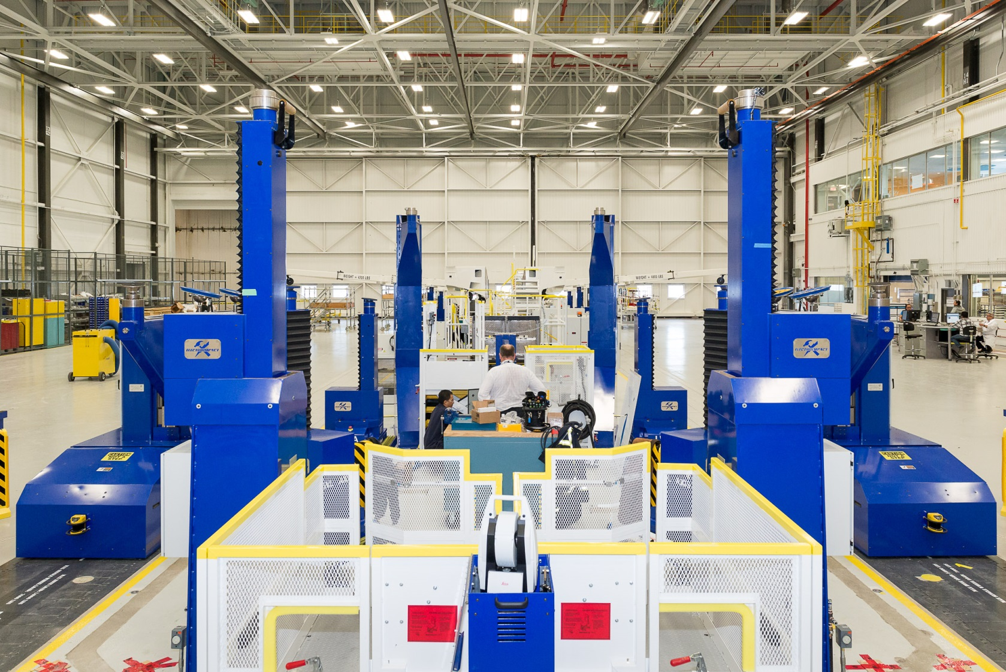
Join Station with Controllers

Slide 19
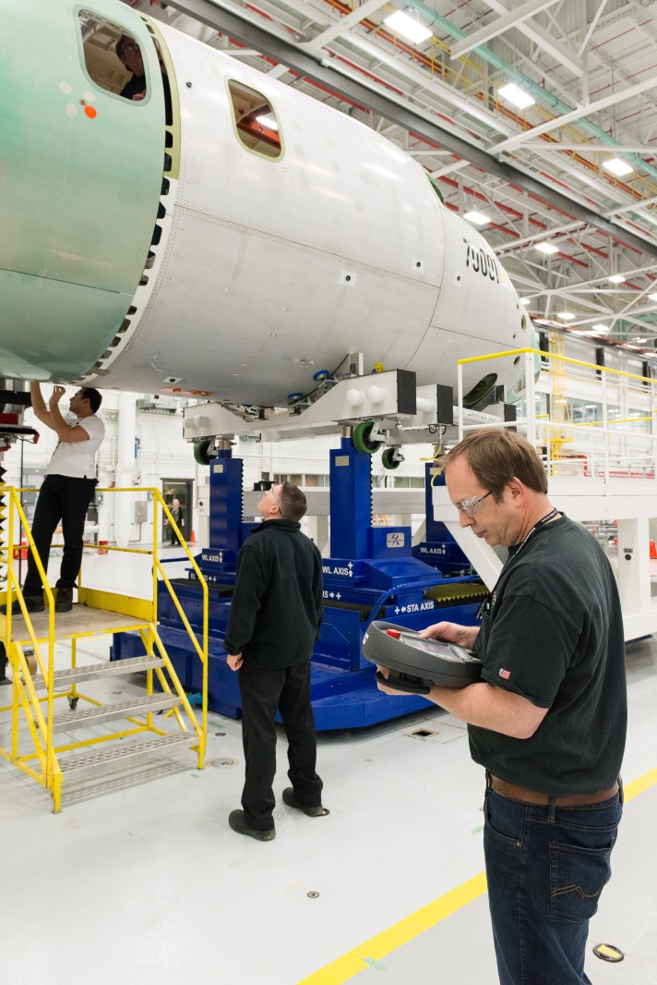
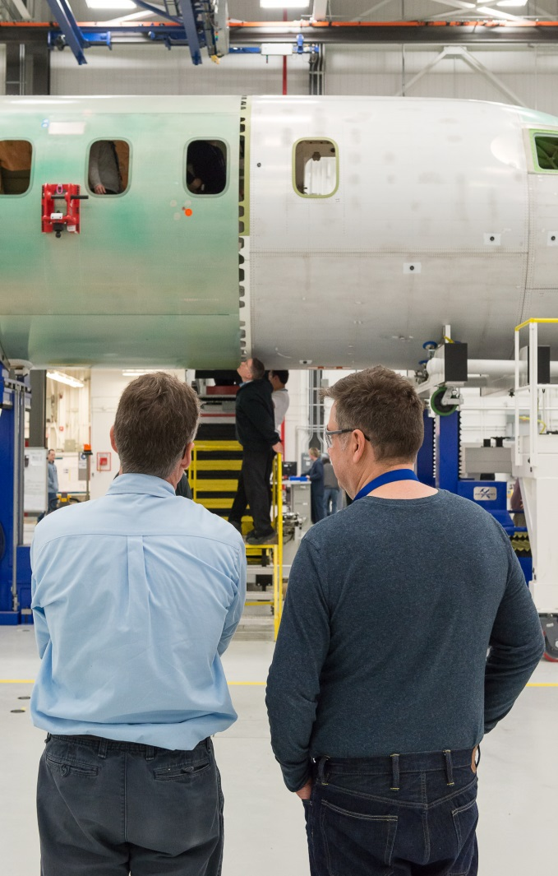
Test Join AC #001

Slide 20
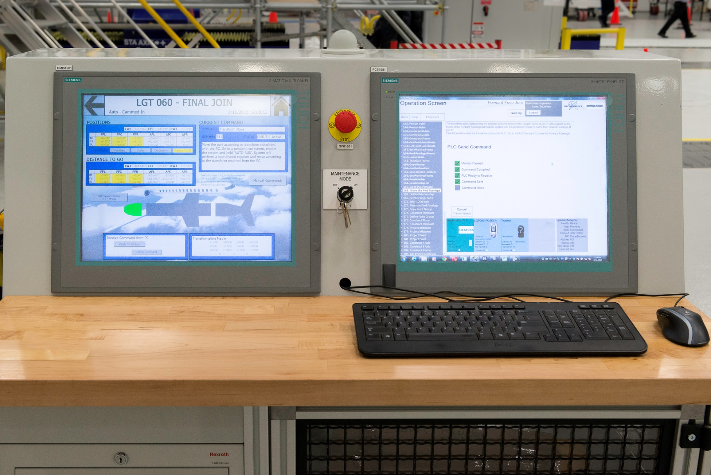
Automated Workstation

Slide 21
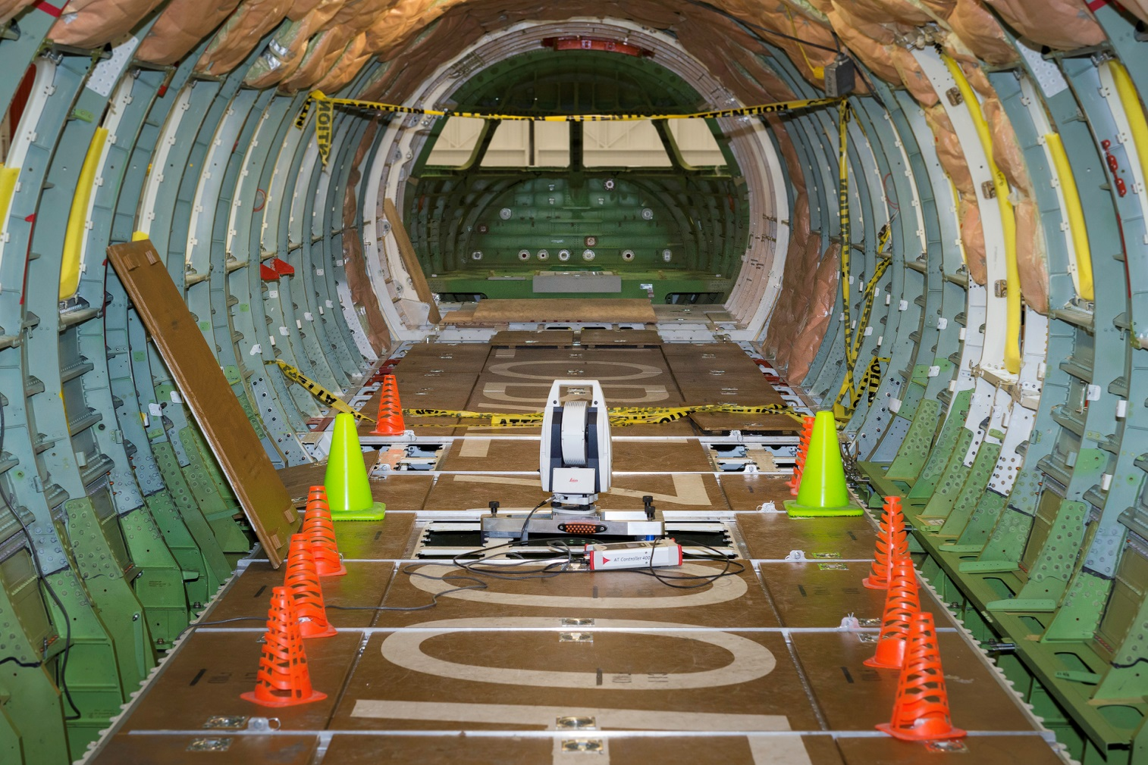
Global 7000 Interior During Join

Slide 22
Final Thoughts on Automation
Automation can be as simple as defining a relationship or using an existing function
The flexibility of SA allows users to begin with existing functions and mature to develop highly efficient and capable MPs or coded programs
The level of automation is dictated by the necessity to repeat a process and the skill of the operators performing the tasks
Many of the tasks initially attempted using some of SA’s built in functions can be upgraded to either partially or fully automated measurements and alignment activities.

