Slide 1
Advanced
SpatialAnalyzer
Steve Seiler
Applications Engineer
Ashley Woolard
Director of Training
Notes:
Welcome and Introduction

Slide 2
Temperature
Compensation
USMN
Relationships
Auto
Measure
Q&A
Notes:
Topics to be discussed with a few minutes at the end for Q&A.

Slide 3
Auto Measure
Decrease measurement time
Increase simplicity of locating
precise measurements
Multi-Pass
Geometry Triggers
Proximity Triggers
Notes:
Using SA’s auto measure capabilities, users can save a great deal of time during measurement. Here are a few easy shortcuts that will help you accelerate measurement processes as well as simplify the process of locating measurements precisely.

Slide 4
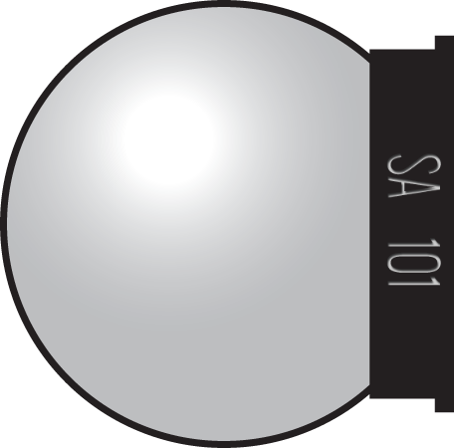
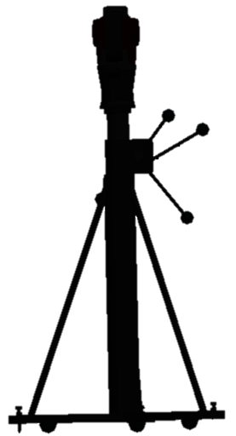
Multi-Pass
Notes:
The first technique is to use what we call Multi-Pass. While measuring the same features repeatedly at regular intervals over an extended time period can be useful for part evaluation, it can be a time consuming and tedious process. Luckily, we have a built-in tool that allows known targets to be measured repeatedly at regular intervals without any user interaction.
To start, set out known targets and measure them once in a single point group. Then go to Instrument> Automatic Measurement>Auto Measure and select the point group and the instrument you want to use.

Slide 5
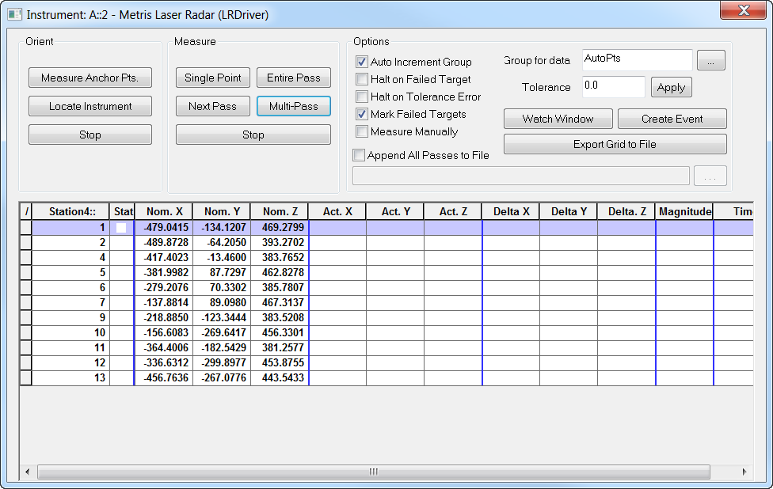
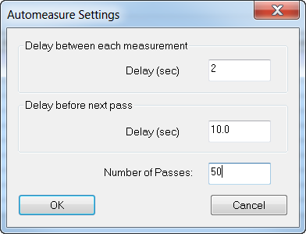
Multi-Pass
Notes:
The keys to automation here are two fold. First, in addition to measuring the individual points in SA, a complete record of every observation can be recorded in a separate text file as you go (this file can be directly imported into Excel for additional analysis).
[CLICK] Second, the Multi-Pass button allows you to repeat the measurement process at regular intervals. You can specify a delay time between individual shots and between entire passes for the points in the group to be measured. This makes it easy to automate the measurement process for any number of iterations. This method can be applied to any instrument that can be robotically pointed at a target such as a tracker or total station.

Slide 6
Notes:
This demo will illustrate how to set up a multi-pass measurement of several points with a laser tracker.

Slide 7
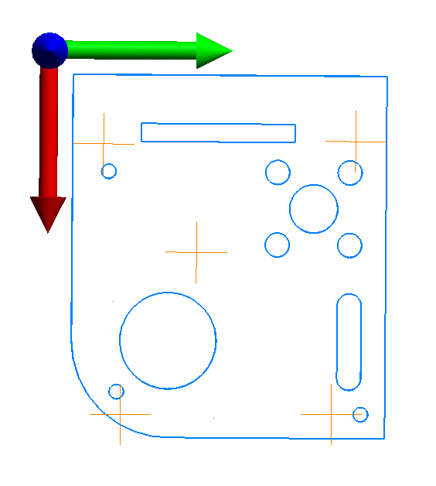
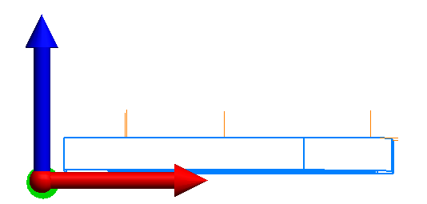
Auto-Correspond to Proximity Triggers
Notes:
If you have nominal points that are laid out on a CAD model and you need to zero them out for measurement, you can save time by using the proximity triggers feature rather than zeroing out each point in a watch window.
For instance, let’s take these five points and say that you need to measure them to with an SMR and flat nest.

Slide 8
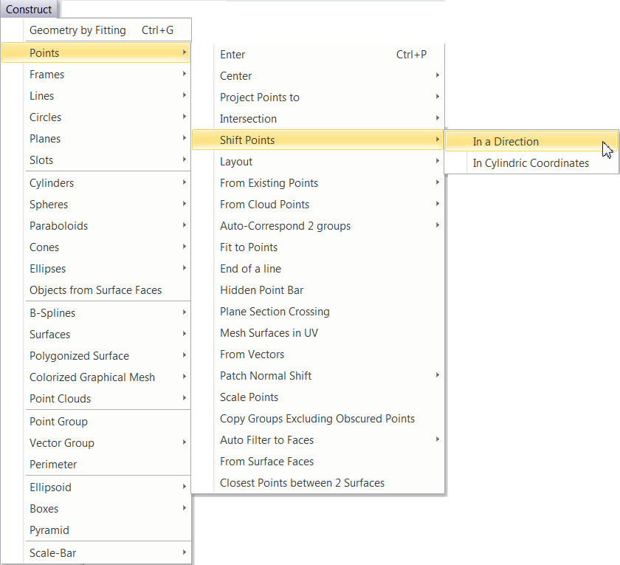
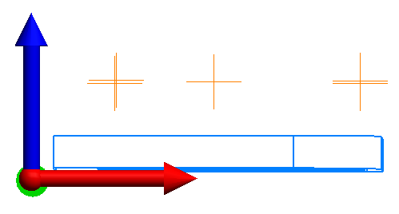
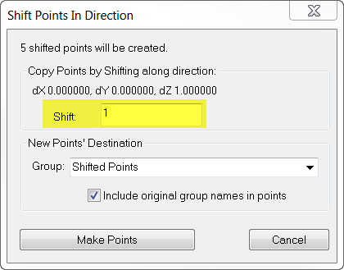
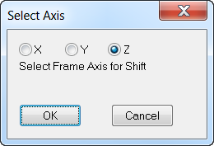
Shift Points to Probe Center
Notes:
The only thing you would need to do is shift these points to the probe center so that when the SMR and flat nest crosses over them, it will take a point.

Slide 9
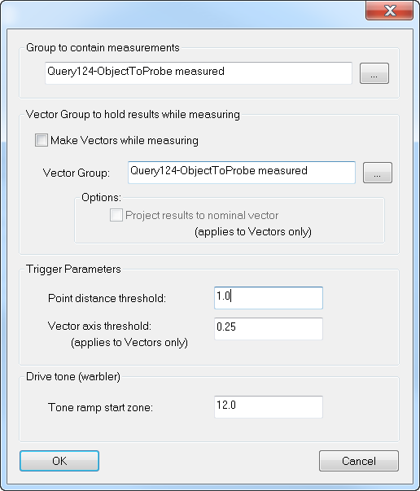
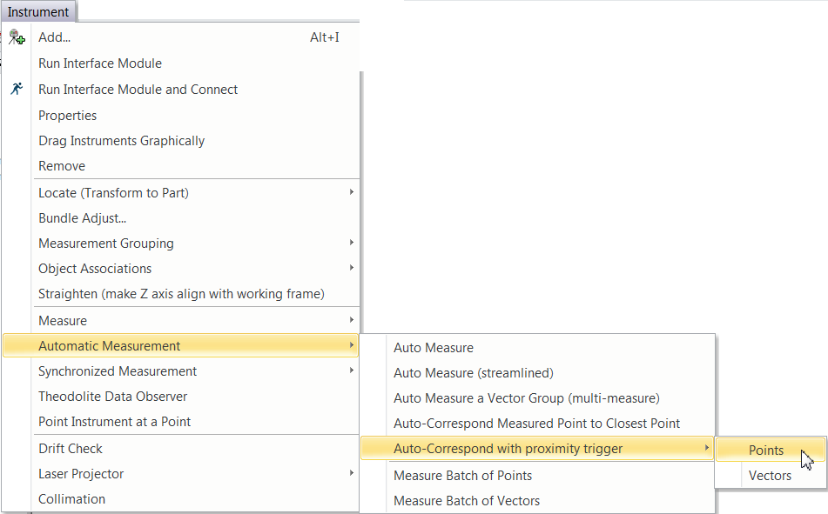
Auto Measure Points
Notes:
Once you are ready to begin the measurement routine, you can select Instrument>Automatic Measurement>Auto-Correspond to Proximity Trigger>Points.

Slide 10
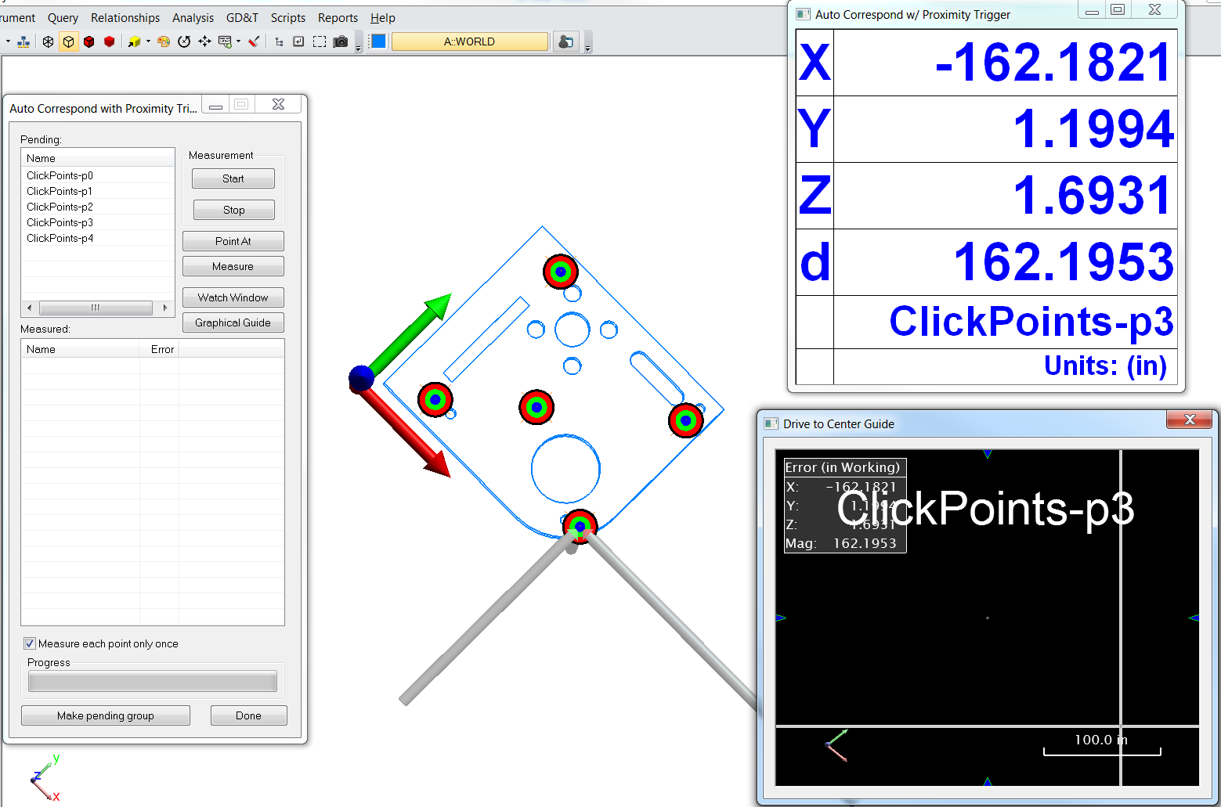

Slide 11
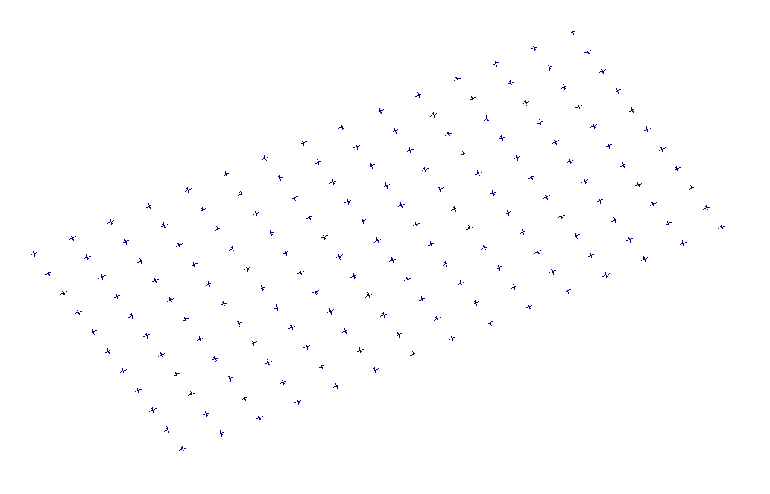
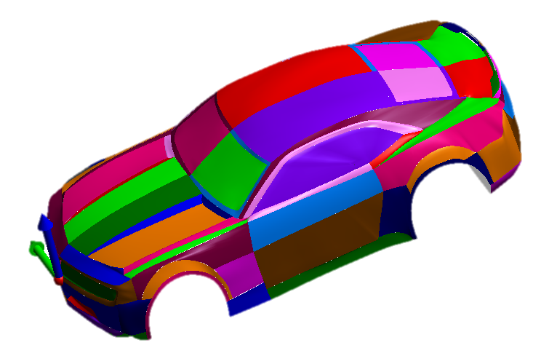
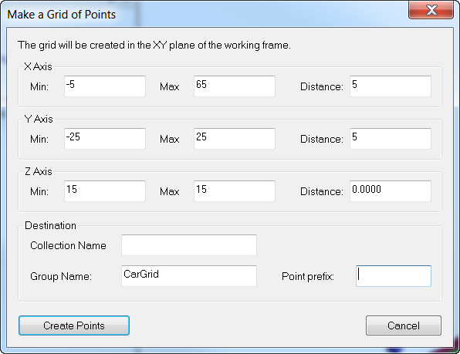
Proximity Triggers on a Curved Part
Notes:
A great way to evaluate a curved part is to lay out a grid across the part and measure at each point on the grid. Doing this by hand with a watch window is time consuming, but you can make it easier by integrating a proximity triggered auto measure routine. To do so, build a grid of points on your part at the density you would like to use, then use Construct>Points>Layout>Grid by Distance overlaying your curved part.

Slide 12
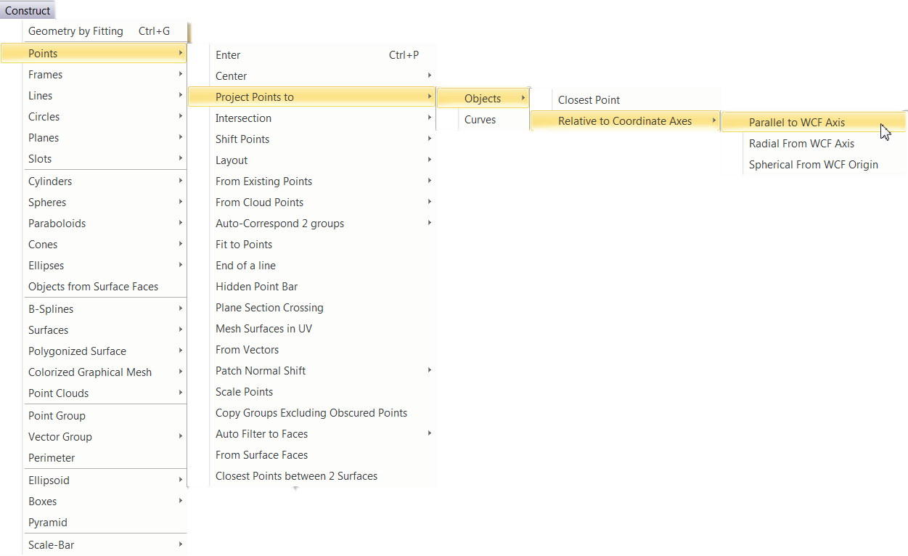
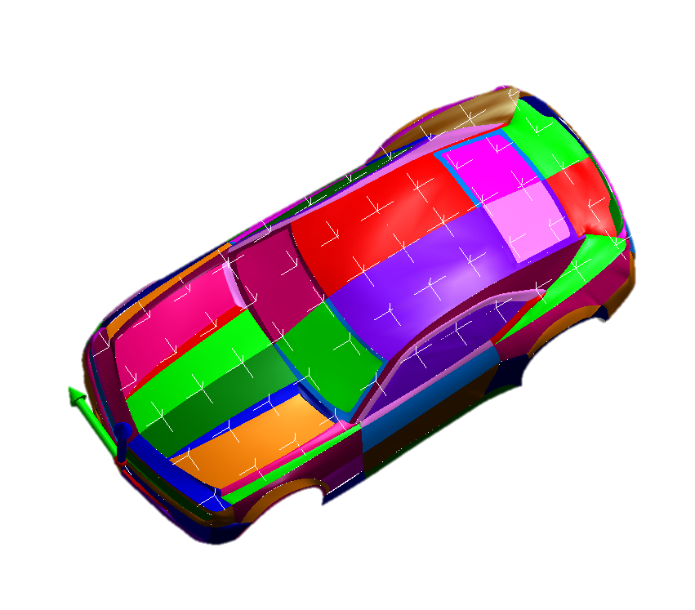
Project Points to Surfaces
Notes:
Next, project those points down onto the part using Construct>Points>Project Points to>Objects>Relative to Coordinate Axes>Parallel to WCF Axis. This will build a perfect XY grid of points projected onto the CAD model, which can be used to trigger measurements when a probe gets close.
(Target icon radius has been increased for visual)

Slide 13
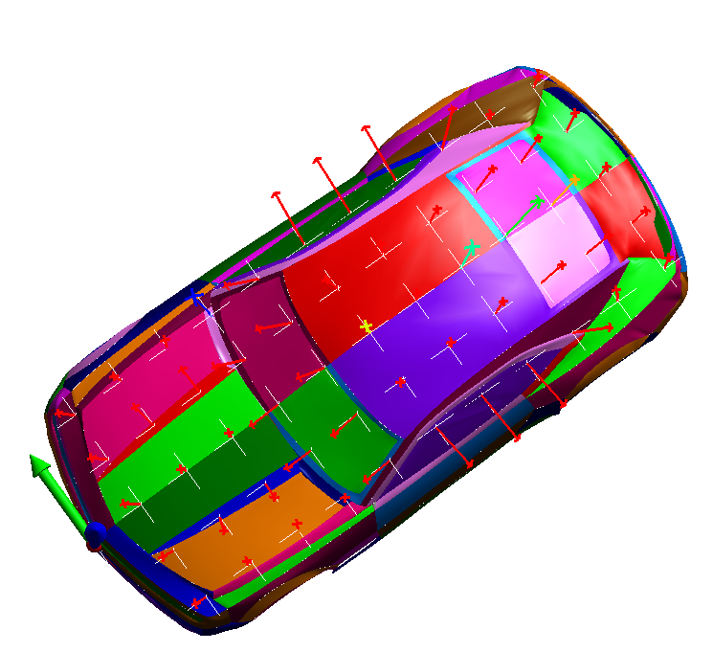
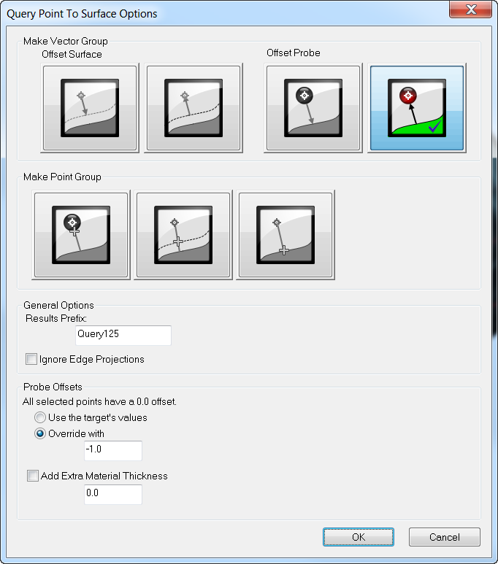
Querying Points to Objects
Notes:
Occasionally, irregularities in a part can make it hard to get close enough to a nominal point to trigger a measurement. To avoid this problem, build a vector group from these grid points by going to Query>Points to Objects and overriding the probe offset to -1. This will create a uniform set of vectors at each point location with normalized vectors extending outward from it. You can then use the vectors to trigger your measurements rather than the points. This allows you to trigger measurements when you get within a proximity to the vector axis, eliminating any issues of getting close enough to the points you want to measure.

Slide 14
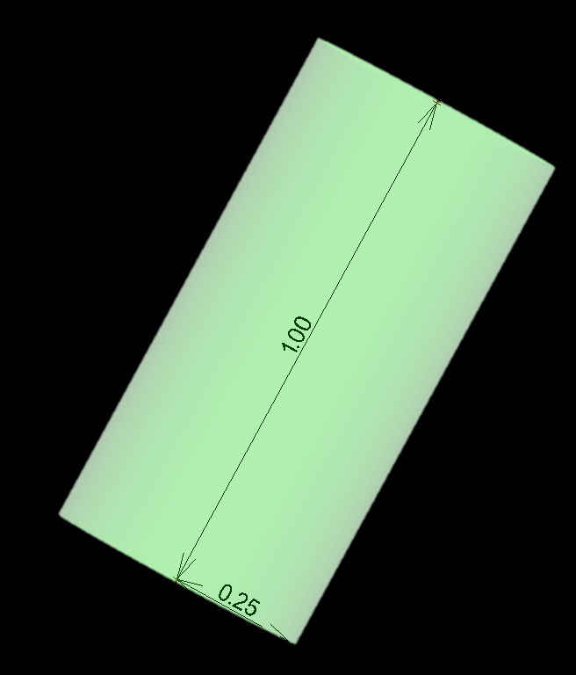
Vector Trigger Parameters
Notes:
Once you are ready to begin the measurement routine, you can select Instrument>Automatic Measurement>Auto-Correspond to Proximity Trigger>Vectors. The proximity trigger zone for vectors is defined as a cylindrical region with a length equal to the Point Distance Threshold and the width equal to the Vector Axis Threshold. Fine control of both the length and width of the trigger allows you to precisely trigger points, even in tight regions or slots between adjacent CAD surfaces.

Slide 15
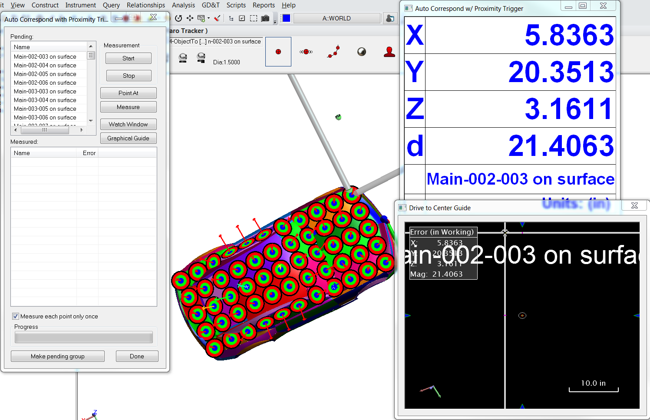
Notes:
Once the routine starts, you can simply run a probe over the part and it will automatically trigger measurements for specific locations every time you get within the trigger distance threshold. Ticking off points’ locations as you go keeps track of points that have been measured and those that still need to be taken. Once the majority of the points have been measured, you can bring up a Graphical Guide window that will help you navigate precisely to the remaining locations, finishing a precise grid measurement of a part.

Slide 16
Notes:
This demo will show auto-proximity trigger measurements using vectors on a curved part.

Slide 17
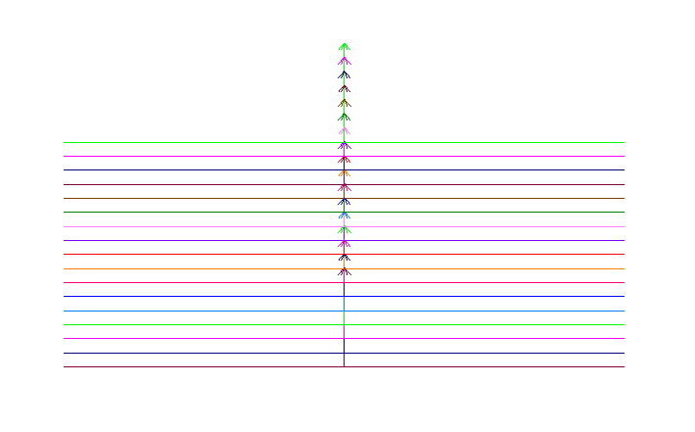
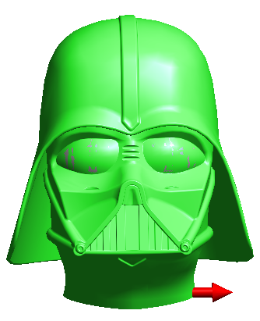
Geometry Triggers
Available in both tracker and arm interface.
Continual point scan mode
Layout geometry in symmetrical manner
Scrub part for clean cross-section measurements
(not necessarily used for measuring)
Notes:
Geometry Triggered Points available in both the tracker interface and arm interface provide not only a unique measurement tool, but also a sophisticated way to layout geometry in a symmetrical manner.
The idea behind Geometry Triggers is that the instrument is placed in a continual point scan measurement mode. The current position of the probe is monitored and points are only sent to SA when the probe crosses predefined trigger geometry. The simplest case is a series of planes laid out along an axis down a part. With these planes defined, you can scrub your part with the probe and get clean cross-section measurement divided evenly in separate point groups for each plane.

Slide 18
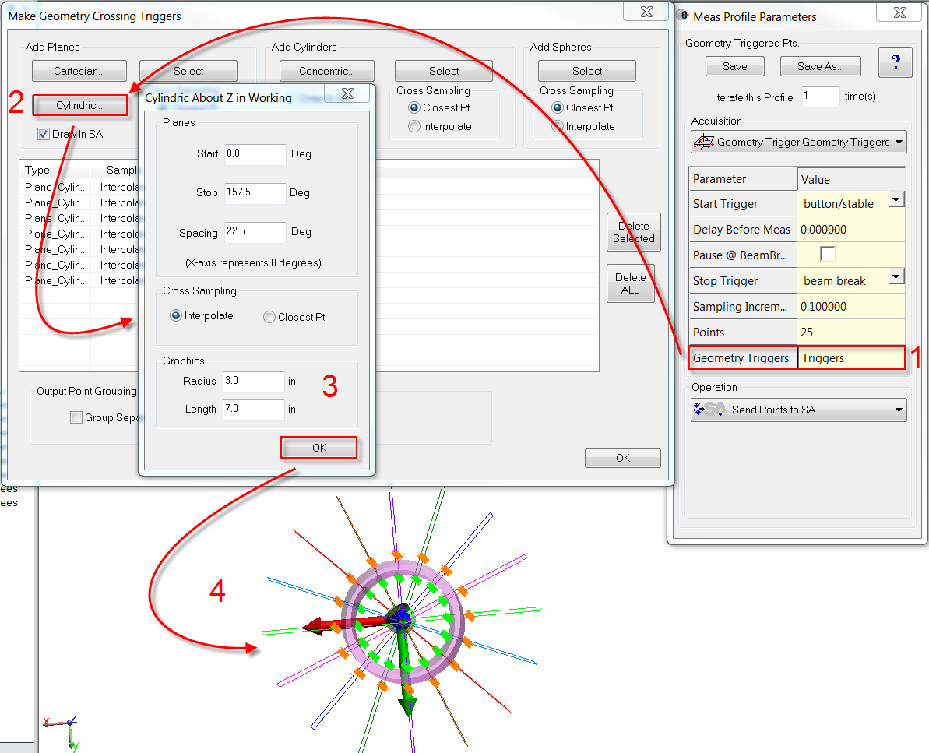
Notes:
This same concept can be applied to planes laid out radially or cylinders laid out in concentric rings.
Simply select the Measurement Profile Geometry Triggered Pts. and select the Geometry Triggers column in the Acquisiton Mode.
This will display the Make Geometry Crossing Triggers dialog. Select the type of triggers you would like to set (Planes or cylinders). This slide shows the cylindric plane parameters.

Slide 19
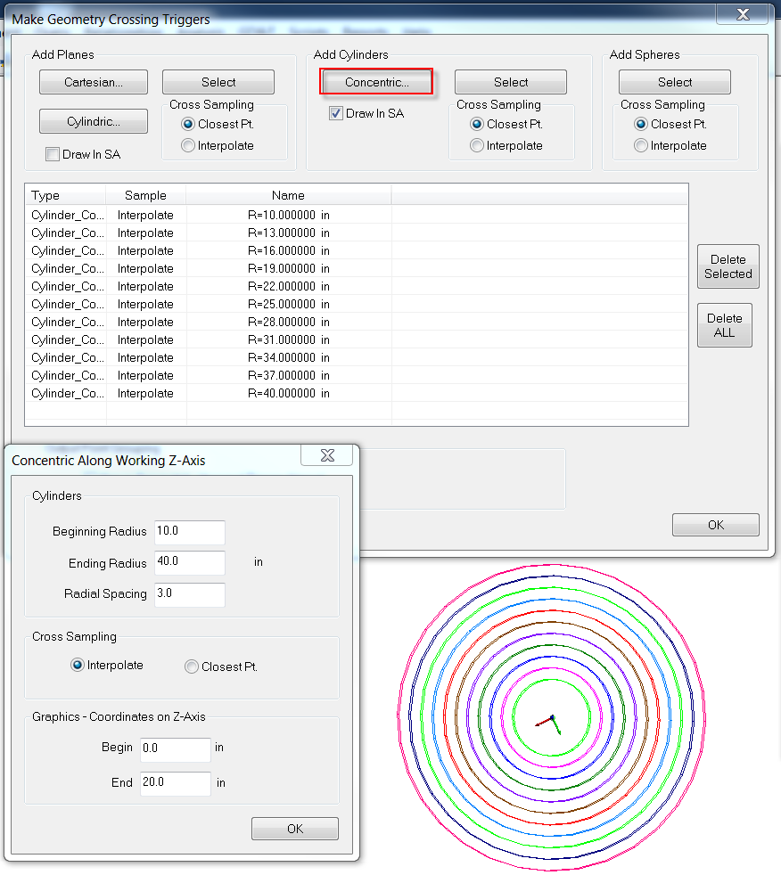
Notes:
And this slide shows the Concentric Cylinder parameters.
The hidden advantage to this profile is that it provides an easy to way to build geometry in SA. If you ever need to lay out a series of planes or cylinders at regular intervals, there is no better way to build them than to use Geometry Triggers Profile to define the geometry within it. By clicking the Draw In SA button, this geometry is sent to SA and can be used for a variety of applications.

Slide 20
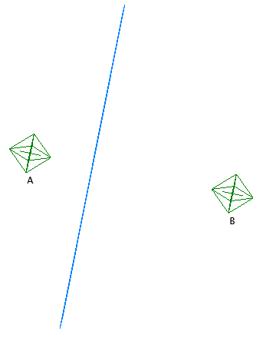
Interpolate
Closest Point
Notes:
Interpolate means that even if a point may not have been measured directly on a cross section, a point will still be placed on the cross section.
Closest Point means that the closest point measured near the cross section will be used, so in other words, it will use a raw measurement.

Slide 21
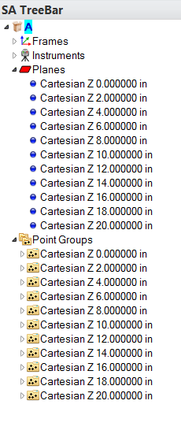
Output Point Grouping
Notes:
It is also important to note the ways in which SA can group the output points. There is a section at the bottom of the Geometry Triggers dialog titled “Outpoint Point Grouping”. By default, this option is checked, which means that it will group each trigger separately..
[CLICK] as you can see here in the tree. All of the points for each trigger are grouped together, but in separate point groups and they take the name of the geometry.
If you wish to group all of the points in the same point group, then make sure this option is unchecked before you begin measuring.

Slide 22
Notes:
This demo will show cross-sections on the hydroplane using planes laid out along the X axis.

Slide 23
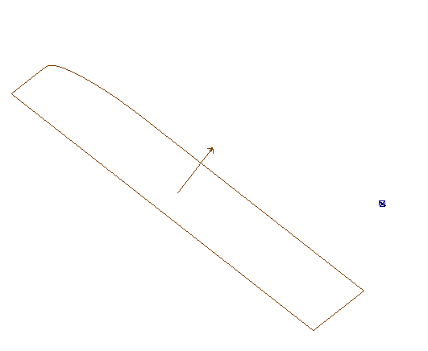
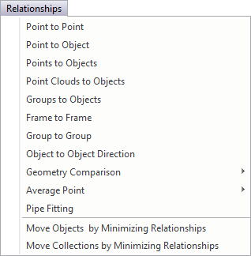
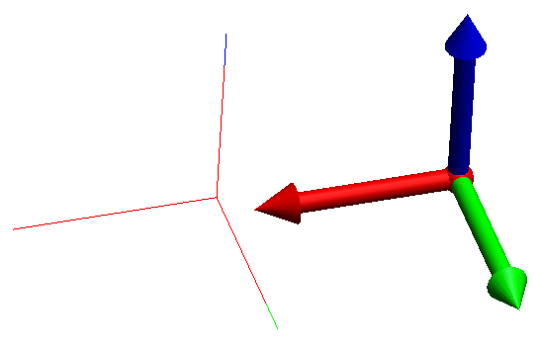
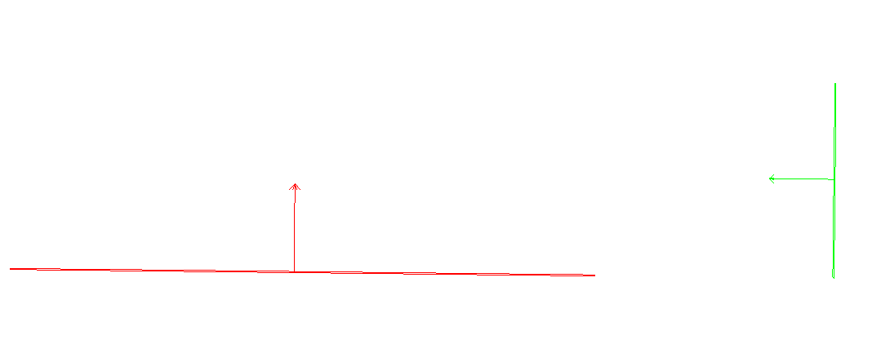
Relationships
Notes:
You probably already know that relationships are similar to queries in that they provide a deviation from one point, group, or object to another. There are many to choose from such as:
[CLICK] Point to Point
[CLICK] Point to Object
[CLICK] Object to Object Direction
[CLICK] Points to Object
[CLICK] Frame to Frame

Slide 24
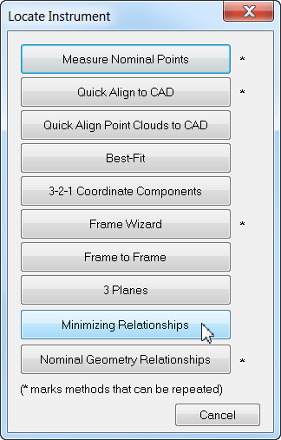
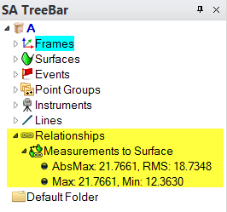
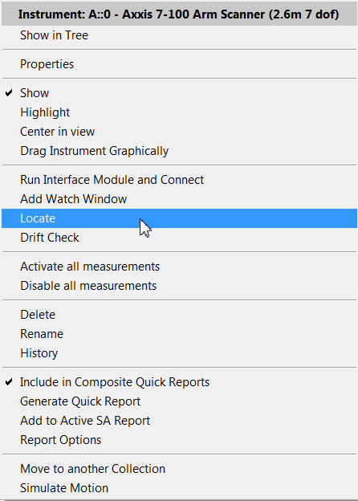
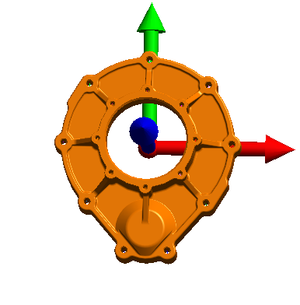
Minimizing Relationships
Notes:
You also probably know that relationship optimization is the capability to find a position in space where you can no longer move the instrument and reduce the overall distance of your points to the object.
[CLICK] If the object, such as a CAD model, is located in the global coordinate system, but the points are not, these relationships (or distance measurements) can be used to move the instrument so that the instrument’s coordinate frame is aligned with the larger coordinate system.
This probably sounds like classic surface fitting to you, but relationships have so much more functionality than that.

Slide 25
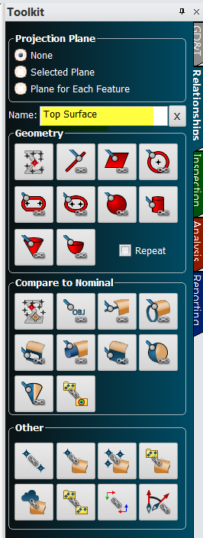
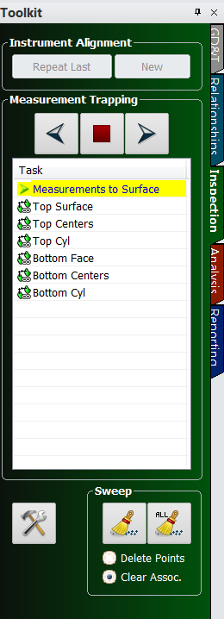
Building Relationships
Notes:
Relationships can be built before or after you make your measurements. Using the Relationships tab in the Toolkit bar, you can quickly build a relationship,
[CLICK] and then trap measurements by double-clicking on the relationship in the inspection tab.
Alternatively, you can right-click on the relationship in the tree and select Associate Data, and then select the points or groups you want to use in the relationship.

Slide 26
Advanced Properties
Auto Vectors
Outlier Rejection
Fit Weight
Degrees of Freedom
Fit Constraints
Notes:
There’s so much more than just building relationships and minimizing them. There are several properties that we are going to discuss and they are:
The ability to turn on auto-vectors which give you a magnified visual of your deviation as the relationship is minimized.
[CLICK] Outlier Rejection: having stray points or accidental measurements automatically ignored.
[CLICK] Fit Weight: weighing relationships based on the number of points in each and tolerance widths.
[CLICK] Degrees of Freedom: constraining degrees of freedom between iterations.
[CLICK] Fit Constraints: forcing a fit between specified limits.

Slide 27
Auto Vectors
Points/Groups to Objects relationships
Dynamic
Magnified visual indicator
Notes:
If you have either a points or groups-to-objects relationship, you can right-click on the relationship in the tree, go to the relationship properties, and turn on Automatic Vector Group.
This vector group will update continuously as you move your instrument or take additional measurements, and it will give you a magnified visual indicator of the distance each measured point is from the part.

Slide 28
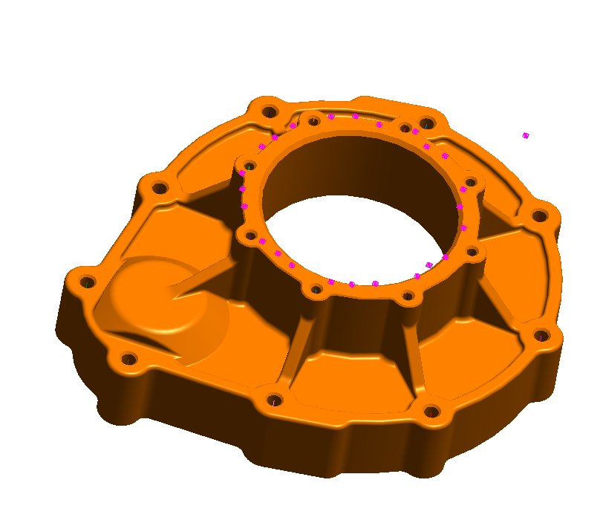
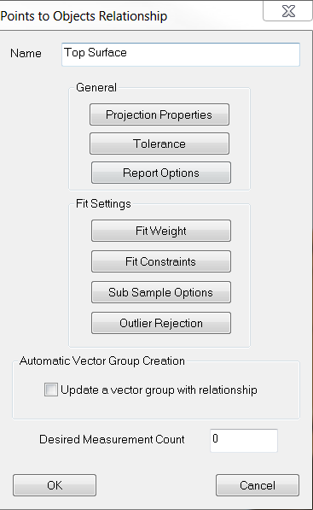
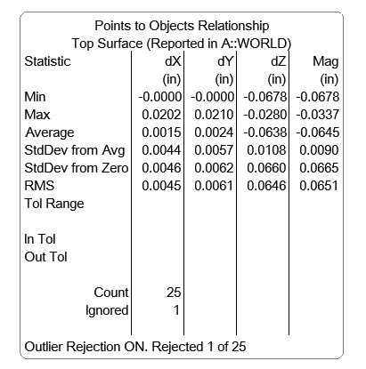
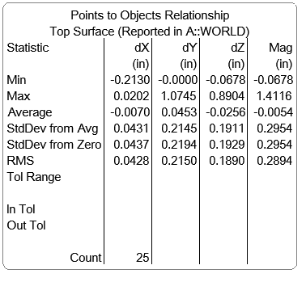
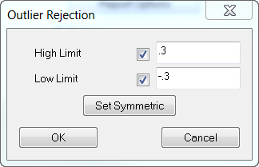
Outlier Rejection
Notes:
Stray points such as accidental measurements can cause your deviations to be considerably higher than normal.
[Click] Under the fit setting for the relationship, there is an option to turn on Outlier Rejection, which automatically removes outliers from your data set.
[CLICK] Once activated, points that are beyond a predefined high and low tolerance will be excluded from the fit solution so they don’t throw off your fit. [CLICK]

Slide 29
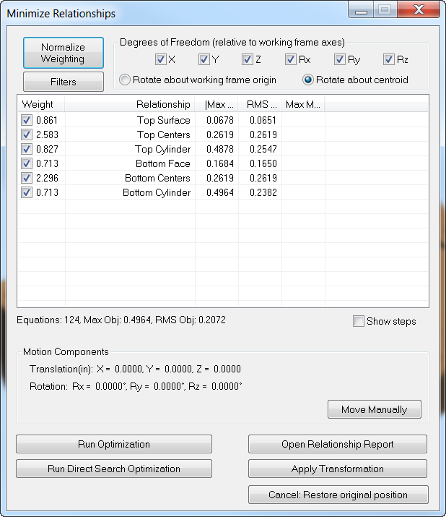
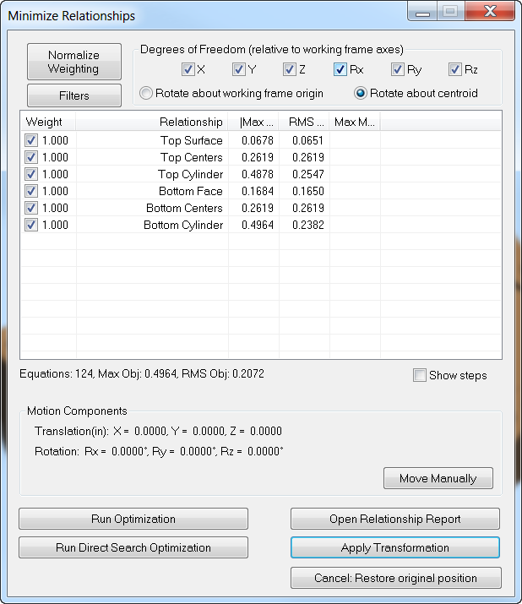
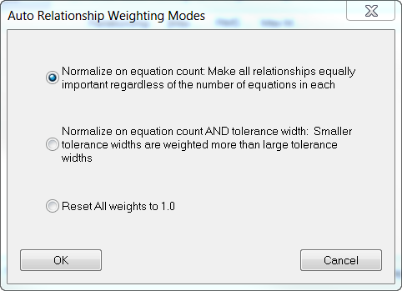
Fit Weight
Notes:
With SA Ultimate, you have even more options at your disposal for relationship fitting. [CLICK] You can build multiple relationships and evaluate them all at the same time. SA provides a number of useful ways to determine which relationships have the most influence on the resulting fit.
[CLICK] The influence of each relationship is determined by the Fit Weight. By default, each point in each relationship has the same influence on the fit (just as if you were fitting all the points to the model at the same time in a single relationship).
[CLICK] If you want each relationship to have the same influence on the fit, regardless of the number of points in the relationship, use the Normalize Weighting button on the top of the Minimize Relationships dialog.
[CLICK] This gives you the ability to normalize based on the number of relationships, the combination of the number of relationships and their assigned tolerances, or simply by the number of measurements.
[CLICK] You can now see here that each relationship now has an equal influence in the fit, regardless of the number of points.

Slide 30
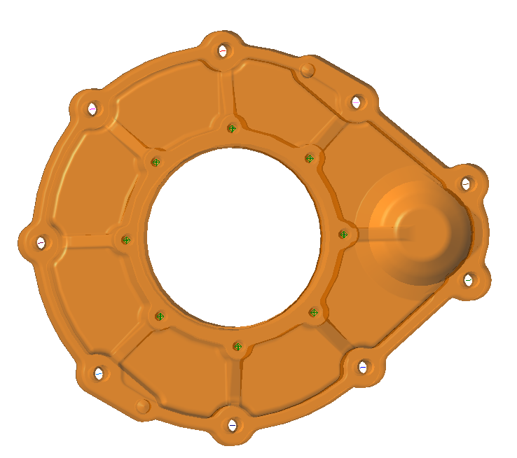
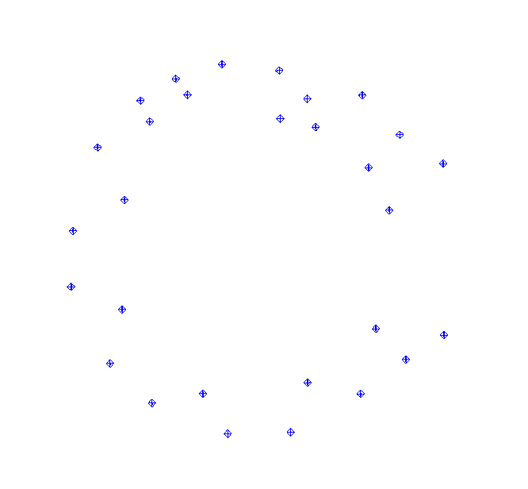
Weight Normalization
Hole Centers
8 points
Weight = 1.0
Weight = 1.0
Bottom Face
24 points
Notes:
Just to make sure that you understand that a Fit Weight of 1.0 does not mean that each relationship has the same influence, let’s use two of these relationships from this job as an example. The first relationship is that of the measured holes to the hole centerlines. This relationship has 8 points in it.
[CLICK] The next relationship is fitting the points measured on the larger face to the CAD model, and it has 24 points in it.
[CLICK] Although they both have the Fit Weight set to one, the bottom face will have more influence in the fit than the hole centers because it has more points. Three times more points in fact, so it has three times the influence.

Slide 31
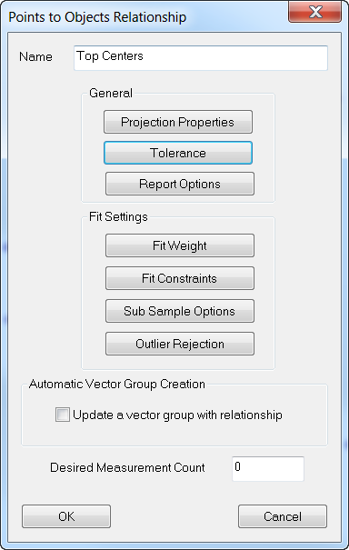
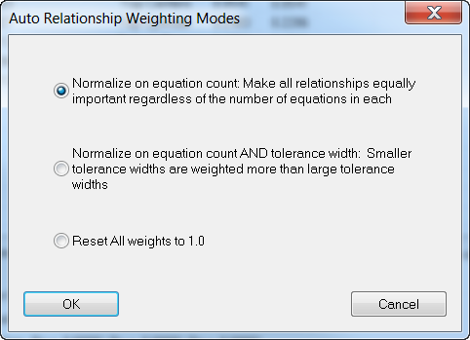
Tolerances
Notes:
Many jobs have different features that have different tolerances, some features being much more criticial than others. For instance, the hole centers to their respective centerlines may have a tolerance of +/- .002” whereas the surface points may only need to fit within +/- .02”. [CLICK] Tolerances for each relationship can be added by right-clicking on the relationship.
[CLICK] Once you set the tolerance, then this automatically populates for your auto vectors as well (if you create them).
[CLICK] The normalize weighting dialog also gives you the option to have the relationships with tighter tolerances to be given more influence in the fit than those with looser tolerances.

Slide 32
Degrees of Freedom
Key Fit-Up Features
Hinge Points
Top of Door
Jamb Face
Notes:
Relationships, by their very nature, automatically take care of constraints when they are created. Different geometric setups will result in different constraints.
[CLICK] By fitting a door up to a door frame we can create three separate relationships using key features and minimize each separately to demonstrate the ability relationships have to set up constraints “naturally” without explicitly defining further constraint parameters.

Slide 33
X
Y
Z
Rx
Ry
Rz
Notes:
Once you create these three relationships, and arrive at the minimize relationships dialog, you will see three relationships.
[CLICK] The hinge would most likely be the most critical fit-up of the three, so let’s fit this up first. There are many ways to run relationships, some of them may be through trial and error. Uncheck the top and face relationships and uncheck the Z and Rotation in Z degrees of freedom, see we will you those with the other two relationships.
[CLICK] Select Run Optimization and here is our result. The door is fit to the hinge, but clearly needs to move down in Z and rotate in Z as well.
[CLICK] Since the Top and Face both require movement in Z and Rz, let’s run all three together, with just Z and Rz checked, since we are already in position and orientation for X and Y.
[CLICK] Once you run the optimization again, you will see that the three relationships are fit.
[click] Since the bottom of the door was not measured, however, it’s obvious that there is a rather large gap there.

Slide 34
Fit Constraints
AT LEAST
EXACTLY
0.25”
0.25”
Notes:
This is where what we call Fit Constraints comes in to play. Let’s say that we need a quarter of an inch clearance between the top of the door and its frame. This means we need to move it down .25”.
[click] There are several options here, one of these being setting a high constraint of -.25” and leaving the low limit unchecked. This means that the door will move down at least .25”…but maybe more.
[click] Another option is to move this door down exactly .25”. So we can set the high and low limits at -.25”.
[click] Once we do this, you will see that the max and RMS have added on an extra .25”.

Slide 35
Fit Constraints
AT LEAST
0.25”
Notes:
Before we run the optimization using either of those options, allow me to make a suggestion when using the AT LEAST method. Since there is no low limit, this means that the door will move down at least .25” but it could keep moving down with no limit. In order to prevent this from happening, it may be a good idea to copy the Top relationship and place a weight of maybe .001 on it. This will provide a weak force to keep the door from literally flying off its hinges.

Slide 36
Fit Constraints
Notes:
With either fit constraint setting applied, once we run the optimization again, anytime that the top relationship is within the high and low limit, you will see a max and rms of 0.

Slide 37
Dead Zone
-0.25
-0.50
Notes:
What this means is the high and low limits essentially serve as what we call a “dead zone”. For instance, if the high limit was set at -.25 and the low at -.5. the RMS will be displayed as what they truly are from the limit.
[click] once the points are within the limits, they will be displayed as 0 and have no influence in the fit whatsoever.

Slide 38
Run Optimization
Newton – Raphson Method
Assembles matrix
6(unknowns) X
N (# of points)
Inverts Matrix
Determines move directions
Notes:
SA makes small progressive movements of the instrument and associated points until the average is reduced as much as possible. Run Optimization is the default mode of operation and it is based on the Newton-Raphson Method. The optimization method performs a version of the steepest-descent algorithm on the system. This means it assembles a matrix that is 6 (unknowns) X N ( number of points), inverts it and determines move directions.

Slide 39
Apply Transformation
Notes:
Once the parameters for the fit are established, the optimization can be run by pressing the Run Optimization button. You can check the “Show Steps” option if you would like to see the points jiggling around as the fit tries to optimize to a solution.
If you look at the dialog after the optimization is finished you will notice a dramatic decrease in the deviations between each relationship.
Do remember the transform has not yet been applied until you hit the Apply Transformation button, so you can zoom and rotate the graphical view and rerun the optimization as many times as necessary before accepting the final solution.

Slide 40
Local Minimum
Notes:
If you notice that SA reaches a solution in a different position and orientation than where it should be, this means you have more than likely reached a local minimum. Essentially, the solution gets stuck.
An easy fix for this is to graphically drag the instrument to a similar position and orientation as the object you are trying to align to.
Another easy fix is to perform a quick align to CAD.

Slide 41
Direct Search
Hooke & Jeeves
Step, Evaluate, Repeat
Tolerancing &
Fit Constraints
Can deal with large point sets
Notes:
Many SA users know that there is a run optimization option and a run direct search optimization and they run both of them without knowing the difference between the two.
What a Direct Search does is it provides a powerful method for searching the solution space. It is also required when using the tolerance-best fitting options since they introduce non-linearities into the solution space.

Slide 42
Step Size
Notes:
It is important to keep in mind that dealing with large points sets can take a long time since the search is exhaustive. At any time during the fit, however, you cancel the operation and use the current location. To use this mode, you set step sizes.
[CLICK] They are set as the ratio of the position and angular perturbation values in the SA units options page. The step size starts at the starting value then decays when it detects no improvement in any direction. Once it decays to the ending step size, a minimum is reached.

Slide 44
Instrument Network
Notes:
USMN is an advanced tool for combining common measurements for two or more instruments into a single instrument network.
In other words, it can solve multi-station networks simultaneously so you can solve for multiple instrument stations in one go.

Slide 45
Prevents Stack- Up Error
Fit
location
Fit
location
C
True
location
A
B
True
location
Stack-Up Error Caused by a Best-Fit
Notes:
Using a best-fit approach introduces error stack-up, very similar to the idea of tolerance stack-up in engineering drawings. This error stack-up can be significant.
This figure depicts an instrument network using a best-fit compared to the true instrument positions (ghosted). A slight error between for the first set of common points (between A and B) will move the position and orientation of B out of its true position.
By fitting C to B, not only does C inherit the error from the first set of common points (which has now been “leveraged” by its distance from those common points) but now errors in the common points between B and C cause even more error stack up.
The end result is a network that could potentially be quite different from reality.

Slide 46
G
F
H
E
A
D
B
C
Closes Measurement Loops
Notes:
By fitting C to B, not only does C inherit the error from the first set of common points (which has now been “leveraged” by its distance from those common points) but now errors in the common points between B and C cause even more error stack up.
The end result is a network that could potentially be quite different from reality.

Slide 47
Composite Group
Yields Most Likely Location of Target
Notes:
At the conclusion of a USMN calculation, you end up with a network of common points that represent the true measured targets.
This is called a USMN Composite Group. But it is not merely an average of the four measurements. It is based on much more than that.

Slide 48
Uses Measurement Uncertainty Weighting
“A measurement result is complete only when accompanied by a quantitative statement of its uncertainty.”
-NIST
Notes:
Unlike a Best-Fit, which basically assumes all measurements are perfect regardless of distance and angle; USMN uses measurement uncertainty weighting to calculate the most likely position and orientation of measurements and their instruments.
Let’s say that an instrument measures a point and that point is recorded in X, Y and Z at 50,50,50. Although this is the reported number, we cannot be 100% sure that this is the exact location since this is not a perfect world.
[CLICK] Therefore, each measurement in SA has an uncertainty that can be computed. When we compute uncertainties of a point, we call it an uncertainty cloud. This particular cloud has 1000 samples, meaning that it is produced as if you had taken 1000 measurements of this target.

Slide 49
Normal Distribution
Notes:
The distribution of the samples in a cloud follows a normal or Gaussian distribution, just as most normal processes do.

Slide 50
Measurement Uncertainty
2’
4’
6’
8’
Notes:
The shape of the cloud also changes depending on the distance and angular error of an instrument. This is an example of uncertainty clouds created from tracker measurements a foot apart from 2 to 8 feet. Notice how the uncertainty cloud gets larger and larger. This is an accurate representation of how 1000 measurements at each foot would look. The cloud is very dense at the center and becomes more sparse in the outer region.
The reason for the cloud becoming larger is due to the distance and angular error. The further away you measure a point from the tracker, or the steeper angle, the more error it has.

Slide 51
Weighted Bundle
Total Station
Tracker
Angle
Distance
Distance
Angle
Notes:
USMN has the capability to perform a weighted bundle. This means that it recognizes the type of instrument you are using and it accounts for that type of instrument’s angular and distance error.
All instruments have different characteristics. Perhaps the simplest example is the comparison of a laser tracker and a total station – both are spherical measurement devices, meaning that they each measure a distance, azimuth angle and elevation angle.

Slide 52
Different Type, Different Uncertainties
Total Station
Tracker
Notes:
USMN has the capability to perform a weighted bundle. This means that it recognizes the type of instrument you are using and it accounts for that type of instrument’s angular and distance error.
All instruments have different characteristics. Perhaps the simplest example is the comparison of a laser tracker and a total station – both are spherical measurement devices, meaning that they each measure a distance, azimuth angle and elevation angle.

Slide 53
Different Brand, Same Uncertainties
We would have to constantly update the values ourselves.
No two instruments are alike.
OEM impartiality
“Real World” factors
Notes:
Although the uncertainty variables of an instrument are dependent on the type of instrument, they are not dependent on the brand.
Take for instance the Faro, API and Leica trackers….all of them have the same uncertainty variables. But why?

Slide 54
“Real World” Contributors to Uncertainty
Instrument
Targeting
Environment
Operator
Geometry
Fixturing
Scale
Notes:
So what sorts of things contribute to the uncertainty of a single measured point?
[CLICK]The most obvious contributor is the instrument itself. Things like the instrument technology, calibration, mounting, compensation, and noise.
[CLICK]Targeting also contributes. For example, with a laser tracker, both the SMR and nest have centering and sphericity imperfections that contribute.
[CLICK]The measurement environment contributes as well. Is it dusty or clean? Are there temperature fluctuations?
[CLICK]Operator technique affects uncertainty as well. For example, ability to sight on a target, whether an SMR is placed in a nest in the same orientation each time, etc.
[CLICK]The geometry of the measurement has an effect. Depending on the type of instrument, distance of the measured target from the instrument or its orientation to the instrument can affect uncertainty.
[CLICK]Fixturing is important as well. How is the part secured. Is it fastened securely?
[CLICK]And then there’s scale. For instance, the tooling itself expands and contracts with temperature fluctuations, which are typically not compensated for. One could argue that the inability to accurately characterize the thermal distortion, expansion, and contraction of measured parts contributes to overall uncertainty as well.
USMN provides a way to actually determine the uncertainty characteristics for your own instrument and measurement system. What’s especially neat about this technique is that since it uses empirical data – that is, is uses actual observed values from the instrument, it factors in all of the different sources of error to give you values that best reflect reality for your specific situation.

Slide 55
Composite Point Uncertainty
Notes:
Not only can USMN calculate the most likely position of the real target based on instrument characteristics, but it can also calculate the uncertainty of that composite point.
In this figure, that composite point is closer to the total station’s line-of-sight position (due to lower angular uncertainties of the total station), but is also much closer to the tracker’s distance measurement). The uncertainty of the composite point itself has less uncertainty than either of the instrument observations, because much of the total station’s uncertainty along the line of sight is rendered extremely unlikely based on the laser tracker’s measurement.

Slide 56
Importance of Calculating Uncertainty
2.5” ± 0.500
2.5” ± 0.050
2.5” ± 0.005
Notes:
To demonstrate the importance of calculating uncertainty, we can measure the length of this paper clip with a ruler.
[click] We can say with certainty that the length of this paper clip is 2.5” with a +/- .500 tolerance.
[click] It’s a little trickier when the tolerance is changed to .050”
[click] And impossible for us to say with certainty to within .005”.

Slide 57
Before the USMN
Common Targets from more than one instrument network
Same point names
Observations from only one instrument for each point in a point group
Notes:
When setting up a network for analysis with USMN, there are several organizational requirement for instruments, measurements, point groups and points names. These are relatively simple in construction as they follow the process commonly used to locate an instrument.

Slide 58
Alt + U
Notes:
To run a USMN, go to Analysis>Coordinate Uncertainty>Unified Spatial Metrology Network and select your instruments when prompted.
[CLICK] After selecting your instruments, the USMN Network Build Settings will appear. This dialog allows you to remove entire instruments or groups from the USMN process.
The dialog will highlight red any pairs of point groups that have one or more measured points with the same name and are measured by the same instrument (to aid in detecting point collisions). An example of this is if you were measuring a common target as a drift point as well.
Any point groups that contain point names that are not repeated in any other point groups will be highlighted blue, to indicate that the groups may not be involved in the USMN network and that you may not want to include them in the USMN solution (of course, those points will still be transformed along with the instrument).
Finally, there is an Exclude points measured by only one instrument option to automatically exclude points from the USMN dialog that are not measured by other instruments. These points are not involved in the USMN network and therefore there is no need to explicitly show them in the USMN dialog.

Slide 59
USMN Dialog
Notes:
The primary purpose of the USMN dialog is to help you optimize the network confidently and get the best Composite Point Group possible from the instrument stations and measurements. The window is composed of seven main parts.
[CLICK] This is the instrument section: It lists the instruments whose measurements are included in the USMN network solution. Instruments have a default weight of one. Each instrument has a checkbox indicating whether that instrument is allowed to move during the calculation. A USMN bundle (or any bundle) is a relative solution. That is, the solution can be reached relative to any instrument. Standard practice is to check all but one instrument to move all readings to that single location.
Double- click an instrument to access that instrument’s properties. For example you can adjust an instrument’s degrees of freedom.
[CLICK] The Measurement Section shows measurement specific information and has a number of columns.
[CLICK] Solve Section – This section contains the parameters and controls for actually calculating the USMN solution.
[CLICK] Uncertainty Field Analysis Section – USMN does not by default calculate the uncertainties of the resulting optimal (USMN Composite) points, because this calculation can take a fair amount of time. As a result, you must initiate this calculation yourself.
[CLICK] Provides methods for reporting results.
[CLICK] Apply Results – This section controls how the calculated results are applied to the job file.
[CLICK] This section lists a general summary of the USMN calculation, including values such as Overall RMS, average point error, uncertainty average, and other statistical information.

Slide 60
Notes:
Let’s run through a basic USMN process. Once you arrive at the USMN dialog, you would ensure that the instrument settings are correct.
[Click] Best-Fit Then Solve. Some users choose to run a Best-Fit Only and then Solve but most simply use a Best-Fit then Solve.
[CLICK] Once it solves, two key columns to look at are Max Error and Ranking.

Slide 61
13
13
Max Error
(spread of measurements)
13
13
13
Notes:
Max error is the largest error between all observations to a common target. It is an indicator of the maximum spread among observations.

Slide 62
Ranking
Notes:
And you can think of Ranking as a golf score, the lower the better. It is an indication of the uncertainty of the point error in the network and displayed as a percentage. It is an efficient method of determining which points may have measurement outliers.
[CLICK] Typically, points over 100% ranking are removed from the solution.
[CLICK] The ranking value for a given point is the largest ranking of all observations of that point. If you double-click on that point’s row, the point properties dialog will appear and you will be able to see the rankings of each instrument’s shot and tells you which observation had the highest error.

Slide 63
Ranking
0%
100%
Notes:
An observation with a ranking of at least 100% is consuming the entire 3-sigma envelope. Points with smaller rankings are more tightly clustered around the optimal value (the composite point).

Slide 64
Trim Outliers
Notes:
The way to remove these points is by selecting Trim Outliers.
[click] Once this is selected, the USMN Outlier Trimming dialog will be displayed. There are two sections: The ranking threshold is by default set at 100%. You then have the option to trim individual measurements that exceed the threshold or trim all observations of a point entirely if one observation exceeds that threshold. We recommend the former of the two.
As for the type of trimming, the default is to weight these measurements to 0. You also have the option to remove outlier measurements from the USMN entirely.
[click] Once you click Trim Outliers, the Residuals dialog appears telling you which observations from which points will be trimmed. Click OK.

Slide 65
Solve
Notes:
Then you may click the Solve button to resolve the solution. Note the Max Error and Ranking values again. Point 10 has a ranking of 110%, however, the rule of thumb is to only trim outliers one time, so we will leave point 10 with its new ranking.
[Click] The overall RMS is only .0015 so we could click Apply and end up with our new instrument network and USMN Composite Point Group. However, if you would like to know the uncertainty of your instrument network, you may want to run an Uncertainty Field Analysis.

Slide 66
Uncertainty Field Analysis
Notes:
When you are ready to initiate the Uncertainty Field Analysis, [CLICK] click begin. The time this process takes to complete depends on the number of samples that you specify. 300 is the default. This number was chosen because it has been statistically determined that 300 or more samples will provide results within the 5% of the “statistically true” value.
[CLICK] Once the analysis is completed, you will see the Ux, Uy, Uz and Umag displayed in the Measurements section as well as in the Summary section.

Slide 67
Instrument Uncertainty Analysis
Notes:
Another type of analysis to run is that of the instrument.
[CLICK] Once Instrument Uncertainty Analysis is selected, you will see a display of the horizontal, vertical and distance errors for each instrument in this network. This allows you to edit each instrument’s uncertainties yourself and run the USMN with these new values for an even more accurate solution.

Slide 68
Notes:
And now we are going to show you a short demo of a USMN with a multi station setup in a particle accelerator.
Here, the ring is a large underground tunnel, so there are both geometric constraints (the scale of the object is larger than a single instrument can measure), and line-of-sight constraints (you can’t physically see from one side of the ring to the other).

Slide 69
Temperature Compensation
Notes:
One of the most noteworthy challenges that metrologists face when measuring is temperature change and its effect on the measured part. How do we account for this change?
First, it is important to note that each tracker comes with a weather station which monitors air temperature and pressure. This information generates a correction factor for the laser wavelength to maintain a consistent measurement.
[click] However, this does not compensate for thermal growth or shrinkage of the part. That’s where we come in.

Slide 70
$$∆L$$
.47 mm
.02 in.
84°
30 °
2.00 m
6.56 ft
68°
20 °
$$∆L$$
2.36 mm
.09 in.
10.00 m
32.81 ft
Notes:
To give an example of how temperature affects material, here are two Aluminum bars: the first is 2 m (6.56 ft) and the second 10 m (32.81 ft).
[click] By raising the temperature from our standard of 68 degrees to 84 degrees, the aluminum bars expand and the delta between the actual length versus the reference is quite notable.
Also, any error in scale is cumulative, which means the error is magnified when applied to large parts.

Slide 71
Assumptions
68°F
(20°C)
Isotropic
Linear
Notes:
Temperature Compensation can be a tricky process due to the varying material types, sizes and shapes of parts. To make it a bit easier, we use a few assumptions when scaling measurements.
First and foremost, we utilize the worldwide standard reference temperature that Design is at 68°F (20°C). We take measurements and scale them up or down to this temperature.
[click] Secondly, we assume that the part is isotropic meaning that it expands or contracts uniformly.
[click] And lastly, we assume that the part is linear and therefore use the linear expansion coefficient formula which solves the fractional change in length per degree of temperature change.

Slide 72
Coefficient of Thermal Expansion
$$α$$
$$L_{i}=$$
$$L_{0}$$
$$(1 − α∆T)$$
$$∆T$$
$$L_{0}$$
$∆$ $L$
$$L_{i}$$
=
Material CTE
(
-
)
Actual
Length
Calibrated
Length
(
)
1
Material CTE
Temperature Delta
Notes:
A traditional and widely accepted means of temperature compensation is to scale based on a good estimate of the object’s coefficient of thermal expansion (CTE). The CTE defines how much a specific material expands or contracts due to a change in its average/core temperature. Multiplying the delta temperature by the object’s CTE will yield the amount the object should change per unit length following this equation:
In this equation, we have all the information necessary to fill in this formula except for the material CTE. Since different materials expand and contract at different rates, each material type must have its own CTE.

Slide 73
Notes:
In this chart you will see four different types of materials, all commonly used in manufacturing. Of these four, aluminum has the highest CTE, therefore temperature will have the greatest effect on it.
There are several reasons why Carbon Fiber is becoming more popular in manufacturing, and one of those reasons is due to it’s incredibly low CTE.
[click] But where do these numbers come from and how do we input them into SA?

Slide 74
Instrument Properties
Notes:
Luckily, all you need to do is feed us the part temperature and material type and we’ll do the rest for you.
Simply double-click on the Instrument in the tree, which will display the instrument properties dialog. Select “Set Manually”.
Choose the CTE option and then select the material type from the drop down.
Then change the initial temp to the temp of the part. A higher initial temperature will result in a scale decrease, as it shrinks your measurements to the reference part temperature. Likewise, a lower initial temperature will result in a scale increase.

Slide 75
Monitoring Part Temperature
Notes:
It is very important to monitor the temperature of your part, since the ambient temperature fluctuates throughout the day and night.
In the standard interface, you can monitor your part temperature by going to Devices>Part Temperature>Monitor. This displays a live readout and feeds updates at an interval that you specify. You can also display the deltas between a baseline temperature and your part temperature.
[click] Another advantage to monitoring your part temperature through this dialog is that you may set an alarm rather than trying to remember to keep checking to see if the temperature has changed. Simply check the alarm option and set a threshold.

Slide 76
Monitoring Part Temperature
Notes:
If you are working from the Instrument Toolbar, simply select the alarm icon and set your thresholds.

Slide 77
So the temperature changed, now what?
Notes:
If the part temperature changes during the measurement process, this can easily be accounted for by adding additional measurement stations. Optimally, an alarm should be set to notify the user that the temperature has changed beyond some pre-established limit.
[click] At that point, a new station can be added by right-clicking on the instrument and selecting “Jump Instrument to New Location”. Each time the temperature changes, you will need to add a new instrument station, just like you would if you lose drift. You then must enter in the new temperature into the initial temperature box.

Slide 78
CTE Challenges
Surface Temperature
≠ Core Temperature
Mounting constraints
several materials.
One part,
Notes:
It may be difficult to account for potential sources of error when basing scale on CTE.
An accurate delta temperature must be obtained in order to calculate scale based on material CTE, and therefore the core/average temperature of the object must be accurately measured to ensure good results. This is why using a certified measurement device is highly recommended. [CLICK] The surface temperature changes more quickly than the core temp so it is also important to “soak” the part before measuring it.
[CLICK] Even if you have an accurate part temperature, you may still face challenges. Large parts may not be made from a single material type. [CLICK], making estimates of CTE much more difficult.
[CLICK] Additionally, the mounting of a part can cause pressure gradients as the constrained part tries to expand or contract (particularly in the absence of a kinematic mount).

Slide 79
Auto-Scaling
Uses reference network
Scaling
automatically
changes
Notes:
An alternative to basing scale on CTE and part temperature estimates is the option of using the measurements themselves to establish scale. Measurements can be scaled using a network of reference points integrated into the object being measured. This practice is often called “Auto-Scaling” or “7 Parameter Best Fit Transformation”.
The advantage is that the scaling will change as the part expands and contracts during and between measurement jobs because of the integration of the reference network into the part.
The drawback to this technique is the need to establish the network at a known temperature in a controlled environment prior to scaling.

Slide 80
Auto-Scaling
Best-Fit
USMN
Notes:
You can easily auto-scale by simply including scale as an additional degree of freedom in the best fit transformation as well as the USMN.
By utilizing this option in the USMN Instrument Settings dialog, you will be able to network a group of instrument stations together and allow all of them to establish their own scale at the same time. Each instrument station may be setup to allow its scale factor to be included or set by their network optimization. Choose to include/exclude scale in the fit or apply the setting to all of the instruments at the same time.

Slide 81
Scale Bars
Measured Length
Calibrated Length
Serial No. SB-123
Length = 28.009” (68°F)
Uncertainty = +/- 0.002”
Serial No. SB-123
Length = 28.009” (68°F)
Uncertainty = +/- 0.002”
Notes:
Another option is to measure a scale bar. Scaling with calibrated lengths integrates a traceable artifact into the measurement process, which adds additional confidence to the measurement scale used and can be used to directly establish scale.

Slide 82
Tips for Measuring with Scale Bars
Serial No. SB-123
Length = 28.009” (68°F)
Uncertainty = +/- 0.002”
SST
Serial No. SB-123
Length = 28.009” (68°F)
Uncertainty = +/- 0.002”
Same Material
Same Nominal Temperatures
SST
Same (Diagonal) Length
Notes:
Here are a few tips for measuring with scale bars:
[CLICK] First, it is important to use a scale bar that is the same material as the part you are measuring. Why? Because we need the scale bar to expand and contract at the same rate.
[CLICK] Secondly, the nominal scale bar temperature should match the nominal temperature of the model.
[CLICK] And lastly, the length of the bar should be very close to the diagonal length of the object for best results. If the measured length of the bar is very close to the calibration sticker on the bar (usually within 0.002”) then you should be good to go.

Slide 83
Scale Bar Advantages
Notes:
Several scaling challenges can be overcome through the use of like material scale bars. For example, adding multiple scale bar positions enables you to set different scales at different locations on the measured object. When measured into different groups by different instrument stations, a solution for a local scale factor can be found which will allow a consistent method to adjust thermal gradients.
[CLICK] In a stable environment such as a tall building with warmer temperatures near the ceiling, this can be quite helpful.
[CLICK] The same can be said for different calibrated scale bar materials. When surveyed by different instrument stations, the same method can be used to compensate for different CTEs within the same surveyed part.

Slide 84
Creating a Scale Bar
Notes:
Luckily, all you need to do is feed us the part temperature and material type and we’ll do the rest for you.
Simply double-click on the Instrument in the tree, which will display the instrument properties dialog. Select “Set Manually”.
Choose the CTE option and then select the material type from the drop down.
Then change the initial temp to the temp of the part. A higher initial temperature will result in a scale decrease, as it shrinks your measurements to the reference part temperature. Likewise, a lower initial temperature will result in a scale increase.

Slide 85
Scaling an Instrument Using Scale Bars

Slide 86
Scaling with USMN
Notes:
Scale lengths with uncertainty estimates can also be effectively considered as instruments within a network, making scale bars an extremely useful tool when performing a USMN analysis. The point-to-point residuals between observations and the calibrated distance can be added as corrections to the network during the optimization. When weighted with their published uncertainty statement, they constrain the resulting Composite Point Group with appropriate weights.
The USMN solution integrates scale lengths as either “Report Only” or as “Constraints” in its optimization and target uncertainty analysis processes. As “Report Only,” the scale bar does not add corrections to the network, but instead provides a reality check for your scaling procedure providing a maximum error and RMS value. When the USMN solution uses scale length as “Constraints,” the network is adjusted along with the components to minimize the delta between the length inputs. This method adds physical traceable length(s) to the network. Reports and instrument uncertainty analysis include direct comparison against these traceable standards.

Slide 87
Notes:
Scale lengths with uncertainty estimates can also be effectively considered as instruments within a network, making scale bars an extremely useful tool when performing a USMN analysis. The point-to-point residuals between observations and the calibrated distance can be added as corrections to the network during the optimization. When weighted with their published uncertainty statement, they constrain the resulting Composite Point Group with appropriate weights.
The USMN solution integrates scale lengths as either “Report Only” or as “Constraints” in its optimization and target uncertainty analysis processes. As “Report Only,” the scale bar does not add corrections to the network, but instead provides a reality check for your scaling procedure providing a maximum error and RMS value. When the USMN solution uses scale length as “Constraints,” the network is adjusted along with the components to minimize the delta between the length inputs. This method adds physical traceable length(s) to the network. Reports and instrument uncertainty analysis include direct comparison against these traceable standards.

