Slide 1
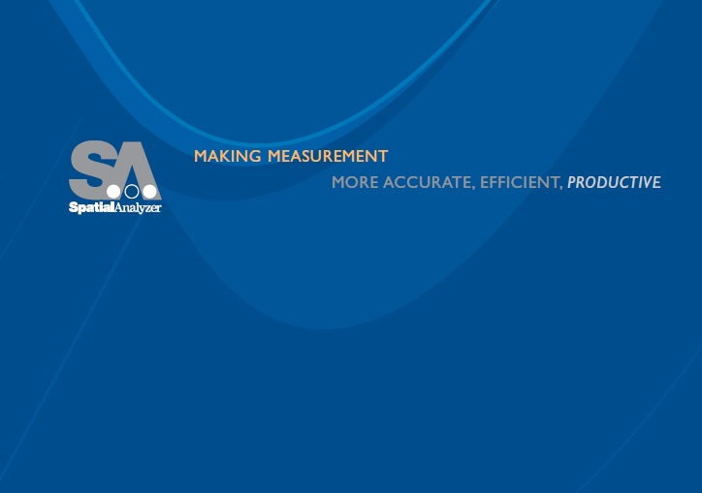
GD&T Inspection in SpatialAnalyzer
Jeremy Winn
Application Engineer
New River Kinematics
Philip Wilson
Application Engineer
New River Kinematics

Slide 2
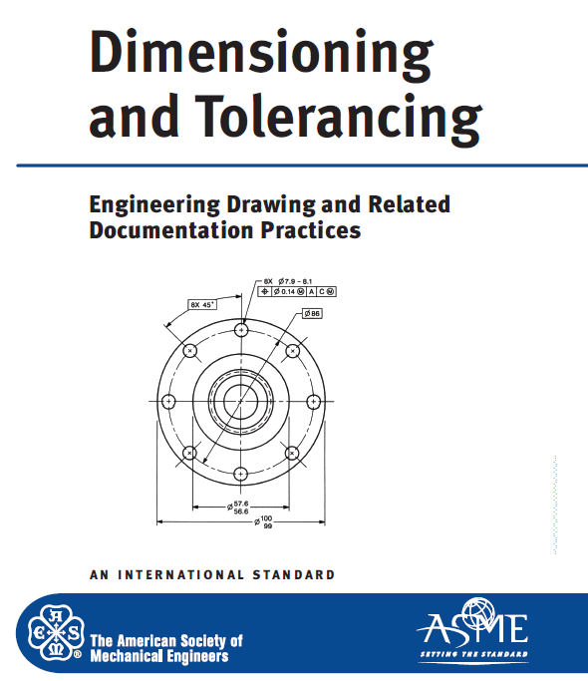
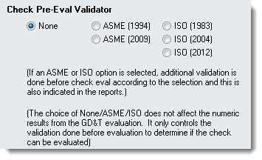
GD&T Inspection
Incorporating
Standardized Inspection within SpatialAnalyzer
Notes:
SA’s GD&T Inspection tools provides engineer’s the ability to perform standardized Geometric Dimensioning and Tolerancing
with complete confidence that their inspection is in accordance with the guidelines of the ASME or ISO standard.

Slide 3
GD&T Inspection
GD&T
“Regular Inspection”
Alignments Datum Structure Current Position
Check Specific
Computation Bounding Tol. Zone RMS (root mean square)
Outlier Pts = Part Error User controls rejection rules
Goals: Pass/Fail at Tolerance Is the part good and if not..,
how do I fix it?
Notes:
SA’s GD&T Inspection tools provides engineer’s the ability to perform standardized Geometric Dimensioning and Tolerancing
with complete confidence that their inspection is in accordance with the guidelines of the ASME or ISO standard.

Slide 4
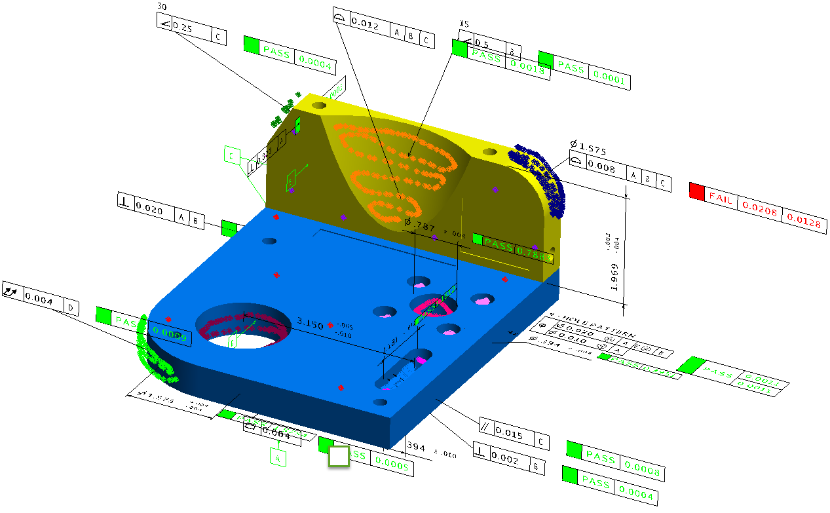
GD&T Inspection
GD&T Inspection can be Divided into 2 Distinct Steps
Defining the Checks
Building Annotations
    Tolerance Structure
    Nominal designation
Measurement Process
  Data Gathering & Association
    Inspection/ inspect scripting
    Toolkit or direction Association
    or Measurement Plan (MP)

Slide 5
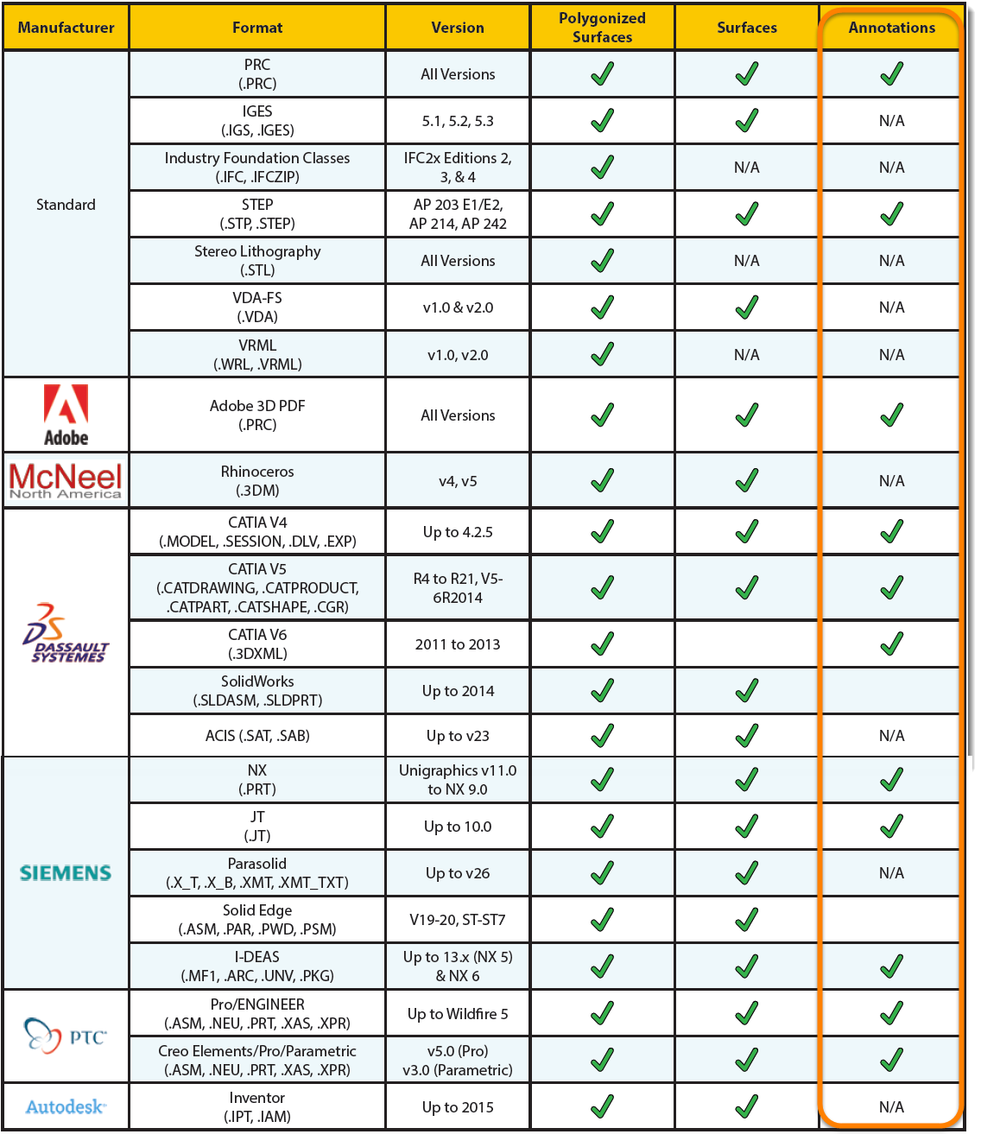
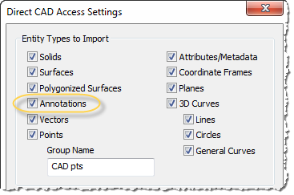
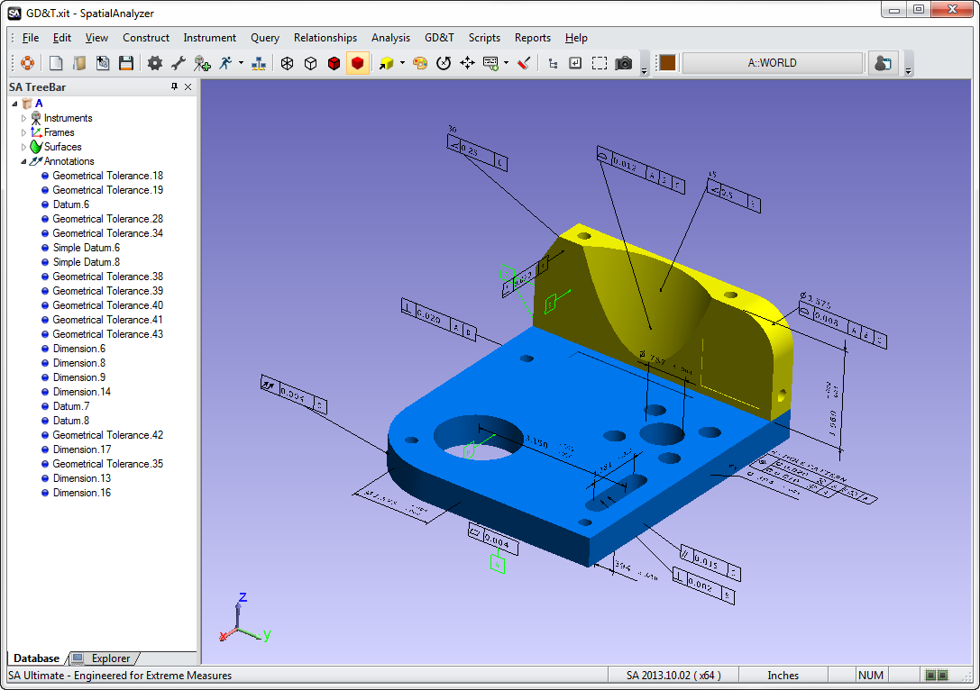
GD&T and CAD Import
Notes:
To the import a CAD model with annotations use File>Import>Direct CAD Access. See Direct CAD Access for supported formats.

Slide 6
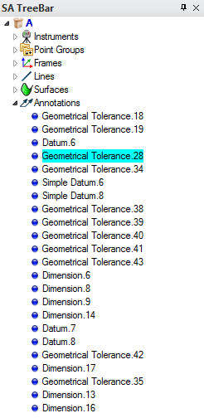
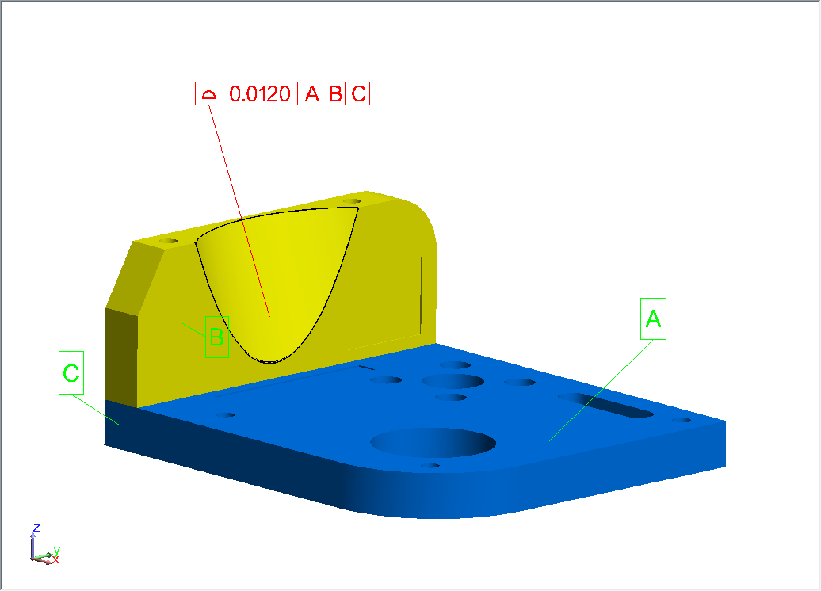
GD&T Annotations

Slide 7
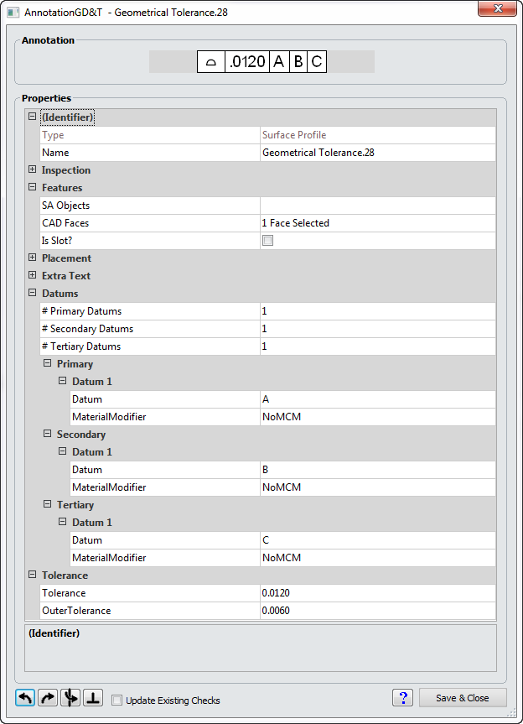
GD&T Annotations
SA Objects/CAD Face
Datum Assignment
Tolerance Definition

Slide 8
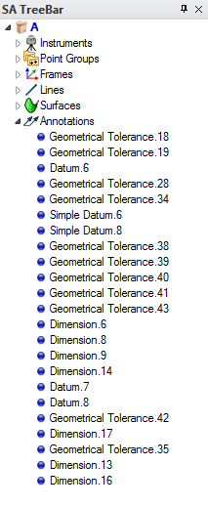
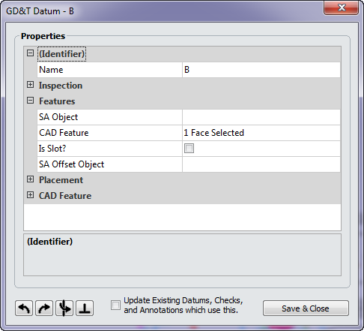
GD&T Annotations
Datum Annotations:
SA Objects/CAD Face

Slide 9
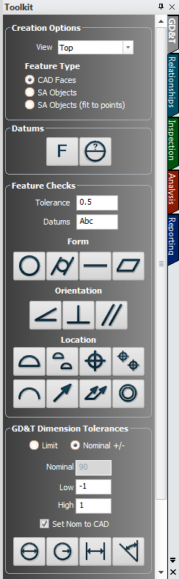


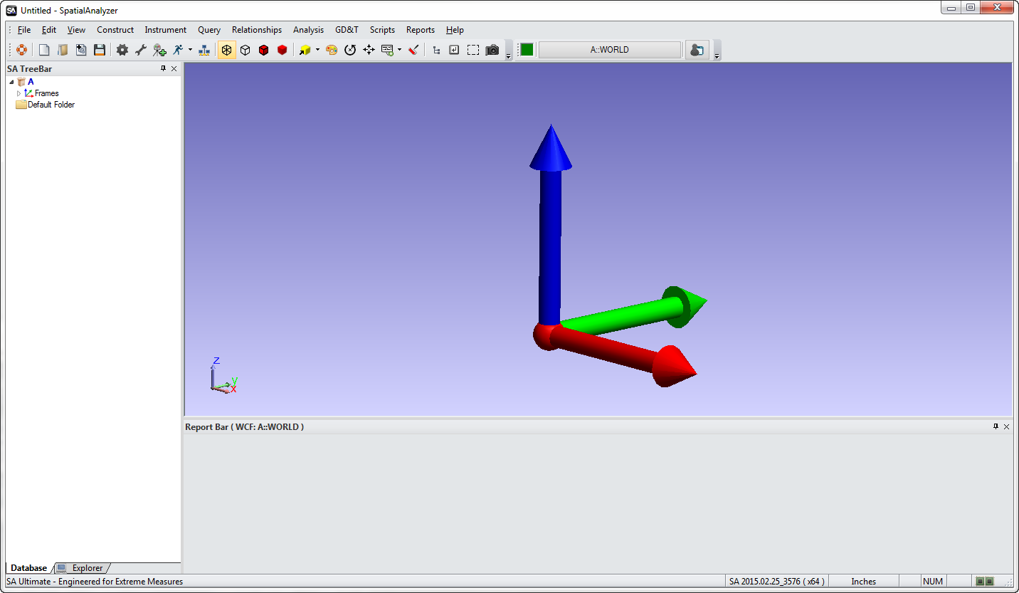
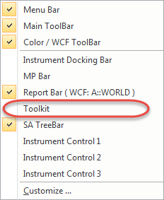
Building Annotations

Slide 10
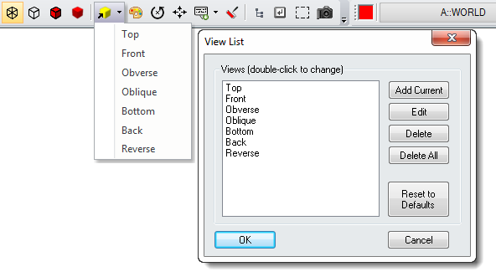
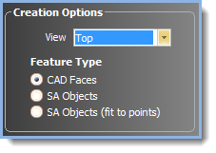
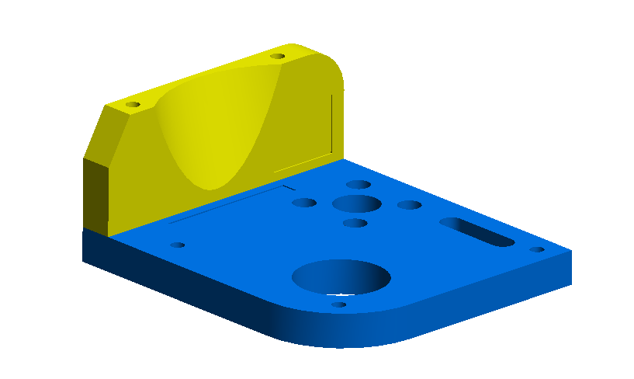
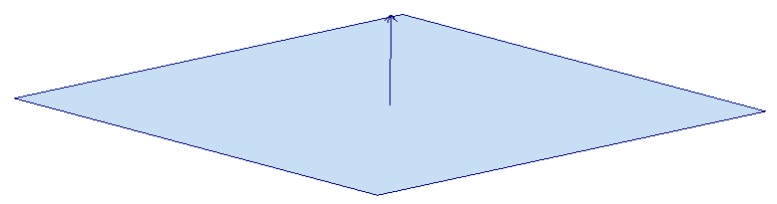
GD&T Annotations
Annotation View Orientation:
CAD Faces vs. SA Objects
  SA Objects (Fit to Points)

Slide 11
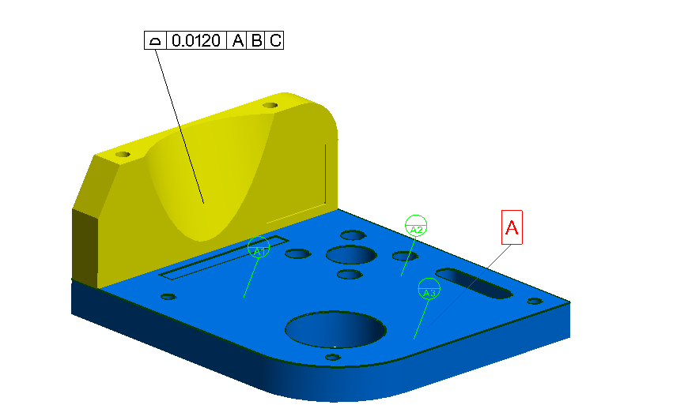

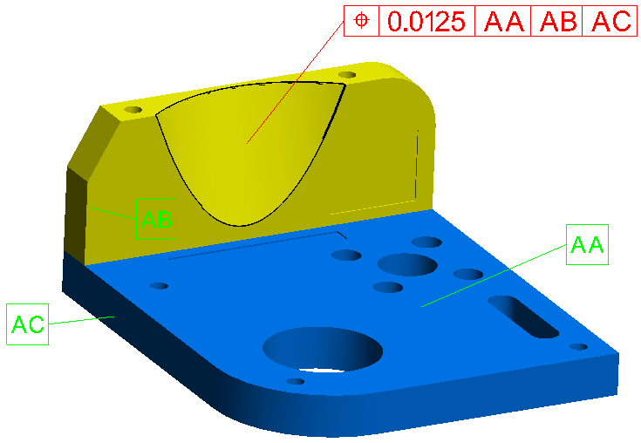
GD&T Annotations
Datum and Datum Target Designations
    (Hold down A-Z to pick a letter)
    Click-point defines leader line anchor point

Slide 12
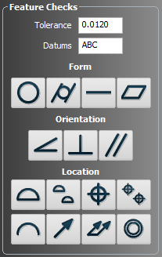

GD&T Annotations
Feature Checks Designation:

Slide 13
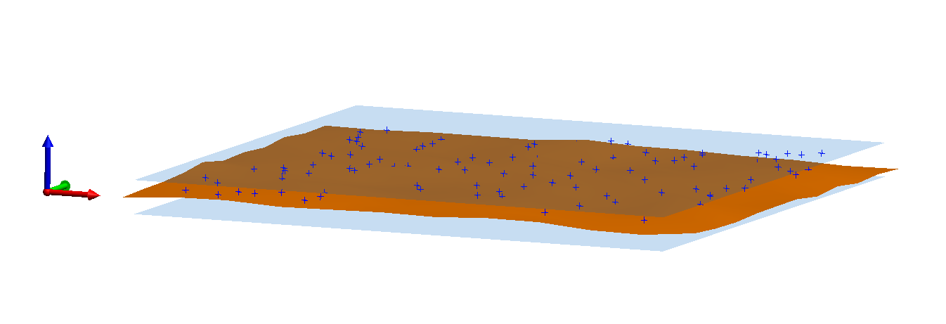
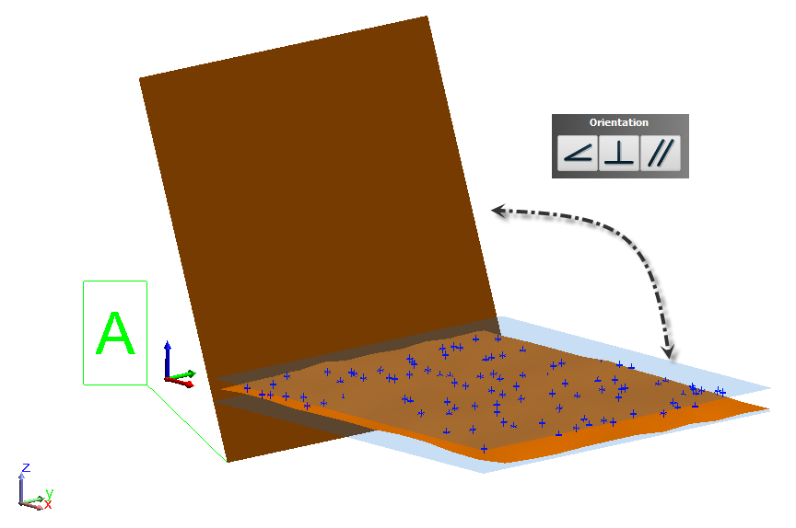
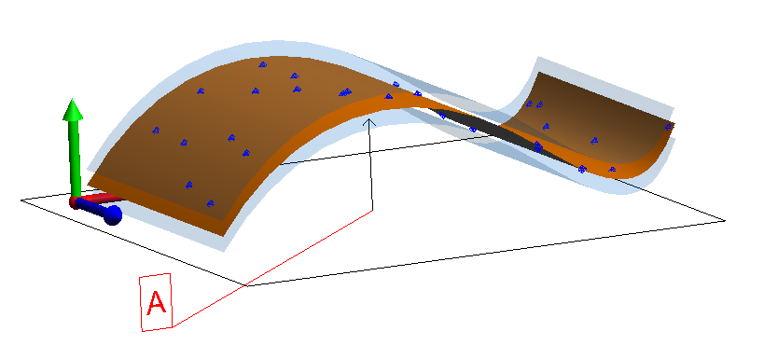

GD&T Annotations
Feature Checks Designation:
  Form Checks
    Datum Independent
  Orientation Checks
    Depend on 1 Datum
  Location Checks
    Can Include 1-3 Datums
    Can Include 1-2 Tiers

Slide 14
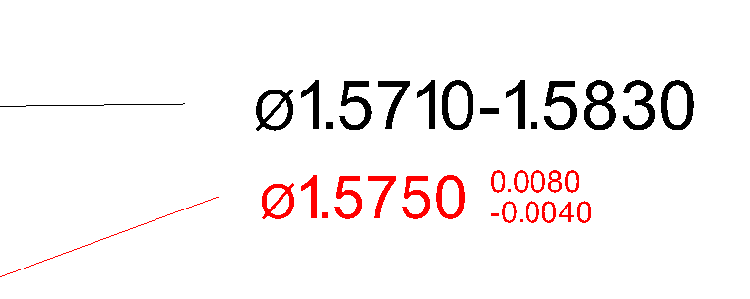
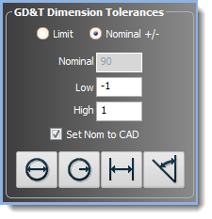
GD&T Annotations
Dimensional Tolerances
  Datum Independent
Required for Material Modifiers
  MMC, LMC

Slide 15
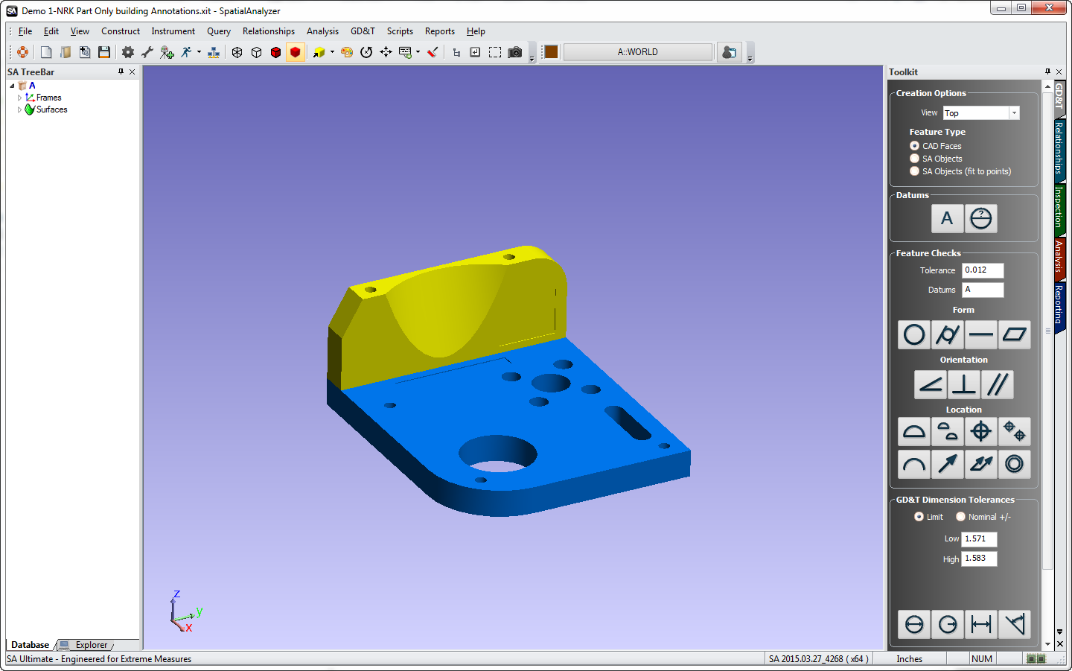
Building Annotations Demo
Notes:
Objective is to demonstrate:
Setting a view for the Annotations
Adding Datums Annotations
Adding Feature checks Annotations
Opening the Properties and changing properties
Controlling Graphical Placement
End with Direct CAD Import with all the annnotations

Slide 16
GD&T Inspection
GD&T Inspection can be Divided into 2 Distinct Steps
Defining the Checks
Building Annotations
    Tolerance Structure
    Nominal designation
Measurement Process
  Data Gathering & Association
    Inspection/ inspect scripting
    Toolkit or direction Association
    or Measurement Plan (MP)

Slide 17
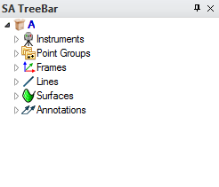
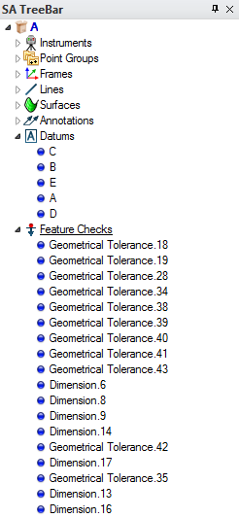
Building Feature Checks
Tree Structure
  Annotations
    Tolerance & check definition
  Datums & Feature Checks
    Link points to annotations
    Point offset & evaluation control
    Contain guided inspection controls

Slide 18
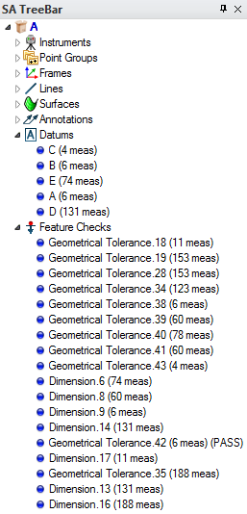
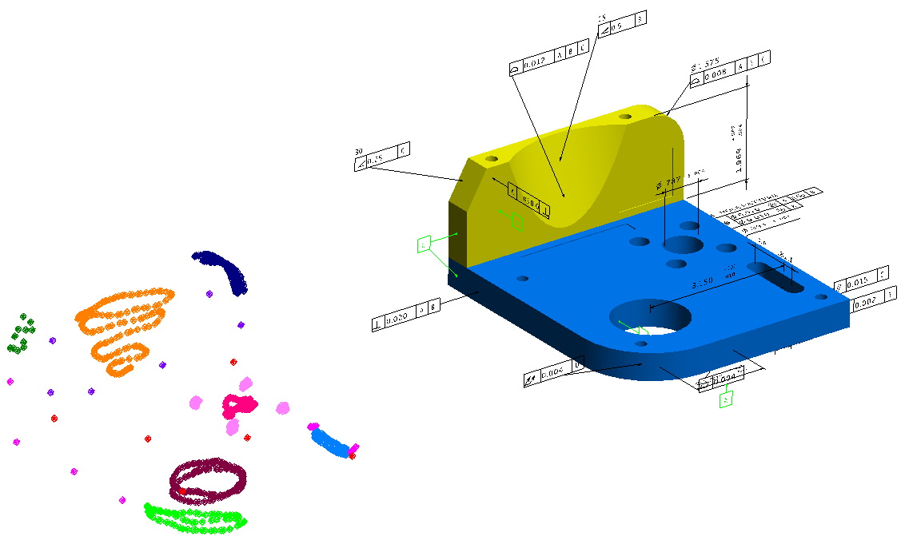
Building Feature Checks

Slide 19
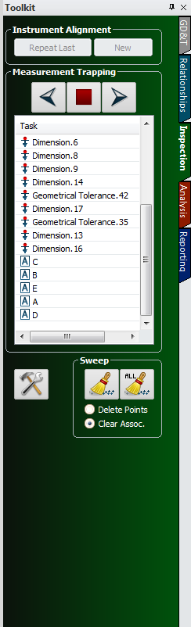
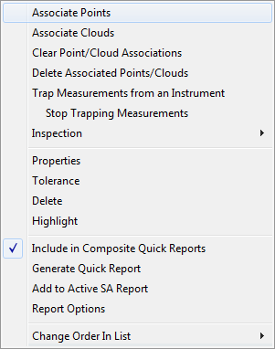
GD&T Inspection
Direct Point Association

Slide 20
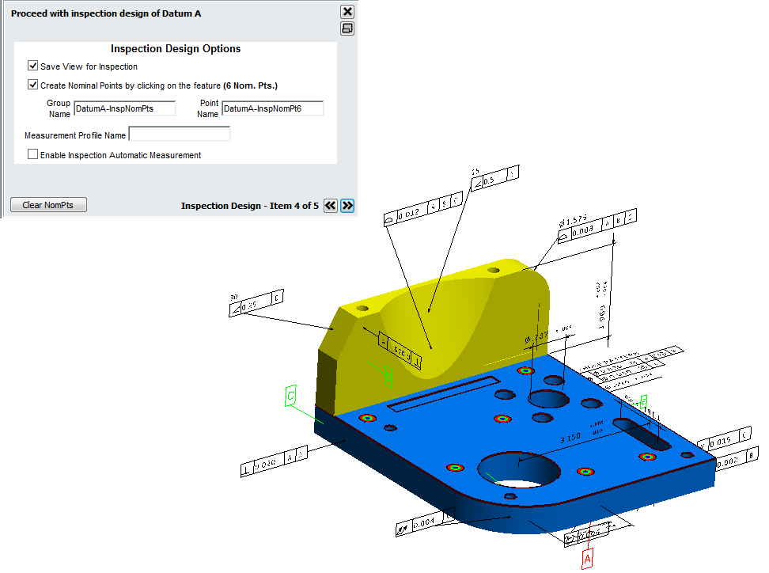
GD&T Inspection
Guided Inspection
Design
Rehearse
Inspect

Slide 21
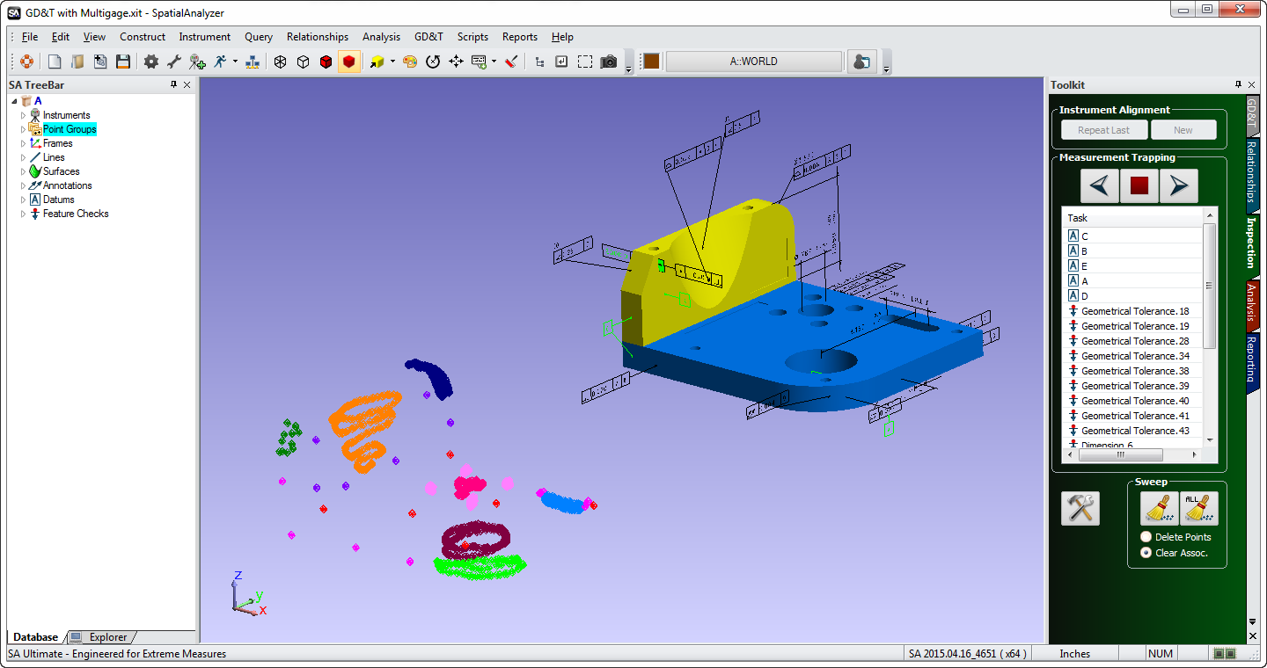
Demo- Basic Fit & Link
Notes:
Objective is to demonstrate:
Setting a view for the Annotations
Adding Datums Annotations
Adding Feature checks Annotations
Opening the Properties and changing properties
Controlling Graphical Placement
End with Direct CAD Import with all the annnotations

Slide 22
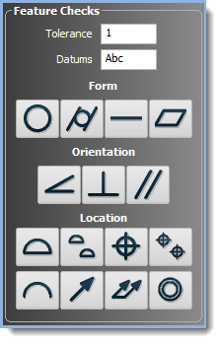
Check Details
Feature Checks come in 3 Categories:
  Form Checks
  Orientation Checks
  Location Checks

Slide 23
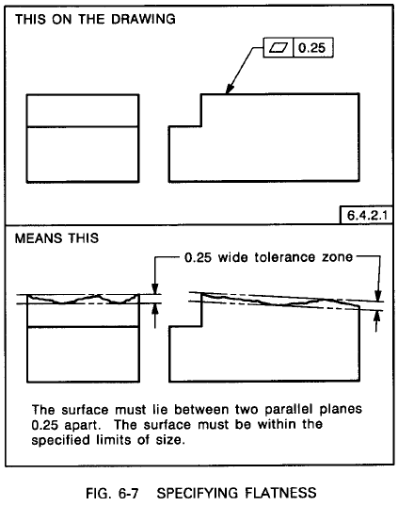
Flatness
Flatness Evaluation Process within SA:
Two parallel planes are built bounding the extents of the data.
These planes are allowed to freely rotate to establish the minimum distance between them while still containing the data.

Slide 24
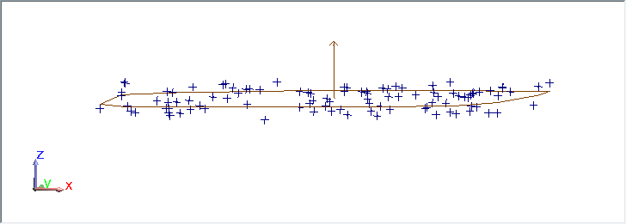
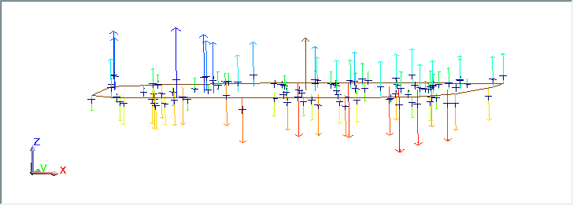
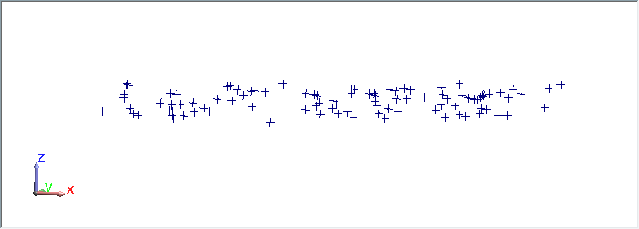
Flatness
Standard Inspection (RMS):

Slide 25
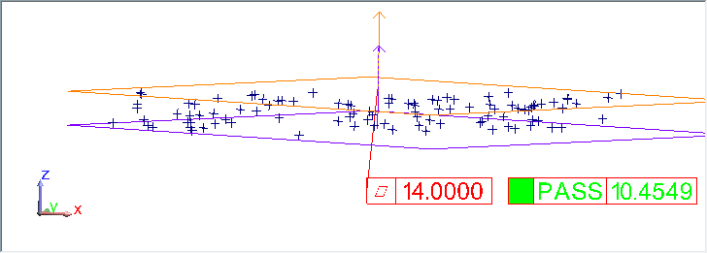
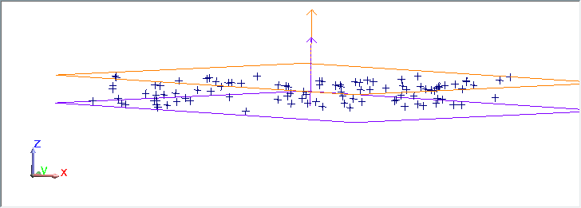
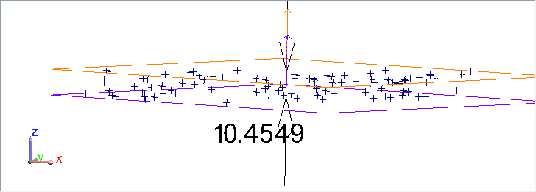
Flatness
Flatness Evaluation Process within SA:
Two parallel planes are built bounding the extents of the data.
These planes are allowed to freely rotate to establish the minimum distance between them while still containing the data.

Slide 26
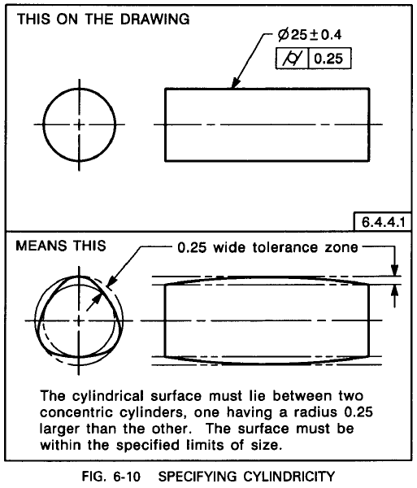
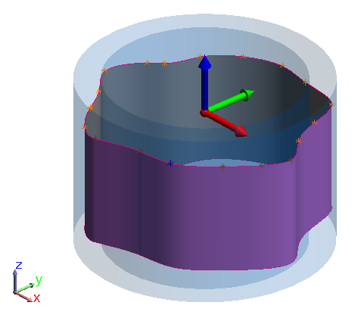
Cylindricty
Cylindricity Evaluation Process within SA:
Two coaxial cylinders are built bounding the extents of the data.
The cylinders are allowed to freely rotate to establish the minimum distance between them while still containing the data.

Slide 27
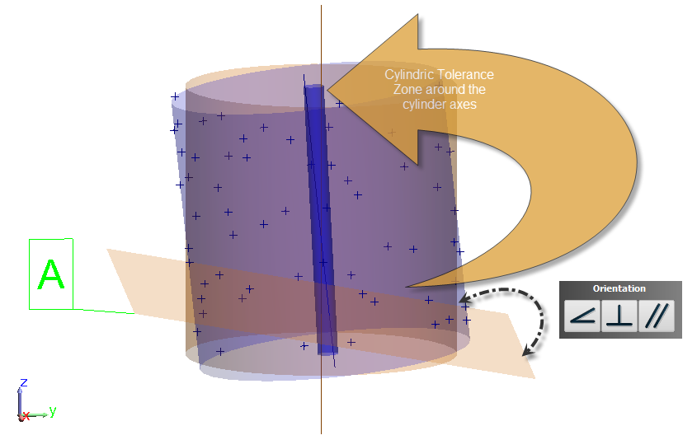
Orientation Checks
Nominal Angle
Deviation = Distance btw Planes
Datum

Slide 28
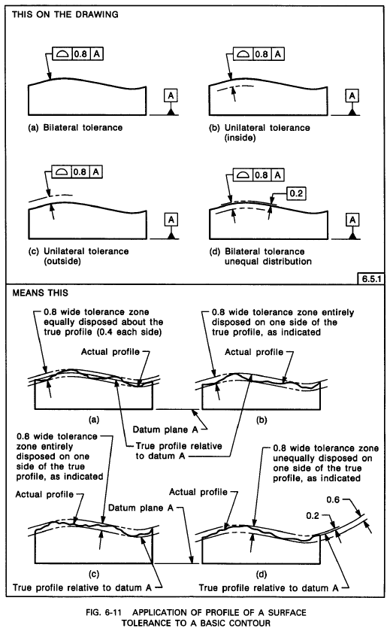

Surface Profile
Surface Profile Evaluation Process within SA:
An inner and outer tolerance boundary is established
The profile is allowed to rotate based on the datum constraints to minimize the deviations
The extent of the max and min deviation is used to establish the measured profile deviation

Slide 29
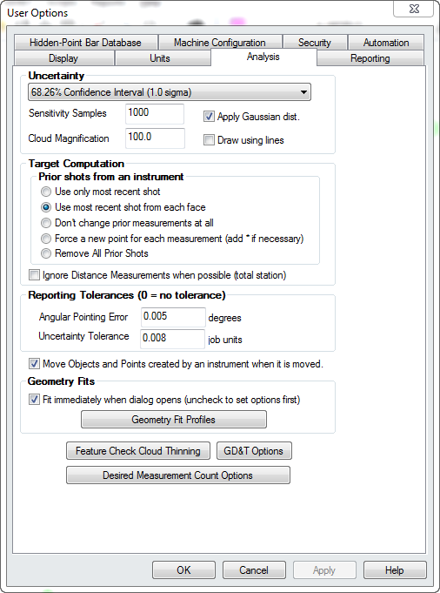
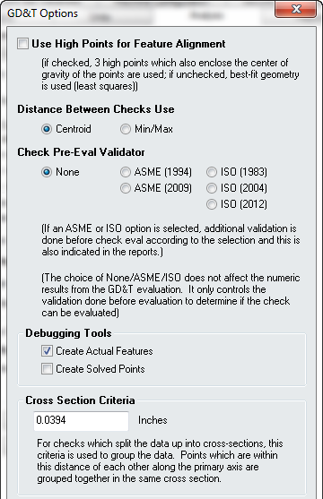


GD&T Annotations
Feature Checks Categories:
Cross Section
Checks

Slide 30

GD&T Annotations
Cross Section Checks:
Runout
Cross Section
Check
Total Runout
Surface Check

Slide 31


Concentricity
Cross Section Checks:
Concentricity
Cross Section
Check

Slide 32

GD&T Annotations
Cross Section
Checks

Slide 33


Datum Alignment
Right- Click Datum Category
  Select “Align”

Slide 34



Building Feature Checks
Cylinder Evaluation Method
Probe Compensation

Slide 35

Datum Alignment
Datums and Degrees of Freedom
Geometry Type is the Key

Slide 36



Datum Alignment
The number of datums specified and the feature type selected controls the degrees of freedom for the check:
SA Objects/CAD Face
SA Offset object

Slide 37

Demo- Basic Fit & Link
Notes:
Objective is to demonstrate:
Setting a view for the Annotations
Adding Datums Annotations
Adding Feature checks Annotations
Opening the Properties and changing properties
Controlling Graphical Placement
End with Direct CAD Import with all the annnotations

Slide 38

Building Feature Checks
Inspection Controls
Evaluation Method

Slide 39


Building Feature Checks
Cylinder Evaluation Method

Slide 40

Building Feature Checks
Cylinder Evaluation Method

Slide 41

Building Feature Checks
Cylinder Evaluation Method

Slide 42

Building Feature Checks
Cylinder Evaluation Method

Slide 43



Composite True Position
Composite Checks:

Slide 44




GD&T Inspection
Automatic Point Association
Proximity Filter
Based on Initial
Alignment

Slide 45

GD&T Inspection
Automatic Point Association

Slide 46


GD&T Inspection
Automatic Point Association

Slide 47



Reporting

Slide 48




Reporting
Summary Table
Fit Transform
Datum Statistics
Details Table
Point Deviations

Slide 49

Reporting
Vectors for Visualization:
Specific Alignment
DoF Understanding

Slide 50



Reporting

Slide 51



Reporting

Slide 52


Evaluations Tools

Slide 53
Thank You

