Slide 1
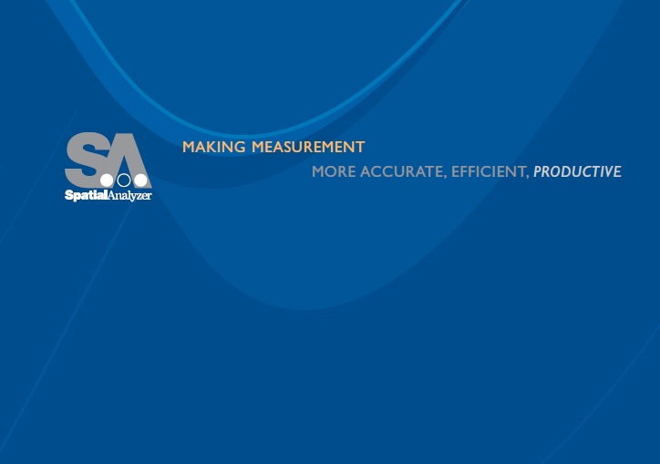
Re-Intro to SA
Jeremy Winn
Application Engineer
New River Kinematics
Richard Nelson
Application Engineer
New River Kinematics

Slide 2


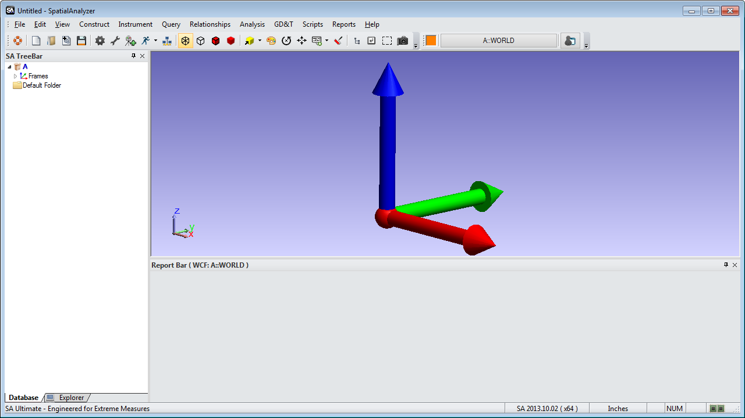
Intro to SA
The SA Workspace
Menu Bar
Access to all of SA’s commands.
Main Toolbar
Quick link to Commonly-used functions.
Graphical View
3D rendering of the job file.
Tree Bar
Hierarchical view of file.
Report Bar
Properties and reporting information.
Notes:
This is what the SA interface looks like when you first start it up. It consists of a few main sections:
First is the menu bar, which provides access to SA’s commands.
Below that is a line containing two toolbars. On the right is the Color/WCF Toolbar, which allows you to control the active color and coordinate system, as well as custom UI profiles, and
The Main Toolbar, which has icons for commonly-used functions.
The Graphical View shows a three-dimensional rendering of your job file.
On the left side is the treebar, which we’ll refer to as the tree from now on. The tree contains a hierarchical view of everything in your job file.
Below the graphical view is the report bar, which shows object properties and reporting information, and
On the very bottom of the interface is the Status Bar, which shows miscellaneous information.
We’re going to be using menu commands and toolbar buttons throughout this course, and I’ll introduce them as we use them. Feel free to refer to Module 3 of your student manual, which illustrates each main menu command and toolbar icon.

Slide 3
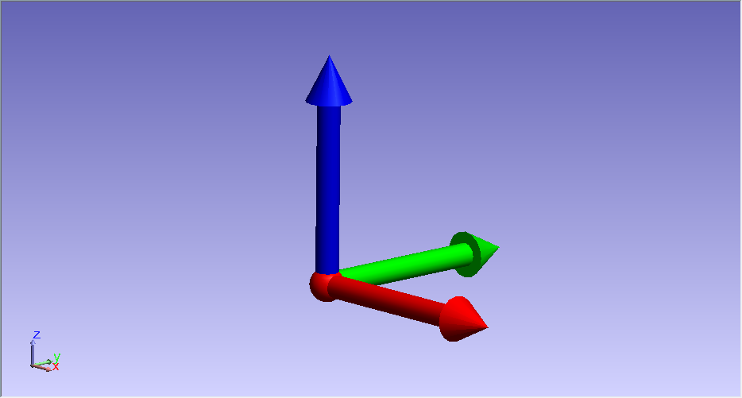
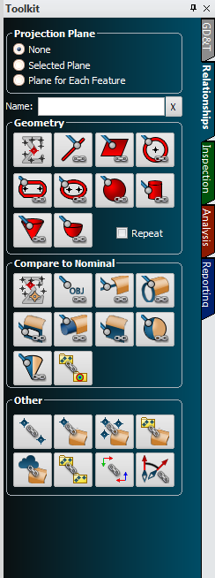
Re-Intro to SA
The SA Workspace
Toolkit
Access to common commands
& most used functions.
Gateway to
Dynamic
Feature Based
Inspection
Notes:
The purpose of this class is to teach with the toolkit and leave the menus untouched. This should provide a new perspective for those who know SA and lead with out best foot forward for those who do not.
…But first lets make sure everyone has some basics.

Slide 4
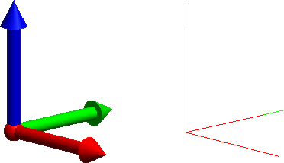
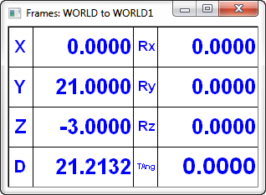
The Working Coordinate Frame
Graphical View:
Inactive Frame
Drawn as a stick figure.
Data is shown with respect to active (working) frame.
Any frame can be set to working at any time.
Active (Working) Frame
Drawn with solid arrows.
Notes:
At any one time when working in SA, there is always an
→active or working coordinate frame. Any data that you view in SA is represented with respect to this coordinate frame, unless specified otherwise. The active coordinate frame is drawn with solid, three-dimensional arrows.
→Any other coordinate frames are drawn as a stick-figure instead of the solid arrows.

Slide 5
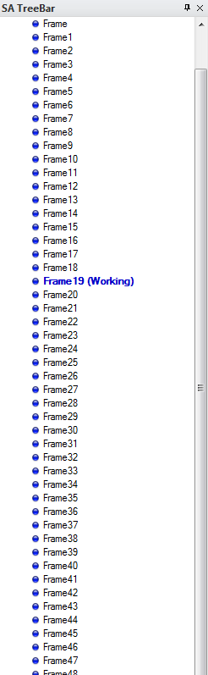
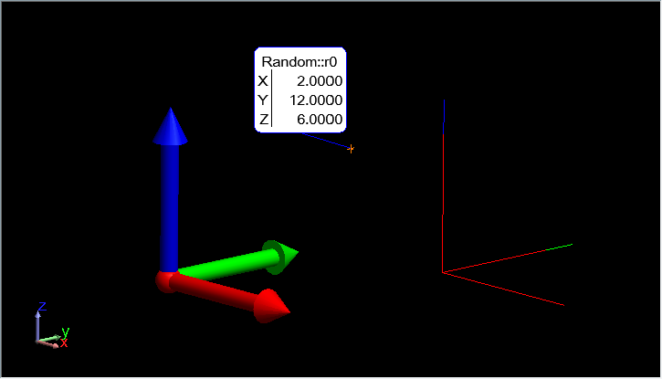
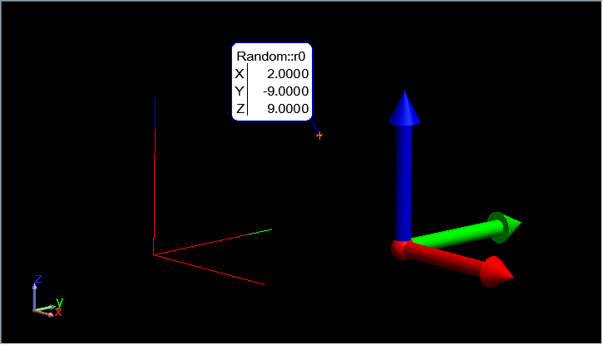
The Working Coordinate Frame
Graphical View:
Data is shown with respect to active (working) frame.
Any frame can be set to working at any time.
Active (Working) Frame
Drawn with solid arrows.
Active (Working) Frame
Drawn with solid arrows.
Notes:
At any one time when working in SA, there is always an
→active or working coordinate frame. Any data that you view in SA is represented with respect to this coordinate frame, unless specified otherwise. The active coordinate frame is drawn with solid, three-dimensional arrows.
→Any other coordinate frames are drawn as a stick-figure instead of the solid arrows.

Slide 6
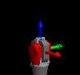
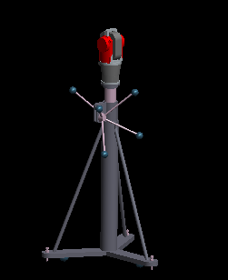
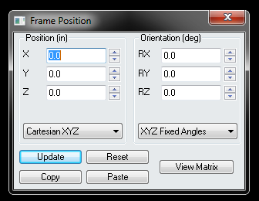
The Working Coordinate Frame
Graphical View:
Data is shown with respect to active (working) frame.
Any frame can be set to working at any time.
Notes:
At any one time when working in SA, there is always an
→active or working coordinate frame. Any data that you view in SA is represented with respect to this coordinate frame, unless specified otherwise. The active coordinate frame is drawn with solid, three-dimensional arrows.
→Any other coordinate frames are drawn as a stick-figure instead of the solid arrows.

Slide 7
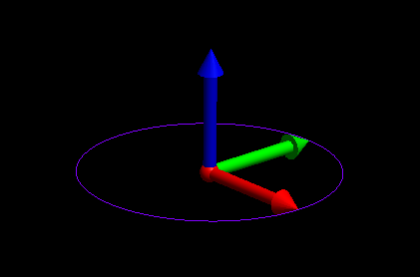
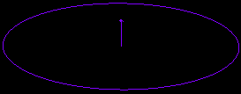
The Working Coordinate Frame
Graphical View:
Data is shown with respect to active (working) frame.
Any frame can be set to working at any time.
Notes:
At any one time when working in SA, there is always an
→active or working coordinate frame. Any data that you view in SA is represented with respect to this coordinate frame, unless specified otherwise. The active coordinate frame is drawn with solid, three-dimensional arrows.
→Any other coordinate frames are drawn as a stick-figure instead of the solid arrows.

Slide 8
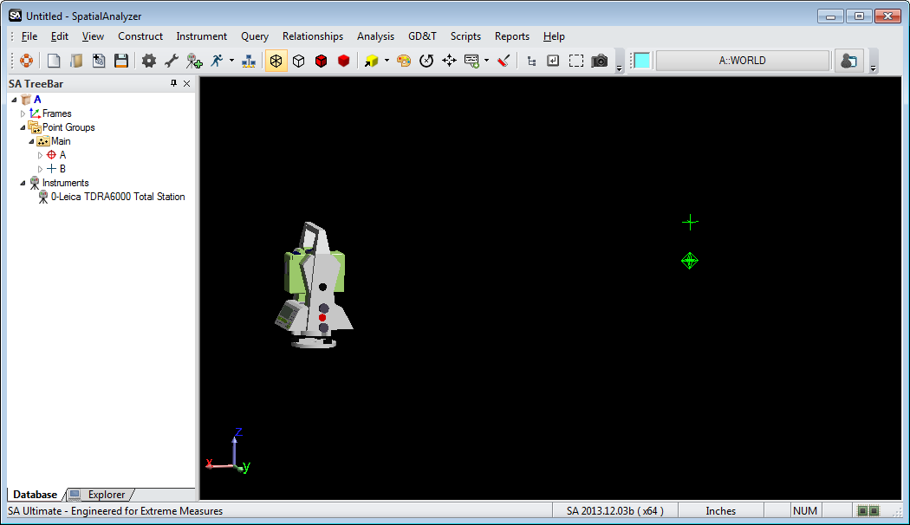
Constructed vs. Measured
Constructed Point
Measured Point
Notes:
SA makes a distinction between →measured points and →constructed points.
Measured points are points that were measured by an instrument, whereas constructed points were created via any other method.
Measured points are depicted as three-dimensional diamonds in the graphical view, and with a target reticle icon in the tree.
Constructed points are depicted as three-dimensional plus signs in the graphical view, and plus signs in the tree.
The distinction is important. It allows you to see if points have been moved from their instrument, or if somebody has intentionally tried to alter a measurement.

Slide 9
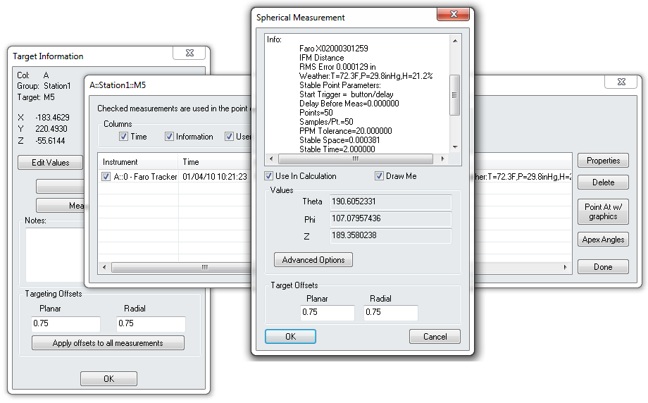
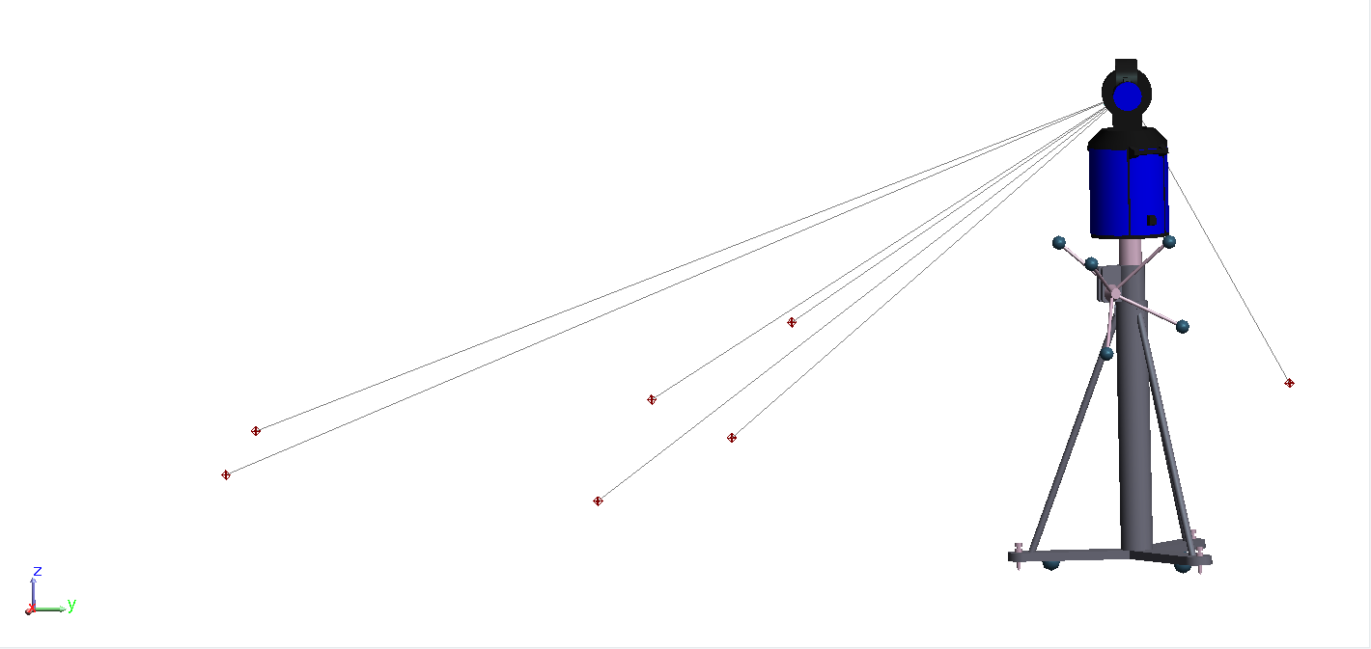
Constructed vs. Measured
Notes:
Tractability is a founding principle and provides a means to always adjust and reevaluate without concern for data integrity.

Slide 10
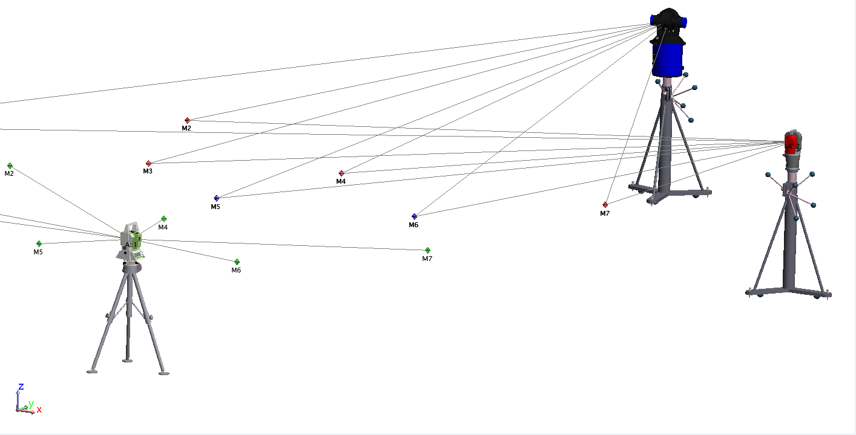
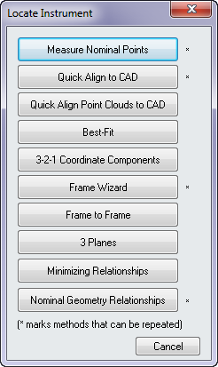
Constructed vs. Measured
Measured points are tied to the
Instrument that measured them
Instruments can be moved as needed
without losing measurement integrity

Slide 11



Best Fit
Notes:
We’ll talk about and use many of these alignment methods throughout this course—right now we’re going to focus on best fit alignment.
The general idea with best fit alignment is that you have a set of reference points to which you’d like to align.
→You first measure the reference points,

Slide 12
Best Fit
Notes:
…then transform the instrument until the measurements best fit the reference points.

Slide 13
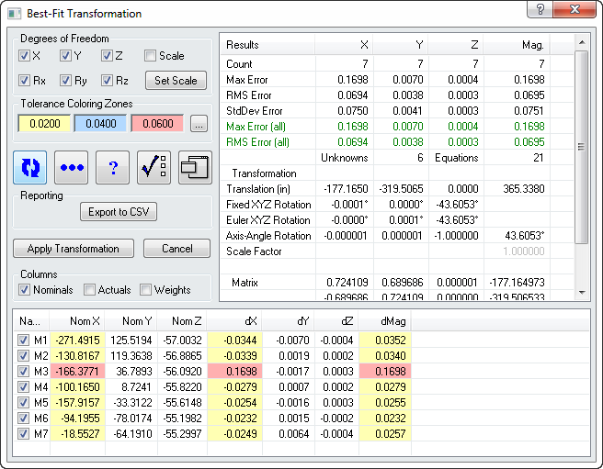
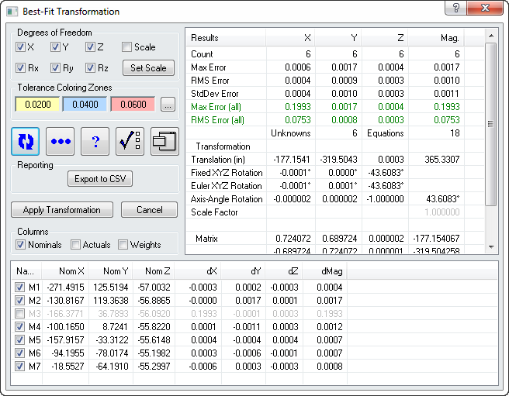
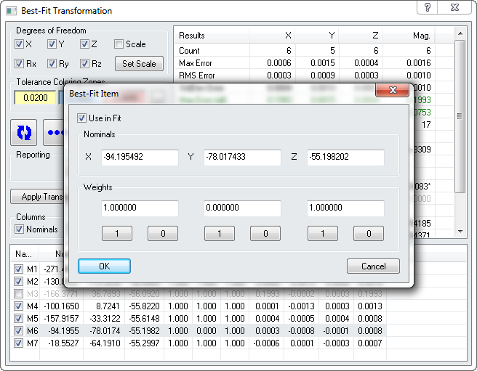
Best Fit
Measured points are tied to the
Instrument that measured them
Fit Statistics
Instruments can be moved as needed
without losing measurement integrity
Point Control

Slide 14
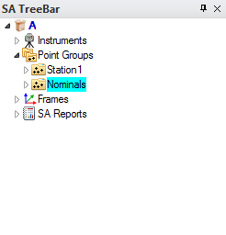
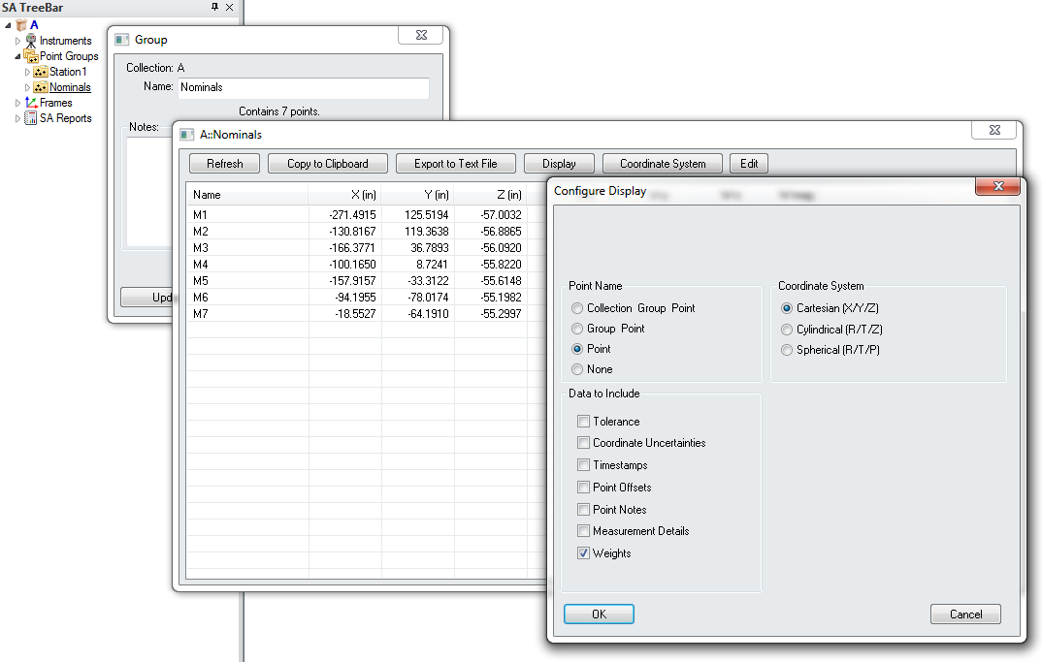
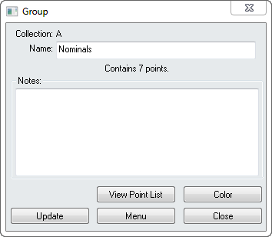
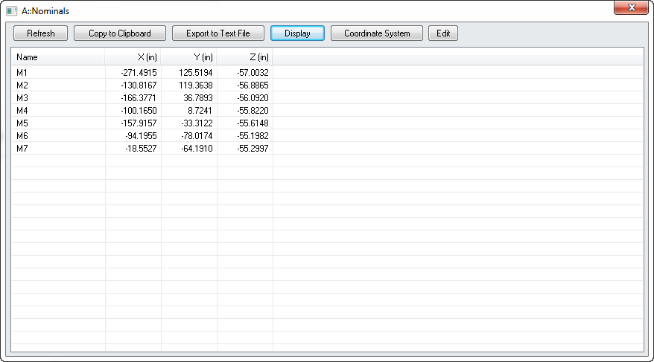
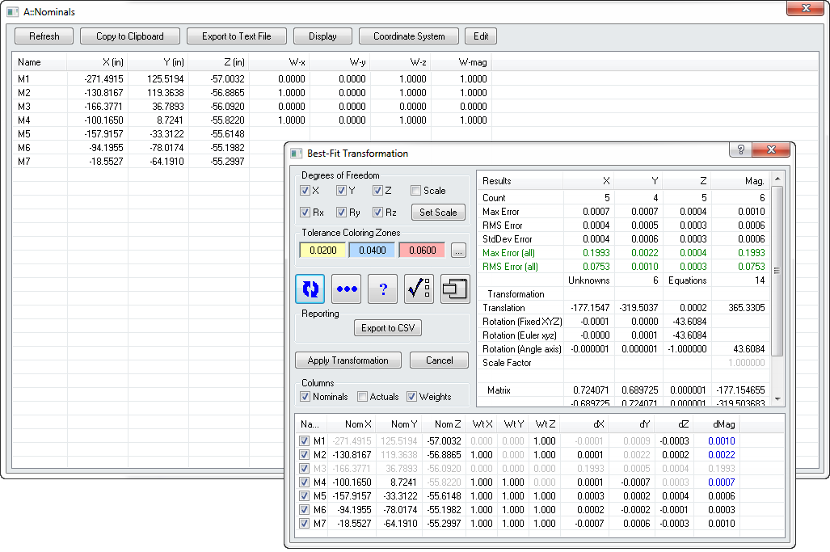
Best Fit
View Point List Control
View Point List is now the one stop shop for all point settings
  Tolerance
  Weight
  Offsets
  Details
  Notes
  Etc.

Slide 15
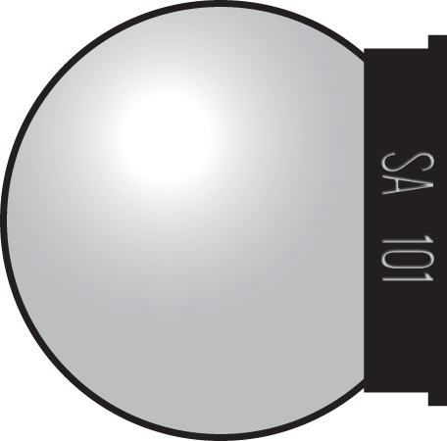
Recorded Measurements
Recorded Point
The recorded point is always the center of the probe.
Offsets
Probe offsets are stored with every measured point.
Notes:
When you measure a point, the position of the center of the probe is almost always what gets recorded.
→SA also records probe offsets for every measured point, so it can calculate where the point of contact is located.
We’ll see later how SA handles this when it tries to determine the deviation between a measured surface and the design surface.

Slide 16
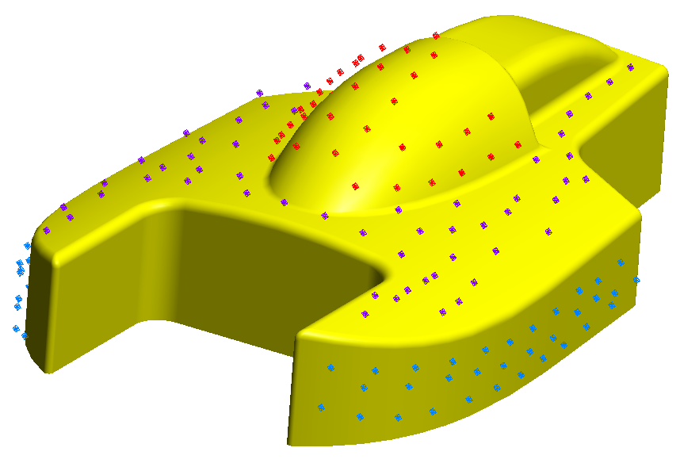
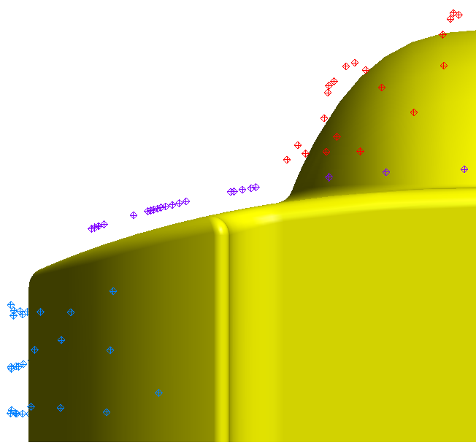
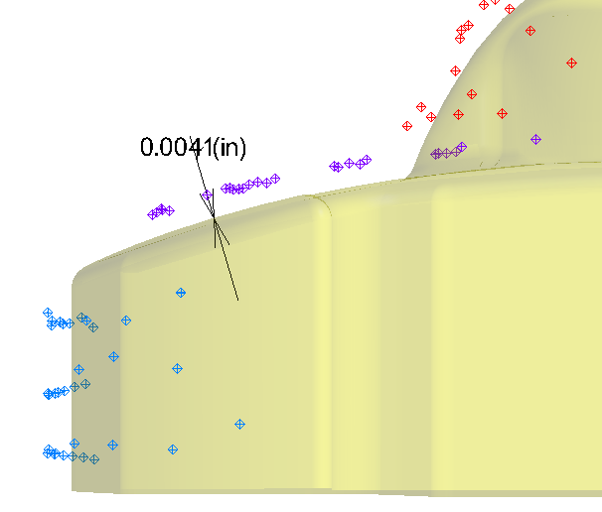
Recorded Measurements
Offsets -
Are applied automatically when a comparison is made
Notes:
When you measure a point, the position of the center of the probe is almost always what gets recorded.
→SA also records probe offsets for every measured point, so it can calculate where the point of contact is located.
We’ll see later how SA handles this when it tries to determine the deviation between a measured surface and the design surface.

Slide 17
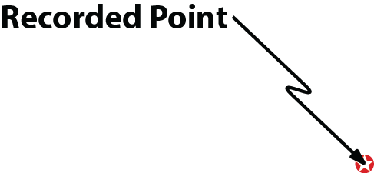
Recorded Measurements
Radius: 0.75”
Design Surface
Notes:
So when you take a measurement, all SA really sees is this: the location of the center of the probe, and an offset value.

Slide 18
Recorded Measurements
Design Surface
Notes:
Knowing the probe offset, and thinking of the problem in just two dimensions, we can draw a circle around the recorded point to represent the probe. We now know that, assuming the probe was touching the measured surface as it should have been, the point of contact is touching that circle somewhere.

Slide 19
Recorded Measurements
Measured Surface?
Design Surface
Notes:
To find the point of contact, SA first finds the closest point on the design surface to the measured point. This is referred to as the “Projected Point”. As it turns out, geometrically the line from this point through the recorded point is perpendicular to the design surface, and no point on the design surface is closer to the recorded point than the projected point.

Slide 20
Recorded Measurements
Measured Surface?
Design Surface
Notes:
You’re probably tempted to conclude at this point that we now know the location of the point on the measured surface. The point of contact is denoted by this blue point and therefore we know the measured surface is somewhere here. Right? Well, let’s zoom out of this picture a little bit to give you the whole story:

Slide 21
Recorded Measurements
Surface Normal
Notes:
The way that SA figures out which side is the inside of a surface is by looking at its surface normal direction. Every surface and geometric feature in SA has surface normals that indicate which side of the surface points toward the outside of the surface that it represents.

Slide 22
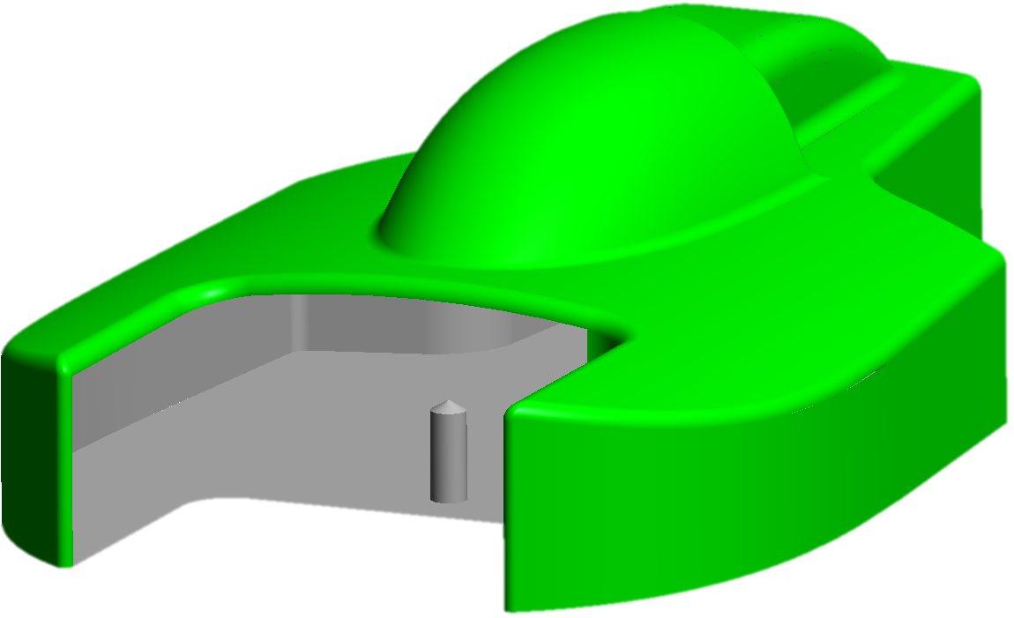
Recorded Measurements

Slide 23
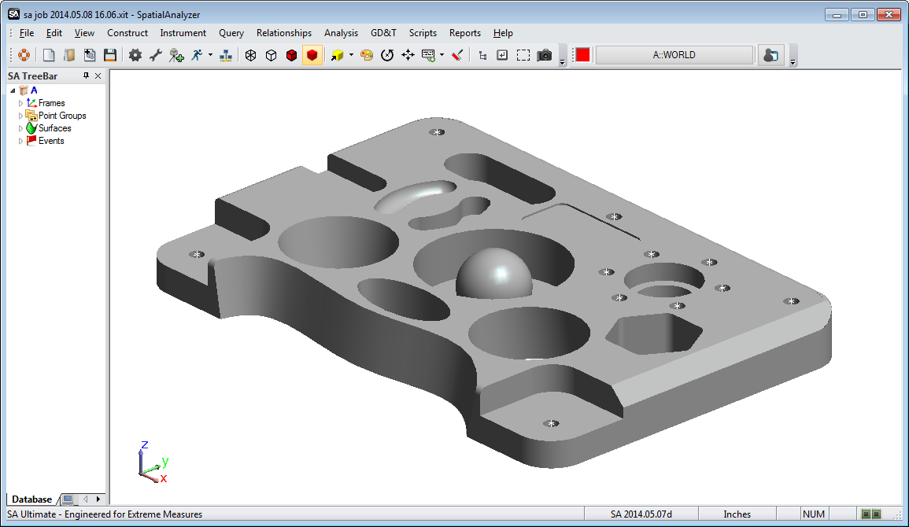
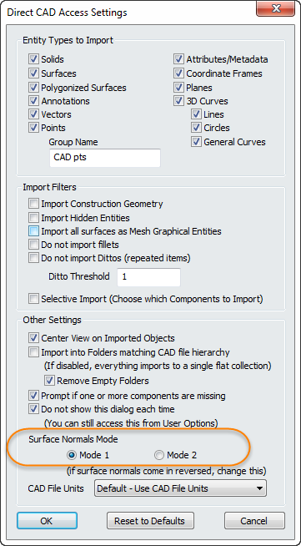
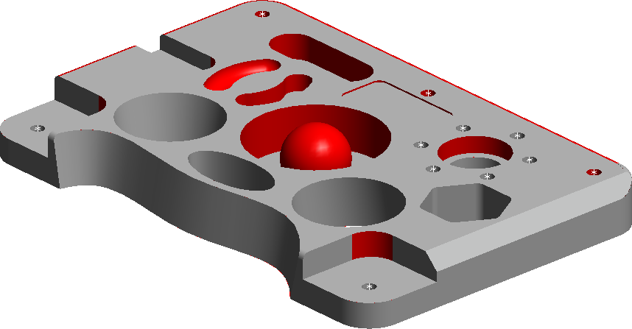
Recorded Measurements
Verifying Surface Normals
Notes:
If we delete some of the faces of this CAD surface, we can see that the model of this boat is really just a shell. If we look at the surface normals for this boat model, they all point outward—away from what would be the material of the real object.

Slide 24
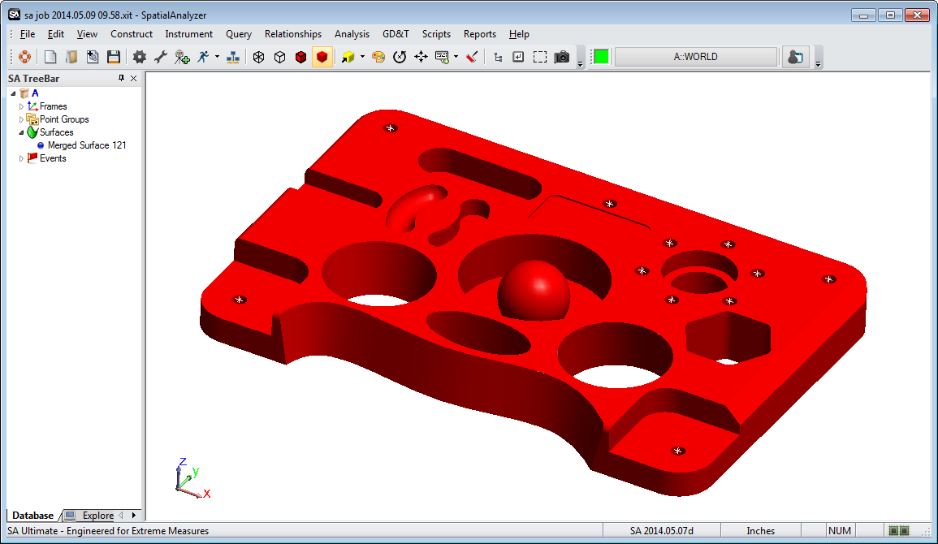
Recorded Measurements
Verifying Surface Normals
Notes:
This way, you’ll end up with a clean model with a single surface in the tree, ready to work with.
It’s worth noting that usually you don’t need to groom a model like this—but it’s important to know how when the need does arise.

Slide 25
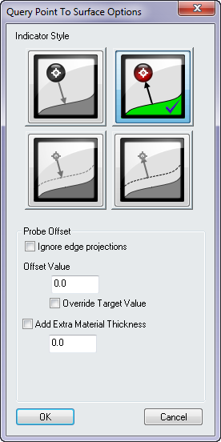
Recorded Measurements
Surface Normal
Measured Surface?
Design Surface
Vectors:
Display a Magnified line from the contract point to the probed point location
Notes:
To find the point of contact, SA first finds the closest point on the design surface to the measured point. This is referred to as the “Projected Point”. As it turns out, geometrically the line from this point through the recorded point is perpendicular to the design surface, and no point on the design surface is closer to the recorded point than the projected point.

Slide 26
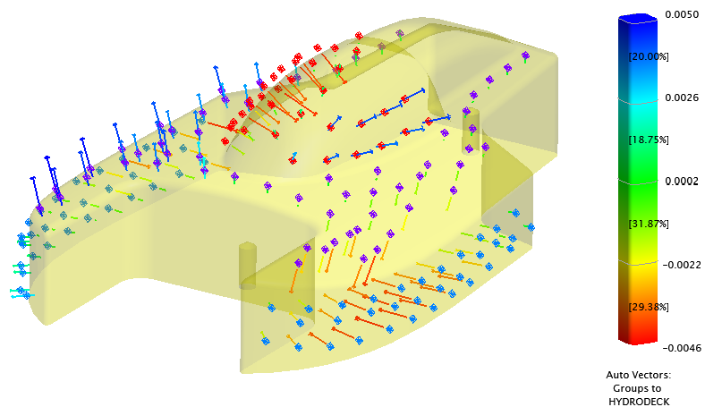
Vectors for Visualization and Alignment
Vectors Visualize Deviations
Notes:
Vector layout options are built on creation
Contact points can also be build here
Ignore Edge projections / Probe Offsets

Slide 27
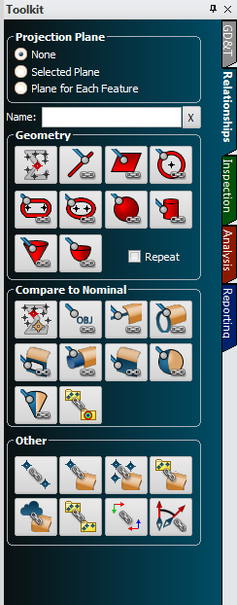
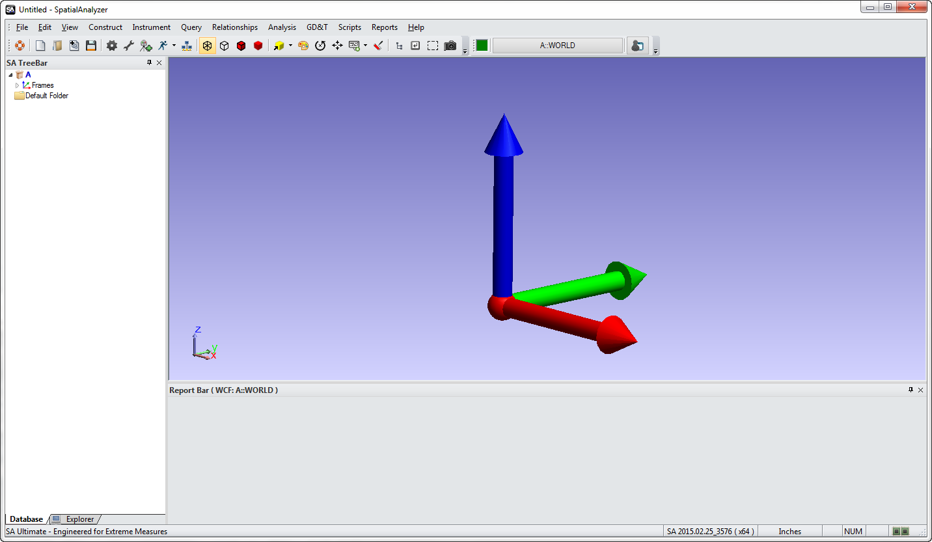
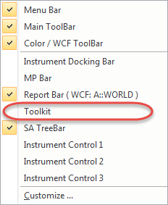
The SA Toolkit

Slide 28
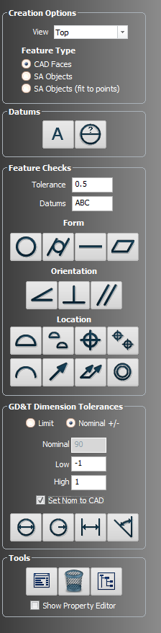
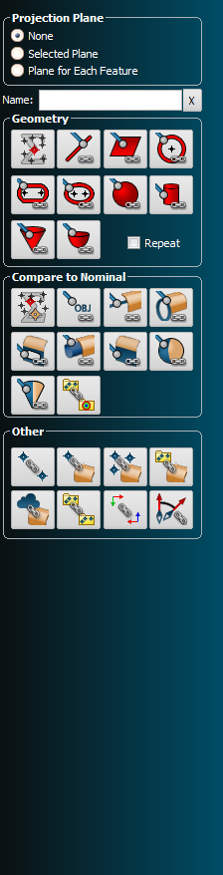
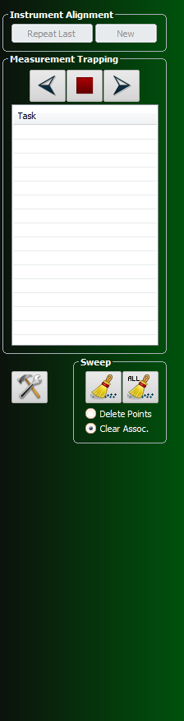
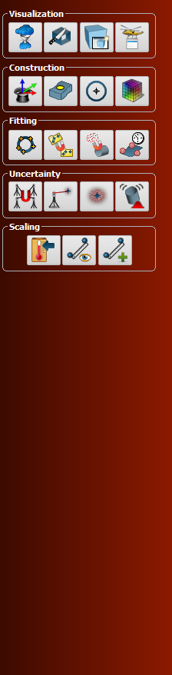
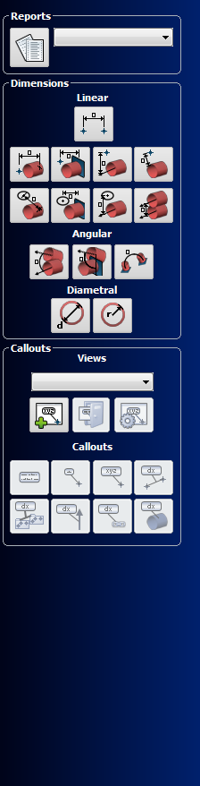
The SA Toolkit
– in -
Measuring &
Inspecting
Analysis &
Reporting
Notes:
The SA Toolkit contains five tabs that provide convenient access to a number of useful SA tools. These tabs include:
GD&T contains tools for creating GD&T checks from CAD surfaces, primitive objects, or directly from points.
Relationships tab contains tools for quickly creating various types of relationships.
Inspection tab allows you access to a list of inspection-ready items with buttons for advancing through the inspection.
Analysis allows one-click access to many analysis tools.
Reporting contains buttons for creating reports, dimensions, and callouts.

Slide 29
The SA Toolkit
Projection Plane
Define/select projection planes
Geometry Name
Control of relationship name
Build Geometry
Dynamic geometry fitting
Compare to Nominal
Quick link to CAD feature Comparison
Other Relationships
Comparison and alignment relationships
Notes:
The relationships tab enables one-click definition of features (defined by CAD or using primitive geometry) primed for easy inspection using geometry relationships, with or without projection planes. Other relationships can be easily defined as well.
The relationships tab is divided into five sections:
Projection Plane: define/select projection planes.
Name: Control name of relationship.
Geometry: dynamic geometry fitting.
Compare to Nominal: fit and compare geometry to a specified nominal geometry.
Other: All other relationship types.

Slide 30

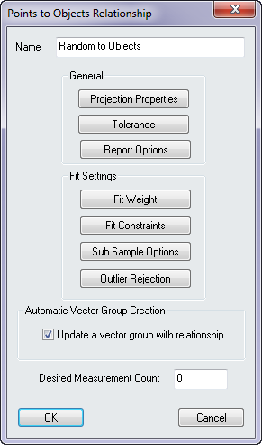


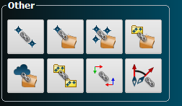
The SA Toolkit
Points to Objects
Groups to Objects
Clouds to Objects
Notes:
The relationships tab enables one-click definition of features (defined by CAD or using primitive geometry) primed for easy inspection using geometry relationships, with or without projection planes. Other relationships can be easily defined as well.
The relationships tab is divided into five sections:
Projection Plane: define/select projection planes.
Name: Control name of relationship.
Geometry: dynamic geometry fitting.
Compare to Nominal: fit and compare geometry to a specified nominal geometry.
Other: All other relationship types.

Slide 31
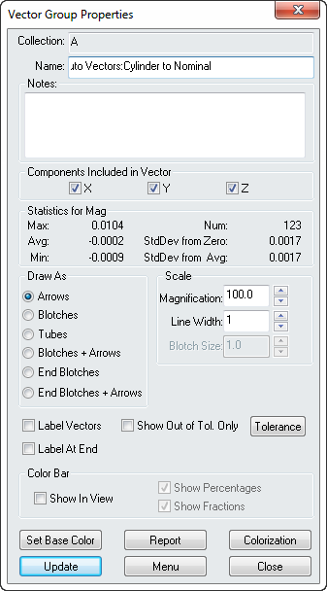






Vectors for Visualization and Alignment
4 Vector Types / Magnification
  Arrows
  Bloches
  Tubes
  Bloches + Arrows
Tolerances
Colorization button
  Tolerance control
  Auto-ranging colors
  Show /hide Color bar
Notes:
Format your vectors for Effect
Vector Type
Vector Magnitude / size

Slide 32



Vectors for Visualization and Alignment
4 Vector Types / Magnification
  Arrows
  Bloches
  Tubes
  Bloches + Arrows
Tolerances
Colorization button
  Tolerance control
  Auto-ranging colors
  Show /hide Color bar
Notes:
Format your vectors for Effect
Vector Tolerance
Vector Colorization / Tolerance Scheme / Color Bar

Slide 33



Vectors for Visualization and Alignment
Tolerance and Colorization
  Each have there own representation in vector table
Notes:
Display Colors appear in tabular data
Magnitude displays Pass / Fail
Colorization column show relative deviation

Slide 34


Vectors for Visualization and Alignment
Demo-
Building
Relationships
Notes:
Demo1_ Simple Relationships:
Build a groups to objects relationship
Show how the vectors update
Relationship alignment
Adjust the relationship properties
For tolerance
For visualization

Slide 35

Measuring Geometry
Lines
Planes
Cylinders
Cones
Paraboloids
Primitive Geometry is Infinite
SA considers this plane to extend infinitely in two dimensions.
Notes:
You should also understand that primitive geometry such as planes, cylinders, paraboloids, lines, and cones are infinite.
For example, we draw the boundaries of a plan in the graphical view so that you can see it. But the plane really extends infinitely in two dimensions. What this means is that if I have a measured point way off to the side of the drawn boundary of a plane, and I ask SA how far the measurement is from the plane, it’s going to tell me this distance—not the distance to the edge of the drawn plane.
Likewise, lines and cylinders are infinite in length, and paraboloids and cones extend infinitely in one direction.

Slide 36
The SA Toolkit
Projection Plane
Define/select projection planes
Geometry Name
Control of relationship name
Build Geometry
Dynamic geometry fitting
Compare to Nominal
Quick link to CAD feature Comparison
Other Relationships
Comparison and alignment relationships
Notes:
The relationships tab enables one-click definition of features (defined by CAD or using primitive geometry) primed for easy inspection using geometry relationships, with or without projection planes. Other relationships can be easily defined as well.
The relationships tab is divided into five sections:
Projection Plane: define/select projection planes.
Name: Control name of relationship.
Geometry: dynamic geometry fitting.
Compare to Nominal: fit and compare geometry to a specified nominal geometry.
Other: All other relationship types.

Slide 37



Measuring Geometry
Plane
Notes:
The relationships tab enables one-click definition of features (defined by CAD or using primitive geometry) primed for easy inspection using geometry relationships, with or without projection planes. Other relationships can be easily defined as well.
The relationships tab is divided into five sections:
Projection Plane: define/select projection planes.
Name: Control name of relationship.
Geometry: dynamic geometry fitting.
Compare to Nominal: fit and compare geometry to a specified nominal geometry.
Other: All other relationship types.

Slide 38


Measuring Geometry
Plane
Notes:
The relationships tab enables one-click definition of features (defined by CAD or using primitive geometry) primed for easy inspection using geometry relationships, with or without projection planes. Other relationships can be easily defined as well.
The relationships tab is divided into five sections:
Projection Plane: define/select projection planes.
Name: Control name of relationship.
Geometry: dynamic geometry fitting.
Compare to Nominal: fit and compare geometry to a specified nominal geometry.
Other: All other relationship types.

Slide 39




Measuring Geometry
Plane
Notes:
The relationships tab enables one-click definition of features (defined by CAD or using primitive geometry) primed for easy inspection using geometry relationships, with or without projection planes. Other relationships can be easily defined as well.
The relationships tab is divided into five sections:
Projection Plane: define/select projection planes.
Name: Control name of relationship.
Geometry: dynamic geometry fitting.
Compare to Nominal: fit and compare geometry to a specified nominal geometry.
Other: All other relationship types.

Slide 40
Recorded Measurements
Surface Normal
Notes:
The way that SA figures out which side is the inside of a surface is by looking at its surface normal direction. Every surface and geometric feature in SA has surface normals that indicate which side of the surface points toward the outside of the surface that it represents.

Slide 41

Measuring Geometry
Notes:
You should also understand that primitive geometry such as planes, cylinders, paraboloids, lines, and cones are infinite.
For example, we draw the boundaries of a plan in the graphical view so that you can see it. But the plane really extends infinitely in two dimensions. What this means is that if I have a measured point way off to the side of the drawn boundary of a plane, and I ask SA how far the measurement is from the plane, it’s going to tell me this distance—not the distance to the edge of the drawn plane.
Likewise, lines and cylinders are infinite in length, and paraboloids and cones extend infinitely in one direction.

Slide 42

Measuring Geometry
Notes:
You should also understand that primitive geometry such as planes, cylinders, paraboloids, lines, and cones are infinite.
For example, we draw the boundaries of a plan in the graphical view so that you can see it. But the plane really extends infinitely in two dimensions. What this means is that if I have a measured point way off to the side of the drawn boundary of a plane, and I ask SA how far the measurement is from the plane, it’s going to tell me this distance—not the distance to the edge of the drawn plane.
Likewise, lines and cylinders are infinite in length, and paraboloids and cones extend infinitely in one direction.

Slide 43


Measuring Geometry
Plane
Notes:
The relationships tab enables one-click definition of features (defined by CAD or using primitive geometry) primed for easy inspection using geometry relationships, with or without projection planes. Other relationships can be easily defined as well.
The relationships tab is divided into five sections:
Projection Plane: define/select projection planes.
Name: Control name of relationship.
Geometry: dynamic geometry fitting.
Compare to Nominal: fit and compare geometry to a specified nominal geometry.
Other: All other relationship types.

Slide 44


Measuring Geometry
Plane
Notes:
The relationships tab enables one-click definition of features (defined by CAD or using primitive geometry) primed for easy inspection using geometry relationships, with or without projection planes. Other relationships can be easily defined as well.
The relationships tab is divided into five sections:
Projection Plane: define/select projection planes.
Name: Control name of relationship.
Geometry: dynamic geometry fitting.
Compare to Nominal: fit and compare geometry to a specified nominal geometry.
Other: All other relationship types.

Slide 45

Measuring Geometry
Demo-
Building
Geometry
Notes:
Demo1_ Simple Relationships:
Build a groups to objects relationship
Show how the vectors update
Relationship alignment
Adjust the relationship properties
For tolerance
For visualization

Slide 46




Instrument Interfaces
Tracker Toolbar
Arm Toolbar
Instrument Interface (PCMM Arm)
Full instrument control.
Instrument Interface (Tracker)
Full instrument control.
Notes:
There are two ways to interface with most instruments in SA. The first is to use the instrument toolbar, and the second is to use the instrument interface.
The instrument toolbar is a simpler, more streamlined interface which is easier to use but is less flexible. The instrument interface has additional complexity, but provides more full-featured control over measurement parameters.
To start out, we’re going to focus on the instrument toolbar. But before we get there, we need to first talk about connecting to an instrument.

Slide 47



The Instrument Toolbar
Target Name
Notes:
So here’s what the instrument toolbar looks like for a laser tracker.
At the far left is a beam status indicator. It provides information on whether you have a lock, whether you’re measuring, whether the tracker’s waiting for the probe to move or become stable, and more. You can click the beam status indicator to initiate a search and try to lock on a target.
Click on the home icon to home the tracker.
The joystick icon can be used to steer the tracker head, and the motor icon will toggle the tracker’s motors, if supported.
Clicking the Target Name text field will allow you to change the collection, group, and target for the measured point. The target name will automatically increment by one for each measurement.
The four icons below the target name allow you to quickly switch between four different tooling combinations. By right-clicking each of these icons, you can assign different tooling to them.
The current tooling offset is listed next to the quick-select. It will show the probe diameter (if using just a probe), or the planar and radial offsets (if using other tooling).
The next 8 icons are measurement profiles—that is, different measurement modes. Click any measurement mode to start it, and click it again to abort or stop it (if applicable). Some of the modes have a few settings that can be adjusted by right-clicking on the icon.
The first 4 measurement modes correspond to Single Point (which records a single measurement when clicked), stable point (which records measurements when the probe becomes stable), spatial scan (which records sequential measurements as the probe moves through space), and tooling ball (which permits scanning of a tooling ball followed by an automatic sphere fit and sphere center creation). The last 4 modes are user-definable—you can assign your own measurement profiles to those slots.
There is an alarm button, which allows you to define thresholds that will trigger an alarm, a checks and utilities button which provides instrument-specific capabilities, and a button to switch back to the tracker interface.
The

Slide 48
The Instrument Toolbar
Tooling
Selection
Notes:
So here’s what the instrument toolbar looks like for a laser tracker.
At the far left is a beam status indicator. It provides information on whether you have a lock, whether you’re measuring, whether the tracker’s waiting for the probe to move or become stable, and more. You can click the beam status indicator to initiate a search and try to lock on a target.
Click on the home icon to home the tracker.
The joystick icon can be used to steer the tracker head, and the motor icon will toggle the tracker’s motors, if supported.
Clicking the Target Name text field will allow you to change the collection, group, and target for the measured point. The target name will automatically increment by one for each measurement.
The four icons below the target name allow you to quickly switch between four different tooling combinations. By right-clicking each of these icons, you can assign different tooling to them.
The current tooling offset is listed next to the quick-select. It will show the probe diameter (if using just a probe), or the planar and radial offsets (if using other tooling).
The next 8 icons are measurement profiles—that is, different measurement modes. Click any measurement mode to start it, and click it again to abort or stop it (if applicable). Some of the modes have a few settings that can be adjusted by right-clicking on the icon.
The first 4 measurement modes correspond to Single Point (which records a single measurement when clicked), stable point (which records measurements when the probe becomes stable), spatial scan (which records sequential measurements as the probe moves through space), and tooling ball (which permits scanning of a tooling ball followed by an automatic sphere fit and sphere center creation). The last 4 modes are user-definable—you can assign your own measurement profiles to those slots.
There is an alarm button, which allows you to define thresholds that will trigger an alarm, a checks and utilities button which provides instrument-specific capabilities, and a button to switch back to the tracker interface.
The

Slide 49


The Instrument Toolbar
Notes:
You can right-click each target slot and select one of your tooling definitions to assign to each button.

Slide 50

The Instrument Toolbar
Manufacturer-defined probes
User-defined probes
Defined tooling (targets)
Notes:
There are 3 main sections in this interface.
The first is the “Manufacturer-defined probes” section. This has a list of all of the probes that are defined on the instrument’s controller.
The user-defined probes contain any custom probes that you’ve defined in SA. For instance, if you assign a custom ADM offset to a probe, it would appear in this list.
At the bottom are the tooling or target definitions. Any tooling combination uses either a manufacturer-defined probe, or a user-defined probe. In addition to defining the probe, here you also specify any lateral (radial) or extra planar offsets to apply to the measurement, if applicable.

Slide 51

The Instrument Toolbar
Notes:
Suppose you’d like to define tooling for a 1.5” SMR on its own, with a pin nest, and with a flat nest. To do this, you first select the manufacturer-defined probe you want to use—1.5” SMR in this case—and then click on the “Add: From Selected Reflector” button.

Slide 52



The Instrument Toolbar
Notes:
This window allows us to quickly define several tooling combinations at once.
In this case we want the probe alone, the probe with a pin nest, and the probe with a plane nest, so you’d check those three boxes. (Standard offsets can be modified if desired).

Slide 53


The Instrument Toolbar
New tooling definitions…
…with custom names
Notes:
When you click OK, the new tooling definitions appear in the targets section.
You can rename them if you’d like. Take a look at the probe radius, extra planar offset, and lateral offset columns.

Slide 54


The Instrument Toolbar
Measurement Profiles
Notes:
So here’s what the instrument toolbar looks like for a laser tracker.
At the far left is a beam status indicator. It provides information on whether you have a lock, whether you’re measuring, whether the tracker’s waiting for the probe to move or become stable, and more. You can click the beam status indicator to initiate a search and try to lock on a target.
Click on the home icon to home the tracker.
The joystick icon can be used to steer the tracker head, and the motor icon will toggle the tracker’s motors, if supported.
Clicking the Target Name text field will allow you to change the collection, group, and target for the measured point. The target name will automatically increment by one for each measurement.
The four icons below the target name allow you to quickly switch between four different tooling combinations. By right-clicking each of these icons, you can assign different tooling to them.
The current tooling offset is listed next to the quick-select. It will show the probe diameter (if using just a probe), or the planar and radial offsets (if using other tooling).
The next 8 icons are measurement profiles—that is, different measurement modes. Click any measurement mode to start it, and click it again to abort or stop it (if applicable). Some of the modes have a few settings that can be adjusted by right-clicking on the icon.
The first 4 measurement modes correspond to Single Point (which records a single measurement when clicked), stable point (which records measurements when the probe becomes stable), spatial scan (which records sequential measurements as the probe moves through space), and tooling ball (which permits scanning of a tooling ball followed by an automatic sphere fit and sphere center creation). The last 4 modes are user-definable—you can assign your own measurement profiles to those slots.
There is an alarm button, which allows you to define thresholds that will trigger an alarm, a checks and utilities button which provides instrument-specific capabilities, and a button to switch back to the tracker interface.
The

Slide 55


The SA Toolkit
Measurement Trapping
Control over current active Item and order in the list
Inspection List
Displays each of the measurable items defined in the tree
Notes:
The relationships tab enables one-click definition of features (defined by CAD or using primitive geometry) primed for easy inspection using geometry relationships, with or without projection planes. Other relationships can be easily defined as well.
The relationships tab is divided into five sections:
Projection Plane: define/select projection planes.
Name: Control name of relationship.
Geometry: dynamic geometry fitting.
Compare to Nominal: fit and compare geometry to a specified nominal geometry.
Other: All other relationship types.

Slide 56

The SA Toolkit
Demo-
Measurement
process in action
Notes:
Intended to cover:
CAD Import
Review of Nominal Assignment & Tolerancing
Measurement Counts
Inspection Process
Rinse and Repeat Functionality

Slide 57

Analysis Tab
Notes:
The analysis tab is divided into five sections:
VISUALIZATION: commonly used commands you may find in the VIEW menu.
CONSTRUCTION: frequently used commands from the construct menu.
FITTING: commands for geometry and relationship fitting as well as two methods for instrument location.
UNCERTAINTY: calculating uncertainties and measurement simulation.
SCALING: temperature compensation and scaling methods.

Slide 58



Analysis Tab
Notes:
Some Construction icons you may find useful are:
Frame Wizard
Constructing Objects from Surface Faces
Creating Circle Centers

Slide 59

Analysis Tab
Notes:
Some Construction icons you may find useful are:
Frame Wizard
Constructing Objects from Surface Faces
Creating Circle Centers

Slide 60





Analysis Tab
Notes:
Some Construction icons you may find useful are:
Frame Wizard
Constructing Objects from Surface Faces
Creating Circle Centers

Slide 61




The SA Toolkit
Building a Report
SA Reports:
Quick Reports
Excel Export
Drag & Drop

Slide 62

Building a Report
Image Capture
Table Construction
Report Generation

Slide 63





Building a Report
Building a Report
Users Options:
Display Options
Unit Control

Slide 64



Building a Report
Users Options:
Angular Units….
  Reporting
Construction….

Slide 65



Building a Report
Render Modes
Translucency
Color Options
  Background
  Object colors
New Graphic Window….
  Cropping
  Formatting

Slide 66


Analysis Tab
Callouts-
  Screen Centric
  2D Annotations
Dimensions-
  Part Centric
  3D Annotations

Slide 67
Analysis Tab
Reports
Build and access SA Reports
Dimensions
Quick format control for linear and angular dimensions.
Callouts
Links to building and annotating Callout Views
Notes:
Some Construction icons you may find useful are:
Frame Wizard
Constructing Objects from Surface Faces
Creating Circle Centers

Slide 68


Dimensions & Callouts
Dimensioning in SA
  3D / Object Oriented
  Right-click formatting

Slide 69



Dimensions & Callouts
Point to Point
Dimensions

Slide 70



Analysis Tab
Point to Object
Dimensions

Slide 71



Analysis Tab
Object to Object
Dimensions

Slide 72




Analysis Tab
Recent Improvements in Dimensions:

Slide 73


Analysis Tab
Recent Improvements in Dimensions:
Text orientation control (Screen / Along)
Dimension component control (Point to Point)

Slide 74


Analysis Tab
Recent Improvements in Dimensions:
Text orientation control (Screen / Along)
Dimension component control (Point to Point)
Text Placement control through offset along axis & radial

Slide 75

Analysis Tab
Recent Improvements in Dimensions:
Text orientation control (Screen / Along)
Dimension component control (Point to Point)
Text Placement control through offset along axis & radial
Logical placement for near parallel Objects

Slide 76




Analysis Tab
Text orientation control (Screen / Along)
Dimension component control (Point to Point)
Text Placement control through offset along axis
Logical placement for near parallel Objects
Dimension Report Tables
In-line Notes

Slide 77



Analysis Tab
Callouts – Screen Centric Annotations

Slide 78


Analysis Tab
Callouts- Screen Centric
Dimensions- Part Centric

Slide 79
Building a Report
Image Capture
Table Construction
Report Generation

Slide 80
Measuring Geometry
Plane
Notes:
The relationships tab enables one-click definition of features (defined by CAD or using primitive geometry) primed for easy inspection using geometry relationships, with or without projection planes. Other relationships can be easily defined as well.
The relationships tab is divided into five sections:
Projection Plane: define/select projection planes.
Name: Control name of relationship.
Geometry: dynamic geometry fitting.
Compare to Nominal: fit and compare geometry to a specified nominal geometry.
Other: All other relationship types.

Slide 81









Building a Report
Right Click Options
Reporting Options
Reporting Frame
Notes:
Right Click → Report Options
Format options
Reporting Frame

Slide 82




Building a Report
Events
Alignments & Fit Results

Slide 83



Building a Report
Fundamentals of an SA Reports
Basic Layout Controls

Slide 84


Building a Report
Fundamentals of an SA Reports
Cover Page Configuration
Headers & Footers
  Provide automatic Mirroring

Slide 85


Building a Report
Quick Reports
By Job and/or Collection
By Object Type
  Include/Exclude Designations

Slide 86



Building a Report
Reporting Enhancements
Angular Units….
Angular Units….
Auto Arrange Controls…
  Auto Arrange Start Marker
  Auto Arrange Stop Marker
    Execute
    Select

Slide 87





Building a Report
  Arrangement
  &
  Formatting
    Alignment
    Formatting
    Locking
    Removal
    Export
    Page insert
    Page deletion

Slide 88



Building a Report
Reporting Fields
  Input & Export
  Values and Tags
  Required Fields

Slide 89




Building a Report
Report Shapes

Slide 90




Building a Report
Fundamentals
of an SA Reports

Slide 91
Thank You

