Slide 1
GD&T Inspection
David Mihal
Regional Manager
Richard Nelson
Applications Engineer

Slide 2
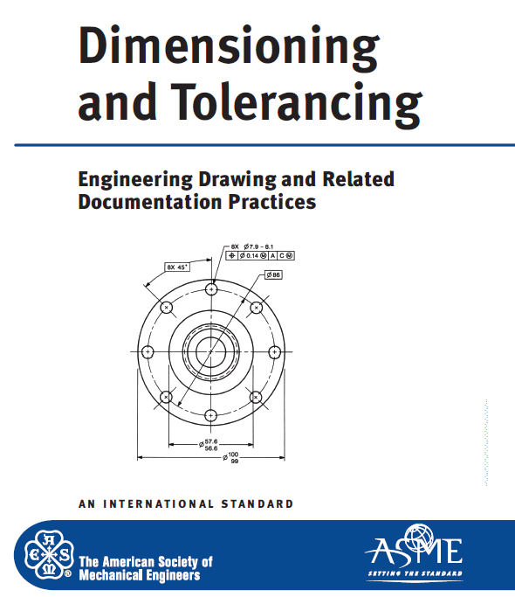
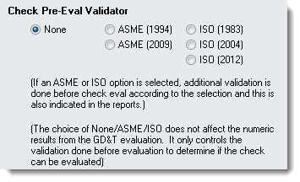
What is “GD&T” in the SA world?
Incorporating Standardized Inspection within SpatialAnalyzer
ASME 1994 Foundation
ASME is a single standard with a thorough explanation and complimentary examples. It is also revised infrequently providing consistency.
Validation for both ASME and ISO is provided.

Slide 3
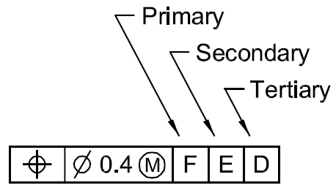
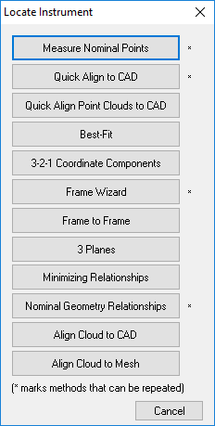
GD&T Inspection
GD&T
“Regular Inspection”
Alignments:
Datum Structure
User Choice…
Notes:
SA’s GD&T Inspection tools provides engineer’s the ability to perform standardized Geometric Dimensioning and Tolerancing
with complete confidence that their inspection is in accordance with the guidelines of the ASME or ISO standard.

Slide 4
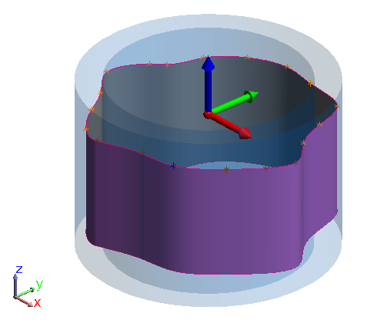
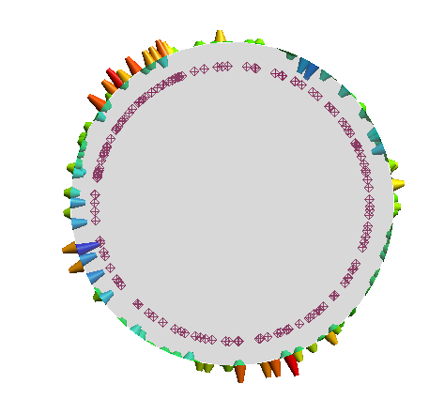
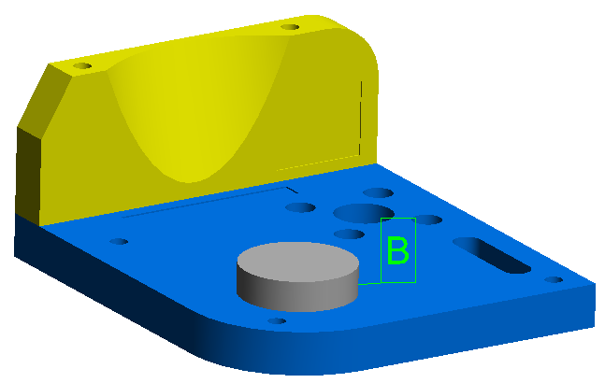
GD&T Inspection
GD&T
“Regular Inspection”
Alignments:
Datum Structure
User Choice…
Evaluation:
Bounding Condition***
RMS (root mean square)
Notes:
SA’s GD&T Inspection tools provides engineer’s the ability to perform standardized Geometric Dimensioning and Tolerancing
with complete confidence that their inspection is in accordance with the guidelines of the ASME or ISO standard.

Slide 5
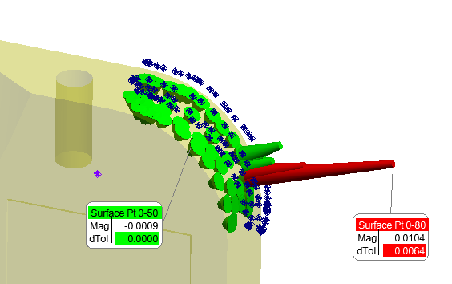
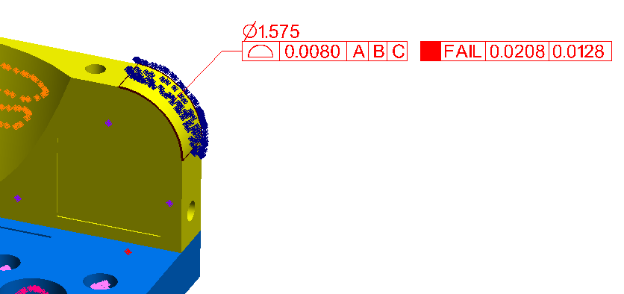
GD&T Inspection
GD&T
“Regular Inspection”
Alignments:
Datum Structure
User Choice…
Evaluation:
Bounding Condition*
RMS (root mean square)
Goal:
Pass / Fail Result
Understand Contributing errors
Notes:
SA’s GD&T Inspection tools provides engineer’s the ability to perform standardized Geometric Dimensioning and Tolerancing
with complete confidence that their inspection is in accordance with the guidelines of the ASME or ISO standard.

Slide 6
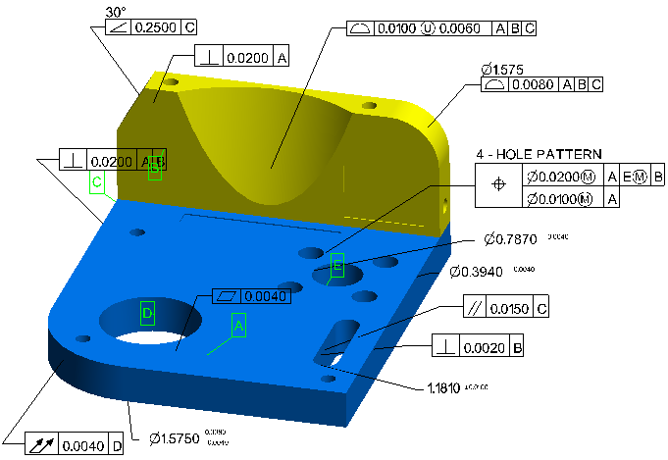
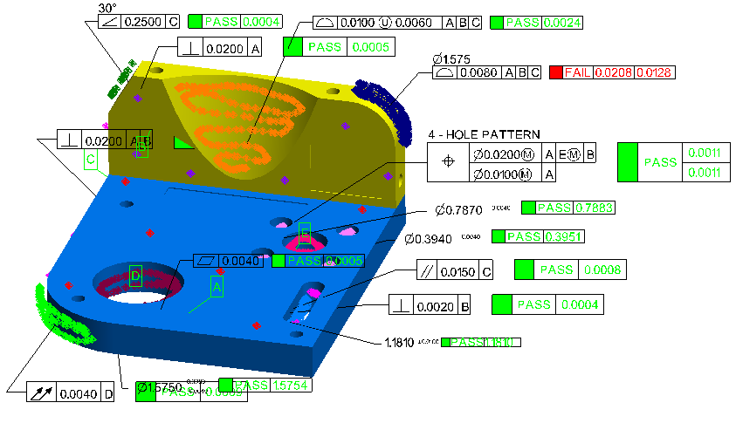
GD&T Inspection
GD&T Inspection - 2 Distinct Steps
1. Defining the Checks
Building Annotations
    Tolerance Structure
    Nominal Designation
2. Measurement Process
  Data Gathering & Association
    Inspection
    Toolkit or Direct Association
    or Measurement Plan (MP)

Slide 7
Building Annotations
The Definition and Details for a Check

Slide 8
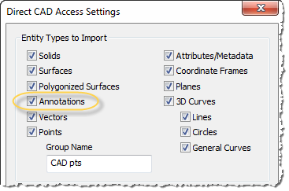
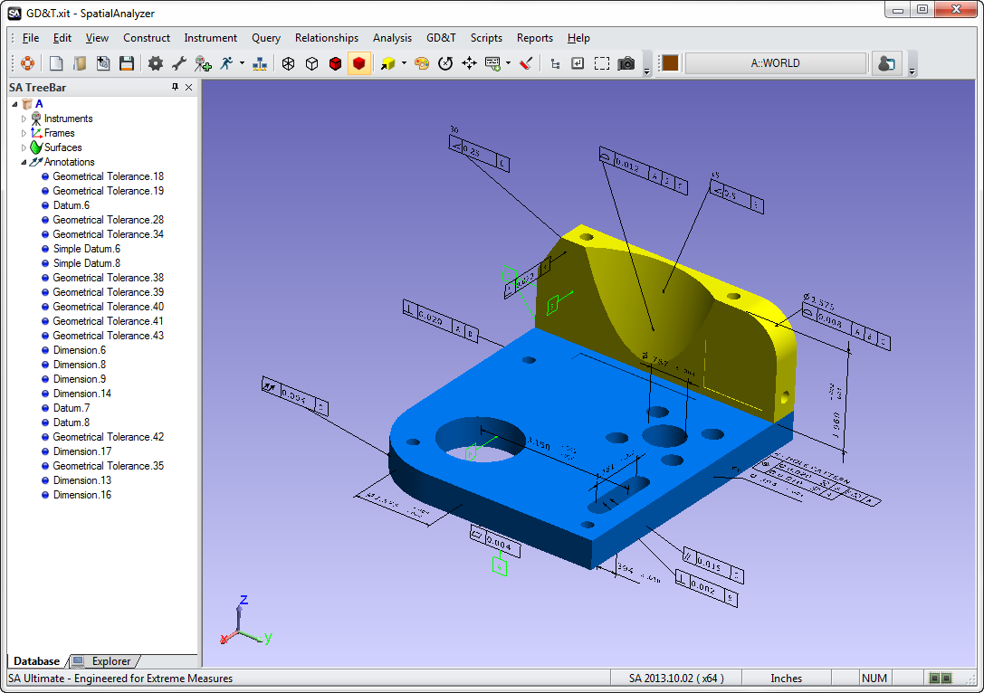
GD&T Annotations
First Option - Import
Importing from CAD:

Slide 9
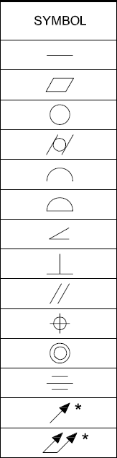
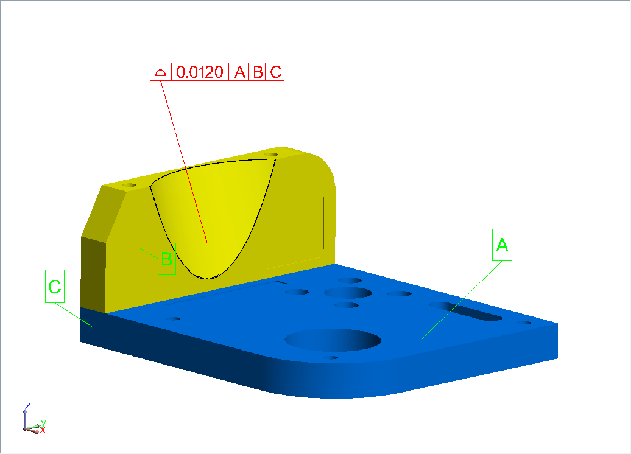
GD&T Annotations
Anatomy of an Annotation
Tolerance = 0.012
With an Alignment:
Primary Datum A
Secondary Datum B
Tertiary Datum C
Surface Profile

Slide 10
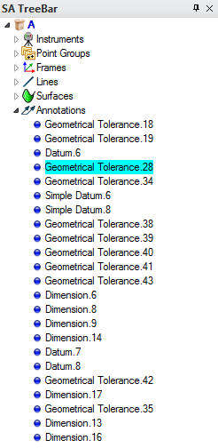
GD&T Annotations
Anatomy of an Annotation

Slide 11
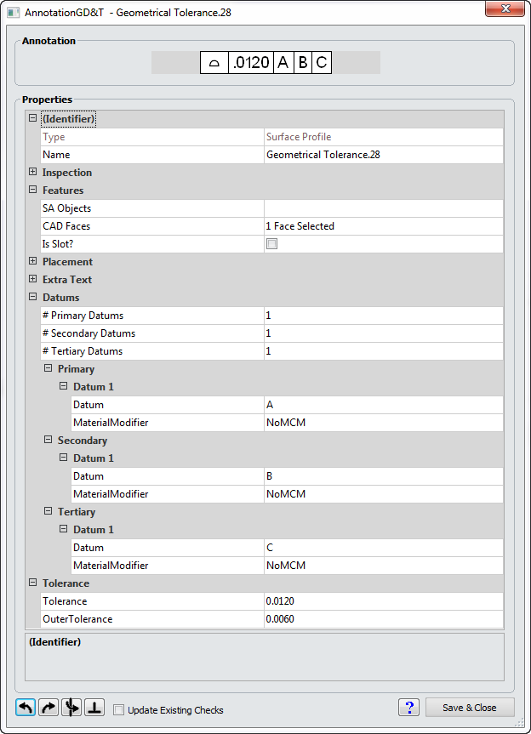
GD&T Annotations
Anatomy of an Annotation
SA Objects/CAD Face
Datum Assignment
Tolerance Definition

Slide 12
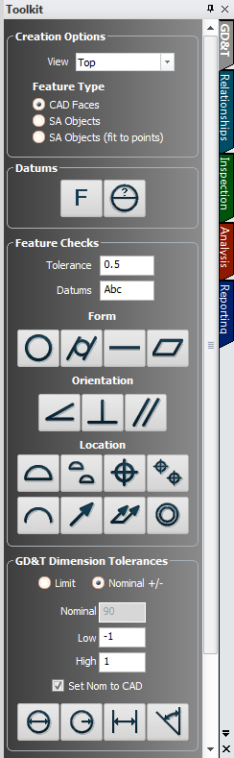


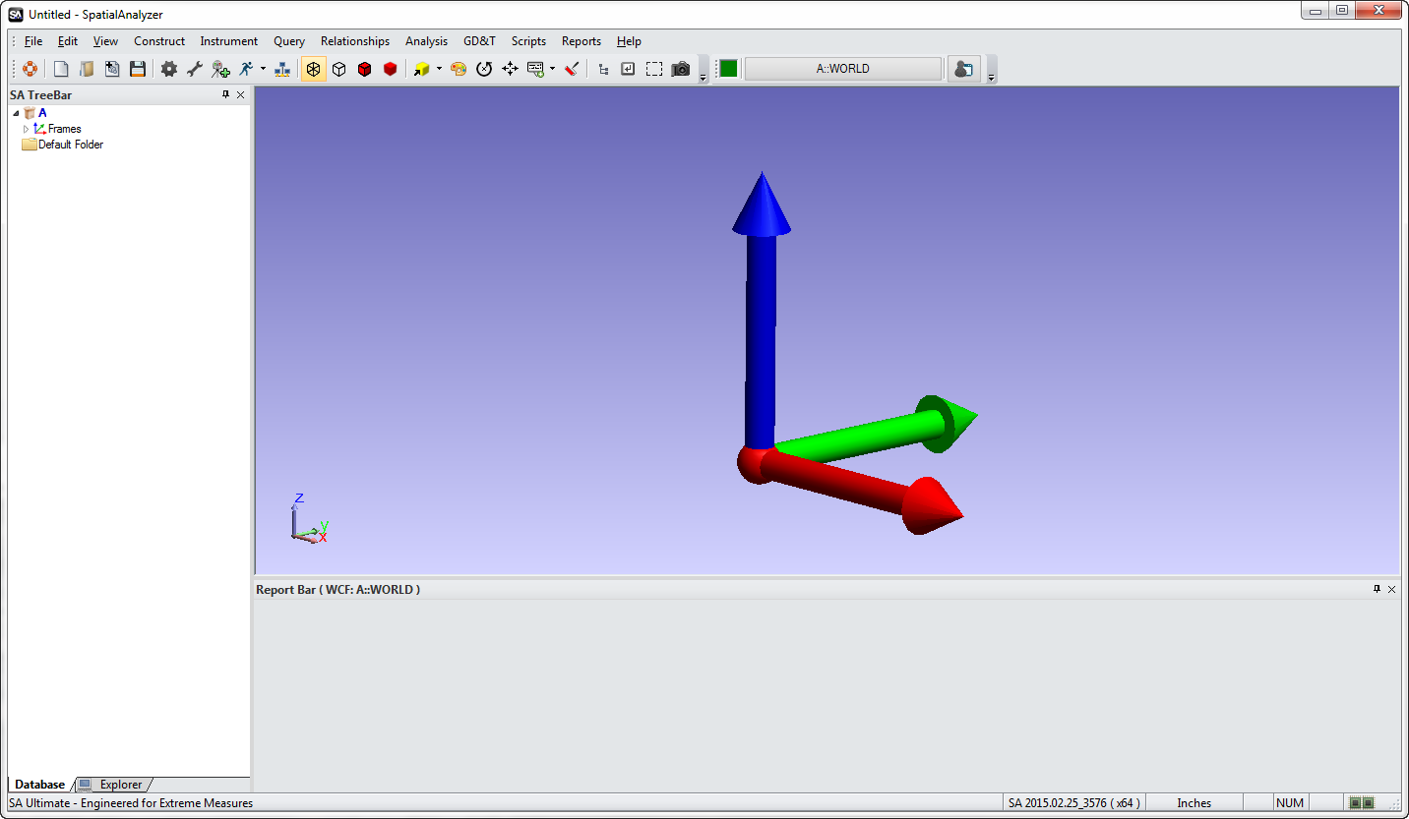
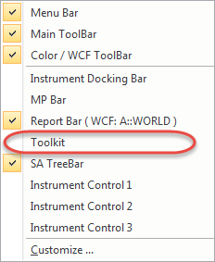
Building Annotations

Slide 13
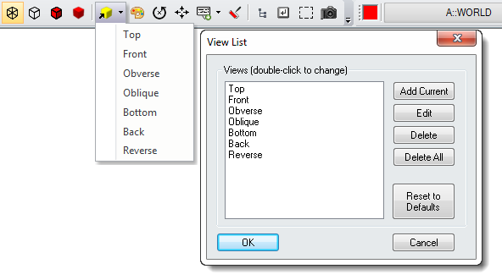
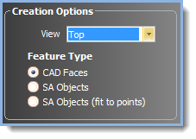
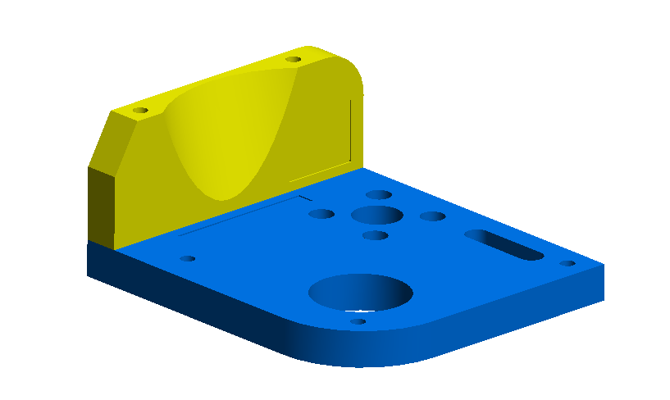
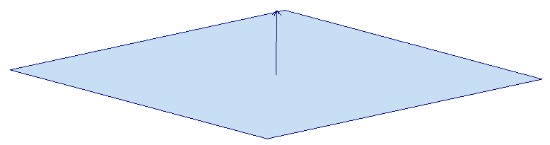
GD&T Annotations
Annotation View Orientation:

Slide 14
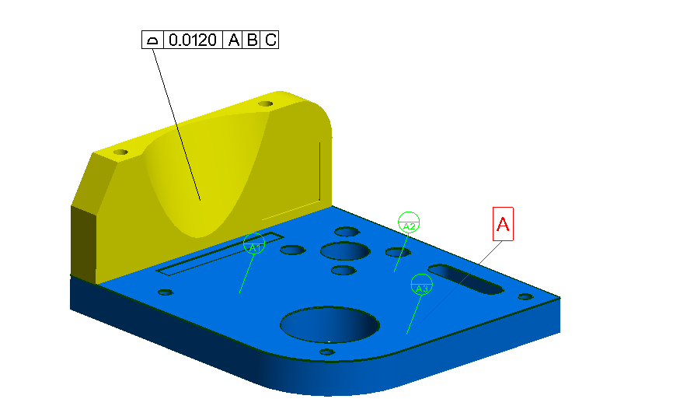

GD&T Annotations
Datum and Datum Target Designations
    (Hold down A-Z to pick a letter)
    Click-point defines leader line anchor point

Slide 15
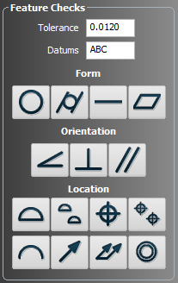

GD&T Annotations
Feature Checks Designation:
1.
3.
2.

Slide 16
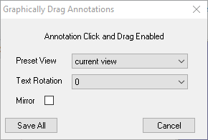
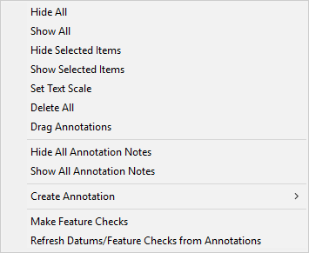
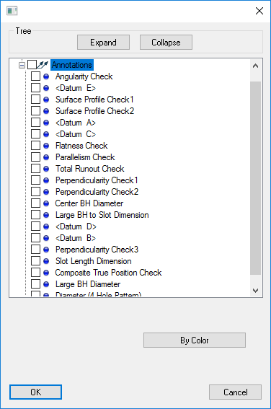
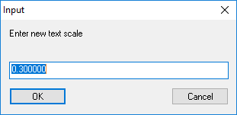
GD&T Annotations
Anatomy of an Annotation
New Right-Click Options:
Annotation Notes
Drag Annotations
Set Text Scale
Show/Hide Selected
Callout Views & Layers

Slide 17
GD&T Inspection
GD&T Inspection - 2 Distinct Steps
1. Defining the Checks
Building Annotations
    Tolerance Structure
    Nominal Designation
2. Measurement Process
  Data Gathering & Association
    Inspection
    Toolkit or Direct Association
    or Measurement Plan (MP)

Slide 18
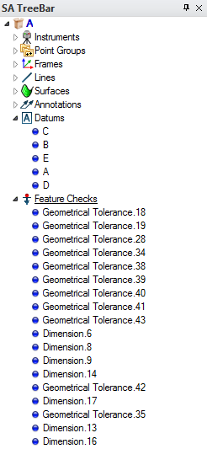
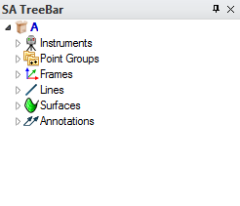
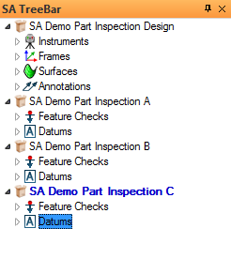
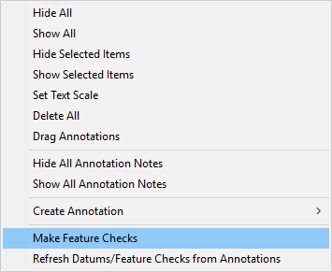
GD&T Inspection
Tree Structure
  Annotations
    Tolerance & check definition
  Datums & Feature Checks
    Link points to annotations
    Point offset & evaluation control
    Contain guided inspection controls
Inspections must be in the working collection and are collection specific.

Slide 19
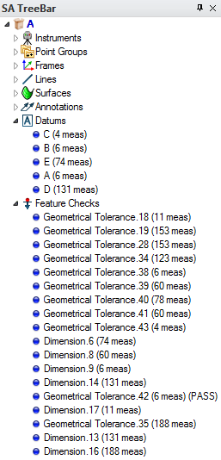
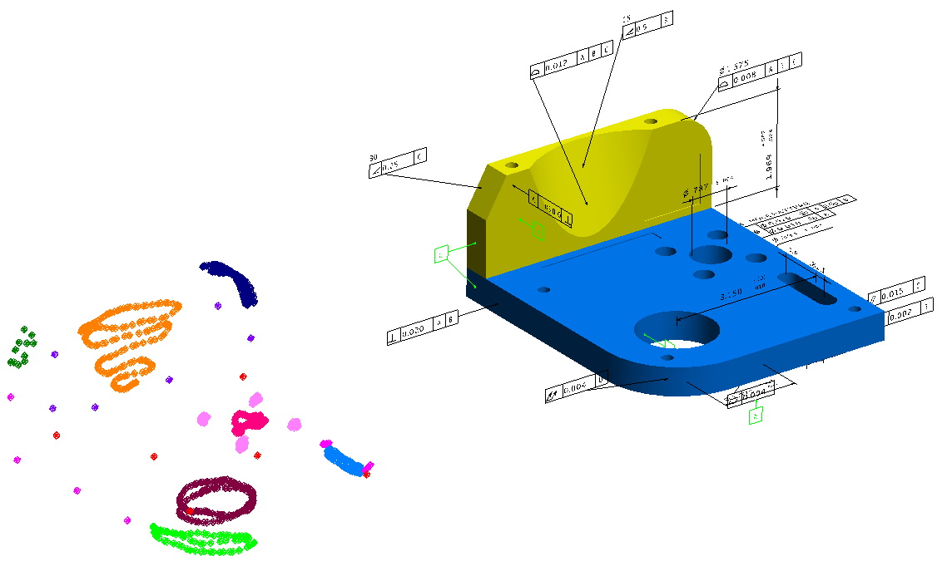
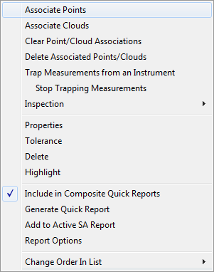
GD&T Inspection
Direct Point Association

Slide 20
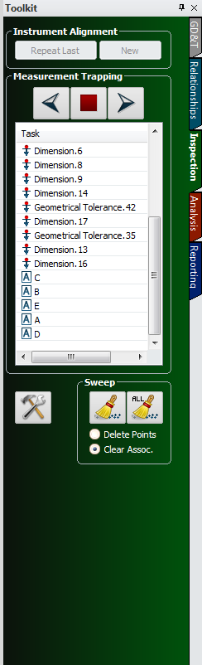
GD&T Inspection
Trapping Measurements

Slide 21
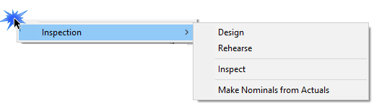
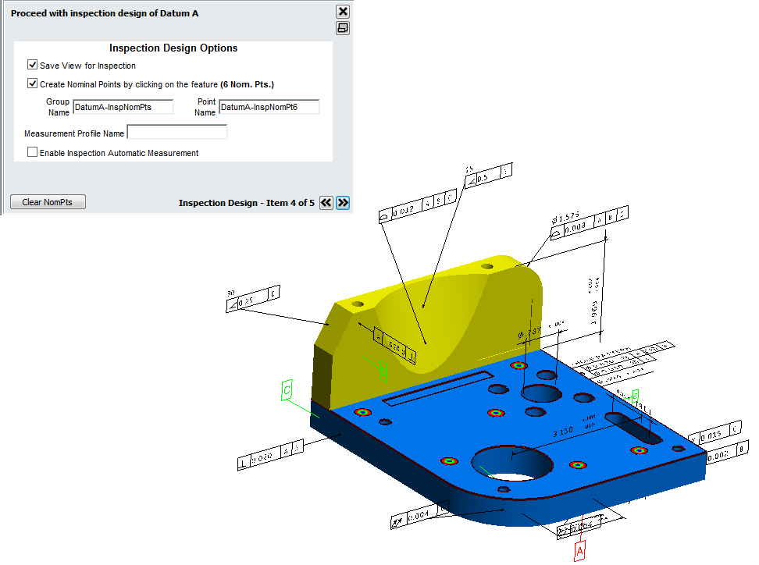
GD&T Inspection
Guided Inspection

Slide 22
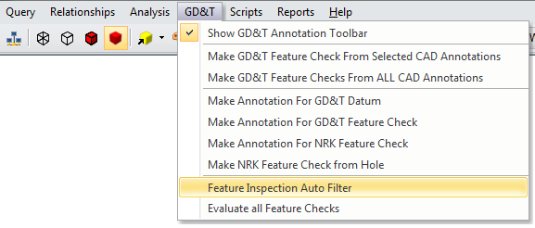
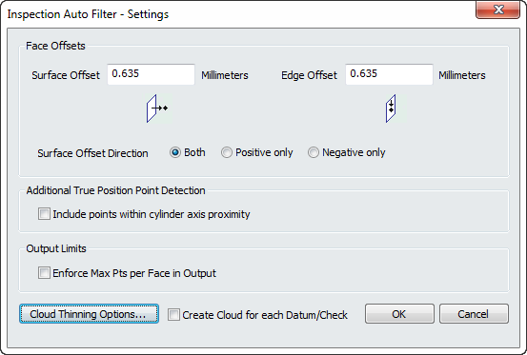
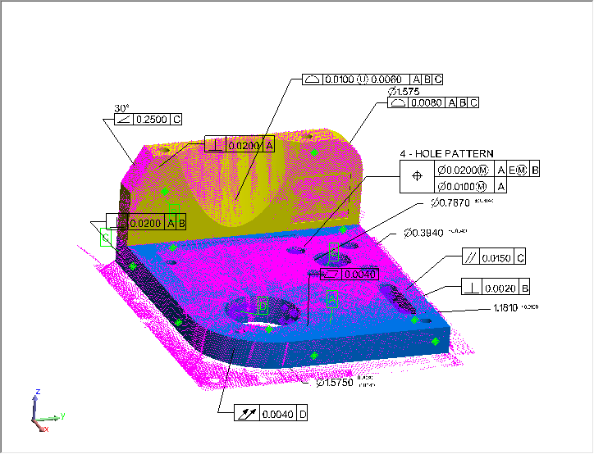
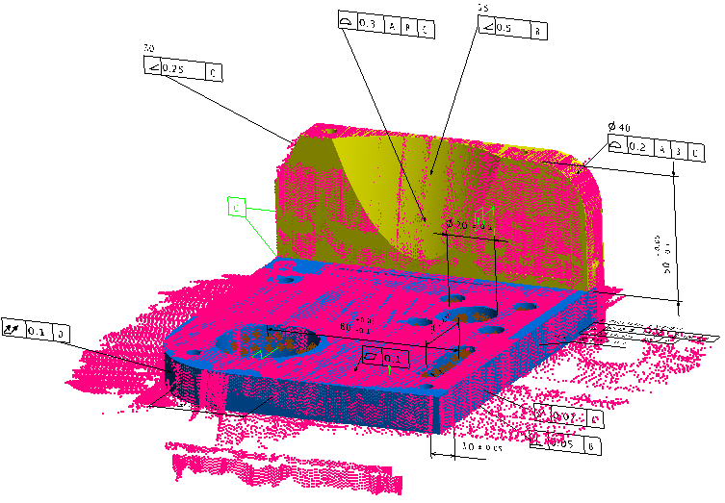
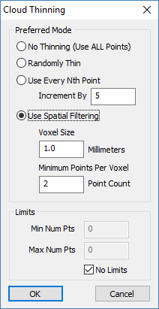
GD&T Inspection
Automatic Point Association
Things to remember:
Proximity Filter
Based on Initial
Alignment

Slide 23
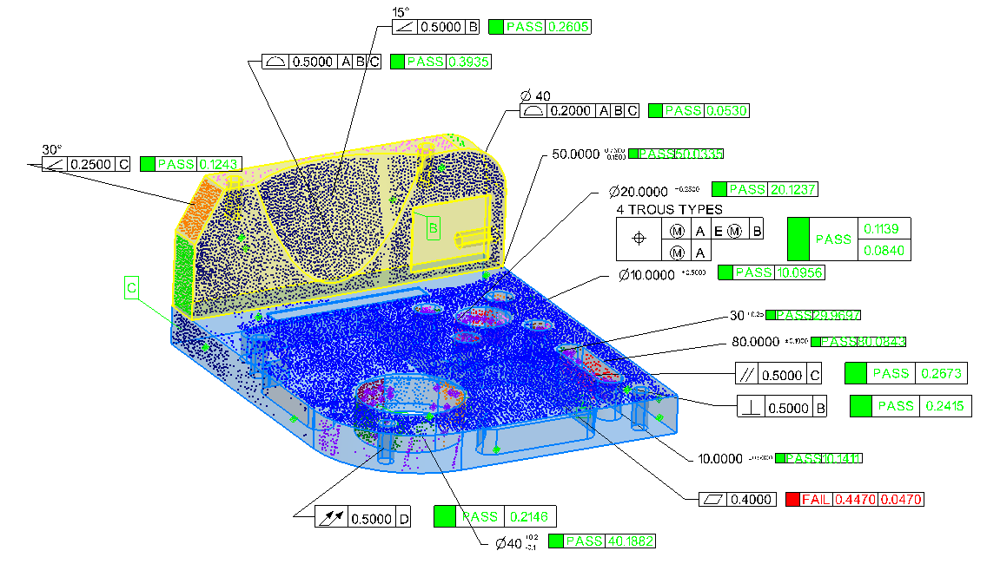
GD&T Inspection
Automatic Point Association

Slide 24
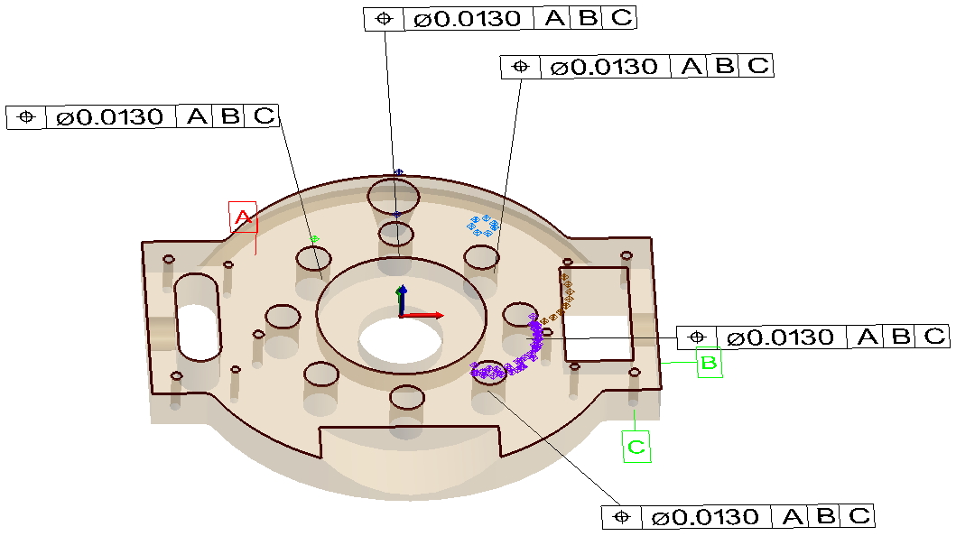
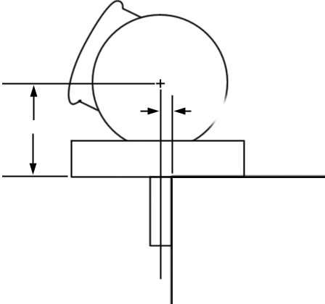
GD&T Inspection
Automatic Point Association

Slide 25
Working Without CAD
Remember Your Basics

Slide 26
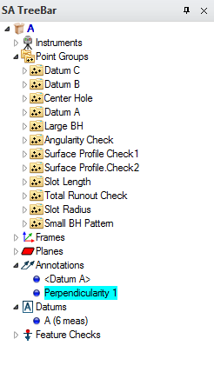
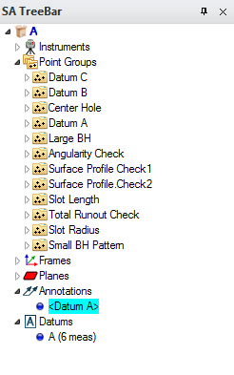






GD&T Inspection

Slide 27





GD&T Inspection

Slide 28
GD&T Inspection
GD&T Inspection - 2 Distinct Steps
1. Defining the Checks
Building Annotations
    Tolerance Structure
    Nominal designation

Slide 29

GD&T Inspection

Slide 30



GD&T Inspection

Slide 31
Report Options

Slide 32



Reporting

Slide 33








Reporting
Basic Report Display Options
Measured Deviation (GD&T Result)
Distance Out of Tolerance
Reports the Worse Value

Slide 34

Reporting
Basic Report Display Options
Measured Deviation (GD&T Result)
Distance Out of Tolerance
Alignment Transform
Datum Deviations Statistics

Slide 35



Reporting
Basic Report Display Options
Bonus Tolerance Information
Pattern Feature Deviation
Position and Profile Only

Slide 36

Reporting
Basic Report Display Options

Slide 37

Reporting
New GD&T Summary Report

Slide 38

Reporting
New GD&T Summary Report

Slide 39

Demo – Basic Fit & Link Data

Slide 40
Getting into the Details
Understanding Check Types

Slide 41


GD&T Annotations
Feature Checks Designation:
  Form Checks
    Datum Independent

Slide 42




Flatness
Standard Inspection (RMS):

Slide 43





Flatness
Flatness Evaluation Process within SA:
Two parallel planes are built bounding the extents of the data.
These planes are allowed to freely rotate to establish the minimum distance between them while still containing the data.

Slide 44

GD&T Annotations
Feature Checks Designation:
  Form Checks
    Datum Independent
  Orientation Checks
    Depend on 1 Datum

Slide 45
Orientation Checks
Nominal Angle
Deviation = Distance btw Planes
Datum

Slide 46

GD&T Annotations
Feature Checks Designation:
  Form Checks
    Datum Independent
  Orientation Checks
    Depend on 1 Datum
  Location Checks
    Can Include 1-3 Datums
    Can Include 1-2 Tiers

Slide 47
GD&T Annotations
Surface Profile:
GD&T Reports:
Measured Deviation (GD&T Result)
Distance Out of Tolerance
Vectors Report:
Radial Deviation
Distance out of Tolerance

Slide 48

GD&T Annotations
Composite True Position:

Slide 49




GD&T Annotations
Dimensional Tolerances
Notes:
Feature Check selection simplifies check assocation

Slide 50


GD&T Annotations
Dimensional Tolerances

Slide 51




GD&T Annotations
Feature Checks Categories:
Cross Section
Checks

Slide 52

GD&T Annotations
Cross Section Checks:
Runout
Cross Section
Check
Total Runout
Surface Check

Slide 53

GD&T Annotations
Cross Section
Checks

Slide 54
Feature Check Properties
Going a Bit Deeper

Slide 55

Building Feature Checks
Offset Compensation
Inspection Controls
Evaluation Method

Slide 56







Building Feature Checks
Cylinder Evaluation Method
Circle Fit Evaluations:
Axis Fit Evaluations:

Slide 57



Building Feature Checks
Cylinder Evaluation Method
Extrapolate Axial Extents
Off…

Slide 58


Building Feature Checks
Cylinder Evaluation Method

Slide 59
Datum Alignment

Slide 60


Datum Alignment
Right- Click Datum Category
  Select “Align”

Slide 61







Datum Alignment
Datums and Degrees of Freedom
Geometry Type
Sequence
A
Rx, Ry, Z
C
3 DoF Remain
X,Z, Rx, Ry, Rz + Y
B
Rx, Ry, Z + X, Rz
1 DoF Remains

Slide 62

Datum Alignment
Datums and Degrees of Freedom
Geometry Type
Sequence
A
Rx, Ry, Z
B
3 DoF Remain
C
X,Y,Z, Rx,Ry, + Rz
Rx, Ry, Z + X, Y
1 DoF Remains

Slide 63




Datum Alignment
Offset Compensation

Slide 64




Datum Alignment
Enable Datum Alignment

Slide 65







Datum Alignment
Aligning to Curved Surfaces
Surface Datums require “Offset Object” designation
Constrains (Rx, Ry, Z )
but not (Rz, X or Y)
Constrains (X,Z,Rx,Rz )
but not (Y or Ry)

Slide 66

Datum Alignment
Aligning to Curved Surfaces
Surface Datums require “Offset Object” designation

Slide 67



Datum Alignment
Aligning to Curved Surfaces

Slide 68



Evaluations Tools

Slide 69
Questions?

Slide 75


Troubleshooting
Check Computation
Geom Relationships
Datum Alignment
Curvy Surfaces

Slide 76

Demo- Basic Fit & Link
Notes:
Objective is to demonstrate:
Setting a view for the Annotations
Adding Datums Annotations
Adding Feature checks Annotations
Opening the Properties and changing properties
Controlling Graphical Placement
End with Direct CAD Import with all the annnotations

Slide 77

Reporting
Basic Report Display Options

Slide 78





Reporting
Basic Report Display Options

Slide 79



Reporting
Inspection
Controls

Slide 80

Reporting
Callout layer control now supports Annotations

Slide 81


Datum Alignment
Z,Rx,Ry
Start thinking:
Datum Priority
Degrees of Freedom
Offset Compensation
X,Y,Z
X,Y,Rx,Ry
X,Y,Z,Rx,Ry
X,Y,Z,Rx,Ry,Rz
All 6 DoF are constrained with 1 datum…

Slide 82


Concentricity
Cross Section Checks:
Concentricity
Cross Section
Check

Slide 83

GD&T Inspection
Why GD&T???
GD&T answers the following questions:
1. How did you align to the part?
2. What evaluation method did you use?
3. What tolerance did you use?
Will the bolt fit in the hole, YES or NO?
Notes:
SA’s GD&T Inspection tools provides engineer’s the ability to perform standardized Geometric Dimensioning and Tolerancing
with complete confidence that their inspection is in accordance with the guidelines of the ASME or ISO standard.

Slide 84

GD&T Annotations
Datum and Datum Target Designations
    (Hold down A-Z to pick a letter)
    Click-point defines leader line anchor point

Slide 85

Building Annotations Demo
Notes:
Objective is to demonstrate:
Setting a view for the Annotations
Adding Datums Annotations
Adding Feature checks Annotations
Opening the Properties and changing properties
Controlling Graphical Placement
End with Direct CAD Import with all the annnotations

Slide 86
Associating Data
Working with Datums and Feature Checks

