Slide 1
Pipe and Relationship Fitting
Scott Sandwith

Slide 2
Relationships = Value
Relationships capture the distances or orientation between measurements and objects
Collections of objects (describe common relationships) → Part Features
EASY TO USE
Directly Optimize Part Features → Best Performance
Transform Features and Instruments to Parts with Relationships (Feature to Feature BEST-FIT)
* Enhanced Reference System

Slide 3
Benefits of Relationship Fitting
Optimize product performance
Relationship between features are optimized directly! → Build / Inspect / Report → Repeat
Cost savings and flow time reduction
Set/Inspect/Report/Repeat part features directly from CAD
Reduces measurement tolerance guess work
Improves assembly reliability
Custom configurations directly on the shop floor
Integrate assembly configuration for design/tolerance improvements

Slide 4
Relationship Fitting Basics
Measure Features then associate to Nominal Features in Relationships
Each measured/nominal pair is saved in at least one relationship
Decide what moves and what remains fixed
Generally move the “measured” to the “nominal”
Define tolerances, sampling, constraints and options
Tolerance, nominal angle/distance between, keep outside/inside, sub sample options, outlier rejection, weight, etc.
Optimize Alignment - Relationships
Solve simultaneously or piecewise
Report Results

Slide 5
Part 1: Relationship Fitting

Slide 6
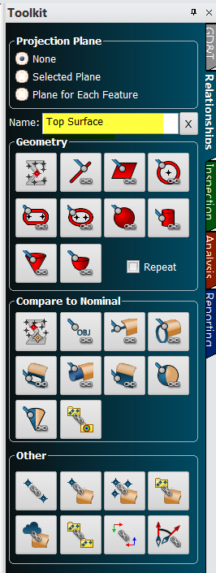
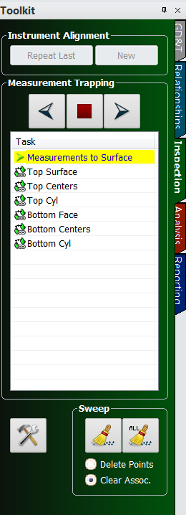
Building Relationships
Notes:
You probably already know that several types of relationships can be built between measured data and design in order and used to align the two.
Relationships can be built before or after you make your measurements. Using the Relationships tab in the Toolkit bar, you can quickly build a relationship,
[CLICK] and then trap measurements by double-clicking on the relationship in the inspection tab.
Alternatively, you can right-click on the relationship in the tree and select Associate Data, and then select the points or groups you want to use in the relationship.

Slide 7
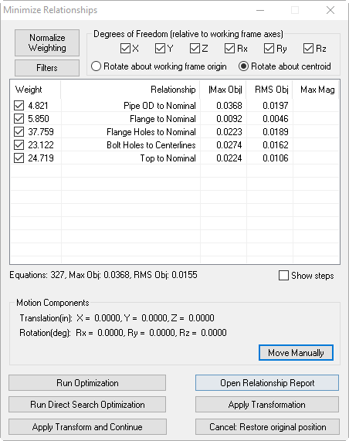
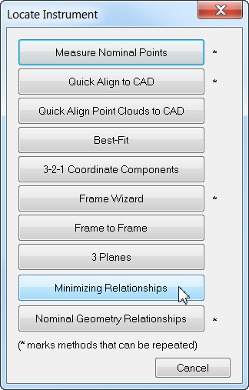
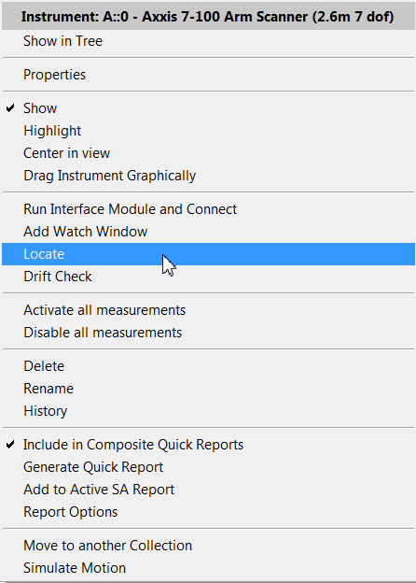
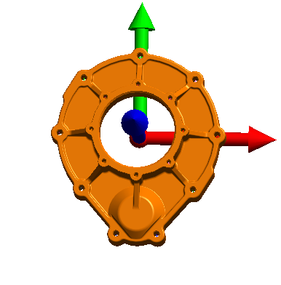
Minimize Relationships
Notes:
Once these relationships are built and measurements are associated with each, you can then located the instrument by selecting the minimize relationships option in the locate instrument dialog.

Slide 8
Advanced Properties
Auto Vectors
Outlier Rejection
Fit Weight
Degrees of Freedom
Fit Constraints
Notes:
But there are several advanced properties that you may not be aware of that can be used to help optimize your fit.

Slide 9
Auto Vectors
Points/Groups to Objects relationships
Dynamic
Magnified visual indicator
Notes:
If you have either a points or groups-to-objects relationship, you can right-click on the relationship in the tree, go to the relationship properties, and turn on Automatic Vector Group.
This vector group will update continuously as you move your instrument or take additional measurements, and it will give you a magnified visual indicator of the distance each measured point is from the part.

Slide 10
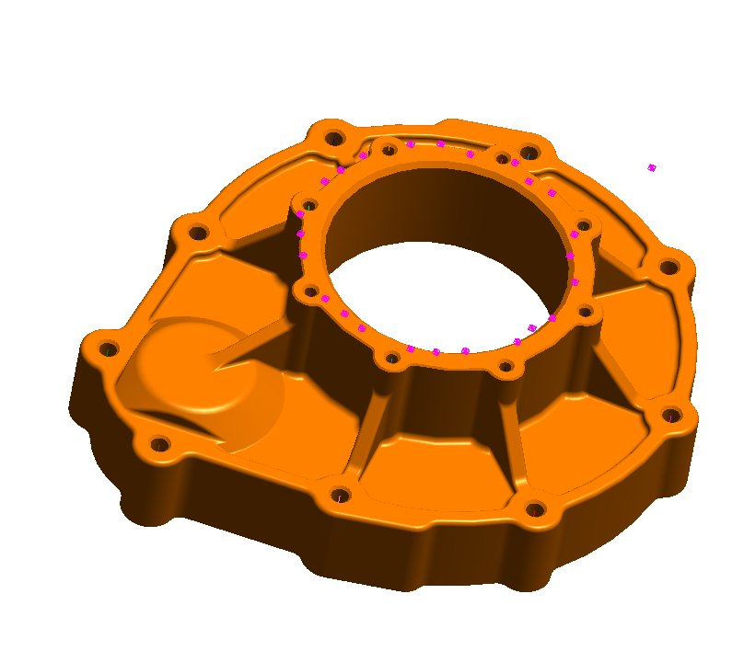
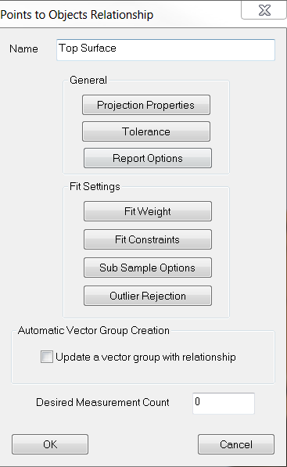
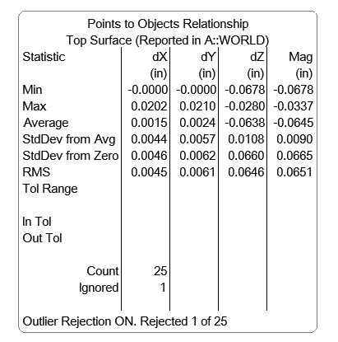
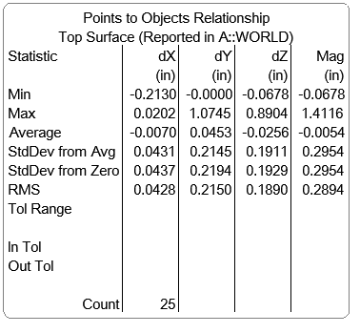
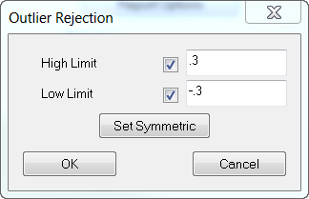
Outlier Rejection
Notes:
Stray points such as accidental measurements can cause your deviations to be considerably higher than normal.
[Click] Under the fit setting for the relationship, there is an option to turn on Outlier Rejection, which automatically removes outliers from your data set.
[CLICK] Once activated, points that are beyond a predefined high and low tolerance will be excluded from the fit solution so they don’t throw off your fit. [CLICK]

Slide 11
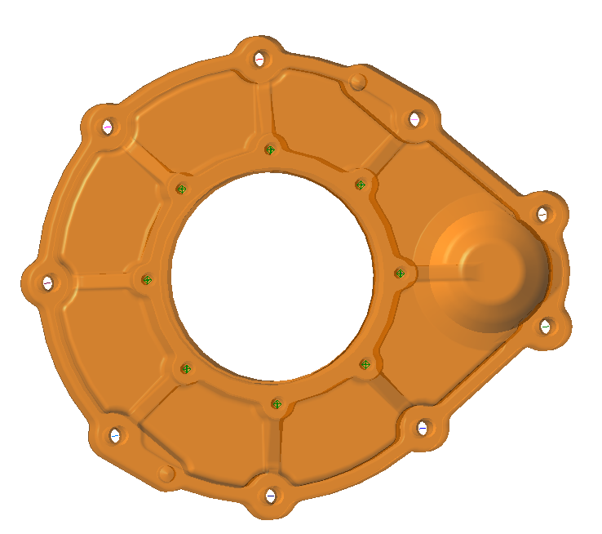
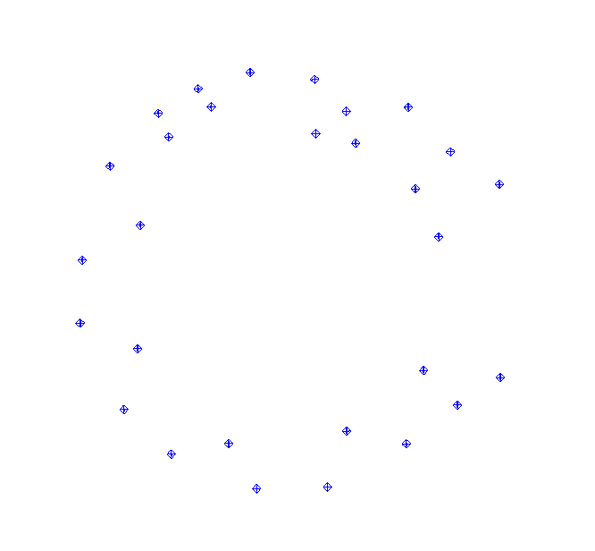
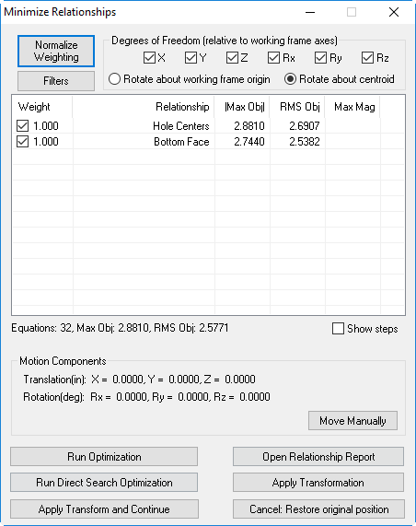
Weight Normalization
Hole Centers
8 points
Bottom Face
24 points
Weight = 1.0
Weight = 1.0
(Triple the total weight)
Notes:
With SA Ultimate, you have even more options at your disposal for relationship fitting. [CLICK] You can build multiple relationships and evaluate them all at the same time. SA provides a number of useful ways to determine which relationships have the most influence on the resulting fit.
[CLICK] Many people assume that a fit weight of 1 for each relationship means that each relationship has equal influence. However, this is not true. This actually means that each point in the relationship has a weight of one, causing relationships with a higher number of points to have more influence.
[CLICK] Let’s take this part as an example that has eight points measured on these hole centers and we are attempting to align those to centerlines.
[CLICK] We create another relationship to align the Bottom Face points to the surface. The bottom face has 24 points in it.
[CLICK] What this means is that the Bottom Face will have triple the weight as the hole centers since it has triple the amount of points.

Slide 12
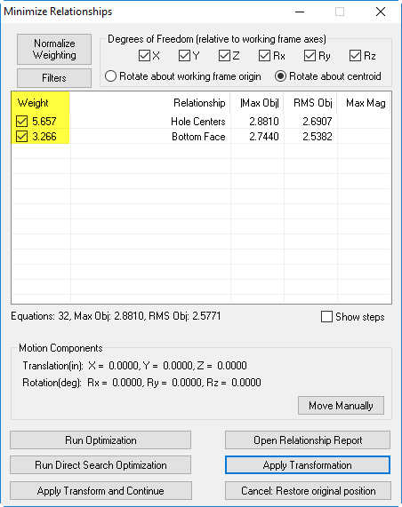
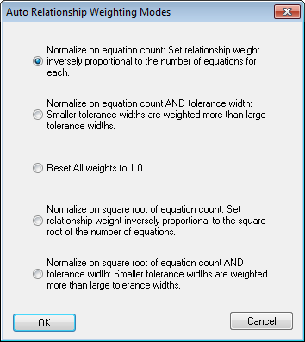
Weight Normalization
Notes:
In order to equalize these relationships, we’ve given you a few options. By selecting Normalize Weighting….
[CLICK] You can select one of five modes. We recommend using either the first option, which is the number of points divided by the respective relationship count (EVERY POINT IS EQUAL)
[CLICK] or the fourth option, which is the number of points divided by the square root of the respective relationship count. (EVERY RELATIONSHIP IS EQUAL)

Slide 13
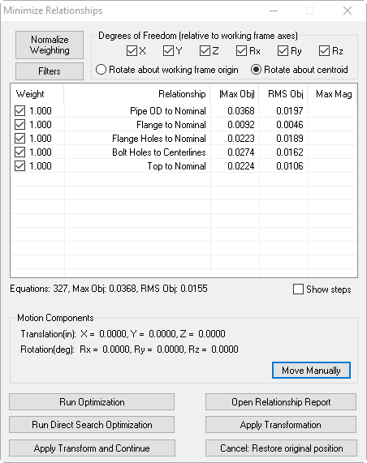
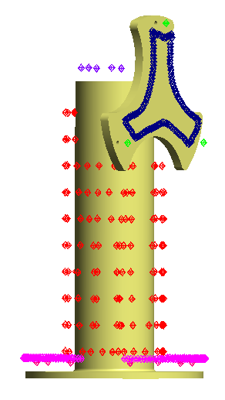
Fit Weighting
Notes:
You can see the advantage here to be able to use SA Ultimate in order to normalize weighting and run all of the relationships simultaneously. Many people change the weighting themselves, and while that is certainly an option as well, this takes out some critical thinking for you.

Slide 14
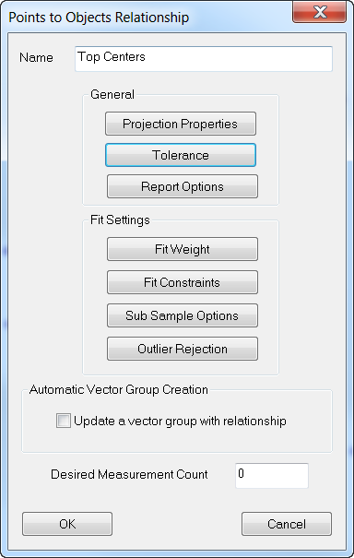
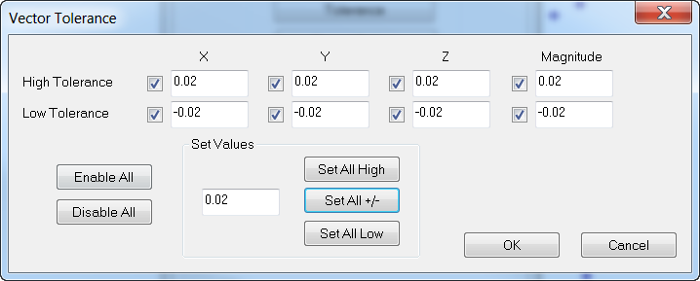
Tolerances
Notes:
One of the most useful settings we have in the relationship settings is the ability to add a tolerance which can be used to solve for the best fit.
[CLICK] Let’s say that we know the tolerance for a particular feature is +/- .02”. Simply type that in and
[CLICK] then go back to the normalize weighting dialog where you have two more options at your disposal which incorporate not only the number of points in a relationship but also the tolerance. Features that have higher tolerances than others will have less influence and be allowed to float around more than the critical features. This has been shown to actually pass parts that would have otherwise failed.

Slide 15
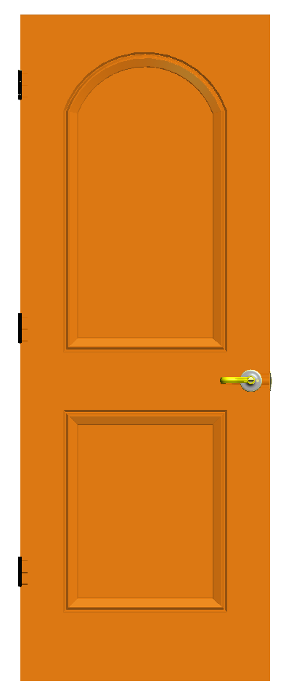
Degrees of Freedom
Key Fit-Up Features
Hinge Points
Top of Door
Jamb Face
Notes:
Relationships, by their very nature, automatically take care of constraints when they are created. Different geometric setups will result in different constraints.
[CLICK] By fitting a door up to a door frame we can create three separate relationships using key features and minimize each separately to demonstrate the ability relationships have to set up constraints “naturally” without explicitly defining further constraint parameters.

Slide 16
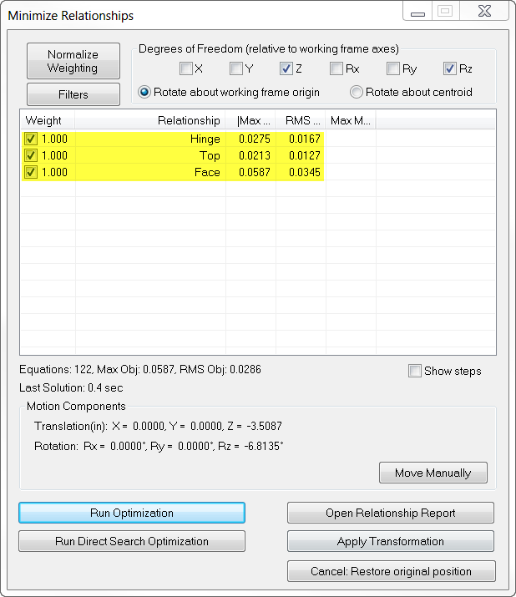
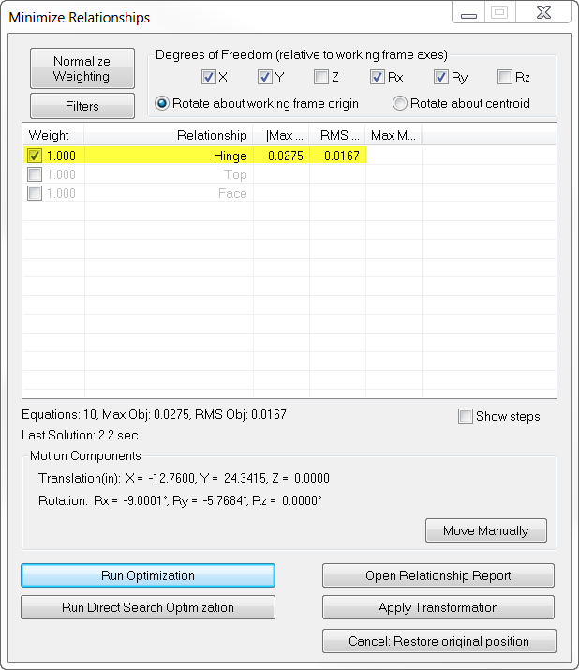
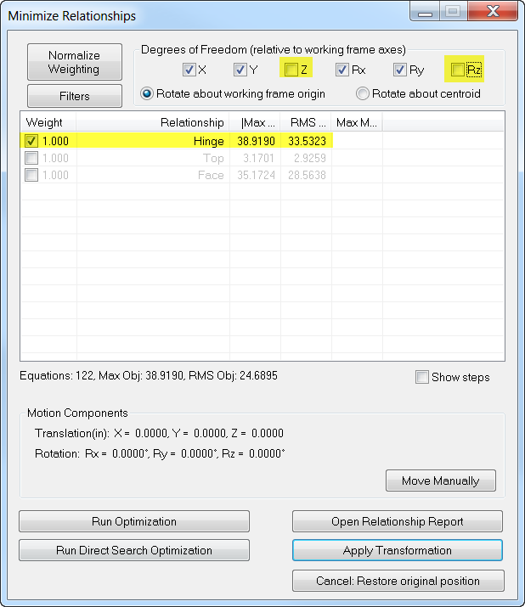
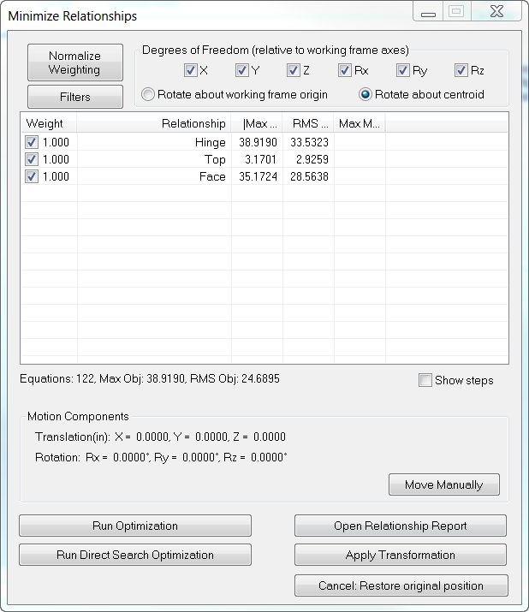
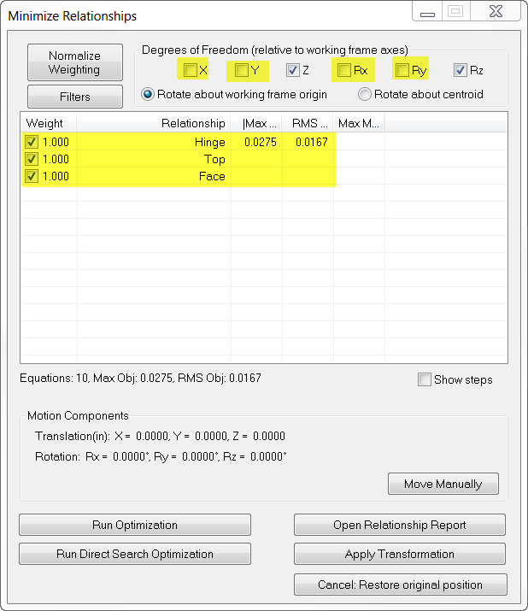
Degrees of Freedom
X
Y
Z
Rx
Ry
Rz
Notes:
Once you create these three relationships, and arrive at the minimize relationships dialog, you will see three relationships.
[CLICK] The hinge would most likely be the most critical fit-up of the three, so let’s fit this up first. There are many ways to run relationships, some of them may be through trial and error. Uncheck the top and face relationships and uncheck the Z and Rotation in Z degrees of freedom, see we will you those with the other two relationships.
[CLICK] Select Run Optimization and here is our result. The door is fit to the hinge, but clearly needs to move down in Z and rotate in Z as well.
[CLICK] Since the Top and Face both require movement in Z and Rz, let’s run all three together, with just Z and Rz checked, since we are already in position and orientation for X and Y.
[CLICK] Once you run the optimization again, you will see that the three relationships are fit.
[click] Since the bottom of the door was not measured, however, it’s obvious that there is a rather large gap there.

Slide 17
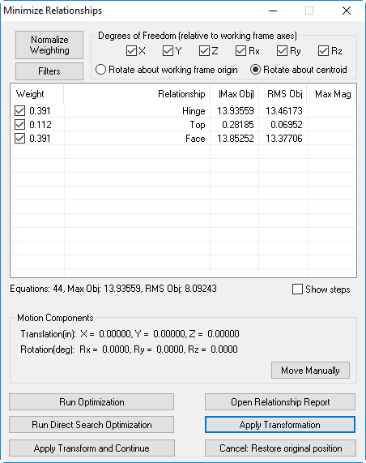
Apply Transform and Continue
Notes:
We’ve added a new option that you can select between each iteration when you are changing degrees of freedom. This will allow the apply the last solution and allow you to make changes to the degrees of freedom so that is the new starting point when running the next optimization.

Slide 18
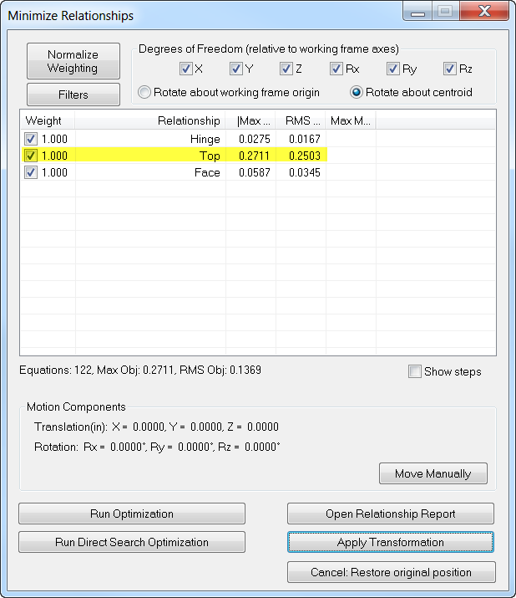
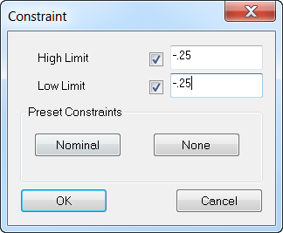
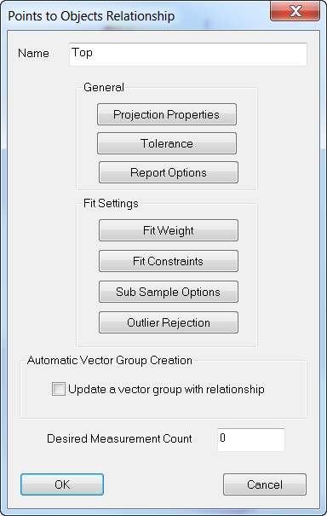
Fit Constraints
EXACTLY
0.25”
Notes:
This is where what we call Fit Constraints comes in to play. Let’s say that we need a quarter of an inch clearance between the top of the door and its frame. This means we need to move it down .25”.
[click] There are several options here, one of these being setting a high constraint of -.25” and leaving the low limit unchecked. This means that the door will move down at least .25”…but maybe more. The highest point in that data set will be at the high limit.
[click] Another option is to move this door down exactly .25”. So we can set the high and low limits at -.25”.
[click] Once we do this, you will see that the max and RMS have added on an extra .25”.

Slide 19
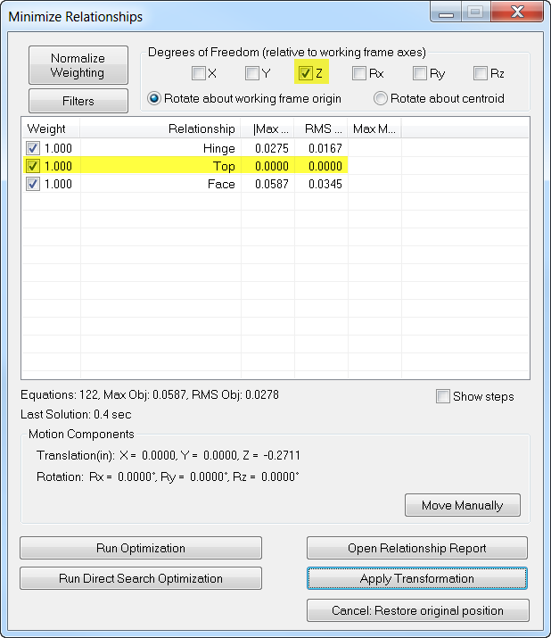
Fit Constraints
Notes:
[CLICK] Once we run the optimization with these new fit constraints in place, you will see the door move down .25” and the new RMS and MAX deviation should read as zero if the solution worked.

Slide 20
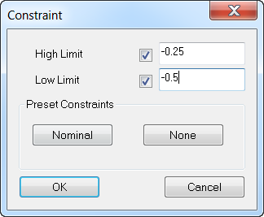
Fit Constraints (Dead Zone)
-0.25
-0.50
Notes:
What this means is the high and low limits essentially serve as what we call a “dead zone”. For instance, if the high limit was set at -.25 and the low at -.5. the RMS will be displayed as what they truly are from the limit.
[click] once the points are within the limits, they will be displayed as 0 and have no influence in the fit whatsoever.

Slide 21
Fit Constraints (Positive)
+ 0.25in
+ 0.50in
FIXED
PART TO BE ASSEMBLED (ALIGNED)
SHIM (GAP MANAGEMENT)

Slide 22
Fit Constraints (Negative)
-0.50in
-0.25in
FIXED
PART TO BE ASSEMBLED (ALIGNED)
TO BE TRIMMED (CLASH MANAGEMENT)

Slide 23
Run Optimization
Newton – Raphson Method
Assembles matrix
6(unknowns) X
N (# of points)
Inverts Matrix
Determines move directions
Notes:
SA makes small progressive movements of the instrument and associated points until the average is reduced as much as possible. Run Optimization is the default mode of operation and it is based on the Newton-Raphson Method. The optimization method performs a version of the steepest-descent algorithm on the system. This means it assembles a matrix that is 6 (unknowns) X N ( number of points), inverts it and determines move directions.

Slide 24
Direct Search Optimization
Hooke & Jeeves
Step, Evaluate, Repeat
Tolerancing &
Fit Constraints
Can deal with large point sets
Notes:
Many SA users know that there is a run optimization option and a run direct search optimization and they run both of them without knowing the difference between the two.
What a Direct Search does is it provides a powerful method for searching the solution space. It is also required when using the tolerance-best fitting options since they introduce non-linearities into the solution space.

Slide 25
Part 2: Virtual Fit & Predictive Shimming

Slide 26
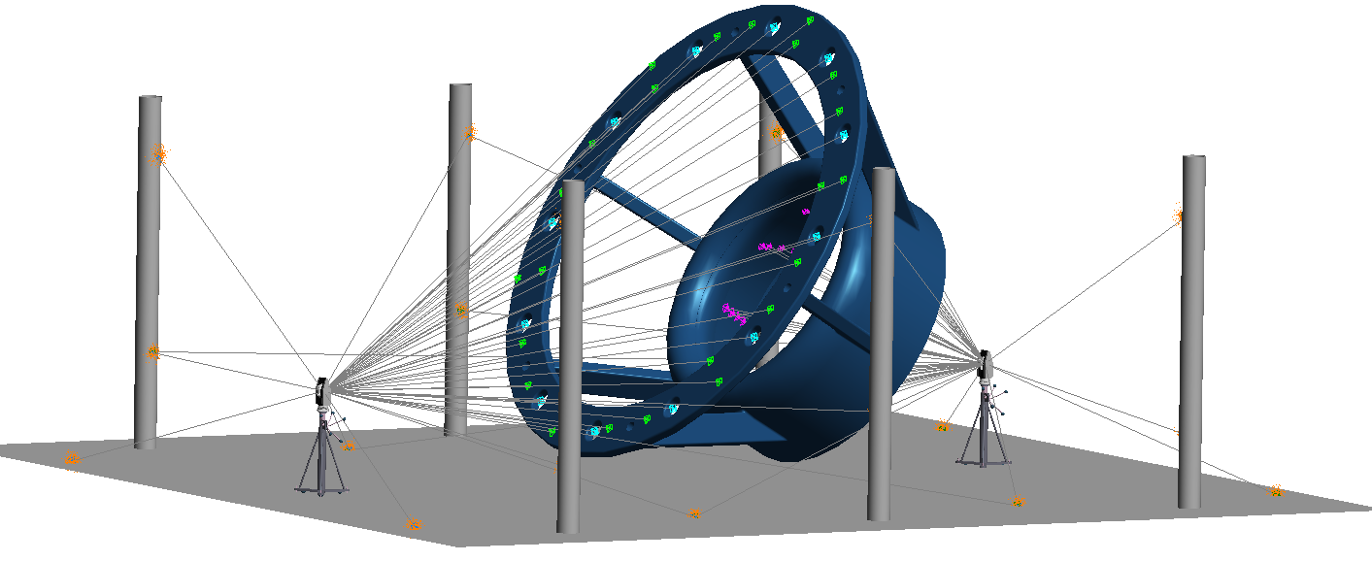
Demo 2: Virtual Fit & Predictive Shimming
Base Survey
Scenario:
Two large parts were measured independently. They will be assembled together.
Goals:
Align the two components such that
Axis of the “Top Inner Cone” and “Base Cylinder” are in line and parallel.
Mating surfaces are as close together as possible without intersecting
Bolt Holes line up.
Top Survey

Slide 27
Process
Import separate inspection files into the same SA file
Create Geometry
Top Cone
Base Cylinder
Base Plane
Create relationships
Solve relationships in sequence

Slide 28
Process
Create relationships
Object to Object Direction
Top Cone/Base Cylinder
Points to Objects
Top Mating Points/Bottom Mating Plane
Group to Group
Top Bolt Hole Centers/Bottom Bold Hole Centers
Make a working frame relative to fixed object.
Solve relationships in sequence

Slide 29
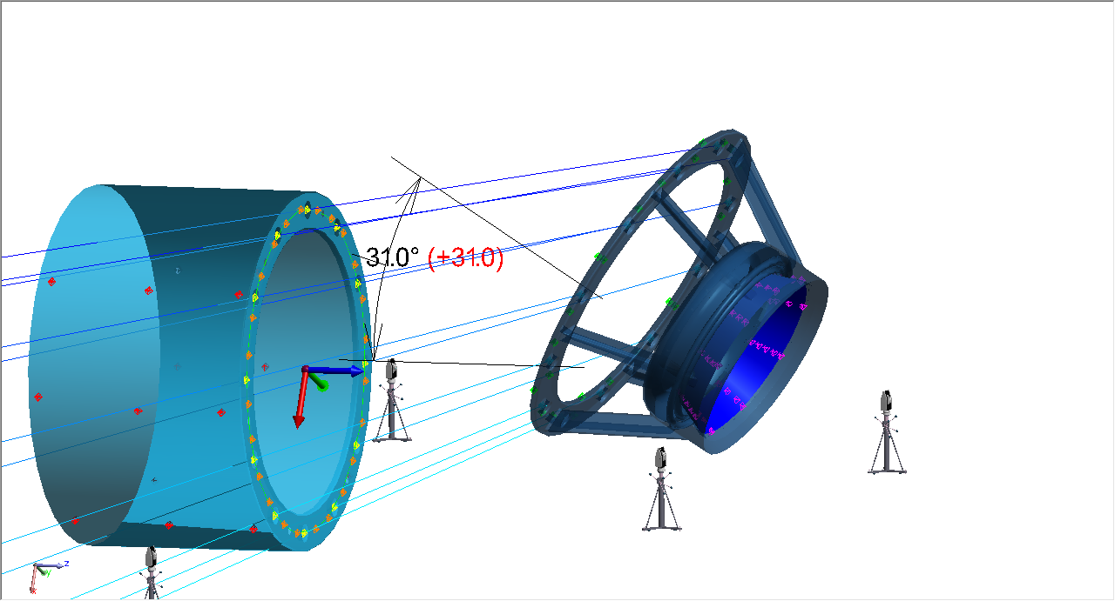
Virtual Alignment
Starting Position

Slide 30
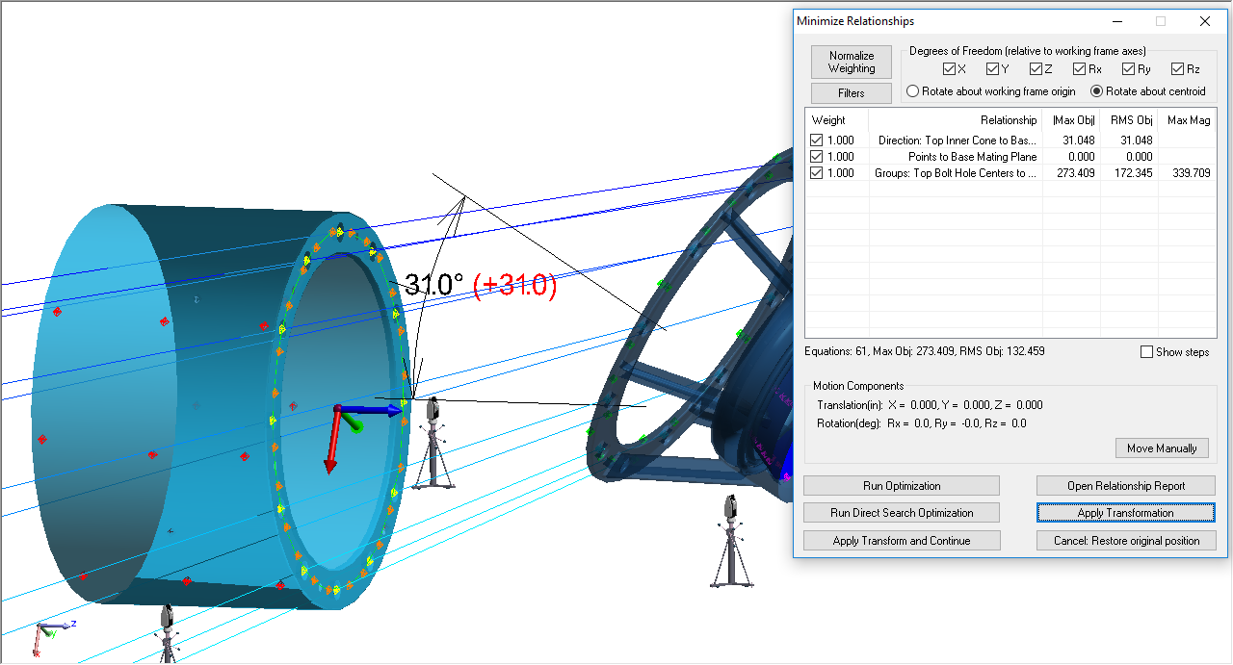
Virtual Alignment
Starting Position

Slide 31
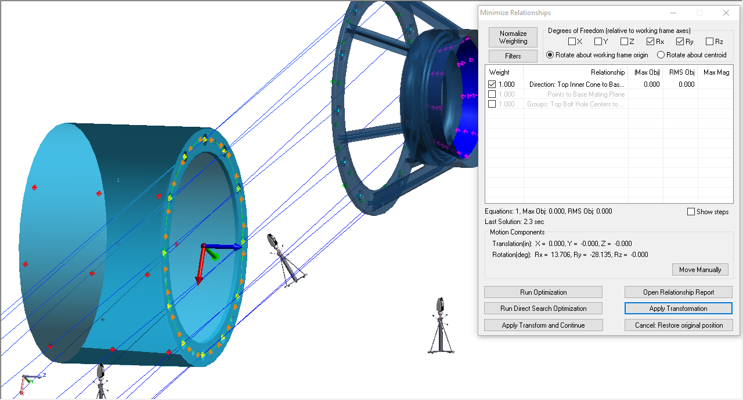
Virtual Alignment
Cone/Cylinder Direction for
Rx, Ry

Slide 32
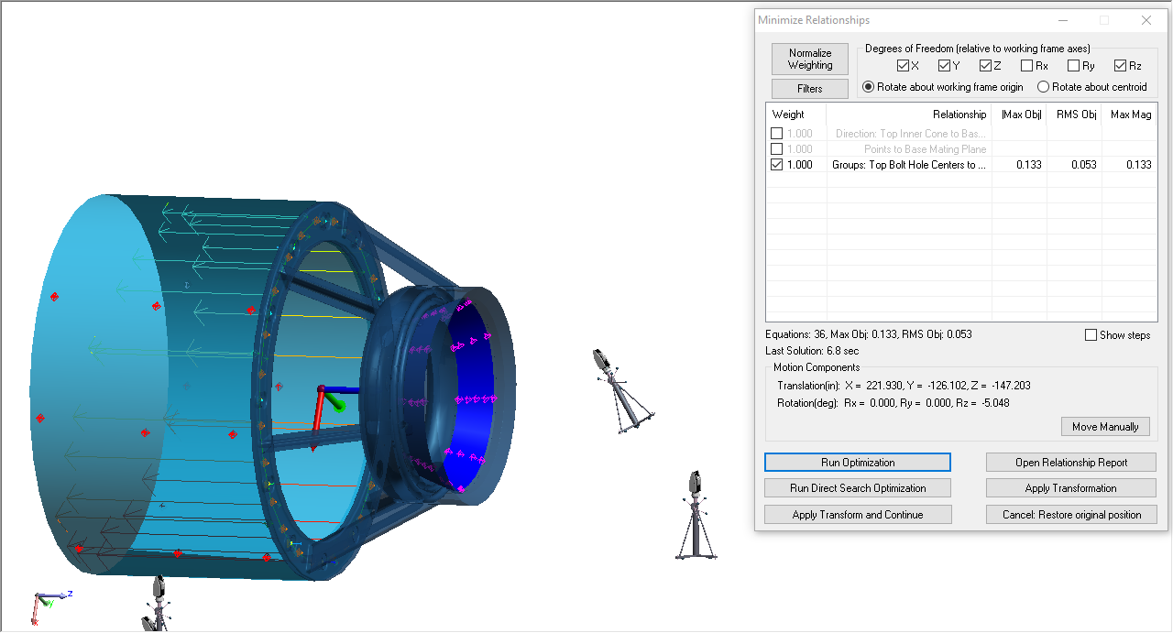
Virtual Alignment
Bolt Hole Group to Group for
X, Y, Z, Rz

Slide 33
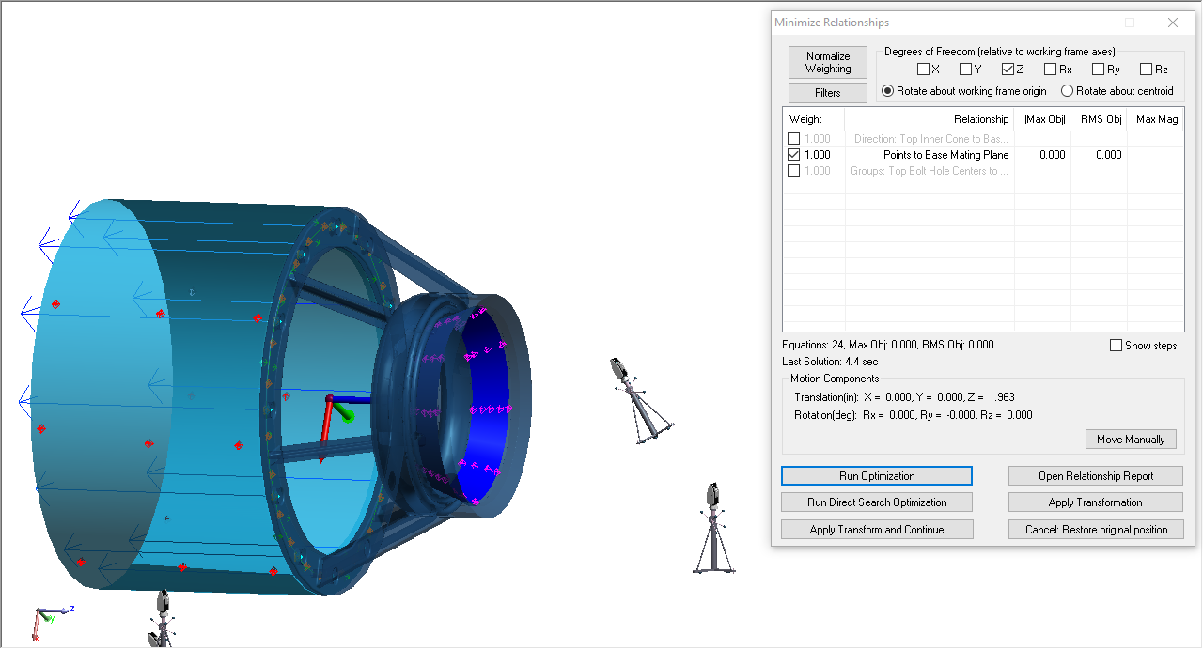
Virtual Alignment
Top Points to Base Plane for
Z

Slide 34
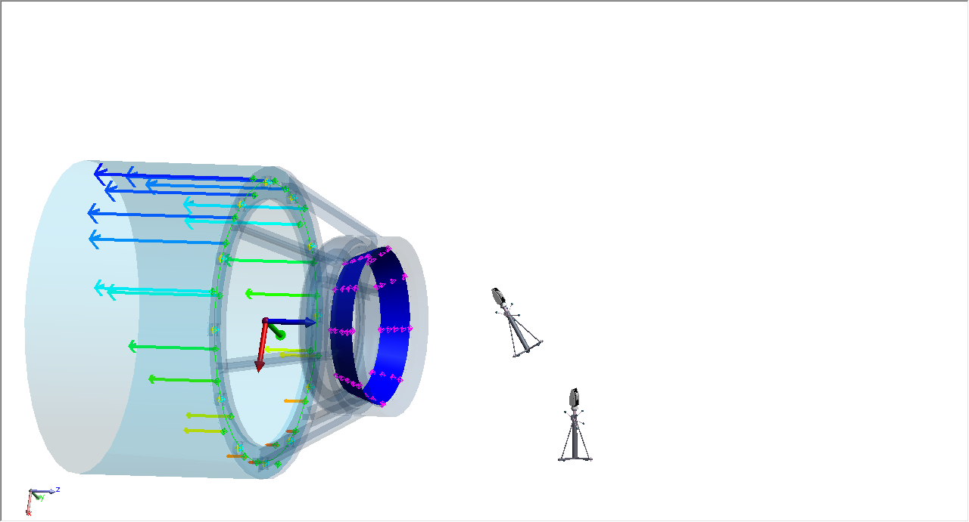
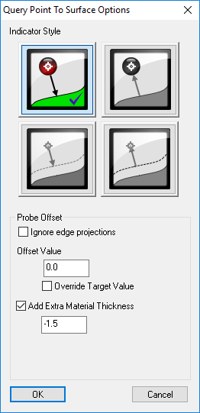
Virtual Alignment
Copy Points to Plane Relationship
Remove 1.5” fit constraint
Turn on auto-vectors (add “extra” material)

Slide 35
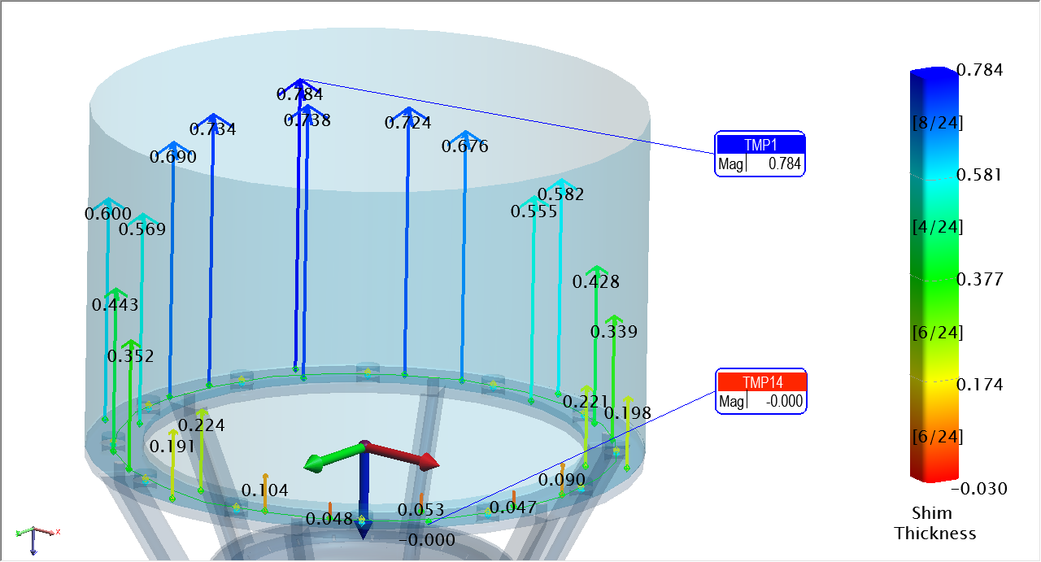
Report Shim Thicknesses

Slide 36
Part 3: Pipe Relationships

Slide 37
Why
Pre-plan where/how to cut each pipe
Save time ($) during install
React to unplanned cuts, use measurements as input
Apply pipe-specific constraints
Solve a pipe network simultaneously with many constraints and influencing parameters (traditional Relationships + Pipe Relationships)

Slide 38
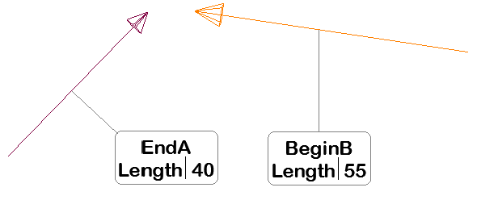
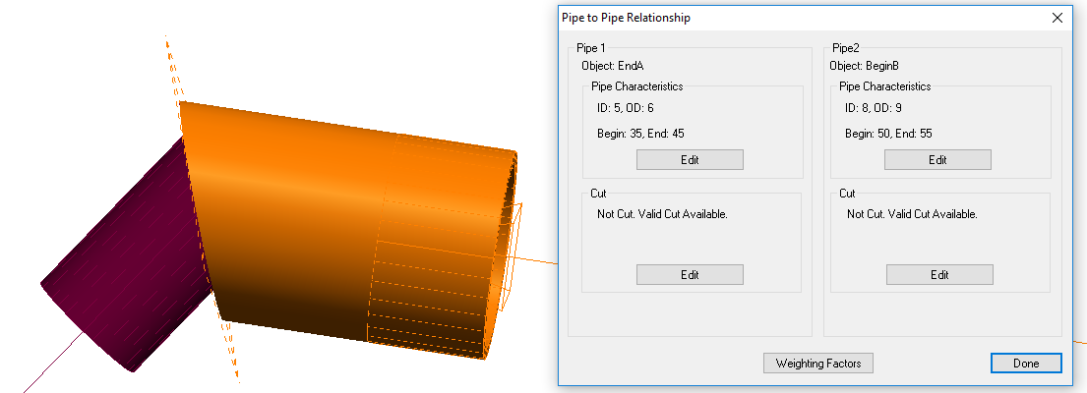
How
Define a relationship at an intersection where two pipes will join.
Each mating end uses an object (line, circle, cylinder, plane, etc.) to define the axis and direction of the pipe
The two objects should point toward the location of the cut
Define ID/OD of the two pipes

Slide 39
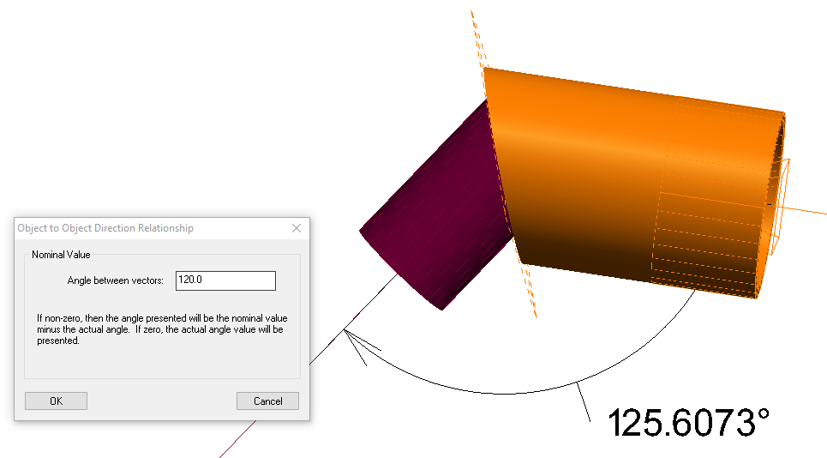
How
Define additional constraints

Slide 40
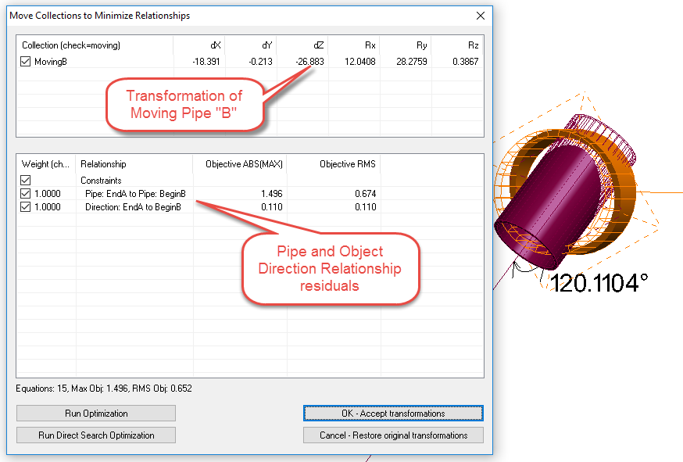
How
Solve Relationship Optimization

Slide 41
How
Allowable Cut Region
Allowable Cut Region

Slide 42
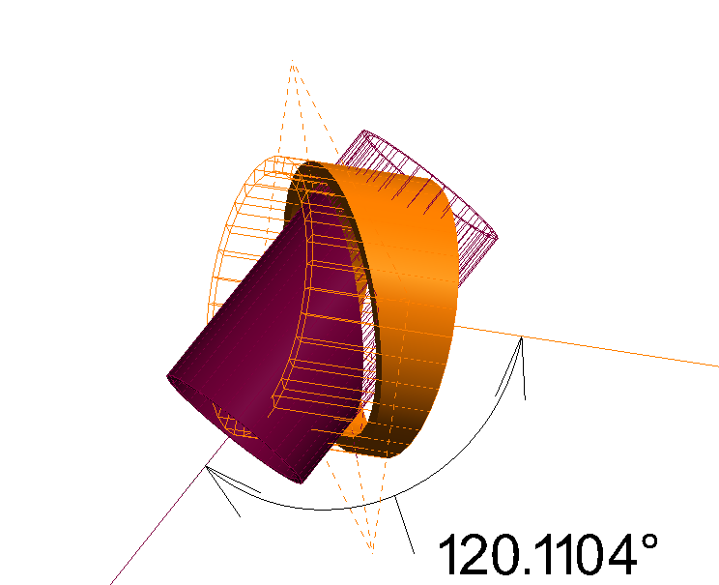
How
Proposed Cut
(dashed plane)

Slide 43
How
Remaining
Pipe
Cut
Pipe

Slide 44
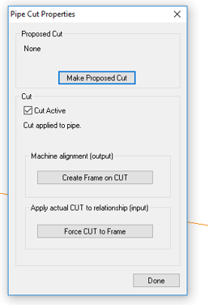
How
Make Proposed Cut(s)

Slide 45
How
To layout the proposed cut plane on the actual pipe:
“Create Frame on CUT”
Layout points or scribe a line using a watch window on this frame
Once the pipe is actually cut
Remeasure the end of the pipe
Define a Frame based on the pipe center and end plane
“Force CUT to Frame”
Re-run optimization with the “as cut” pipe end.
Solve for the necessary cut plane of the mating end.

Slide 46
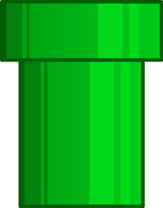
Constraints
Center Pull:
The importance of overlapping the center of each pipe segment’s cut region (along the axis direction). Larger values assign more importance
Axis Alignment:
The importance of minimizing the angle between the two pipe segments. Larger values will force the pipe segments to be more parallel.
Axis Offset:
The importance of minimizing the mutual perpendicular midpoint between the two pipe segments (i.e. how “coaxial” the two pipe segments are). Larger values attempt to bring the segments closer together.

Slide 47
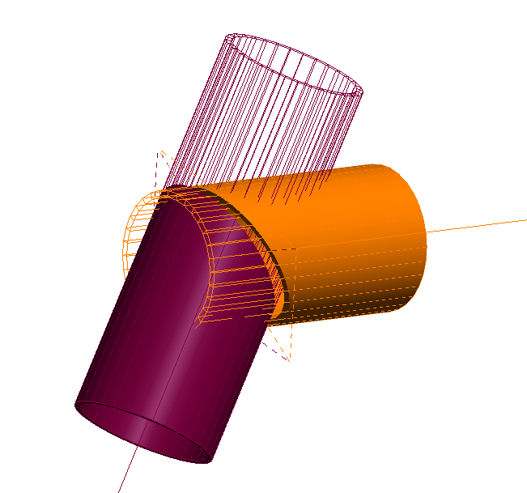
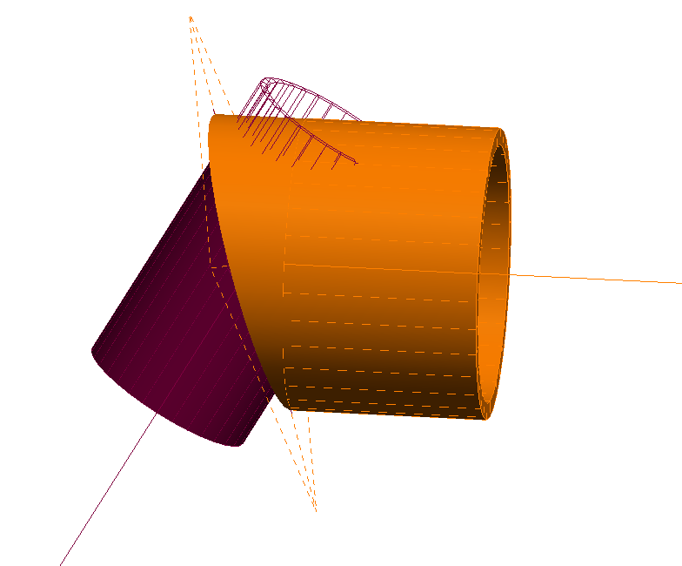
Constraints
Constrain Cut to Region at OD:
If checked, ensures that the cut angle at the outer diameter does not cause the cut plane to exceed the defined region. If unchecked, this restriction is ignored.
Constrain Cut so ID/OD Overlap:
If enabled, the inner diameter/outer diameter values for the pipes are used to ensure that
there is sufficient material based on the angle of alignment.
Weight:
The importance of having sufficient material for the weld. A value of zero implies that the solution does not care if there is sufficient material for the weld.
Static Offset:
A value that controls “how bad” the solution gets when there is insufficient material for the weld. Higher values assign a larger penalty to having insufficient material, effectively ensuring that material requirement is more crucial in the eyes of the solution.
Gap
Allowable Cut Region

Slide 48
Demo 3: Pipe Relationships
Goal:
Connect the 3 fixed couplings using:
1 “T” coupling
1 “45” coupling
4 Straight Pipes
Straight 45C
Straight AT

Slide 49
Demo

Slide 50
Tips
If both ends of a pipe need cut, define each end with its own object.
The object type used to build the Pipe Relationship doesn’t matter as long as position and orientation are defined
The direction of the objects used in the pipe relationship should both point to the cut plane (intersection)
Once a solution is found, the rendered pipe will be solid where material remains, and wireframe where material was removed. If the cut happened on the wrong side, flip the orientation of the defining object.
If a valid cut plane isn’t found but seems to be possible, try changing the OD/ID values of one pipe end so that it doesn’t exactly match the mating pipe, or uncheck “Constrain Cut so ID/OD Overlap”
Isolate each independently moving entity in its own collection. During optimization, use “Move Collections by Minimizing Relationships”.

Slide 51
Questions?

