Slide 1

What’s New in SpatialAnalyzer!
SA 2015.11.06 – SA 2017.08.11
David Mihal – Regional Manager, Western USA and Canada
Richard Nelson – Application Engineer

Slide 2
SA 2015.11.06
Side Note: Last Boeing accredited release was SA 2015.07.28

Slide 3
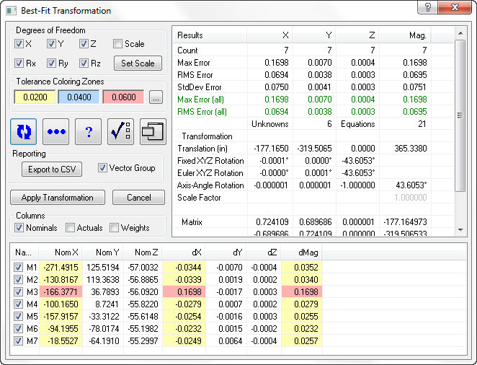
Vector Group from Best Fit
Notes:
Visualize the deviations in your alignment

Slide 4
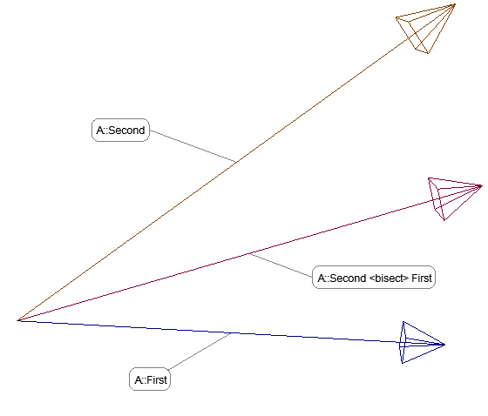
Construct > Line > Bisect 2 Lines
Notes:
Product line is the average length and directly between the two input lines

Slide 5
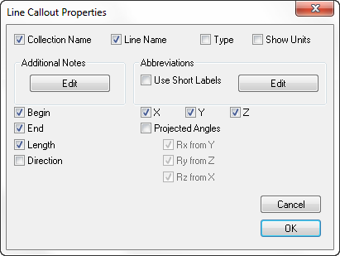
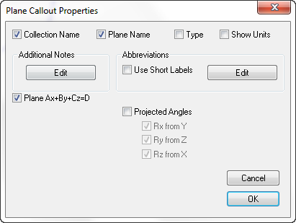
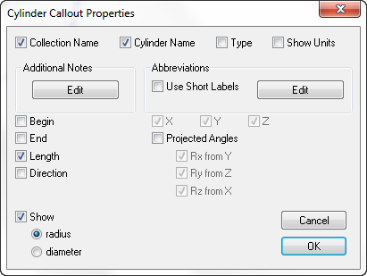
Object Callout Properties
Notes:
Display only what you want to see

Slide 6
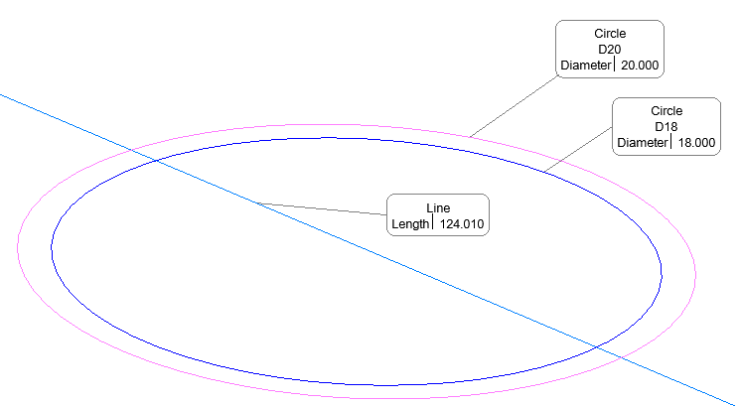
Callout Anchor Point Control
Notes:
No longer always at the centroid!

Slide 7
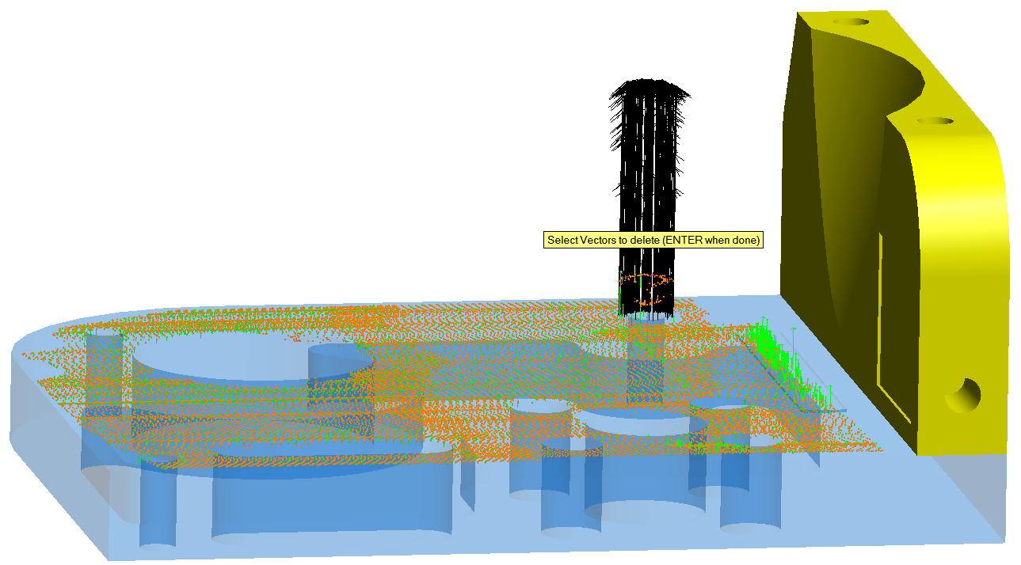
Delete Vector Point/Cloud Pairs
Notes:
Quickly eliminate outliers made obvious by their vectors. All deleted points are logged!

Slide 8
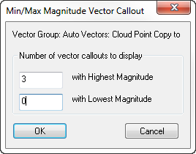
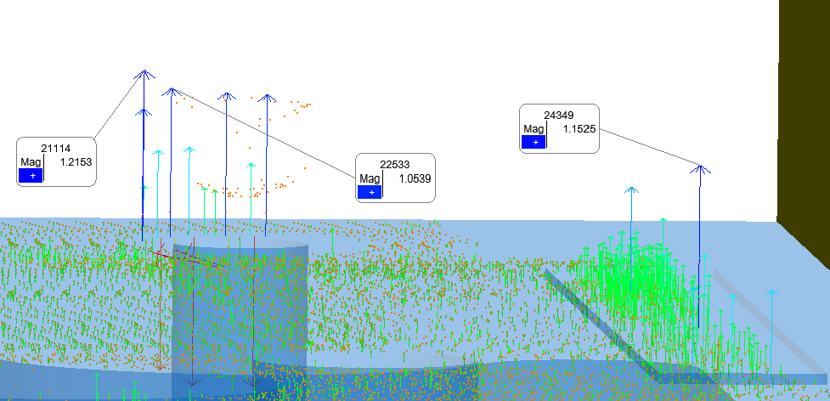

Min/Max Vector Group Callouts
Label “m” highest, “n” lowest vectors

Slide 9
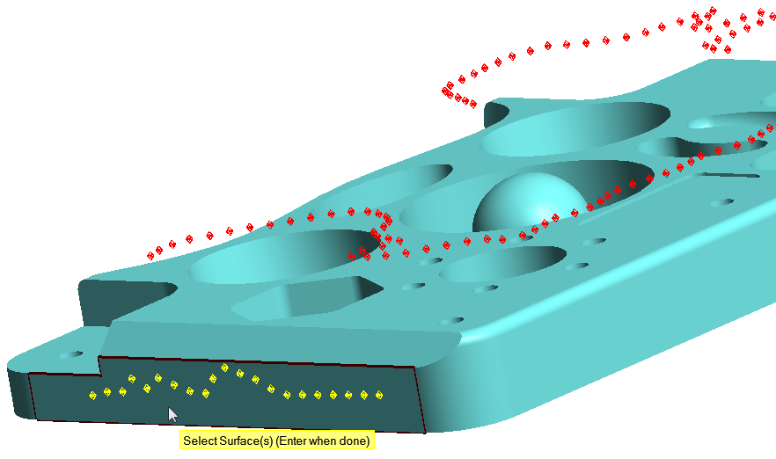
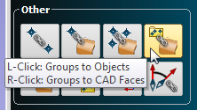
Points to Surface Faces
  For Query and Relationships
Notes:
Allows a finer resolution and more control than selecting the entire surface.

Slide 10
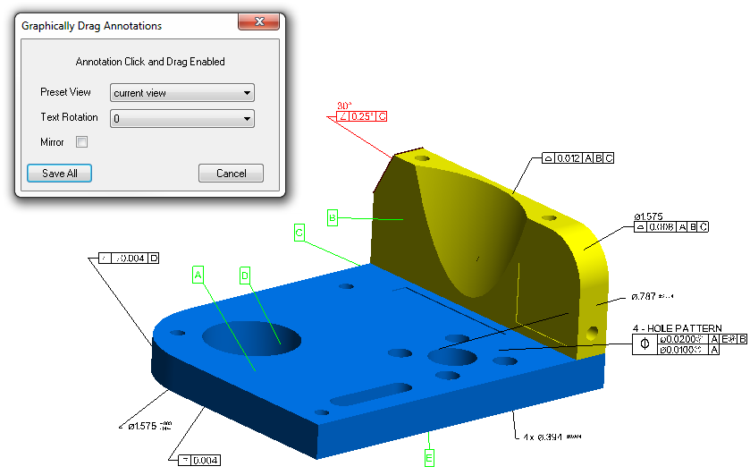
GD&T Annotations
Drag Annotations allows editing for several annotations within one command
“Current View” allows annotation to always face the screen when rotated
Notes:
Right Click on Annotations Category in the TreeBar → Drag Annotations
Dragging annotations has also become easier to control (the depth is now handled better)

Slide 11
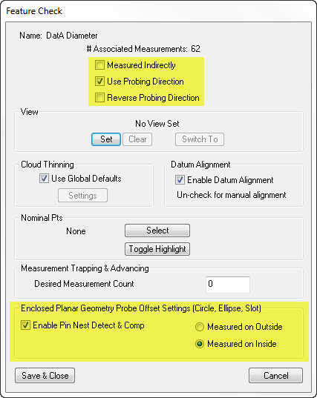
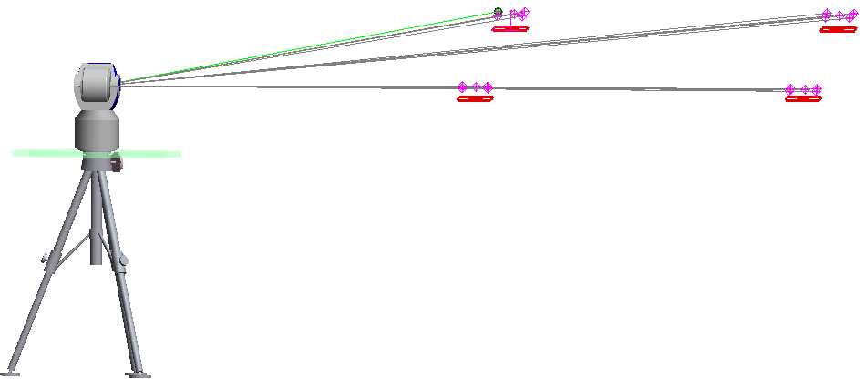
GD&T Probe Compensation
The odd case when the offset direction needs to be reversed can now be handled
Circular features or Datums can now properly account for pin nests
-Important for diameter/radius callouts or circular datums with material modifiers

Slide 12
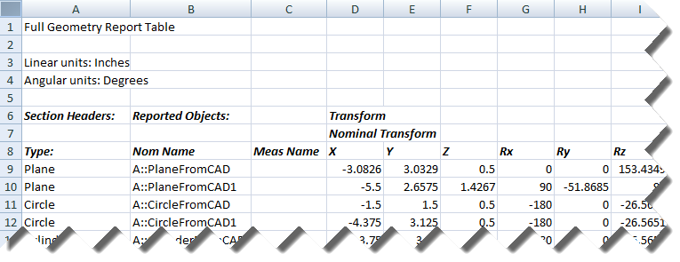
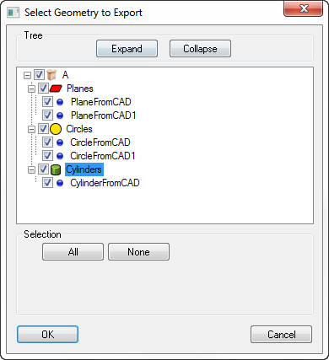
Export Geometry
Creates a .csv with all information for the selected geometry
-Nominal, Measured, Delta, Tolerance for transform, physical stats, etc.
-Fit statistics
Notes:
File > Export > Geometry

Slide 13
MP Commands
Instrument Op Checks added for
  AICON MoveInspect
  Surphaser
Watch Point to Point With View Zooming
Get Targets Measured by Instrument
Construct Plane, Bisect 2 Planes
SA SDK
  Angular Units argument
  Trigonometric Function argument
  Logarithmic Function argument
  Added Math Operations argument
…and more
Notes:
!

Slide 14
SA 2016.02.18

Slide 15
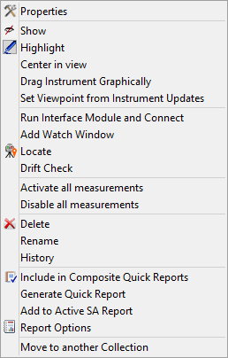
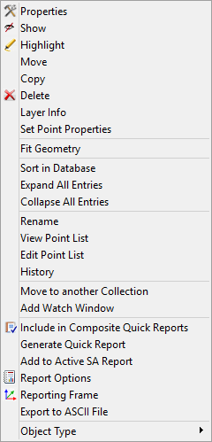
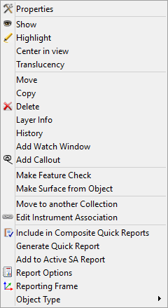
Pop Up Menu Icons
Instrument
Point Group
Plane
Notes:
Makes it easier to find the common items in the multitude of right click options.

Slide 16
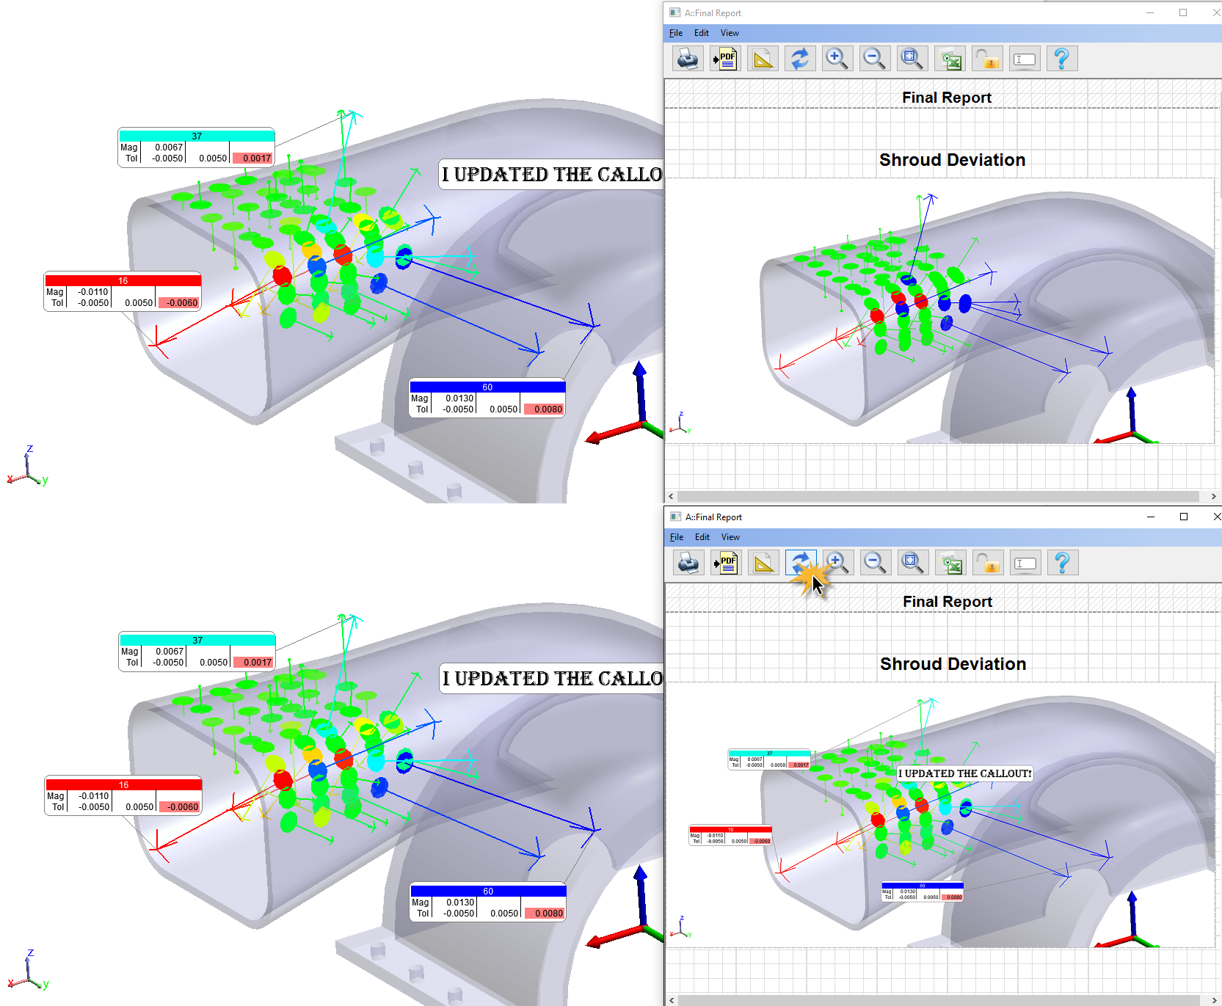

Dynamic Callout Images in Reports
Refreshing the report will now update any callout views contained in the report.
Notes:
The aspect ratio of the original callout image will persist even if the graphics window proportions have changed (report bar shifted, docked instrument interface, etc)

Slide 17
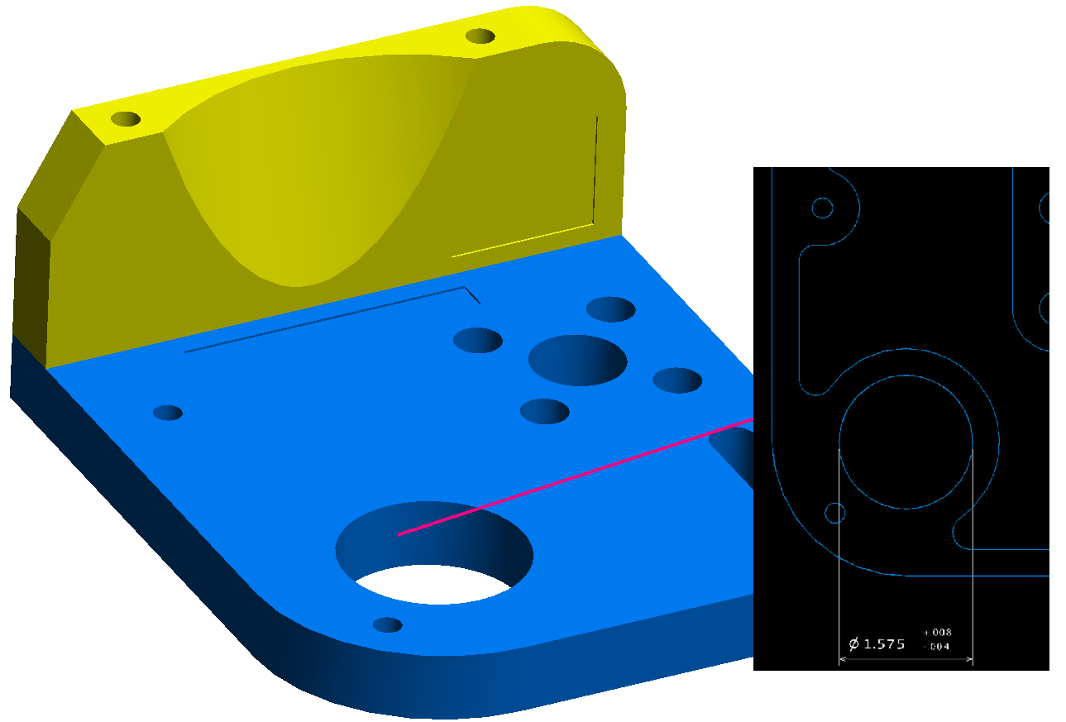
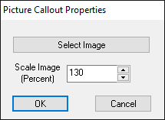

Picture Callouts
Notes:
Images can be used in callouts. They can be tied to objects with leaders and resized by rolling the mouse over the image, or changing the scale in the properties.

Slide 18
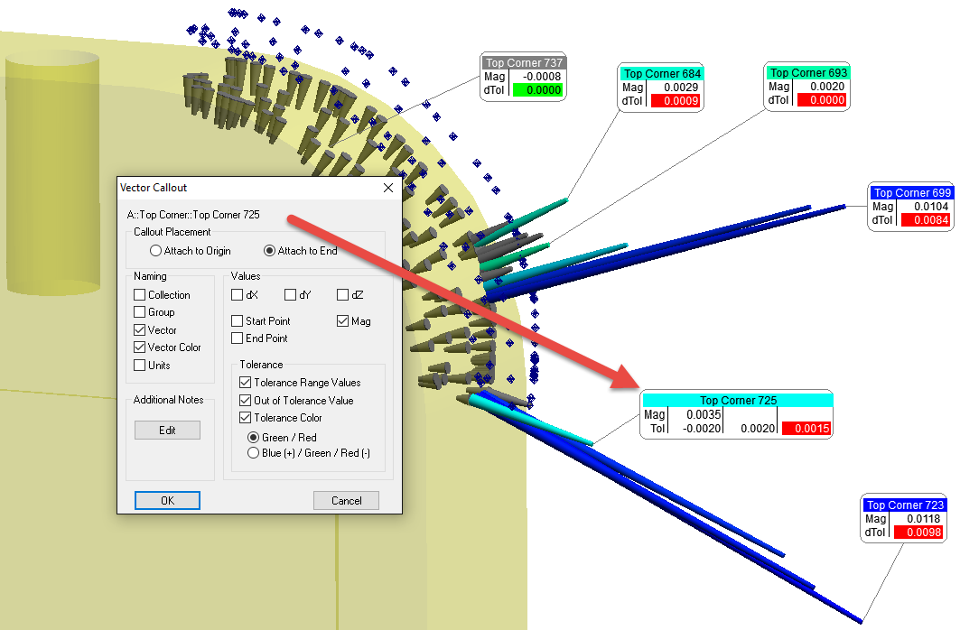
Vector Callout Controls

Slide 19
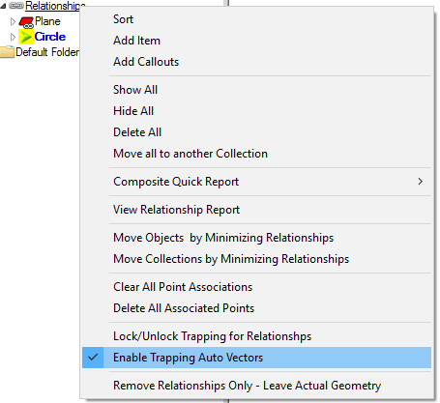
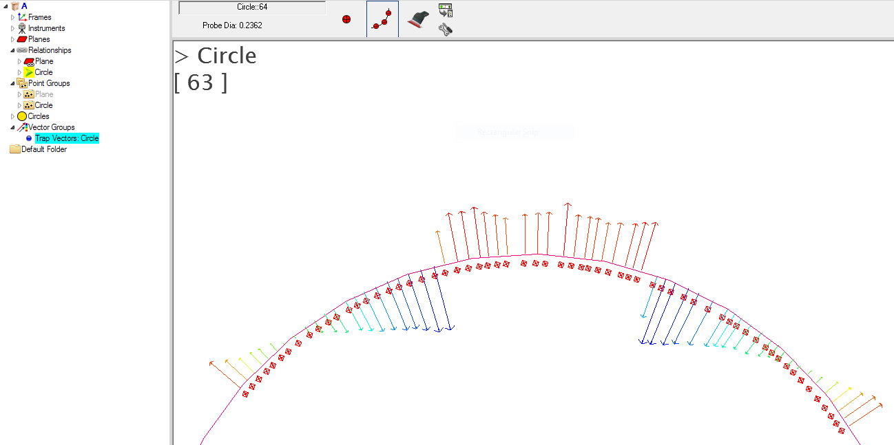
Trapping Auto Vectors
Notes:
Trapping vectors show the deviation for the active relationship. This temporary vector group appears and disappears when trapping starts and stops and can give a quick indication if your measurements are good as you’re taking them, or as you toggle through your relationships when you review a job.

Slide 20
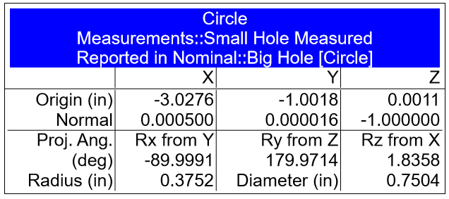
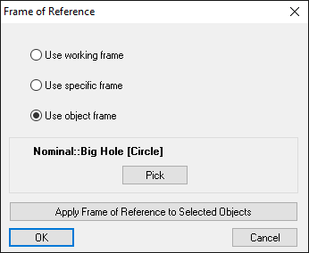
Reporting Frame from Nearly any Object
(Right Click Menu Icon Changes)

Slide 21
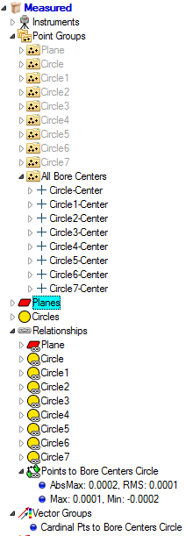
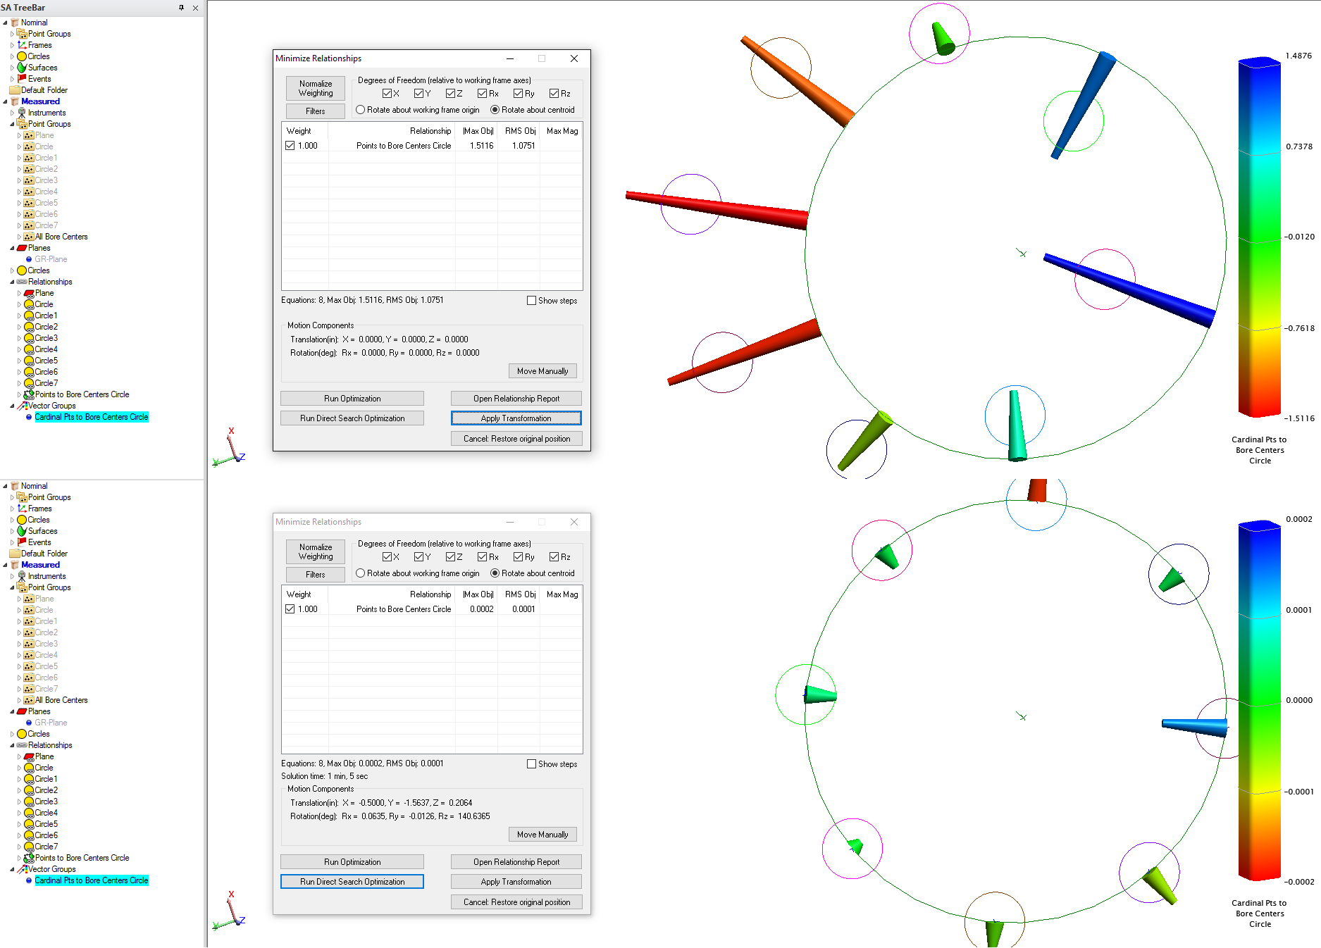
Cardinal Points in Optimizations
Notes:
Centroids for the 8 smaller bores are compared to the nominal “Bore Centers Circle” and optimized through Move Objects by Minimizing Relationships.

Slide 22
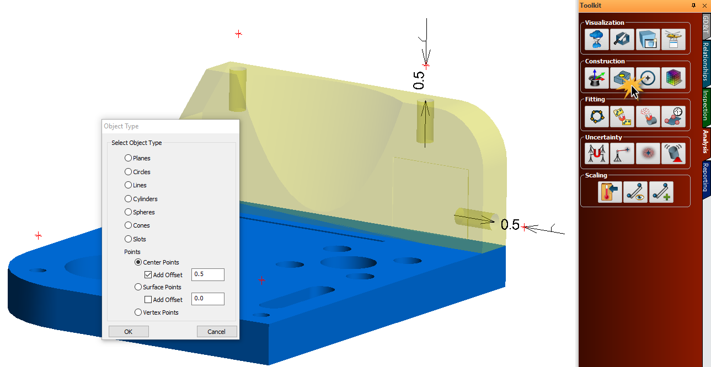
Offset Points along Hole Axis or Surface Normal
Notes:
Offset Center Points are good for laying out tooling ball or pin nest control points on your CAD. Surface points offset the probe radius are good for laying out targets to measure by proximity trigger.

Slide 23
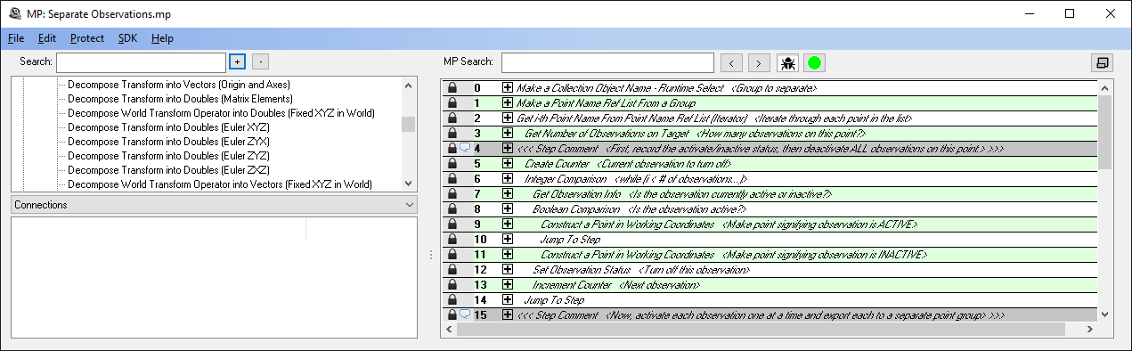
21 New MP commands
  Angular Representation
  Working with vectors
  Synchronized Measurement
  Set Geom Relationship Criteria
MP editor divider can now slide

Slide 24
SA 2016.06.03

Slide 25
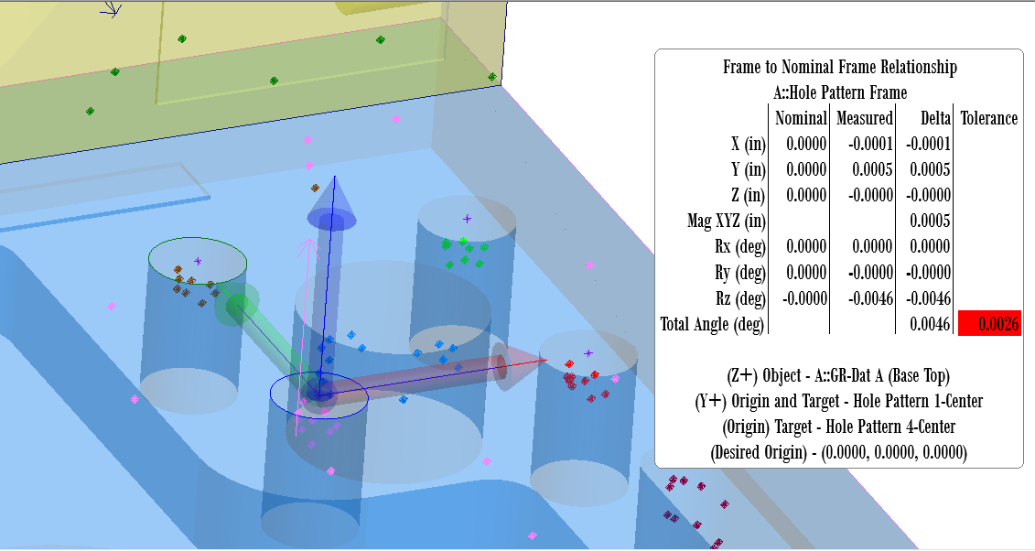
Dynamic Frames
Notes:
Allows for frames to update if based on geometry relationship objects/points

Slide 26
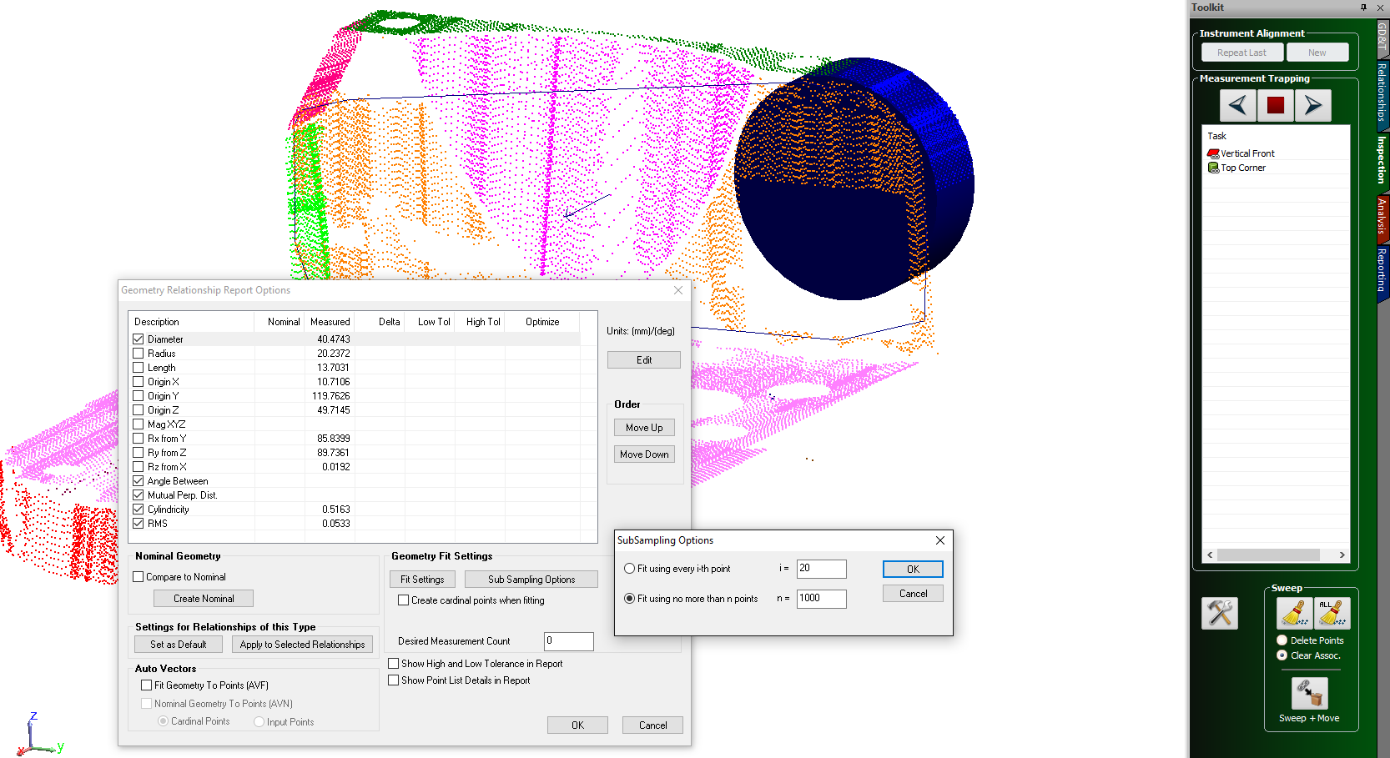
Clouds for Geometry Relationships
Notes:
Use clouds for geometry relationships. Sub-sampling options are available in the properties of the Geometry Relationship.

Slide 27
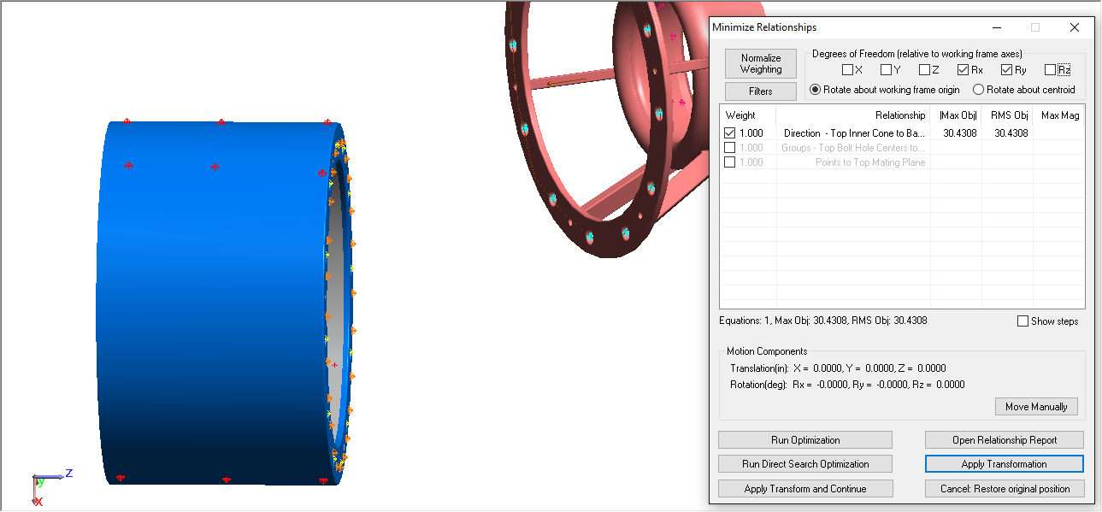
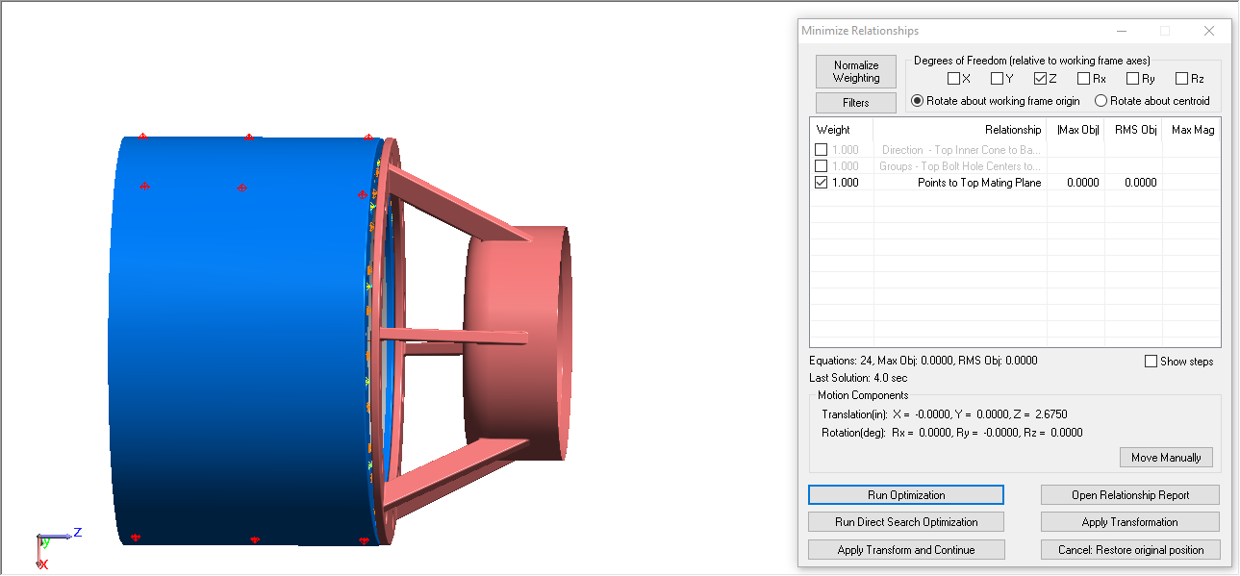
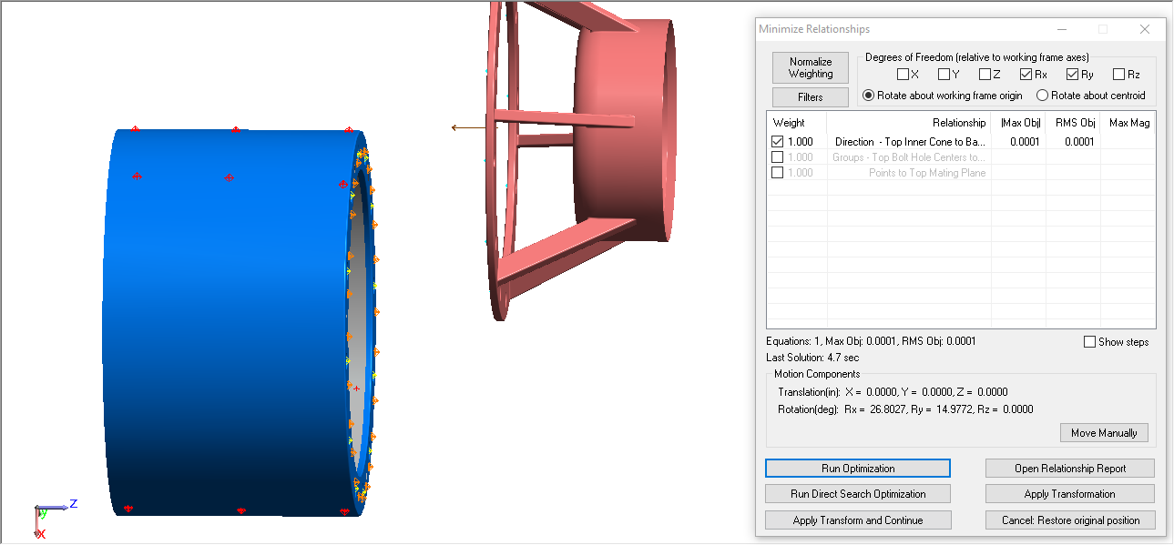
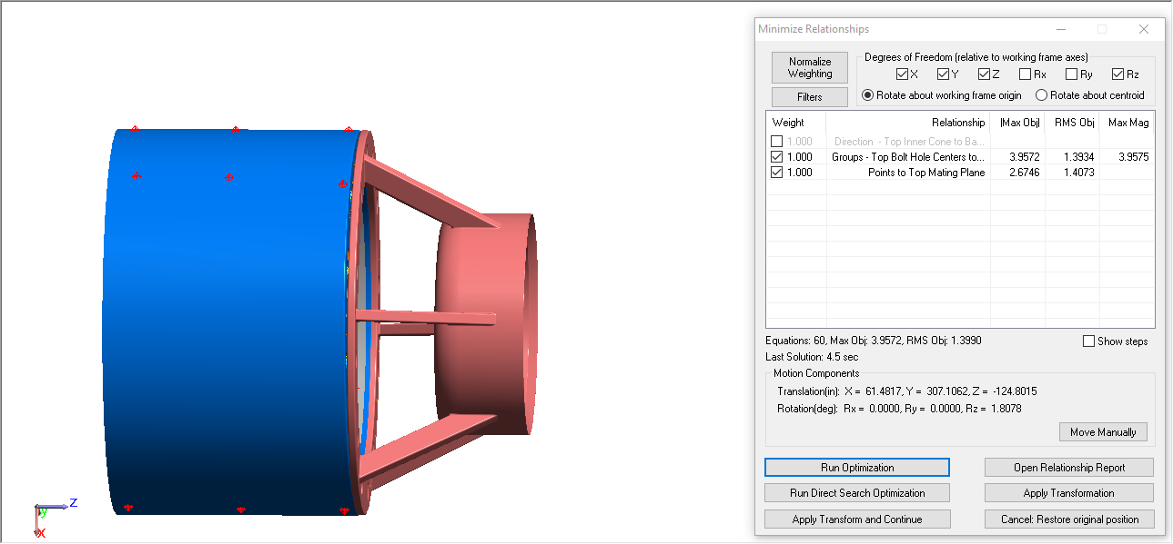
Minimize Relationships, Sequential Fit
Notes:
Saves re-opening dialog for changes in degrees of freedom/relationship sets.

Slide 28
Individual Point Cloud Display Options
Rotational thinning helps lesser graphic cards.
Notes:
Thinning, Size and Rotation Thinning can now be set at the cloud level, rather than a global file setting.

Slide 29
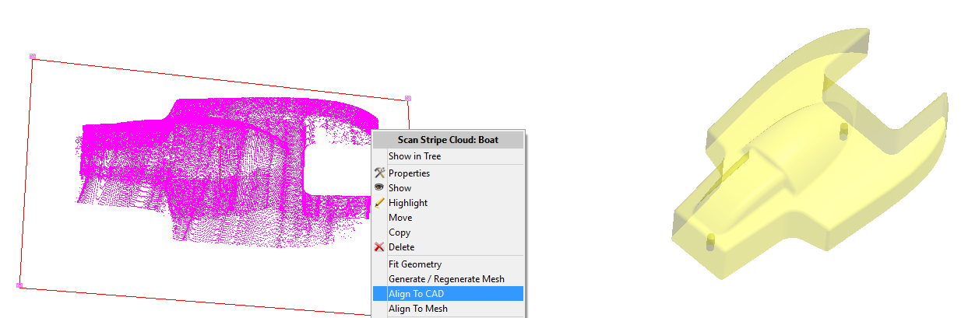
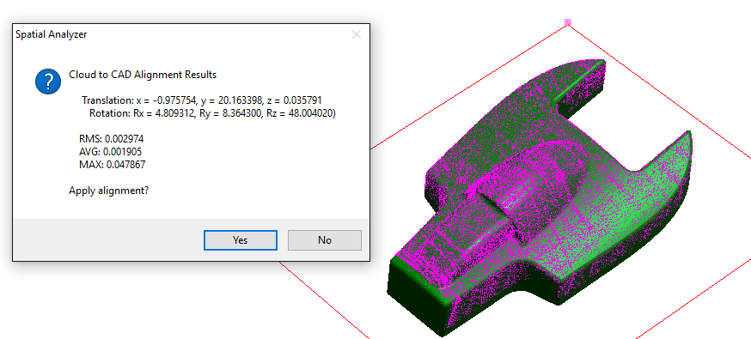
Cloud to CAD & Cloud to Mesh alignments
Notes:
Fast, easy way to align an instrument to CAD or to a previous scan’s mesh. Available as a right click option on the cloud.

Slide 30
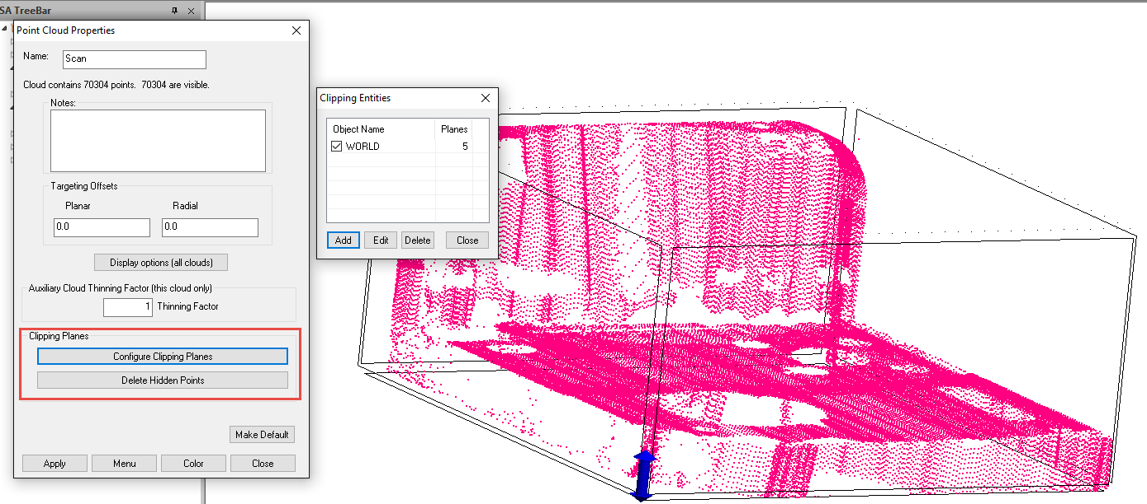
Cloud Clipping Planes
Notes:
Pre-filter or post-filter. Optionally delete hidden points. Define a plane or a volume.

Slide 31
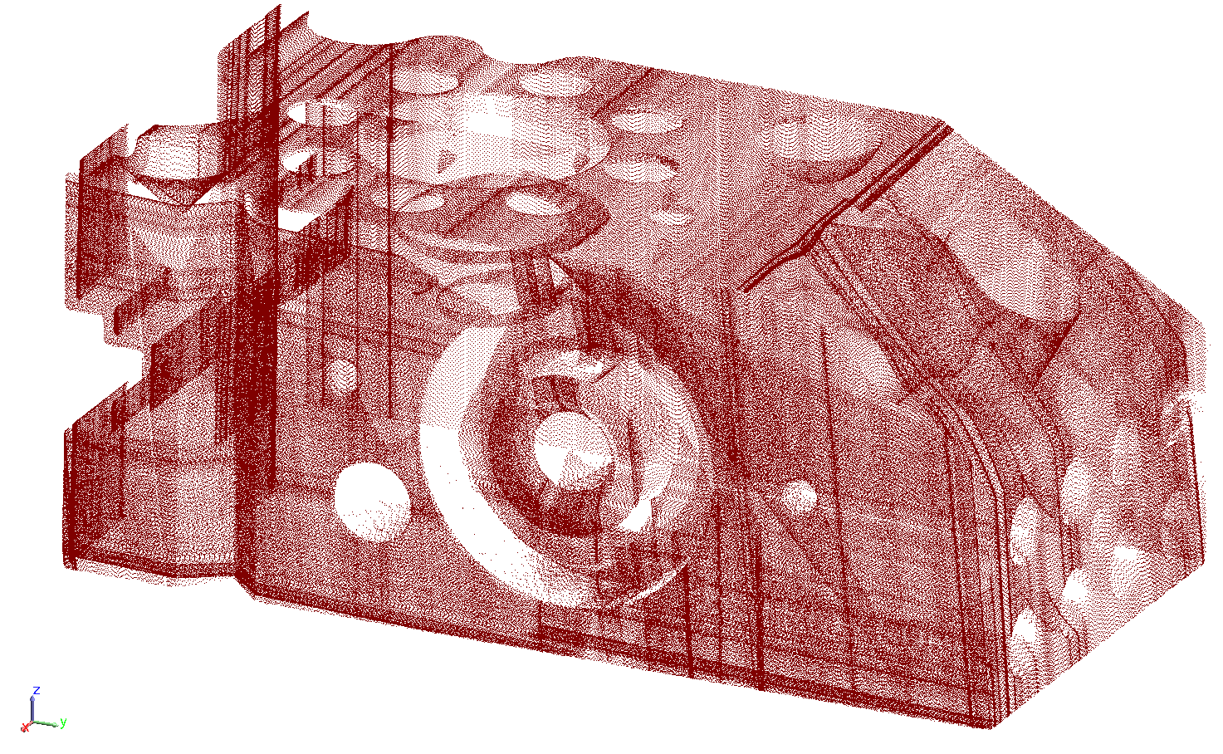
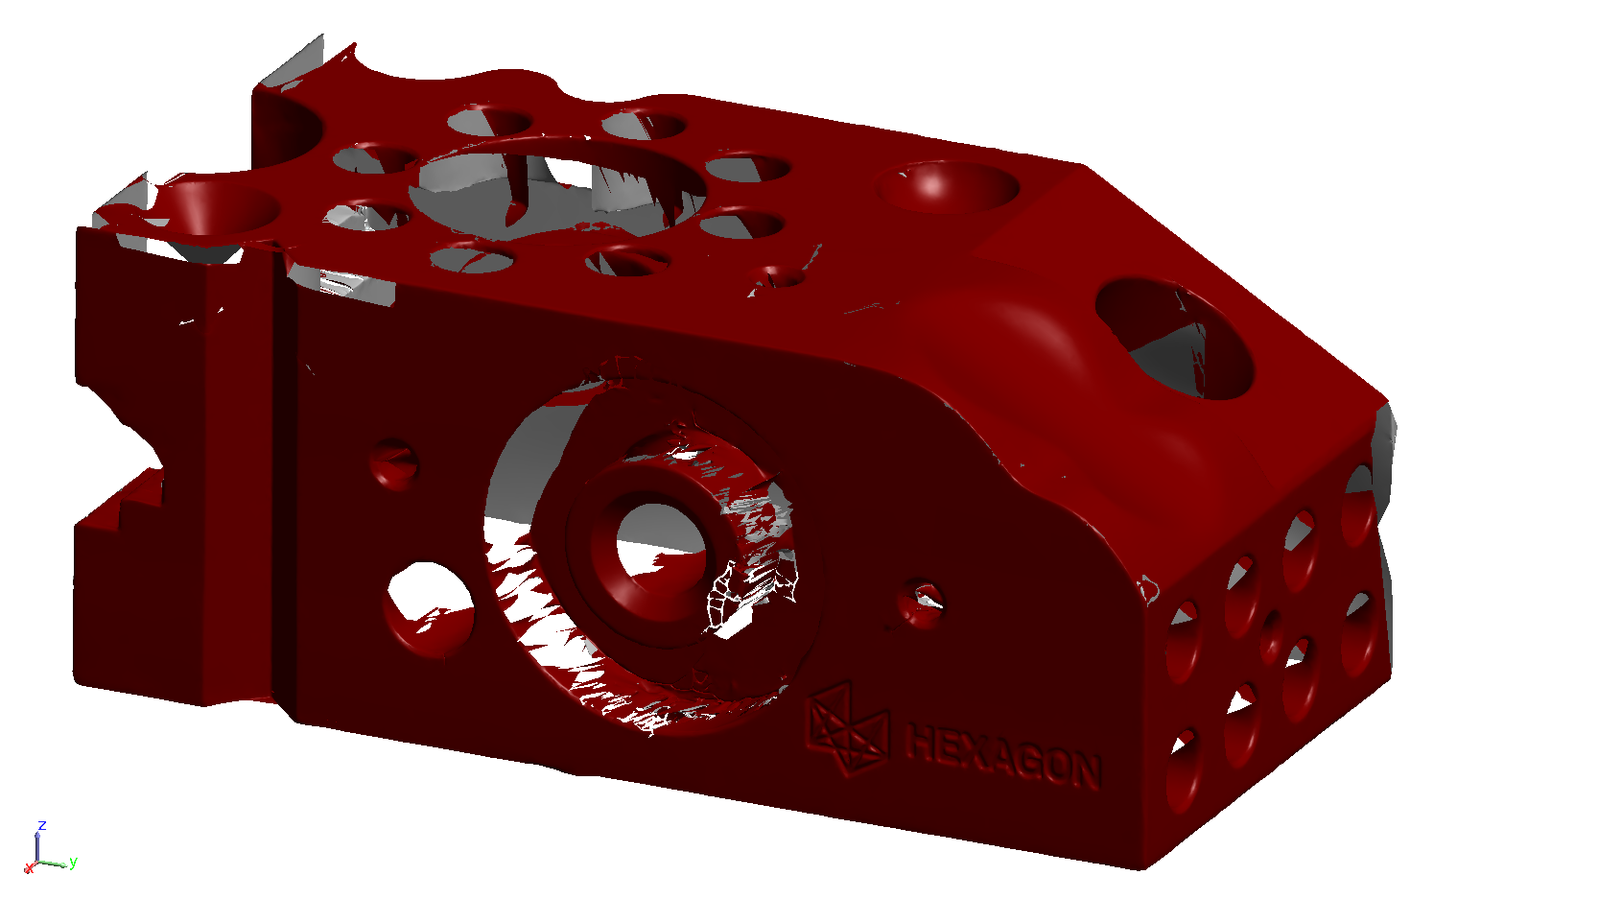
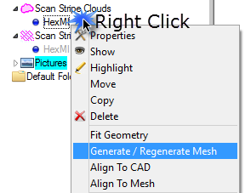
Mesh from Scan Stripe Clouds
Optional real time coarse mesh during scan
Generate/Regenerate final mesh with various parameter controls

Slide 32
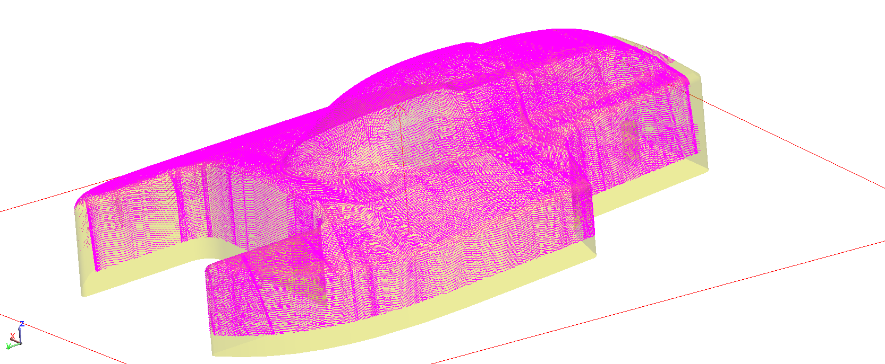
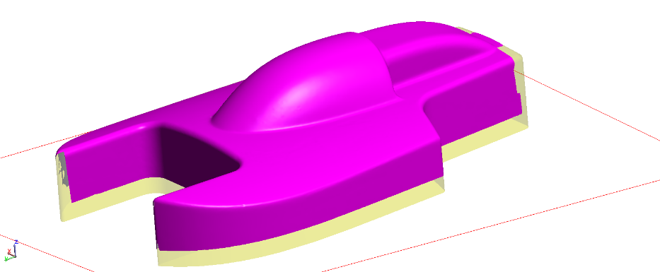
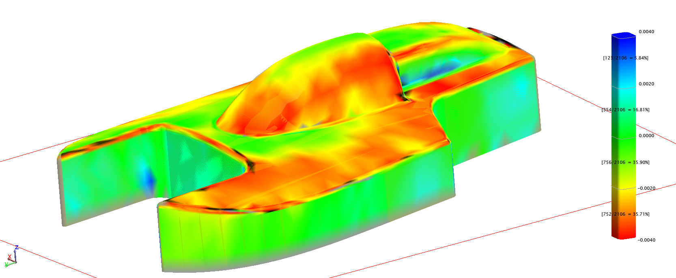
Colorized Mesh from Point Clouds
Scan Stripe Mesh
Original Cloud
Construct > Colorized Graphical Mesh> From Cloud Points
Notes:
Previously existed only for points. Align to CAD first.

Slide 33
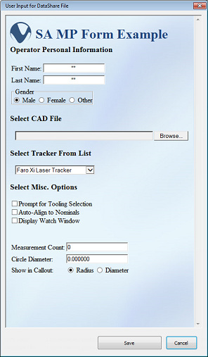
13 New MP Commands
Get/Set Geometry Relationship …
Make UDP Settings
Move Collections by Minimizing Relationships
Load HTML Form
Notes:
HTML form allows an MP to gather a lot of information from a user in one window

Slide 34
SA 2016.09.01

Slide 35
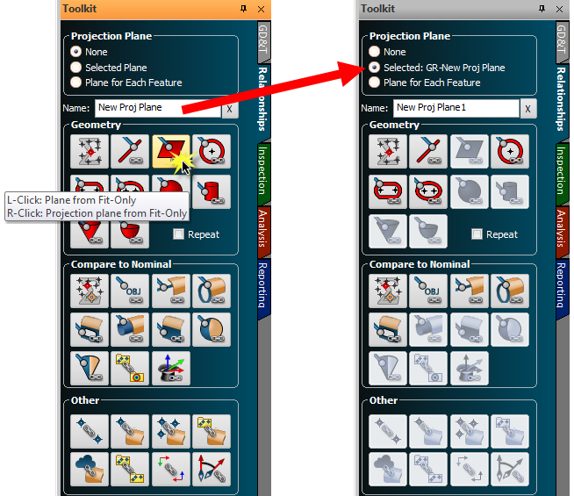
Easy Projection Plane Selection
Right clicking on Plane or Plane from CAD will pre-select the resulting measured object as the projection plane for the next Geometry Relationship

Slide 36
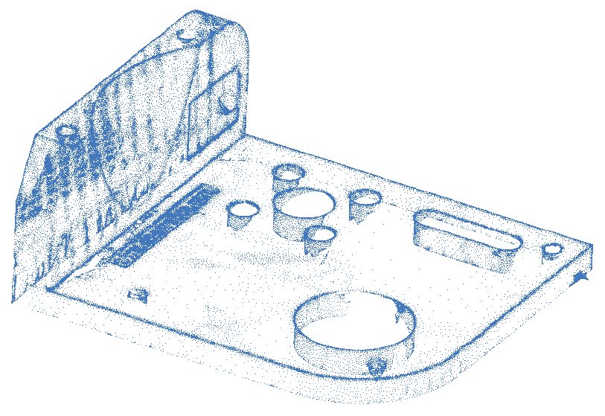
Generate a point cloud from mesh vertices
Right click on scan stripe mesh > Generate/Regenerate Point Cloud
Construct > Point Clouds > On Object’s Vertices (for multiple meshes)

Slide 37
STL Import Improvements
Notes:
Very fast import of STL data as a mesh, a point cloud, or both. Mesh export as STL is also supported.

Slide 38
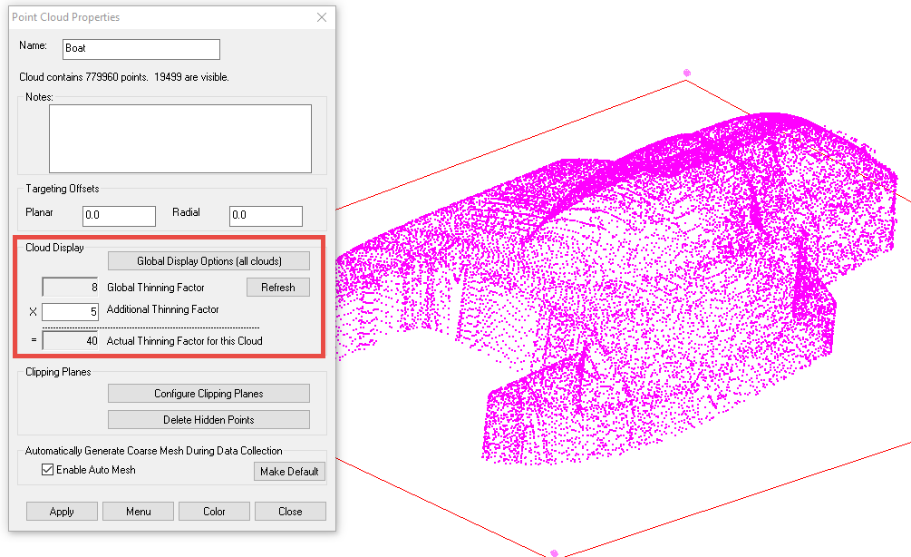
Dynamic Cloud Thinning During Scanning
Notes:
The total number of cloud points displayed is limited during scanning to ease the burden on the computer’s graphics card. Millions of points can be gathered without a hiccup in graphical display.

Slide 39

Clipping Planes per Cloud and/or Global Clipping Planes
Notes:
All measured and to-be-measured clouds will inherit the global clipping entities once defined.

Slide 40


Mesh Callouts
Cloud Report Tables

Slide 41

MP Updates
HTML Form enhancements
Notify/Notice commands are now resizable, have scroll bars (when necessary), and maintain word wrap.
Notes:
Gettysburg Address MP

Slide 42
SA 2017.01.12

Slide 43




GD&T
True Position Report Options
Inspection Summary Table
Slot Width, and open slot (midplane) as datum now supported

Slide 44

Extended True Position Report includes evaluated tolerance zone and vector deltas at the solved points

Slide 45


More GD&T Enhancements
Prompt for automatic creation of diameter checks for TP checks with material modifiers
R-Click option to annotate multiple TP features
Single point measurement mode for True Position checks of circles and lines
New option to either evaluate True Position checks at the measured extents, or extrapolate to the length of the nominal feature
Number of reported cross sections for line profile is now correct
Screen oriented annotations

Slide 46

Dynamic Bisection/Intersection

Slide 47

Angular and Linear Dimensions with Optional Nominal Value and Tolerance

Slide 48

Cloud/Mesh/CAD Alignment
Right Click on Cloud or Mesh
Align N-Points to Objects
  Cloud to Cloud
  Cloud to Mesh
  Mesh to Mesh
  Cloud to CAD
  Mesh to CAD

Slide 49

Relationship Callouts
Multi-select relationships to create callouts simultaneously
Simultaneously edit properties of multiple Relationship callouts
Apply to selected Relationships (of same type)
Set as Default
Show Title Only (new option)

Slide 50


Direct CAD Access for
  ACIS v26.0
  Autodesk Inventor 2017
  CATIA V6 V5-6 R2016 (R26)
  CATIA V6 2013x
  Creo 3.0
  Pro/E 19.0
  Parasolid v28.1
  SolidWorks from 97 up to 2016
Cloud Graphics Display ~30x faster!
  Drag instrument graphically also faster when large cloud is associated to the instrument
  Cloud Bounding Box for troubleshooting

Slide 51



Instrument Updates
New Instrument – Creaform Vxelements MetraScan 3D and HandyProbe Next
Updates to Leica Nova MultiStation (MS50, MS60)
  Scan region defined from 2 points and a distance (or perimeter)
  Min/max distance filter for scan points
GSI Vstars – Dream 6D targets supported

Slide 52
SA 2017.02.09

Slide 53

New Instrument
Faro Vantage S and Vantage E
Notes:
This requires an update to new JRE and Camera (for older trackers
with side mount camera) files, which are available for download
from our FTP site
The interface was updated to corresponding SDK v.5.0.0.1
from 4.3.0. This fully supports older tracker models, but the
update is required for all models due to the SDK update.

Slide 54

Aicon MoveInspect Enhancements
Define new reference sets within SA
Switch among active available reference systems

Slide 55

Refined feature measurement counts
Now you can define only the pertinent geometry types

Slide 56


Construct > Points > Layout > Ellipse

Slide 57
SA 2017.08.11

Slide 58


Toolbar Additions
Instrument View (follows probe/SMR, makes instrument transparent)
Tablet-friendly mouse toggle
Middle Mouse button now pans the graphical view

Slide 59


Mesh from large volume scanners
Notes:
Rough mesh from surphaser, Faro Focus, Leica Pxx, etc.

Slide 60

Shortcut to create Geometry Relationship
Also, cylinder fit is now ~100x faster!

Slide 61


Vector Display
Discrete or continuous colors
3 color spectrums
Continuous or Symmetric distribution
4, 8, or 12 bins for Discrete colors

Slide 62

Vector Display

Slide 63

Vector Display
Color Profiles now include:
  Single Color
  Continuous
  Toleranced (Continuous)
  Toleranced (Go/No-Go)
  Toleranced (Go/No-Go With Warning
  Discrete Colors
High/Low Limit based on
  Max/Min error
  1σ, 2σ, or 3σ CI
  Custom

Slide 64

Status-Indicating Icons for GR
Shows if a valid fit is available, and if the geometry is in/out of tolerance (when a tolerance is specified).

Slide 65

Auto Filter to Nominal
Notes:
Users can now build cloud based features directly from a scan
by fi ltering to nominal. Align to the part and scan, then go to
Relationships>Geometry Comparison>Auto-Filter to Nominal.

Slide 66

Easy Cloud Cross Sections

Slide 67

Easy Cloud Cross Sections

Slide 68


Cardinal Point Naming

Slide 69

Set as Default and Apply to Selected Relationships

Slide 70


New blotch orientation
Also, vector labels now better at avoiding overlap

Slide 71


Group to Nominal Group
Now allows view zooming with proximity and point rejection criteria.

Slide 72

Leica AT403
New AT403 fully supported
Continuous measurement
Improved B-Probe functionality

Slide 73


Overhauled Surphaser Interface

Slide 74



Surface Profile Vector Groups
Also, Spatial Filtering for Feature Check Cloud Thinning

Slide 75



SA CAD Validation

Slide 76



NIST Dataset Geometry Fit Test

Slide 77
Direct CAD Access Import Additions
SolidWorks 2017
Solid Edge ST9
NX 11
Creo 4.0
CATIA V5 V5-6 R2017
New and Modified MP Commands
Cloud Cross Section commands
Get/Set Boolean DataShare
Set Relationship Dormant Status
Double List Variable commands
Construct Point Clouds from Existing Clouds – Uniform Spacing
Many others

Slide 78


Where to Find More Details
SA Readme.txt loads with SA
What’s New in SA link in the SA Help menu

Slide 79
Thank You for All of Your
Suggestions and Requests!
David Mihal david.mihal@kinematics.com M: 206-696-2756
Richard Nelson richard@kinematics.com M: 817-733-9730
SA Support support@kinematics.com

