Slide 1
Predictive Shim Tool – Vector Group to Vector Group Relationship

Slide 2
Richard Nelson, Application Engineer, Western Region US
Notes:
Introduce NRK team participating in presentation

Slide 3
Text Your Questions to +1(757) 300-1774
Notes:
Introduce NRK team participating in presentation

Slide 4
Ribbons
SA has added Ribbons!
NRK never stops developing-Always striving to be the best
Continued Investment for now and the future
SA has never been better and easier to use

Slide 5
Ribbons
Why:
Streamline processes/Easier to use
Modern look and feel
Reduces mouse clicks
Easier access to frequently used commands
Without loss of functionality
Legacy Interface will remain and easily reset

Slide 6
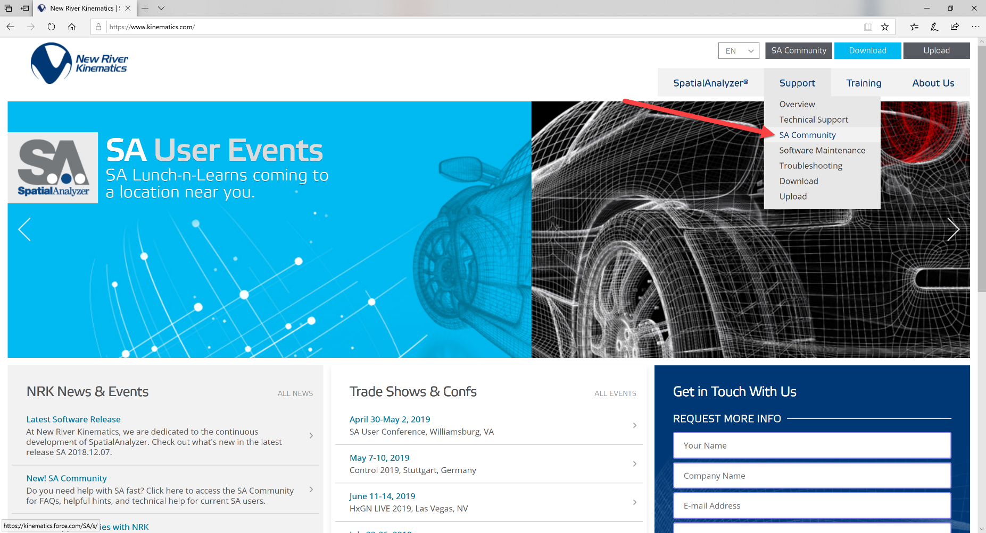
SA User Community
Navigate to via www.kinematics.com OR Direct Access – kinematics.force.com/SA

Slide 7
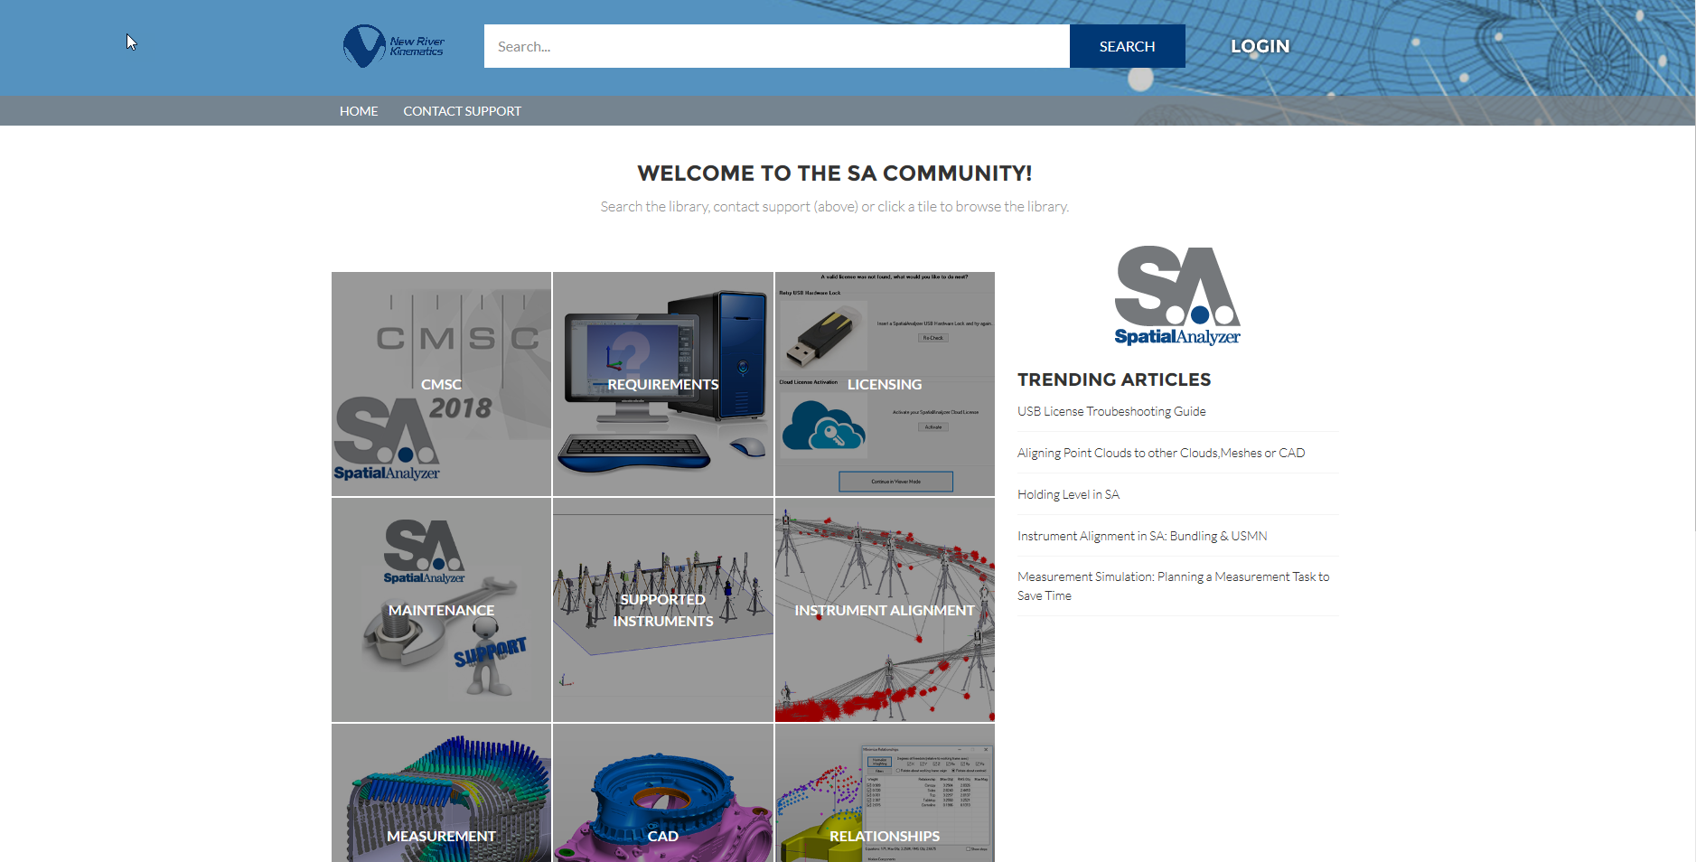
SA User Community
Navigate to via www.kinematics.com OR Direct Access – kinematics.force.com/SA

Slide 8
Vector Group to Vector Group Relationship – Opposing Direction
Designed with shim and gap applications in mind, this new relationship builds a composite vector group from two corresponding vector groups. The resulting graphical and numerical statistics can be reported directly, defining the gap width, and the relationship can be used within a relationship fit to equalize the gap distribution relative to a nominal.
Notes:
Introduce the topic.
Vector Group to Vector group was introduced in the 2018.12.07 release.
Designed with Shim and Gap Applications in mind
this new relationship builds a composite vector group from two corresponding vector
groups. The resulting graphical and numerical statistics can be
reported directly, defining the gap width.
The relationship can be used within a relationship fit to equalize the gap distribution relative
to a nominal.

Slide 9
Vector Group to Vector Group Relationship – Same Direction
Used for sequential surface measurement where the same surface is measured a second time and the relative change in deviation is desired.
Notes:
Used for sequential surface measurement where the same surface is measured a second time and the relative change in deviation is desired.
Consider a case where you measure a mold tooling surface. Layup the part and then come back and measure the panel ins same approximate areas
Where mold was measured to get the panel thickness.
Vector Group to Vector group is looking at the as built of one and compares it to the as built of the other. Vector group reports thickness at each point.

Slide 10
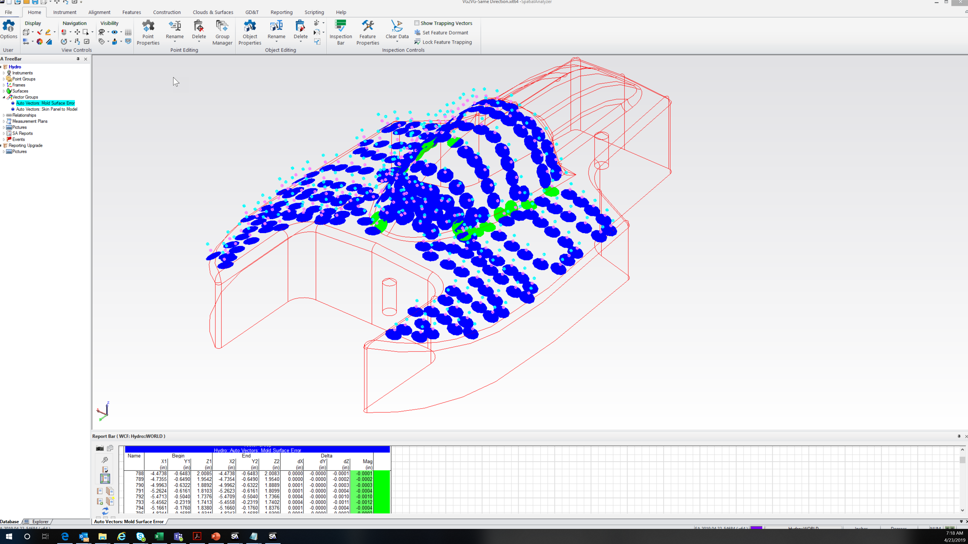
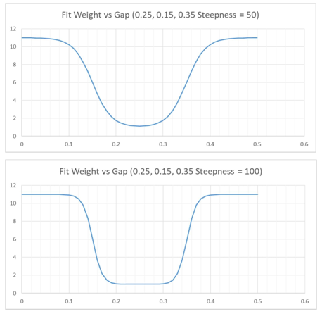
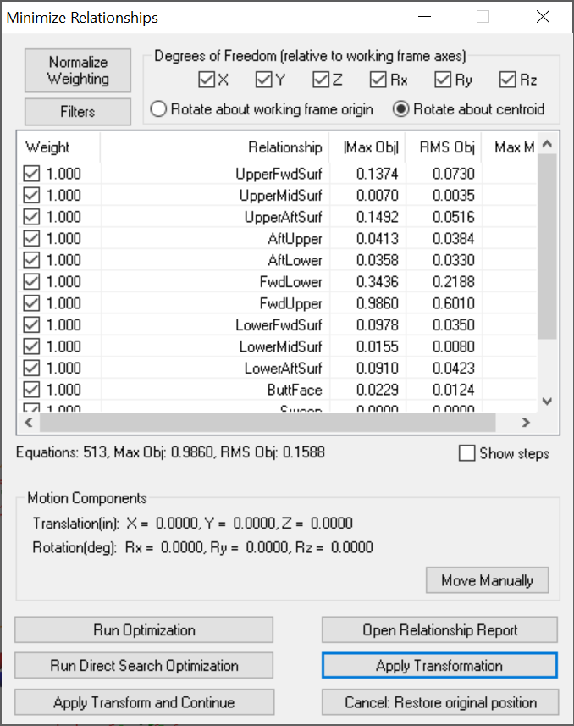
Agenda
Process Flow for setting up the inputs
Creating up the Vector Group to Vector Group Relationship
Setting the Specifications for this special relationship
Utilizing this relationship along with other constraints to perform a virtual fit up
Notes:
Basic shim and Gap application would go as follows:
Preliminary Setup:
1. Start with two nominal surfaces that are expected to mate together in some fashion.
2. Declare one of these surfaces to be the primary and define a Points to Surface Face Relationship to which points can be added to characterize the as-built surface relative to the nominal CAD surface. Use this relationship for a best-fit if desired and enable auto-vectors.
3. Declare the second of the two mating surfaces to be the secondary by defining a second points to surface relationship to characterize the second as-built surface. The collected points need to correspond to those points collected for the primary surface. Use this relationship for a best-fit if desired (if using a second instrument station) and enable auto-vectors.
Configuring the VG to VG Relationship
1. Create a “Vector Group to Vector Group” relationship and select the primary Points to Surface Face relationship auto-vectors as the primary input and then select the secondary Points to Surface Face relationship auto-vectors as the secondary input.
2. Open the properties for the VG to VG Relationship and set the proximity parameters as desired (Figure 24-9). The vectors in the first vector group will be used for reference and the closes (radial) corresponding vector will be found from the corresponding vector group. Also ensure that the Opposing Direction radio button is selected. Same Direction should be used when comparing points on the same surface.
Fitting with a VG to VG Relationship
VG to VG Relationships can be used in an optimization.
1. Set the properties for the “Vector Group to Vector Group” such that the nominal, minimum, and maximum gap values are set appropriately.
2. Enter an appropriate Gradient Steepness Factor.
3. Run the relationship fit by selecting Relationship>Move Objects by Minimizing Relationships

Slide 11
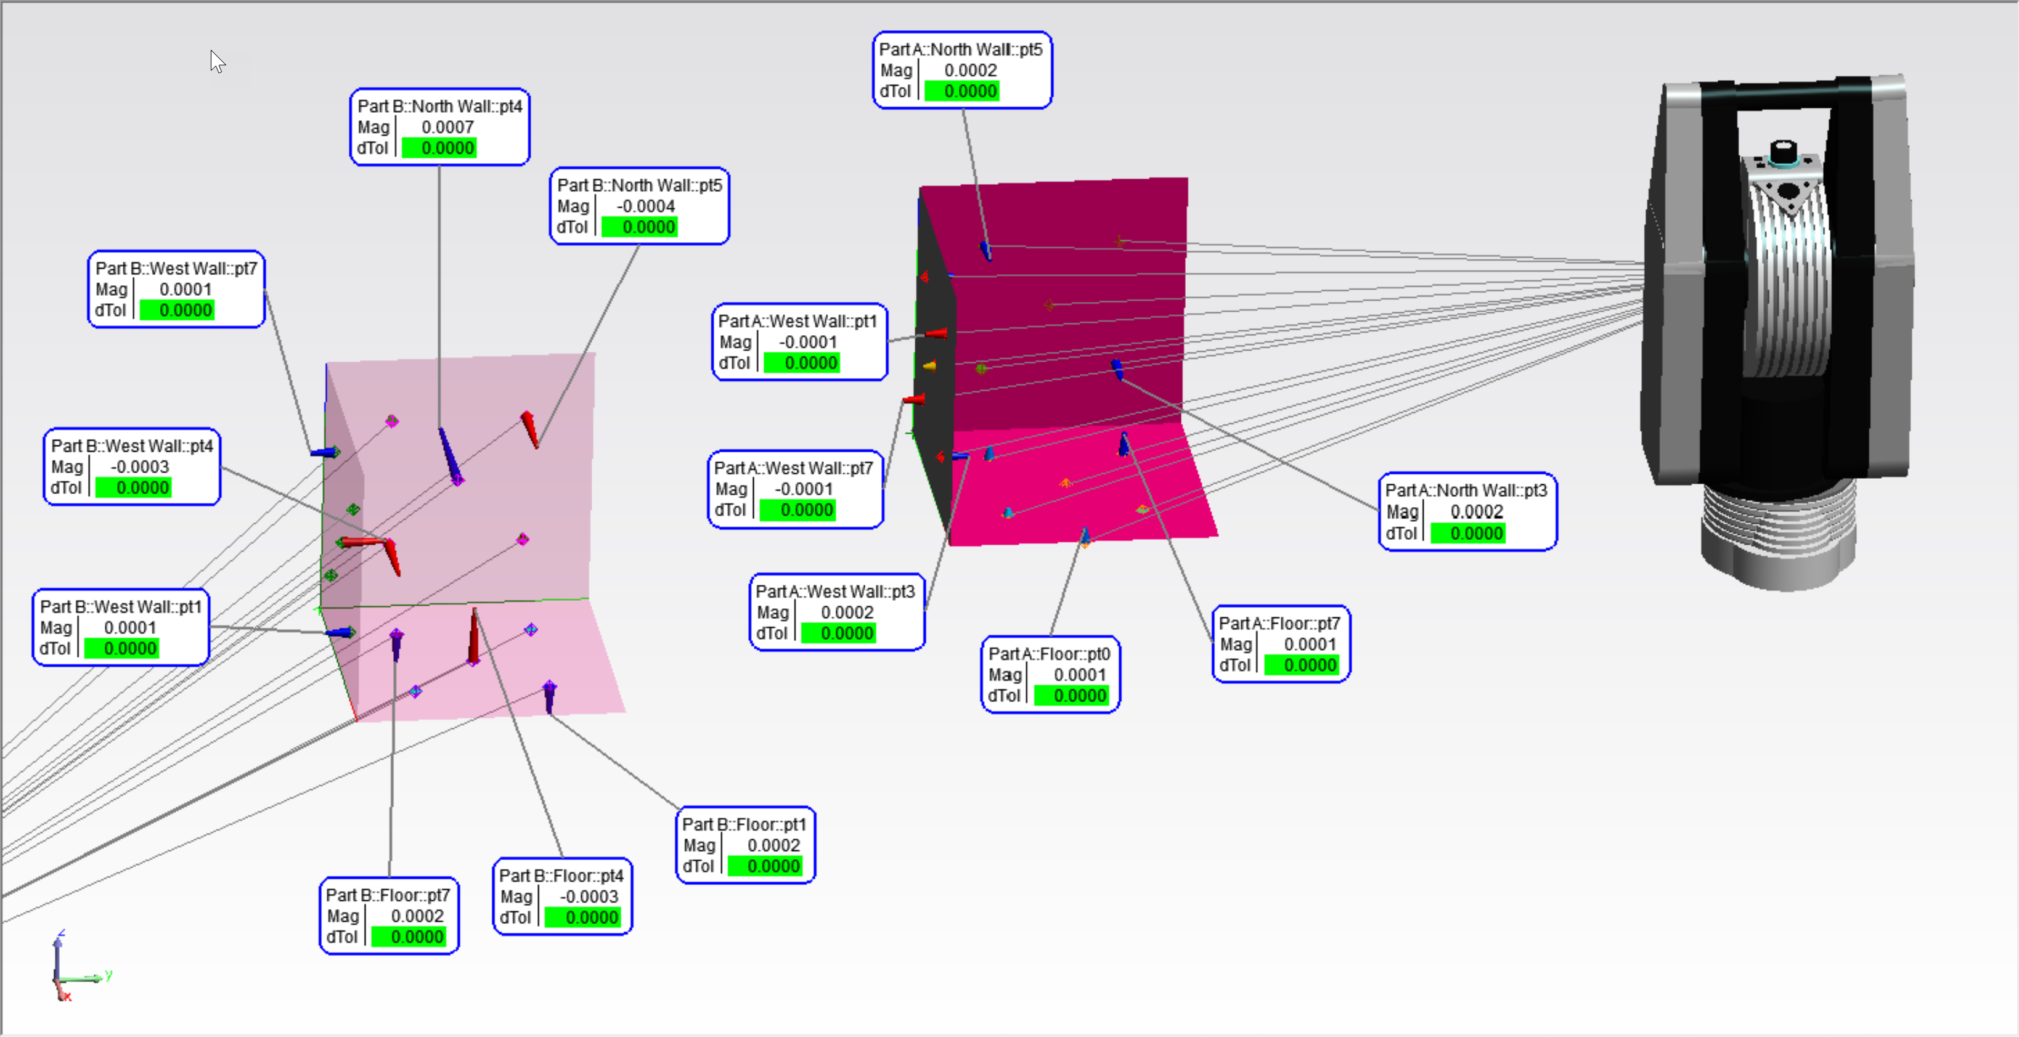
Measure the Two Mating Parts
Mating Parts. Each independently surveyed
Proximity Triggers are a good method for making sure you measure each part close to where they will fit up.
Names do not need to match
Proximity between vectors does not have to be very precise.
You do need to have the two surveys aligned within their relative working frame.
You will need to know the max distance between matching vectors.
Notes:
Basic shim and Gap application would go as follows:
You have mating parts with measurements on the mating surfaces
Naming convention – unlike points to points this is not looking for name matching
Proximity – Does not have to be precise…….but you are looking for gap in an area so you have to decide what is a reasonable threshold based on your part

Slide 12
Create the Vector Groups for the respective mating surfaces
Utilize Points to Objects with Auto Vectors turned on so you only need to deal with moving instruments or point groups when performing the optimization fit.
Go ahead and align your surveys through normal or traditional methods
Frame to Frame
Relationship Fit
Best-fit
No name matching needed
Know the max distance between matching vectors
For the Gap or Shim calculation you will want to consider one-part stationary, the other part as moving. Afterwards you can align your solved network to engineering requirements but with the gap optimally set.
Notes:
Preliminary Setup:
Start with two nominal surfaces that are expected to mate together in some fashion.
2. Declare one of these surfaces to be the primary and define a Points to Surface Face Relationship to which points can be added to characterize the as-built surface relative to the nominal CAD surface. Use this relationship for a best-fit if desired and enable auto-vectors.
3. Declare the second of the two mating surfaces to be the secondary by defining a second points to surface relationship to characterize the second as-built surface. The collected points need to correspond to those points collected for the primary surface. Use this relationship for a best-fit if desired (if using a second instrument station) and enable auto-vectors.

Slide 13
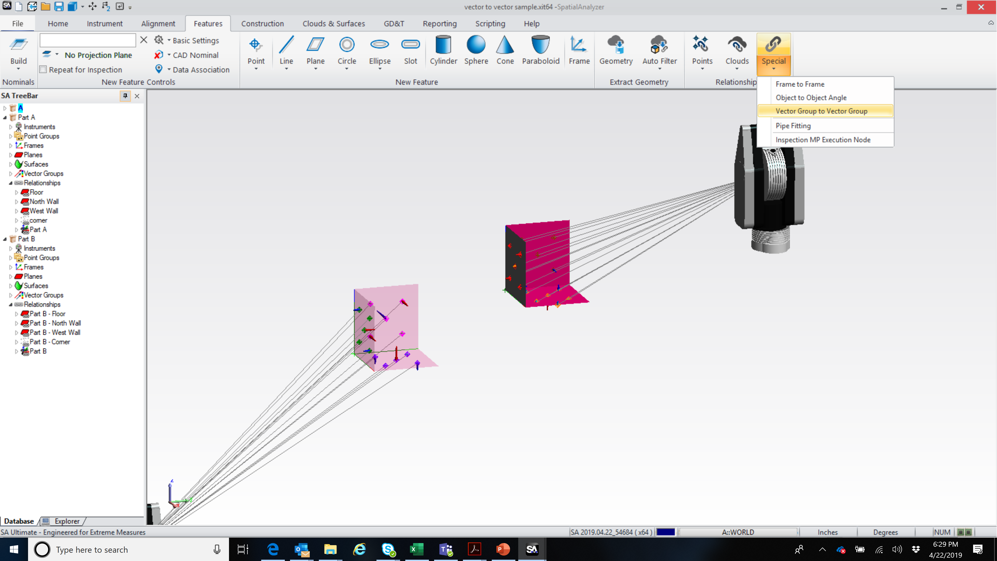
Create the Vector Group to Vector Group Relationship
Operation is found in the Features Tab, Special, Vector Group to Vector Group.
Notes:
Next slide has video showing the steps. Point out where the function is located. When you pick it you will be prompted to pick the reference (stationary) and the Corresponding (moving)

Slide 14
Create the Vector Group to Vector Group Relationship
Consider creating a separate collection to place these special relationships in. You will also want to include any other constraints that need to be considered when aligning.
Notes:
Configuring the VG to VG Relationship – Video will run on slide load. You have 56 seconds before video ends.
Make a new collection. Will be helpful if you plan to do a fit afterwards.
Create a “Vector Group to Vector Group” relationship and select the primary Points to Surface Face relationship auto-vectors as the primary input and then select the secondary Points to Surface Face relationship auto-vectors as the secondary input.

Slide 15
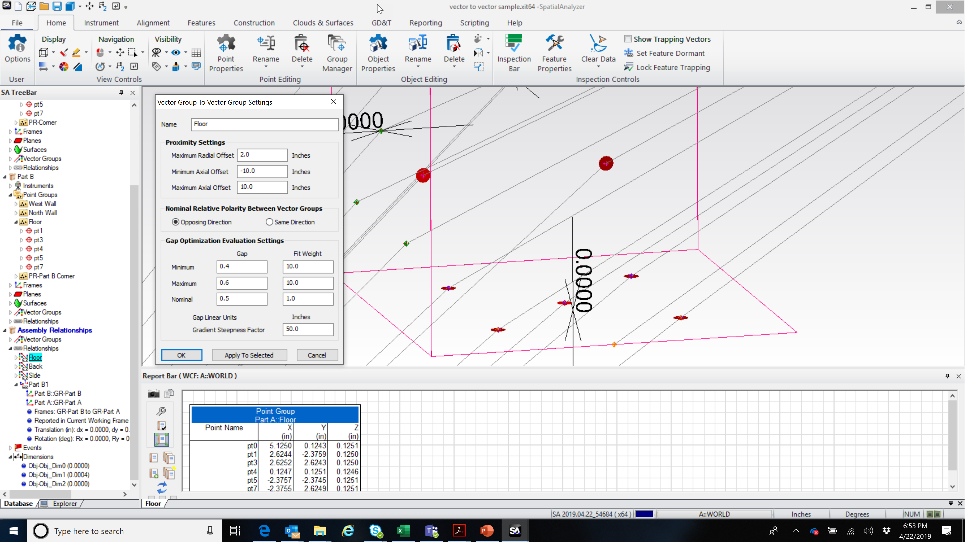
Walk through User Interface
Notes:
2. Open the properties for the VG to VG Relationship and set the proximity parameters as desired.

Slide 16
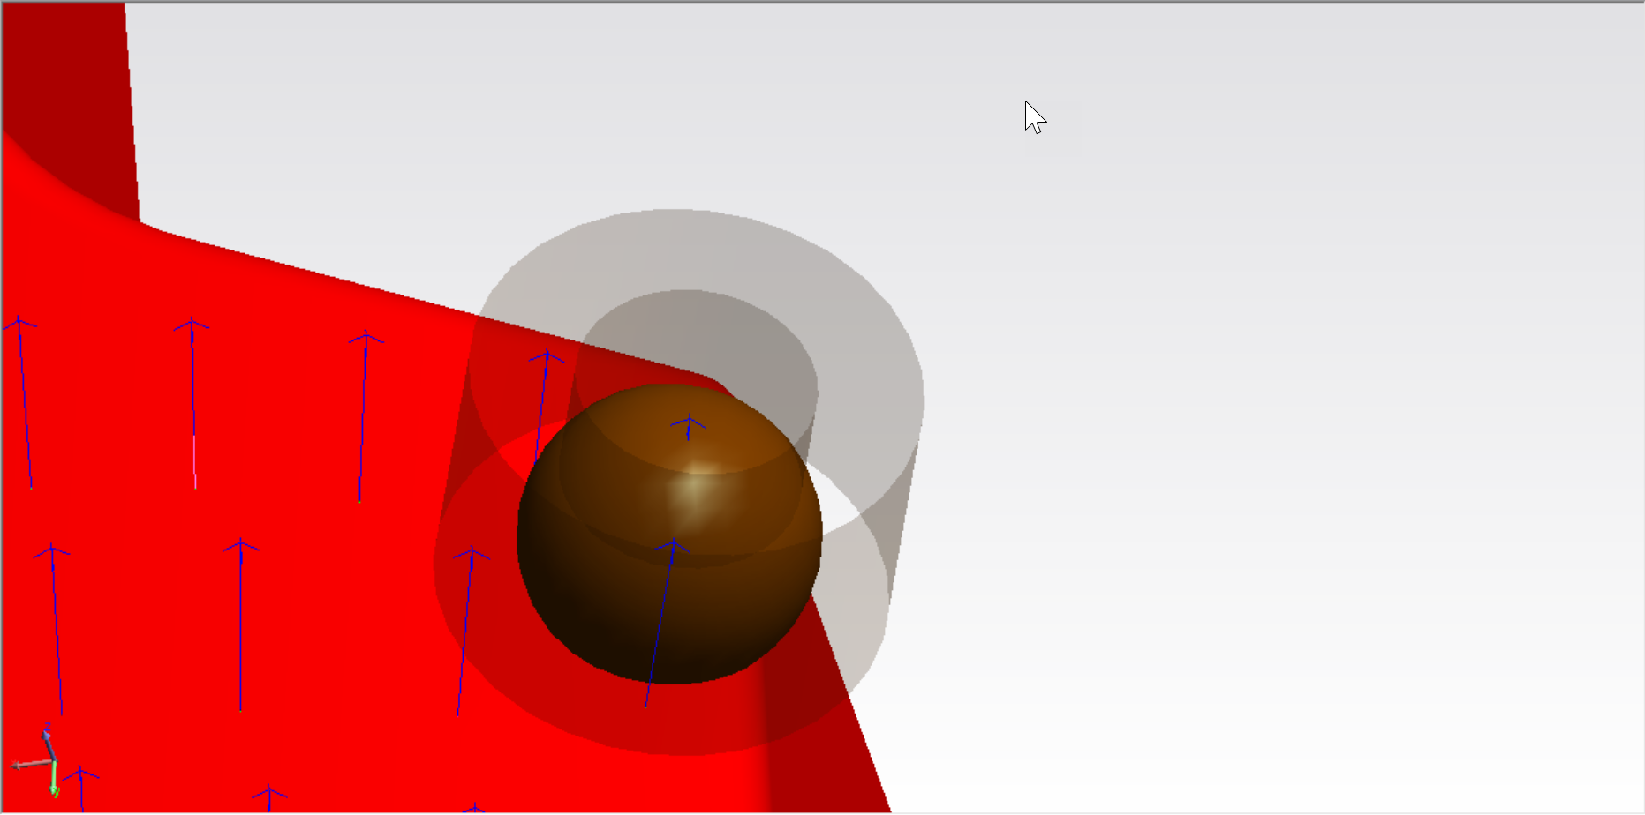
Walk through User Interface
MIN AXIAL
MAX AXIAL
MAX RADIAL (Spherical)
Notes:
The vectors in the first vector group will be used for reference and the closes (radial) corresponding vector will be found from the corresponding vector group. Also ensure that the Opposing Direction radio button is selected. Same Direction should be used when comparing points on the same surface.

Slide 17
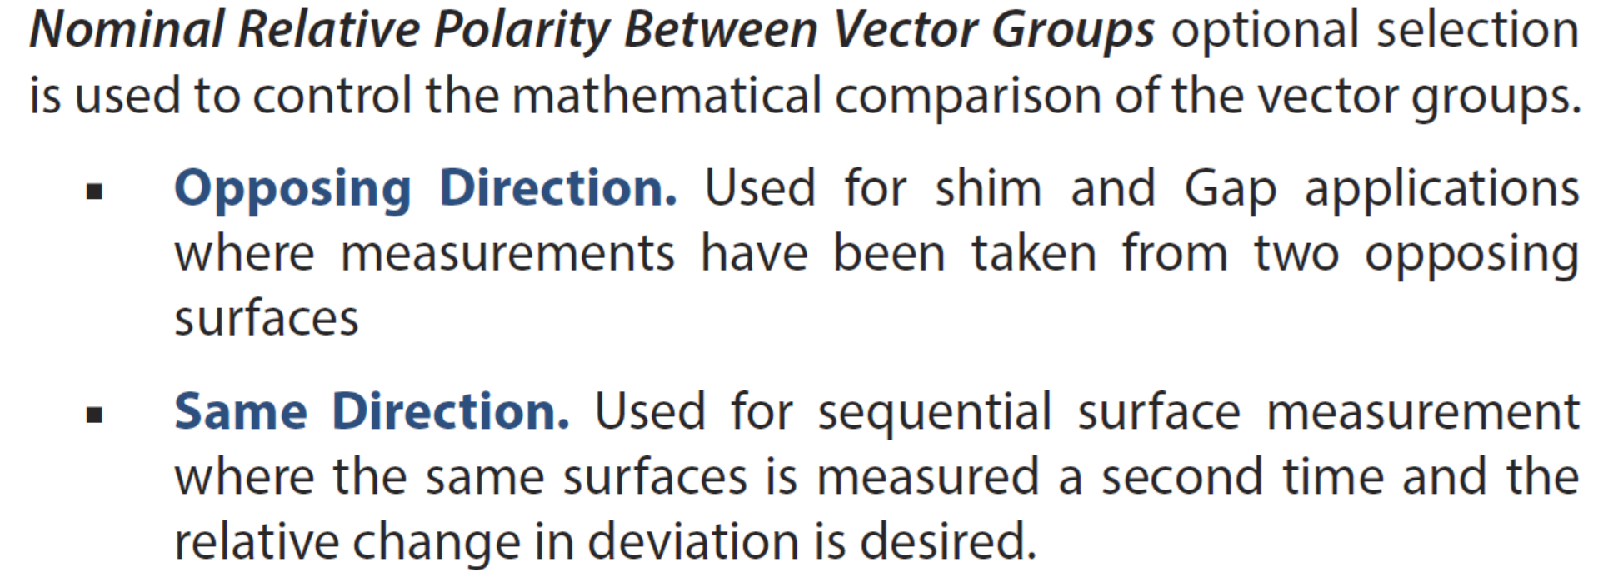
Walk through User Interface
GAP or SHIM
Notes:
Opposing direction is taken from the surface normal.
Default setting will be opposing directions so if you are measuring change to a surface you will need to change this setting to see the vector group provide results

Slide 18
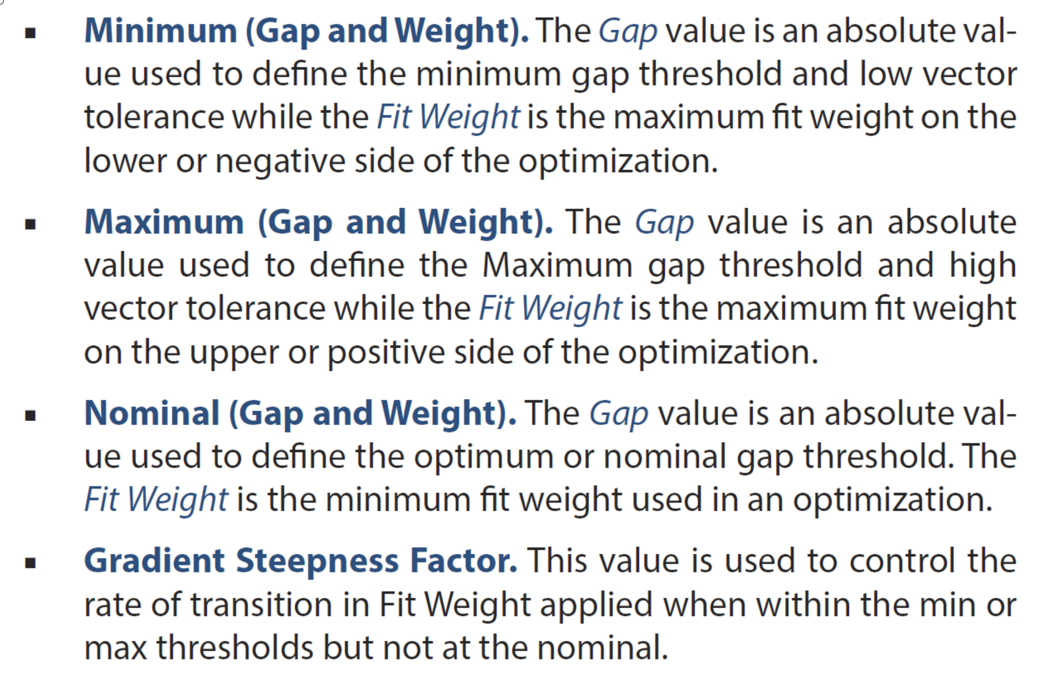
Walk through User Interface
Notes:
Pretty straight forward….mostly
Minimum, Maximum, and Nominal all are for the nominal gap size. No plus or minus, we need the min and max range and the nominal.
If you want to utilize the gap requirements for an alignment, you can set the weights and behavior for how the gap definition contributes to the fit optimization

Slide 19
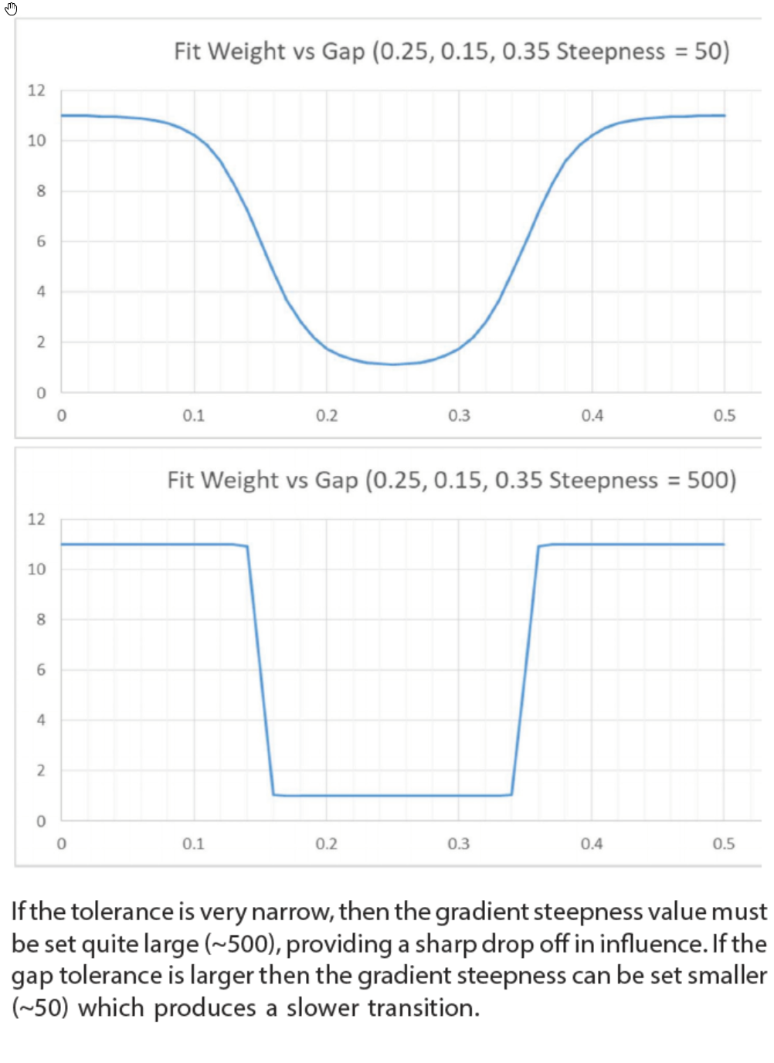
Walk through User Interface
Large Gap Tolerance – Smaller Factor
Narrow Gap Tolerance – Larger Factor
Notes:
If the tolerance is very narrow, then the gradient steepness value must be set quite large (~500), providing a sharp drop off in influence. If the gap tolerance is larger then the gradient steepness can be set smaller (~50) which produces a slower transition.
Fit constraints (which are still available to use) provide a way to establish a dead zone. In other words if I am outside the fit envelope, pull me in. But once inside don’t pull at all so the result can rattle around this zone. The fit result is this case has some ambiguity, depends on where you start from as to where you wind up.
The larger the Gradient Steepness factor, the more it will behave like a traditional fit constraint, however if the tolerance is narrow the larger steepness gradient will allow a faster transition into the allowable zone without exerting unneeded influence to pull the gap to the nominal value.
Mostly I think you’ll find working with the weighting for the min, max, and nominal will get you where you want to be. The steepness gradient takes those fit weights into consideration with its value to effect the fit results.
We can provide a translation of this explanation in Greek if that helps anyone.

Slide 20
Vector Group to Vector Group demo
Simple - Nested part
Complex - Wing to Side of Body
Measure part thickness to mold

Slide 21
Thank you!
2019 Spatial Analyzer User Conference

