Slide 1
Part Inspection using SpatialAnalyzer’s Ribbon Menus
Jeremy Winn
Support AE
Williamsburg, VA

Slide 2
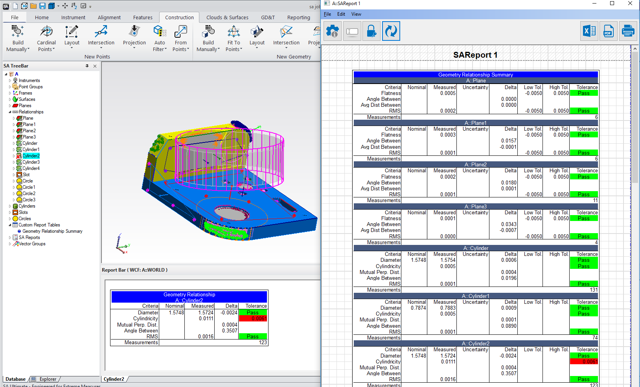
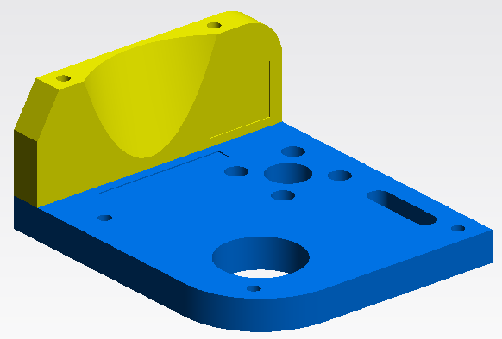
Two Topics to Cover Today:
How to Efficiently… Perform Feature Inspection
Notes:
Two topics to cover Focused on one subject… how to…
Most of you know more about this than I do so I am going to focus on the new features added in the last couple of years.

Slide 3
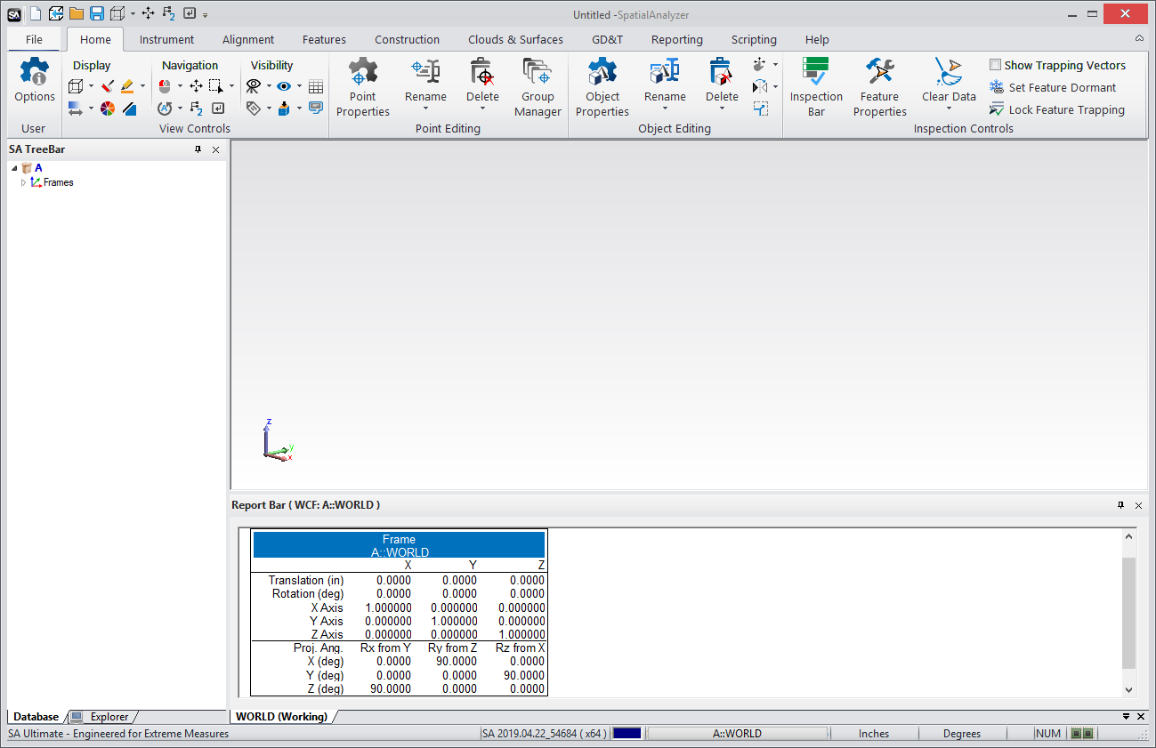
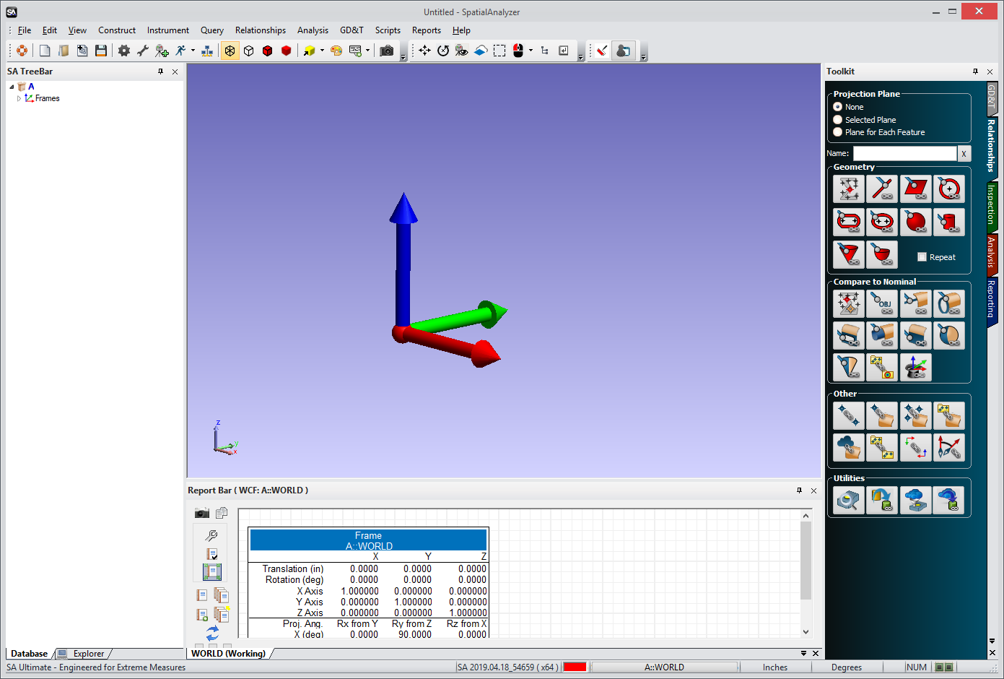
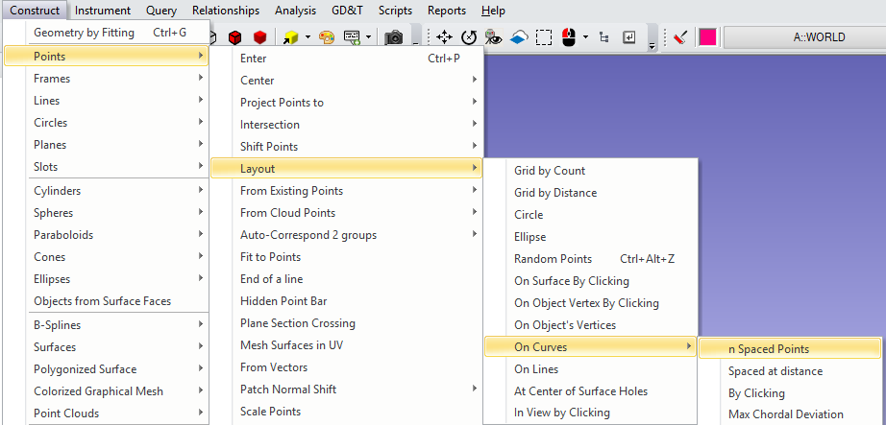
SA’s Ribbon Menu:
Objectives with ribbons were 3-fold:
Provide more modern look and feel
Easier access to frequently used commands
Loose the dropdown menus… reduces mouse clicks
Notes:
Let’s start with the ribbon menu and the new look of SA…. If you haven’t seen it yet… here it is.
Objectives were 3 fold…

Slide 4
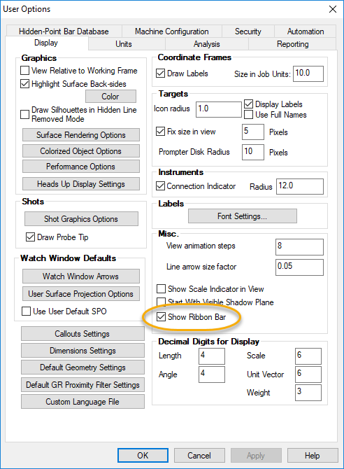
SA’s Ribbon Menu:
Objectives were 3-fold:
Provide more modern look and feel
Easier access to frequently used commands
Loose the dropdown menus… and reduces mouse clicks
Notes:
Let’s start with the ribbon menu and the new look of SA…. If you haven’t seen it yet… here it is.
Objectives were 3 fold…

Slide 5
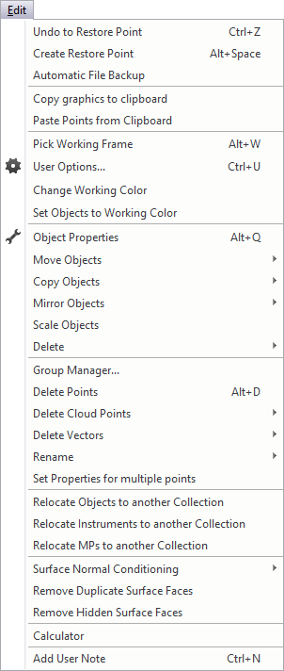
SA’s Ribbon Menu:
View Controls and Editing for Job Management
Notes:
So What do we have here… Lets take a loser look:
Mimic Microsoft Word menus

Slide 6
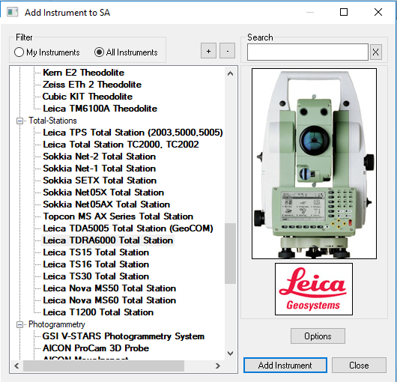
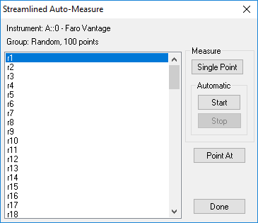
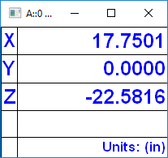
SA’s Ribbon Menu:
View Controls and Editing for Job Management
Instrument Station, Observation and Measurement Controls
Notes:
So What do we have here… Lets take a loser look:

Slide 7
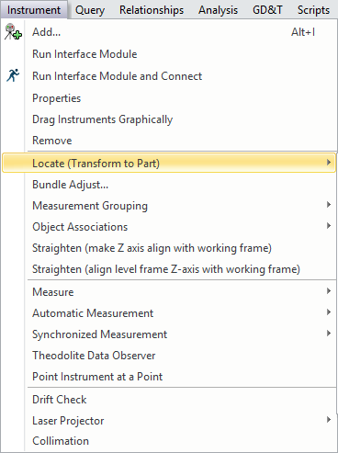
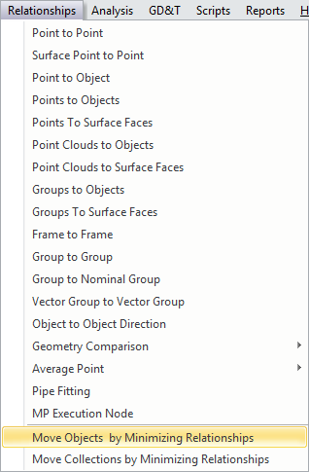
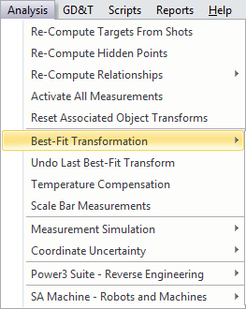
SA’s Ribbon Menu:
View Controls and Editing for Job Management
Instrument Station, Observation and Measurement Controls
Complete Selection of Alignment Options
Notes:
So What do we have here… Lets take a loser look:

Slide 8
SA’s Ribbon Menu:
View Controls and Editing for Job Management
Instrument Station, Observation and Measurement Controls
Complete Selection of Alignment Options
Feature Construction… more to come…
Notes:
So What do we have here… Lets take a loser look:

Slide 9
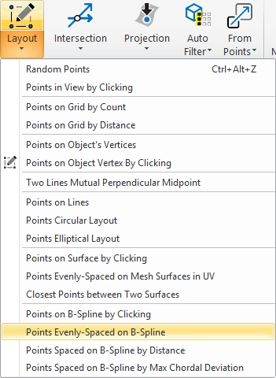
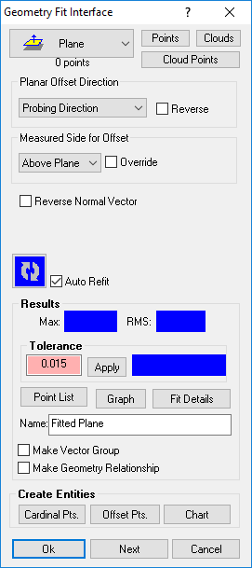
SA’s Ribbon Menu:
Construction page replacement…operation based?
Notes:
So What do we have here… Lets take a loser look:

Slide 10
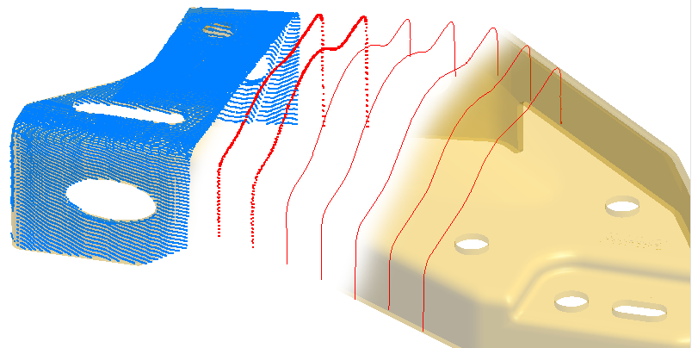
SA’s Ribbon Menu:
Construction page replacement…operation based?
Cloud, Spline and Surface Management
Notes:
So What do we have here… Lets take a loser look:

Slide 11
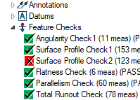
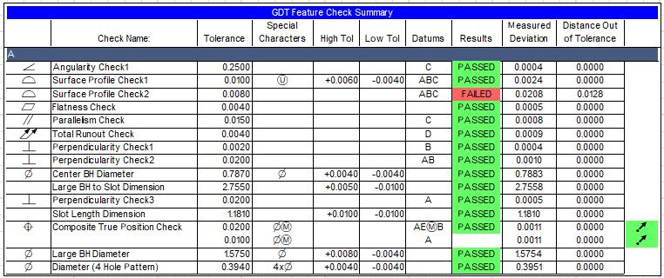
SA’s Ribbon Menu:
Construction page replacement…operation based?
Cloud, Spline and Surface Management
GD&T Controls
Notes:
So What do we have here… Lets take a loser look:

Slide 12
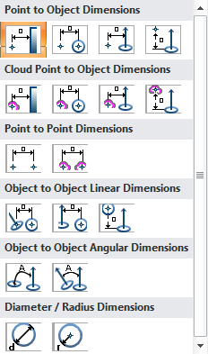
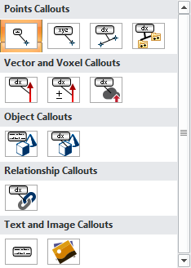
SA’s Ribbon Menu:
Reporting, Queries, Dimensions, and Callouts
Notes:
So What do we have here… Lets take a loser look:

Slide 13
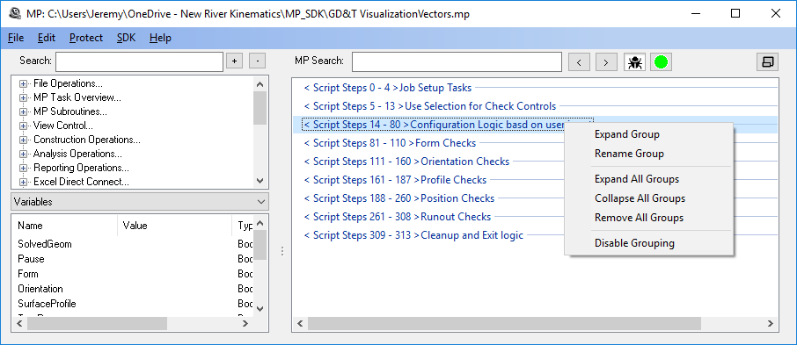
SA’s Ribbon Menu:
Scripting…
Notes:
So What do we have here… Lets take a loser look:

Slide 14
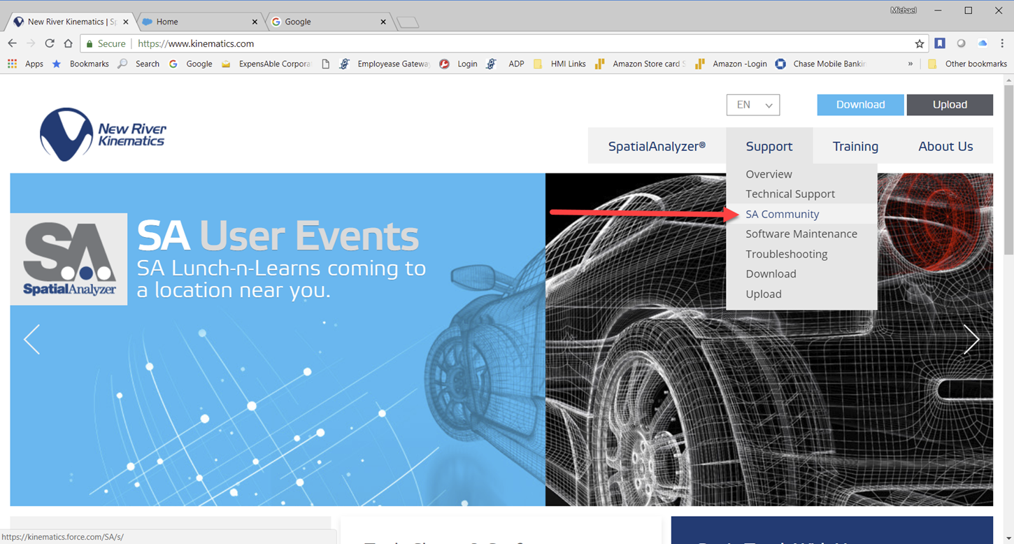
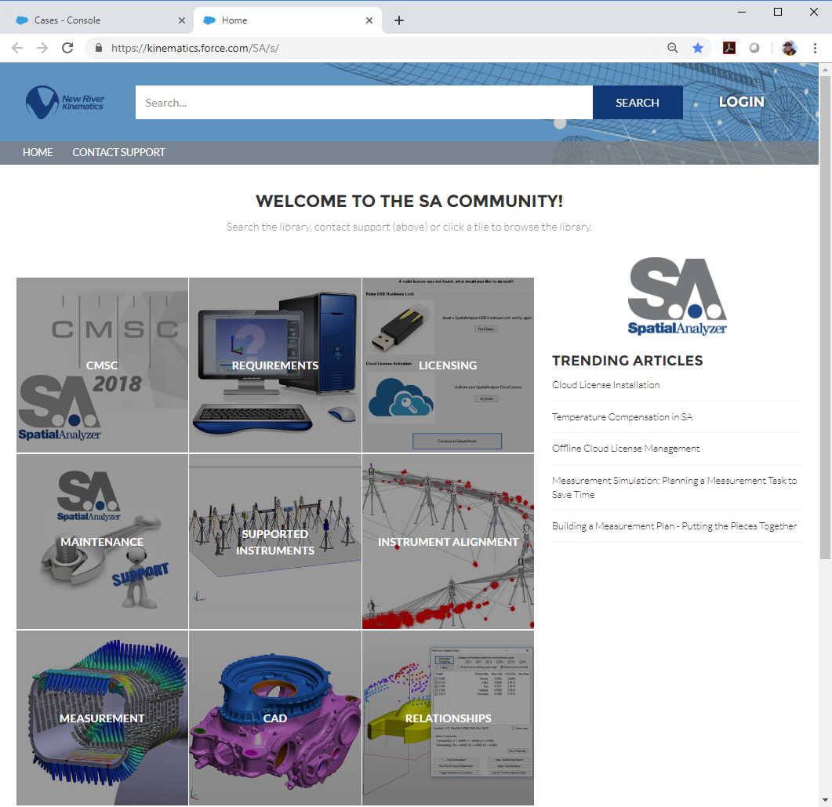
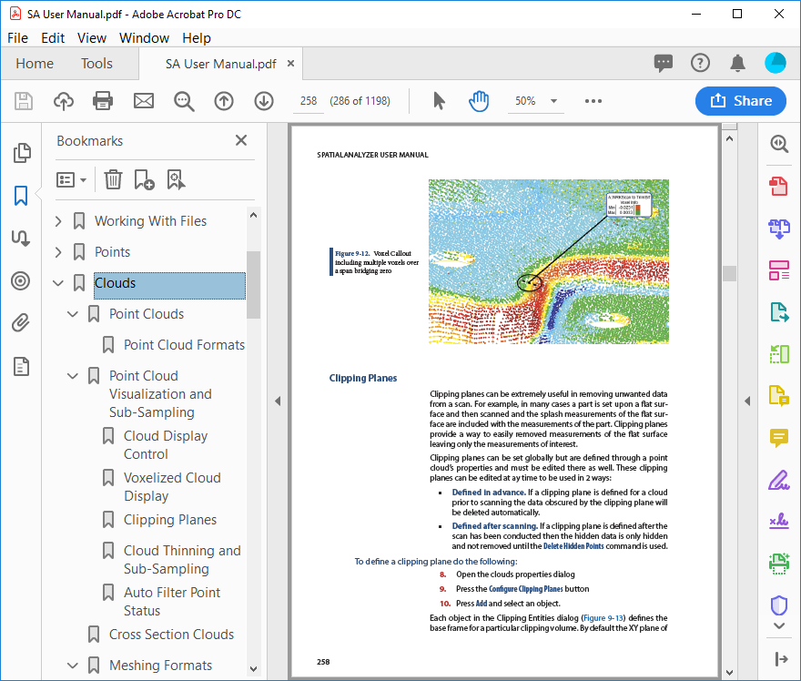
SA’s Ribbon Menu:
Last but not least… HELP
Notes:
So What do we have here… Lets take a loser look:

Slide 15
So…What is a Feature?
SA’s Ribbon Menu:
View Controls and Editing for Job Management
Instrument Station, Observation and Measurement Controls
Complete Selection of Alignment Options
And who really cares…
Notes:
So What do we have here… Lets take a loser look:

Slide 16
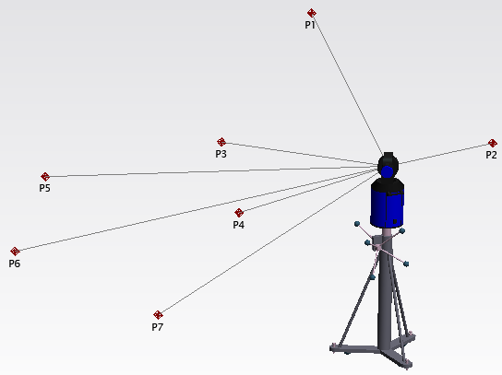
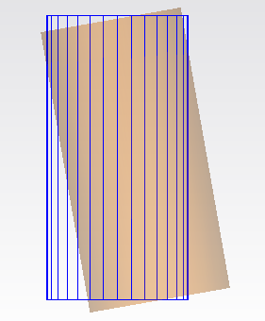
Why Feature Inspection?
SA is a Points Based Software
Always been easy to measure and fit geometry… we all know the hot keys.
But…
Feature inspection is geometry to geometry comparison.
…so how do we get there?
Notes:
SA is a points-based software and point traceability is its foundation.
But the deliverable to the customer in many cases is… where are the features relative to the nominal and are they within tolerance.
So how do we get there?

Slide 17
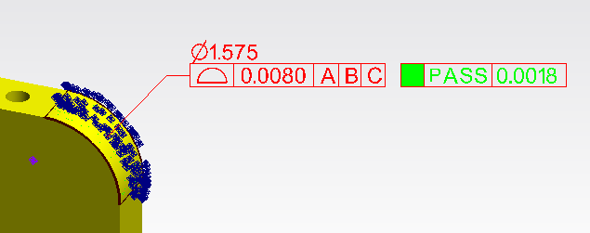
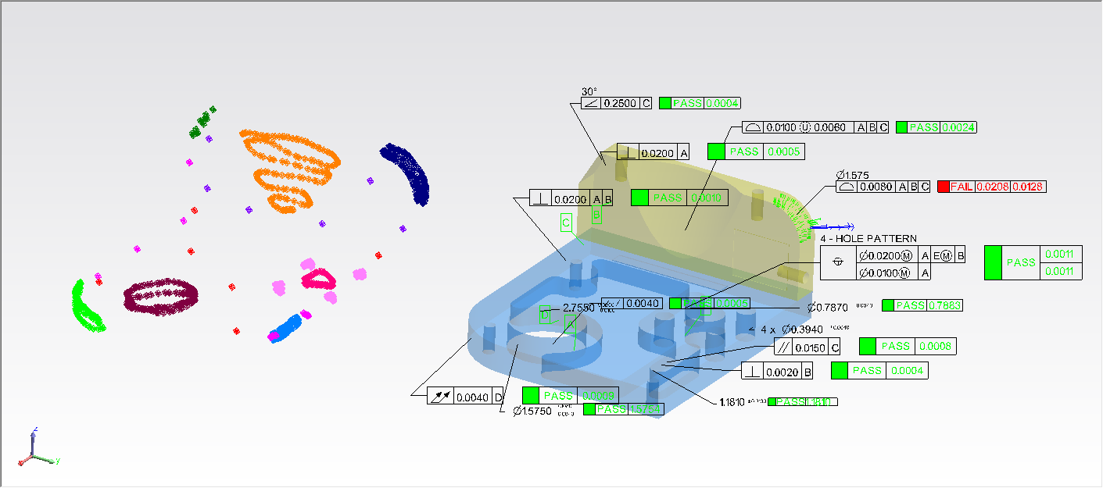
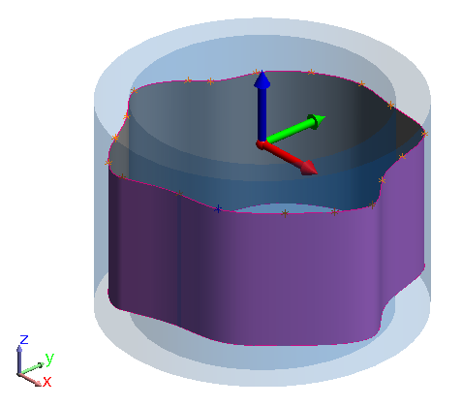
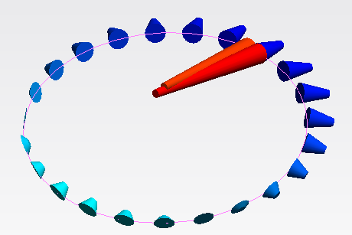
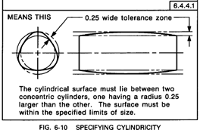
GD&T Inspection?
Why did the check fail?
GD&T…
GD&T have built in datum alignments
GD&T uses Standardized bounding thresholds (outlier dependent).
Geometry fits and vectors offer visual explanations and RMS fits to explain point deviations.
Notes:
Standardized Inspection both ISO and ASME delivers part to part comparison and evaluation… however,
GD&T has a built in Alignment you don’t see
GD&T is more heavily influenced by outliers – which reflect part deviation

Slide 18
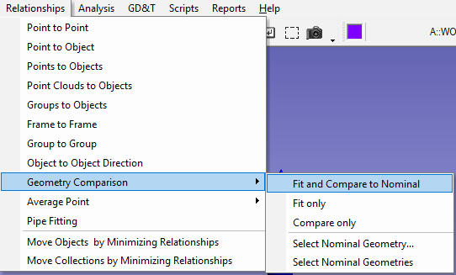
Geometry Comparisons?
SA Toolkit Inspection was added in 2012
Added to bring feature (GR) inspection into view
Thus…GR-Feature
Because “Fit and Compare Geometry Relationship” is too long
Notes:
What we need is an efficient means to take point measurements and perform feature evaluations using those points
Toolkit was introduced to help with that process by offering quick access to existing tools
And these tools have continued to evolve as has the toolkit.

Slide 19
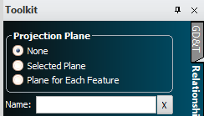
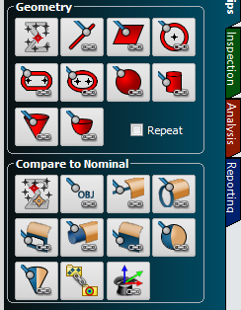
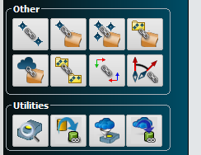
Nothing to fear…
Same Content in a horizontal layout

Slide 20
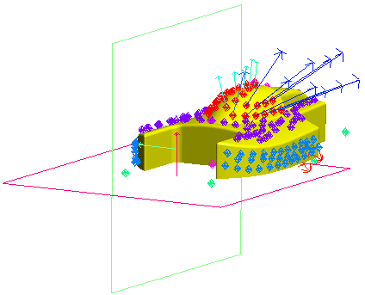
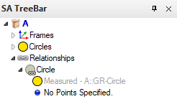
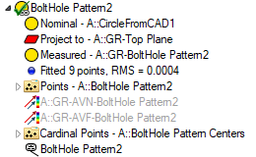
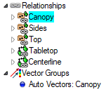
Geometry Relationships
“Relationship = Dynamic Query”…?
Anatomy of a GR- Feature
Notes:
We often think of a relationship as being a “Dynamic Query”, But it can be more..
It can be a Dynamic Link between many things… When you build a relationship from a circle it looks kind of redundant
But when it pulls all the pieces together for you, the power starts to be more apparent.

Slide 21
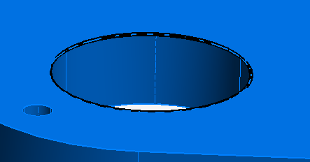
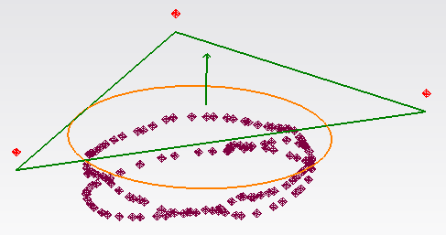
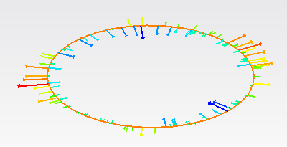
Anatomy of a GR-Feature
Circle Feature:
Nominal Circle
Projection plane
Measured Circle
List of fit points
Vectors
Inspection Callout
Cardinal points
AVF (Fit) -AVN (Nominal)
Linked items also display visibility and provides direct access.

Slide 22
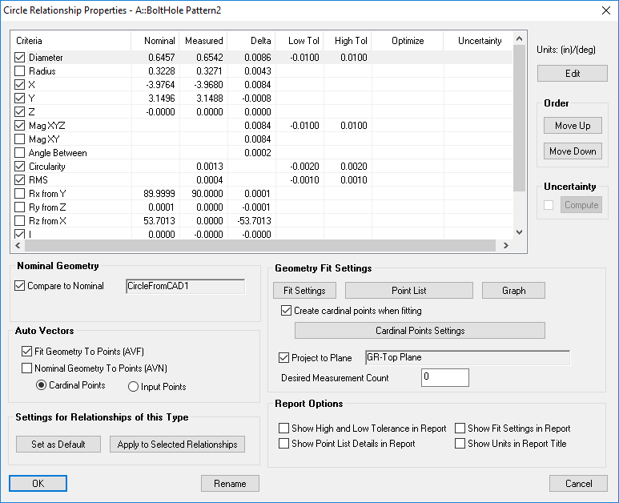
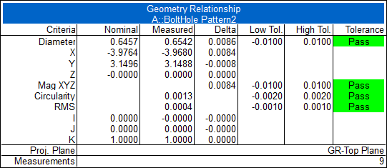
Anatomy of a GR-Feature
GR-Feature Properties
Multiple Controls Combined:
Reporting Criteria
Notes:
In addition to the links between items GR-Features compute the difference between nominal and measured

Slide 23
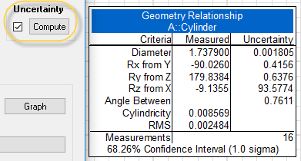
Anatomy of a GR-Feature
GR-Feature Properties
Multiple Controls Combined:
Reporting Criteria
Notes:
In addition to the links between items GR-Features compute the difference between nominal and measured

Slide 24
Anatomy of a GR-Feature
GR-Feature Properties
Multiple Controls Combined:
Reporting Criteria
Nominal Reference
Dynamic Fit Control
Auto Vector Display

Slide 25
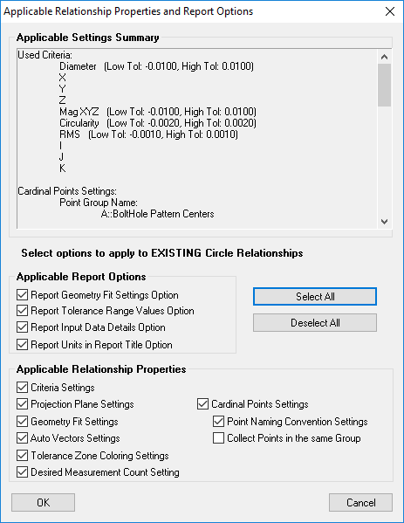
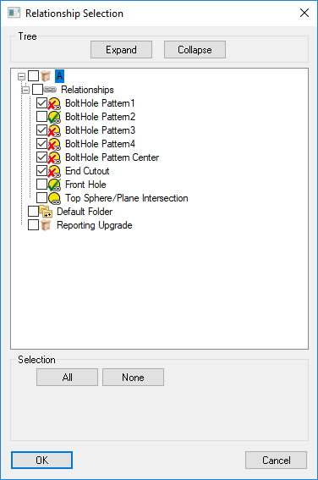
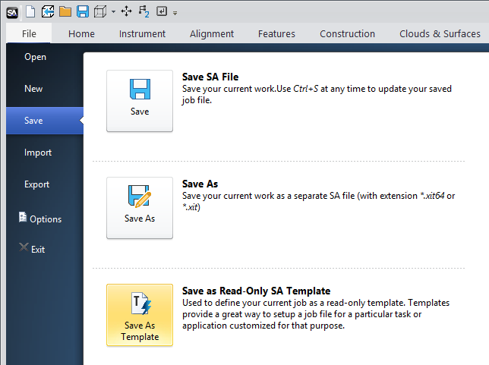
Anatomy of a GR-Feature
GR-Feature Properties
Preview Window
Multiple Controls Combined:
Reporting Criteria
Nominal Reference
Auto Vector Display
Dynamic Fit Control
Component Control

Slide 26
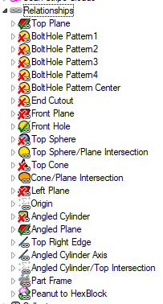
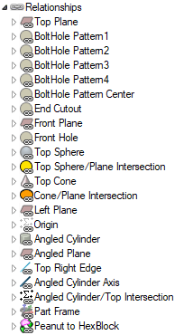
Notes:
The heart of the Features tab is the New Feature section. When you want a new feature push the button.
How does 2 sections of the toolkit fit into one set of buttons?

Slide 27
GR-Features
That’s why we suggest GR-Features.. And continue to develop…
So how the next question is workflow…

Slide 28
Notes:
The heart of the Features tab is the New Feature section. When you want a new feature push the button.
How does 2 sections of the toolkit fit into one set of buttons?

Slide 32
Build GR-Features from selected Geometry
Detect Nominals by proximity
Filter Data based upon proximity to nominals
Build geometry directly from Clouds

Slide 33
Path’s to Inspection
Building Manually from a Print
Measure Feature
Open properties and create nominal
Edit Nominal properties to match print
Import or Build Nominal Geometry
Import or Geometry
Select Nominal Geometry button
Inspect

Slide 34
Path’s to Inspection
Building manually from a Print
Measure Feature
Open properties and create nominal
Edit Nominal properties to match print
Import or Build Nominal Geometry
Import or Geometry
Select Nominal Geometry button
Inspect
Build and detect Nominal from CAD
Measure
Align
Detect
Building Nominal from CAD in advance
Build Nominal GR
Inspect

Slide 35
Quick Demo
Ribbon Features in Action

