Slide 1
GD&T with SpatialAnalyzer
Caleb Canal
Applications Engineer

Slide 2
Introduction and Overview
A little about me and this presentation

Slide 3

Caleb Canal
BS Eng, LeTourneau University
10 years in industry, General Dynamics, CB&I
5 years with NRK
Applications Engineer
Central US (Tyler, TX)
5 kids
2 dogs
1 busy schedule

Slide 4
Overview
What’s new in SA with GD&T
Getting started
Feature checks
Alignments and evaluation
Reporting GD&T
Your Questions

Slide 5
What’s new in GD&T
Stuff we’ve added in the last 2 years

Slide 6
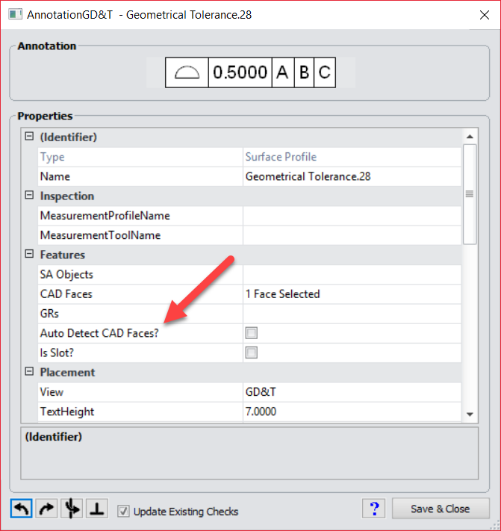
What’s new in GD&T
Added "Auto Detect Faces" option to surface profiles to extend surface profile checks to include all surface faces proximate to input points.

Slide 7
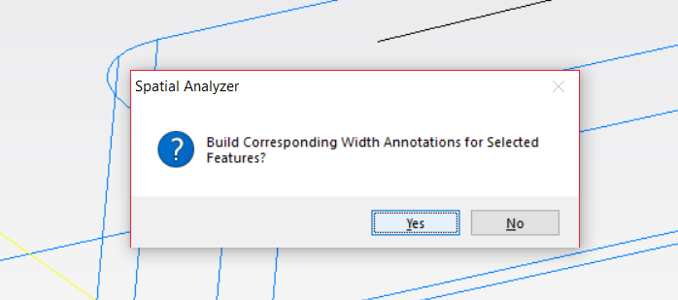
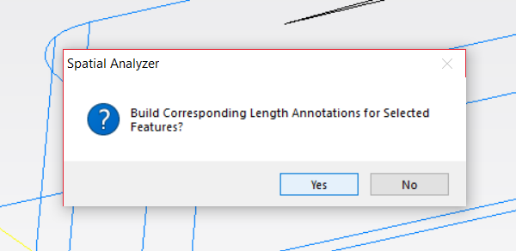
What’s new in GD&T
Added "Auto Detect Faces" option to surface profiles to extend surface profile checks to include all surface faces proximate to input points.
Added capability for generation of width and/or length checks when creating true position checks for slots from GD&T Toolkit.

Slide 8
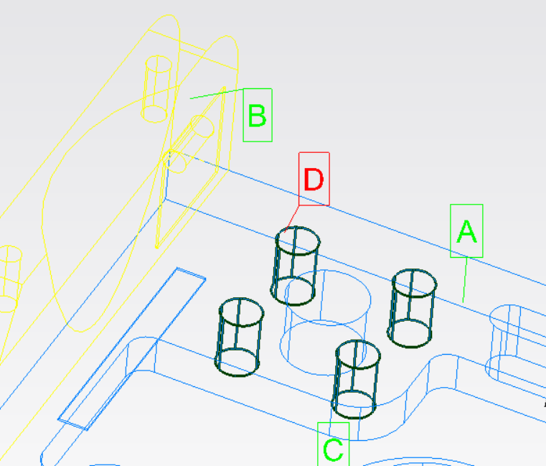
What’s new in GD&T
Added "Auto Detect Faces" option to surface profiles to extend surface profile checks to include all surface faces proximate to input points.
Added capability for generation width and/or length checks when creating true position checks for slots from GD&T Toolkit.
Added capability for creating multiple-feature datums (Pattern Datums)- currently supports multiple cylinders only.
Notes:
Use a pattern like a series of bolt holes as a single datum

Slide 9
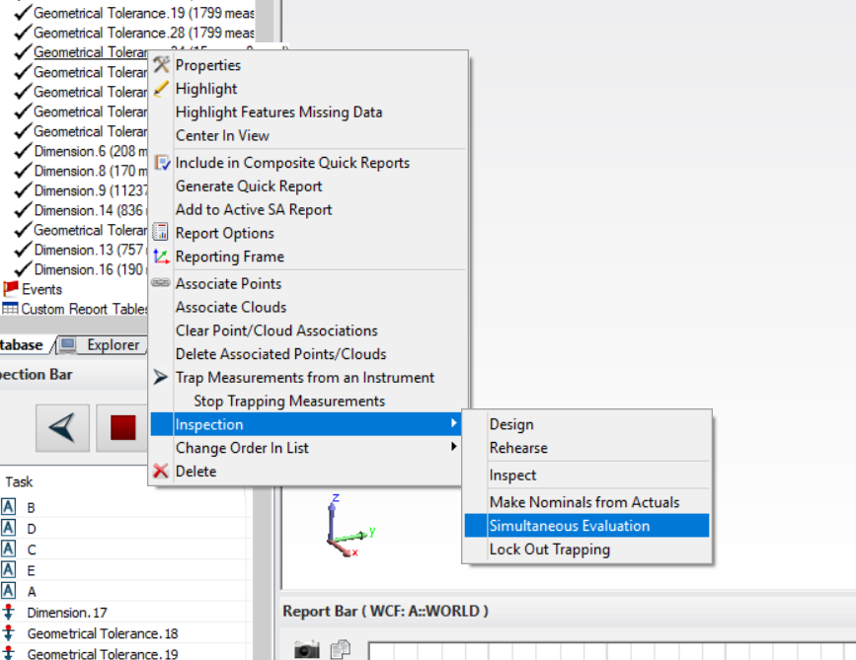
What’s new in GD&T
Added "Auto Detect Faces" option to surface profiles to extend surface profile checks to include all surface faces proximate to input points.
Added capability for generation width and/or length checks when creating true position checks for slots from GD&T Toolkit.
Added capability for creating multiple-feature datum - currently supports multiple cylinders only.
Added capability for performing simultaneous evaluations.
Notes:
Simultaneous evaluation will allow you to simultaneously evaluate all feature checks that use the same datum reference frame.

Slide 10
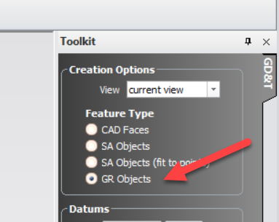
What’s new in GD&T
Added "Auto Detect Faces" option to surface profiles to extend surface profile checks to include all surface faces proximate to input points.
Added capability for generation width and/or length checks when creating true position checks for slots from GD&T Toolkit.
Added capability for creating multiple-feature datum - currently supports multiple cylinders only.
Added capability for performing simultaneous evaluations.
Added capability for using geometry relationships (nominal geometry) as GD&T reference objects and as the input point source.
Notes:
No need to associate points. Once the feature check is created from the annotation, points are automatically associated.

Slide 11
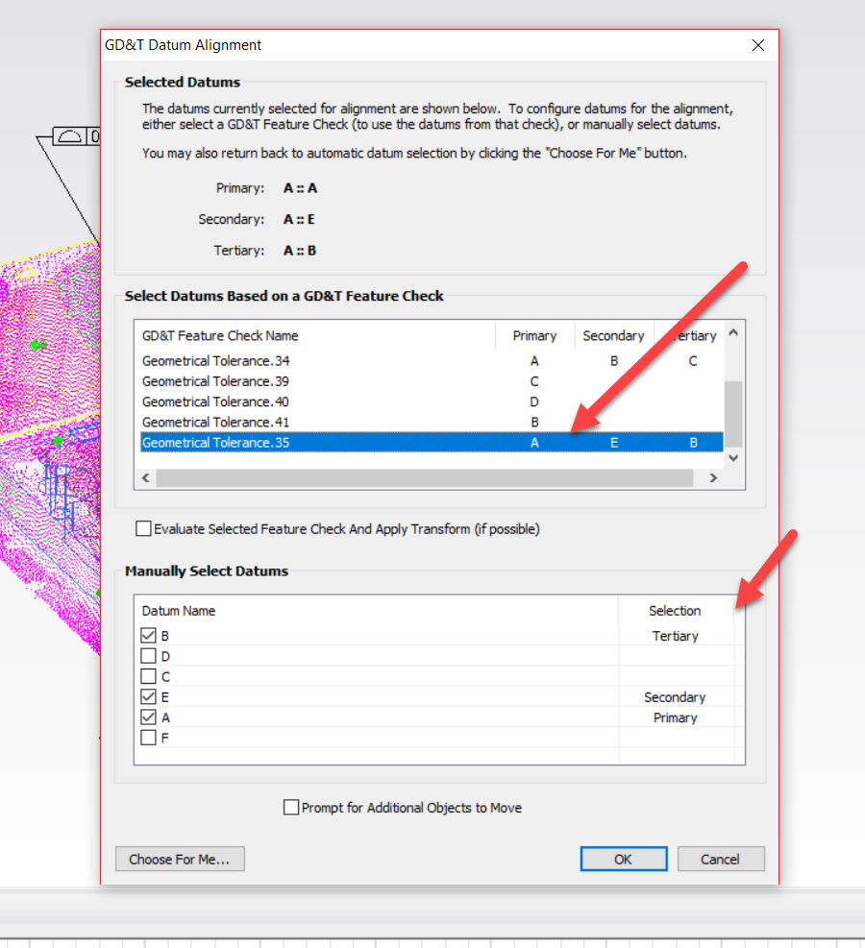
What’s new in GD&T
Added "Auto Detect Faces" option to surface profiles to extend surface profile checks to include all surface faces proximate to input points.
Added capability for generation width and/or length checks when creating true position checks for slots from GD&T Toolkit.
Added capability for creating multiple-feature datum - currently supports multiple cylinders only.
Added capability for performing simultaneous evaluations.
Added capability for using geometry relationships (nominal geometry) as GD&T reference objects and as the input point source.
Added an option to manually select GD&T Datum Alignments function to allow using a selected feature check to assert its evaluation transform as the alignment transform.

Slide 12
What’s new in GD&T
Added "Auto Detect Faces" option to surface profiles to extend surface profile checks to include all surface faces proximate to input points.
Added capability for generation width and/or length checks when creating true position checks for slots from GD&T Toolkit.
Added capability for creating multiple-feature datum - currently supports multiple cylinders only.
Added capability for performing simultaneous evaluations.
Added capability for using geometry relationships (nominal geometry) as GD&T reference objects and as the input point source.
Added an option to manual GD&T Datum Alignments function to allow using a selected feature check to assert its evaluation transform as the alignment transform.
Now importing arrows, attachment triangles, and attachment points for imported CAD annotations.

Slide 13
What’s new in GD&T
Added "Auto Detect Faces" option to surface profiles to extend surface profile checks to include all surface faces proximate to input points.
Added capability for generation width and/or length checks when creating true position checks for slots from GD&T Toolkit.
Added capability for creating multiple-feature datum - currently supports multiple cylinders only.
Added capability for performing simultaneous evaluations.
Added capability for using geometry relationships (nominal geometry) as GD&T reference objects and as the input point source.
Added an option to manual GD&T Datum Alignments function to allow using a selected feature check to assert its evaluation transform as the alignment transform.
Now importing arrows, attachment triangles, and attachment points for imported CAD annotations.
Annotations are now always visible.

Slide 14
What’s new in GD&T
Added "Auto Detect Faces" option to surface profiles to extend surface profile checks to include all surface faces proximate to input points.
Added capability for generation width and/or length checks when creating true position checks for slots from GD&T Toolkit.
Added capability for creating multiple-feature datum - currently supports multiple cylinders only.
Added capability for performing simultaneous evaluations.
Added capability for using geometry relationships (nominal geometry) as GD&T reference objects and as the input point source.
Added an option to manual GD&T Datum Alignments function to allow using a selected feature check to assert its evaluation transform as the alignment transform.
Now importing arrows, attachment triangles, and attachment points for imported CAD annotations.
Annotations are now always visible.
Selected feature check will be the only one displayed along with any datum elements it utilizes to construct its evaluation frame.

Slide 15
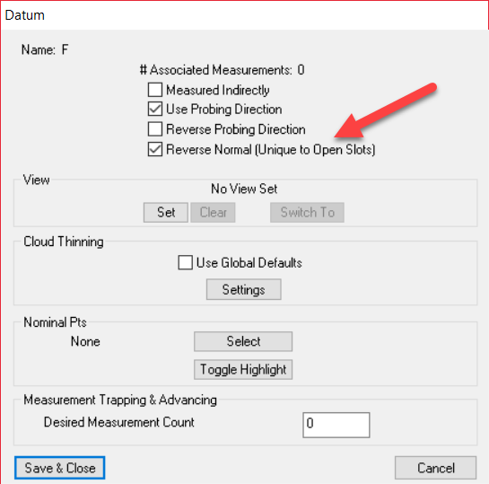
What’s new in GD&T
Added "Auto Detect Faces" option to surface profiles to extend surface profile checks to include all surface faces proximate to input points.
Added capability for generation width and/or length checks when creating true position checks for slots from GD&T Toolkit.
Added capability for creating multiple-feature datum - currently supports multiple cylinders only.
Added capability for performing simultaneous evaluations.
Added capability for using geometry relationships (nominal geometry) as GD&T reference objects and as the input point source.
Added an option to manual GD&T Datum Alignments function to allow using a selected feature check to assert its evaluation transform as the alignment transform.
Now importing arrows, attachment triangles, and attachment points for importede CAD annotations.
Annotations are now always visible.
Selected feature check will be the only one displayed along with any datum elements it utilizes to construct its evaluation frame.
Added option for GD&T Datum properties to allow reversing open slot mid-plane normal.

Slide 16
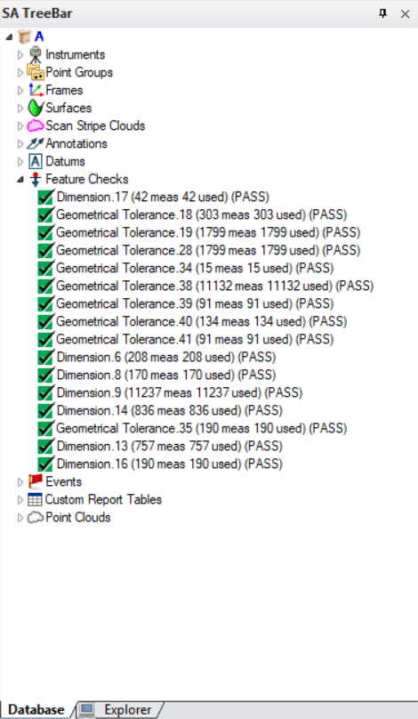
What’s new in GD&T
Added "Auto Detect Faces" option to surface profiles to extend surface profile checks to include all surface faces proximate to input points.
Added capability for generation width and/or length checks when creating true position checks for slots from GD&T Toolkit.
Added capability for creating multiple-feature datum - currently supports multiple cylinders only.
Added capability for performing simultaneous evaluations.
Added capability for using geometry relationships (nominal geometry) as GD&T reference objects and as the input point source.
Added an option to manual GD&T Datum Alignments function to allow using a selected feature check to assert its evaluation transform as the alignment transform.
Now importing arrows, attachment triangles, and attachment points for importede CAD annotations.
Annotations are now always visible.
Selected feature check will be the only one displayed along with any datum elements it utilizes to construct its evaluation frame.
Added option for GD&T Datum properties to allow reversing open slot mid-plane normal.
Added GD&T status indicators for datums/feature checks in tree and inspection tool bar.

Slide 17
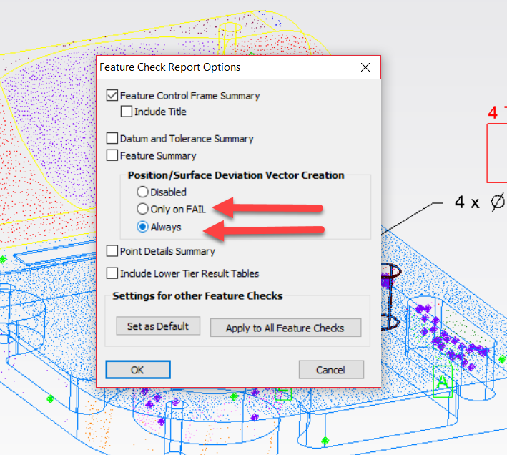
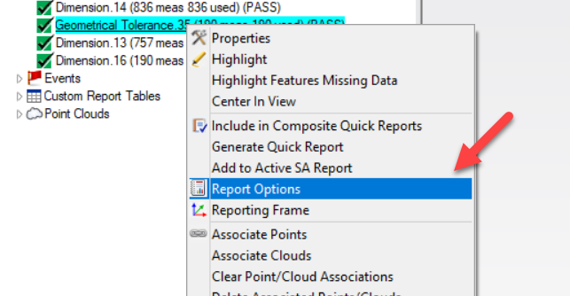
What’s new in GD&T
Added "Auto Detect Faces" option to surface profiles to extend surface profile checks to include all surface faces proximate to input points.
Added capability for generation width and/or length checks when creating true position checks for slots from GD&T Toolkit.
Added capability for creating multiple-feature datum - currently supports multiple cylinders only.
Added capability for performing simultaneous evaluations.
Added capability for using geometry relationships (nominal geometry) as GD&T reference objects and as the input point source.
Added an option to manual GD&T Datum Alignments function to allow using a selected feature check to assert its evaluation transform as the alignment transform.
Now importing arrows, attachment triangles, and attachment points for importede CAD annotations.
Annotations are now always visible.
Selected feature check will be the only one displayed along with any datum elements it utilizes to construct its evaluation frame.
Added option for GD&T Datum properties to allow reversing open slot mid-plane normal.
Added GD&T status indicators for datums/feature checks in tree and inspection tool bar.
Added auto vectors for GD&T surface profile deviations.

Slide 18
What’s new in GD&T
Added "Auto Detect Faces" option to surface profiles to extend surface profile checks to include all surface faces proximate to input points.
Added capability for generation width and/or length checks when creating true position checks for slots from GD&T Toolkit.
Added capability for creating multiple-feature datum - currently supports multiple cylinders only.
Added capability for performing simultaneous evaluations.
Added capability for using geometry relationships (nominal geometry) as GD&T reference objects and as the input point source.
Added an option to manual GD&T Datum Alignments function to allow using a selected feature check to assert its evaluation transform as the alignment transform.
Now importing arrows, attachment triangles, and attachment points for importede CAD annotations.
Annotations are now always visible.
Selected feature check will be the only one displayed along with any datum elements it utilizes to construct its evaluation frame.
Added option for GD&T Datum properties to allow reversing open slot mid-plane normal.
Added GD&T status indicators for datums/feature checks in tree and inspection tool bar.
Added auto vectors for GD&T surface profile deviations.
Activated cones as GD&T features available for GD&T operations to include circular and total runout checks.
Notes:
Previously command was relegated to only cylindrical surfaces.

Slide 19
Getting Started
Ribbons make life easier

Slide 20
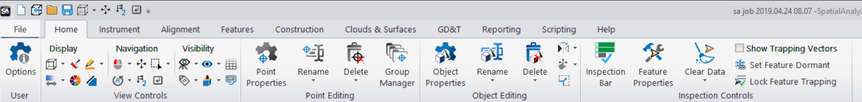
Ribbons
SA has added Ribbons!
  NRK never stops developing-Always striving to be the best
  Continued Investment for now and the future
  SA has never been better and easier to use

Slide 21
Ribbons
Why:
  Streamline processes/Easier to use
  Modern look and feel
  Reduces mouse clicks
  Easier access to frequently used commands
  Without loss of functionality
  Legacy Interface will remain and easily reset

Slide 22
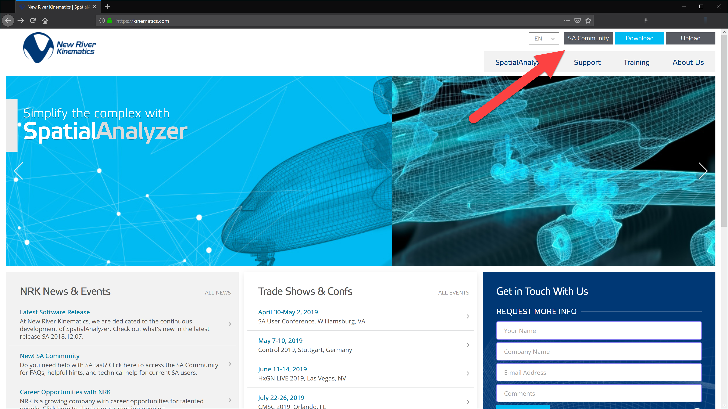
SA User Community
Navigate to via www.kinematics.com OR Direct Access – kinematics.force.com/SA

Slide 23
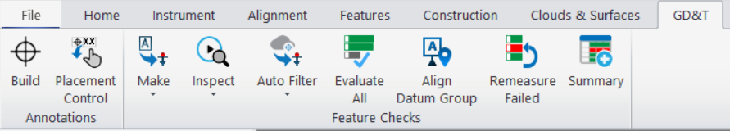
Getting Started
Controls

Slide 24
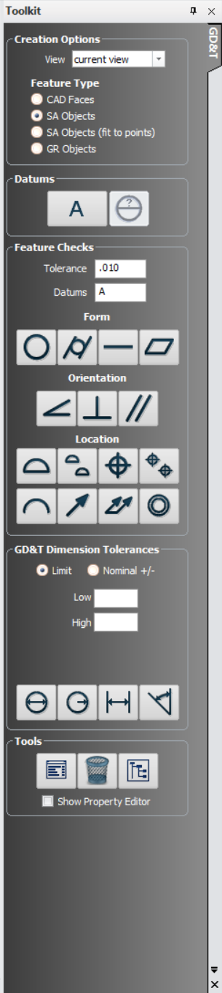
Getting Started
Controls

Slide 25
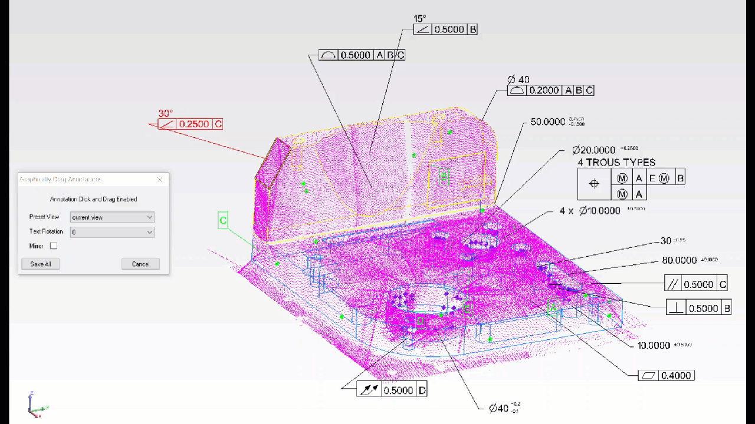
Getting Started
Controls

Slide 26
Getting Started
Controls

Slide 27
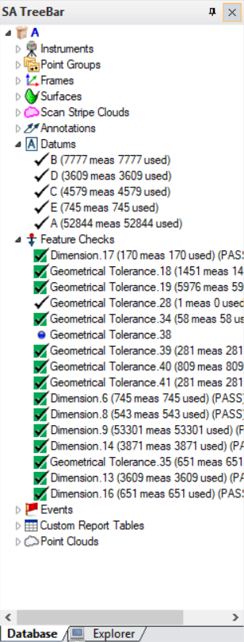
Getting Started
Controls
Annotations
  Define the checks
  Imported from cad…
  Or Created
Feature Checks and Datums
  Define the measurement process
  Evaluate the measured data

Slide 28
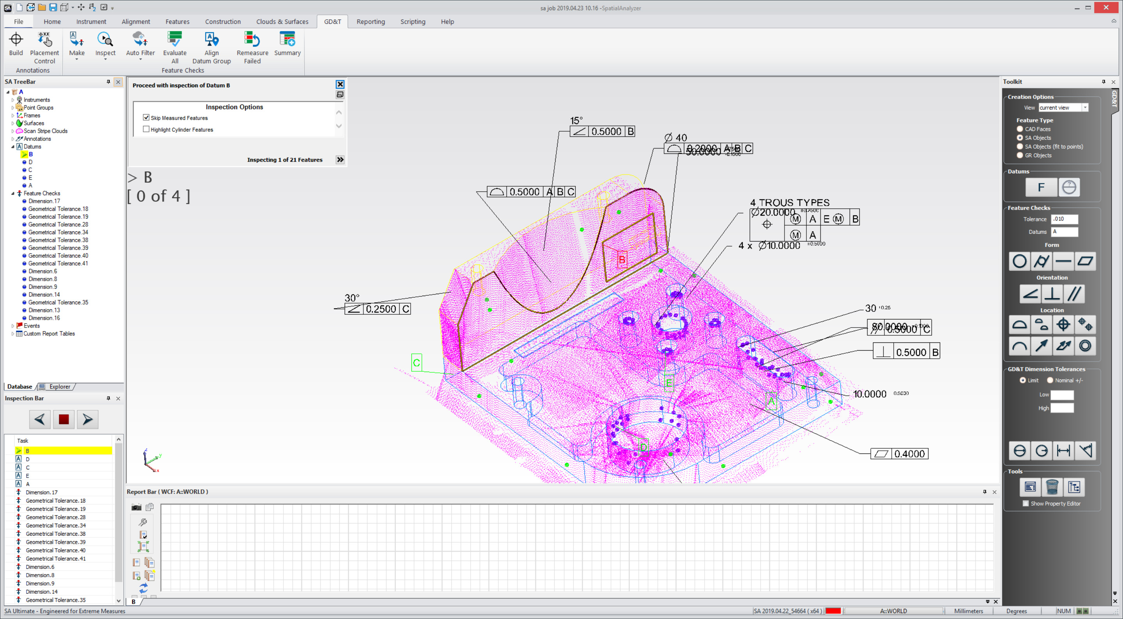
Getting Started
1. Status Window
Controls
Highlighted Faces 2.
3. Inspection Bar

Slide 29
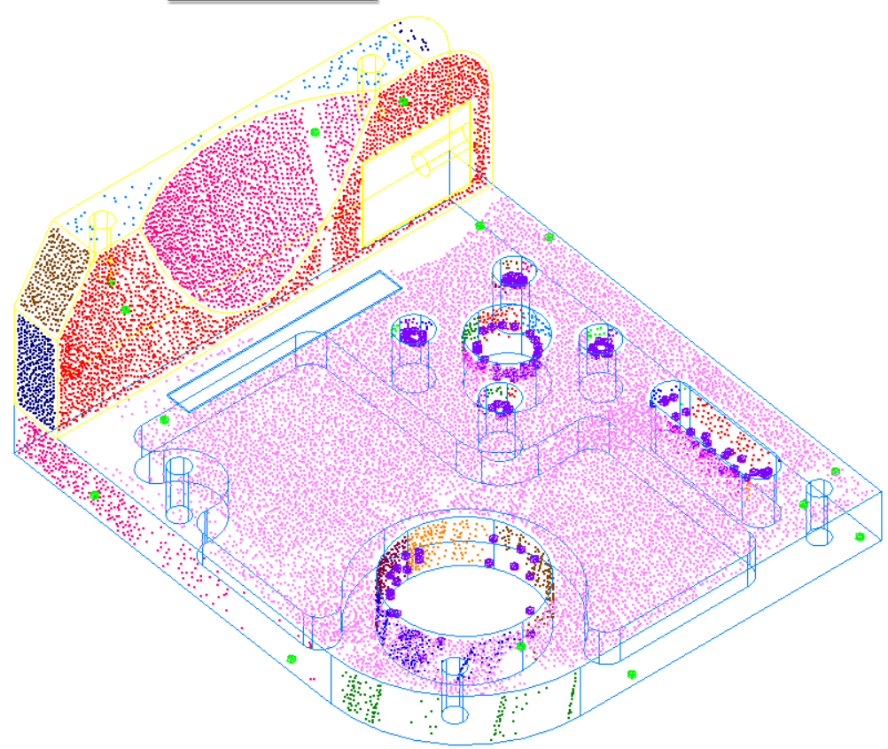
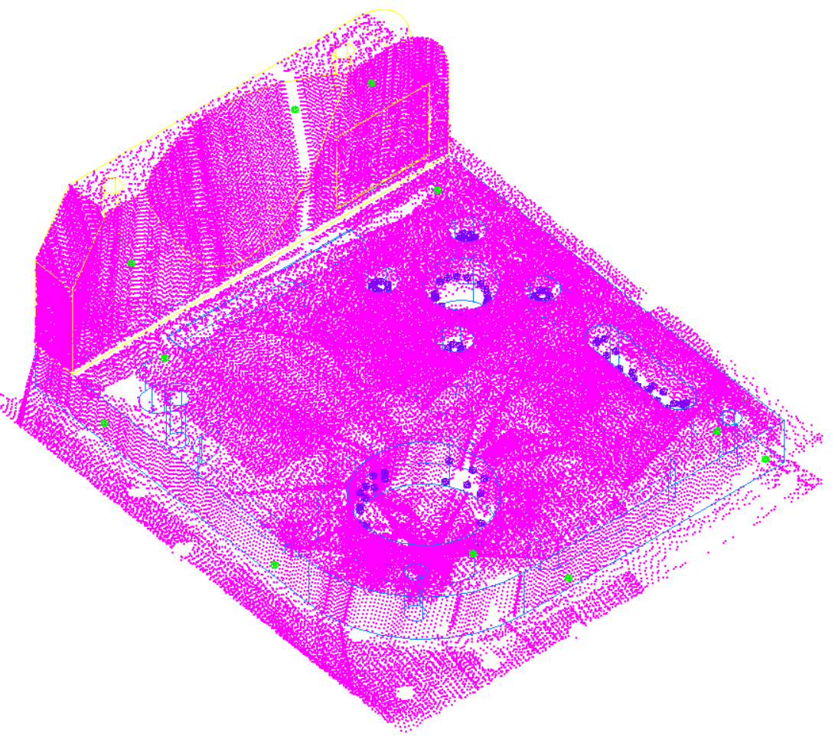
Getting Started
Controls

Slide 30
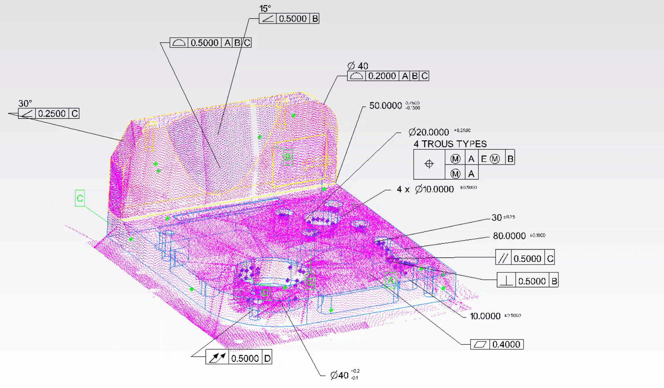
Getting Started
Controls

Slide 31
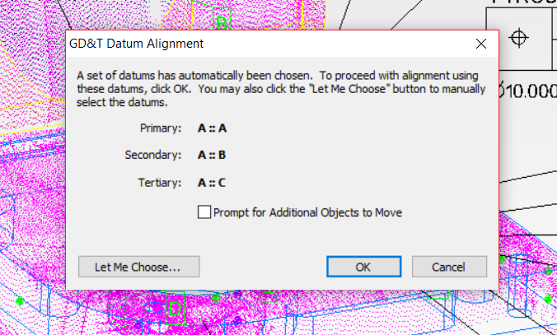
Getting Started
Controls

Slide 32
Getting Started
Controls
Remeasures only the failed checks

Slide 33
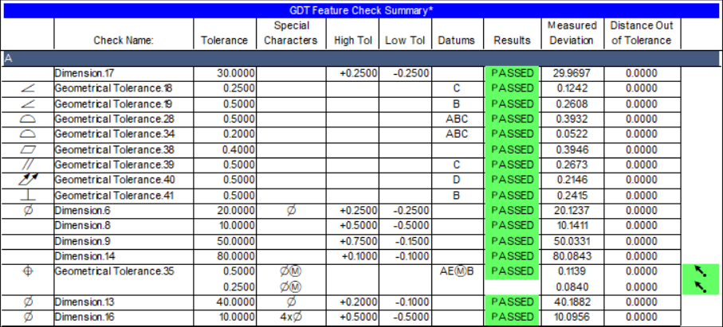
Getting Started
Controls

Slide 34
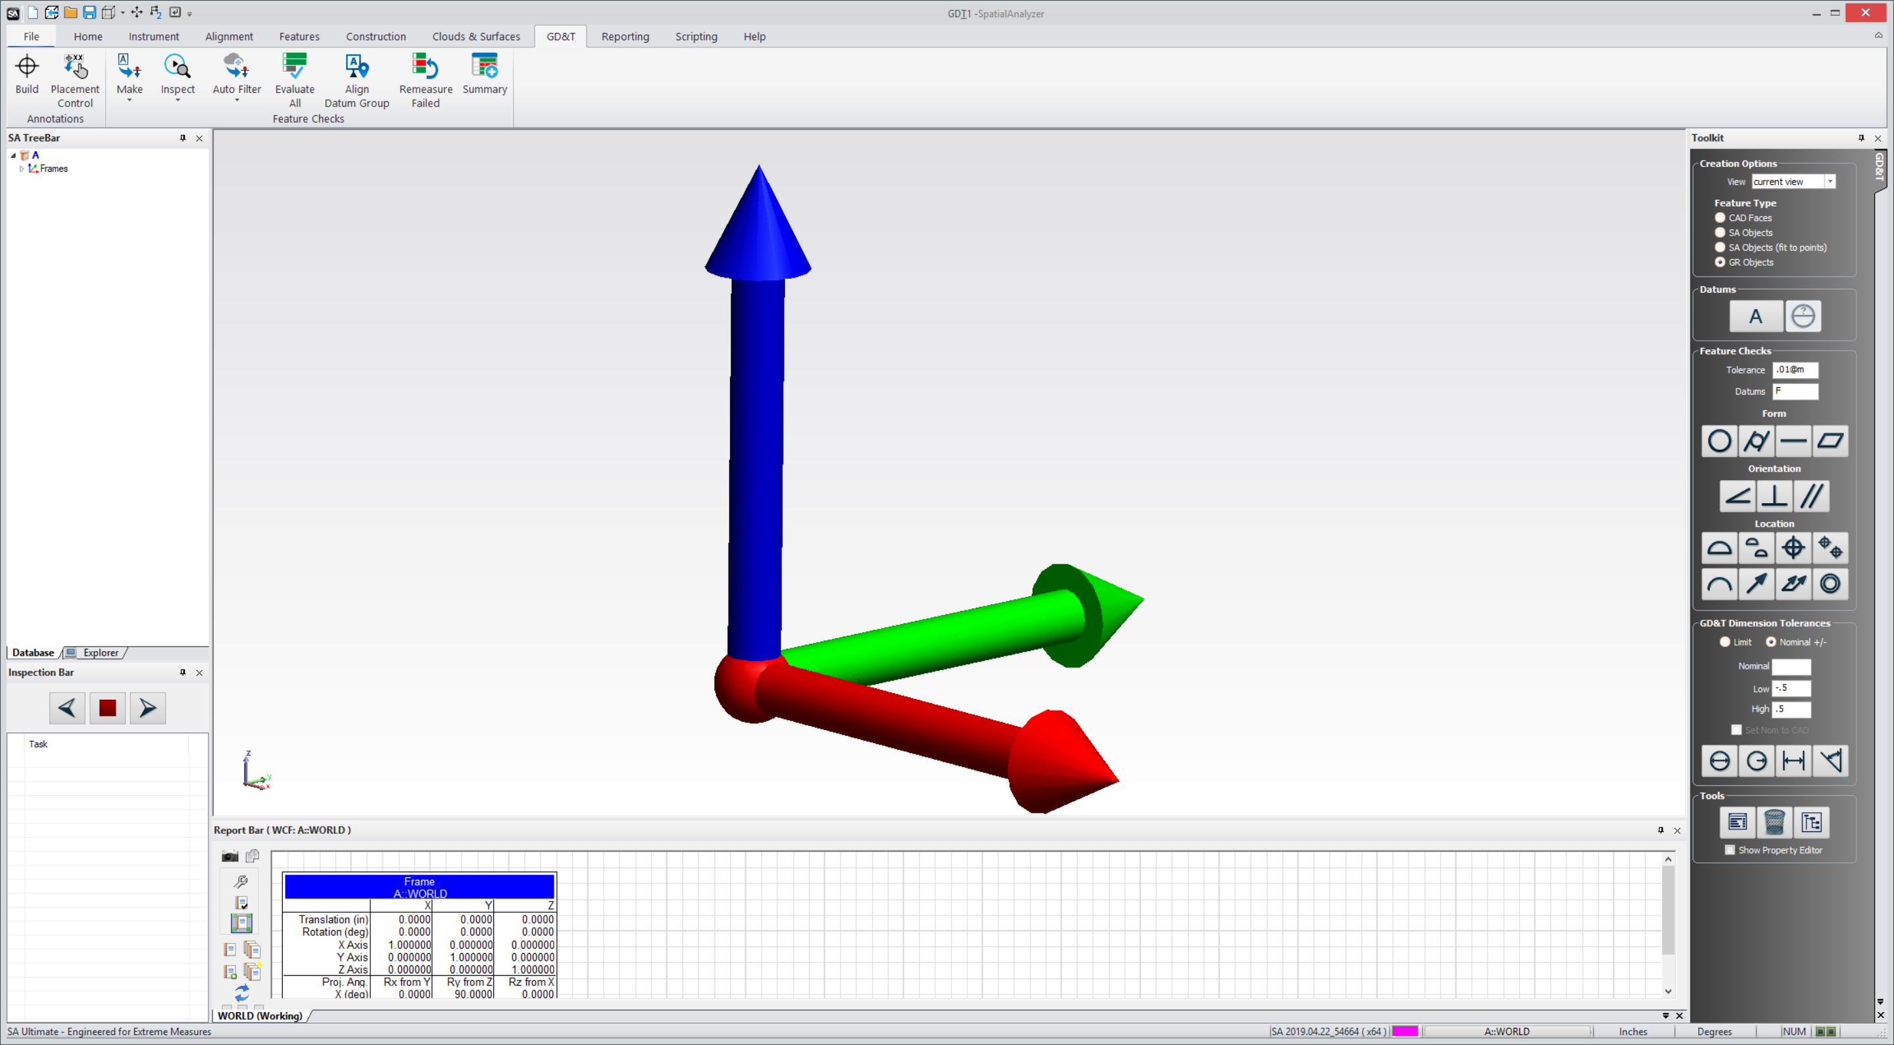
Getting Started
Importing CAD

Slide 35
Questions?

Slide 36

That’s all folks

