Slide 1
ALIGNMENTS: RPS and Sequential
By: Jay Urquhart

Slide 2



JAY URQUHART
ABOUT ME
Dimensional Control Apprentice 2007-2011
Metrology Technician 2011 – 2015
New River Kinematics 2015 - Present

Slide 3
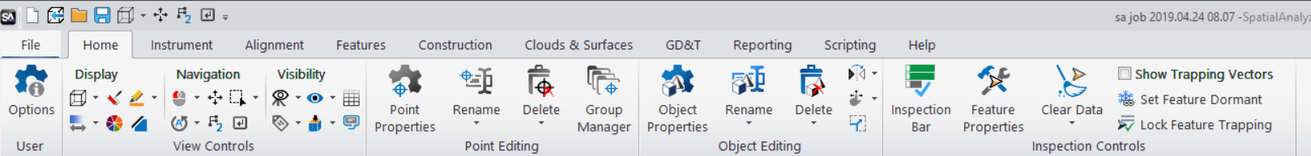
Ribbons
SA has added Ribbons!
  NRK never stops developing-Always striving to be the best
  Continued Investment for now and the future
  SA has never been better and easier to use

Slide 4
Ribbons
Why:
  Streamline processes/Easier to use
  Modern look and feel
  Reduces mouse clicks
  Easier access to frequently used commands
  Without loss of functionality
  Legacy Interface will remain and easily reset

Slide 5
ALIGNMENTS
TEXT Questions to (757)-300-1774

Slide 6
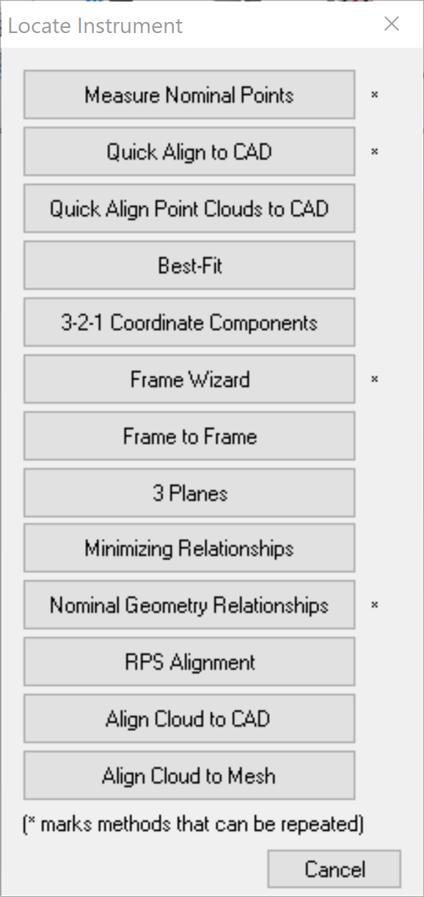
INSTRUMENT > LOCATE
Point to Point Alignments
Measure Nominal Points
Best-Fit
Nominal Geometry Relationships
RPS Alignment
Points to Objects Alignments
Quick Align to CAD
Minimizing Relationships
RPS Alignment
Frame to Frame Alignments
Frame Wizard
Frame to Frame
Cloud to Object Alignments
Align Cloud to CAD
Align Cloud to Mesh
*Sequential Alignment*

Slide 7
NEW ALIGNMENT TECHNIQUES
RPS & Sequential Alignments
  What are they?
  What do you need to run them in SA?
  How to flow through the alignment process.

Slide 8
RPS ALIGNMENT

Slide 9


RPS ALIGNMENT?
Reference Point System
Uses surface points
Point reducible features
(Circles, Slots and Spheres)

Slide 10
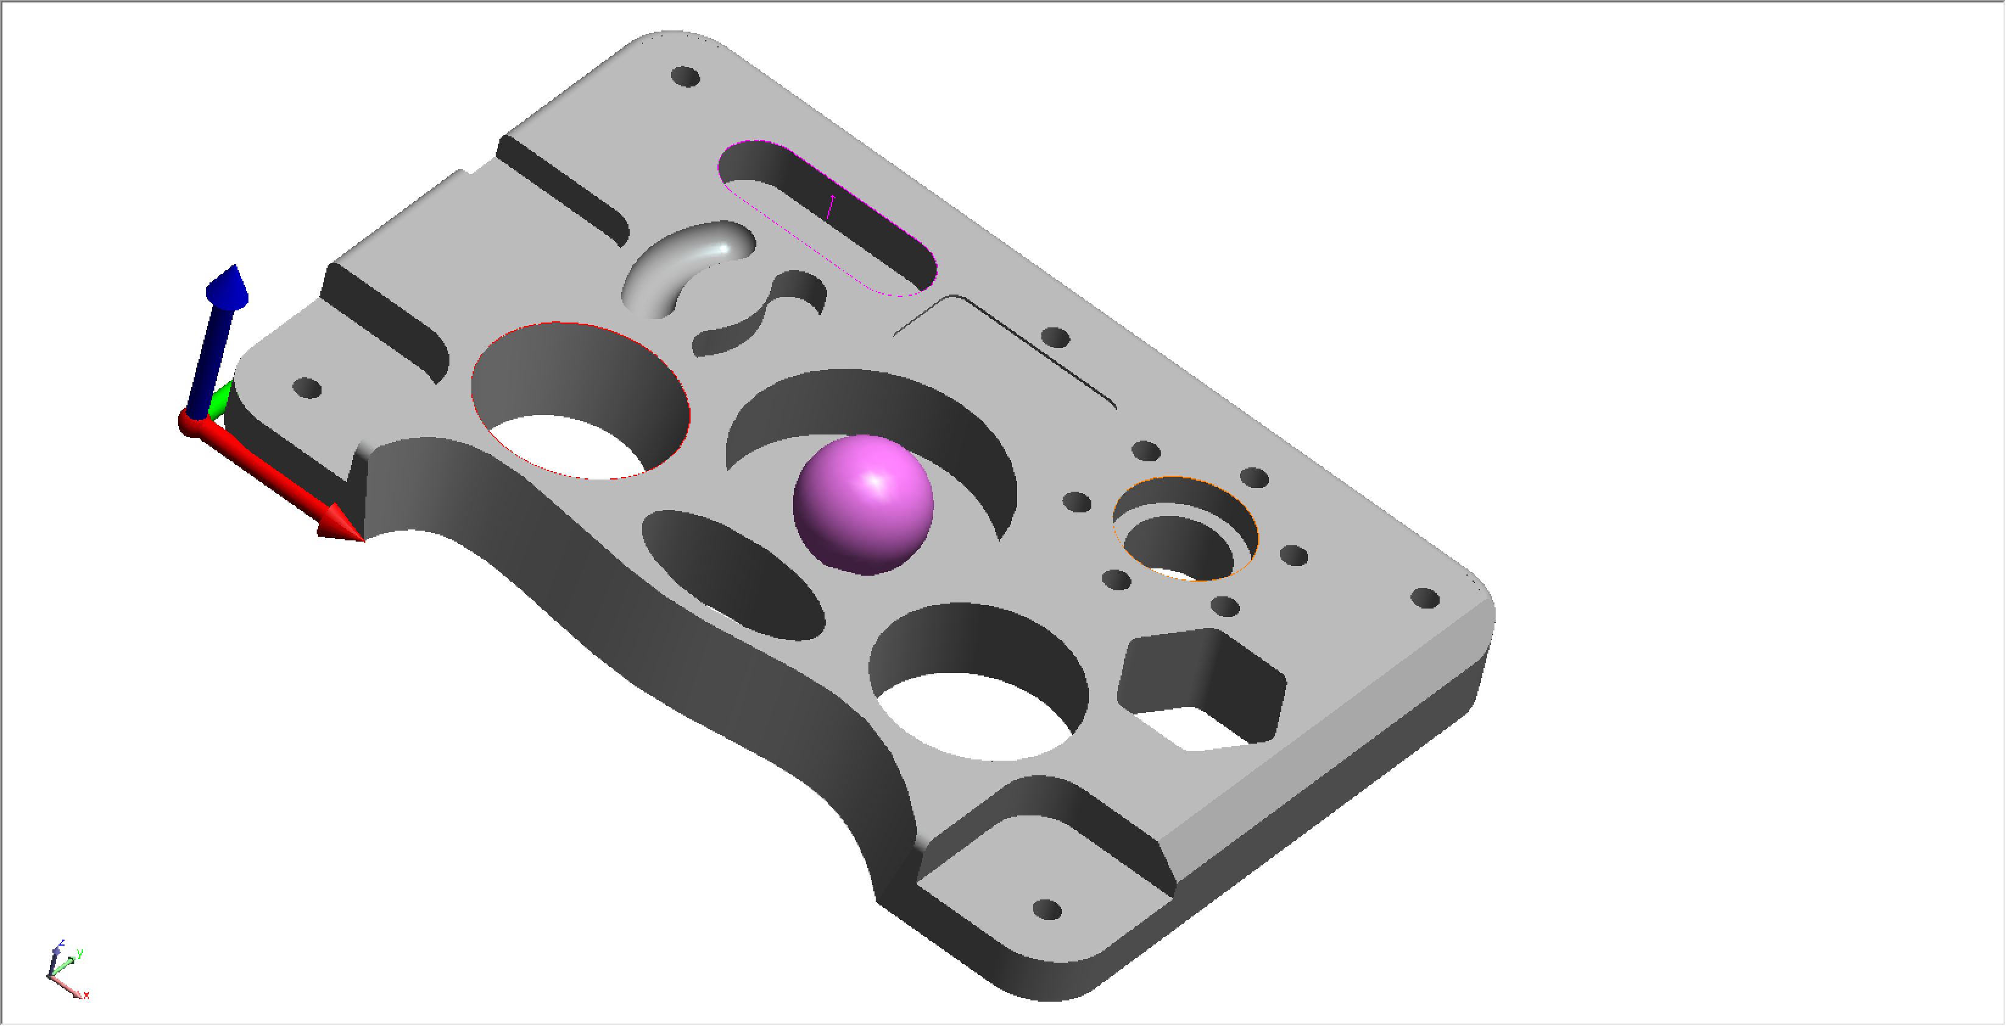
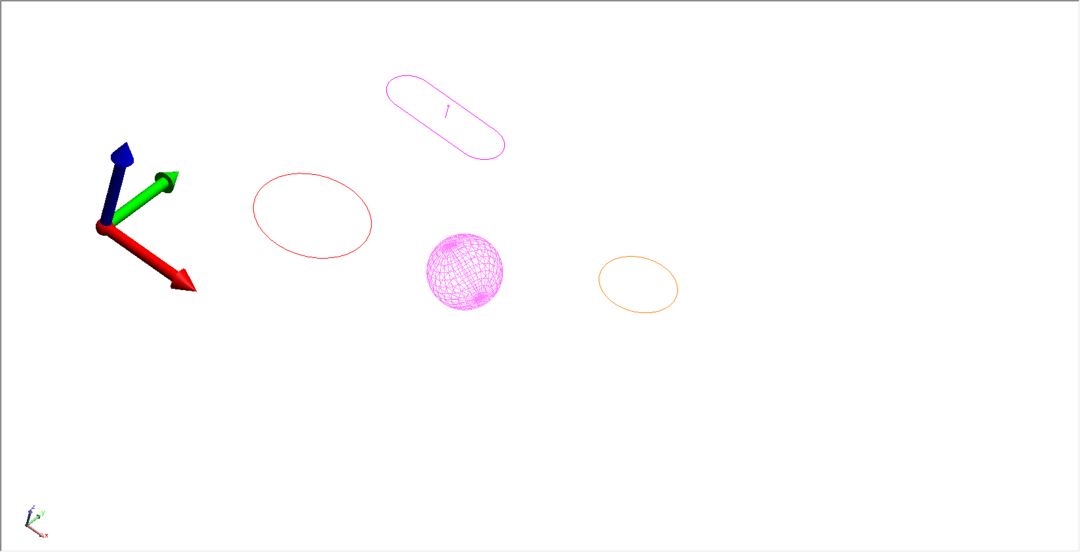
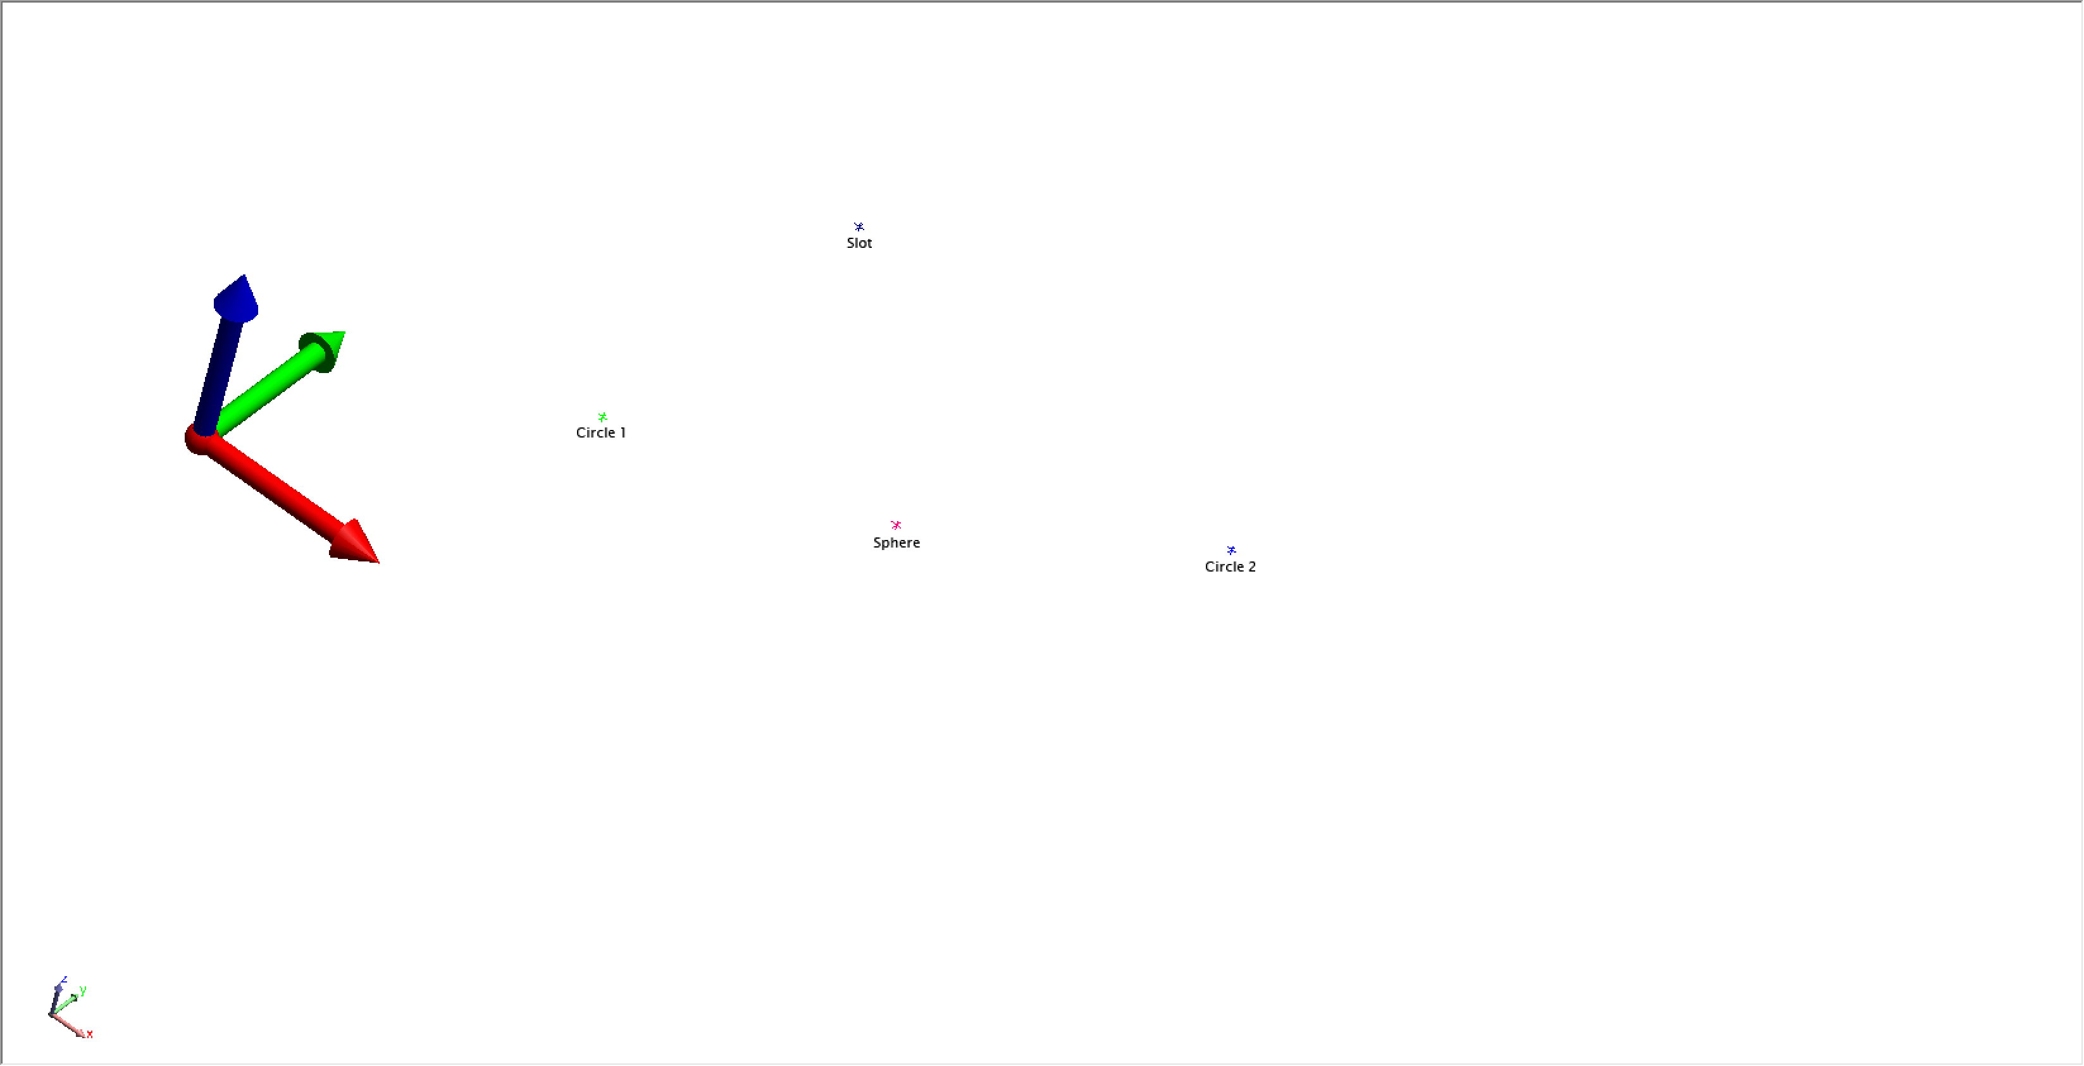
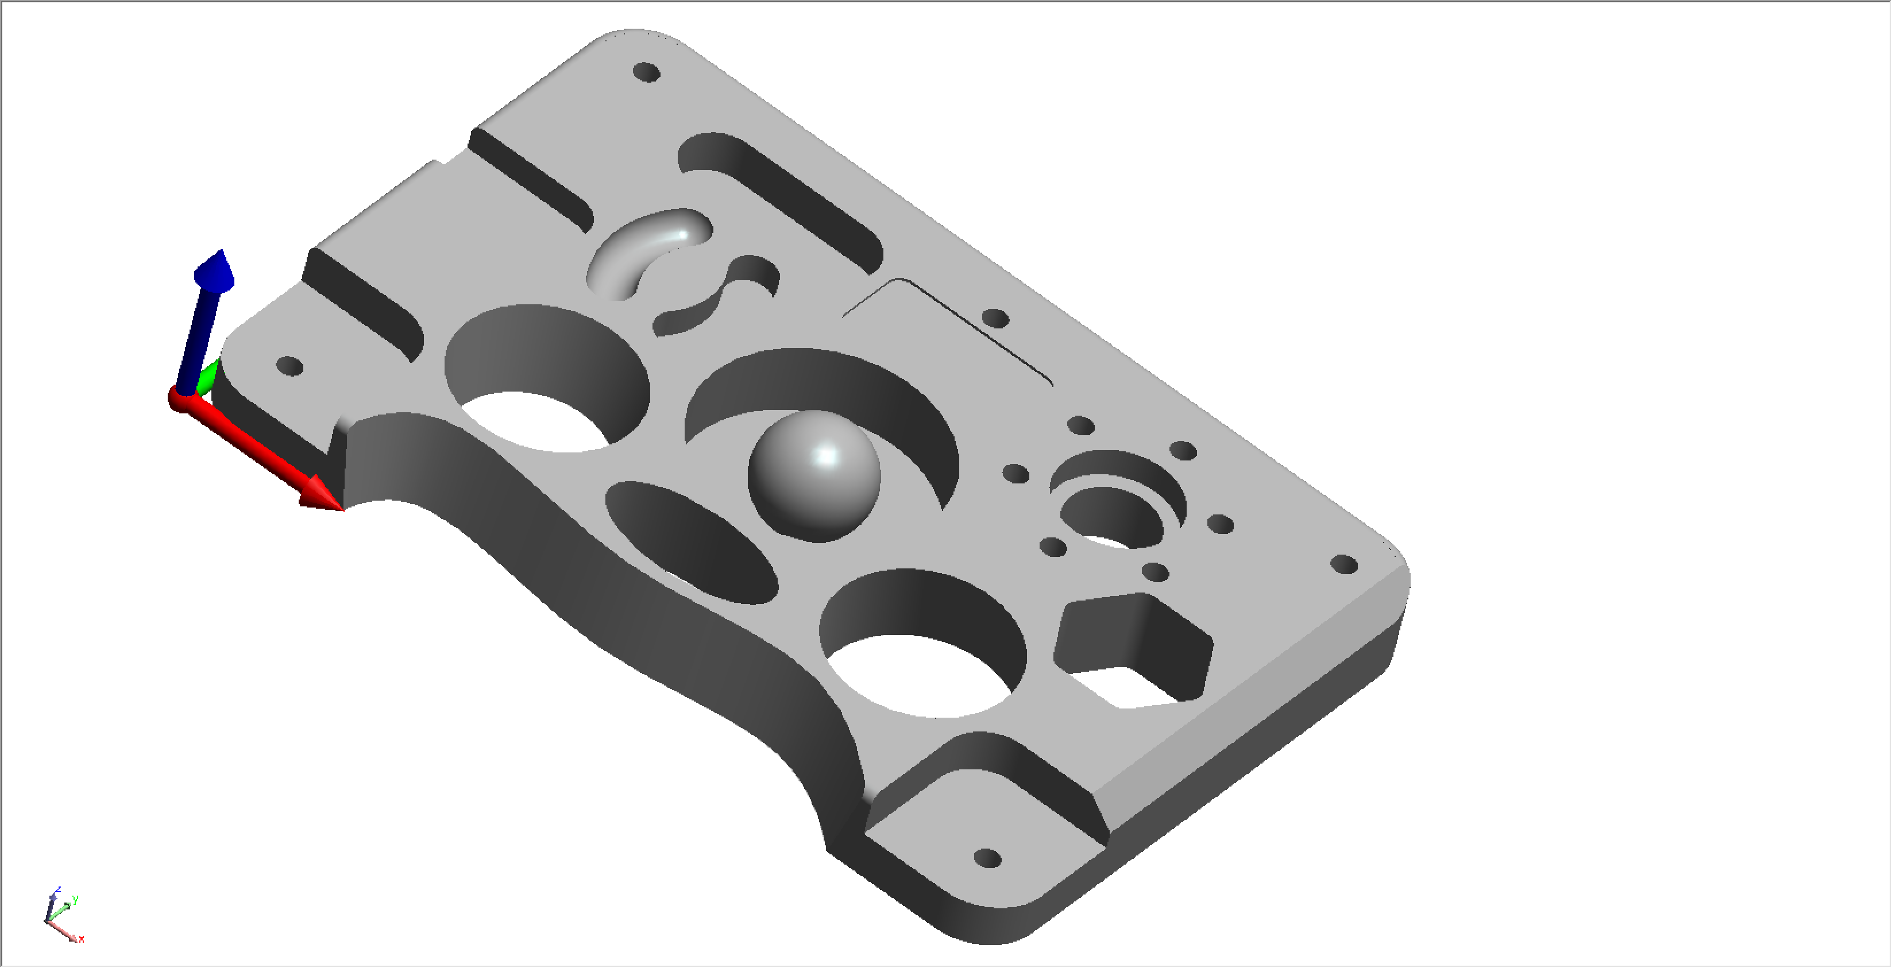
RPS ALIGNMENT
RPS is unique in that it provides the means to use a set of point reducible features (such as circle centers) as well as surface points to achieve an alignment.
Slot
Circle 2
Circle 1
Sphere

Slide 11
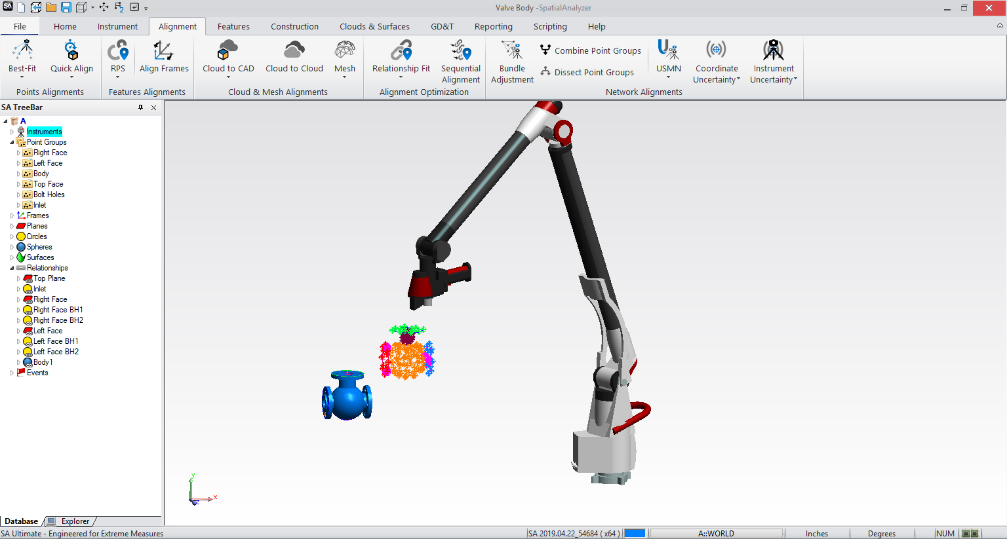
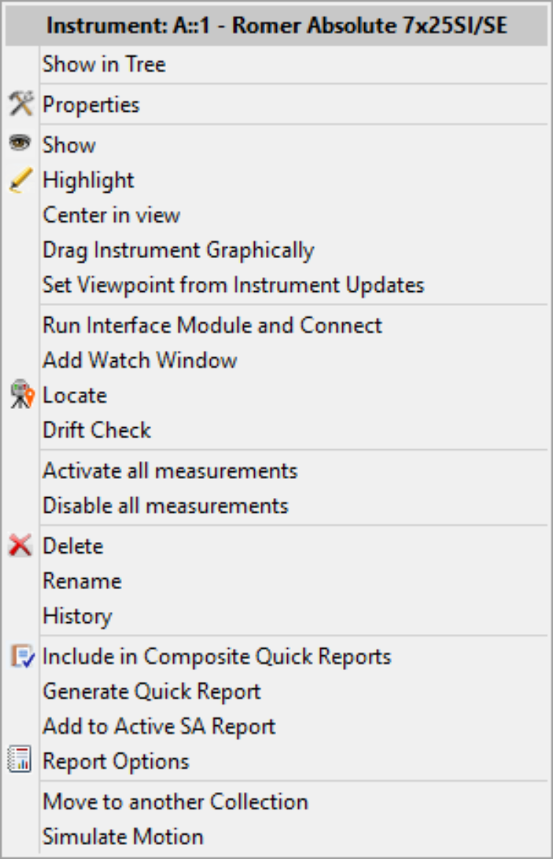
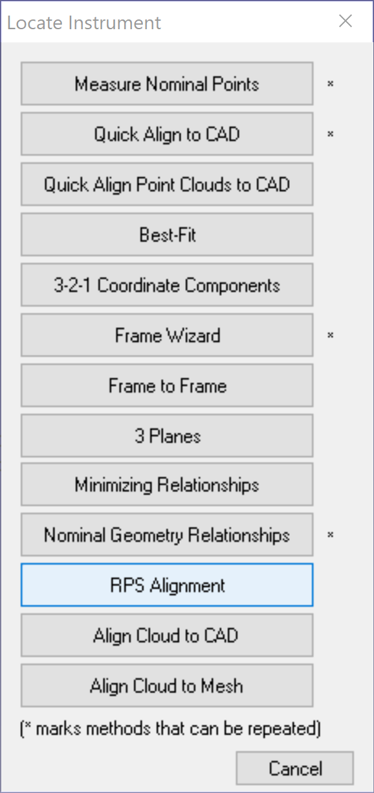

RPS ALIGNMENT
(Reference Point System Alignment)

Slide 12
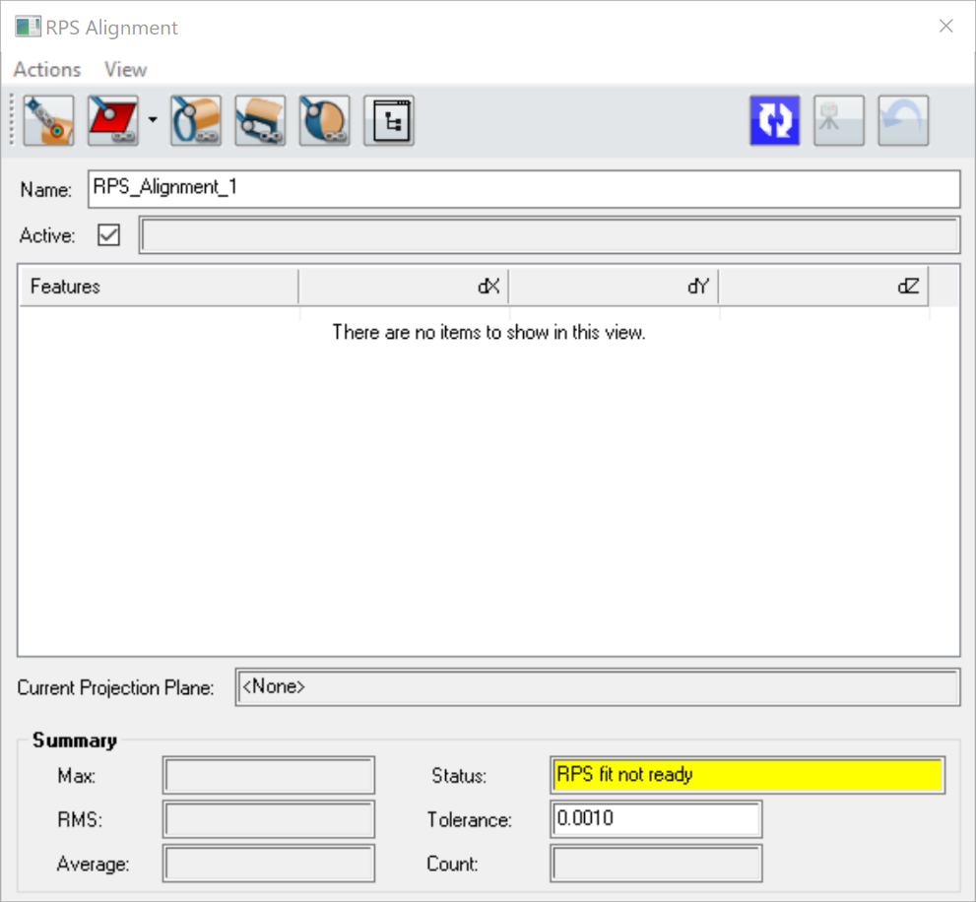
RPS ALIGNMENT
(Reference Point System Alignment)
Creates nominal geometry slot relationship
Run (re-run) Alignment Fit
Nominal geometry circle relationship
Creates nominal geometry sphere relationship
Apply Alignment Fit
Allows for selection or creation projection plane
Select Existing Geometry Relationship
Point to reference point relationship
Undo Previous Instrument Locate

Slide 13
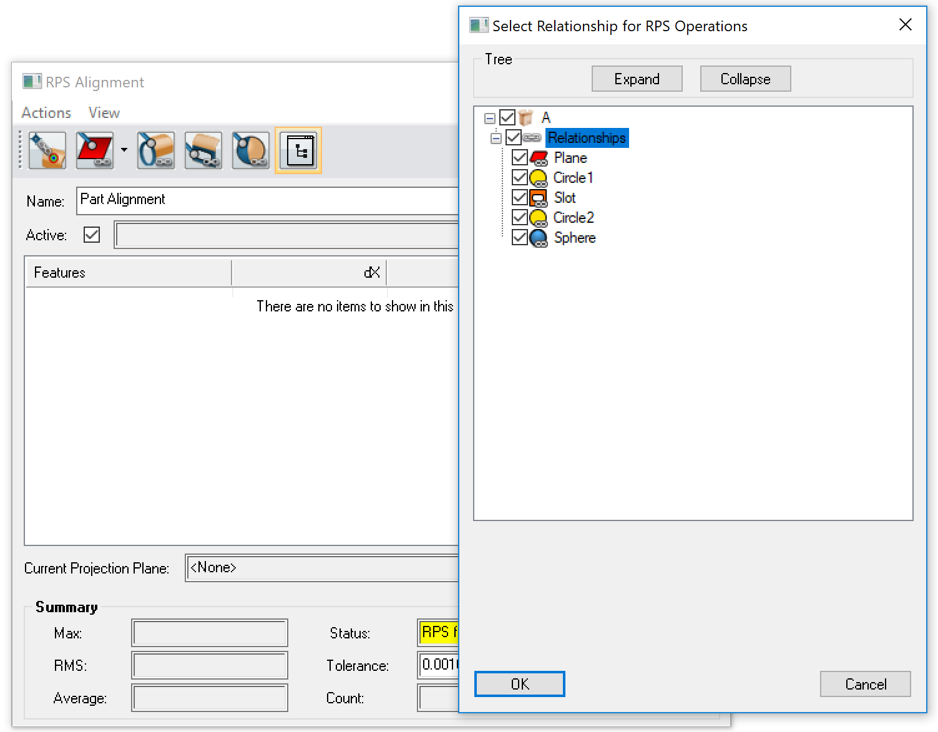
RPS ALIGNMENT
(Reference Point System Alignment)
Nominal geometry relationships can be created ahead of time or from the RPS dialog.
Visit our Part Inspection and Job Templating Sections to learn more!!

Slide 14
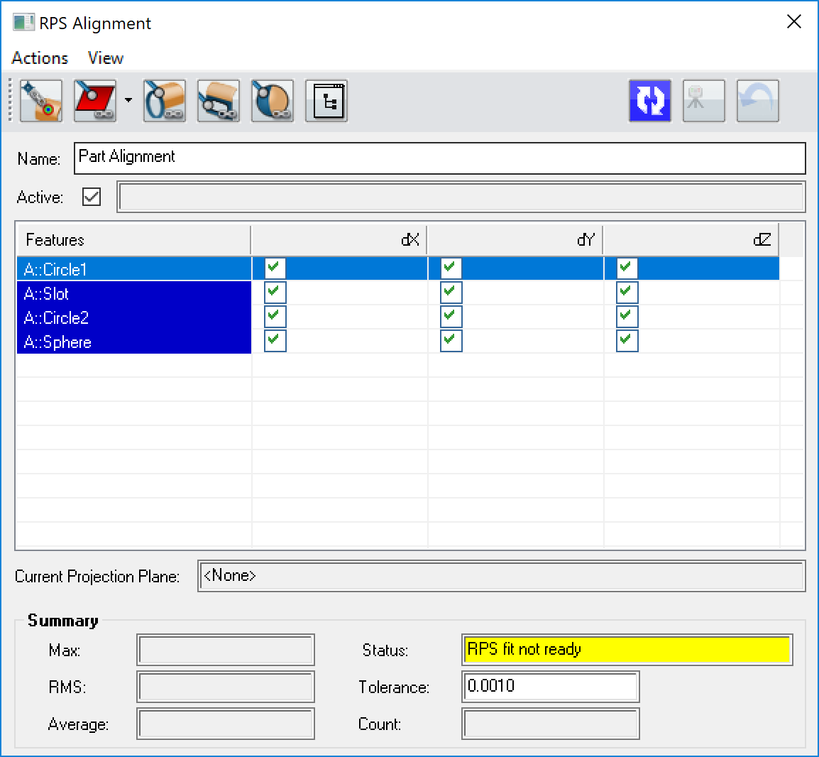
RPS ALIGNMENT
(Reference Point System Alignment)
Name Alignment
Choose degrees of freedom

Slide 15
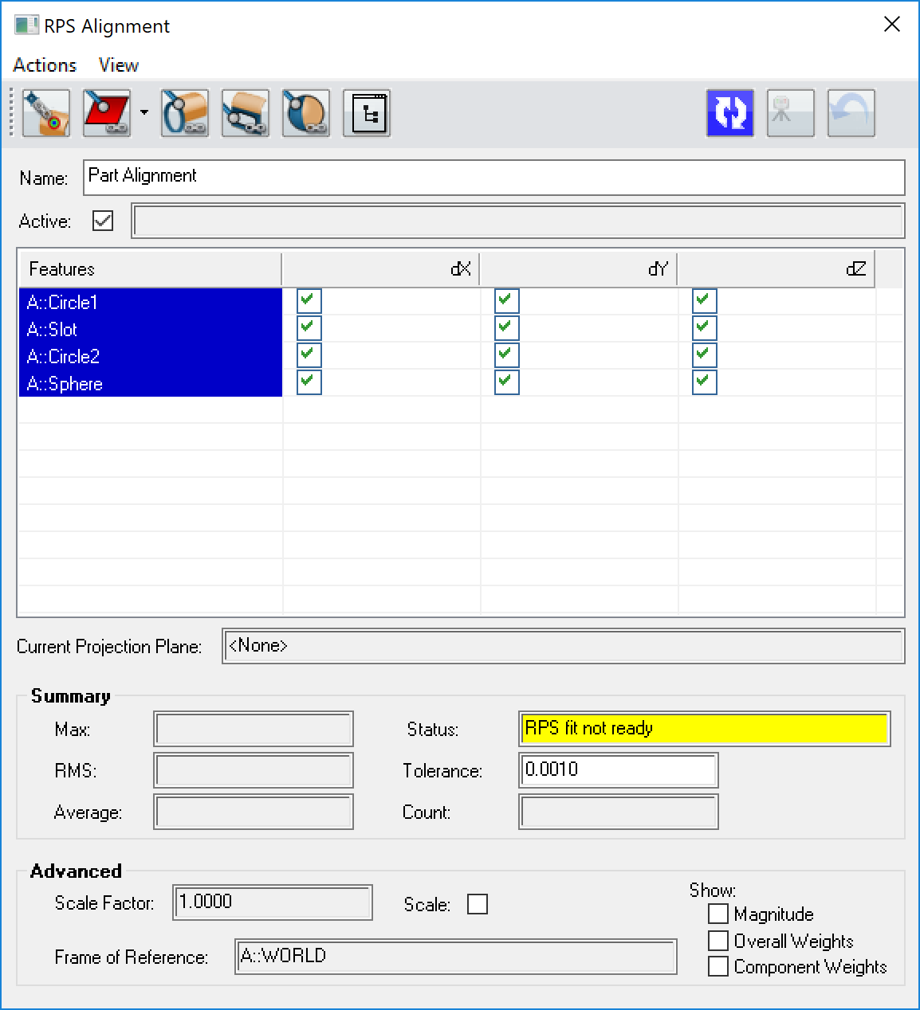
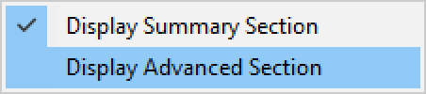
RPS ALIGNMENT
(Reference Point System Alignment)
Show the advanced section for more information.

Slide 16
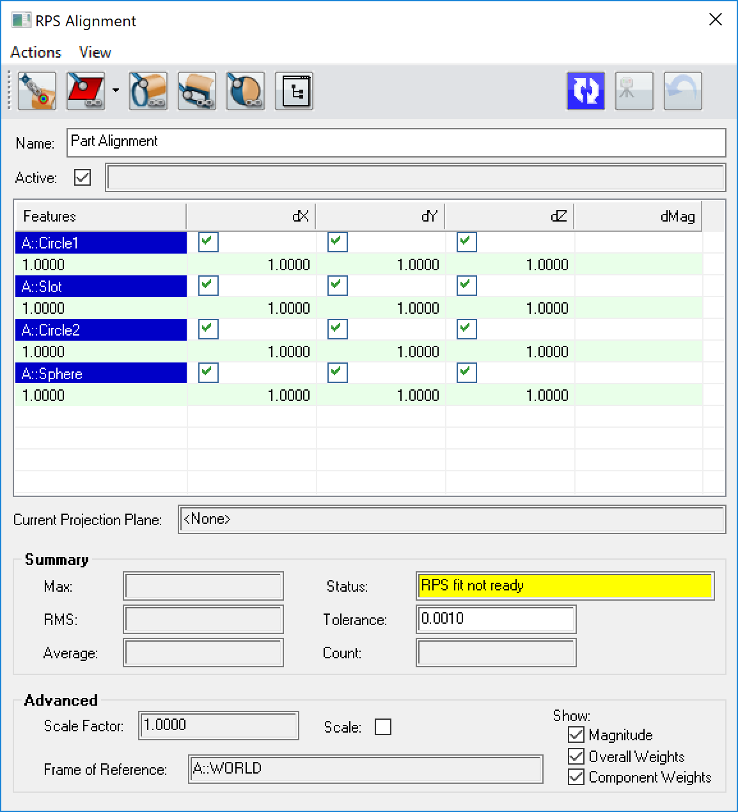
RPS ALIGNMENT
(Reference Point System Alignment)
Magnitude Column
Overall RelationshipWeight
Component Weights

Slide 17

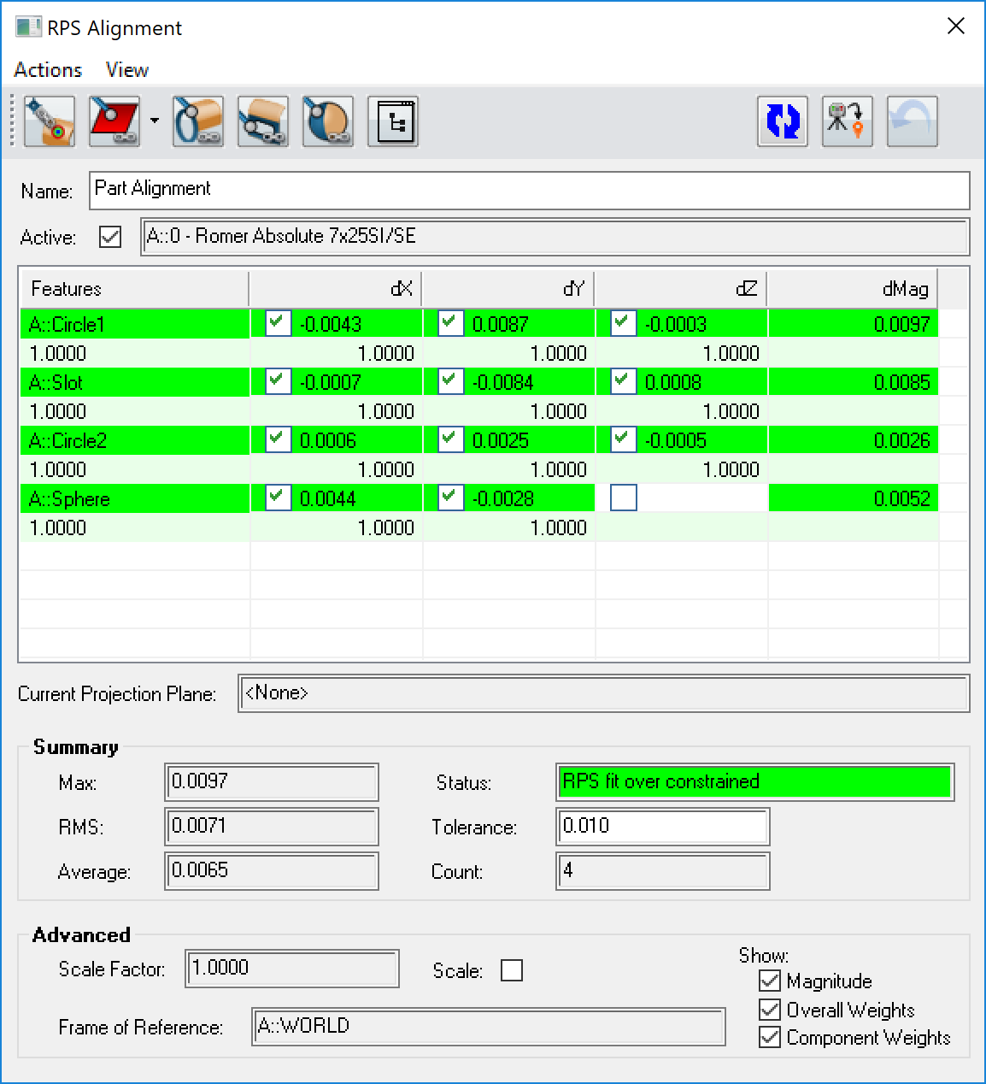



RPS ALIGNMENT
(Reference Point System Alignment)
The Moving Instrument
* IF UNCHECKED, YOU WILL BE PROMPTED TO SELECT THE MOVING OBJECTS AND INSTRUMENTS WHEN THE APPLY ALIGNMENT FIT BUTTON IS SELECTED*

Slide 18
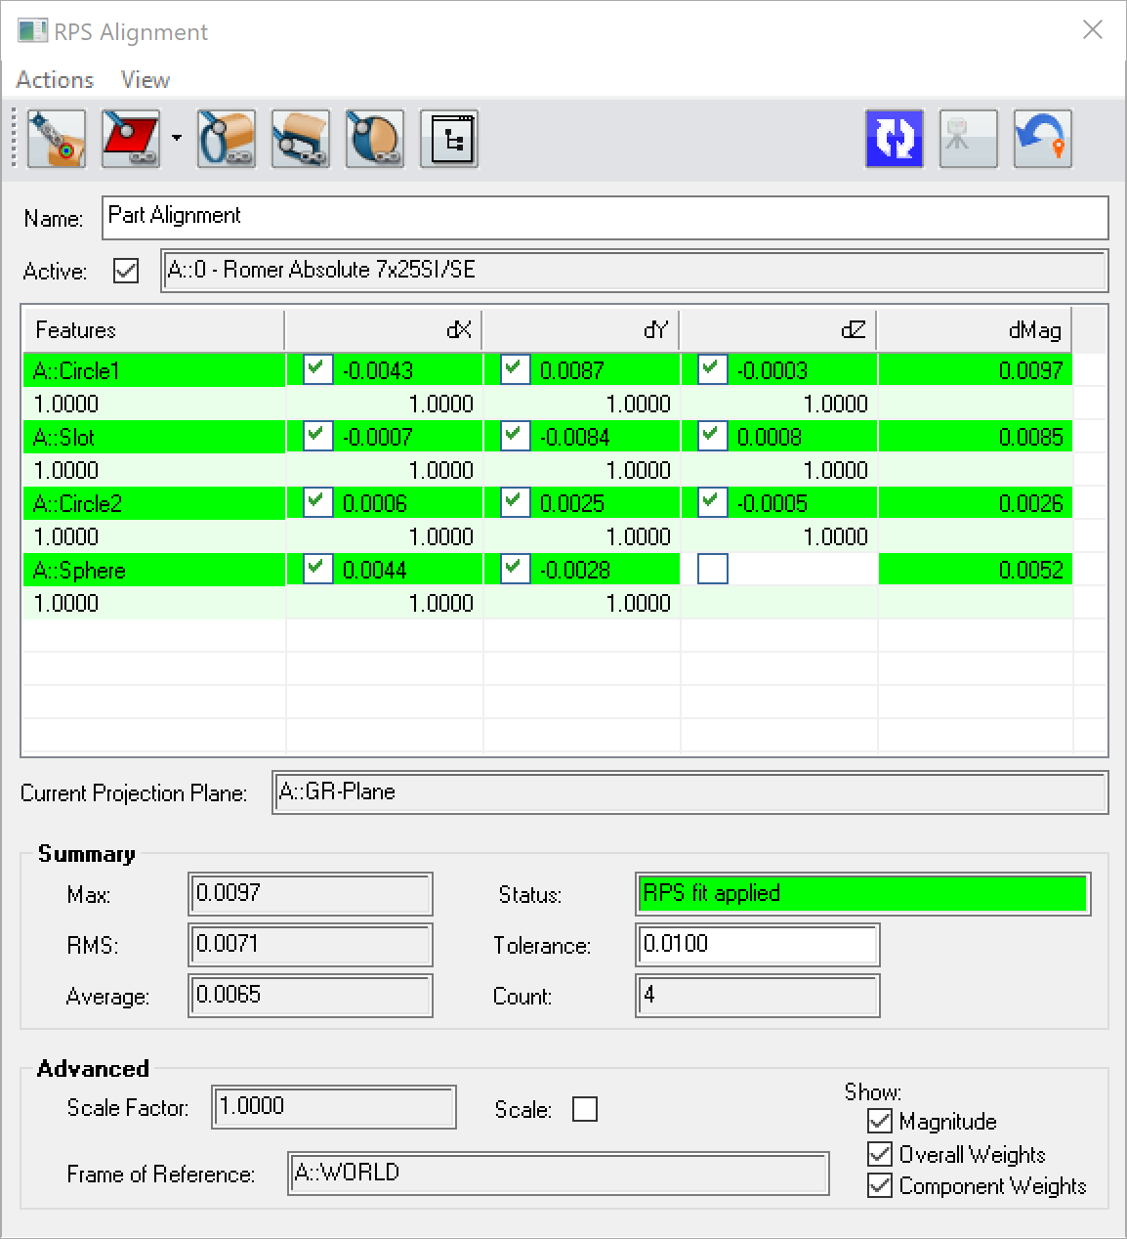
RPS ALIGNMENT
(Reference Point System Alignment)
Undo Instrument Locate

Slide 19
RPS ALIGNMENT
(Reference Point System Alignment)
Performing a Basic RPS Alignment
1. Import a CAD model into your job and add an instrument.
2. Select the RPS Alignment from the Alignment tab of the ribbon bar.
3. Build a set of surface points or point reducible features on a CAD model to define the coordinate axes.
4. Indicate how the point features will be used by checking the component check boxes
5. Press the Run Alignment Icon and check that everything is within the specified tolerance (set within the Summary Section). And then press the Apply Alignment Button to locate the instrument.

Slide 20
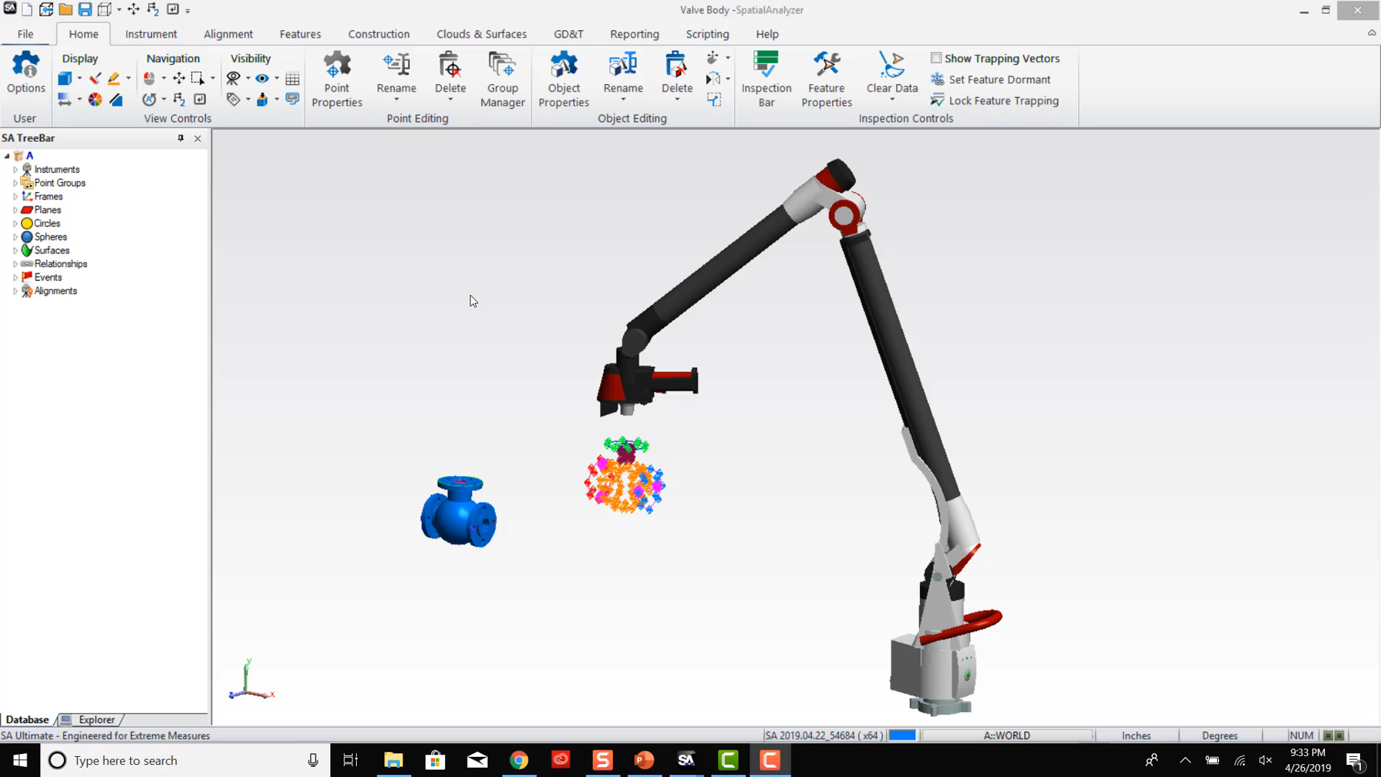
RPS ALIGNMENT EXAMPLE

Slide 21
SEQUENTIAL ALIGNMENT

Slide 22
SEQUENTIAL ALIGNMENT?
Apply one relationship optimization after another in a specific sequence
Individual degrees of freedom can be set with each relationship or group of relationships
Uses points/group to objects relationships
Ideal to for GD&T style alignments
A
B
C

Slide 23

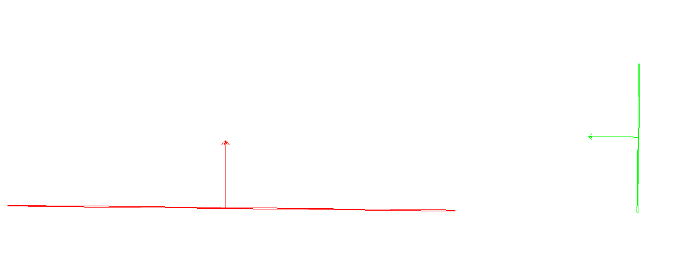
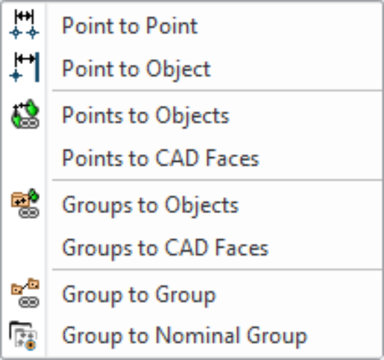
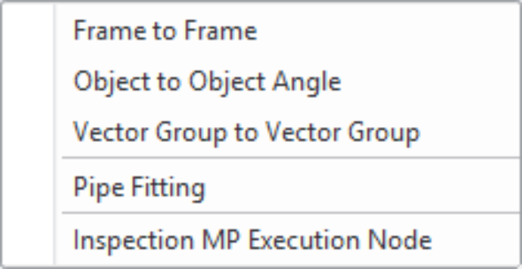
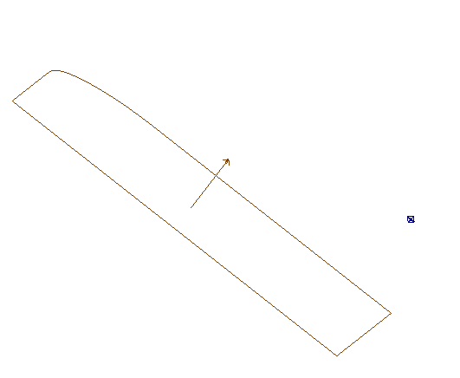

SEQUENTIAL ALIGNMENT
Typical relationships types used:
Point to Point
Object to Object Angle
Point to Object or CAD Faces
Points to Objects or CAD Faces

Slide 24
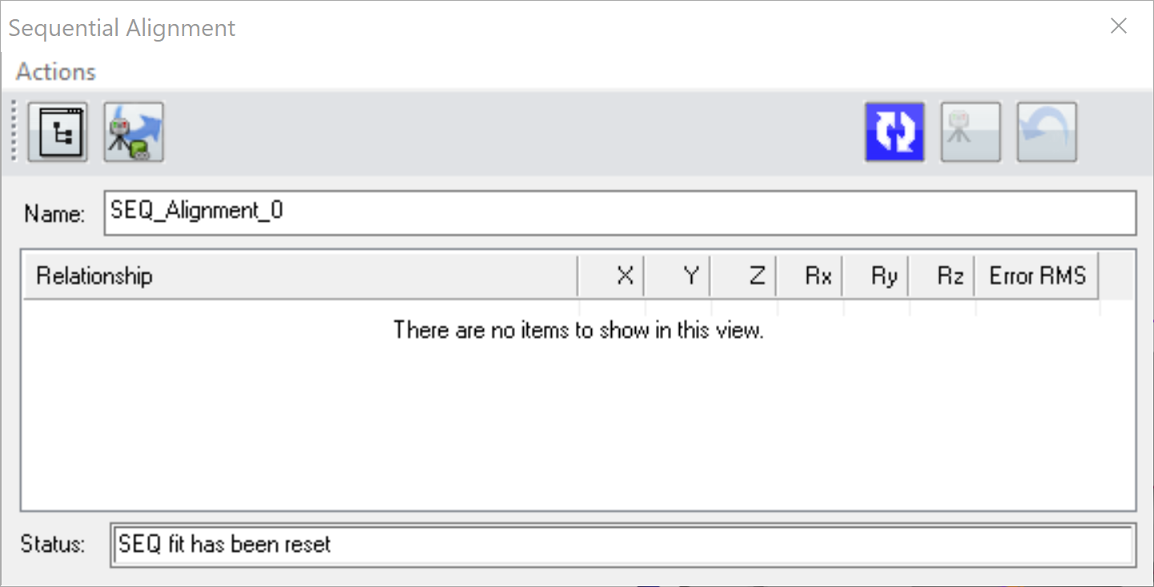
SEQUENTIAL ALIGNMENT

Slide 25
SEQUENTIAL ALIGNMENT
Allows for selection of moving objects and instruments
Apply Alignment Fit
Run (re-run) Alignment Fit
Undo Previous Instrument Locate
Select existing relationship

Slide 26
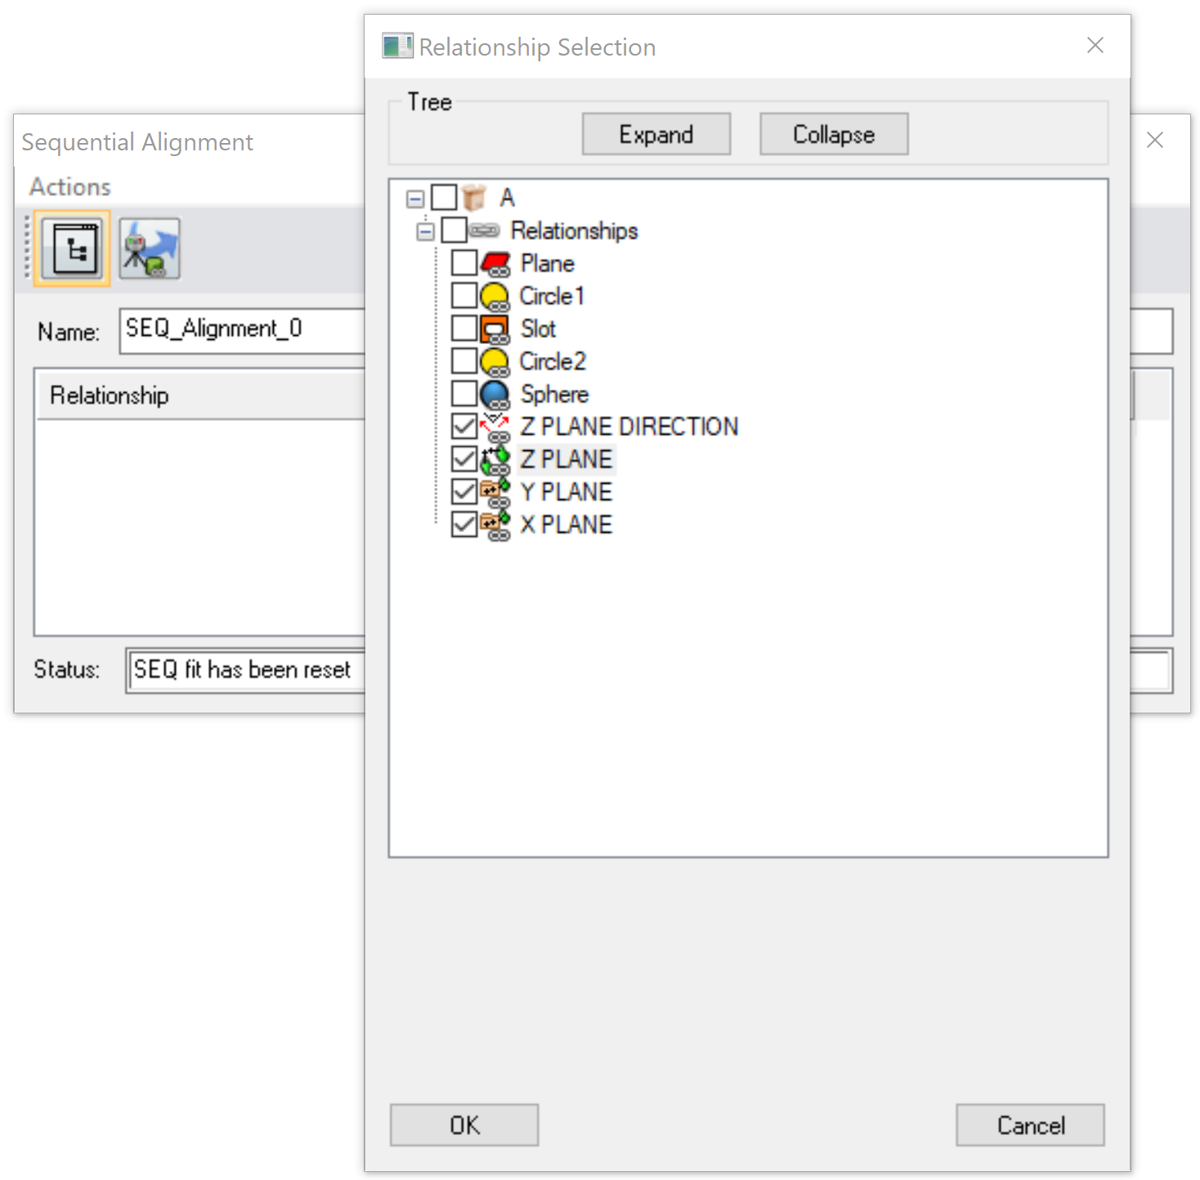
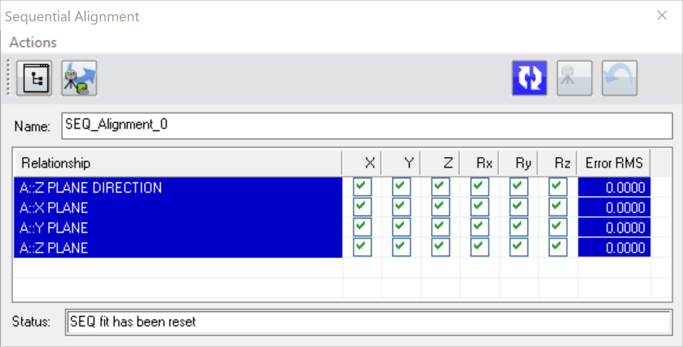
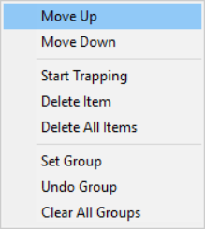
SEQUENTIAL ALIGNMENT
Choose desired relationships…

Slide 27
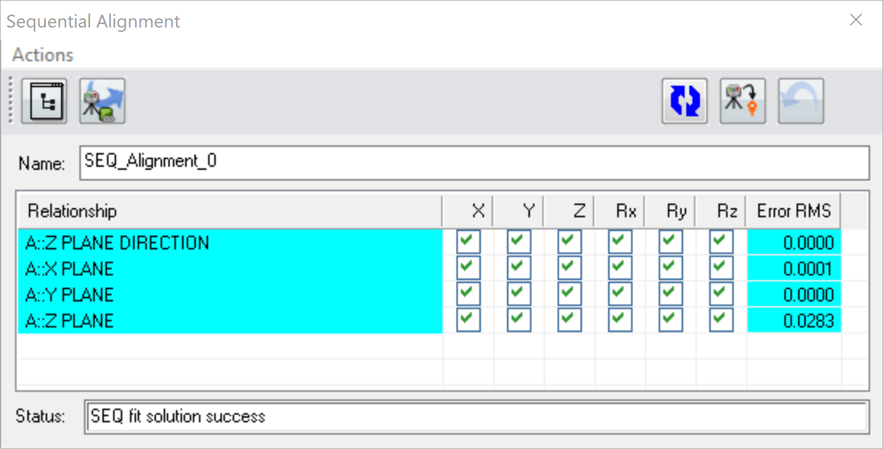
SEQUENTIAL ALIGNMENT

Slide 28
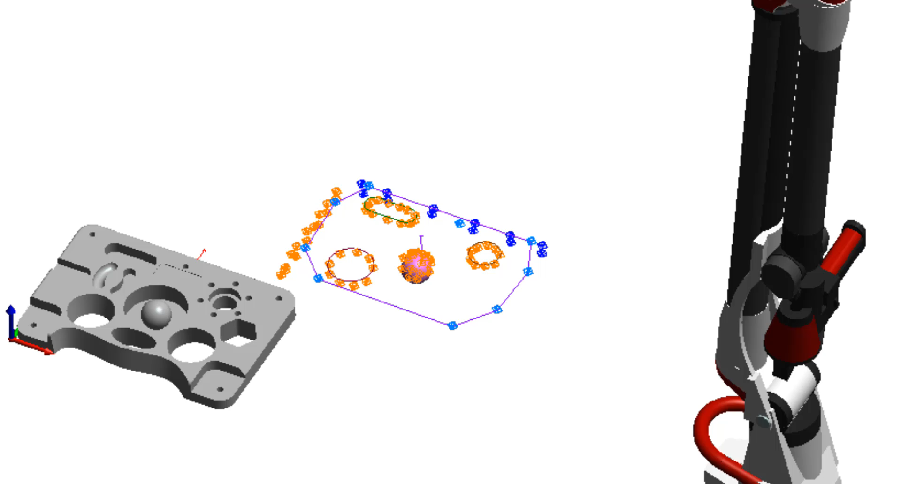
SEQUENTIAL ALIGNMENT

Slide 29
SEQUENTIAL ALIGNMENT
Performing a basic Sequential Alignment
1. Select the RPS Alignment from the Alignment tab of the ribbon bar.
2. Select Existing Relationships button to select the desired relationships.
3. Select the Objects and Instruments to Move button and choose what you wish to move. (Typically instrument selection is all that is required.)
4. Rearrange the order of the relationships for the desired sequence and select the degrees of freedom you wish to influence through the relationship.
6. Select the Run (Re-Run) the Alignment Fit button to compute a fit.
7. When the numbers look good apply the fit by selecting the Apply Alignment Fit button which graphically aligns your data.
8. If necessary, the instrument can be put back in its starting position by selecting the Undo the Applied Alignment button.

Slide 30
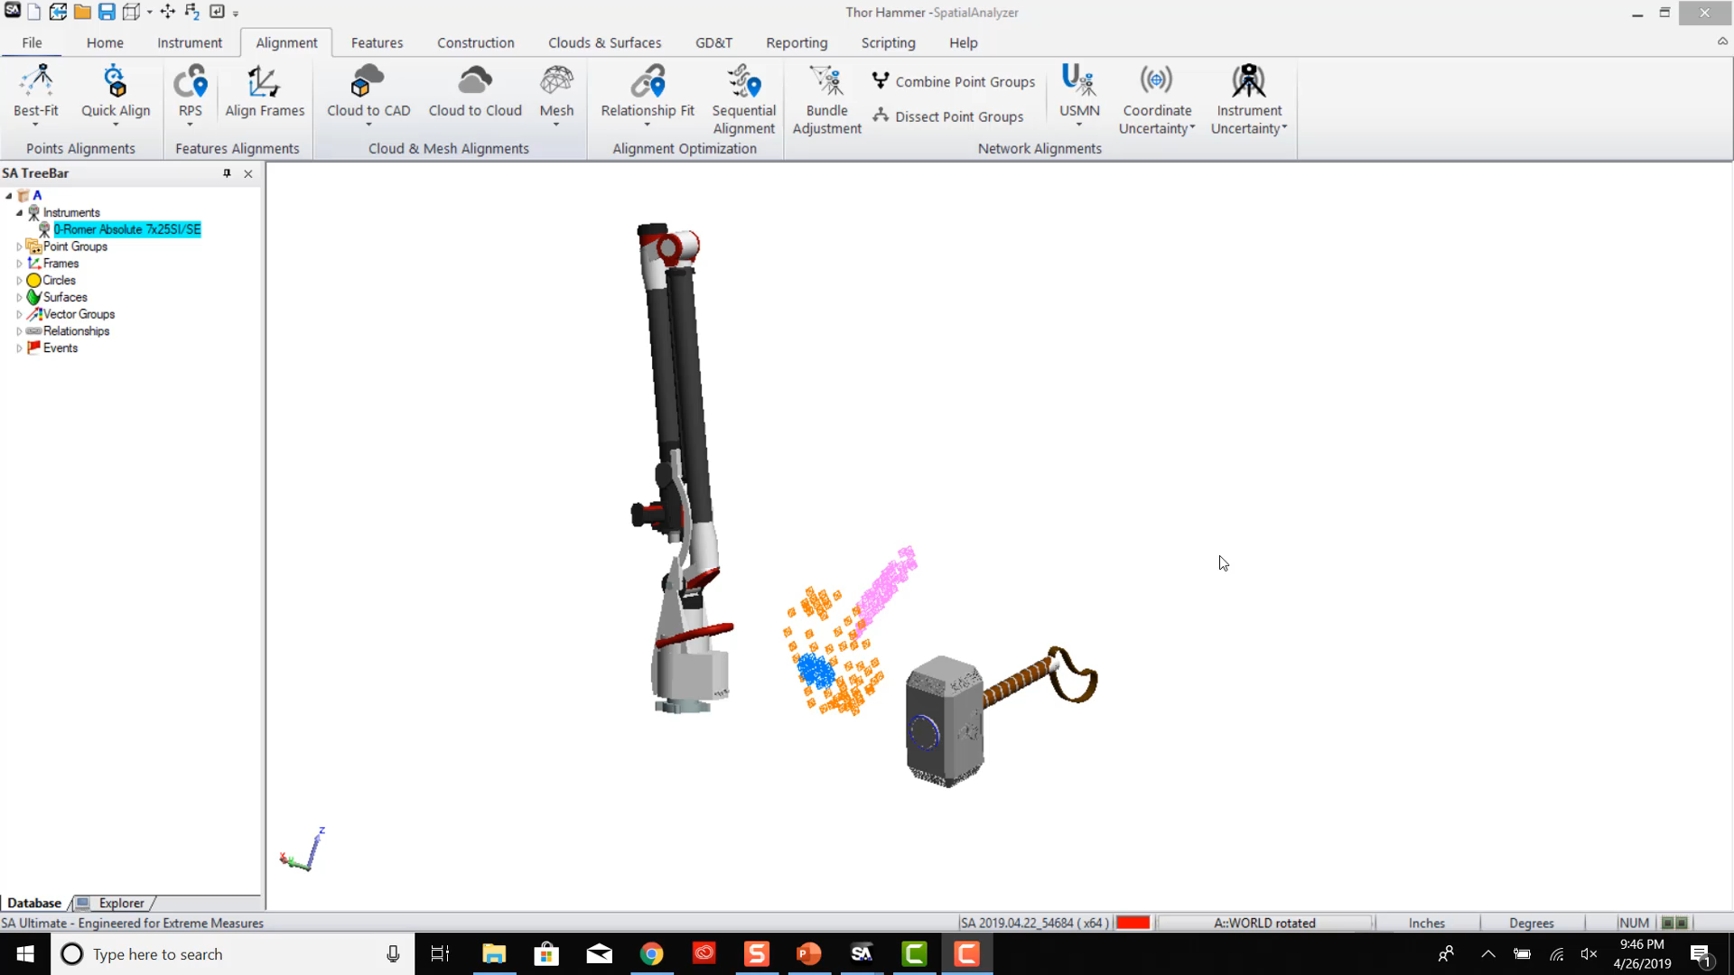
SEQUENTIAL ALIGNMENT EXAMPLE

Slide 31
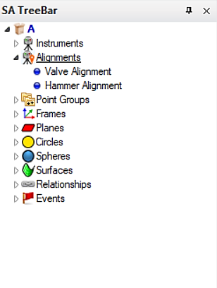
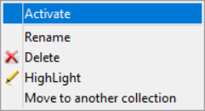
Alignments in the tree
RIGHT-CLICK

Slide 32
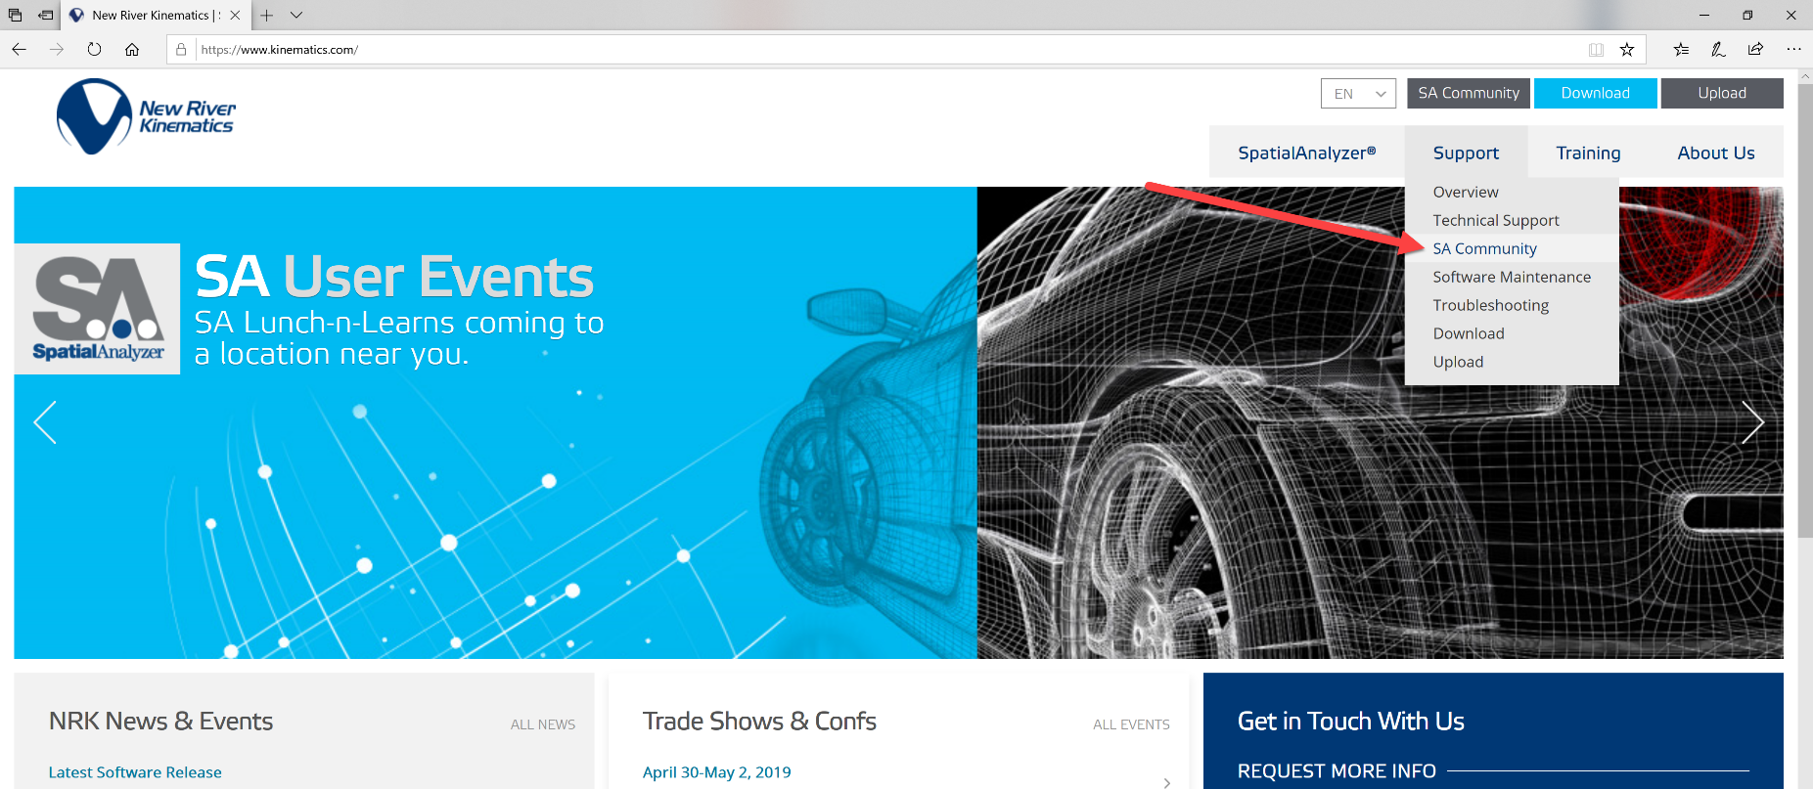
SA User Community
Navigate to via www.kinematics.com OR Direct Access – kinematics.force.com/SA
TEXT Questions to (757)-300-1774 for closing remarks discussion

Slide 33


