Slide 1
Relationships
Perfect Parts & Assemblies in an Imperfect World
Zach Rogers, Sr. Application Engineer EMEAR

Slide 2
Questions?
Text 757-300-1774

Slide 3
Ribbons
SA has added Ribbons!
NRK never stops developing-Always striving to be the best
Continued Investment for now and the future
SA has never been better and easier to use

Slide 4
Ribbons
Why:
Streamline processes/Easier to use
Modern look and feel
Reduces mouse clicks
Easier access to frequently used commands
Without loss of functionality
Legacy Interface will remain and easily reset

Slide 5
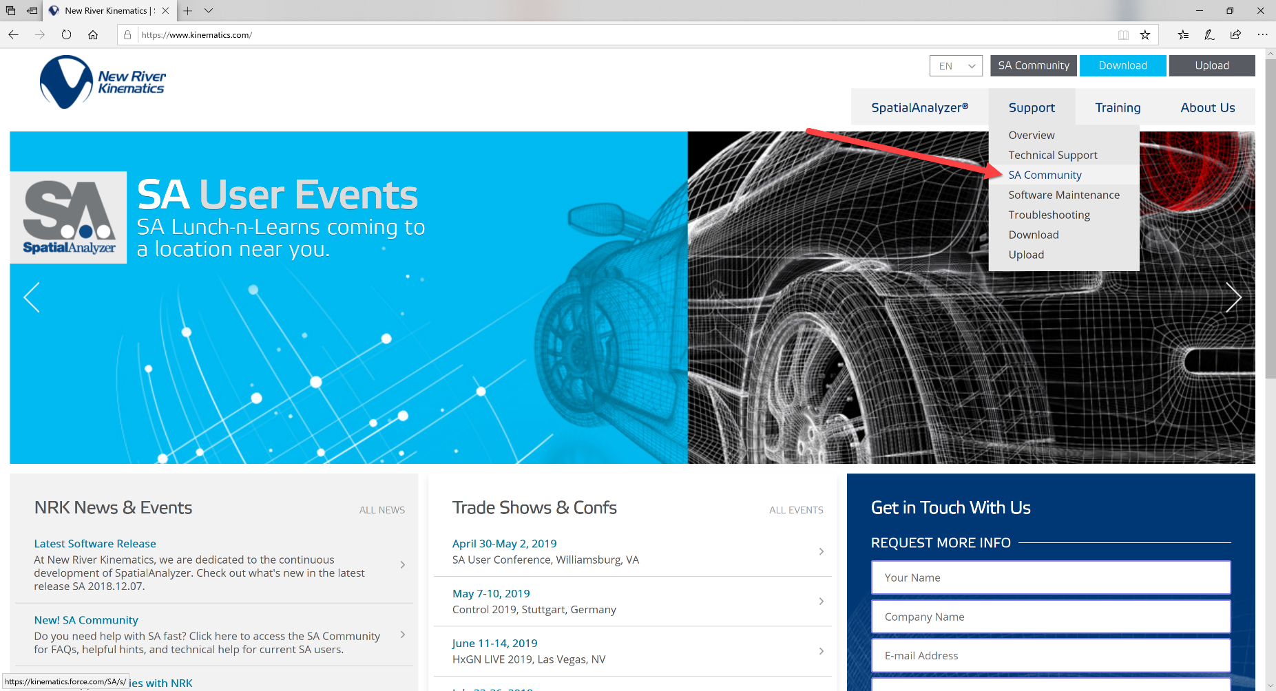
SA User Community
Navigate to via www.kinematics.com OR Direct Access – kinematics.force.com/SA

Slide 6
Relationships
Perfect Parts & Assemblies in an Imperfect World
Zach Rogers, Sr. Application Engineer EMEAR

Slide 7
Relationships are a powerful tool
As Designed
Notes:
Very simply… Relationships are the tool to get to here…

Slide 8
Relationships are a powerful tool
As Built
Notes:
From here.

Slide 9
What are Relationships?
Relationships are a way of connecting two pieces of information together
Relationships can be between combinations of
Point(s) or Group(s) of Points
CAD Surfaces
SA Objects
Clouds

Slide 10
What are Relationships?
Relationships are a way of connecting two pieces of information together
There are special kinds of Relationships too
Frame to Frame
Object to Object
Vector Group to Vector Group
Pipe Fitting

Slide 11
What are Relationships?
Relationships are a way of connecting two pieces of information together
Relationships can be used for
Alignment/Fit
Study/Analysis
Adjustment/Planning
Reporting

Slide 12
What are Relationships?
Relationships are a way of connecting two pieces of information together
Relationships have
Rules (Fit Constraints)
Importance (Weights)
Pass-Fail Reporting Criteria (Tolerance)

Slide 13
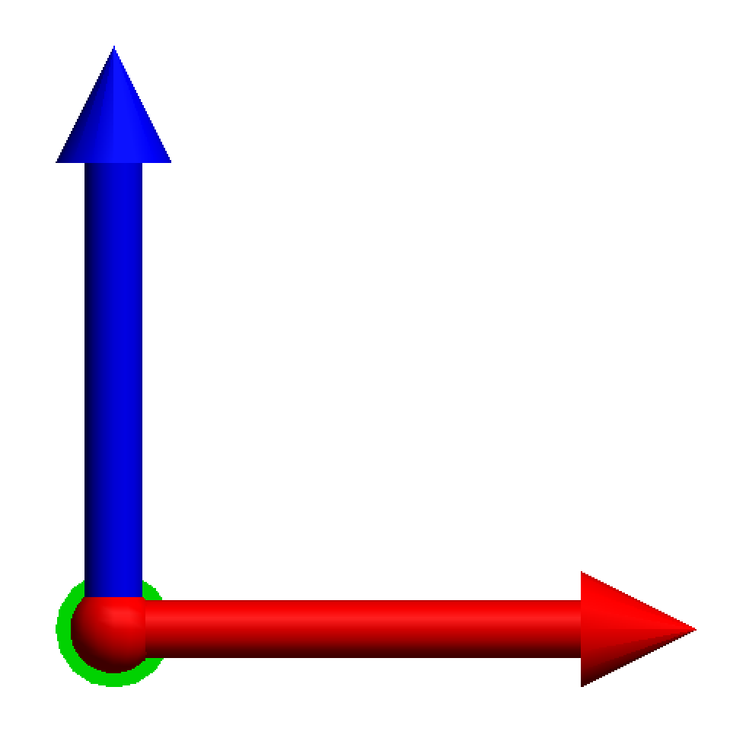
Ideal World
Build the mating parts
Everything good – exactly to nominal!
Assemble to print
Works great in CAD!
Notes:
Relationships are ideal at bridging the gap between the Ideal World, where everything is perfect &….

Slide 14
Real World
Imperfect World = Imperfect Parts
Large components, larger assembly
Small tolerances
With Relationships, tolerances do not need to “stack-up”. Measure & adjust at each critical step.
Notes:
The Real World, where imperfections are guaranteed.

Slide 15
Improve the Process
Plan Establish your objectives and how you plan to achieve them
Do Implement the plan
Check Measure to determine what happened
Act Correct root causes that create differences between actual and planned results
Do
Check
Plan
Act
Notes:
The only way relationships can benefit you though, is if you use them wisely. Best route, is to use them to improve your production processes.
You may have seen this cycle before. To me, it describes how metrology has traditionally fit into manufacturing. We make components, check to see if they meet spec, then when they don’t, Root Causes are ID’d & production of the next batch of parts is adjusted.

Slide 16
Improve the Process
Plan Establish your objectives and how you plan to achieve them
Do Implement the plan
Study Measure to determine what needs to happen next
Adjust Adjust to current data from this production cycle, don’t wait for the next iteration
Do
Study
Plan
Adjust
Notes:
But, with just a slight change, this is a much better process.
The problem is, that the “Check“, in “Plan-Do-Check-Act” emphasizes inspection & a “pass/fail” mentality.
We don’t measure parts to accept or reject them, we measure to drive the production of good products. When we integrate measurement into the Production process, we can then use our measurement data to Adjust the next step in the process.
This is what Relationships in SA is all about.

Slide 17
Plan-Do-Study-Adjust = Relationships
Relationship Fitting lets us decide when to allow imperfections & how to deal with them

Slide 18
Relationships in the Real World
Constraints, Weights, and Tolerance

Slide 19
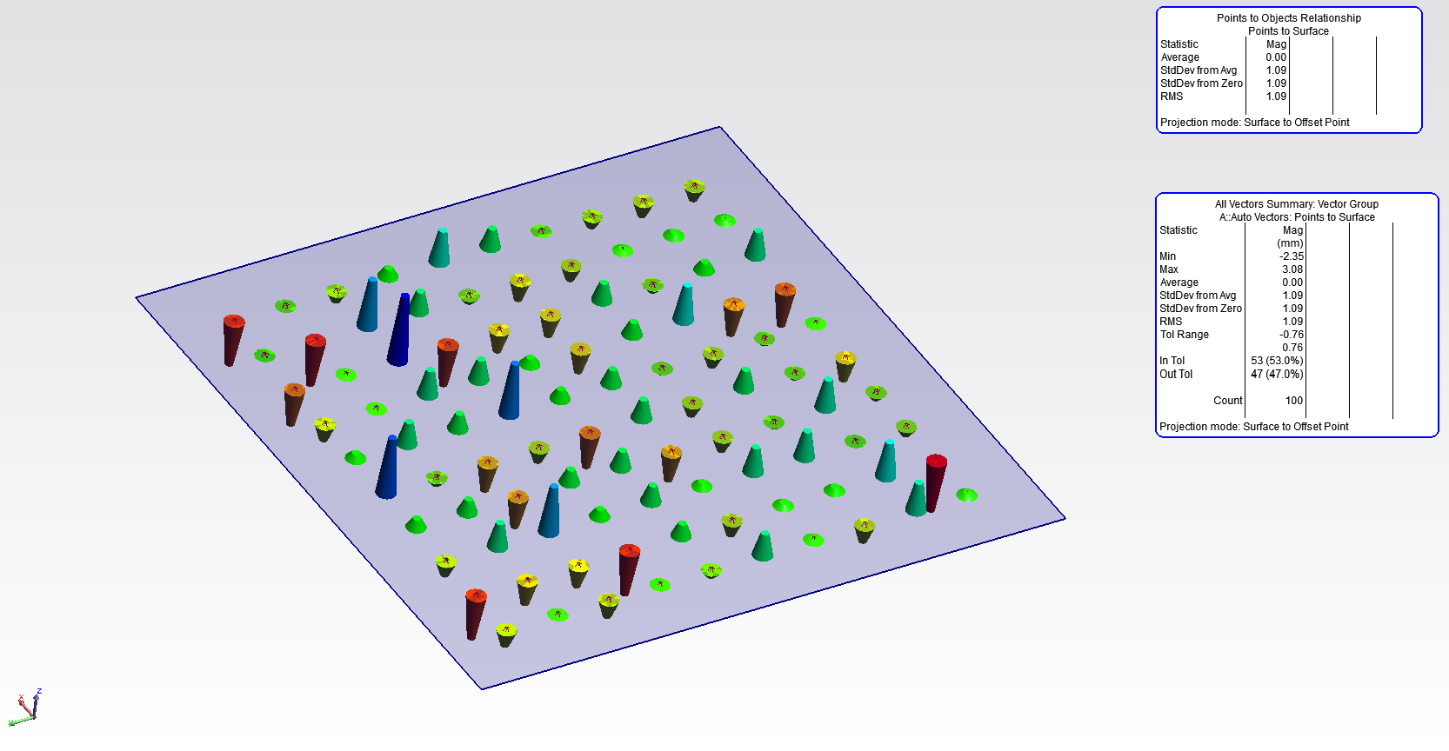
Relationships in the Real World
Single Relationships with default options are nice & simple
Average will try solve to 0.00

Slide 20
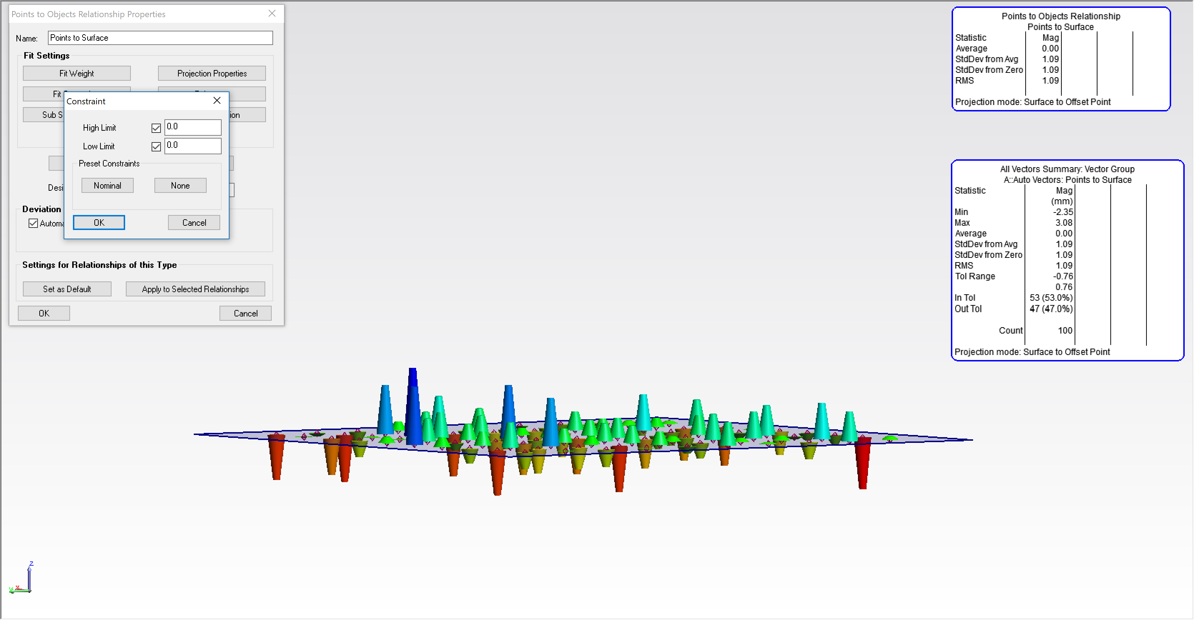
Relationships in the Real World
By default, a Relationship will try to even out deviations
0.0 Average Deviation
Measured points average value is on surface, some a little above, some a little below

Slide 21
Relationships in the Real World
By default, a Relationship will try to even out deviations
Constraints set to 0.0
0.0 Average Deviation
Measured points average value is on surface, some a little above, some a little below

Slide 22
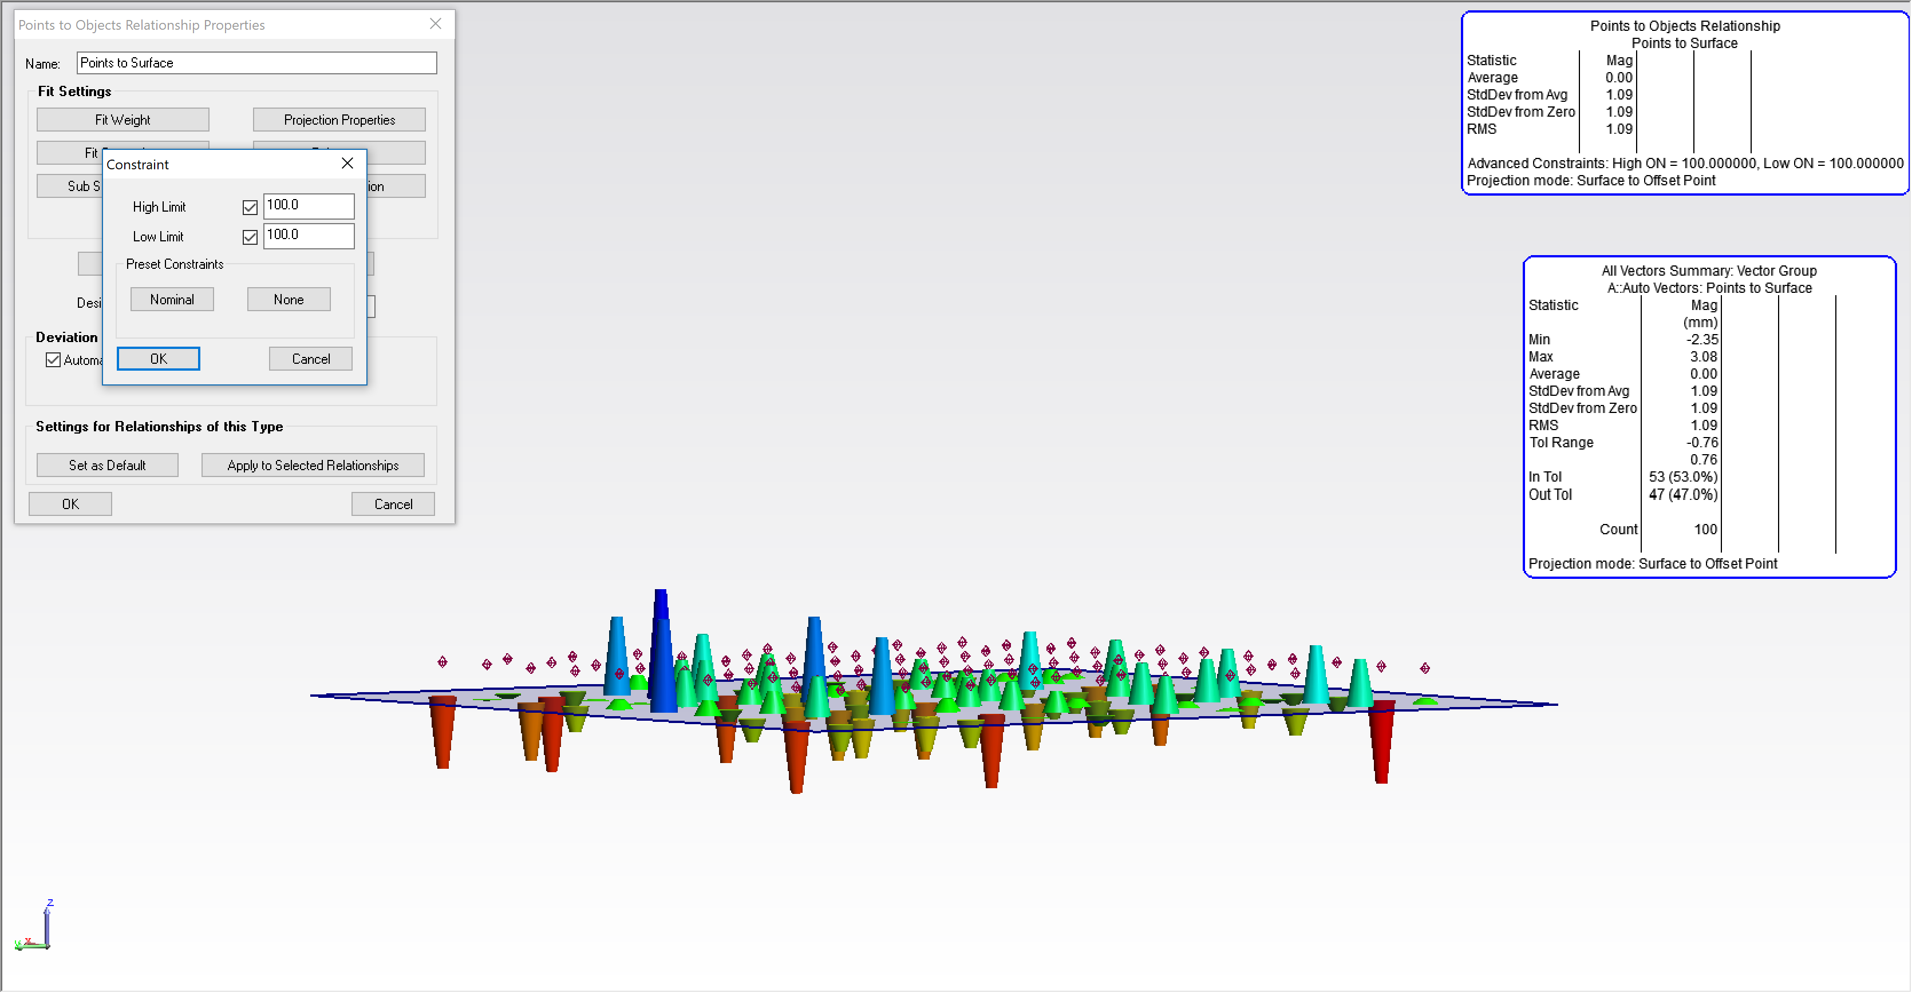
Relationships in the Real World
With Constraints, we can move the relationship in another direction
Constraints set to 100.0 (both High & Low)
Still 0.0 Average Deviation
Measured points are NOT directly on surface (they are ~100.0mm above)
*Important: Reporting always takes Constraints into account!

Slide 23
Relationships in the Real World
With Constraints, we can move the relationship in another direction
Constraints set to -100.0 (both High & Low)
Still 0.0 Average Deviation
Measured points are NOT directly on surface (they are ~100.0mm Below)
*Important: Reporting always takes Constraints into account!

Slide 24
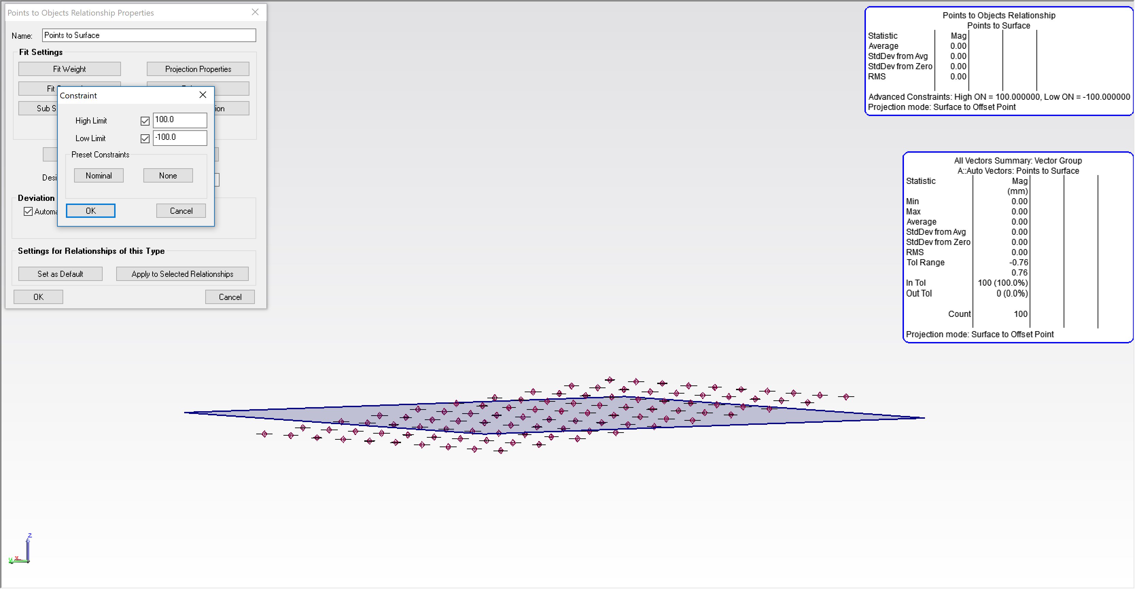
Relationships in the Real World
With Constraints, we can also open up the Relationship
Constraints set to High = 100.0
Low = -100.0
Still 0.0 Average Deviation
Measured points will lie inside the Constraint envelope (they are between +/-100.0mm)
*Important: Reporting always takes Constraints into account!

Slide 25
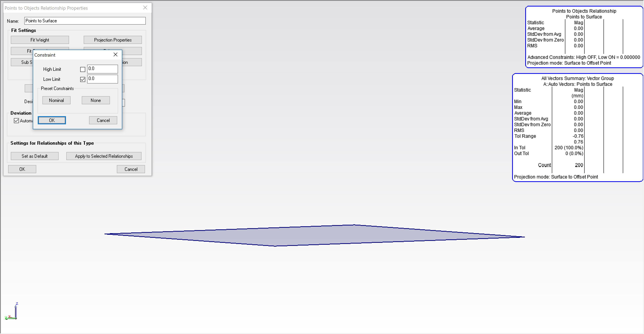
Relationships in the Real World
With Constraints, we can also really open up the Relationship
Constraints set to High = OFF
Low = 0
Still 0.0 Average Deviation
Measured Points can be anywhere above the surface! (they are up there… somewhere)
*Important: Reporting always takes Constraints into account!

Slide 26
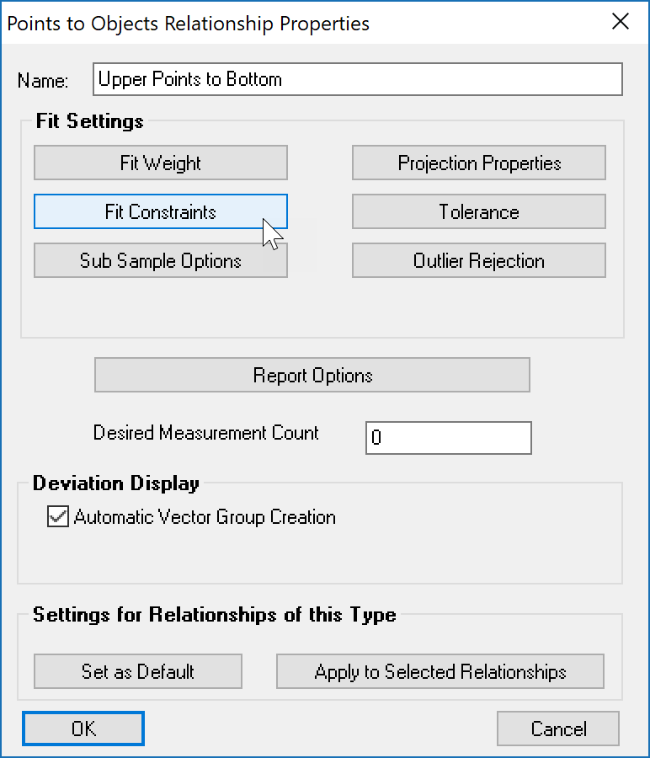
Relationships in the Real World
Constraints give us power to control Relationship Fits

Slide 27
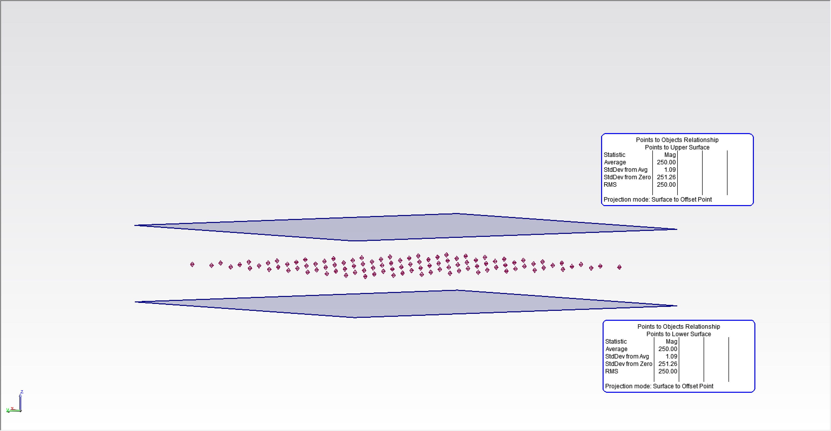
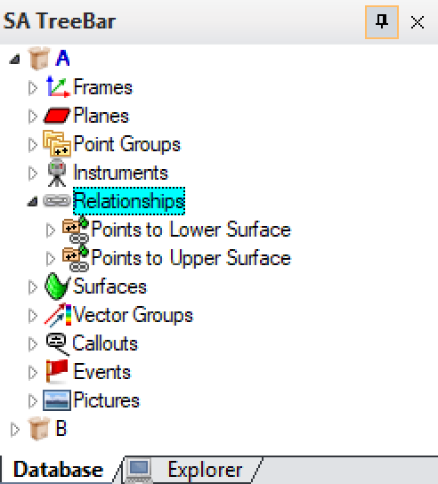
Relationships in the Real World
Often, we have multiple Relationships, with conflicting Constraints
This is known as an Overconstrained system
Two Relationships, Points to Lower Surface & Points to Upper Surface
*Constraints are set to 0.0
Relationship fit will balance deviations
Measured points will end up pulled to the middle of the two Relationships

Slide 28
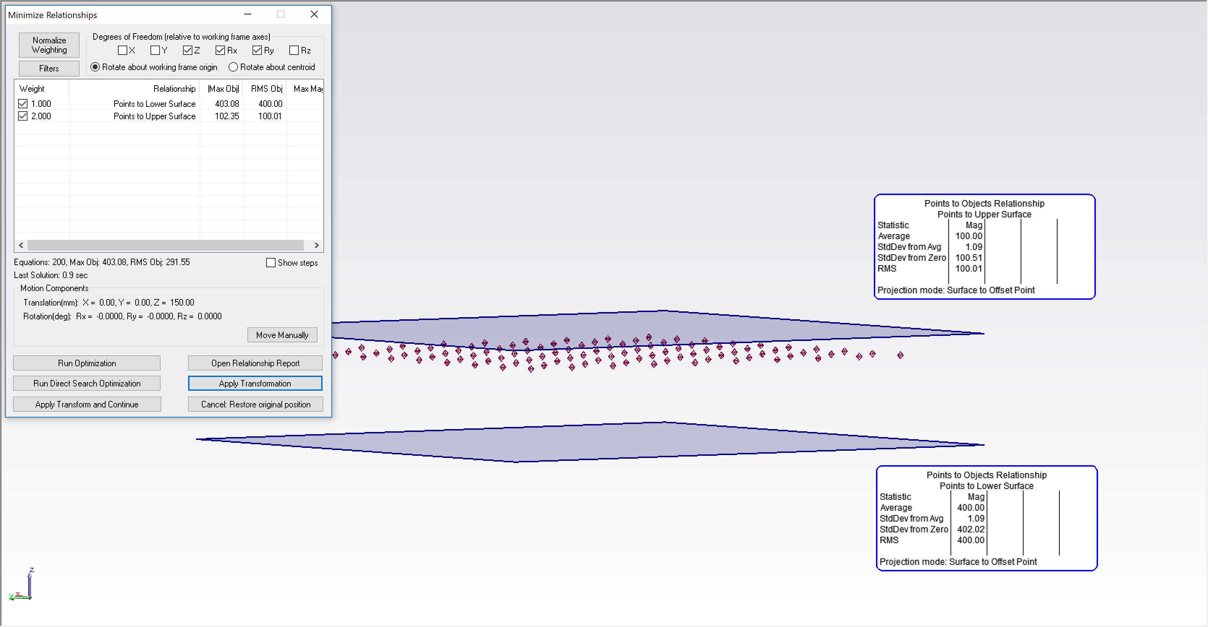
Relationships in the Real World
Weighting allows setting the relative importance of each Relationship
Weighting on Upper Surface is 2x the Weight on Lower
*Constraints are set to 0.0
Deviations will reflect Weights
Measured points will end up pulled to towards the Relationship with more weight
Relationship fit results will be proportional to the Square of the Weights & the number of equations in each Relationship
Notes:
Weighting gives us another tool we can use to influence the behavior of our Relationships
Quite simply, increased Weighting, increases the importance of that Relationship

Slide 29
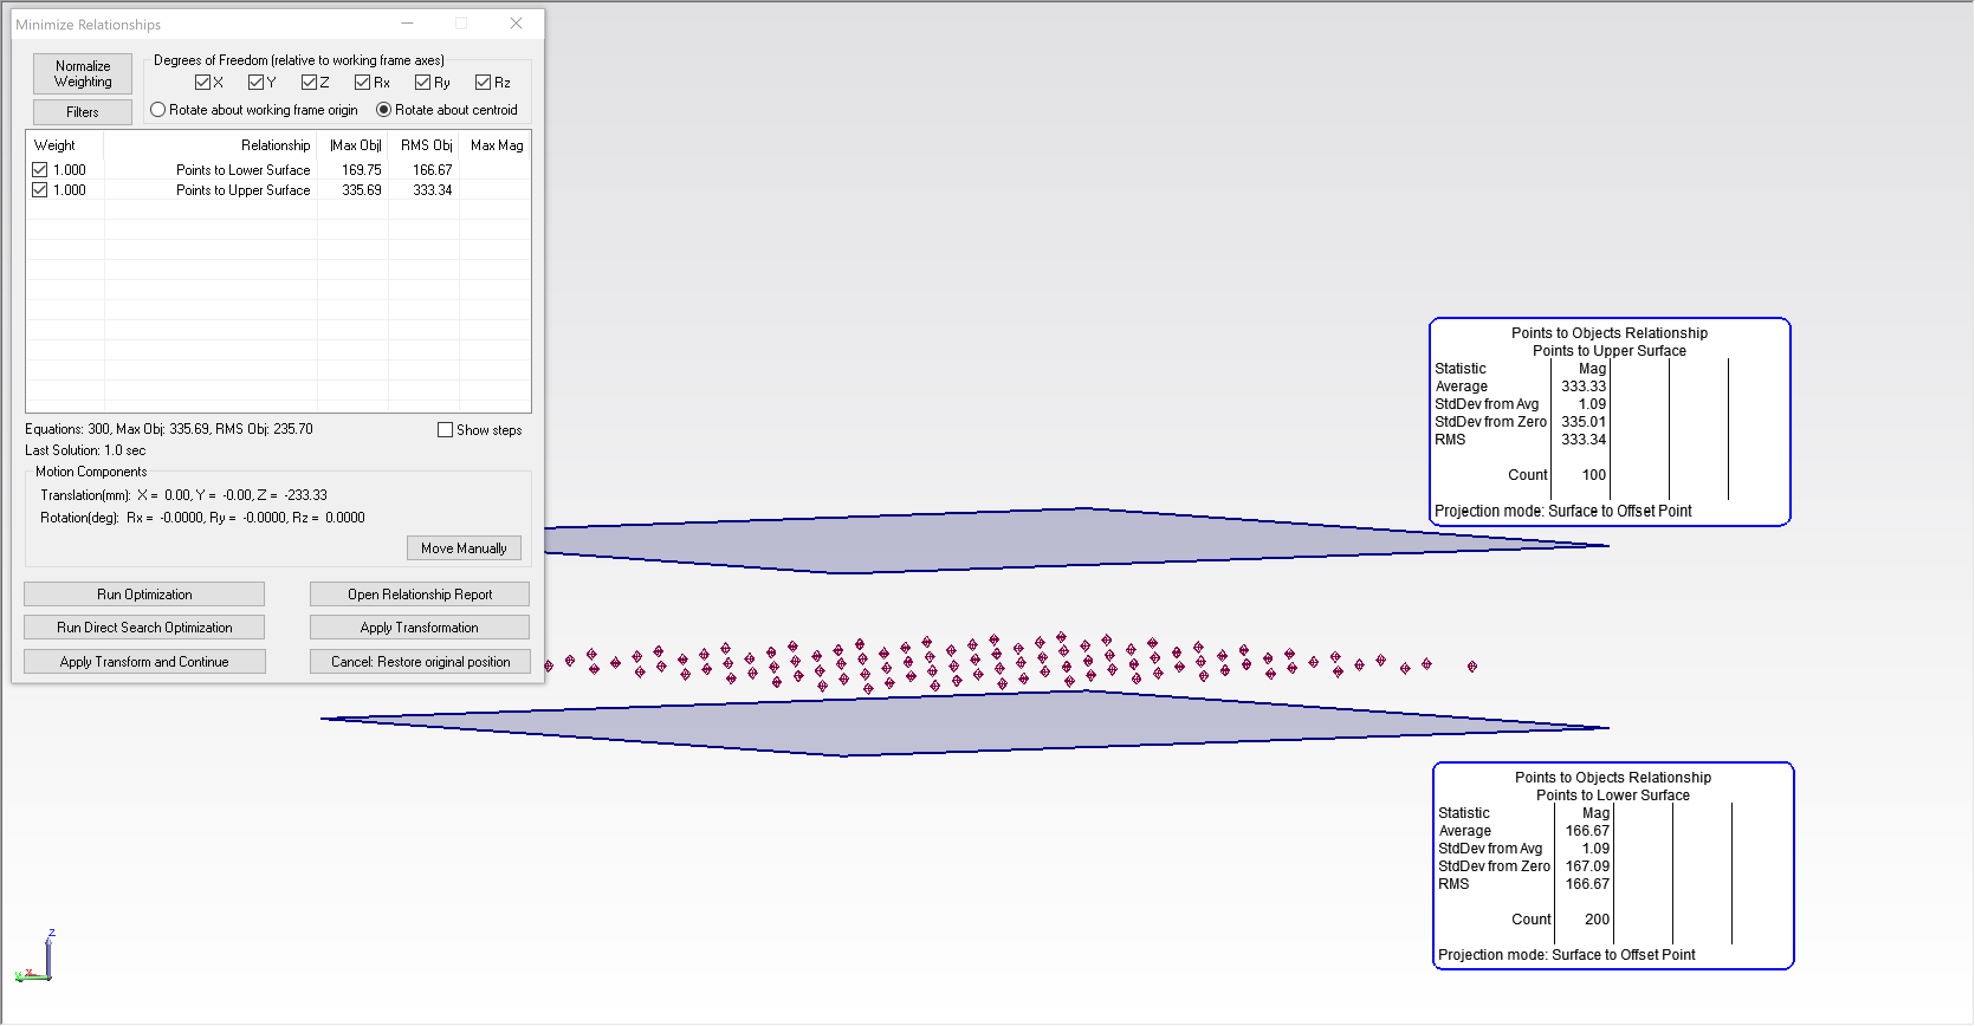
Relationships in the Real World
Relationships with more points will naturally have more Weight
Weighting is equal
*Constraints are set to 0.0
Deviations will be proportional to number of points
Relationship fit will pull towards the Relationship with more points

Slide 30
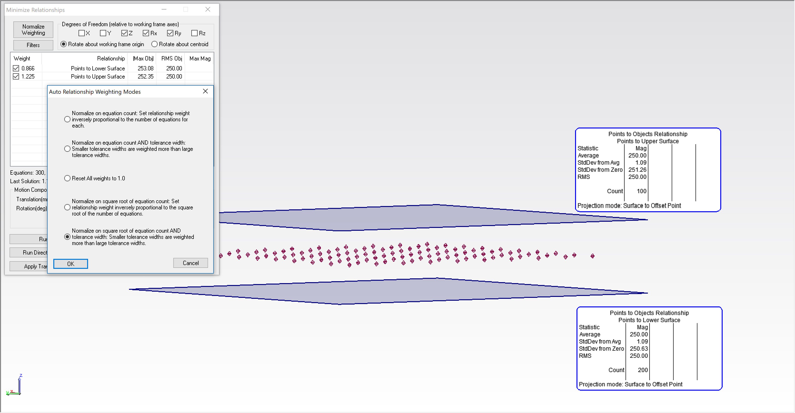
Relationships in the Real World
Use Normalize Weighting to make all Relationships equal
Weighting is automatically determined based on Point Counts
*Constraints are set to 0.0
Relationship fit will balance deviations
Relationship fit results with data centered between the two Relationships

Slide 31
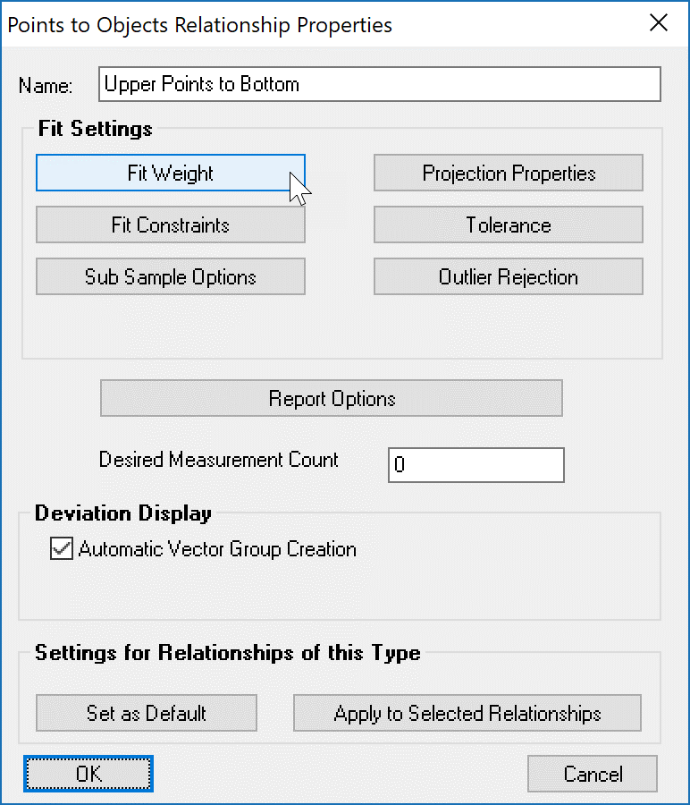
Relationships in the Real World
Fit Weight lets you fine tune the results of a Relationship Fit

Slide 32
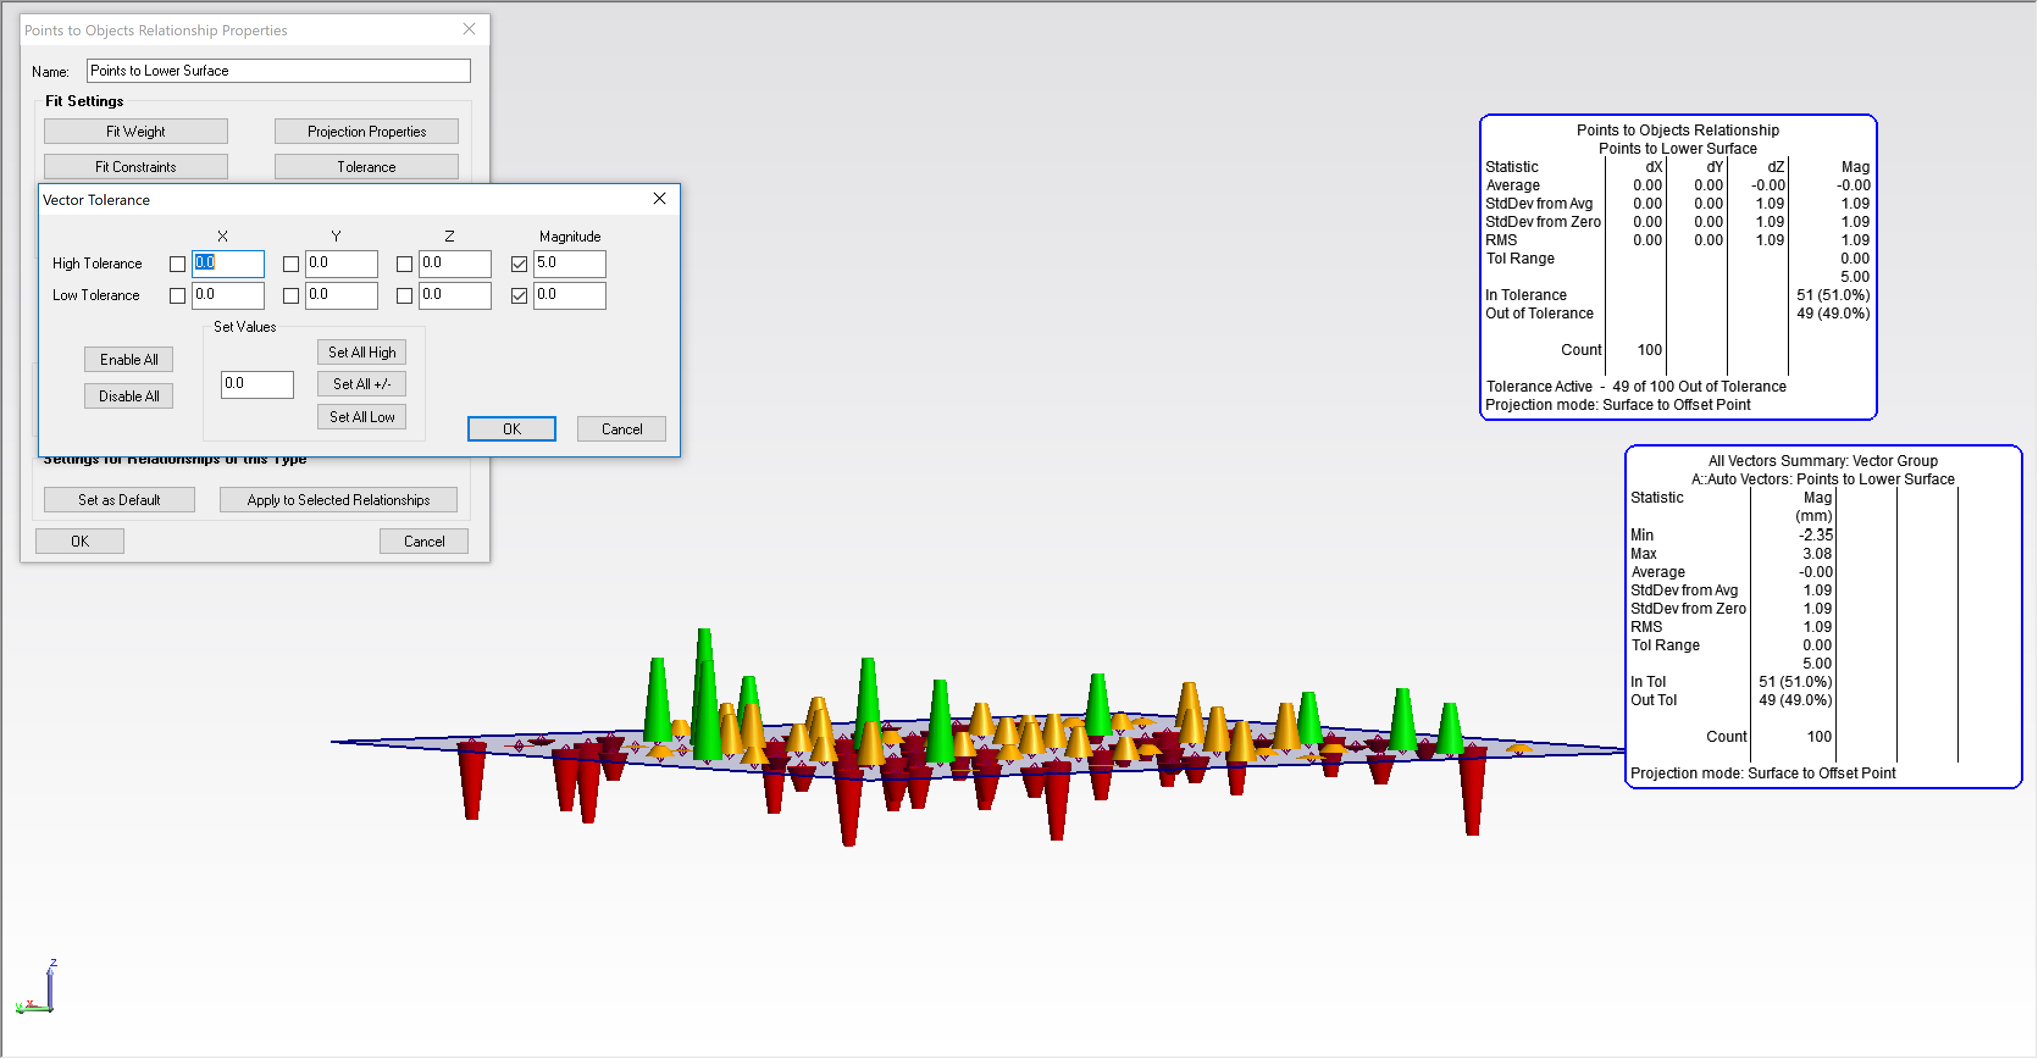
Relationships in the Real World
Tolerances give easy visibility of Go/NoGo conditions for Reporting
Tolerance is enabled in Relationship Properties
Relationship Fit is not affected by Tolerance
*Use Tolerances in combination with Constraints to control both Reporting & Fitting

Slide 33
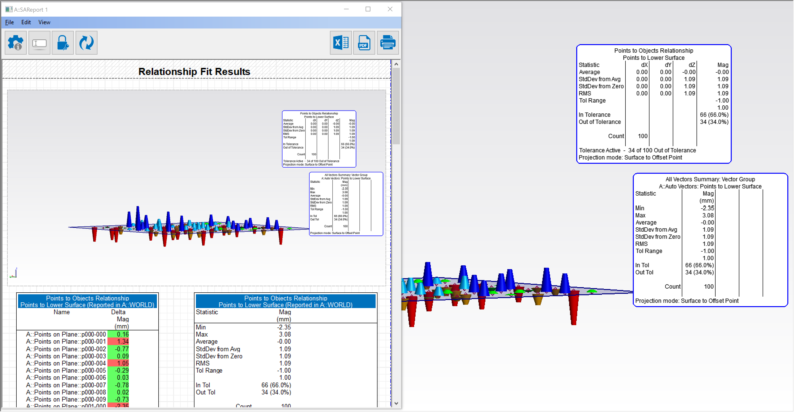
Relationships in the Real World
Tolerances give easy visibility of Go/NoGo conditions for Reporting
Tolerance is enabled in Relationship Properties
Tolerance will apply to Reports & AutoVectors

Slide 34
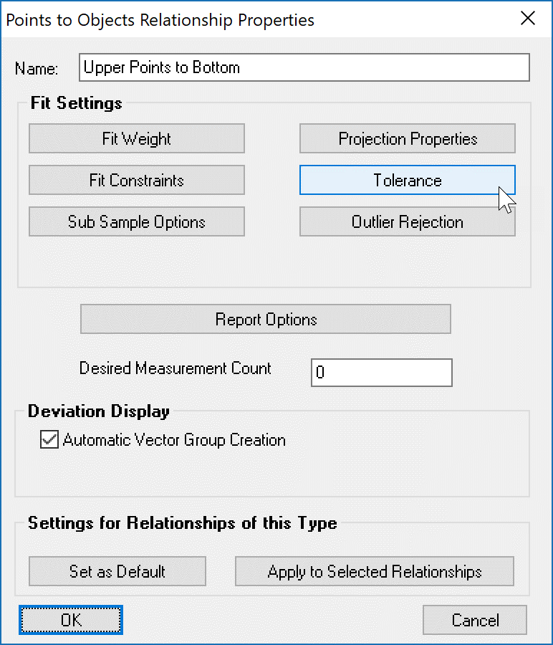
Relationships in the Real World
Tolerance allows easy visibility of results in Reports

Slide 35
Demo: Putting Humpty Dumpty Back Together Again

